Slide 1
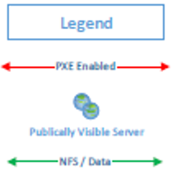
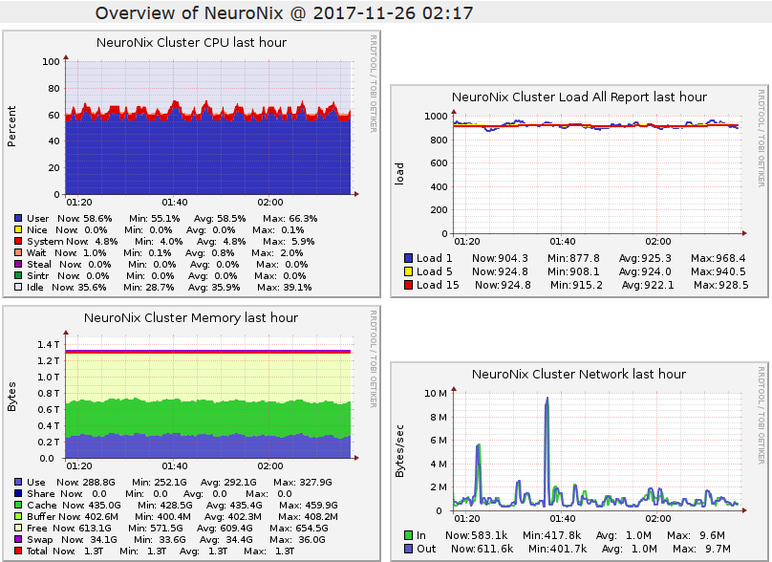
The Neuronix HPC Cluster:
Cluster Management Using Free and Open Source Software Tools
C. Campbell, N. Mecca, I. Obeid and J. Picone
The Neural Engineering Data Consortium, Temple University
College of Engineering
Temple University
www.nedcdata.org
Abstract
In order to be effective, machine learning must operate on problems of scale, requiring suitably large data and computing resources.
HPC clusters based on open source software and consumer grade hardware have enabled a new generation of extremely computationally demanding research based on deep learning and big data.
In this poster we discuss the Neuronix cluster, an implementation of the HPC cluster concept that provides an unprecedented price/performance ratio using commercial off the shelf parts (COTS).
The environment is heterogeneous because of the need to mix GPUs and CPUs. GPUs are critical today to the success of deep learning algorithms.
Methods of horizontal scaling and managing node availability based on requested resources and server load are discussed.
Tools that are central to our management strategy include Ganglia, mdadm and smartctl.
Cluster Management
Compute nodes are booted from the network (PXE) with Warewulf (Lawrence Berkeley National Labs).
A single kernel/initramfs (bootstrap) and root filesystem (VNFS) image combination can boot any number of machines over the network, allowing nodes to be added to the cluster in O(1) time.
Software tools and data are made available to the compute nodes via NFS mount of the login node.
Since the nodes on the cluster have CPUs using 3 different microarchitectures, each type of node has its own software environment, stored on nedc_000.
The use of RAID arrays provides fault tolerance in the event of disk failure.
Ganglia provides a web-based method for viewing node statistics.
Job Submission
Jobs are managed through the queue manager using a combination of Torque (resource manager) and Maui (scheduler).
Users can submit their jobs using qsub, with which resources can be requested as well (otherwise they will use the system defaults).
Jobs will wait in the queue until resources become available; the scheduler can be configured to provide the desired distribution of cluster resources.
Node availability (i.e. online/offline) can be managed through Torque.
Nodes can be given different resource specifiers to control what type of node a job runs on.
For example, CPU compute nodes have the ‘normal’ resource and GPU compute nodes have the ‘gpu’ resource, so jobs can be directed to run on either a CPU or GPU node.
Job Scheduling Strategies
Virtual processors: An abstract unit provided by the resource manager, can be used to represent compute threads, GPUs or a general measure of the processing power required for a job.
Maui scheduler doesn’t honor requests for GPUs when jobs are submitted (e.g. “qsub –l gpus=1...”).
A strategy to manage GPU scheduling is to map one virtual processor in the resource manager to one GPU on a compute node.
In this manner, a user may request a GPU using “qsub –l ppn=1 …”, where ppn=1 (virtual processor) is understood to correspond to a GPU.
Redundant Array of Independent Disks
Used to expand the capacity of a filesystem beyond a single physical disk.
Introduces fault tolerance by allowing for the failure of one or multiple drive failures.
The Neuronix cluster makes use of RAID level 6, which prevents data loss in the event of any 2 disks in the array failing.
Higher levels of RAID have not been useful.
Monitoring
Ganglia: monitoring system that collects data from nodes in a cluster/grid and displays the data in graphical form from a web interface.
Reported statistics include memory usage, network throughput and disk I/O.
Other system monitoring tools include mdadm for software RAID arrays, which monitors the health of the disks in the array, and smartctl, which monitors the health of individual sectors in hard drives.
Configuration Management
Ansible: a tool that allows for automating the setup and configuring of different types of node (e.g. file server, archive machine), reducing time to launch and ensuring that configurations are identical.
Provisioning with Warewulf
In addition to operating system images, any file from the master node can be made available to the compute nodes.
Files are added to Warewulf’s data store on the main node, and then can be provisioned (made available) to compute nodes.
Can be used for user authentication by provisioning /etc/passwd, /etc/shadow and /etc/group.
When using driver software in a heterogeneous environment (e.g. NVIDIA drivers on nodes with different versions of the Linux kernel), the initramfs created by Warewulf can be manually edited to add the required kernel modules.
By default, Warewulf initramfs images are located in /var/lib/tftpboot/warewulf/bootstrap/ and can be manipulated with the cpio command.
When changes are made to a Warewulf VNFS image, the compute nodes using that VNFS would normally have to be rebooted for the changes to take effect. If this is undesirable, the wwgetvnfs command can be used to reload the entire filesystem without rebooting the node.
nedc_000:
/haswell /bdver2 /broadwell
Haswell:
nedc_000
nedc_001
nedc_100
Bdver2:
nedc_002
nedc_003
nedc_004
nedc_005
Broadwell:
nedc_000
nedc_001
nedc_100
A Heterogeneous Microarchitecture Environment
Example: provisioning /etc/bashrc
Import file into the Warewulf datastore:
wwsh file import /etc/bashrc –name=custom_bashrc
Make file available to the compute nodes:
wwsh provision set nedc_00[2-7] –fileadd custom_bashrc
The Neuronix Cluster
Login node: nedc_000
42 TB HDD (14x3TB), 64 GB RAM, 2x Intel ® Xeon ® E5-2623 v3 (3.00 GHz)
CPU compute nodes: nedc_002 – nedc-005
500GB SSD, 256 GB RAM,2x AMD Opteron™ 6378 (2.4 GHz)
GPU compute node: nedc_006
128GB SSD, 128 GB RAM, 2x Intel ® Xeon ® CPU E5-2603 v4 (1.70GHz), 4x NVIDIA GeForce GTX 980 Ti
GPU compute node: nedc_007
500GB SSD, 128 GB RAM, 2x Intel ® Xeon ® CPU E5-2603 v4 (1.70GHz), 4x NVIDIA GeForce GTX 1070
Newest node (nedc_008): 4x NVIDIA Tesla P40
nedc_002
nedc_003
nedc_001
nedc_000
qsub –l nodes=1:gpu:ppn=2 job.py
The qsub command indicates what resources are required to execute the job.
The resource manager will find a node that is able to fulfill the requirements of the job.
switch
nedc_004
router
nedc_100
gpu
nedc_005
Summary
A heterogeneous cluster using a free software stack running on a collection of inexpensive compute nodes can be used to work on even the most computationally intensive problems.
Computing resources can be quickly assimilated using Warewulf and the queue manager, and can be administrated from the main node
RAID and monitoring utilities can be used to minimize downtime, identify system bottlenecks and determine future growth directions.
The Neuronix cluster has has 1.4TB of RAM, over 200 TB of hard disk capacity and 18944 CUDA cores
Acknowledgements
Research reported in this publication was most recently supported by the National Human Genome Research Institute of the National Institutes of Health under award number U01HG008468. The content is solely the responsibility of the authors and does not necessarily represent the official views of the National Institutes of Health.
nedc_006
nedc_101
nedc_006
available ppn: 1
nedc_007
available ppn: 3
nedc_007

