Slide 1


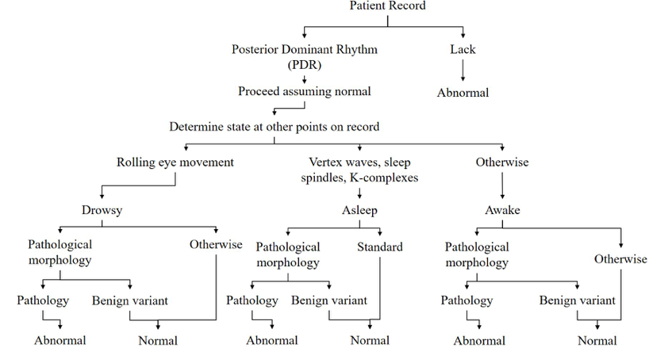
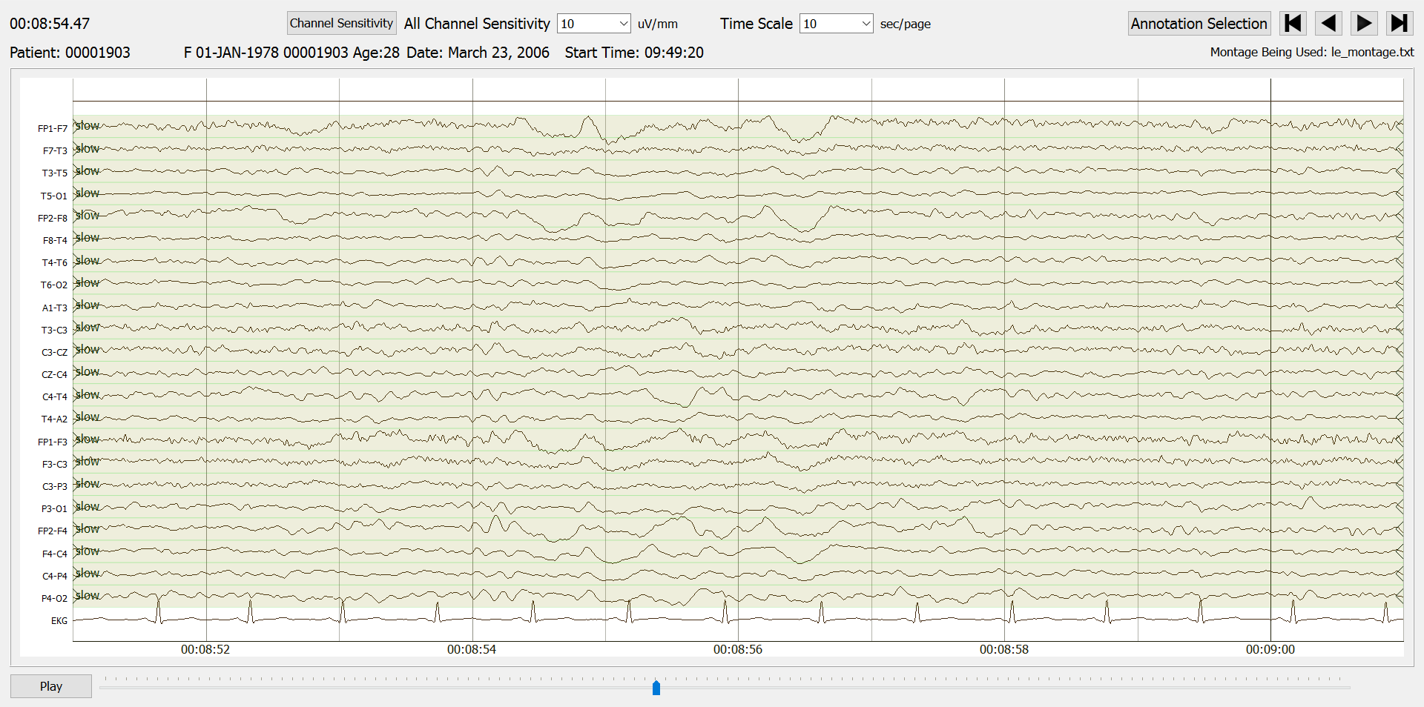
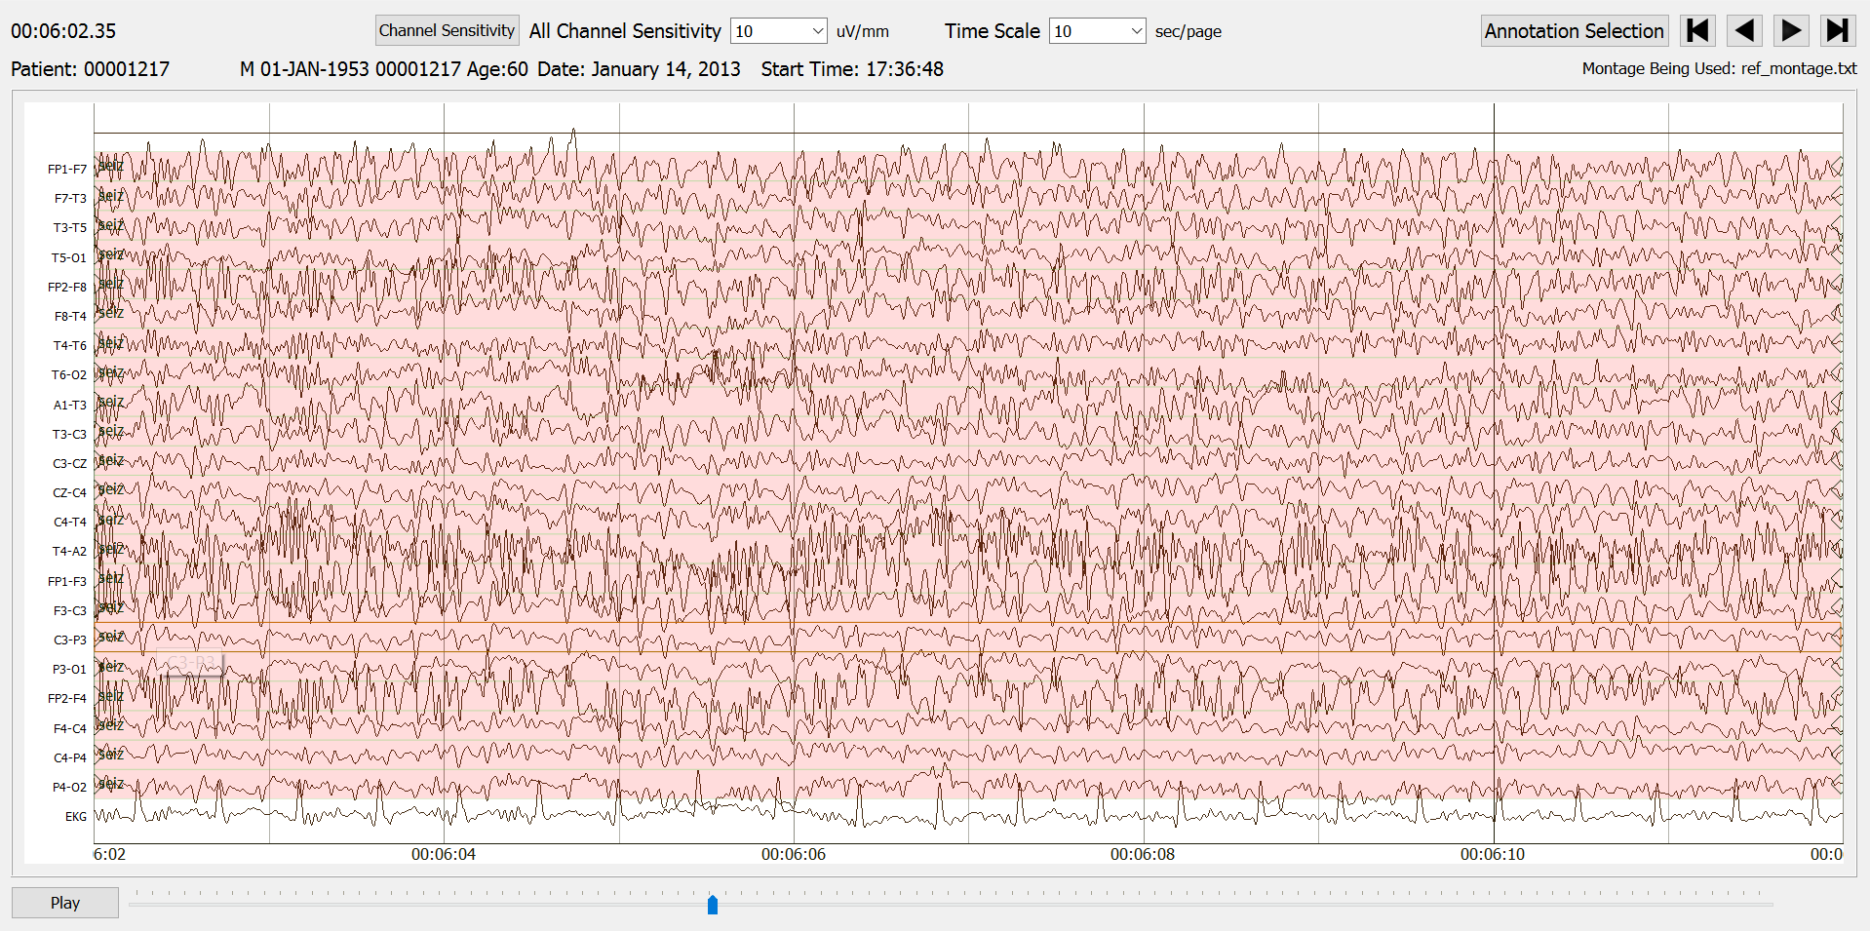
Open Source Resources to Advance EEG Research
S. Ferrell, E. von Weltin, I. Obeid and J. Picone
The Neural Engineering Data Consortium, Temple University
College of Engineering
Temple University
www.nedcdata.org
Abstract
Created in 2012, the Temple University Hospital Electroencephalography Corpus (TUH EEG) is the world’s largest open source EEG corpus.
There are a number of important subsets of this corpus that were developed to support specific types of EEG analysis:
  TUH EEG Seizure Corpus: supports the development of automatic seizure detection technology.
  TUH Abnormal EEG Corpus: supports the development of automatic detection of abnormal EEGs.
  TUH EEG Slowing Corpus: aids in the development of technology that can differentiate between post-ictal and transient slowing.
  TUH EEG Epilepsy Corpus: supports the study of patients diagnosed as epileptic.
  TUH EEG Events Corpus: used to develop the six-way classification system.
In addition to data resources, supporting tools to facilitate research are also provided:
  NEDC Demo System: a visualization tool developed to rapidly annotate EEG signals.
  NEDC Eval EEG: a standardized scoring package that is an important piece of any common evaluation framework.
The TUH EEG Corpus (v1.1.0)
The main corpus: contains every EEG session collected at TUH from 2002 to 2015. Data collection is ongoing (increasing at a rate of 3K sessions/yr).
There is a variety of patients and medical histories included in the corpus:
The signal data totals 959 GB, while the reports are a total of 94 MB.
The latest release includes three types of automatically generated annotations that include: (1) seizure events, (2) abnormal events, and (3) six-way classification of each one-second epoch.
The TUH Abnormal EEG Corpus (v2.0.0)
Supports the development of automatic detection of abnormal EEGs.
Approximately 50% of the data constitute abnormal EEG sessions.
Each session is
labeled as either
normal or abnormal
using a specific
decision-making
process.
The TUH EEG Slowing Corpus (v1.0.1)
Aids in the development of technology that can differentiate between post-ictal and transient slowing.
Slowing can be a focal or generalized decrease in frequency and is either a part of a seizure or an independent event.
The NEDC Demo System (v0.4.1)
A visualization tool developed to rapidly annotate EEG signals.
Written in Python using the PyQt toolkit and is easily customized to support specific annotation tasks.
User can annotate EEG signals on a per-channel basis.
A cohort retrieval system has been integrated into this viewer that allows users to query the TUH EEG Corpus for sessions that match particular search criteria.
NEDC Eval EEG (v1.2.0)
A standardized scoring package that is an important piece of any common evaluation framework.
Implements a variety of popular scoring metrics based on common measures such as sensitivity, specificity, and Cohen’s kappa statistic.
Includes a new metric based on time-aligned and epoch scoring, providing a more balanced view of performance.
Can be used on most popular operating systems including Windows, Linux, and Mac systems.
This corpus has been used to study common error modalities in automated seizure detection.
No. of Patients | No. of Sessions | Total Duration
13,539 | 23,002 | 15,757 hours
Introduction
NEDC’s historical archive of EEG data dates as far back as 2002 and includes every EEG collected at Temple University Hospital (TUH).
This corpus now includes over 40,000 EEG studies from more than 18,000 patients.
This dataset is the first database large enough to support the application of state of the art machine learning algorithms.
Each study includes a report that contains information about the patient, the patient’s medical history, and a neurologist’s findings.
The patient numbering is consistent throughout these corpora; users can study specific patients or diseases across a broad range of conditions.
Documentation about the corpus has been expanded to explain electrode locations, channel labels, sample frequencies, and annotation formats.
Automatically generated annotations of the data are also available (e.g., normal/abnormal).
The TUH EEG Seizure Corpus (v1.3.0)
A subset of TUH EEG (TUSZ) developed towards automatic seizure detection through machine learning research.
Every EEG file has been manually annotated for seizure events including channel number, start and stop times, and type of seizure.
A record of calibration start and end times that occur in the beginning of an EEG recording are now included.
A held-out blind evaluation dataset was developed which will be used in an upcoming Kaggle-style challenge hosted by IBM.
The TUH EEG Epilepsy Corpus (v1.0.0)
Supports the study of characteristics of patients diagnosed as epileptic.
The patients are sorted into two classes: (1) epileptic and (2) non-epileptic.
Patients were sorted into these classes based on medications listed during the recording, clinical history of the patient, and EEG signal features associated with epilepsy.
Some keywords that indicate seizure behavior include: spike and wave, sharp wave, sharp waves, and spike.
The TUH EEG Events Corpus (v1.0.1)
This corpus is used to develop a six-way classification system of each one-second epoch.
The system detects three events of clinical interest: (1) spike and/or sharp waves, (2) periodic lateralized epileptiform discharges, and (3) generalized epileptiform discharges.
Three events used to model background are also detected: (1) eye movement, (2) artifacts, and (3) background.
Summary
The TUH EEG Corpus and its variants promote the development of machine learning technology for automatic interpretation of EEGs.
These corpora and supporting tools are open source and freely available at https://www.isip.piconepress.
com/projects/tuh_eeg/downloads/.
Future plans include:
Acknowledgements
Research reported in this publication was most recently supported by the National Human Genome Research Institute of the National Institutes of Health under award number U01HG008468. The content is solely the responsibility of the authors and does not necessarily represent the official views of the National Institutes of Health.
This research was also supported in part by a grant from the Temple University College of Engineering Research Experience for Undergraduates program and the Pennsylvania Commonwealth Universal Research Enhancement Program (PA CURE).
Database | Version | Date
TUH EEG | v2.0.0 | January, 2019
TUSZ | v1.7.0 | January, 2019
TUH EEG | v3.0.0 | March, 2019
TUSZ | v1.8.0 | March, 2019
Patient Preparation
EEG
Recording
An EEG ranging in duration from 20 minutes to several days is recorded.
EEG Interpretation
The recording is visually interpreted by board-certified neurologist.
Report Production
The clinical findings are reported using a standard format.
The electrodes are attached to a patient’s head using conductive gel.
 | No. of Patients | No. of Sessions | No. of Seizures
Training | 264 | 580 | 1,247
Dev test | 50 | 238 | 685
 | No. of Patients | No. of Files | No. of Events
Training | 290 | 359 | 547
Evaluation | 80 | 159 | 240

