Slide 1
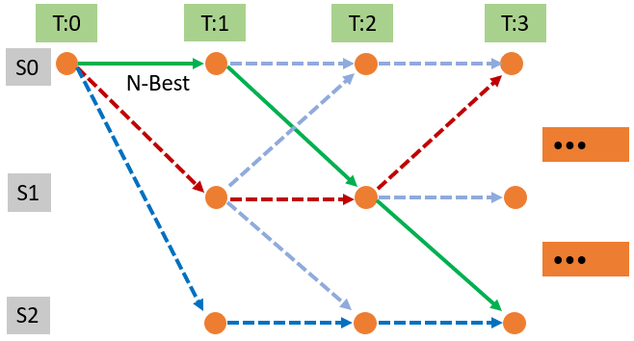
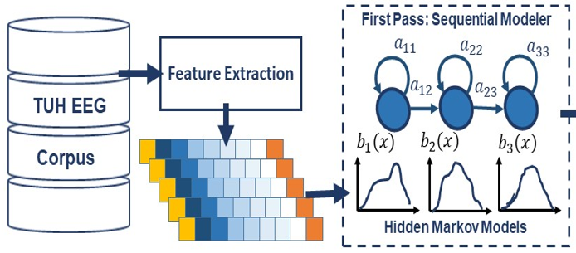
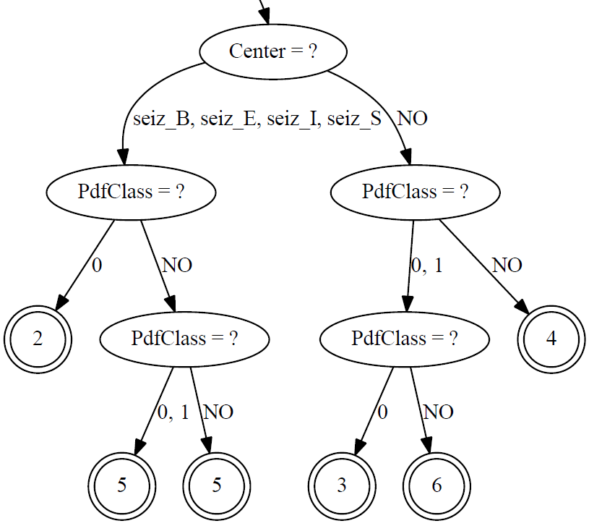
Adapting an Automatic Speech Recognition System to Event Classification of EEGs
V. Shah, R. Anstotz, I. Obeid and J. Picone
The Neural Engineering Data Consortium, Temple University
College of Engineering
Temple University
www.nedcdata.org
Abstract
Interpretation of electroencephalogram (EEG) events is a tedious, time-consuming and expensive task.
Automatic interpretation will accelerate the review process and lead to better healthcare outcomes.
In this study, we analyze EEGs in terms of six types events which are either of clinical interest or are related background noise.
Due to the similarities between speech and EEG signals, machine learning (ML) algorithms developed for automatic speech recognition (ASR) can be used for identification of the six-way events.
We adapt a very well-known state of the art automatic speech recognition (ASR) toolkit, Kaldi.
We developed a Multi-pass Kaldi system that integrates a hidden Markov model (HMM) based system for segmentation, a maximum likelihood linear transformation (MLLT) system for adaptation and a multilayer perceptron (MLP) deep learning system for classification.
Unfortunately, Kaldi delivers lower performance (37.5% sensitivity) than our previous best HMM system implemented using HTK (57.3%).
Adapting Kaldi to EEG Interpretation
Decoding
Lattices are used during decoding to track temporal information.
Each node of a lattice includes acoustic as well as language model scores.
The Viterbi algorithm is used during decoding with the lattice beam value within the range (0.7 – 1.0).
Decoding was performed using 1-best, pushed lattices and event-level posteriors. Event-level posteriors gives the most balanced results.
Event-level posteriors are collected for each frame and mapped back to its time-stamp/phone boundary in the output hypothesis files.
Parameter Count and Complexity
Kaldi’s baseline GMM-HMM monophone model uses 8,438 parameters. A similar model based on HTK uses 12,494 parameters.
Kaldi’s Viterbi training requires ~40 minutes to train the model across 8 CPU cores. HTK required same amount of time for Baum-Welch training on only 1 CPU core.
Background:
HTK is a portable toolkit for building and manipulating Hidden Markov Models (HMMs).
Kaldi is a similar toolkit that has gained widespread adoption due to its state of the art performance on large vocabulary speech recognition tasks.
Kaldi is based on finite state transducer technology and integrates powerful deep learning technology.
System Overview:
Feature Extraction: Features (26) consist of energy terms (2), linear frequency cepstral coefficients (7), deltas (9) and delta-deltas (8).
Acoustic Model: A simple 3-state left-to-right Bakis model topology with Gaussian Mixture Models (GMMs) for output distributions (8).
Language Model: Since EEG events do not appear in a specific order, no LM penalties were applied. However, postprocessing is typically used in a later stage.
Training: The Viterbi algorithm is used to estimate the parameters of the HMMs (40 iterations).
Sequential Modeler
TUH EEG
Lattice Decoding & Scoring
Events
Bakis Model:
Traditionally used in speech recognition.
Enforces a dynamic time-warping of the signal.
Each event uses the same number of states.
Decision Trees:
Ties HMM states based on acoustic phonetic features such as tone and stress.
Allows GMM components to be efficiently shared.
TUH EEG Events Corpus (TUEV–v1.0.1)
Contains annotations for three types of clinically-relevant EEG events:
Periodic Lateralized Epileptiform Discharge (PLED)
Generalized Periodic Epileptiform Discharges (GPED)
Spike or Sharp and Wave discharges (SPSW)
and three types of events used to model background:
Artifacts (ARTF)
Eye Movements (EYEM)
Background (BCKG)
Note: By design there is one session per patient.
The release includes signal data stored in an EDF format, per-channel annotations of the six events (.lab format) , HTK formatted features, and an associated EEG report for the session.
The proportion of the partially annotated EEG events is fairly balanced between the train and eval sets.
Performance on Six-Way Classification (TUEV)
Summary
EEGs show similar behavior to speech waveforms but certain morphologies such as spike / sharp and wave discharges are difficult to detect.
Kaldi’s multi-pass HMMs developed for the six-way classification do not show any improvement over our HTK baseline system.
LDA-MLLT system’s perform better than Kaldi’s other variants. However, systems which use LDA features perform extremely poorly on SPSW events.
Future Work
Focus on the development of Kaldi’s complex DNN variants on this data. i.e. T-DNN and Kaldi’s nnet2, nnet3 recipes.
Investigate Kaldi’s approaches to speech activity detection and integrate more temporal information about the waveshapes.
Implement neural network postprocessors to learn the spatial context of the signals along with its temporal properties.
Acknowledgements
Research reported in this poster was supported by National Human Genome Research Institute of the National Institutes of Health under award number 3U01HG008468-02S1. The content is solely the responsibility of the authors and does not necessarily represent the official views of the National Institutes of Health.
The authors would like to thank Dan Povey, Alan McCree, John Steinberg and many other members of the Kaldi and HLTCoE teams for their guidance in adapting Kaldi to this task.
Models:
GMM-HMM Monophone System: This is a flat-start model and was trained using Viterbi algorithm for 40 iterations with a total of 50 gaussian components.
LDA-MLLT Triphone System: Used MLLT to estimate a global covariance matrix to be shared over GMM distributions. Used Linear Discriminant Analysis (LDA) to reduce the dimensionality of the classes.
DNN-HMM MLP System: Used a deep neural network (DNN) to model observation distributions instead of GMMs. Fully connected layers with 256 neurons are used with 3 hidden layers. A Rectified Linear Unit (ReLU) activation function and Stochastic Gradient Descent (SGD) optimizer were used.
Baseline HTK system: A similar GMM-HMM model with 8 GMMs assigned to each state. The Baum-Welch reestimation algorithm is used for training.
Performance Evaluation:
Epoch scoring with an epoch duration of 1 sec is used.
The LDA-MLLT system performs the best among all Kaldi systems.
Kaldi performance is lacking compared to a GMM-HMM model of HTK system.
SPSW event is consistently harder for all recognition systems to detect.
Ref/Hyp | PLED | GPED | SPSW | ARTF | EYEM | BCKG
PLED | 46.68 | 18.19 | 22.22 | 1.58 | 7.39 | 3.94
GPED | 41.00 | 20.36 | 8.94 | 6.21 | 12.35 | 11.14
SPSW | 6.46 | 34.26 | 11.41 | 2.95 | 16.29 | 28.62
ARTF | 2.59 | 1.41 | 0.76 | 13.76 | 40.19 | 41.30
EYEM | 2.80 | 0.26 | 0.33 | 5.62 | 48.90 | 42.09
BCKG | 5.38 | 5.26 | 8.97 | 1.93 | 10.78 | 67.68
Kaldi’s GMM-HMM Monophone System
Ref/Hyp | PLED | GPED | SPSW | ARTF | EYEM | BCKG
PLED | 43.08 | 26.87 | 11.11 | 5.31 | 11.38 | 2.26
GPED | 29.80 | 31.01 | 5.92 | 10.58 | 3.98 | 18.71
SPSW | 1.34 | 37.12 | 3.33 | 21.69 | 18.64 | 17.88
ARTF | 0.63 | 2.52 | 0.72 | 30.67 | 38.43 | 27.03
EYEM | 0.22 | 1.92 | 0.00 | 8.60 | 54.36 | 34.89
BCKG | 2.29 | 1.52 | 10.21 | 15.21 | 8.69 | 62.08
 | Train | Eval
Patients / Sessions¹ | 290 / 290 | 80 / 80
Duration (Hrs) | 100.5 | 48.3
Kaldi’s LDA-MLLT Triphone System
Ref/Hyp | PLED | GPED | SPSW | ARTF | EYEM | BCKG
PLED | 46.83 | 28.38 | 9.58 | 3.96 | 3.52 | 7.70
GPED | 21.20 | 20.87 | 2.93 | 43.78 | 0.39 | 10.80
SPSW | 0.04 | 36.55 | 1.80 | 9.81 | 9.7 | 42.04
ARTF | 0.39 | 2.58 | 6.15 | 24.35 | 27.87 | 38.65
EYEM | 0.42 | 0.35 | 3.63 | 1.70 | 25.75 | 68.11
BCKG | 0.35 | 2.18 | 7.63 | 13.31 | 2.71 | 73.79
Events | Train Set |  | Eval Set
 | Epochs | Dist. (%) | Epochs | Dist. (%)
PLED | 11,254 | 13.4 | 4,677 | 15.9
GPED | 6,184 | 7.4 | 1,998 | 6.8
SPSW | 645 | 0.8 | 567 | 2.0
ARTF | 11,053 | 13.2 | 2,204 | 7.5
EYEM | 1,170 | 1.4 | 329 | 1.1
BCKG | 53,726 | 63.9 | 19,646 | 66.8
Total | 84,032 | 100.0 | 29,421 | 100.0
Kaldi’s DNN-HMM MLP System
Ref/Hyp | PLED | GPED | SPSW | ARTF | EYEM | BCKG
PLED | 54.80 | 17.62 | 20.32 | 0.70 | 4.70 | 1.85
GPED | 20.42 | 53.32 | 11.55 | 7.46 | 2.39 | 4.85
SPSW | 4.59 | 33.33 | 40.21 | 4.41 | 9.17 | 8.29
ARTF | 2.77 | 3.81 | 4.81 | 41.24 | 2.18 | 45.19
EYEM | 8.51 | 2.13 | 4.26 | 2.13 | 82.37 | 0.61
BCKG | 2.28 | 7.37 | 8.81 | 7.02 | 2.59 | 71.93
HTK’s Baseline GMM-HMM System

