Slide 1
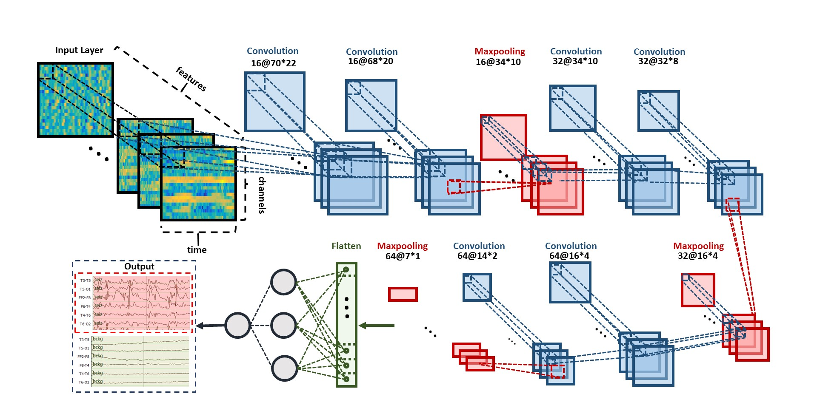
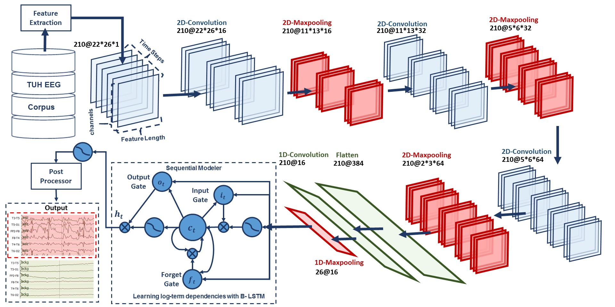
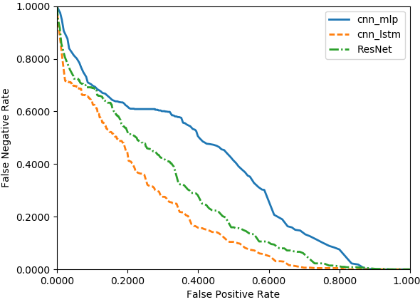
Deep Residual Learning for Automatic Seizure Detection
M. Golmohammadi, I. Obeid and J. Picone
The Neural Engineering Data Consortium, Temple University
College of Engineering
Temple University
www.nedcdata.org
Abstract
Automated seizure detection using clinical electroencephalograms (EEGs) is a challenging machine learning problem due to low signal to noise ratios, signal artifacts and benign variants.
Commercially available seizure detection systems suffer from unacceptably high false alarm rates.
Deep learning algorithms, like Convolutional Neural Networks (CNNs), have not previously been effective due to the lack of big data resources.
A significant big data resource, known as TUH EEG Corpus, has recently become available for EEG interpretation creating a unique opportunity to advance technology using CNNs.
In this study, a deep residual learning framework for automatic seizure detection task is introduced that overcomes the limitations of deep CNNs by reformulating the layers as learning residual functions with reference to the layer inputs, instead of learning unreferenced functions.
This architecture delivers 30% sensitivity at 13 false alarms per 24 hours. Our work enables designing deeper architectures that are easier to optimize and can achieve better performance from considerably increased depth.
Deep Learning Architectures
Performance on Clinical Data
Performance on TUSZ:
The results are reported in Any-Overlap Method (OVLP). TPs are counted when the hypothesis overlaps with reference annotation.
FPs correspond to situations in which the hypothesis does not overlap with the reference.
A DET curve comparing performance on TUSZ:
While ResNet significantly improves the results of CNN/MLP, it does not outperform CNN/LSTM.
...another point explaining this ...
CNN/MLP: Two-dimensional decoding of EEG signals using a CNN/MLP hybrid architecture that consists of six convolutional layers, three max pooling layers and two fully-connected layers.
Another point... Another point... Another point... Another point... Another point... Another point... Another point... Another point... Another point... Another point... Another point... Another point...
Another point... Another point... Another point... Another point... Another point... Another point... Another point... Another point... Another point... Another point... Another point... Another............
System | Sensitivity | Specificity | FA/24 Hrs.
CNN/MLP | 39.09% | 76.84% | 77.XX
CNN/LSTM | 30.83% | 96.86% | 7.XX
ResNet | 30.50% | 94.24% | 13.78
CNN/MLP
CNN/LSTM: Deep recurrent convolutional architecture for two-dimensional decoding of EEG signals that integrates 2D CNNs, 1-D CNNs and LSTM networks.
Another point... Another point... Another point... Another point... Another point... Another point... Another point... Another point...
Another point... Another point... Another point... Another point... Another point... Another point... Another point... Another point...
Another point... Another point... Another point... Another point... Another point... Another point... Another point... Another point...
TUH EEG Seizure Detection (TUSZ)
Subset of the publicly available TUH EEG Corpus (www.isip.piconepress.com/projects/tuh_eeg).
Evaluation Data:
50 patients, 239 sessions, 1015 files
171 hours of data including 16 hours of seizures.
Training Data:
264 patients, 584 sessions, 1989 files
330 hours of data including 21 hours of seizures.
Seizure event annotations include:
start and stop times;
localization of a seizure (e.g., focal, generalized) with the appropriate channels marked;
type of seizure (e.g., simple partial, complex partial, tonic-clonic, gelastic, absence, atonic);
nature of the seizure (e.g., convulsive)
*** NEED ANOTHER FIGURE HERE ***
CNN/LSTM
x
There are two obstacles for increasing the depth of CNN: (1) the convergence problem created by vanishing/exploding gradients; and (2) the degradation problem in which accuracy saturates when the number of layers is increased.
Solution: ResNet is ... introducing an “identity shortcut connection” that skips one or more layers, as shown in the residual learning block.
Training the stacked layers to fit a residual mapping is easier than training them directly to fit the desired underlying mapping.
... Another point ... Another point ... Another point ... Another point ... Another point ... Another point ... Another point ...
Weight Layer
F(x)
Activation
Weight Layer
F(x) + x
+
Summary
By .... explain what you did... .... explain what you did... .... explain what you did... .... explain what you did.... a deep residual learning structure was successfully applied to automatic seizure detection.
A ResNet structure was developed that ... Explain ... Explain ... Explain... ... Explain ... Explain ... Explain... ... Explain ... Explain ... Explain.... It outperformed CNN/MLP but did not exceed the performance of CNN/LSTM.
[... Restate this ...] The key to the better performance of ResNet in comparison with CNN/MLP is very deep convolutional network. ... .. ... .. ... .. ... .. ... .. ... .. ... .. ... .. ... .. ... .. ... .. ... ... ...
Acknowledgements
Research reported in this poster was supported by National Human Genome Research Institute of the National Institutes of Health under award number 3U01HG008468-02S1.
The content is solely the responsibility of the authors and does not necessarily represent the official views of the National Institutes of Health.
Activation
Residual learning block
*** Reduce this to fit the panel ***
Formally, denoting the desired underlying mapping as H(x), we let the stacked nonlinear layers fit another mapping of F(x) = H(x) - x. The original mapping is recast into F(x) + x.
It is easier to optimize the residual mapping than to optimize the original, unreferenced mapping.
To the extreme if an identity mapping were optimal, it would be easier to push the residual to zero than to fit an identity mapping by a stack of nonlinear layers.
From implementation perspective, there are two different approaches for defining deep learning models in tools like Keras and TensorFlow:
Sequential: applied in design of CNN/MLP and CNN/LSTM architectures.
Functional API: applied in design of deep residual learning architecture (ResNet).
The identity shortcuts (x) can be directly used when the input and output are of the same dimensions.
A deep residual learning structure is designed for automatic seizure detection. We arrived at an architecture which is 14 layers of convolution followed by a fully connected layer and a sigmoid.
The network consists of 6 residual blocks with two 2D convolutional layers per block.
The 2D convolutional layers all have a filter length of (3, 3). The first 7 layers of 2D-CNN have 32 and the last layers have 64 filters.
Except for the first and last layers of the network, before each convolutional layer we apply a rectified linear activation.
We apply Dropout between the convolutional layers and after ReLU.
We use the Adam optimizer with parameters of lr=0.00005, beta_1=0.9, beta_2=0.999, epsilon=1e-08, decay=0.0001.
Deep Residual Learning Structure

Slide 2
There are two obstacles for increasing the depth of CNN:
Convergence Problem: created by vanishing/exploding gradients; Solution is normalized initialization and intermediate normalization layers.
Degradation Problem: By increasing the number of convolutional layers, the accuracy gets saturated and starts degrading rapidly. Solution is residual learning.
The core idea of ResNet is introducing an “identity shortcut connection” that skips one or more layers, as shown in the residual learning block.
Training the stacked layers to fit a residual mapping is easier than training them directly to fit the desired underlying mapping.
Formally, denoting the desired underlying mapping as H(x), we let the stacked nonlinear layers fit another mapping of F(x) = H(x) - x. The original mapping is recast into F(x) + x.
It is easier to optimize the residual mapping than to optimize the original, unreferenced mapping.
To the extreme if an identity mapping were optimal, it would be easier to push the residual to zero than to fit an identity mapping by a stack of nonlinear layers.
From implementation perspective, there are two different approaches for defining deep learning models in tools like Keras and TensorFlow:
Sequential: applied in design of CNN/MLP and CNN/LSTM architectures.
Functional API: applied in design of deep residual learning architecture (ResNet).
The identity shortcuts (x) can be directly used when the input and output are of the same dimensions.
A deep residual learning structure is designed for automatic seizure detection. We arrived at an architecture which is 14 layers of convolution followed by a fully connected layer and a sigmoid.
The network consists of 6 residual blocks with two 2D convolutional layers per block.
The 2D convolutional layers all have a filter length of (3, 3). The first 7 layers of 2D-CNN have 32 and the last layers have 64 filters.
Except for the first and last layers of the network, before each convolutional layer we apply a rectified linear activation.
We apply Dropout between the convolutional layers and after ReLU.
We use the Adam optimizer with parameters of lr=0.00005, beta_1=0.9, beta_2=0.999, epsilon=1e-08, decay=0.0001.

