Slide 1
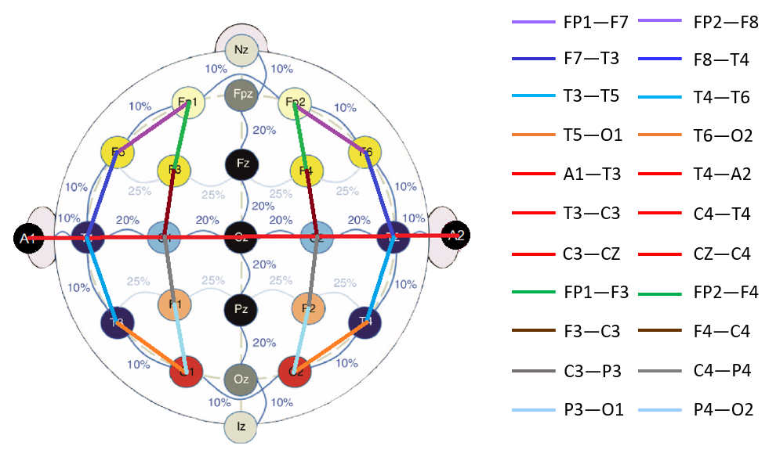
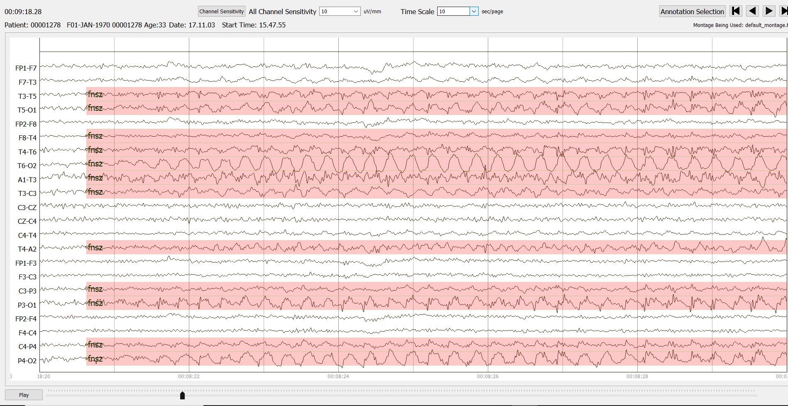
Recent Advances in the TUH EEG Corpus: Improving the Interrater Agreement for Artifacts and Epileptiform Events
G. Buckwalter, S. Chhin, S. Rahman, I. Obeid and J. Picone
The Neural Engineering Data Consortium, Temple University
College of Engineering
Temple University
www.nedcdata.org
Abstract
The latest version of TUSZ (v1.5.3) and TUAR (v2.0.0) represents our efforts to review the quality of the annotations based on feedback from the community.
Enhancements to TUSZ include:
High frequency seizures (above 3 Hz frequency) were annotated.
The overlap of subjects in training, development, and blind evaluation was removed.
All annotations were reviewed by two annotators to ensure there is high interrater agreement among the annotators.
Long files were split into smaller sections to eliminate memory issues in the Python code.
Enhancements to TUAR include:
Support of an XML format that allows annotations to be arbitrarily complex and support overlaps in time.
Eye movements and other artifacts were annotated with greater precision.
Inclusion of artifact bleeding among channels
The Temple University Hospital Seizure Detection Corpus (TUSZ) and TUH EEG Artifact Corpus (TUAR) are subsets of the TUH EEG Corpus (TUEG).
TUEG currently includes over 5,000 subscribers.
TUH EEG Seizure Corpus (TUSZ: v1.5.3)
This is a subset of TUH EEG (TUEG) developed to identify seizure activity
In v1.5.3, there are three subsets; development, training, and blind evaluations
Statistics for development subset for latest releases:
Annotation Process
In v1.5.2, each file was reviewed by a minimum of three annotators.
In v1.5.3, the previous annotations from v1.5.2 were reviewed using updated annotation guidelines.
The files are divided amongst the annotators and are annotated individually.
After each file has been reviewed once, the annotators review their annotations together. This second step is repeated to ensure complex epileptic form activity present in files is consistently accurate.
Inter-rater agreement is quite high (kappa > 0.8) for this process.
Machine learning experiments are underway to assess the impact of the new annotations.
File Formats
The longest duration files in the corpus can extend for hours, requiring Gbytes of memory in Python, making it difficult to annotate on laptops.
Long files were split into smaller sections of one hour or less to eliminate these memory issues.
We also deprecated our rec file format in favor of CSV and XML formats. Our users expressed a strong preference for CSV formats because it is an easy format to manipulate in Python.
XML files allow more flexible descriptions of the annotations and allow annotations to be represented as directed graphs.
Below is a typical XML file (00000258_s002_t000):
<?xml version="1.0" ?>
<label name="00000258_s002_t000" dtype="parent">
<endpoints name="endpoints" dtype="list">[[0.0, 1.0255]]</endpoints>
<probability name="probability" dtype="list">[1.0, 1.0]</probability>
<tcp_ar name="tcp_ar" dtype="parent">
<FP1-F7 name="FP1-F7" dtype="*">
<bckg name="bckg" dtype="parent">
<endpoints name="endpoints" dtype="list">[[0.0, 1.0255]]</endpoints>
<probability name="probability" dtype="list">[1.0]</probability>
</bckg>
</FP1-F7>
</tcp_ar>
</label>
The CSV equivalent is:
# version = csv_v1.0.0
# montage file: C:\Users\Grace\Desktop\EEGResearch\nedc_annotator_v5.0.3\lib\ned
c_ann_eeg_tools_map_v01.txt
# annotation label file: C:\Users\Grace\Desktop\EEGResearch\nedc_annotator_v5.0.
3\lib\nedc_ann_eeg_tools_map_v01.txt
#
00000258_s002_t000, FP1-F7, 0.0000, 1.0255, bckg, 1.0000
Development Releases | v1.5.1 | v1.5.2 | v1.5.3
Patients | 50 | 50 | 53
Sessions | 259 | 238 | 341
Files | 1152 | 1012 | 1832
Seizure Files | 309 | 280 | 324
Total No. Seizure Events | 718 | 673 | 1239
Total Duration (Hours) | 191 | 170.3 | 435.5
Seizure Duration (Hours) | 16.9 | 16.2 | 21.8
Introduction
In TUSZ, every seizure event that occurs in a file has been annotated.
This latest version of the corpus uses updated annotation standards to reduce the amount of mislabeled background that was contained in seizure files. This helps machine learning algorithms reduce their false alarm rate.
New documentation for the corpus includes:
Annotation guidelines were updated to include high frequency seizures.
The overlap of subjects in training, development, and blind evaluation was removed.
Files > 1 hour were split into shorter segments to reduce computing memory requirements.
Included absence (absz), complex partial (cpsz), generalized (gnsz), focal non-specific (fnsz), simple partial (spsz,) tonic-clonic (tcsz), and tonic (tnsz)
However, artifacts were not annotated and are a major source of error for machine learning systems.
In TUAR, every artifact event present in a file has been annotated.
Our annotation file format was modified to use XML, which enabled multiple artifact tags to be used at one time without causing clutter.
TUH EEG Artifact Corpus (TUAR: v2.1.0)
This is a subset of TUH EEG (TUEG) developed to differentiate artifacts from seizure activity.
The types of annotation tags include eye movement (eyem), muscle (musc), shivering (shiv), chewing (chew), and electrode (elec).
In the case of multiple simultaneous artifact events, there are coupled tags (ex: musc+elec).
Eye movement is often mistaken as seizure activity as seen below:
TUAR v2.1.0 consists of eye movements that were annotated individually, as opposed to one continuous tag.
There are 310 files, 259 sessions, and 213 patients in the TUAR Corpus. It has been a popular choice to benchmark the performance of artifact detection.
Updated Annotation Guidelines
The official annotation guidelines used by NEDC can be found here: https://www.isip.piconepress.com/ publications/ reports/2020/tuh_eeg/annotations/.
High frequency seizures have a frequency greater than 3 Hz. These seizures were not previously annotated in v1.5.2.
In v1.5.2 there were 718 seizures, while in v1.5.3 there were 843 seizures annotated.
Instead of using only general seizures (gnsz) and focal seizures (fnsz) tags, the specific types of seizures were also annotated, including absz, cpsz, fnsz, spsz, tcsz, and tnsz
All annotations were reviewed by two annotators to ensure accuracy and consistency among annotators.
Summary
These corpora and supporting tools are open source and freely available at:
https://www.isip.piconepress.com/projects/tuh_eeg
For further information, contact help@nedcdata.org.
Future release plans include:
Acknowledgements
Research reported in this publication was most recently supported by the National Science Foundation Partnership for Innovation award no. IIP-1827565. Any opinions, findings, and conclusions or recommendations expressed in this material are those of the author(s) and do not necessarily reflect the official views of any of these organizations.
We are deeply indebted to Dr. Mercedes Jacobson for her continued support of this project, and to Dr. Vinit Shah, a recent PhD graduate from our program, who was instrumental in training our annotators.
Database | Version | Description | Expected Date
TUSZ | v1.5.3 | Improved annotations of /dev and elimination of patient overlap | December 2021
TUAR | v2.1.0 | Improved annotations of eye movement | December 2021
TUSZ | v1.5.4 | Improved annotations of /train and /eval | March 2022
TUEG | v2.0.0 | Includes data from 2016-2021 | May 2022

