Slide 1
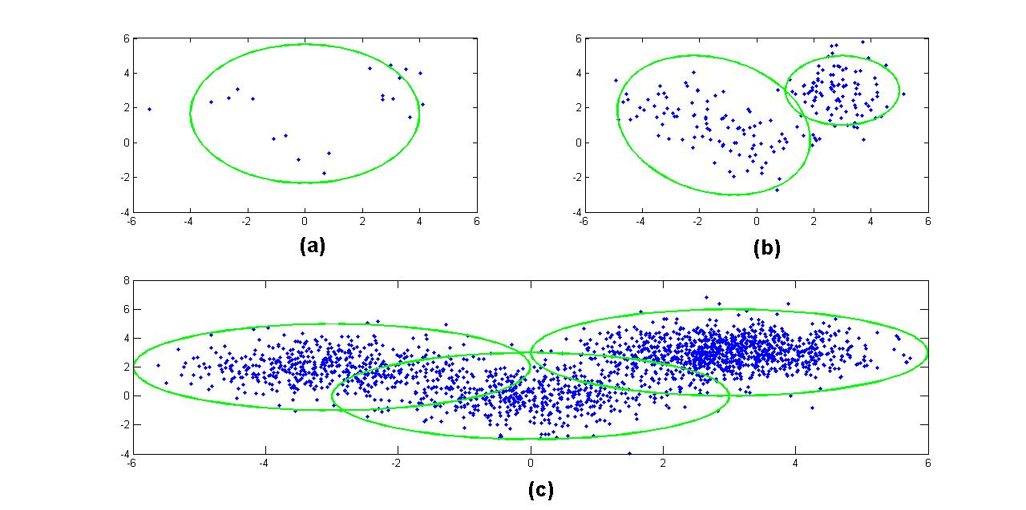
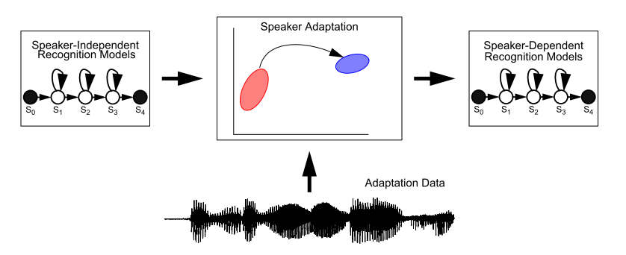
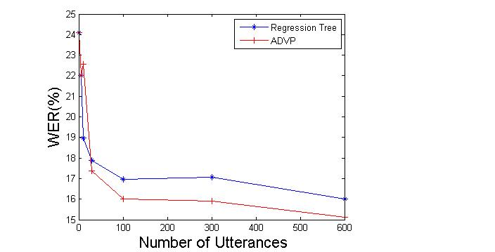
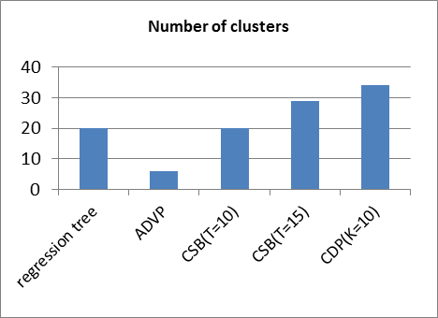
Applications of Dirichlet Process Mixtures to Speaker Adaptation
Amir Harati and Joseph Picone Marc Sobel
Institute for Signal and Information Processing, Temple University Department of Statistics, Temple University
www.isip.piconepress.com
Introduction
Major challenge in machine learning is generalization – can systems successfully recognize previously unseen data?
Controlling complexity is key to good generalization.
Data-driven modeling must be capable of preserving important modalities in the data.
The complexity of the model should be adapted to available data.
Application to Speaker Adaption
Adapting speaker independent models requires balancing complexity (e.g., parameter counts) with the amount of adaptation data.
Classical solutions to speaker adaptation include the use of Maximum Likelihood Linear Regression (MLLR) and regression trees.
Our goal is to replace the regression tree with a DPM and to achieve better performance at a comparable or reduced level of complexity.
Pilot Experiment: Monophones
Experiments use Resource Management (RM).
12 different speakers with 600 training utterances.
Models use a single Gaussian mixture.
Word error rate (WER) can be reduced by more than 10%.
DPM preserves 6 clusters in the data while the regression tree finds only 2 clusters.
Observations
10% reduction in WER over MLLR.
DPMs produce meaningful interpretations of the acoustic distances between data (e.g., broad phonetic classes).
Decreases in performance may be related to the tree construction approach.
Extensions To This Work
Generalize the assignment of a distribution to one cluster using soft-tying.
Expand statistical models to multiple mixtures.
The nonparametric Bayesian framework provides two important features:
number of clusters is not known a priori and could possibly grow with obtaining new data
generalization of parameter sharing and model (and state) tying.
Figure 1. Model Complexity as a Function of Available Data. (a) 20 (b) 200 (c) 2000 data points
Figure 2. Mapping Speaker Independent Models to Speaker Dependent Models
Figure 3. Regression Tree vs. ADVP
Dirichlet Processes
Random probability measure over such that for any measurable partition over :
is the base distribution and acts like mean of DP. is the concentration parameter and is proportional to the inverse of the variance.
Example: Chinese restaurant process
Dirichlet Process Mixture (DPM) models place a prior on the number of clusters.
Hierarchical Dirichlet Processes (HDP): extend this by allowing sharing of parameters (atoms) across groups.
Training Algorithm
Train speaker independent (SI) model. Collect mixture components and their frequencies.
Generate samples for each component and cluster them using a DPM model.
Construct a tree structure of the final result using a bottom-up approach. Merge leaf nodes based on a Euclidean distance.
Assign clusters to each component using a majority vote scheme.
Compute the transformation matrix using a maximum likelihood approach.
Inference Algorithms
Three different variational algorithms:
Accelerated variational Dirichlet process mixture (AVDP).
Collapsed variational stick-breaking (CSB).
Collapsed Dirichlet priors (CDP).
Pilot Experiment: Triphones
ADVP better for moderate amounts of data while CDP and CSB better for larger amounts of data.
Future Work
Use HDP-HMM to discover new acoustic units.
Use HDP-HMM to relax the standard HMM left-to-right topology.
Integrate HDP-HMM into the training loop so that training and testing operate under matched conditions.
Key References
E. Sudderth, “Graphical models for visual object recognition and tracking,” Ph.D. dissertation, MIT, May 2006.
J. Paisley, “Machine learning with Dirichlet and beta process priors: Theory and Applications,” Ph.D. Dissertation, Duke University, May 2010.
P. Liang, et al., “Probabilistic grammars and hierarchical Dirichlet processes”, The Handbook of Applied Bayesian Analysis, Oxford University Press, 2010.
Figure 4. The Number of Discovered Clusters
Figure 5. Regression Tree vs. Several DPM Inference Algorithms

