Slide 1
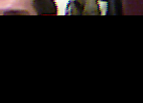
Input Gesture (‘P')
LB₁
‘P’
LB₂
Syntactic Constraints
Level I
…
Sub-Gestures
SB
P₁
SB
P₂
P_{N}
SB
Level II
P₂₁
P₂₂
P₂₃
P₂₄
…
P_{2N}
SB₁
States

