Slide 1
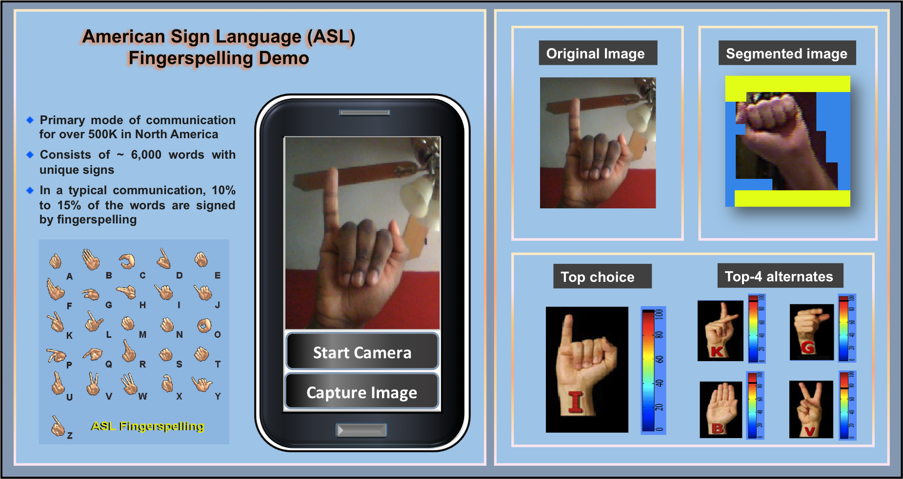
Fingerspelling Alphabet Recognition Using A Two-level Hidden Markov Model
Shuang Lu, Joseph Picone and Seong G. Kong
Institute for Signal and Information Processing
Temple University
Philadelphia, Pennsylvania, USA

Slide 2
Abstract
Advanced gaming interfaces have generated renewed interest in hand gesture recognition as an ideal interface for human computer interaction.
Signer-independent (SI) fingerspelling alphabet recognition is a very challenging task due to a number of factors including the large number of similar gestures, hand orientation and cluttered background.
We propose a novel framework that uses a two-level hidden Markov model (HMM) that can recognize each gesture as a sequence of sub-units and performs integrated segmentation and recognition.
We present results on signer-dependent (SD) and signer-independent (SI) tasks for the ASL Fingerspelling Dataset: error rates of 2.0% and 46.8% respectively.

Slide 3
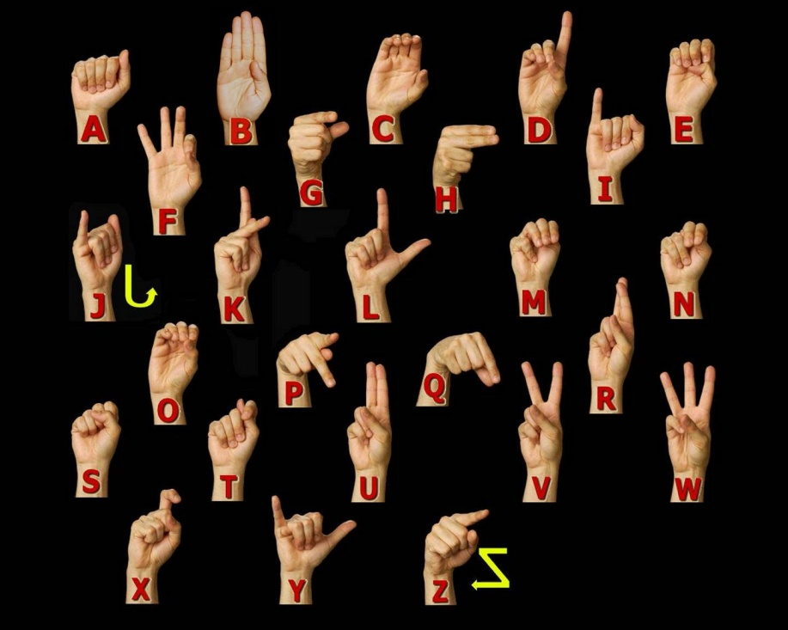
American Sign Language (ASL) Recognition
Primary mode of communication for over 500,000 people in North America alone.
In a typical communication, 10% to 15% of the words are signed by fingerspelling of alphabet signs.
Similar to written English, the one-handed Latin alphabet in ASL consists of 26 hand gestures.
The objective of our work is to classify 24 ASL alphabet signs from a static 2D image (we exclude “J” and “Z” because they are dynamic hand gestures).

Slide 4
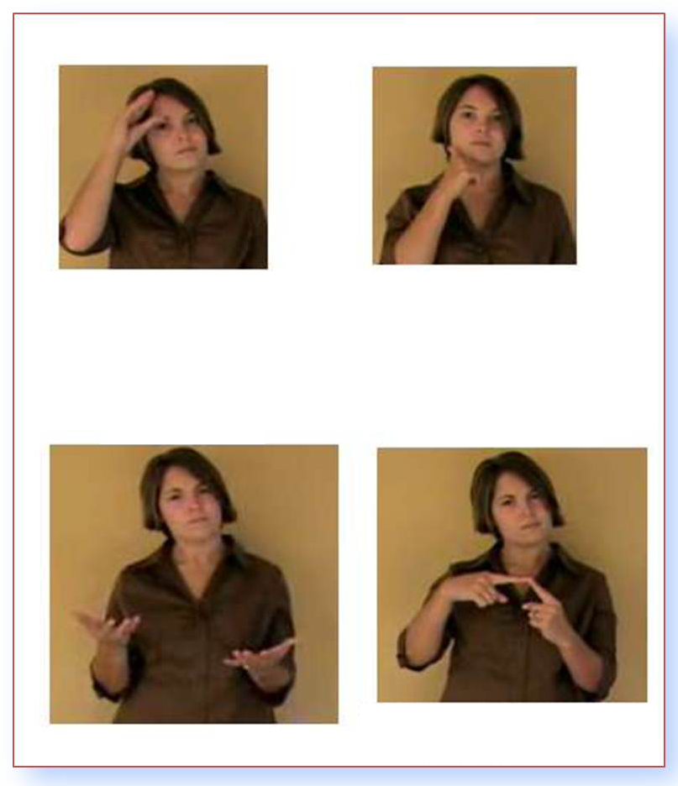
ASL Still A Challenging Problem
Similar shapes (e.g., “r” vs. “u”)
Separation of hand from background
Hand and background are similar in color
Hand and arm are similar in color
Background occurs within a hand shape
Rotation, magnification, perspective, lighting, complex backgrounds, skin color, …
Signer independent (SI) vs. signer dependent (SD)

Slide 5
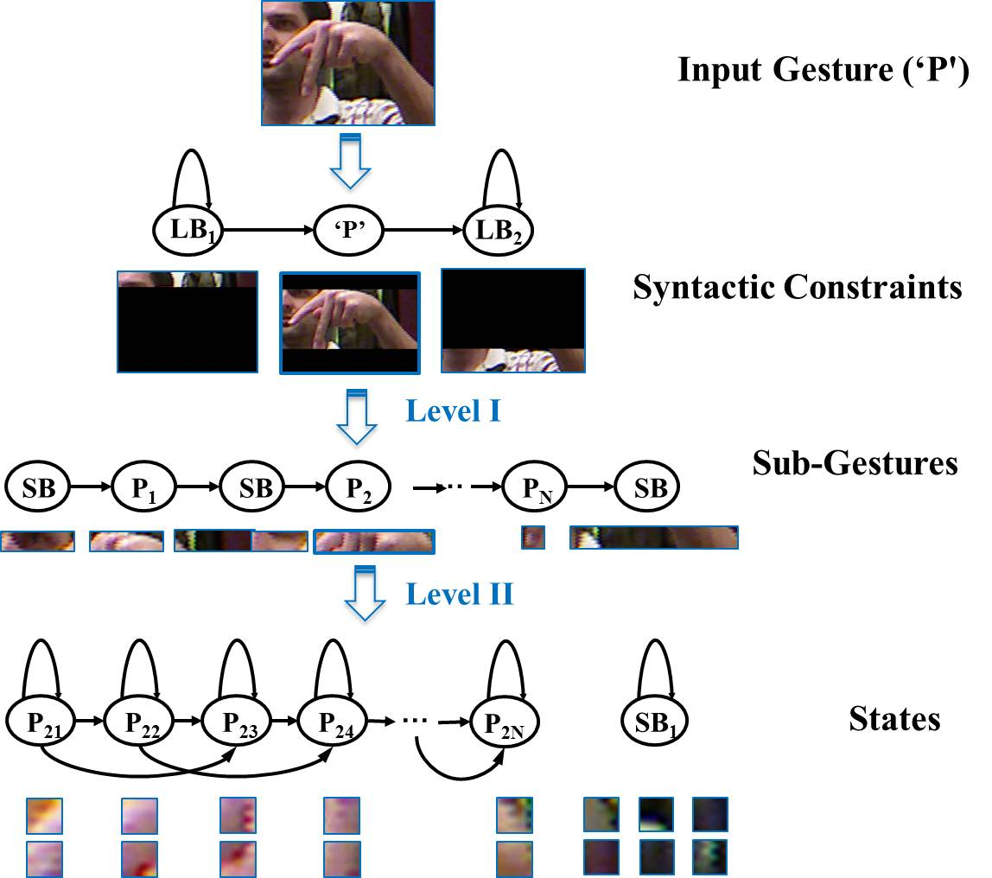
Architecture: Two-Level Hidden Markov Model

Slide 6
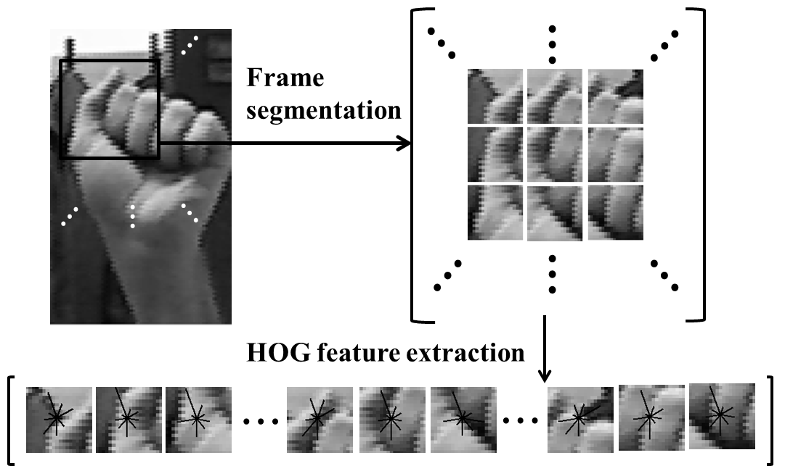
Architecture: Histogram of Oriented Gradient (HOG)
Gradient intensity and orientation:
In every window, separate A(x, y) (from 0 to 2π) into 9 regions; sum all G(x, y) within the same region.
Normalize features inside each block:
Benefits:
Illumination invariance due to the normalization of the gradient of the intensity values within a window.
Emphasizes edges by the use of an intensity gradient calculation.
Less sensitive to background details because the features use a distribution rather than a spatially-organized signal.

Slide 7
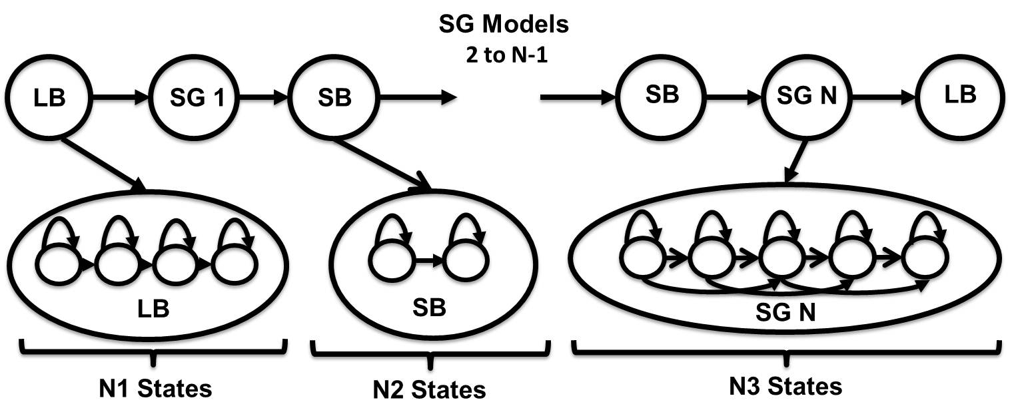
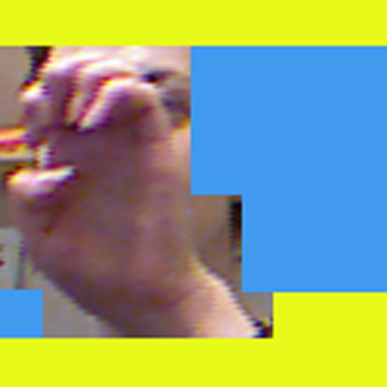
Architecture: Two-Levels of Hidden Markov Models

Slide 8
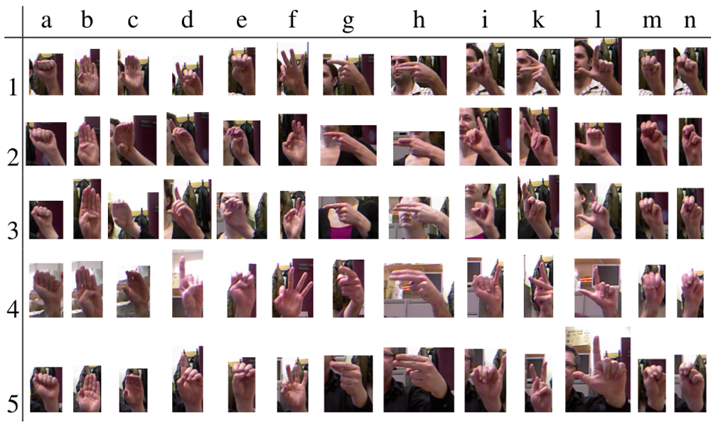
Experiments: ASL Fingerspelling Corpus
24 static gestures (excluding letters ”J” and ”Z”)
5 subsets from 4 subjects
More than 500 images per sign per subject
A total of 60,000 images
Similar gestures
Different image sizes
Face occlusion
Changes in illumination
Variations in signers
Sign rotation

Slide 9
Experiments: Parameter Tuning
Performance as a function of the frame/window size
Performance as a function of the number of mixture components
Frame (N) | Window (M) | % Overlap | Error (%)
5 | 20 | 75% | 7.1%
5 | 30 | 83% | 4.4%
10 | 20 | 50% | 5.1%
10 | 30 | 67% | 5.0%
10 | 60 | 83% | 8.0%
No. Mixtures | Error Rate (%)
1 | 9.9
2 | 6.8
4 | 4.4
8 | 2.9
16 | 2.0
System Parameter | Value
Frame Size (pixels) | 5
Window Size (pixels) | 30
No. HOG Bins | 9
No. Sub-gesture Segments | 11
No. States Per Sub-gesture Model | 21
No. States Long Background (LB) | 11
No. States Short Background (SB) | 1
No. Gaussian Mixtures (SG models) | 16
No. Gaussian Mixtures (LB/SB models) | 32
An overview of the optimal system parameters
Parameters were sequentially optimized and then jointly varied to test for optimality
Optimal settings are a function of the amount of data and magnification of the image

Slide 10
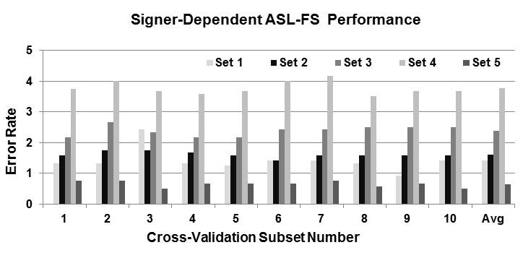
Experiments: SD vs. SI Recognition
Performance is relatively constant as a function of the cross-validation set
Greater variation as a function of the subject
System | SD | Shared | SI
Pugeault (Color Only) | N/A | 27.0% | 65.0%
Pugeault (Color + Depth) | N/A | 25.0% | 53.0%
HMM (Color Only) | 2.0% | 7.8% | 46.8%
SD performance is significantly better than SI performance.
“Shared” is a closed-subject test where 50% of the data is used for training and the other 50% is used for testing.
HMM performance doesn’t improve dramatically with depth.

Slide 11
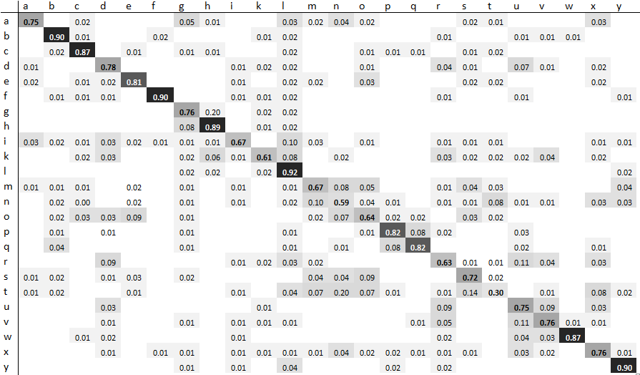
Analysis: Confusion Matrix

Slide 12
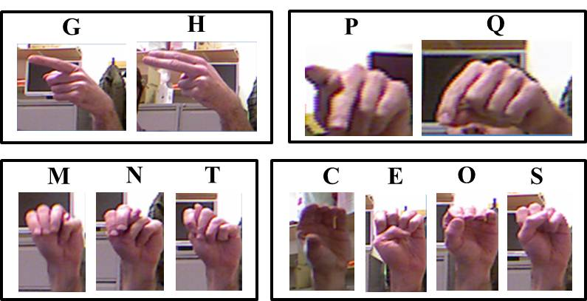
Experiments: Error Analysis
Gestures with a high confusion error rate.
Images with significant variations in background and hand rotation.
Another point… Another point… Another point…Another point…
Another point… Another point…Another point… Another point
“SB” model is not reliably detecting background.
Solution: transcribed data?

Slide 13
Summary and Future Directions
A two-level HMM‑based ASL fingerspelling alphabet recognition system that trains gesture and background noise models automatically:
Five essential parameters were tuned by cross-validation.
Our best system configuration achieved a 2.0% error rate on an SD task, and a 46.8% error rate on an SI task.
Currently developing new architectures that perform improved segmentation. Both supervised and unsupervised methods will be employed.
We expect performance to be significantly better on the SI task.
All scripts, models, and data related to these experiments are available from our project web site:
http://www.isip.piconepress.com/projects/asl_fs.

Slide 14
Brief Bibliography of Related Research
[1] Picone, J., Lu, S., & Harati, A. (2013). Hand Gesture Recognition Using Hidden Markov Models. IEEE Section Meeting, Northern Virginia. Arlington, Virginia, USA.
[2] Pugeault, N. & Bowden, R. (2011). Spelling It Out: Real-time ASL Fingerspelling Recognition. Proceedings of the IEEE International Conference on Computer Vision Workshops (pp. 1114–1119). (available at http://info.ee.surrey.ac.uk/Personal/N.Pugeault/index.php?section=FingerSpellingDataset).
[3] Vieriu, R., Goras, B. & Goras, L. (2011). On HMM Static Hand Gesture Recognition. Proceedings of International Symposium on Signals, Circuits and Systems (pp. 1–4). Iasi, Romania.
[4] Kaaniche, M. & Bremond, F. (2009). Tracking HOG Descriptors for Gesture Recognition. Proceedings of the Sixth IEEE International Conference on Advanced Video and Signal Based Surveillance (pp. 140–145). Genova, Italy.
[5] Wachs, J. P., Kölsch, M., Stern, H., & Edan, Y. (2011). Vision-based Hand-gesture Applications. Communications of the ACM, 54(2), 60–71.

Slide 15
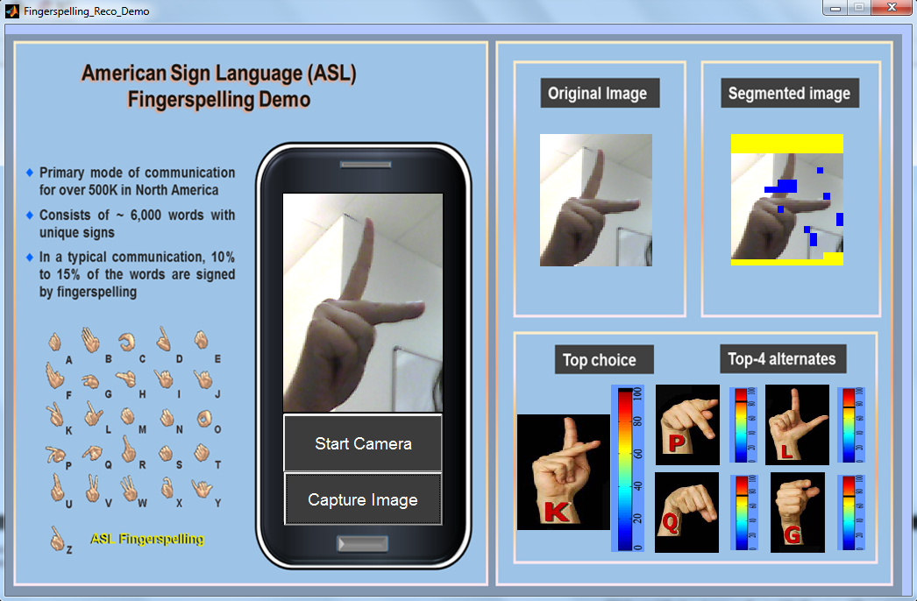
Demonstration

Slide 16
Project Web Site

Slide 17
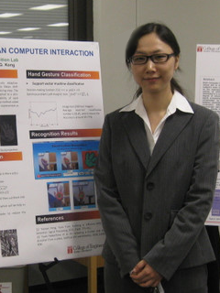
Biography
Shuang Lu received her BS in Electrical Engineering in 2008 and her MSEE in 2010, both from Jiangnan University, located in Wuxi, Jiangsu Province, China. … say something about your MS thesis or significant project…… say something about your MS thesis or significant project…
She is currently pursuing a PhD in Electrical Engineering in the Department of Electrical and Computer Engineering at Temple University in Philadelphia, Pennsylvania, USA, where she works as a teaching assistant responsible for the entry-level analog and digital electronics laboratories.
Ms. Lu’s primary research interests are object tracking, gesture recognition and ASL fingerspelling recognition. [… say something about the focus of your disseration….] [… say something about the focus of your disseration….] She has published 2 journal papers and 3 peer-reviewed conference papers. She is a student member of the IEEE, as well as a member of the Society of Woman Engineers (SWE). (Are you not a member of Etta Kappa Nu?) … one sentence about your artistic interests and hobbies…

