Slide 1
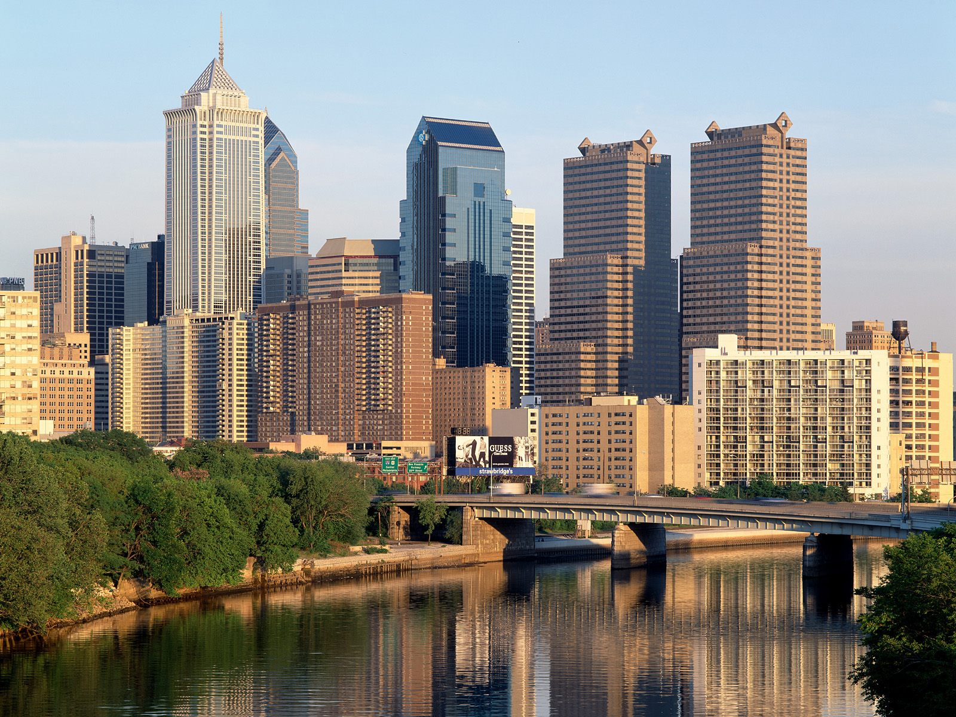


IEEE Signal Processing in
Medicine and Biology
Symposium
Temple University, Philadelphia, Pennsylvania
December 13, 2014
Time | Room | Presenter | Session
Lecture Session No. 3 (Chair: Davide Piovesan)
03:30 PM – 03:50 PM | 223 | Zach French | L3.01: Z. French, E. Mays, C. Hassett, J. Moon, N. Langhals, P. Cederna and M. Urbanchek, “Complete Regenerative Peripheral Nerve Interfaces, Fatigue and Recovery”
03:50 PM – 04:10 PM | 223 | Kanza Khan | L3.02: K. Khan, D. Qin, D. Glaser, A. Nalci, C. Printzy, C. McElroyy and P. Cosman, “Finger Pressure Variability for Physical Therapists and Untrained Subjects”
04:10 PM – 04:30 PM | 223 | Mike O’Brien | L3.03: M. Brien, M. Keegan, T. Goldsteiny, R. Millin, J. Benvenuto, K. Kayz and R. Bhattacharyya, “Sparse Atomic Feature Learning via Gradient Regularization: With Applications to Finding Sparse Representations of fMRI Activity Patterns”
04:30 PM – 04:50 PM | 223 | Davide Piovesan | L3.04: R. Romero, A. Cardenas and D. Piovesan, “Viscoelastic Properties of the Ankle During Quiet Standing via Raster Images and EKF”

