Slide 1
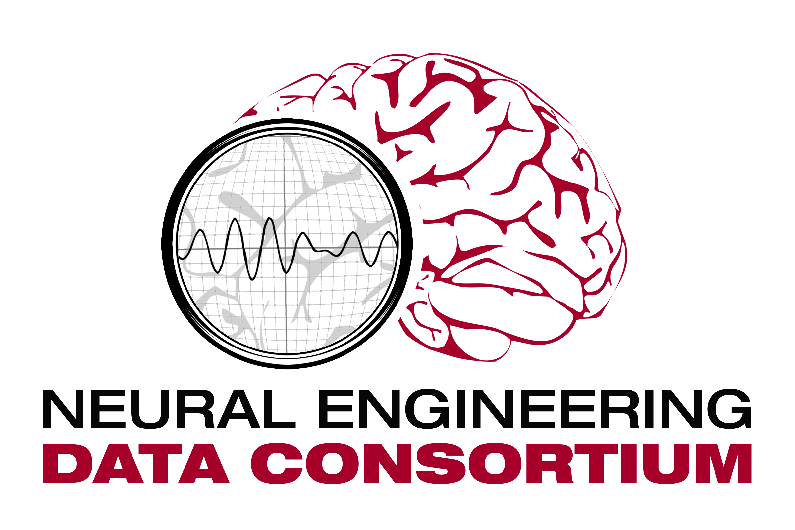
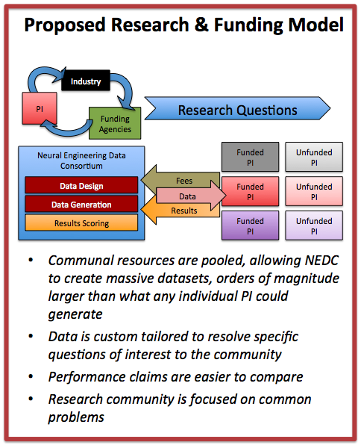
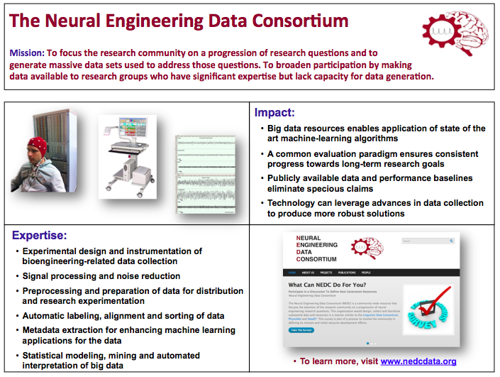
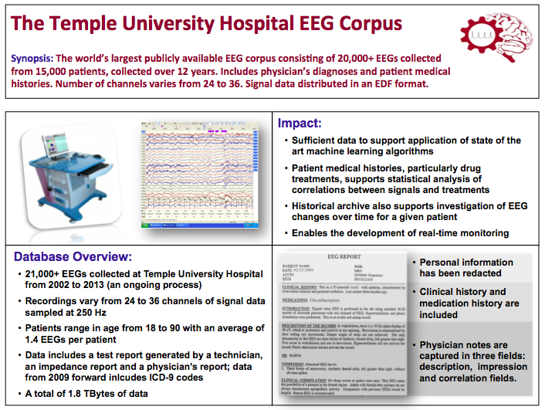
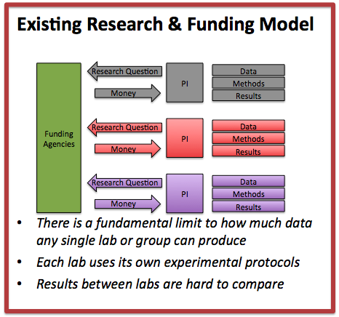
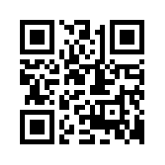
The Neural Engineering Data Consortium
Iyad Obeid PhD, Joseph Picone PhD
Temple University, Philadelphia, Pennsylvania
Objective: We present the launch of a neuroscience community-wide resource whose goal is to accelerate research in neural signal processing by creating, curating, and archiving massive neural datasets. A focused collaboration between stakeholders, including researchers, funding agencies, regulators, and industry, can define common problems of broad interest. Pooled resources can then be used to generate massive common datasets for community-wide adoption; best methods for data decoding or processing can be identified using large-scale computing competitions on the common data corpora. This paradigm extends well beyond the basic concept of ‘data sharing’ into a more integrated resource for focusing community attention and funding.
Methods: The Neural Engineering Data Consortium (NEDC) has been launched to meet this role. Based at Temple University and supported by NSF seed funding, the NEDC has recruited a board of directors from academia, industry, federal funding agencies, and government regulators, and is presently soliciting input from the community on goals and priorities. The NEDC is also releasing its first curated corpus to the public: a dataset of approximately 25,000 clinical EEGs with corresponding physician reports taken from the electronic medical record archives.
Results: The NEDC anticipates that its EEG corpus will of interest to neuroscientists, biomedical engineers, machine learning experts, and big data researchers alike. The corpus will be available at www.nedcdata.org.
Conclusion: Community-wide data infrastructure can support neuroscience investigation by focusing attention and by exploiting efficiencies of scale.
Significance: By presenting an alternative to the predominant neuroscience funding paradigm (‘investigator collects data to test own hypothesis’), the NEDC aims to accelerate discovery by having communities of investigators focus on common problems, pool data generation resources, and then compete for data processing tools and methods. The NEDC can also greatly facilitate research by providing a community framework for handling the multitude of legal and privacy concerns when human data is shared between parties.
Take The Survey:
www.nedcdata.org

