Slide 1
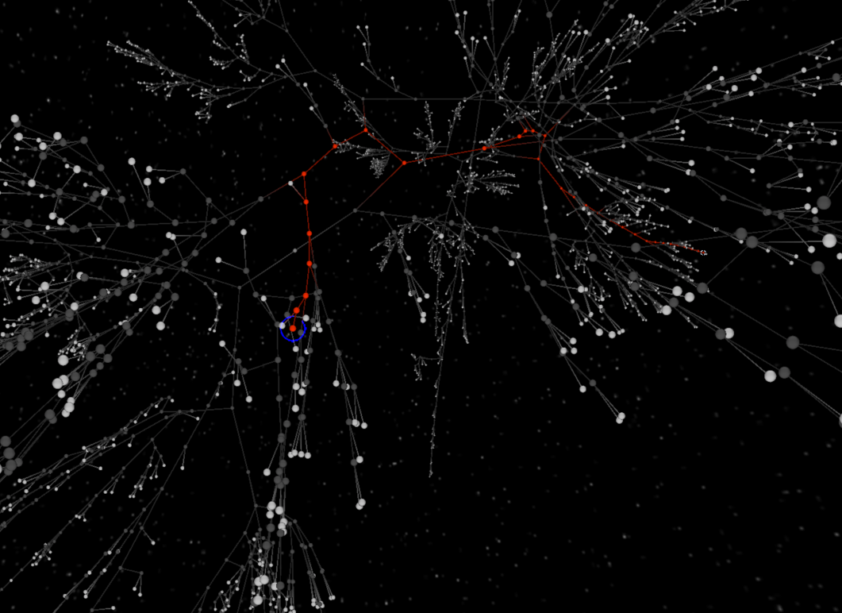
Automated Identification of
Abnormal Adult EEG
S. López, G. Suarez, D. Jungreis, I. Obeid and J. Picone
Neural Engineering Data Consortium
Temple University

Slide 2
Manual Interpretation of EEGs
Manual interpretation of an EEG is performed by a board-certified neurologist. It takes several years to receive this certification.
Interrater agreement is low: the interpretation of an EEG depends somewhat on the training and subjective judgement of the examiner.
Increasing the interrater agreement for EEG interpretation is one of the advantages of an automated technique.
Patient Preparation
EEG Recording
EEG ranging from 22 minutes to several days is recorded
EEG is Interpreted
Certified physicians interpret EEG
Patients are prepared for the test
EEG Report is Produced
Report of findings (e.g. abnormality) is prepared

Slide 3
Normal/Abnormal Classification
When reports are generated, the records are categorized as either normal or abnormal.
Automatic classification of EEGs as normal or abnormal is a significant step in the reduction of the visual bias.
The normal/abnormal decision is made through the examination of the presence of abnormal EEG events or lack of normal EEG characteristics ???? this doesn’t say much ???
Normal EEG
Abnormal EEG
Possible benign variables
Presence of normal EEG characteristics
Presence of abnormalities
Lack of normal EEG characteristics

Slide 4
Normal EEG Characteristics
The main characteristics of a normal EEG are the following:
Reactivity: Response to certain physiological changes or provocations.
Alpha Rhythm: Waves originated in the occipital lobe (predominantly), between 8-13 Hz and 15 to 45 μV.
Mu Rhythm: Central rhythm of alpha activity commonly between 8-10 Hz visible in 17% to 19% of adults.
Beta Activity: Activities in the frequency bands of 18-25 Hz, 14-16 Hz and 35-40 Hz.
Theta Activity: Traces of 6-7 Hz activity present in the frontal or frontocentral regions of the brain.
The normal/Abnormal classification heavily depends on the frequency, presence or distortion of this feature. Its emergence during the closed-eyes period is known as Posterior Dominant Rhythm (PDR)
We decided to focus on this characteristic.

Slide 5
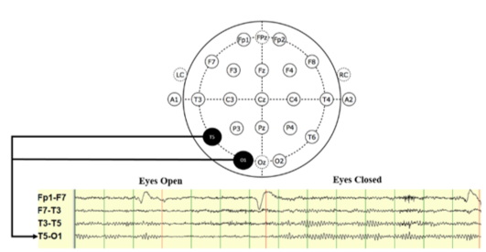
Data
The data used was a subset of the TUH EEG Corpus. The data was divided as follows:
Set | Normal | Abnormal
Training | 102 EEGs | 100 EEGs
Development | 50 EEGs | 50 EEGs
Evaluation | 50 EEGs | 50 EEGs
Because the PDR can be observed in the posterior and occipital channels, channel T5-O1 was selected for the experiments.

Slide 6
Experimental Design
First 60 seconds of each EEG recording were used
Signal Features were extracted
MFCC-like features (8 cepstral coefficients)
Differential Energy
Vectors for the selected channel were concatenated in a supervector
First and second derivatives
PCA was used to reduce the dimensionality of the feature matrix.

Slide 7
Algorithms
Two standard Algorithms were explored and compared:
k-Nearest Neighbor (kNN)
Random Forest
$${\hat{C}}_{rf}^{B}\left(x\right)=majority vote {\left\{{\hat{C}}_{b}(x)\right\}}_{1}^{B}$$
Systems for different values of k were tested
…
+
Decision

Slide 8
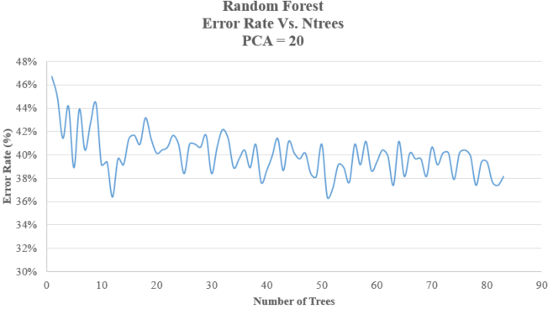
Random Forest and the Number of Trees
The performance of the systems higher than 20 trees are comparable to each other.
Taking performance and computational time for the classification into account, a number of 50 trees was chosen for the rest of the experiments.

Slide 9
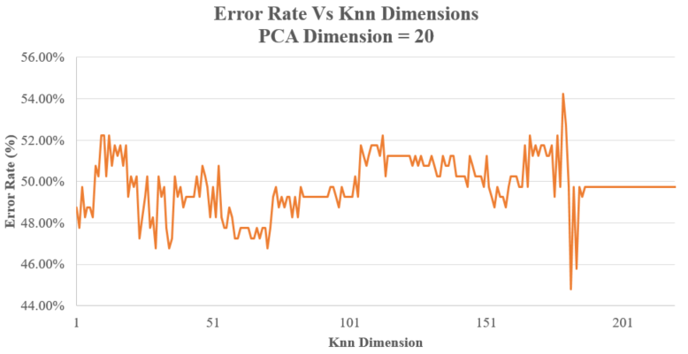
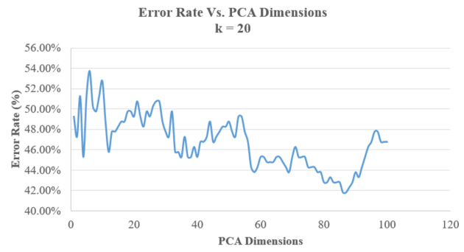
kNN: Tuning the System
The lowest k for the best operating interval was chosen.
This point corresponds to k = 20.
The best error rate achieved by the system is 41.79% for k = 86.

Slide 10
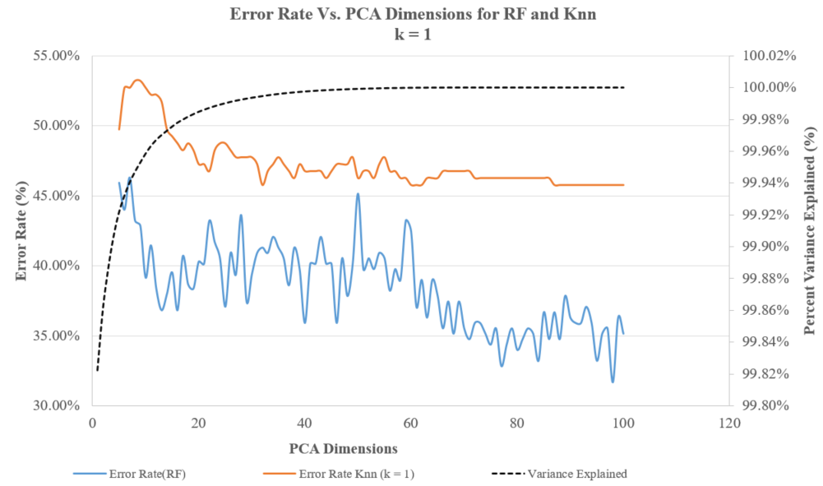
Comparing the Two Systems
For PCA dimensions higher than 20 both systems perform better than guessing based on priors (49.79% error rate).
99.82% of the variance is explained by the first principal component

Slide 11
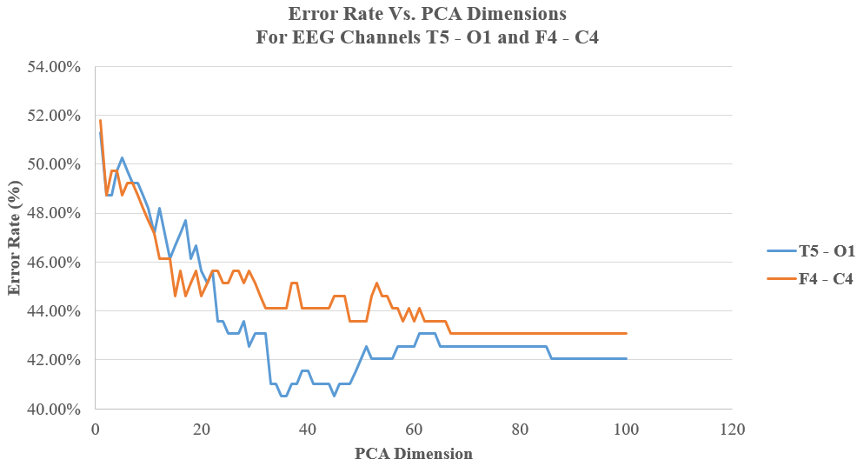
Channel Comparison
The performance for the T5-O1 channel was better for all operating points with PCA dimensions higher than 20.
This correlates with the information learned from neurologists about their reliance on occipital channels for the classification of EEGs.

Slide 12
Error Analysis
 | Normal | Abnormal
Normal | 50.49% | 49.50%
Abnormal | 34.00% | 66.00%
No. | System Description | Error
1 | Random Guessing | 49.75%
2 | kNN (k = 20) | 41.79%
3 | RF (Ntrees = 50) | 31.66%

Slide 13
Summary
Normal/Abnormal Classification:
These pilot experiments have allowed the creation of a normal/abnormal baseline system.
The classification decisions were made through the random forest ensemble learning and later compared to the kNN algorithm and the guessing based on priors.
Results show that kNN and random forest outperform guessing based on priors.
Knowledge about the PDR and its characteristics was used for selecting a significant EEG channel
Events that encapsulate benign EEG variants should be labeled and incorporated into the system
Time should be invested in the analysis and extraction of features that are more meaningful and adequate for this particular problem.

Slide 14
Brief Bibliography
[1] F. Fahoum, R. Lopes, F. Pittau, F. Dubeau, and J. Gotman, “Widespread epileptic networks in focal epilepsies: EEG-fMRI study,” Epilepsia, vol. 53, no. 9, pp. 1618–1627, Sep. 2012.
[2] H. Azuma, S. Hori, M. Nakanishi, S. Fujimoto, N. Ichikawa, and T. A. Furukawa, “An intervention to improve the interrater reliability of clinical EEG interpretations,” Psychiatry Clin. Neurosci., vol. 57, no. 5, pp. 485–489, Oct. 2003.
[3] S. Smith, “EEG in the diagnosis, classification, and management of patients with epilepsy,” J. Neurol. Neurosurg. Psychiatry, vol. 76, no. Suppl 2, pp. ii2–ii7, Jun. 2005.
[4] J. S. Ebersole and T. A. Pedley, Current practice of clinical electroencephalography, 4th ed. Philadelphia, Pennsylvania, USA: Wolters Kluwer, 2014.
[5] A. Harati, S. Lopez, I. Obeid, M. Jacobson, S. Tobochnik, and J. Picone, “THE TUH EEG CORPUS: A Big Data Resource for Automated EEG Interpretation,” in Proceedings of the IEEE Signal Processing in Medicine and Biology Symposium, 2014, pp. 1–5.

Slide 15
Brief Bibliography
[6] A. C. N. Society, “Guideline 6: A Proposal for Standard Montages to Be Used in Clinical EEG [White Paper]. Retrieved from http://www.acns.org/pdf/guidelines/Guideline-6.pdf, 2006.
[7] A. Harati, M. Golmohammadi, S. Lopez, I. Obeid, and J. Picone, “Improved EEG Event Classification Using Differential Energy,” in Proceedings of the IEEE Signal Processing in Medicine and Biology Symposium, 2015, pp. 1–4.
[8] I. T. Jolliffe, Principal Component Analysis, 2nd ed. New York City, New York, USA: Springer-Verlag, 2002.
[9] R. O. Duda, P. E. Hart, and D. G. Stork, Pattern classification, 2nd ed. New York City, New York, USA: John Wiley & Sons, 2003.
[10] L. Breiman, J. Friedman, R. A. Olshen, and C. Stone, Classification and Regression Trees, 1st ed. Boca Raton, Florida, USA: Chapman and Hall/CRC, 1984.
[11] Mathworks, “TreeBagger,” Statistics and Machine Learning Toolbox, 2015. [Online]. Available: http://www.mathworks.com/help/stats/ treebagger.html. [Accessed: 18-Oct-2015].
[12] A. Ganapathiraju, J. Hamaker, and J. Picone, “Applications of Support Vector Machines to Speech Recognition,” IEEE Trans. Speech Audio Process., 2002.

