Slide 1
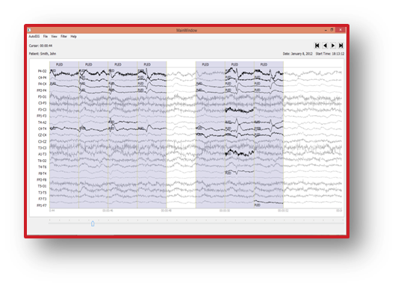
AN ANALYSIS OF TWO COMMON REFERENCE POINTS FOR EEGS
S. López, A. Gross, S. Yang, M. Golmohammadi,
I. Obeid and J. Picone
Neural Engineering Data Consortium
Temple University

Slide 2
Abstract
Clinical EEG data exhibits a number of variations which arise from factors including the type and placement of electrodes, as well as the type of electrical grounding used.
Two types of referential montages known as REF and LE each comprise about 45% of the data in the TUH EEG corpus. The these two grounding schemes were explored to better understand the effects of different grounding schemes on machine learning systems.
Specifically, the statistical properties of features generated using the two montage types were compared. The performance of baseline Hidden Markov Model systems when trained and evaluated on different mixes of each class were evaluated as well.
The system trained on LE class data significantly outperforms that trained on REF, with a detection rate of 77.2% for the former and only 61.4% for the latter.
Statistical analysis of the data revealed that normalization techniques might help to resolve the discrepancies in performance, however cepstral mean normalization failed to yield an improvement.

Slide 3
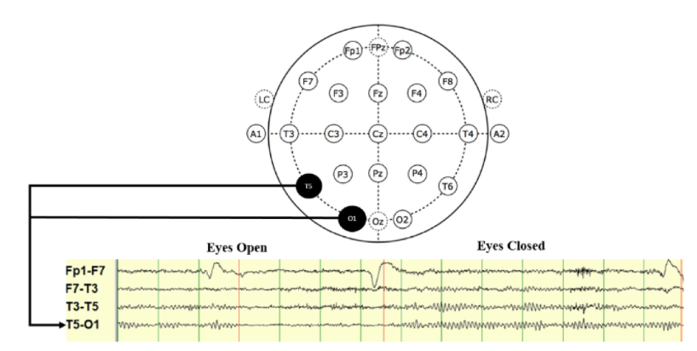
EEG Referencing Schemes
In the neuroscience community the lack of standards regarding EEG signals has resulted in a high degree of variability between recordings. One way in which recordings differ is the chosen referencing scheme.
A given channel of an EEG signal records the difference in voltage between two electrodes which must be measured with respect to a reference.
Unfortunately, due to the nonlinear nature of conductive paths in the brain and scalp, the common reference point cannot be assumed to be canceled by the subtraction of two channels in a differential montage.

Slide 4
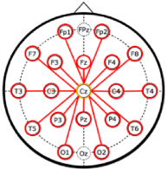
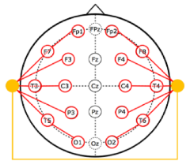
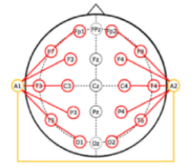
EEG Referencing Schemes
Three common referencing schemes are the Common Vertex Reference, the Average Reference, and the Linked Ear reference.
The TUH EEG Corpus contains at least 4 different types of reference points. In this study we consider two of them: Average Reference (REF) and Left Ear Reference (LE).
It is unclear whether different referencing schemes can be represented by the same statistical model, or whether there are irreconcilable differences between them.
Common Vertex Reference
Average Reference
Linked Ear Reference

Slide 5
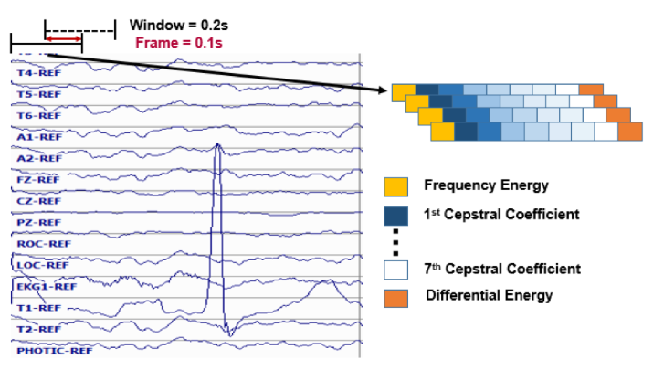
Feature Extraction
Features are calculated from the signal using a window of 0.2 seconds and a frame of 0.1 seconds.
Nine base features comprised of the frequency domain energy, 1st through 7th cepstral coefficients, and a differential energy term are computed.
Using these base features, first and second derivative features are calculated, forming feature vectors of dimension 26.

Slide 6
Experimental Design
Calculation of simple descriptive statistics (mean and variance)
Principal Components Analysis
Baseline HMM recognition experiment

Slide 7
Descriptive Statistics and PCA
The mean and variance of the 9 base features were calculated for files in the TUH EEG corpus representing a subset of each class.
Set | Number of Recordings | Percentage of Total
REF | 17,858 | 51.5%
LE | 16,840 | 48.5%
To perform a principal components analysis of each class, the 9 dimensional mean vector, µ, was used to center the data. Following this the 9x9 covariance matrix, Σ, was calculated from the 9 base features.
The eigenvalues and eigenvectors of the covariance matrix for each class were calculated, then analyzed and compared to the eigenvectors in the opposite class.

Slide 8
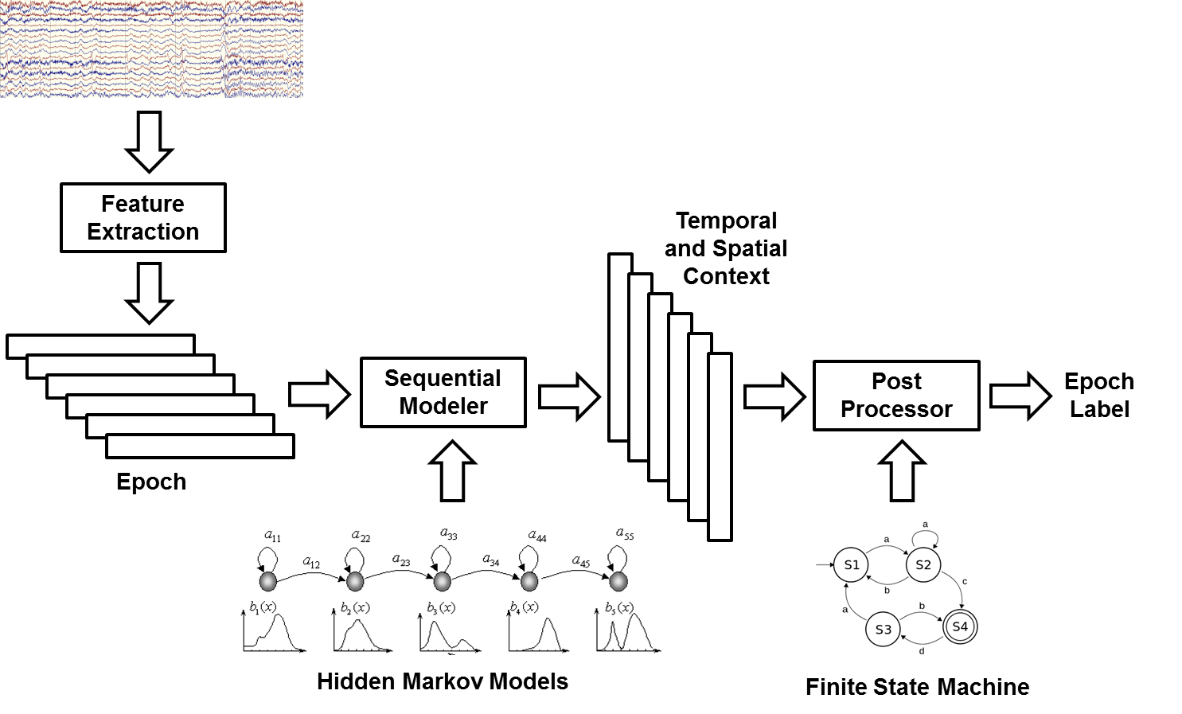
HMM Baseline Recognition
A baseline HMM system was trained to evaluate the mismatch between the features of each class.
The system was trained to detect seizure (SEIZ) and background (BCKG) events using sets of unique patients for training and evaluation.

Slide 9
HMM Baseline Recognition
Three models were trained, one using LE features, one using REF features, and one using a mix of REF and LE features.
Once trained, the models were evaluated on a similar distribution of evaluation sets, with one containing LE features, another REF features, and the final containing a mixture of REF and LE features.
A pilot experiment was also performed for the same features after Cepstral Mean Normalization (CMN) had been applied in an effort to offset the biases between the two different montages.
Set/Class | REF | LE
Train | 44 Files | 44 Files
Evaluation | 10 Files | 10 Files

Slide 10
Results of the Descriptive Statistics
Mean | Variance
Feature | REF | LE | REF | LE
E_{f} | 12.390 | 1.685 | 19.368 | 49.560
c₁ | 1.949 | 2.296 | 1.171 | 0.891
c₂ | 0.677 | 0.991 | 0.675 | 0.510
c₃ | 0.296 | 0.320 | 0.250 | 0.166
c₄ | -0.009 | -0.060 | 0.128 | 0.107
c₅ | 0.037 | -0.026 | 0.050 | 0.037
c₆ | -0.035 | -0.007 | 0.027 | 0.024
c₇ | 0.042 | 0.045 | 0.016 | 0.017
E_{d} | 3.001 | 1.887 | 21.824 | 23.298
There is a significant amount of difference between the mean and variance of each class. This indicates that these two sets have a high degree of contrast in the frequency domain.
An analysis of individual channels (not shown) also revealed a significant amount of variance between each class.

Slide 11
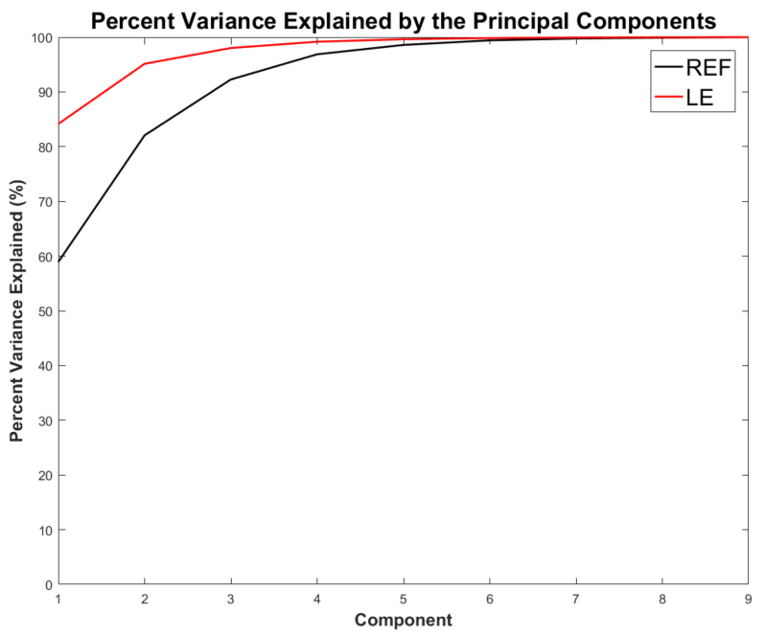
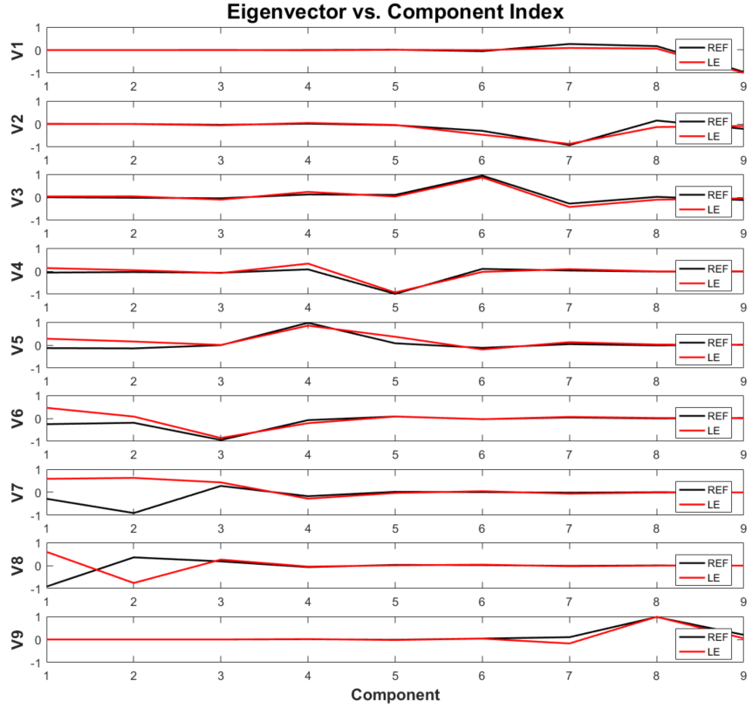
Results of Principal Component Analysis
The analysis continued with PCA, which reveals that the first principal component of the LE class accounts for much more variation in the data than the first component of the REF class.
We can see that the lower order eigenvectors, which correspond to the largest eigenvalues, weigh the higher cepstral coefficients more heavily.

Slide 12
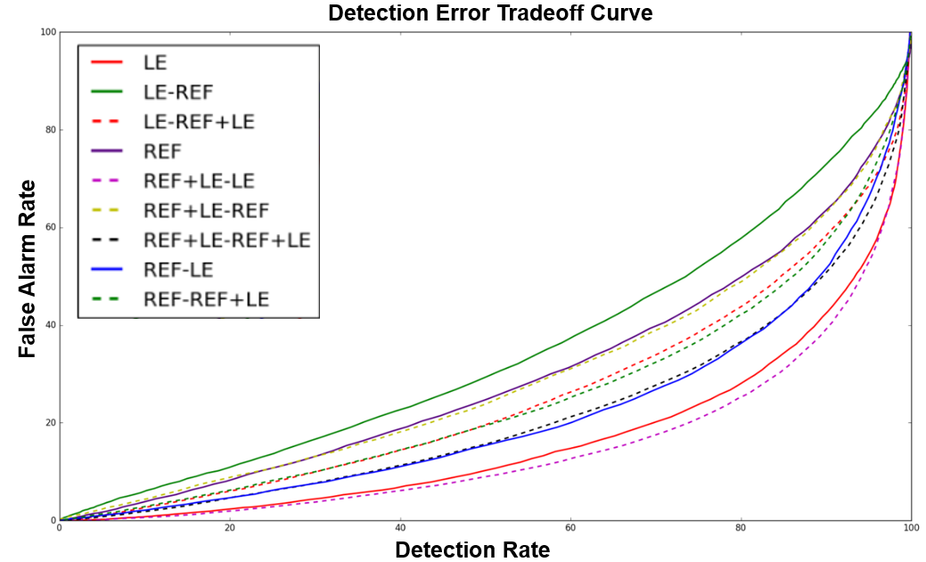
Results of the Baseline HHM System
Both the Detection Error Tradeoff (DET) curves and the tabular summary show that the highest performing system is obtained when training on a mixture of REF and LE features and evaluating only on LE features.
Train/Eval | REF | LE | REF+LE
REF | 61.4% | 55.9% | 60.9%
LE | 72.9% | 77.2% | 78.5%
REF+LE | 68.3% | 68.6% | 71.4%

Slide 13
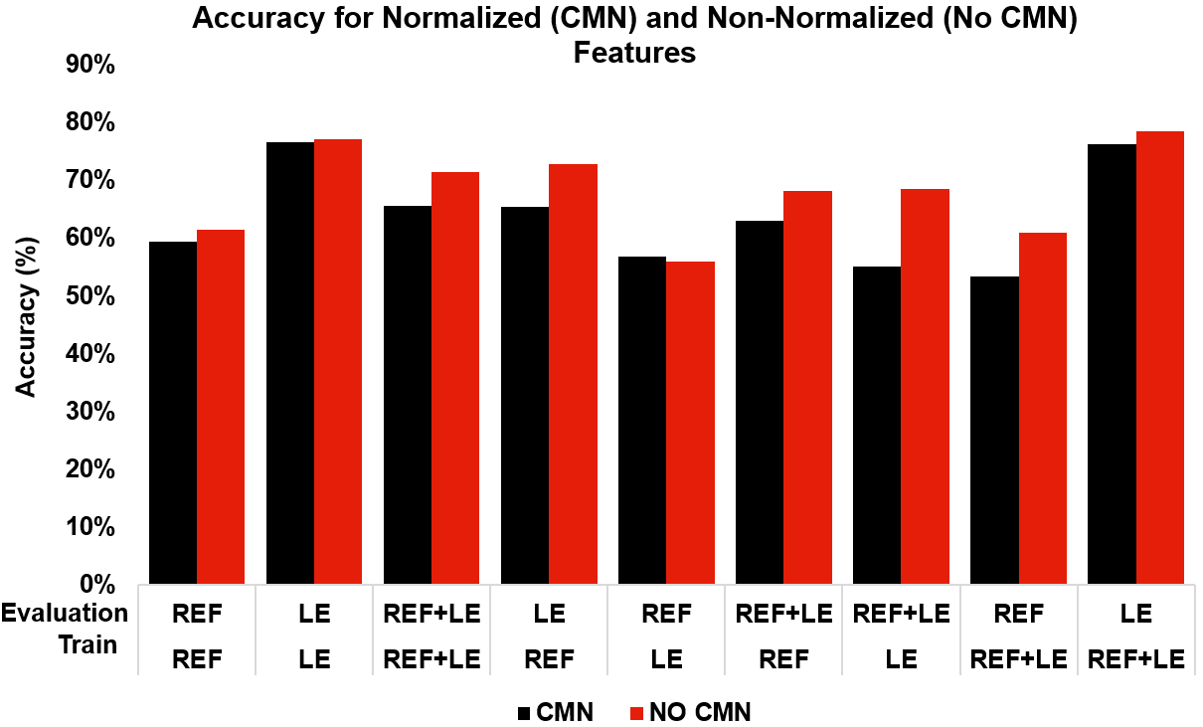
Results of the Baseline HHM system
The bias between the features revealed by the descriptive statistics was addressed by implementing CMN. Unfortunately, this attempt was not successful and for every case except the model trained on REF features and evaluated on LE features the performance was worse.

Slide 14
Summary
In clinical usage, EEG machine learning technology needs to be adaptable and robust enough to handle the variety of referencing schemes used by clinicians.
We have shown that here are systematic differences in the underlying statistics of frequency domain features in EEG signals using different reference points.
A principal component analysis has provided further evidence that this is the case.
Cepstral Mean Normalization, a technique that had been successfully applied in the field of speech recognition, was implemented in order to address the mean bias present in the two different referential systems.
CMN was ultimately not successful, performing worse than the normalized system in most cases.
In order for the data to be mixed, and therefore for the entire TUH EEG Corpus to be fully utilized for research, a successful normalization approach needs to be implemented.

Slide 15
Acknowledgments
This talk is based in part upon work supported by the National Institutes of Health under Award Number U01HG008468. Any opinions, findings, and conclusions or recommendations expressed in this material are those of the author(s) and do not necessarily reflect the views of the National Institutes of Health.
Research reported in this talk was also supported by the National Science Foundation under Grant No. IIP-1622765.
The TUH EEG Corpus effort was funded by (1) the Defense Advanced Research Projects Agency (DARPA) MTO under the auspices of Dr. Doug Weber through the Contract No. D13AP00065, (2) Temple University’s College of Engineering and (3) Temple University’s Office of the Senior Vice-Provost for Research.

Slide 16
Brief Bibliography
[1] C. Panayiotopoulos, “Optimal Use of the EEG in the Diagnosis and Management of Epilepsies,” in The Epilepsies: Seizures, Syndromes and Management, B. M. Publishing, Ed. Oxfordshire UK, 2005.
[2] X. Huang, A. Acero, and H.-W. Hon, Spoken Language Processing: A Guide to Theory, Algorithm and System Development. Upper Saddle River, New Jersey, USA: Prentice Hall, 2001.
[3] J. Acharya, A. Hani, P. Thirumala, and T. Tsuchida, “American Clinical Neurophysiology Society Guideline 3: A Proposal for Standard Montages to Be Used in Clinical EEG,” J. Clin. Neurophysiol., vol. 33, no. 4, 2016.
[4] E. Hagemann and J. F. Thayer, “The quest for the EEG reference revisited: a glance from brain asymmetry research,” Psychophysiology, vol. 38, no. 5, pp. 847–857, 2001.
[5] A. Harati, M. Golmohammadi, S. Lopez, I. Obeid, and J. Picone, “Improved EEG Event Classification Using Differential Energy,” in Proceedings of the IEEE Signal Processing in Medicine and Biology Symposium, 2015, pp. 1–4.
[6] F. Liu, R.M. Stern, X. Huang, & A. Acero, “Efficient cepstral normalization for robust speech recognition,” in Proceedings of the Workshop on Human Language Technology, 1993.

Slide 17
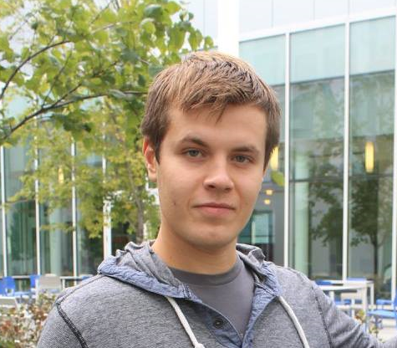
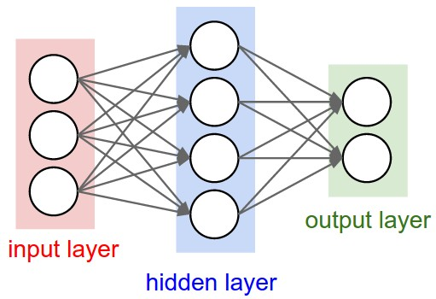
Biography: Aaron Gross
Aaron Gross is a senior undergraduate Electrical Engineering major in Temple University’s College of Engineering. He has been a member of the Neural Engineering Data Consortium (NEDC) research group headed by Drs. Iyad Obeid and Joseph Picone for roughly a year. His work in the research group has been supported and directed by fellow researchers Silvia Lopez and Meysam Golmohammadi.
His primary research interests involve machine learning, specifically neural networks and their variations, as well as the subject of natural language processing. His interest in machine learning started after reading a blog post by Andrej Karpathy titled “The Unreasonable Effectiveness of Recurrent Neural Networks.”
Aaron is a recipient of the Temple University Presidential Scholarship, as well as a member of the Temple Honors Program. He is a Junior Member of the IEEE.

