Slide 1
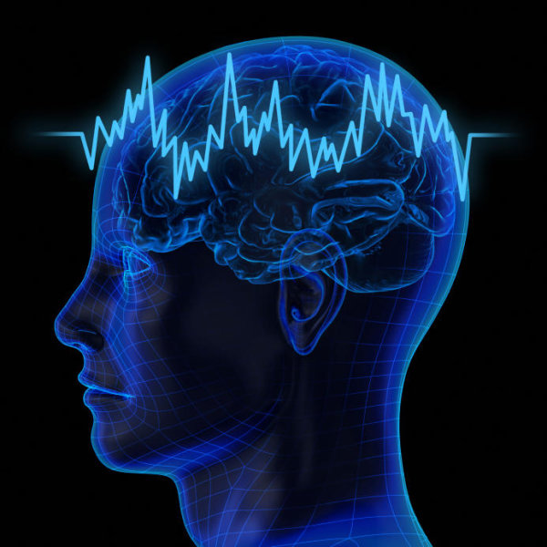
Electroencephalographic Slowing: A Primary Source of Error in Automatic Seizure Detection
E. von Weltin, T. Ahsan, V. Shah, D. Jamshed, M. Golmohammadi, I. Obeid and J. Picone
Neural Engineering Data Consortium
Temple University

Slide 2
Abstract
Although a seizure event represents a major deviation from a baseline electroencephalographic signal, there are features of seizure morphology that can be seen in non-epileptic portions of the record.
Electrographic slowing, a transient decrease in frequency can be seen both independently and in seizure termination.
In annotation of seizure events in the TUH EEG Seizure Corpus, independent slowing events were identified as a major source of false alarm error.
Preliminary results demonstrated the difficulty in automatic differentiation between seizure events and independent slowing events.
The TUH EEG Slowing database, a subset of the TUH EEG Corpus, was created, and is introduced here, to aid in the development of a seizure detection tool that can differentiate between slowing at the end of a seizure and an independent non-seizure slowing event. The corpus contains 100 10-second samples each of background, slowing, and seizure events.
Preliminary experiments show that 77% sensitivity can be achieved in seizure detection using models trained on all three sample types, compared to 43% sensitivity with only seizure and background samples.

Slide 3
Introduction
An EEG record, especially an abnormal one, can exhibit features associated with seizures without actually containing a seizure.
Slowing, a focal or generalized decrease in frequency, can be part of a seizure or can be seen as an independent event.
Automatic systems must be able to differentiate between these events based on the morphologies of features associated with and separate from seizure events
Slowing was found to be associated with a significant portion of false alarm events in EEG records annotated as part of the Temple University Hospital Seizure Detection Corpus (TUSZ).
Post-ictal slowing cannot simply be excluded from seizure annotations, as it plays an important role in marking the termination of many seizures.
Temple University Hospital Slowing Corpus (TUSL) was created to aid in the development of a an automatic system that can differentiate between post-ictal and transient slowing.
Notes:
Include muscle artifact problem comparison?

Slide 4
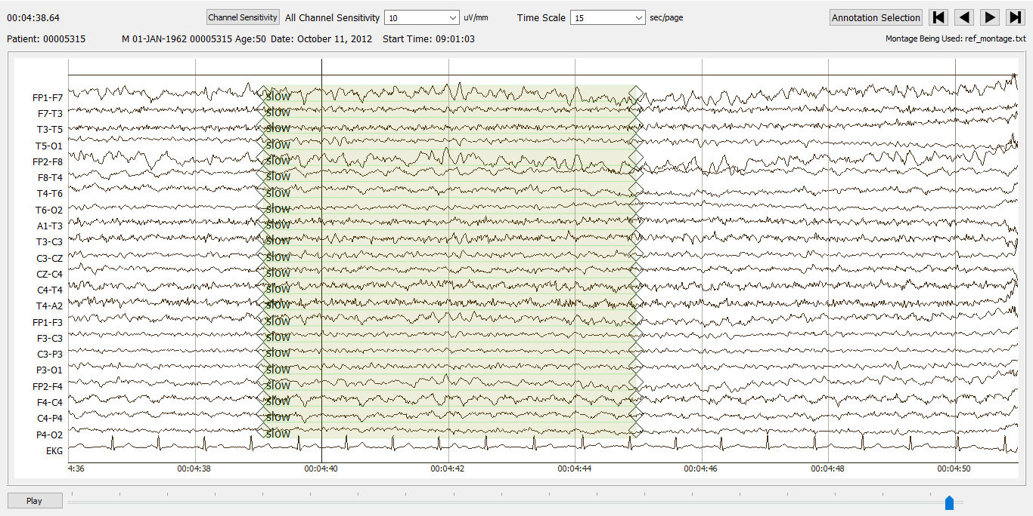
Introduction
Notes:
Include muscle artifact problem comparison?

Slide 5
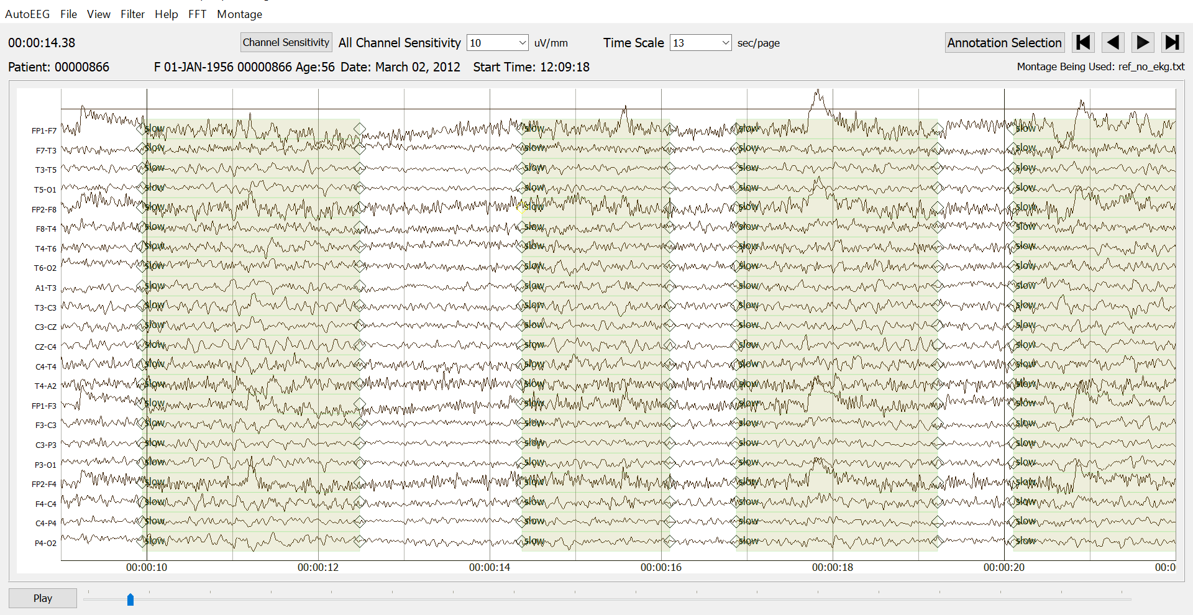
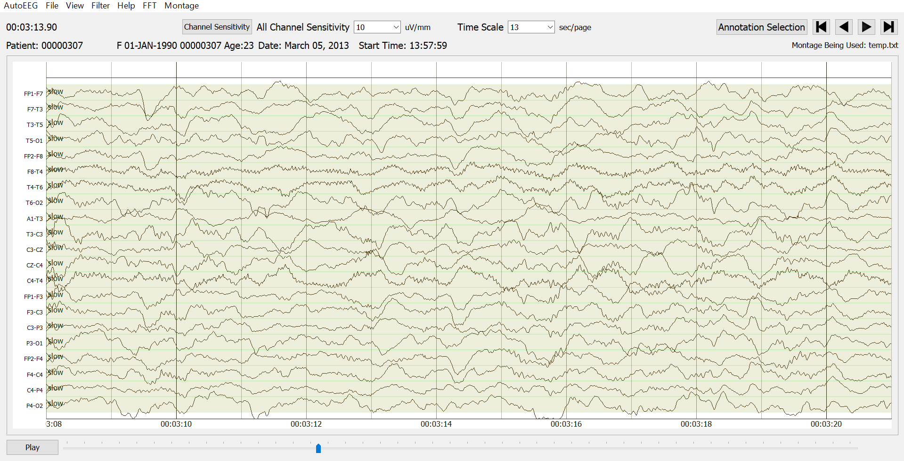
Intermittent vs Continuous Slowing

Slide 6
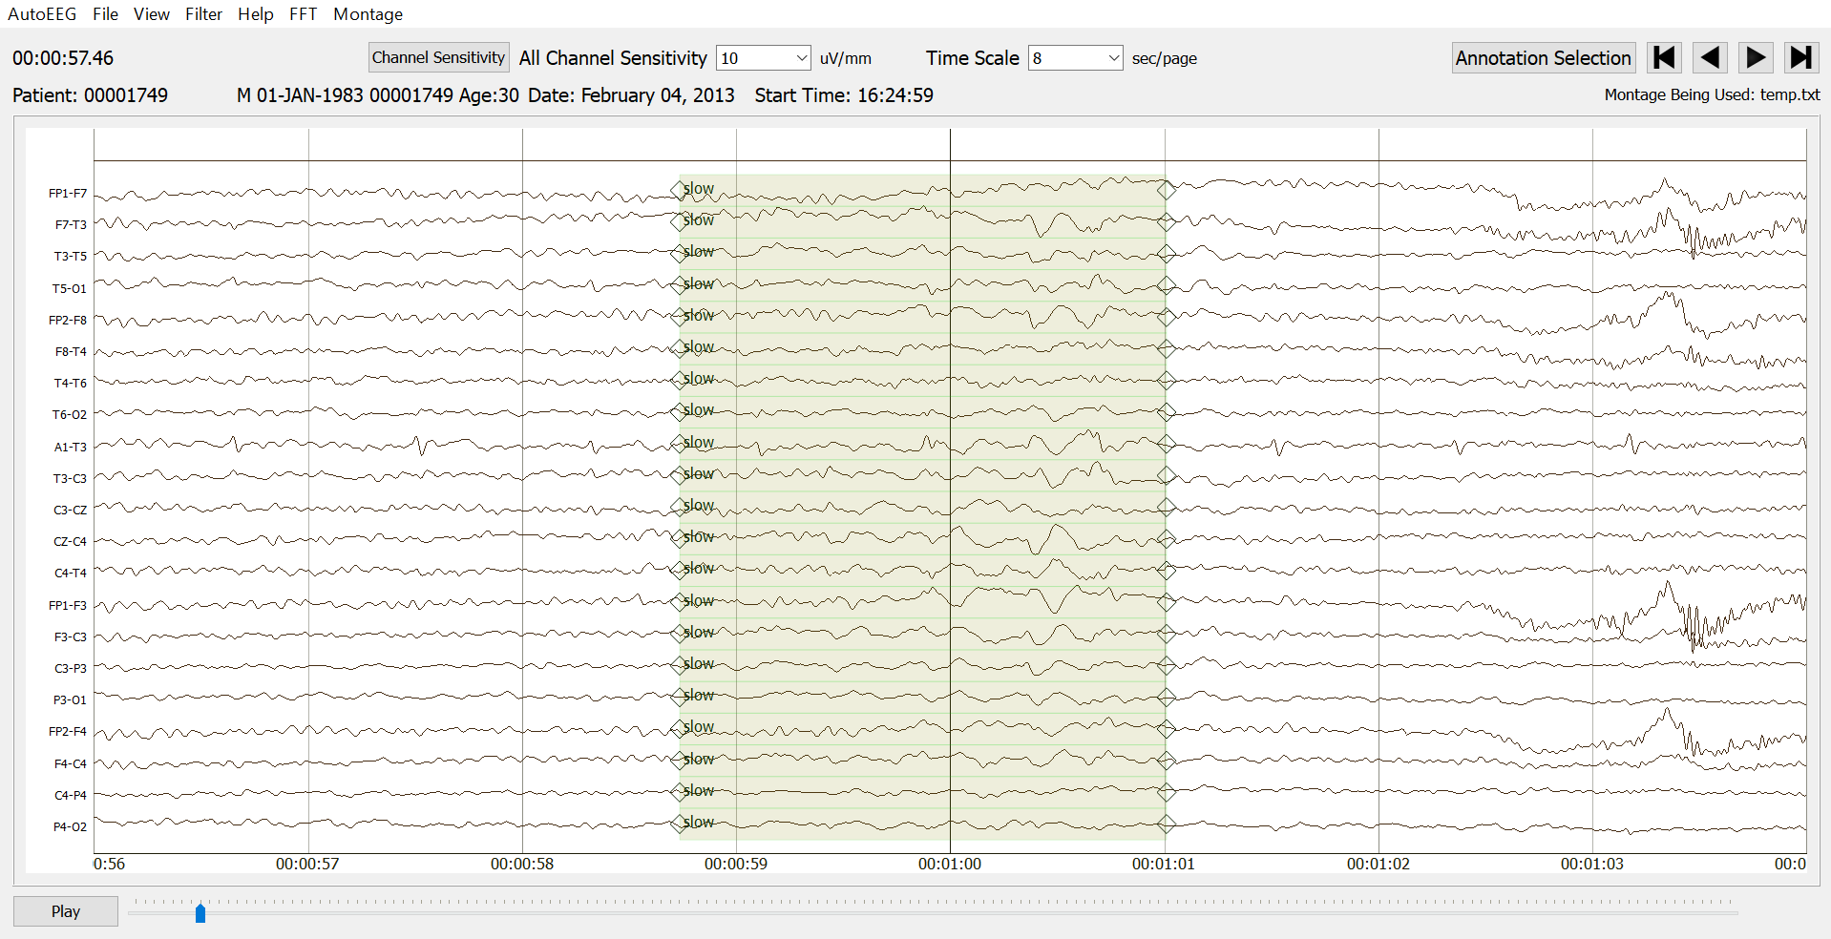
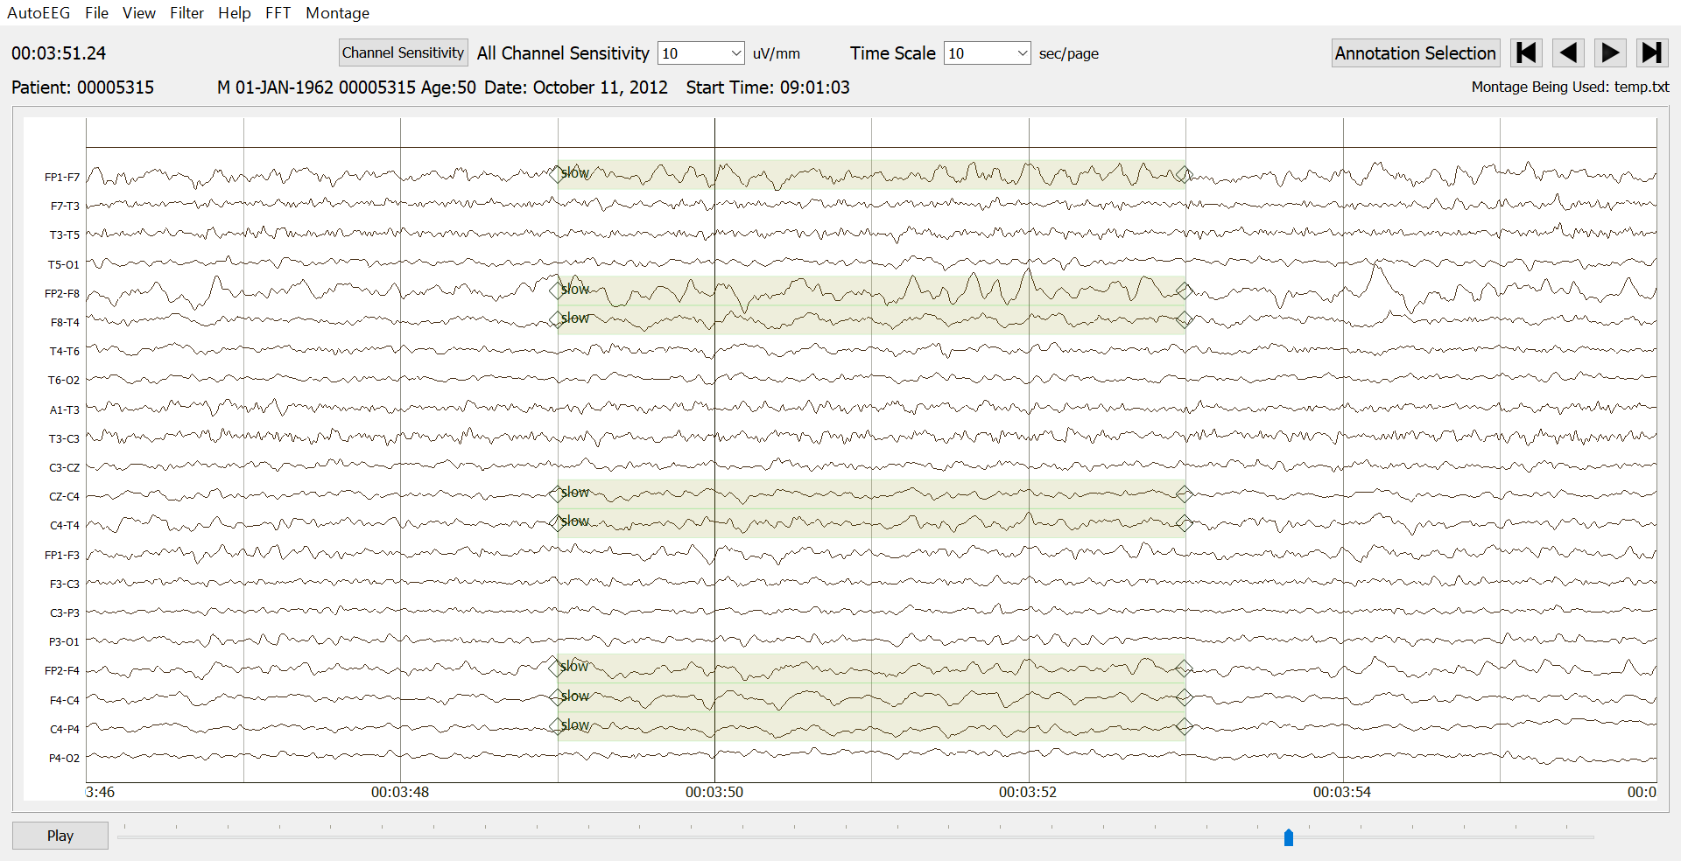
Focal/Hemispheric vs Generalized Intermittent Slowing

Slide 7
TUH EEG Slowing Corpus
The TUH EEG Corpus:
World's largest publicly available database of clinical EEG data.
Files used in the TUSL corpus were selected from TUSZ.
TUSZ is an annotated subset of TUH EEG.
Slowing Corpus:
100 10-second samples of slowing.
Within each sample, slowing event may last 2-10 seconds.
100 10-second samples of seizure.
100 seizures lasting at least 10 seconds were randomly selected for inclusion.
Sample is taken from the midpoint of the seizure event, variety of timepoints in seizure time course are captured.
100 10-second samples of complex background.
In TUSZ, there is no differentiation of transient slowing and background.
Samples are considered complex because they contain a variety of background features including muscle artifacts and epileptic discharges.

Slide 8
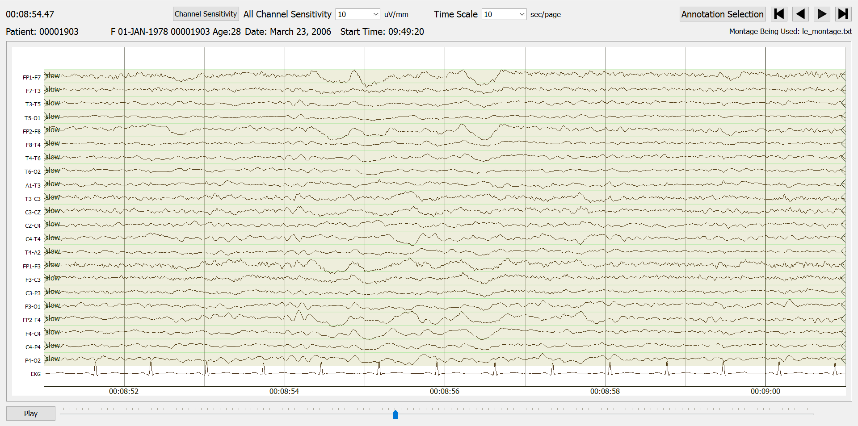
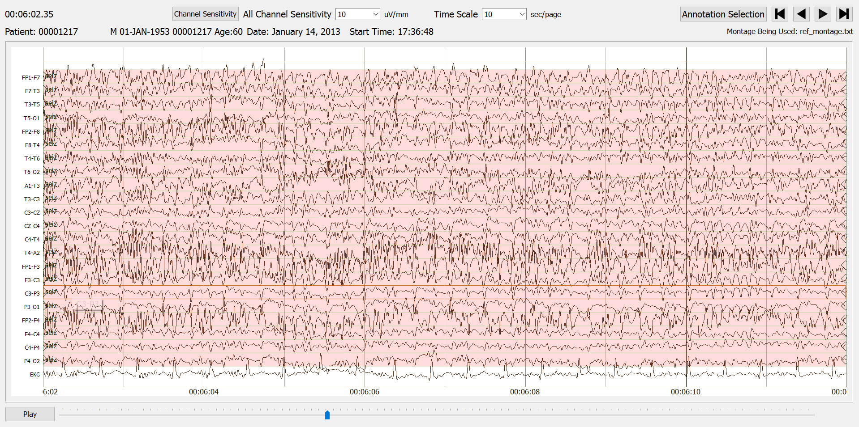
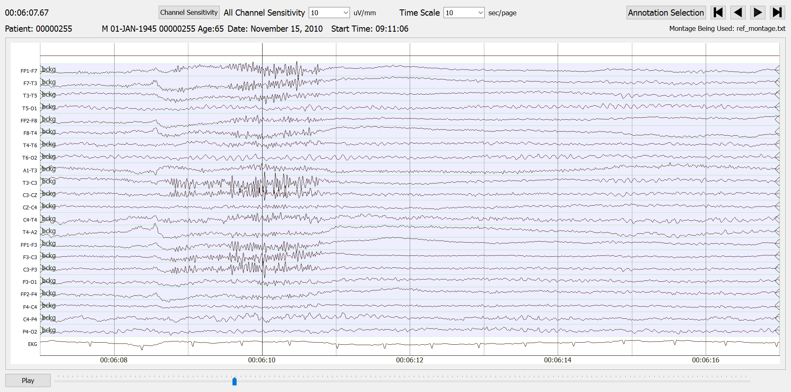
TUH EEG Slowing Corpus
 | Independent Slowing
 | Complex Background
 | Seizure

Slide 9
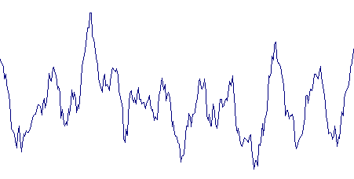
Preliminary Experiments
First Approach: augment the training process for our machine learning systems using the slowing corpus.
Feature Extraction
Model Training
$$a_{11}$$
$$a_{22}$$
$$a_{33}$$
Slowing sample set
$$a_{12}$$
$$a_{23}$$
$$b_{1}(x)$$
$$b_{2}(x)$$
$$b_{3}(x)$$
TUSZ Evaluation Set
Overfit System
Recognition
label
TUSZ Training Set
Re-train

Slide 10
Preliminary Experiments
Approach 1: Initialize training of our existing seizure detection system:
Model is trained using all three 10-second sample sets: seizure slowing, and background
System failed to train (sensitivity = 0%).
False alarms on slowing events are caused by a failure in training to differentiate between slowing and seizure events.

Slide 11
Preliminary Experiments
Second approach: closed-loop experiment using CNN trained and evaluated on seizure, slowing, and background samples.
Slowing sample set
Model Training
Feature Extraction
$$a_{11}$$
$$a_{22}$$
$$a_{33}$$
$$a_{12}$$
$$a_{23}$$
$$b_{1}(x)$$
$$b_{2}(x)$$
$$b_{3}(x)$$
Recognition
label

Slide 12
Preliminary Experiments
Approach 1: Initialize training of our existing seizure detection system:
Model is trained using all three 10-second sample sets: seizure sloqing, and background
System failed to train (sensitivity = 0%).
False alarms on slowing events are caused by a failure in training to differentiate between slowing and seizure events.
Approach 2: CNN trained with and evaluated on the slowing corpus in a closed-loop experiment
Initially 25% error rate
Preserve drop out layers in only first and second layers of the CNN: 20% error rate.
Remove all drop out layers: 0% error rate.

Slide 13
Preliminary Experiments
Third Approach: open-loop experiments training MLP on 3 subsets of the slowing corpus.
Evaluation Set
No Shuffling
Shuffling
Slowing sample set
Training Set
Model Training
Feature Extraction
$$a_{11}$$
$$a_{22}$$
$$a_{33}$$
$$a_{12}$$
$$a_{23}$$
$$b_{1}(x)$$
$$b_{2}(x)$$
$$b_{3}(x)$$
Recognition
label

Slide 14
Preliminary Experiments
Approach 1: Initialize training of our existing seizure detection system:
Model is trained using all three 10-second sample sets: seizure slowing, and background
System failed to train (sensitivity = 0%).
False alarms on slowing events are caused by a failure in training to differentiate between slowing and seizure events.
Approach 2: CNN trained with and evaluated on the slowing corpus in a closed-loop experiment
Initially 25% error rate
Preserve drop out layers in only first and second layers of the CNN: 20% error rate.
Remove all drop out layers: 0% error rate.
Approach 3:
Feature | Shuffling |  |  | No Shuffling
 | 2-Way |  | 3-way | 2-Way |  | 3-way
 | - slow | + slow |  | - slow | + slow
Sensitivity | 43.7% | 73.2% | 77.2% | 31.5% | 70.1% | 64.6%
Specificity | 87.6% | 93.6% | 92.2% | 84.7% | 94.8% | 95.6%

Slide 15
Summary
Electrographic seizures, though abnormal, do share morphology with non-seizure EEG features.
For successful automatic seizure detection to occur, systems must be able to differentiate between epileptic and non-epileptic variants.
We have introduced the TUH EEG Slowing Corpus to support investigations into these problems.
This corpus consists of 100 10-second samples of independent slowing, seizure, and complex background events.
These data are a subset of the TUH-EEG and TUSZ.
Preliminary results with machine learning have yet to show a significant improvement in performance when pre-training using these data.
Open-loop experiments found that training using the slowing annotations improves seizure detection compared to a model trained only with seizure and background files.
When using shuffling, training using all three annotation types improved performance compared to a model trained using only slowing and seizure files.

Slide 16
Future Work
We expect to continue developing resources to improve seizure detection technology over the next three years.
Open source data and resources can be found on our web site:
https://www.Isip.piconepress.com/projects/tuh_eeg
Though we are not currently working towards expanding this corpus, we will continue to investigate our seizure detection systems for sources of error and to gain a greater understanding, not only of the complexities of the machine learning system, but of the underlying biological signal.

Slide 17
Acknowledgments
This talk is based in part upon work supported by the National Institutes of Health under Award Number U01HG008468. Any opinions, findings, and conclusions or recommendations expressed in this material are those of the author(s) and do not necessarily reflect the views of the National Institutes of Health.
Research reported in this talk was also supported by the National Science Foundation under Grant No. IIP-1622765.
The TUH EEG Corpus effort was funded by (1) the Defense Advanced Research Projects Agency (DARPA) MTO under the auspices of Dr. Doug Weber through the Contract No. D13AP00065, (2) Temple University’s College of Engineering and (3) Temple University’s Office of the Senior Vice-Provost for Research.

Slide 18
Breif Bibliography
Obeid, I., & Picone, J. (2016). The Temple University Hospital EEG Data Corpus. Frontiers in Neuroscience, Section Neural Technology, 10, 196. https://doi.org/http://dx.doi.org/10.3389/fnins.2016.00196
V. Shah et al., “The TUH EEG Seizure Corpus,” Front. Neurosci., p. 6, 2017.
M. Anastasiadou et al., “Automatic detection and removal of muscle artifacts from scalp EEG recordings in patients with epilepsy,” Proceedings of the Annual International Conference of the IEEE Engineering in Medicine and Biology Society, EMBS, 2015, pp. 1946–1950.
J. X. Tao et al., “Interictal regional delta slowing is an EEG marker of epileptic network in temporal lobe epilepsy,” Epilepsia, vol. 52, no. 3, pp. 467–476, 2011.
P. R. Bauer et al., “Dynamics of convulsive seizure termination and postictal generalized EEG suppression,” Brain, p. aww322, 2017.
M. E. C. Andraus and S. V. Alves-Leon, “Non-epileptiform EEG abnormalities: an overview,” Arq. Neuropsiquiatr., vol. 69, no. 5, pp. 829–835, 2011.
N. Srivastava, G. Hinton, A. Krizhevsky, I. Sutskever, and R. Salakhutdinov, “Dropout: A Simple Way to Prevent Neural Networks from Overfitting,” J. Mach. Learn. Res., vol. 15, pp. 1929–1958, 2014.

