Slide 1
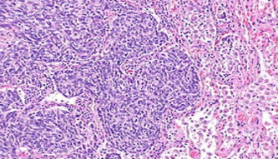

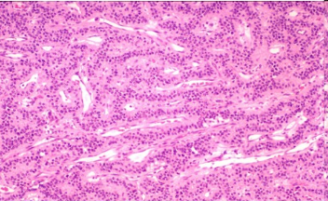
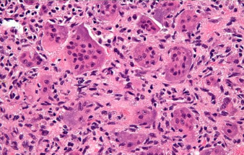
Baseline Experiments
In Digital Pathology
T. Elseify, L. Jakielaszek, R. Anstotz,
C. Campbell, I. Obeid, J. Picone
Neural Engineering Data Consortium
Temple University

Slide 2
Abstract
Digital pathology is a relatively new field that stands to gain from modern big data and machine learning techniques.
In the United States alone, millions of pathology slides are created and interpreted by a human expert each year, suggesting that there is ample data available to support machine learning research.
The relevant corpora, however, contain only hundreds of images which is insufficient in developing a deep learning model. There is also the added hindrance of the lack of publicly accessible data.
The goal of our digital pathology corpus is to place a large amount of clinical pathology slides obtained from Temple University Hospital into the public domain to support the development of automatic interpretation technology.
The goal of this ambitious project is to create a corpus of 1M images within a period of 3 years.
We have currently released over 10,000 images from over 600 clinical cases.

Slide 3
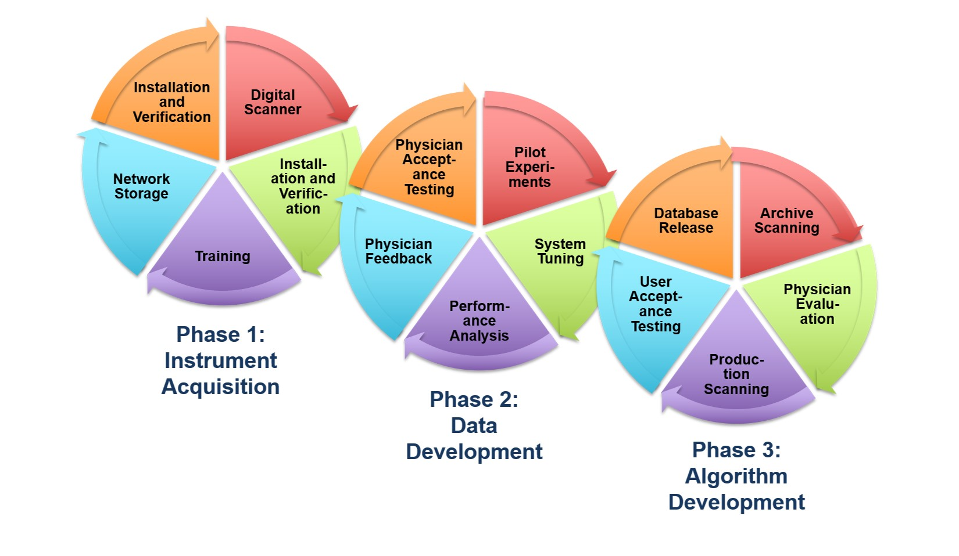
NSF Major Research Instrumentation Grant: Goals
The overarching goal of the project was threefold:
Integrate digital imaging into Temple University Hospital’s clinical operation.
Establishment of a public database of pathology slides.
Development of an image classification system to automatically annotate each pathology slide.
The end goal of this is endeavor is to establish a public database of 1 million slides to support machine learning research.

Slide 4
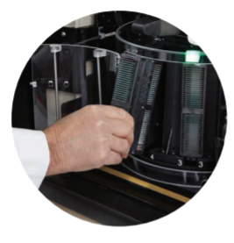
Digital Slide Scanner
The slides were scanned using the Leica Aperio AT2 high volume scanner that utilizes a 40x scanning resolution and a z stacking feature (up to 25 layers).
The AT2 scanner can hold and scan a total of 400 slides arranged into 10 carousels of 40 slides each.
The Scanning period is approximately 8 hours where the scanning rate is around 50 slides per hour.
The scanning operation is run overnight and the scanned slides are organized using eSM the following day.

Slide 5
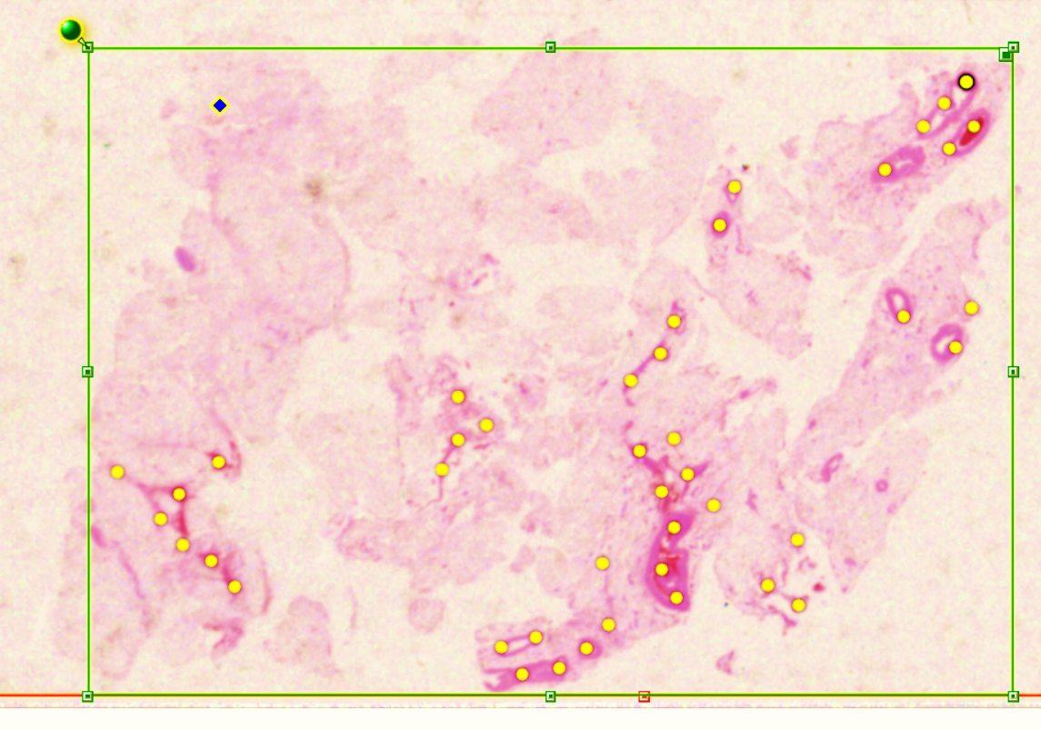
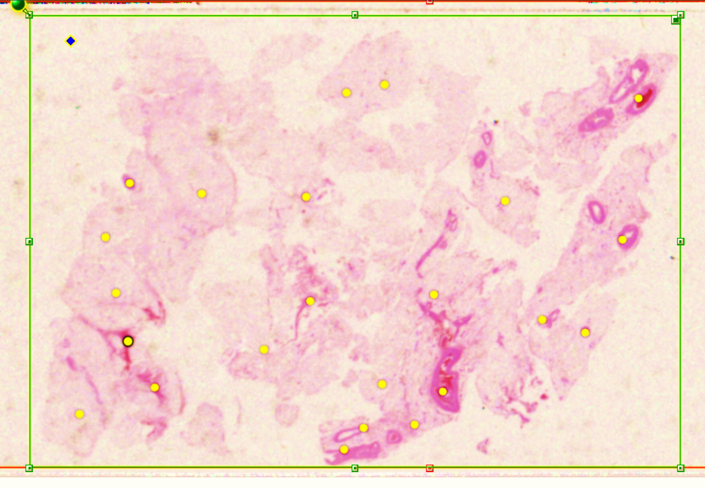
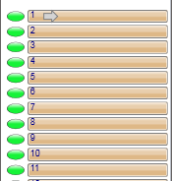
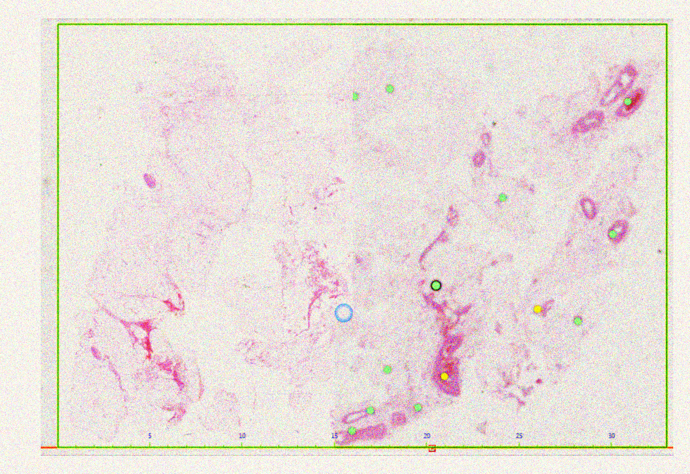
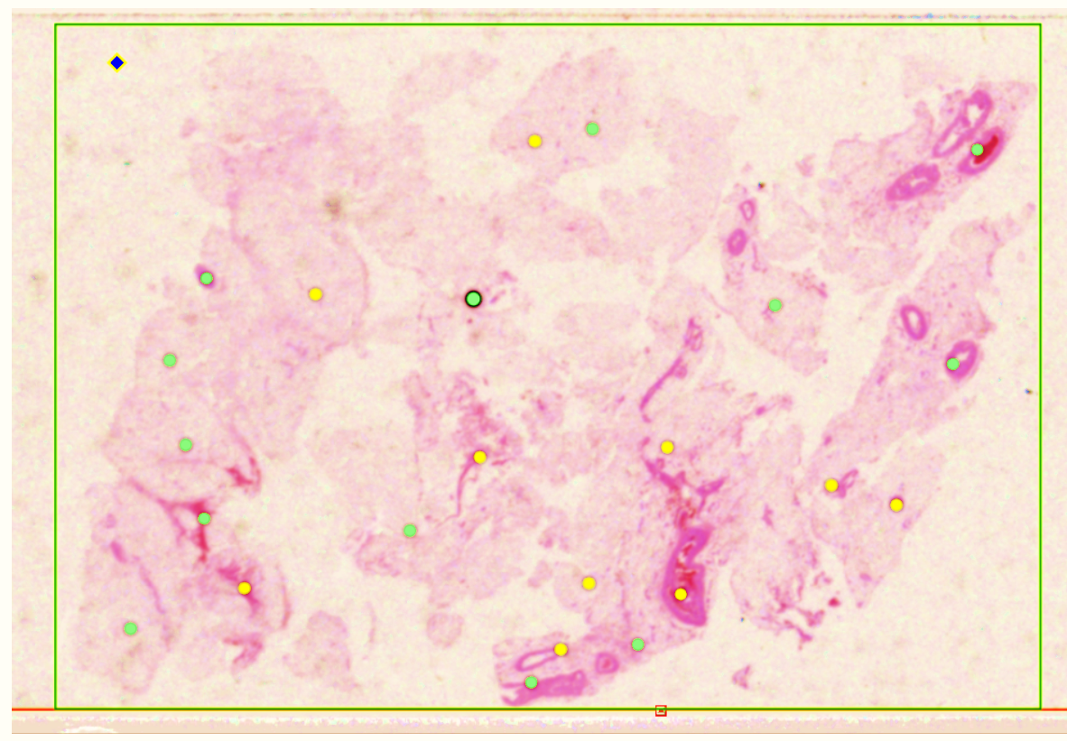
Image Digitization
Before slides are scanned, pre-scan snapshots were taken
The snapshots are completed to allow for focus points to be placed on each snapshot and to specify the area of the slide to be scanned.
In some cases, the software cannot locate enough focus points and doesn’t specify the scanning area properly. In such cases the focus points must be manually added, and the area is adjusted.
After the pre-scan is adjusted, the slides are set to scan

Slide 6
SVS File Format
After scanning the slide as a digital image, it is stored in a proprietary file format known as a .svs file.
This file contains the raw image data and metadata captured during the scanning process.
A .svs file is a layered TIFF which uses JPEG 2000 compression to compress the actual image.
The .svs file contains a thumbnail which is a low-quality image of the slide, and the label image which is a low-resolution image of the slide’s label.
Though the digital slides could be converted to standard JPEG image files (.jpg), because the scanner scans at such a high resolution, the dimensions of a full-slide image exceed the limits of the JPEG format.
Therefore, we are using .svs files as the primary filetype for the corpus because it is efficient and handles full resolution images
Both .svs and JPEG file formats are viewable when the slide is opened in Aperio ImageScope software.

Slide 7
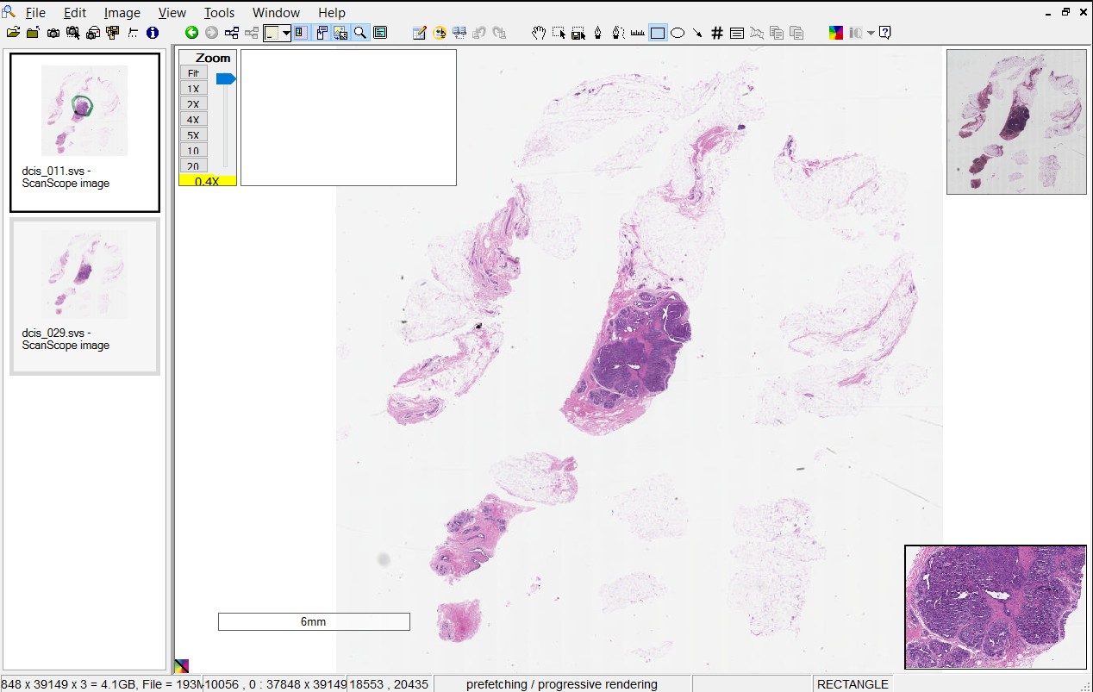
ImageScope
Imagescope main window and pane
Toolbar
Zoomslider
Eslide Label
Filmstrip
Thumbnail
Status Bar
Magnifier

Slide 8

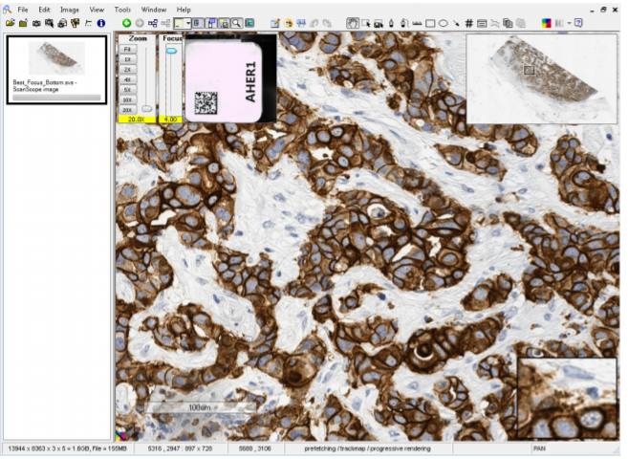
Z-Stack Scanning
The Aperio scanner can create multiple digital images of slide tissue scanned at different focal depths, creating a 3D image.
This allows visual navigation similar to that of a microscope.
This ability to create a 3D image is called “z-stack scanning.”
Aperio ImageScope automatically opens a z-stack image to the best focused layer, as determined by the Aperio scanner when the slide is scanned.
The number of layers and the layer separation (depth, in microns (µm), between the layers) is set during scanning
The Focus slider is used
to view different layers of
the z-stack image. The
number at the bottom of
the slider represents the
current focus point
Click to view image information, including information for each z-stack layer

Slide 9
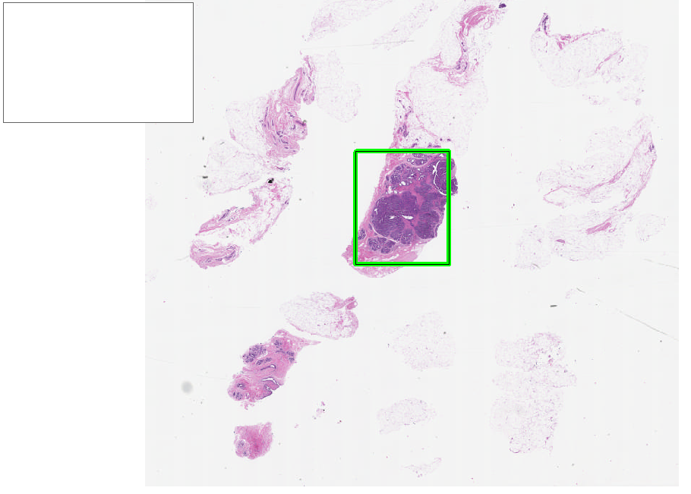
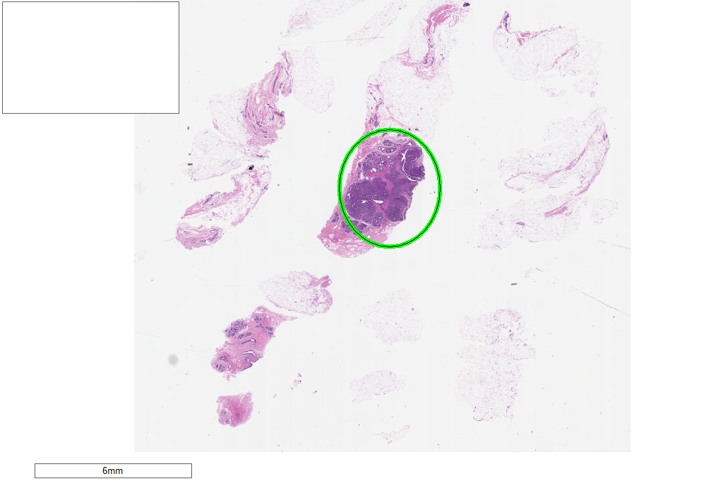
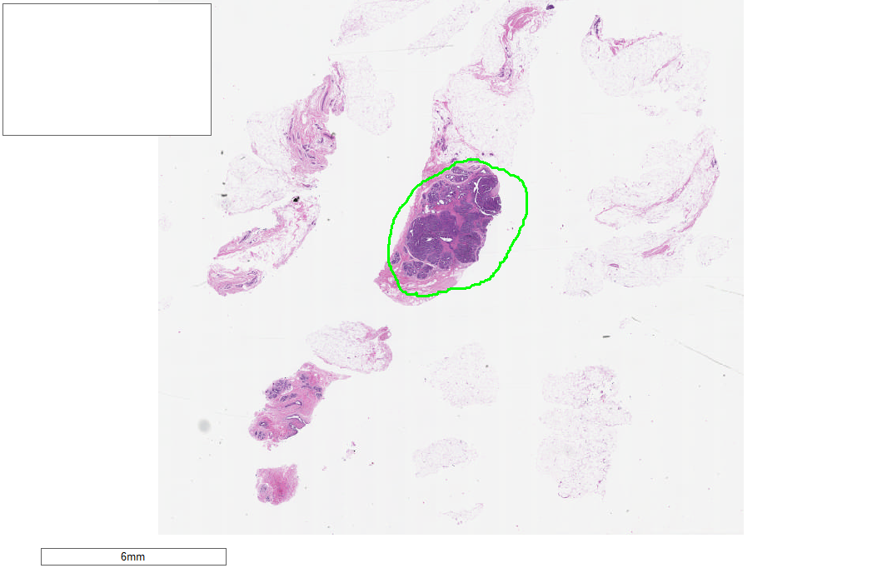
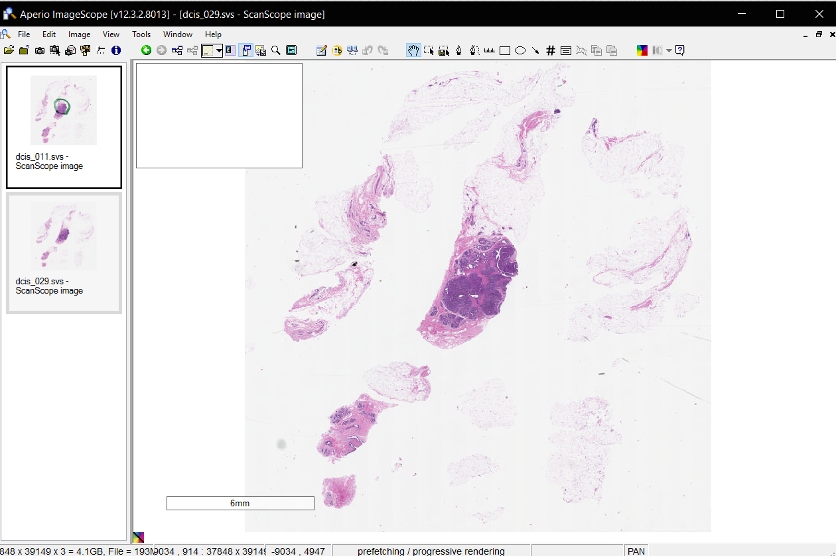
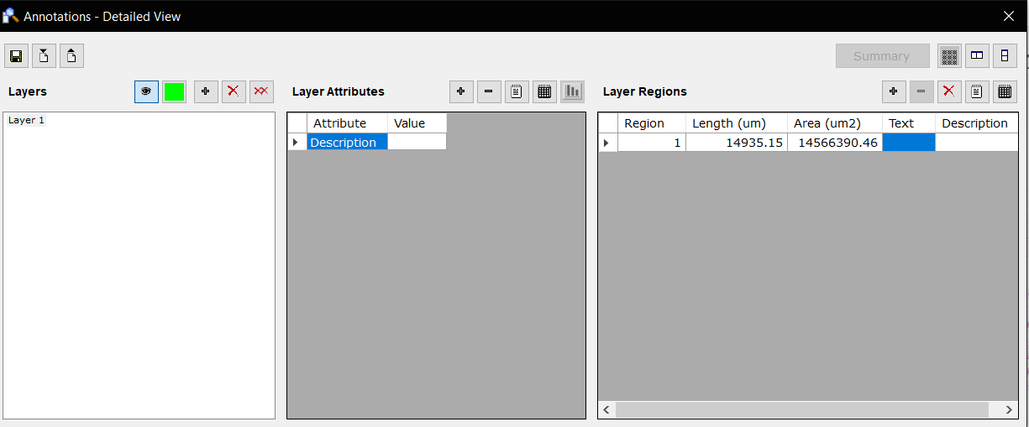
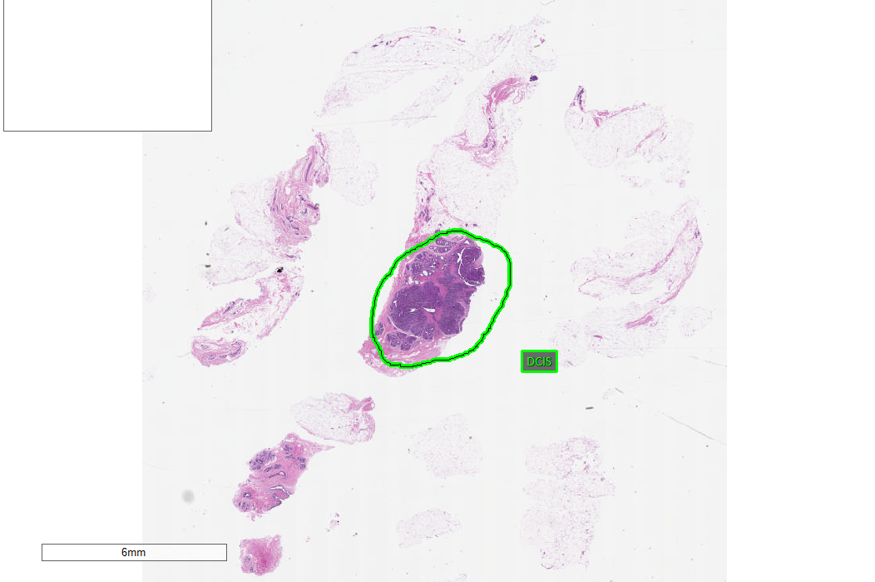
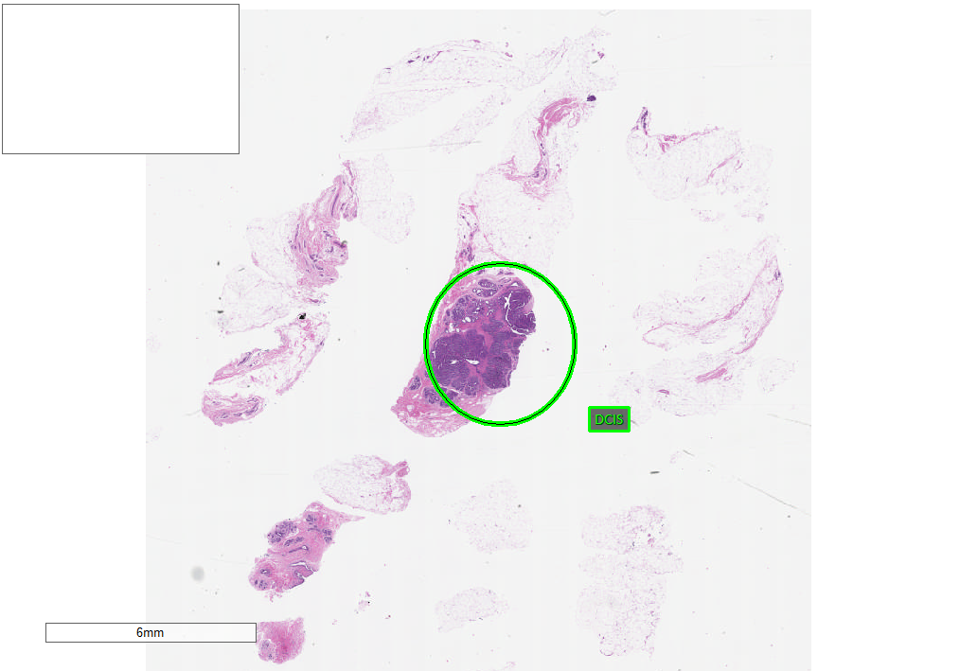
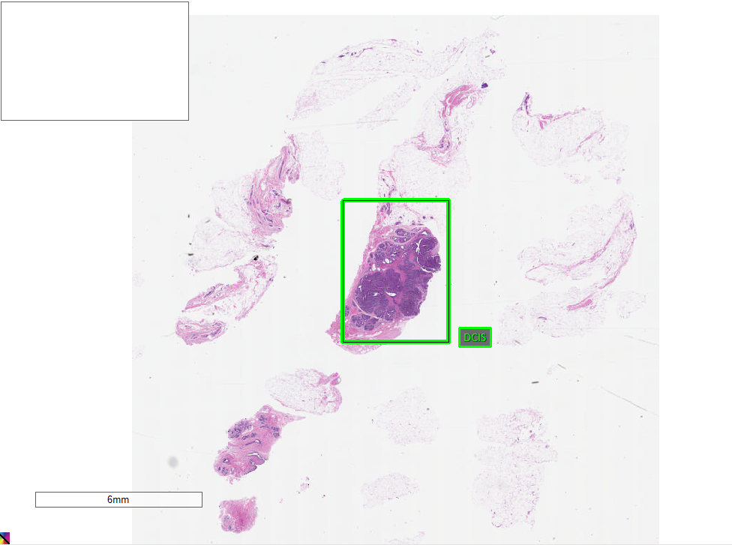
Data Annotation
Digital slides are opened with the Aperio ImageScope application where the region of annotation is selected using the rectangle, ellipsis and pen tool.
Rectangle Tool
Elliptical Tool
Pen Tool
After the area of annotation has been selected, the annotation is opened where pathologists can place text describing the type of cancer and can give further description on the tumor type.

Slide 10
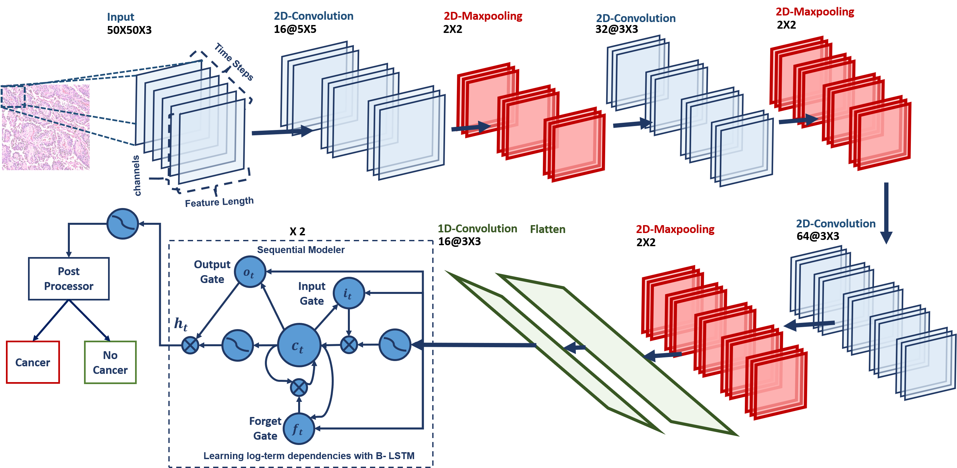
Algorithm Development
The TUH EEG Corpus deep learning system was adapted to this project
Once a baseline system is in place, our analysis will be compared with physician feedback and the system will be adjusted accordingly.
The software was developed according to strict design and formatting requirements and included regression testing and built-in certifications
Our software was developed using Python and executes on general purpose processors and high-speed GPUs.

Slide 11
Storage Demands
A single image from a clinical-grade digital pathology scanner can range in size from hundreds of megabytes to five gigabytes.
A 1M image database requires over a petabyte (PB) of disk space. To do meaningful work in this problem space requires a significant allocation of computing resources.
The improvements and expansions to our HPC (high performance computing) cluster, known as Neuronix, required to support working with digital pathology fall into two broad categories: computation and storage.
To handle the increased computational burden and increase job throughput, we are using Slurm, a workload manager, as our scheduler and resource manager.
For storage, we have designed and implemented a multi-layer filesystem architecture to distribute a filesystem across multiple machines.
These enhancements, which are entirely based on open source software, have extended the capabilities of our cluster and increased its cost-effectiveness.

Slide 12
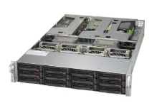
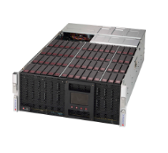
Storage Hardware
The Leica Aperio eSlide Manager and Image Scope applications is hosted on our app server.
A cost-effective Petabyte server is used to store the slides.
Two Petabyte machines are used where one is used to store the slides and the other is used as a backup
Each Petabyte machine contains two JBODs with each containing 60 8TB hard drives each. This means that there are 240 total hard drives installed on both machines combined.
To support these disks, we have two server units, each equipped with Intel Xeon CPUs and 128GB of RAM.

Slide 13
Network Map
At the filesystem level, we have implemented a multi-layer solution that:
Connects the disks together into a single filesystem/mountpoint using the ZFS (Zettabyte File System)
Connects filesystems on multiple machines together to form a single mountpoint using Gluster.

Slide 14
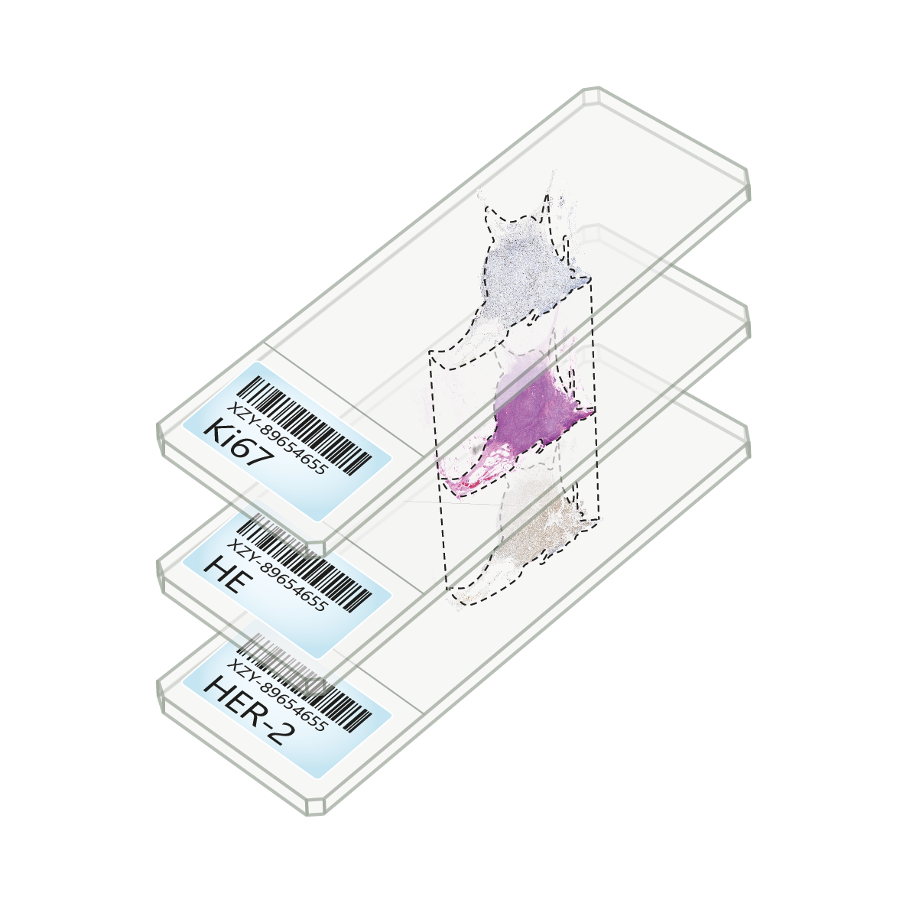
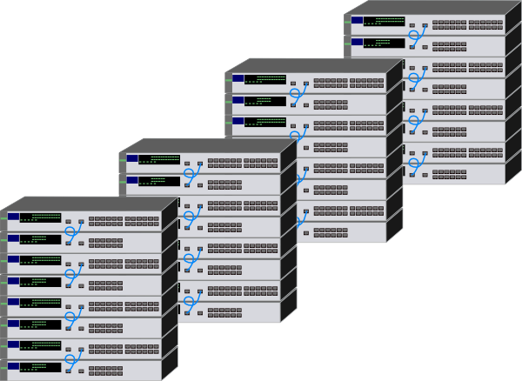

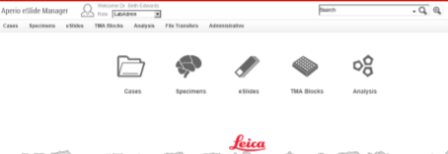

Corpus Workflow
Slides are loaded onto the Digital Slide Scanner (DSS)
Scanned slides are uploaded to the petabyte server
Slides from the server are uploaded to the electronic slide manager (eSM)
Annotated Slides are now available to anonymized before being available to the public domain.
Pathologists review and annotate the slides

Slide 15
Summary
WSI digitization is enhancing educational practice by providing access to a large, open source pathology corpus that can be easily searched using unstructured queries.
The physical storage required to manage such a large archive electronically is now affordable and can be implemented using the relatively simple architecture.
This corpus enables the development of state-of-the art machine learning systems, which require vast amounts of training data, for pathology applications such as cancer identification.
Enable the development of software systems to assist diagnosis and accelerate the diagnostic process which will ease pathologist workloads.
Join our mailing list and go to our web site for more information: https://www.isip.piconepress.com/

Slide 16
Acknowledgements
This material is based upon work supported by the National Science Foundation under Grant No. CNS- 1726188. Any opinions, findings, and conclusions or recommendations expressed in this material are those of the author(s) and do not necessarily reflect the views of the National Science Foundation.

