Slide 1
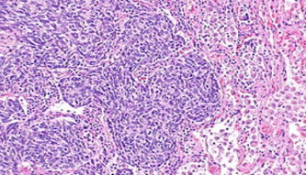

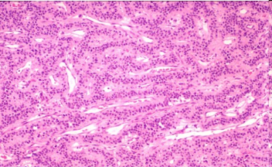
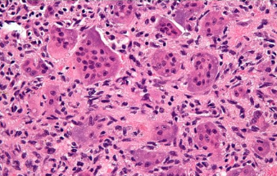
The
Temple University Hospital
Digital Pathology
Corpus
D. Houser, G. Shadhin, R. Anstotz,
C. Campbell, I. Obeid, J. Picone
Neural Engineering Data Consortium
Temple University
T. Farkas, Y. Persidsky and N. Jhala
Department of Pathology
Lewis Katz School of Medicine
Temple University Hospital

Slide 2
Abstract
Digital pathology, often referred to as whole slide imaging (WSI), is a relatively new field that will benefit from big data and machine learning.
In the United States alone, millions of pathology slides are created and interpreted by a human expert each year, suggesting that there is ample data available to support machine learning research.
The relevant corpora, however, contain only hundreds of images which is insufficient in developing a deep learning method. There is also the added hindrance of the lack of publicly accessible data.
The goal of our digital pathology corpus is to place a large amount of clinical pathology slides obtained from Temple University Hospital into the public domain to support the development of automatic interpretation technology.
The goal of this ambitious project is to create a corpus of 1M images within a period of 3 years.
We have currently released over 10,000 images from over 600 clinical cases.
The data is open source:
https://www.isip.piconepress.com/projects/nsf_dpath/
Join our listserv: nedc_tuh_dpath@googlegroups.com.

Slide 3
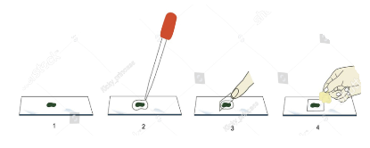
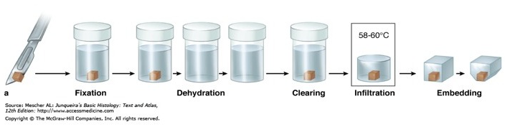
Introduction to Digital Pathology
A branch of medical science which deals with the extraction and storage of cause, origin and nature of disease in digital format.
Typical steps in a tissue storage workflow:
Tissues are prepared by preventing them from deteriorating from autolysis. These samples are then transferred to the cassettes and stored into thin sections.
The slide is prepared by mounting the specimen on a glass slide. A stain is applied on top and cover slip is placed to generate a single sample.
The glass slides are then sorted by their respective tissue type and archived at an off site location.
A board-certified pathologist views the stained specimen through an analog microscope to determine a diagnosis.

Slide 4










Advantages of Digital Imaging
In recent days, image based information extraction is used extensively for virtual microscopy which is a practice called digital pathology of converting glass slides in a digital format.
Slides are converted from analog to digital using digital slide scanner
Slide and tissue preparation
Slides are then stored on remote servers where they are automatically uploaded in the public domain.
Slides can be accessed remotely where multiple pathologists can analyse specimen concurrently.
This process is simplified by retrieving WSIs through simple keyboard search of medical records.

Slide 5
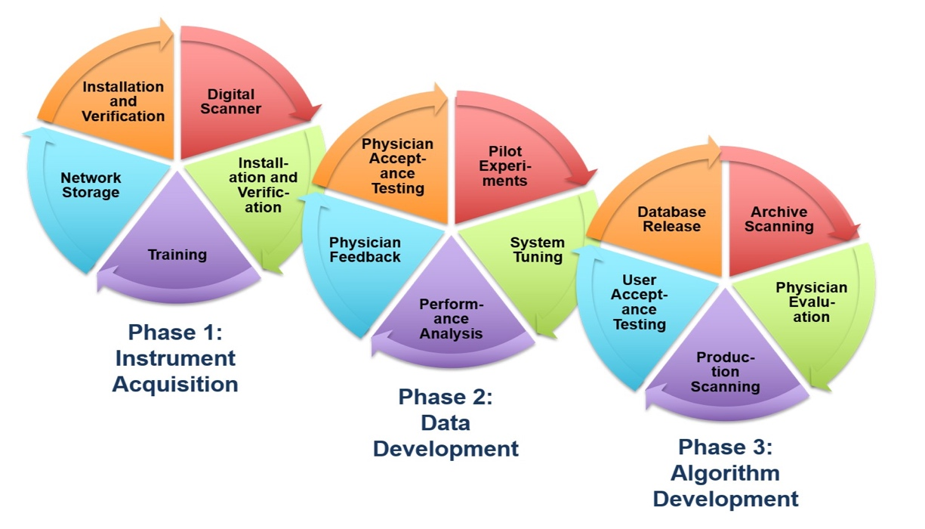
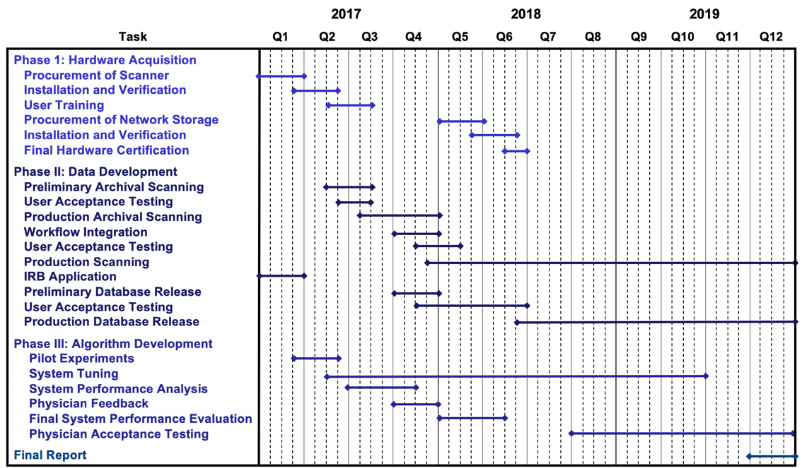
NSF Major Research Instrumentation Grant
Three goals:
Integration digital imaging
into Temple University
Hospital’s clinical operation.
Establishment of a public
database of pathology slides.
Development of an image classification
system to automatically annotate pathology slides.
Three-year plan:
Infrastructure development (complete).
Data Development: 1M slides requiring 1 Petabyte of storage (underway).
Algorithm Development: visit our demo at the poster session!

Slide 6
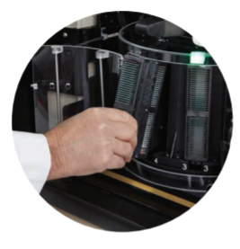
Digital Slide Scanner
Slides are scanned using a Leica Aperio AT2 high volume scanner.
Maximum resolution: 40x
Includes a Z-stacking feature (up to 25 layers) for 3D scans.
Generates .svs files because the images are too big for JPEG’s.
The AT2 scanner can hold and scan a total of 400 slides arranged into 10 carousels of 40 slides each.
The scanning period is approx. 8 hours where the scanning rate is around 50 slides per hour.
The scanning operation runs overnight and the scanned slides are organized using eSM the following day.
Scanning is not completely automated since focus points have to be set manually in many cases.

Slide 7
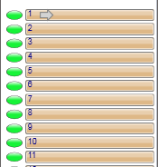
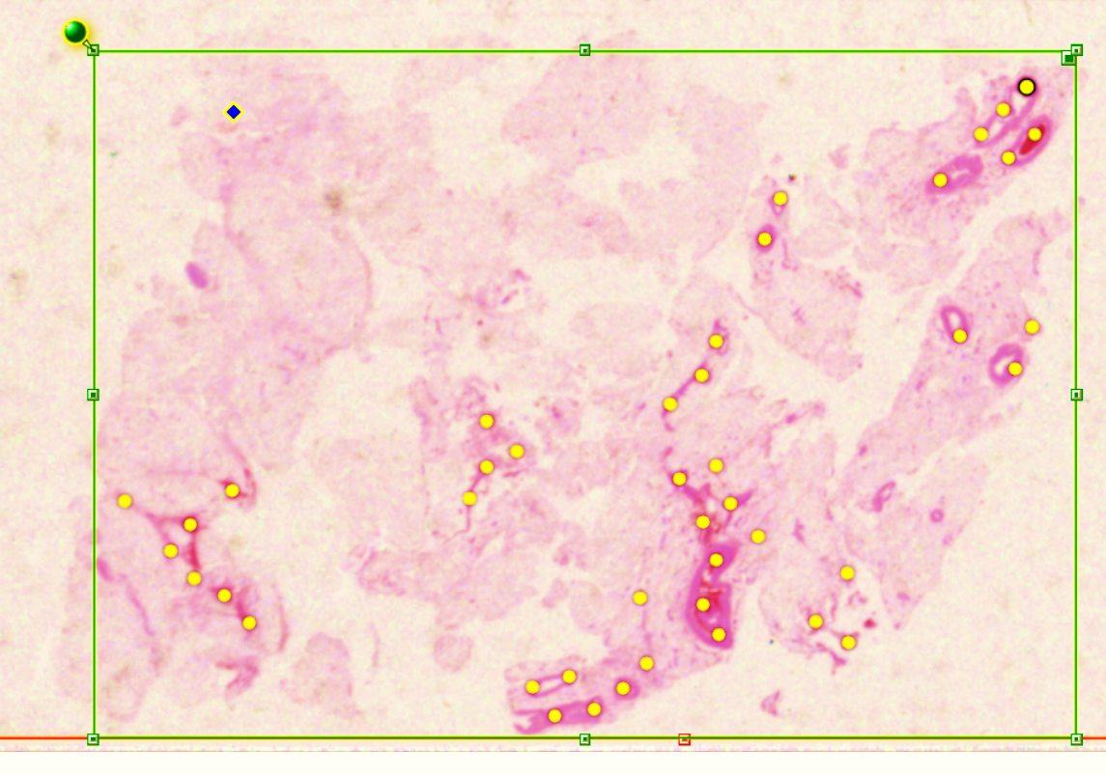
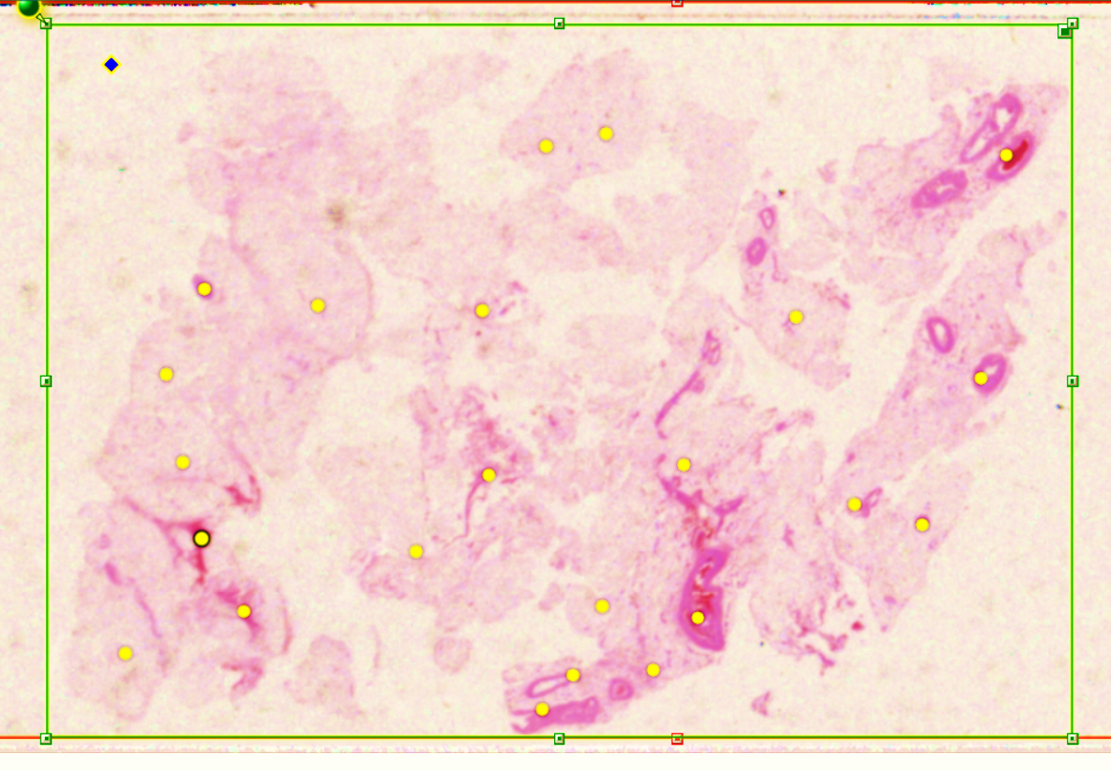
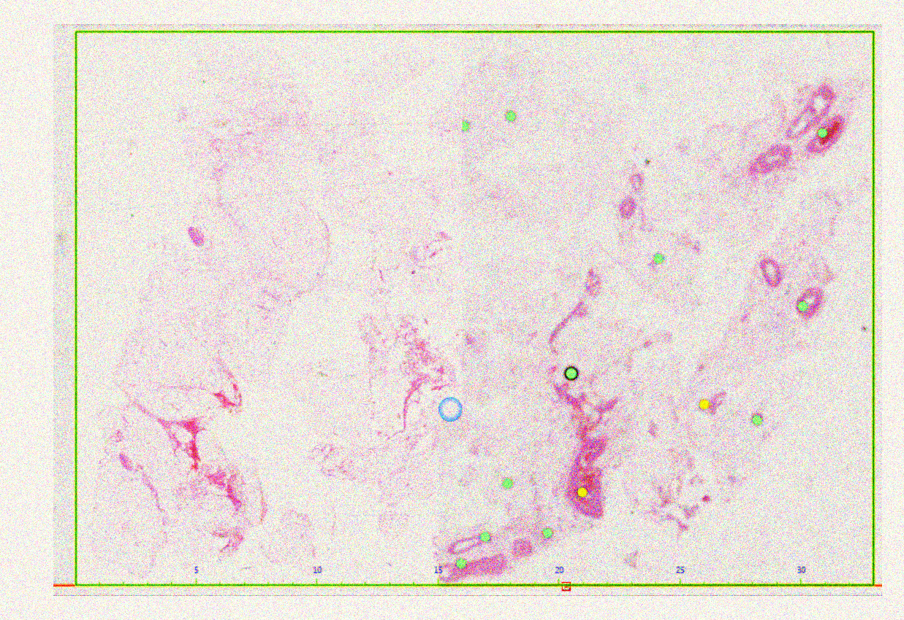
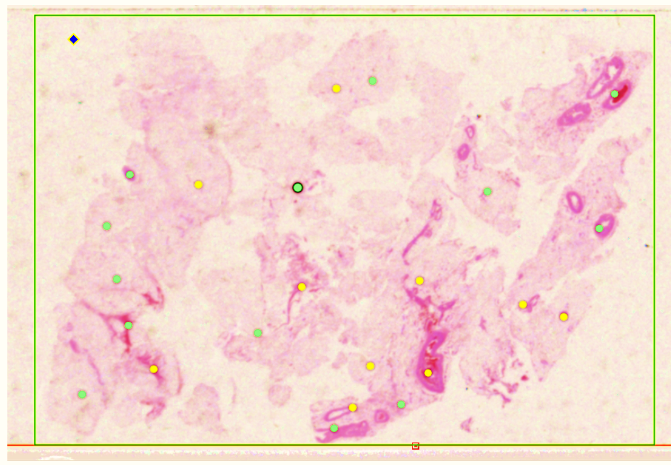
Image Digitization
Pre-scan snapshots are taken prior to scanning process.
Focus points are placed on each snapshot to specify the area of the slide to be scanned.
In some cases, focus points must be manually added, and the boundaries are adjusted.
After the pre-scan is adjusted, the slides are scanned at high resolution.
The resulting images are databased using Aperio’s eSM software.

Slide 8
SVS File Format
After scanning the slide as a digital image,
the image is stored in a proprietary file format
known as an .svs file.
This file contains the raw image data and
some metadata captured during the
scanning process.
An .svs file is a layered TIFF which uses
JPEG 2000 compression to compress the
actual image.
The .svs file also contains a thumbnail, which
is a low-quality image of the slide, and the label
image which is a low-resolution picture of the slide’s label.
Digital slides are scanned at a higher resolution which exceeds the allowable dimensions of a JPEG file.
Therefore, we are using .svs files as the primary filetype for the corpus because it is efficient and handles full resolution images.
Slides can be viewed using Aperio’s ImageScope software, which is freely available, or using several open-source tools. Python supports .svs.

Slide 9
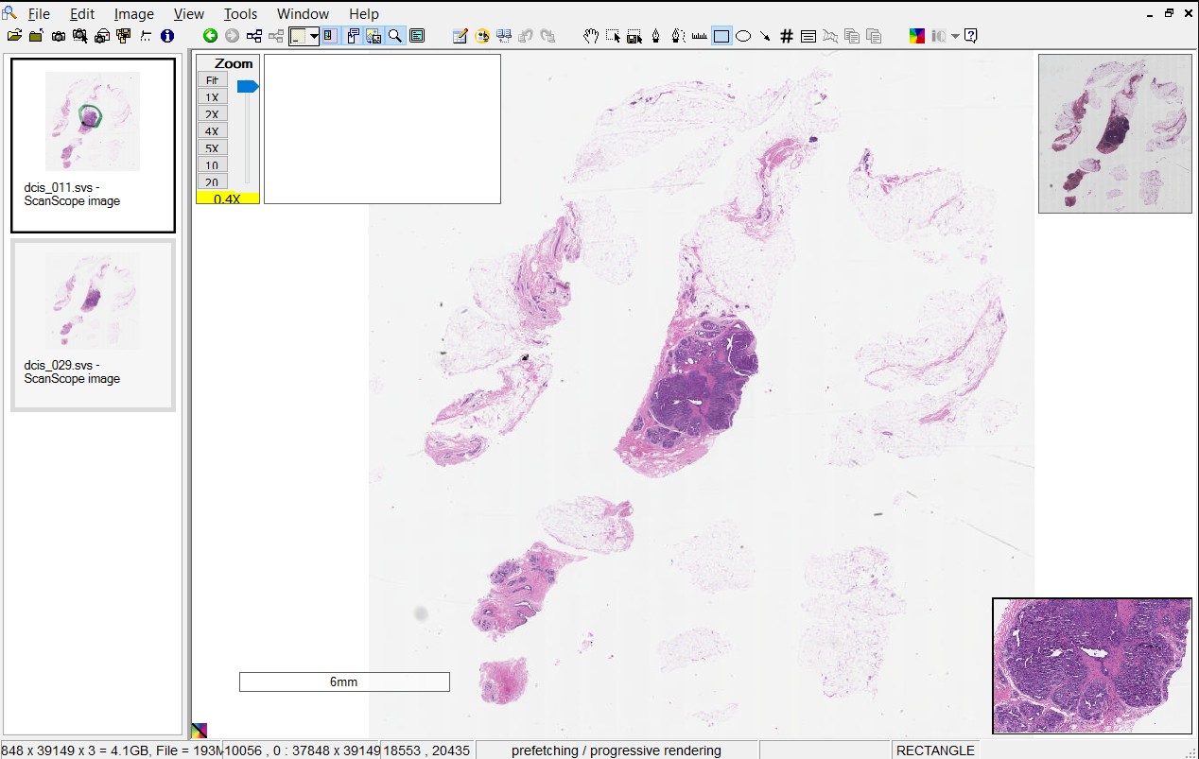
Aperio ImageScope Viewer
The software provides user-friendly annotation and adjustment tools necessary for the interpretation of the specimen:
Filmstrip
Zoomslider
Eslide Label
Main Window
Toolbar
Thumbnail
Status Bar
Magnifier

Slide 10
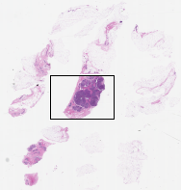
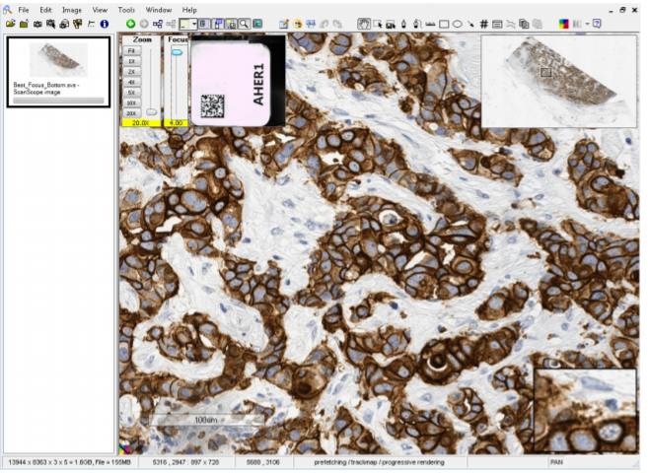
Key Imagescope Features
The Imagescope provides convenient features such as panning, autopanning, scrolling, and Z-stacking.
Z-stacking: a process of extracting information of an image at different focus distances to give a resulting image with greater depth of field.
Z-stacking is used to create a 3D image that is similar to what pathologists can do with their analog microscopes.
The Focus Slider is used to view Z-stacked images.
This feature has not been extensively explored yet in the Department of Pathology at Temple University Hospital.
The resulting image is very large (Gigabytes) and a challenge for machine learning.
Focus Slider

Slide 11
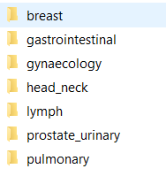
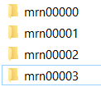


Data Organization
The slides are uploaded to the eSM where they are organized into 3 data groups:
  Clinical
  Research
  Educational
where the Research option was chosen as the initial method of data organization.
The top level of the research category contains broad tissue type categories called cases
Within each case the data is further categorized into the patient’s MRN and then into the specimen ID of each slide.
The .svs images are then catalogued with the specimen id, the tissue block of the specimen, the level of sectioning and the stain applied.

Slide 12
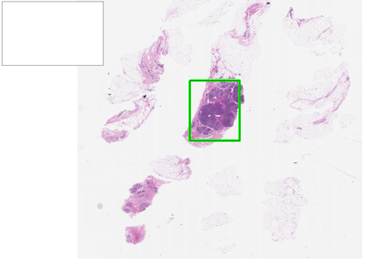
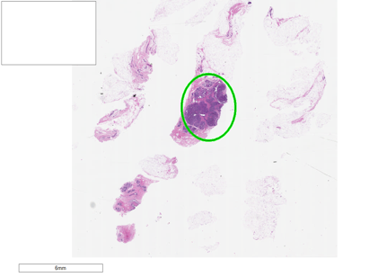
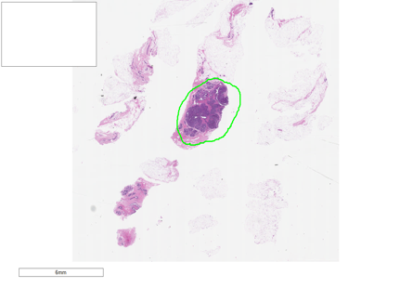
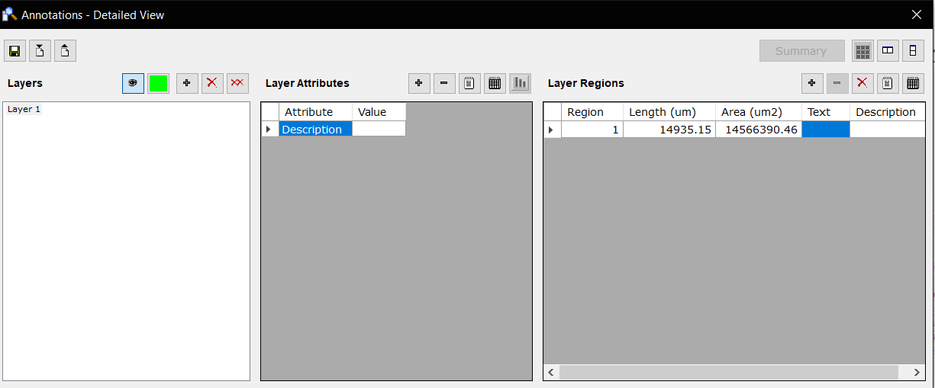
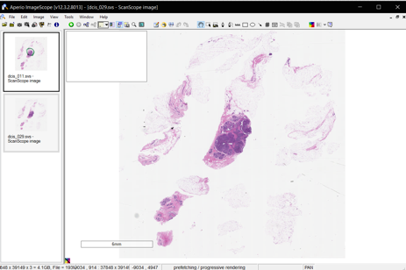
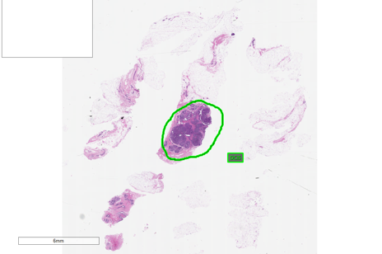
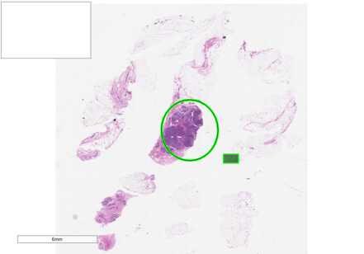
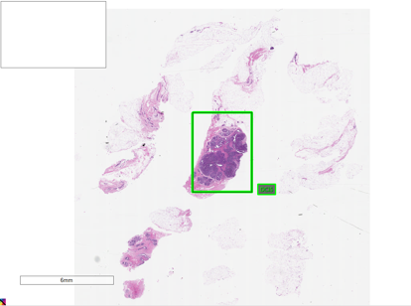
Data Annotation
Rectangle Tool
Elliptical Tool
Pen Tool
Region of the annotation is selected using the rectangle, ellipsis and pen tool.
An annotation is created by a pathologist by describing the event
(e.g., the type of cancer).
We are early in the process of developing annotation standards.

Slide 13

Annotation tools
Button | Name | Description
 | Pen | Click and drag to draw a free-form shape to indicate an area of interest or to enclose an area to analyze.
 | Negative Pen | Click and drag to draw a free-form shape around an area you want to exclude from analysis.
 | Ruler | Click and drag to measure an object on the eSlide. The unit of measure adjusts to the current resolution.
 | Rectangle | Click and drag to draw a rectangle. To draw a square, press and hold the Shift key as you draw.
 | Ellipsis | Click and drag to draw an ellipsis. To draw a circle, press and hold the Shift key as you draw.
 | Arrow | Click and drag to draw an arrow.
 | Counter | Click to mark the eSlide image with a numbered annotation. Counters are numbered automatically in the order they were placed.
 | Report | Click the area of the image to include in a report. You can only create one report image per report. To draw an area of a fixed size, press the Ctrl key while you draw.
 | Distance Measurements | Enables you to measure the distance (in microns) between two free-hand line annotations.
 | Copy/Paste Annotations | Select the annotation you want to copy, and click the Copy Annotations button. Click the Paste Annotations button, and then click to place the annotation in the eSlide image.

Slide 14
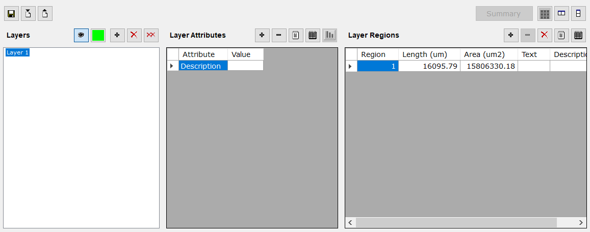
Annotation View Window
To open the annotation window, go to the view menu and select annotations.
  Layers – lists all layers for the eSlide.
  Layer Attributes – enables you to add and delete attributes for a layer.
  Layer Regions – enables you to add and delete attributes for an annotation.
  Annotation information is accessible in the layer region.

Slide 15
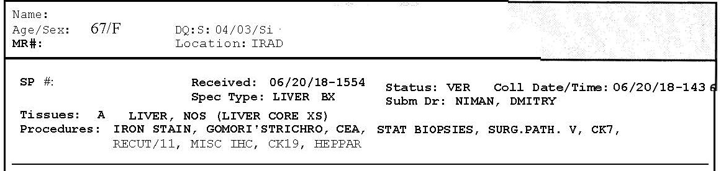
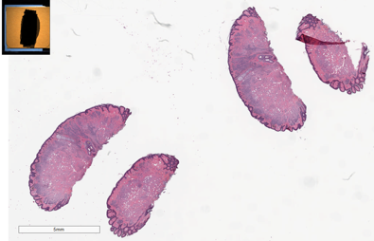
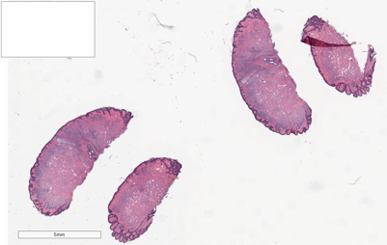
Data Anonymization
Under the Health Insurance Probability and Accountability Act (HIPAA), patient identity is kept anonymous.
The scanner and slides resides at the hospital. The digital images are also stored on a secure HIPAA network until the data is anonymized.
Data Anonymization
Case Reports
Digital Slides
Patient’s name
MRN
Specimen ID
Anonymizing slide labels’ information

Slide 16
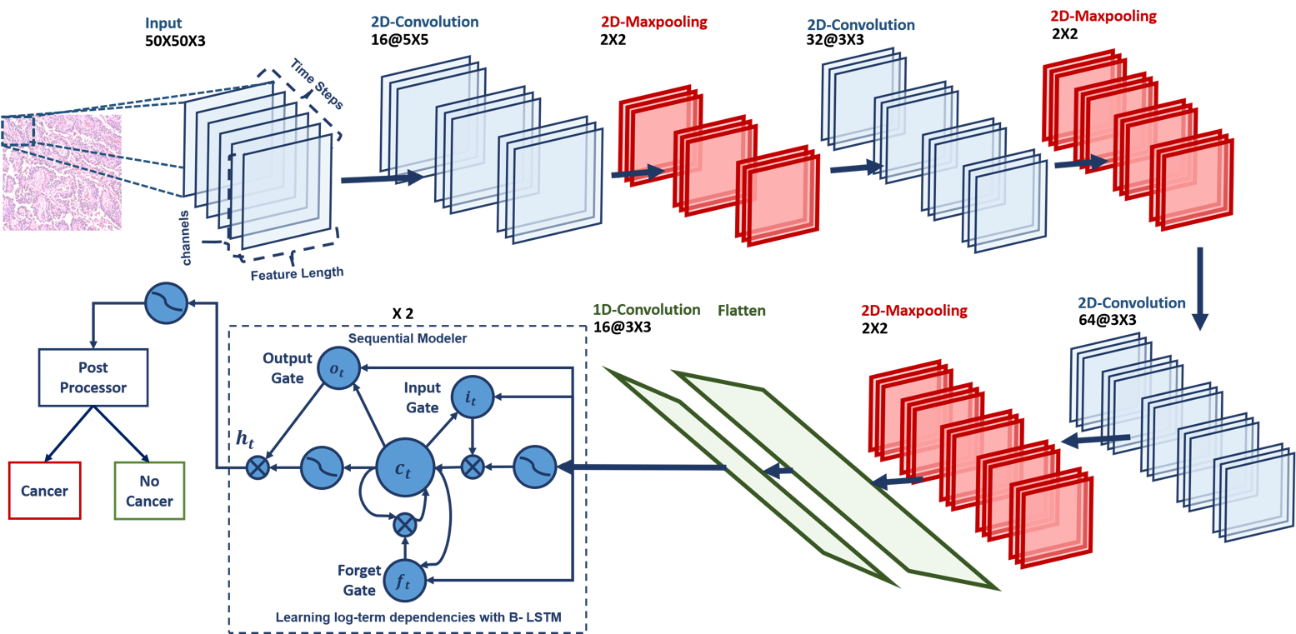
Algorithm Development
Baseline system developed for the seizure detection project, CNN-LSTM, was partially adapted for this project.
Once a baseline system is in place, our analysis will be compared with physician feedback and the system will be adjusted accordingly.
Our software was developed using Python and executes on general purpose processors and high-speed GPUs.
For faster software integration and model development, we use deep learning tools such as TensorFlow and Keras.

Slide 17
Storage Demands
A single image from a clinical-grade digital
pathology scanner can range in size from
hundreds of megabytes to five gigabytes.
A 1M image database requires over a
petabyte (PB) of disk space. To do meaningful
work in this problem space requires a
significant allocation of computing resources.
The improvements and expansions to our
HPC (high performance computing) cluster,
known as Neuronix, required to support working with digital pathology fall into two broad categories: computation and storage.
For storage, we have designed and implemented a multi-layer filesystem architecture to distribute a filesystem across multiple machines.
To handle the increased computational burden, we are using Slurm, an open source workload manager, as our scheduler and resource manager.
These enhancements, which are entirely based on open source software, have extended the capabilities of our cluster and increased its cost-effectiveness. For example, our storage costs are a very respectable $40K/Petabyte.

Slide 18
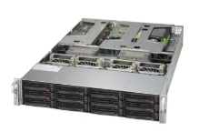
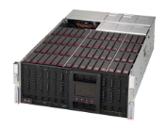
Storage Hardware
The Leica Aperio eSlide Manager and ImageScope applications are hosted on a Windows app server.
eSM runs as a web application.
Pathologists are authenticated using their standard Temple Hospital accounts.
A Linux Petabyte file server is used to store the image data while the app server manages the database and web applications.
The primary file server is mirrored using a second identical server and a virtual file system implemented using Gluster and ZFS.
Each Petabyte machine contains two JBODs with each containing 60 8TB hard drives.
To support these disks, we have two server units, each equipped with Intel Xeon CPUs and 128GB of memory.

Slide 19
Network Map
We have implemented a multi-layer solution that:
connects the disks
together into a single
filesystem/mountpoint
using the Zettabyte File
System (ZFS).
connects filesystems
on multiple machines
together to form a
single mountpoint
using Gluster.
ZFS and Gluster are open source packages.
There are three secure networks that must communicate: Temple Hospital’s HIPAA network, Temple Main Campus HIPAA network and Temple University’s main network.
Satisfying all of the necessary security constraints was not trivial and took about 9 months work by dozens of people.

Slide 20
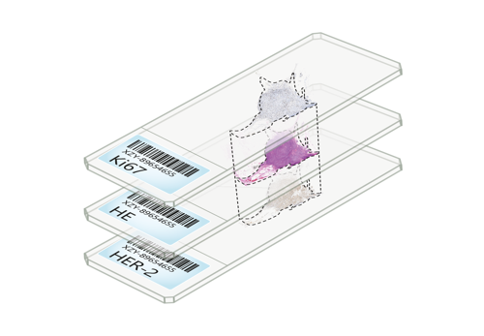
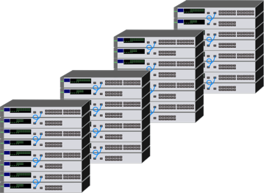
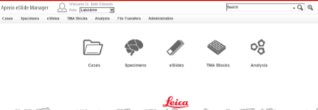

Corpus Development Workflow
Scanned slides are uploaded to the petabyte server
Slides are loaded onto the Digital Slide Scanner (DSS)
Slides from the server are uploaded to the electronic slide manager (eSM)
Annotated slides are now available to be anonymized before being available in the public domain
Pathologists review and annotate the slides

Slide 21
Preliminary Statistics For A Pilot Corpus
Spec Type | Number of Patients | Number of Cases | Number of Slides | Average Number of Slides per Patient
Breast | 292 | 304 | 3,224 | 11.0
Endocrine | 7 | 11 | 136 | 19.4
Gastrointestinal | 109 | 109 | 1,966 | 18.0
Head_Neck | 4 | 4 | 75 | 18.8
Pulmonary | 4 | 4 | 55 | 13.8
Urology | 180 | 194 | 5,083 | 28.2
Miscellaneous | 8 | 25 | 684 | 85.5
Total | 604 | 651 | 11,223 | 18.6
We have currently scanned over 16,000 slides.
Our goal is to scan every slide available at Temple Hospital.

Slide 22
Summary
The ability to scan slides into digital images and place them on a secure HIPPA network accessible to pathologists promotes remote accessibility and collaboration on patient cases.
The physical storage required to manage such a large archive electronically is now affordable and can be implemented using a relatively simple architecture.
Our primary goal in this three-year project is to scan and annotate 1M slides, where each image will have an associated clinical report.
This corpus will enable the development of state-of-the art machine learning systems, which require vast amounts of training data, for pathology applications such as cancer identification.
This project will also enable the development of software systems to assist diagnosis and accelerate the diagnostic process, thereby easing pathologist workloads. This is important since the industry expects there will be a severe shortage of pathologists over the next 20 years.
Digital pathology is also enhancing educational practice by providing access to a large, open source pathology corpus that can be easily searched.
More information about our project can be found at:
https://www.isip.piconepress.com/projects/nsf_dpath/

Slide 23
Acknowledgements
This material is based upon work supported by the National Science Foundation under Grant No. CNS- 1726188. Any opinions, findings, and conclusions or recommendations expressed in this material are those of the author(s) and do not necessarily reflect the views of the National Science Foundation.

Slide 24
References
“Mounting Tissue Sections,” National Diagnostics, 2011. https://www.nationaldiagnostics.com/histology/article/mounting-tissue-sections.
D. Gutman, J. Cobb, D. Somanna, Y. Park, F. Wang, T. Kurc, J. Saltz, D. Brat, L. Cooper, and J. Kong, “Cancer Digital Slide Archive: an informatics resource to support integrated in silico analysis of TCGA pathology data,” J. Am. Med. Informatics Assoc., vol. 20, no. 6, pp. 1091–1098, 2013.
J. Barker, A. Hoogi, A. Depeursinge, and D. Rubin, “Automated classification of brain tumor type in whole-slide digital pathology images using local representative tiles,” Med. Image Anal., vol. 30, no. 1, pp. 60–71, 2016.
J. Picone, T. Farkas, I. Obeid, and Y. Persidsky, “MRI: High Performance Digital Pathology Using Big Data and Machine Learning,” Major Research Instrumentation (MRI), Division of Computer and Network Systems, National Science Foundation, January 1, 2018.
M. Satyanarayanan, A. Goode, B. Gilbert, J. Harkes, and D. Jukic, “OpenSlide: A vendor-neutral software foundation for digital pathology,” J. Pathol. Inform., vol. 4, no. 1, p. 27, 2013.
R. Brzezinski, HIPAA Privacy and Security Compliance - Simplified: Practical Guide for Healthcare Providers and Managers 2016 Edition, 3rd ed. Seattle, Washington, USA: CreateSpace Independent Publishing Platform, 2016.
I. Obeid and J. Picone, “The Temple University Hospital EEG Data Corpus,” Front. Neurosci. Sect. Neural Technol., vol. 10, p. 00196, 2016.
“Simple Monthly Calculator,” Amazon Web Services, 2018. http://calculator.s3.amazonaws.com/index.html
C. Campbell, N. Mecca, T. Duong, I. Obeid, and J. Picone, “Expanding an HPC Cluster to Support the Computational Demands of Digital Pathology,” in IEEE Signal Processing in Medicine and Biology Symposium, 2018, pp. 1–2.
N. Jhala, “Digital pathology: Advancing frontiers,” in IEEE Signal Processing in Medicine and Biology Symposium (SPMB), 2017.

