Slide 1
A Comparative Analysis of Nonlinear Features for an HMM-Based Seizure Detection System
Masih Tabrizi and Joseph Picone
Neural Engineering Data Consortium
Institute for Signal and Information Processing
Temple University
Philadelphia, Pennsylvania, USA

Slide 2
Outline
Abstract
Data base
Software description
Results
Summary

Slide 3
Abstract
An electroencephalogram (EEG)
Measures brain activity
Diagnose cortex dysfunctions
CHB-MIT database
The objective of this project is to
Add and apply statistical discriminative features
Build a statistical model based on these features

Slide 4
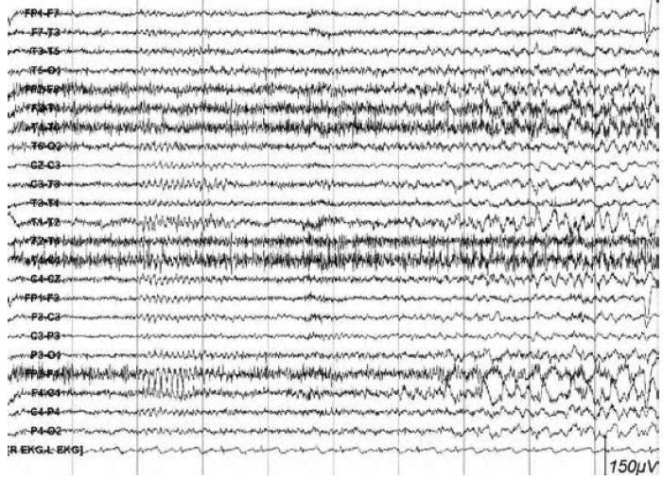
Temporal lobe Seizure
A temporal lobe seizure
Relatively high amplitude of above 60 μV
Frequencies of 4–6 Hz. (Sanei 2007)
Burst of repetitive spikes
Handbook of EEG
(Tatum et al. 2008)

Slide 5
CHB_MIT Dataset
Records include 198 seizures selected by physicians.
The dataset Consists of
916 hours
Artifact free, continuous EEG
24 patients
Single type seizures (temporal lobe seizure)
sampled at a 256 Hz
digitized to 16 bit by an analogue-to-digital converter.
international 10-20 placement system

Slide 6
The Baseline System – Feature Extraction
The baseline system is created by ISIP members, written in C++ environment.
The primarily version of the software generates
Temporal Energy
Frequency Energy
Filter bank Amplitude
Cepstral coefficients.
Parameter file defines
Output directory
Channel selection and montage
The type of window
filter bank

Slide 7
The Baseline System – Statistical Model
Gaussian Mixtures
weighted sum of Gaussian component densities
GMM with 10 mixture components
One leave out cross validation
The results of the baseline system (using fenergy and 8 Cepstral coefficients):

Slide 8
Appended Features
The features that have been add to the software:
Temporal Features
Kurtosis
Average Peak/Valley
Zero-crossing
Frequency Features
Wavelet Energy
Non-linear Features
Hurst Exponent
Approximate Entropy

Slide 9
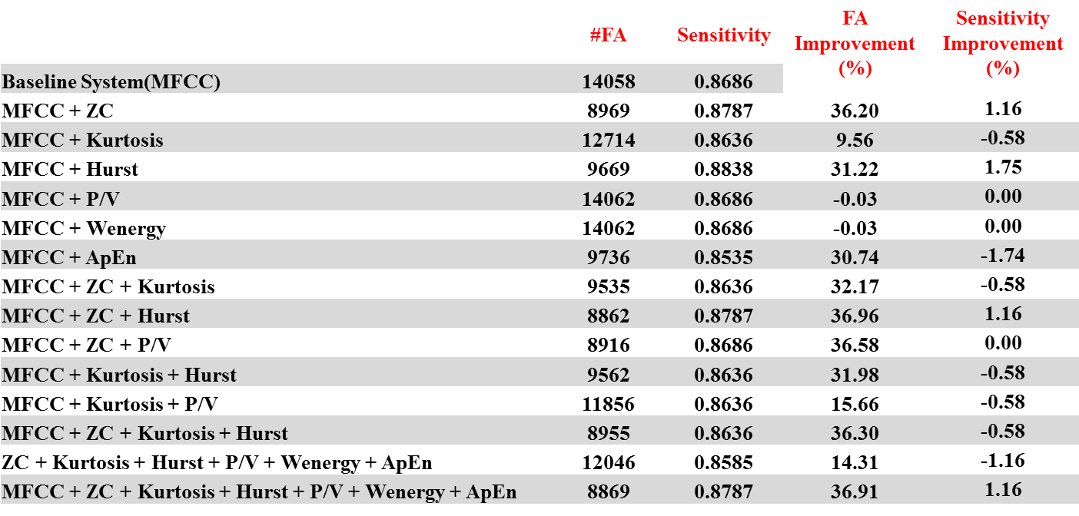
Results
System performance using baseline feature set(MFCC), MFCCs plus appended features, and combinations of appended features and MFCCs.

Slide 10
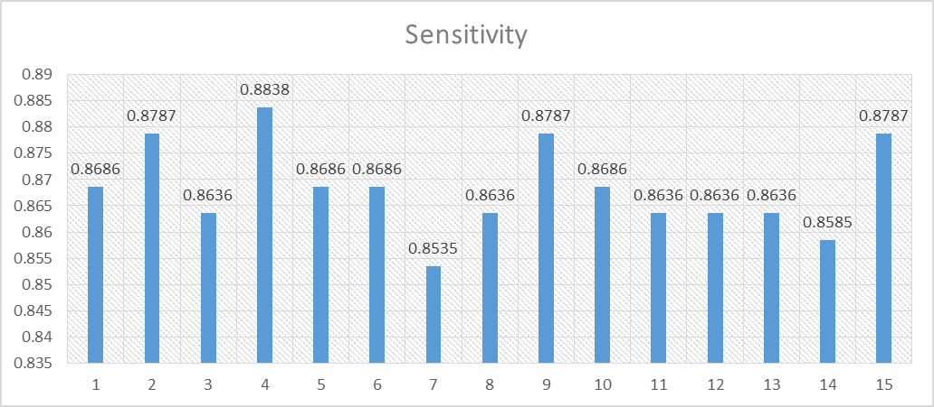
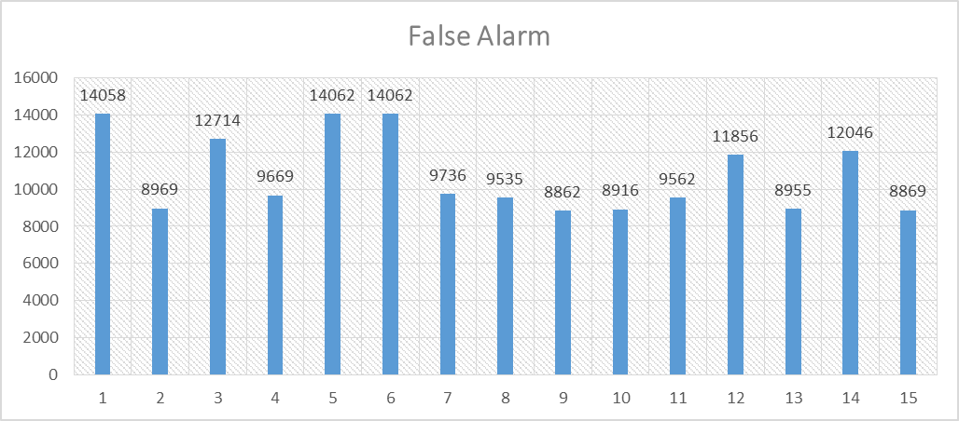
Results
Sensitivity and False alarm for baseline features, MFCCs plus each one of six features and combinations of appended feature and MFCCs.

Slide 11
Summary
Sequential data such as EEG have to be modeled by Hidden Markov Model (HMM) or similar approaches that designed to classify temporal sequences.
The objective of this project is to add and apply statistical discriminative features in order to be applied to a HMM-based system and whether selected features could improve recognition performance for this seizure detection system.
The performance improvements suggest that most of appended features have a significant contribution to seizure detection and can be used to construct more accurate seizure models.

Slide 12
Brief Bibliography, References
[1] Sanei, S., & Chambers, J. A. (2007). EEG SIGNAL PROCESSING (p. 313). John Wilet and sons, Ltd.
[2] Tatum, W., Husain, A., Benbadis, S., & Kaplan, P. (2008). Handbook of EEG interpretation (p.289). Demos Medical Publishing.
[3] Wulsin, D. F., Gupta, J. R., Mani, R., Blanco, J. a, & Litt, B. (2011). Modeling electroencephalography waveforms with semi-supervised deep belief nets: fast classification and anomaly measurement. Journal of neural engineering, 8(3), 036015. doi:10.1088/1741-2560/8/3/036015
[4] Sharbrough, F. W., ‘Nonspecific abnormal EEG patterns’, Chapter. 12, in Electroencephalography, Basic Principles, Clinical Applications, and Related Fields, Eds E. Niedermeyer and F. Lopes Da Silva, 4th edn., Lippincott, Williams and Wilkins, Philadelphia, Pennsylvania, 1999.
[5] Diambra L, Bastos de Figueiredo J.C, Malta P. (1999) Epileptic activity recognition in EEG recording
[6] Yuan, Q., Zhou, W., Li, S., & Cai, D. (2011). Epileptic EEG classification based on extreme learning machine and nonlinear features. Epilepsy research, 96(1-2), 29–38. doi:10.1016/j.eplepsyres.2011.04.013

