Slide 1

Hyperspectral Imaging to Discern Benign and Malignant Canine Mammary tumors
Amrita Sahu
9th May, 2013.
Dr. Chang-Hee Won (Advisory Chair)
Dr. Nancy Pleshko
Dr. Joseph Picone
Control Sensor Network and Perception Laboratory
Electrical and Computer Engineering Department
Temple University
Philadelphia, PA 19122, U.S.A.
Notes:
Thanks everyone
Excited to be part of NEBEC 2012
Firdous Saleheen, PhD, TU, Philadelphia
Today I am going to present
Tactile sensation is the sensation of touch, perception of external pressure via physical contact.
Tactile Imaing Sensor gives a visual representation of that touch sensation
What is tactile imaging sensor?
Why is normal force estimation important?

Slide 2
Outline
Motivation
Background and Literature Review
Objectives
Image Processing Methods
Experimental Setup
Characterization of System
Data Acquisition
Results
Conclusions
Future Work

Slide 3
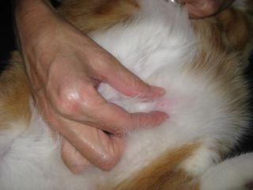
Motivation
Using Hyperspectral Imaging (HSI) for tumor detection
Non-invasive
Less time-consuming
Allows assessment of a large area
of tissue.
Applications of HSI tissue imaging:
Mammary tumors
  Human Breast Cancer
  Canine Cancer
  Feline Cancer
http://www.thepetcenter.com/gen/can.html

Slide 4
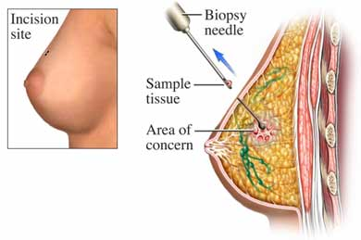
Motivation
No good device to identify malignant mammary tumors.
Doctors usually perform biopsy or just ‘wait and watch’.
Biopsy is the gold standard for cancer detection.
It is invasive and requires several days for the results to be determined.
To avoid the above disadvantages, we propose to use a non-invasive hyperspectral imaging sensor for characterizing canine mammary tumors.
http://www.beliefnet.com/healthandhealing/getcontent.aspx?cid=14777

Slide 5
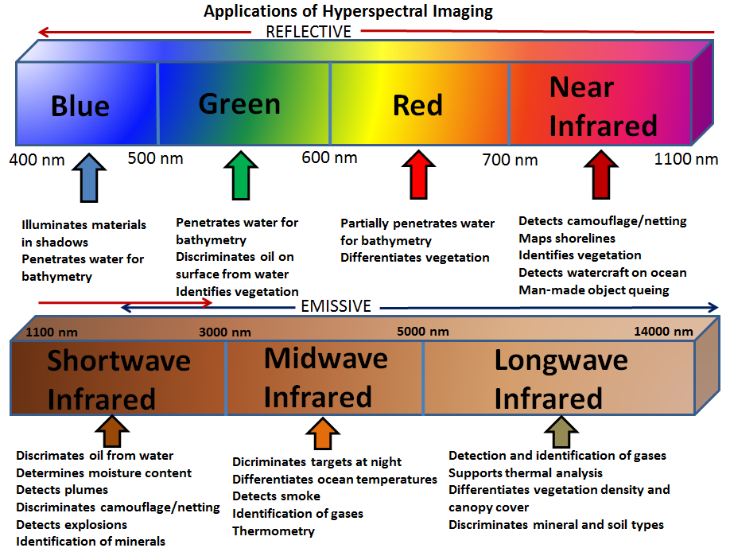
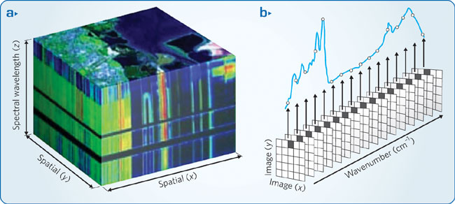
Background
  Hyperspectral imaging measures and collects reflectance intensity information of more than hundred spectral bands across the electromagnetic spectrum.
http://www.nature.com/nphoton/journal/v3/n11/fig_tab/nphoton.2009.205_F3.html

Slide 6
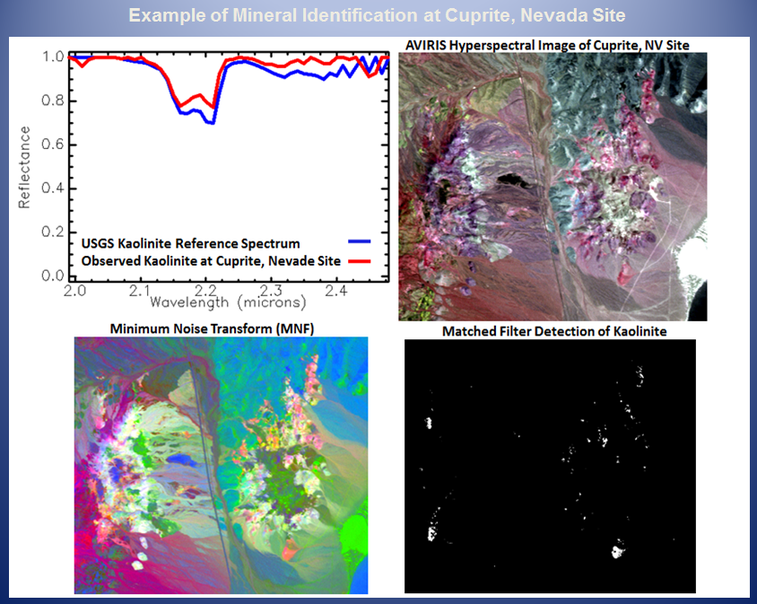
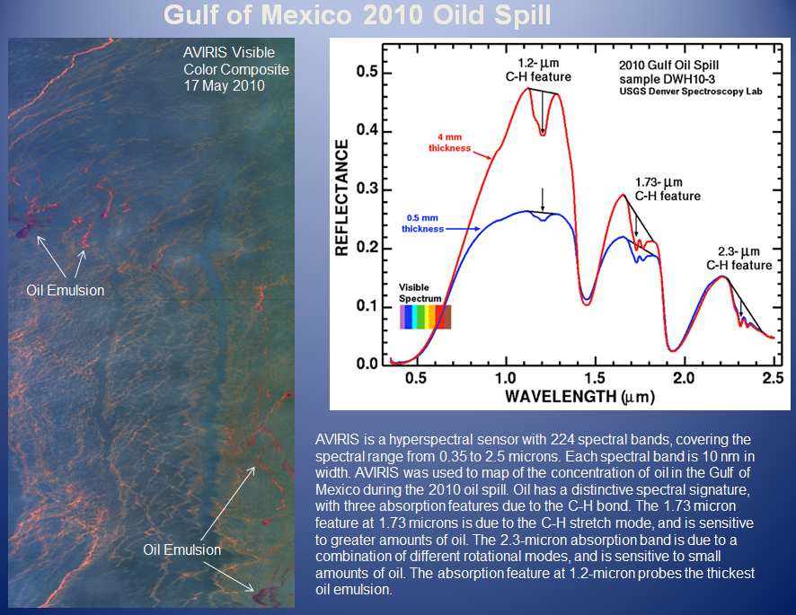
Applications of Hyperspectral Imaging
  Applications of Hyperspectral Imaging are:
  Agriculture
  Mineralogy
  Surveillance
  Monitoring of Oil Drilling
  Non-Invasive Tissue Analysis
http://www.markelowitz.com/Hyperspectral.html

Slide 7
Cancer Detection using Infrared Hyperspectral Imaging
Breast Cancer
Canine Mammary Cancer
Tongue Cancer
Gastric Cancer
Skin Cancer
Other diseases: intestinal ischemia, lung emphysema
Liu, Z. et. al, “Tongue Tumor Detection in Medical Hyperspectral Images”, Sensors, 12(1), 162-174 (2012).
Balas, C., Themelis et. al “A Novel Hyper-Spectral Imaging System : Application on in-vivo Detection and Grading of Cervical Precancers and of Pigmented Skin Lesions”, In Proc. of "Computer Vision Beyond the Visible Spectrum" CVBVS'01 Workshop, Hawaii, USA, (2001).
Lee, J., Won, C. H., “Characterization of Lung Tissues using Liquid-Crystal Tunable Filter and hyperspectral Imaging System,” Proc. IEEE EMBC 09, 1416-1419 (2009).

Slide 8
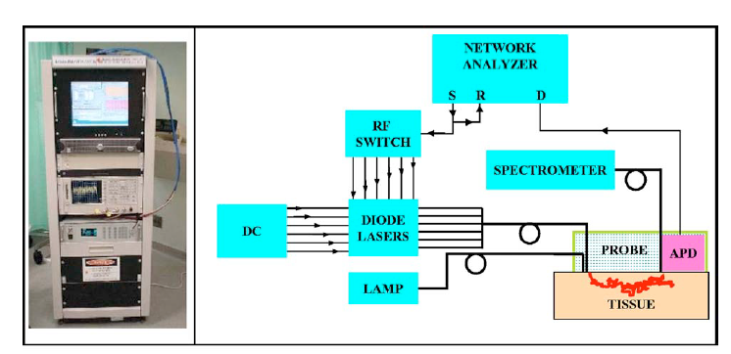
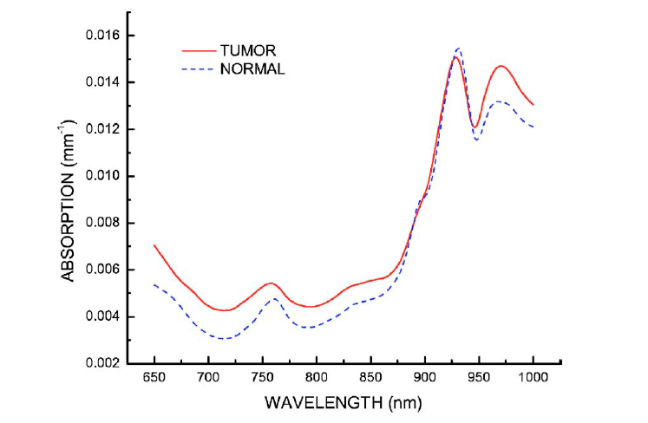
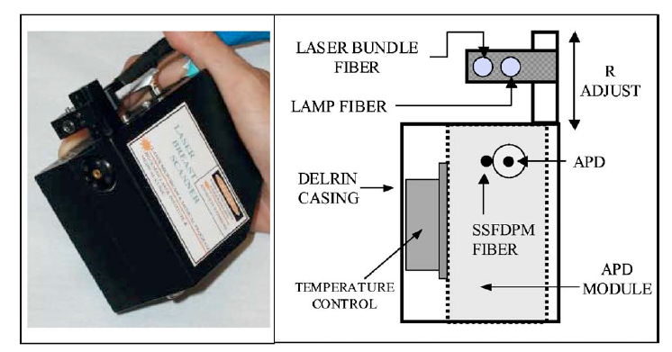
Breast Cancer
Results from 58 malignant breast tumors are reported.
A steady state spectrometer used (650-1100nm).
Six laser diodes used for illumination.
Fiber Optic cable delivers laser light to tissue.
Shah, N., A. E. Cerussi, D. Jakubowski, D. Hsiang, J. Butler, and B. J. Tromberg, The role of diffuse optical spectroscopy in the clinical management of breast cancer. Dis. Markers 19:95–105, 2003.

Slide 9
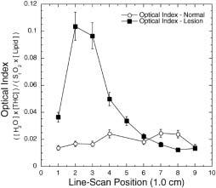
Breast Cancer
Hemoglobin, water and lipid content is different in malignant and benign tumors.
Tissue Optical Index (TOI) was developed.
Higher TOI indicates tumor malignancy.
Shah, N., A. E. Cerussi, D. Jakubowski, D. Hsiang, J. Butler, and B. J. Tromberg, The role of diffuse optical spectroscopy in the clinical management of breast cancer. Dis. Markers 19:95–105, 2003.

Slide 10
Canine Mammary Cancer
Fluorescent dyes used.
The dyes were administered in the vein of the canine patient.
For illumination, a 660nm laser diode beam used.
The uptake and release rates of the dye varied in the diseased and normal tissue.
M. Gurfinkel et al, Pharmacokinetics of ICG and HPPH-car for the Detection of Normal and Tumor Tissue Using Fluorescence, Near-Infrared Reflectance Imaging: A Case Study, Photochemistry and Photobiology, 2000, 72(1), 94-102

Slide 11
Objectives
Characterize a hyperspectral imaging system and use it to discern malignant and benign canine mammary tumors.
Normalize and preprocess the spectral data.
Develop algorithms to discern malignant tumors and benign canine mammary tumors.
Design an experiment to acquire the clinical data and analyze the results.

Slide 12
Why is Near Infrared Spectral Range Used?
Near Infrared Hyperspectral Imaging has been used in literature for the detection of various kinds of cancer.
NIR light has good penetration depth into tissue, because tissue has low absorptivity in this region.
NIR light is absorbed by certain chromophores in the tissue that are biochemically significant.
In this thesis, we use the visible - NIR spectral range, 650 nm to 1100 nm.

Slide 13
Methods
1. Image Preprocessing
  To improve the signal to noise ratio.
  Savitzky-Golay Smoothing process used.
  It performs local polynomial regression using method of least squares.
2. Image Normalization
  Data should be normalized to treat spectral non-uniformity of device.
  Raw data may change due to illumination, temperature and non-uniform contour of the subject.
  Range normalization used.
  In range normalization, each spectral row is divided by its range (max value - min value).

Slide 14
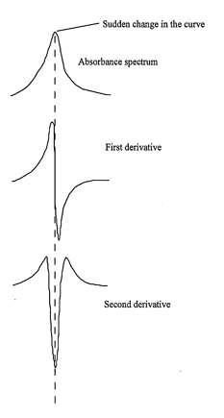
Methods
3. Identification of chromophore-specific wavelengths
  Second derivative method applied to the
  reflectance spectra.
  Negative peaks in the second derivative
  spectra would give the wavelengths
  corresponding to the chromophores.
4. Algorithm to detect malignancy
Algorithm | Literature | Canine Cancer
Support Vector Machine | Most widely used in detection of prostate, gastric cancer. | Does not work well
PCA-LDA | Also used in some kinds of cancers. | Sensitivity and Specificity 86 % and 86 %
Tissue Optical Index (TOI) | Used in breast cancer | Sensitivity and Specificity 86 % and 95%

Slide 15
Tissue Optical Indices Method
A is the absorption of NIR light,
ε is the molar extinction coefficient (mol/litre/cm)
[c] is the concentration of chromophore (mol/litre)
l is the photon path length (cm)
Notes:
StO₂ is the quantification of the ratio of oxygenated hemoglobin to total hemoglobin in the microcirculation of a volume of illuminated tissue and is an absolute number.

Slide 16
Tissue Optical Indices Method
Higher content of hemoglobin (HbT) suggests elevated blood volume and angiogenesis.
Higher water content (H₂O) suggest edema and increased cellularity
Decreased StO₂ (tissue oxygen saturation) indicated tissue hypoxia driven by metabolically active tumor cells
Decreased lipid content reflects displacement of parenchymal adipose
A higher TOI suggest that the tumor is malignant, because it indicates higher metabolic activity of the cells.

Slide 17
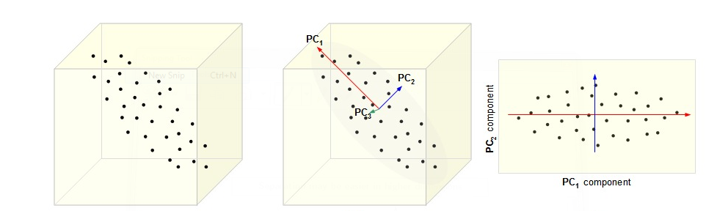
PCA-LDA Method
Principal Component Analysis
Converts a larger number of correlated variables into a smaller number of linearly uncorrelated variables called principal components (PC).
The first principal component has the highest variance, the second principal component has the second highest variance and so on.
Each PC is orthogonal to each other.
http://cnx.org/content/m11461/latest/

Slide 18
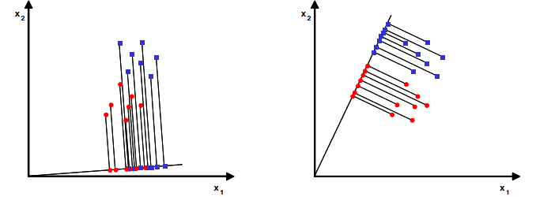
PCA-LDA Method
Linear Discriminant Analysis
Linear Discriminant Analysis is widely used in statistics, machine learning and pattern recognition.
It finds a linear combination of features which characterized two or more classes of objects.
It used Bayes’ Formula, and we assume that the prior probabilities for groups are given.

Slide 19
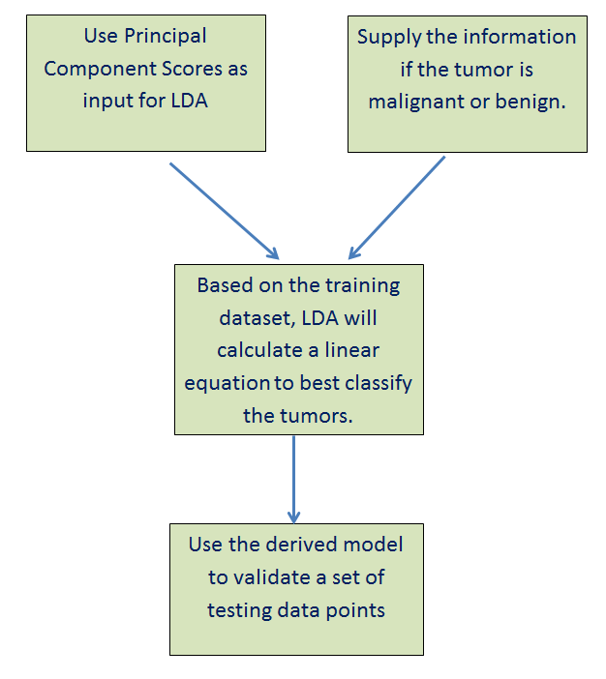
PCA-LDA Method

Slide 20
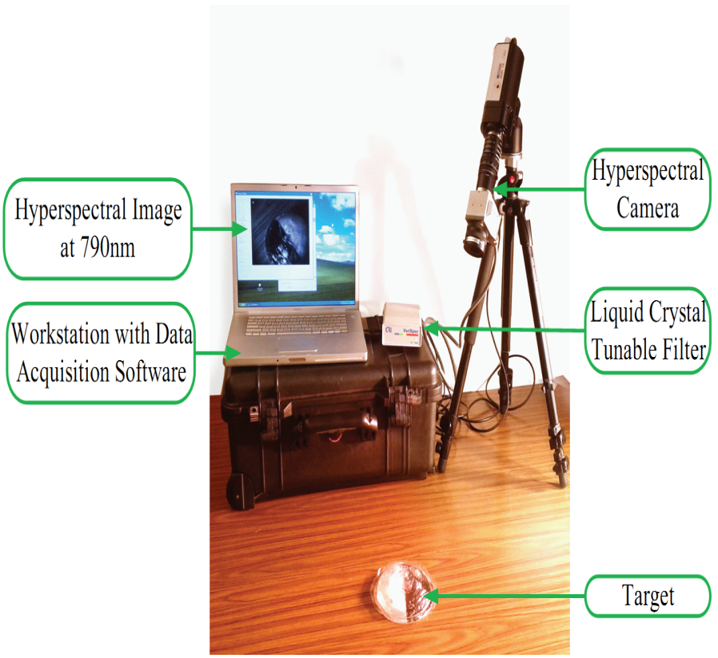
Hyperspectral Imaging System Description
The imaging system consists of:
A digital imager (CCD camera, 1.4 megapixel, 12 bit output).
A Liquid Crystal Tunable Filter.
LCTF Controller.
500W dual quartz tungsten halogen lamps (360-2500nm) were used for illumination.

Slide 21
Characterization of HSI System
Experiment 1
To test the repeatability of the HSI system
Experiment 2
Depth of penetration of NIR light into chicken breast
tissue.
Experiment 3
Effect of camera-to-sample distance on the reflectance
intensity spectra.

Slide 22
Repeatability Experiment
Hyperspectral image of a neoprene rubber sheet is captured for 5 consecutive days.
The ambient temperature and humidity are recorded.
External conditions such as lighting were kept as similar as possible.
The reflectance spectra were compared.

Slide 23
Results
Day | Temperature | Humidity | Weather conditions
1 | 22.9 ˚C | 28% | Cloudy
2 | 22.7 ˚C | 29% | Cloudy
3 | 23.6 ˚C | 26% | Sunny
4 | 23.8 ˚C | 25% | Sunny
5 | 24.1˚C | 25% | Sunny
System found to be fairly repeatable.

Slide 24
Depth of Penetration Experiment
Chicken breast tissue was cut into sections of varying thickness.
Neoprene rubber sheet was placed under the chicken slice.
Quantify at what minimum width of the chicken slice the spectral effect of neoprene rubber is obtained.

Slide 25
Results
The depth of penetration of NIR light into chicken breast to be between 3 mm to 5 mm

Slide 26
Effect of camera to sample distance on the output spectra.
The distance between the sample and the camera is varied each time.
The target was a slice of chicken breast.
The reflectance spectra is not affected by the camera to sample distance.

Slide 27
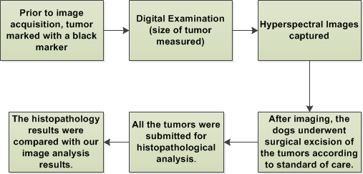
Data Acquisition From Canine Patients
The data were acquired in collaboration with the Veterinary Hospital of the University of Pennsylvania.

Slide 28
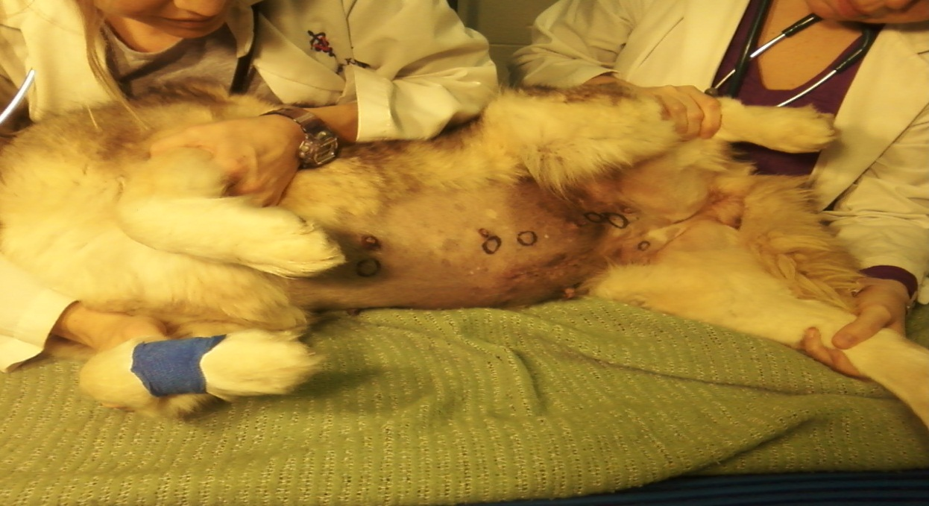
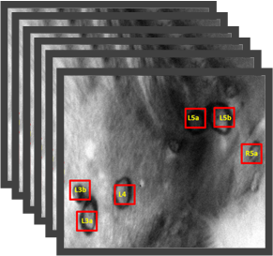
Data Acquisition From Canine Patients
Hyperpspectral image cube of a canine patient
Increasing wavelength

Slide 29
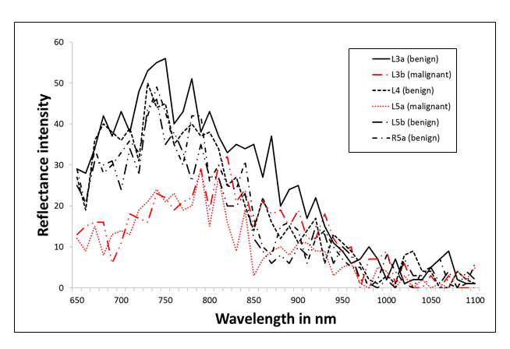
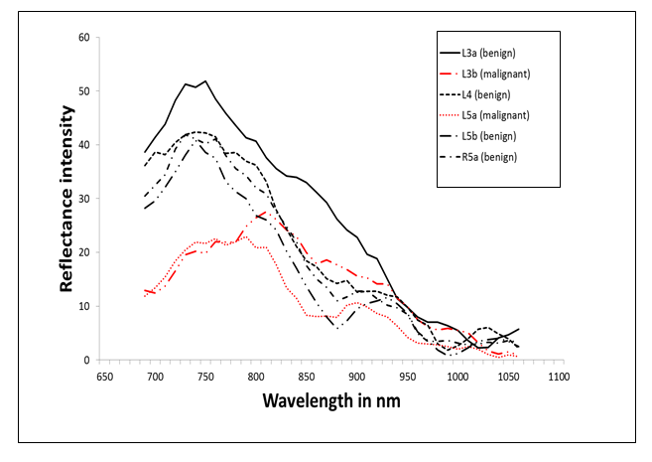
Results
Spectral data smoothed by Savitzky-Golay filtering
Smoothing applied on raw data to minimize noise

Slide 30
Results
Smoothed spectral data from one of the canine patients shown.
Cancer tissue has relatively lower reflectance intensity compared to the benign and the normal tissue.

Slide 31
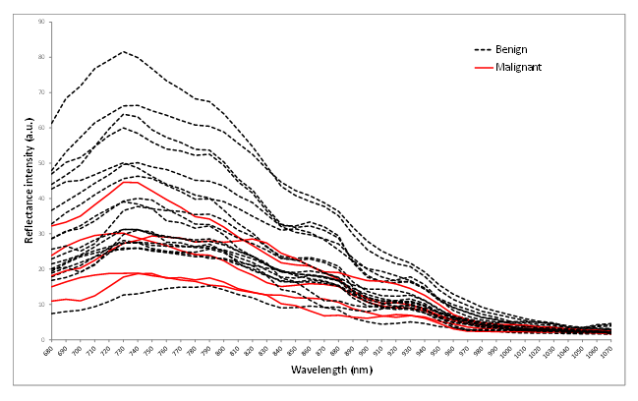
Results
Before range normalization
After range normalization

Slide 32
Results
Identifying chromophore-specific wavelength
Negative Peaks at 700, 840, 900 and 970 nm observed in the second derivative reflectance spectra, these peaks were attributed to deoxy-hemoglobin, oxy-hemoglobin, lipid and water respectively.

Slide 33
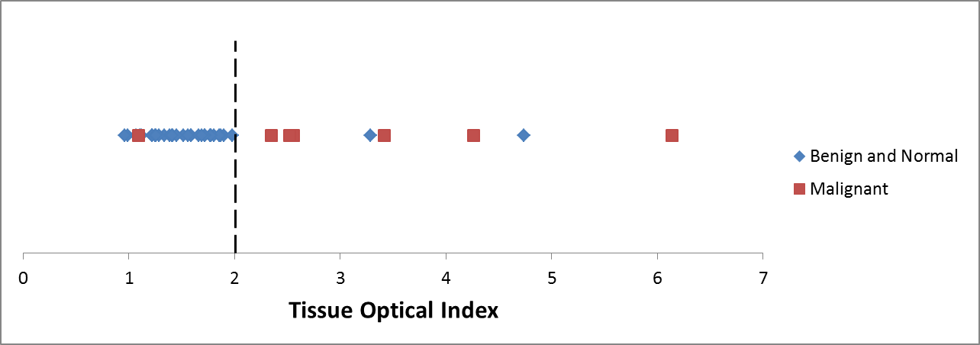
Results (TOI Method)
Using a TOI threshold of 2.00 units,
  6 out of 7 malignant tumors,
  13 out of 15 benign tumors,
  All of 22 normal tissue ROIs were correctly identified.
Sensitivity and specificity of the proposed method were 86% and 95% respectively.
Sahu A., McGoverin C. et. al “Hyperspectral Imagimg to Discern Malignant and Benign Canine Mammary Tumors”, In Proc. of SPIE Defense Security Sensing 2013

Slide 34
Results (PCA-LDA Method)
We have 44 Regions of Interest (ROI). Cannot construct separate training and testing dataset.
44-fold cross validation is used.
Sensitivity and specificity is 86% and 86%.

Slide 35
Discussions
Type of cancer | Sensitivity and specificity
Prostate | 93% and 97%
Gastric | 93% and 91%
Skin | 90% and 75%
Tongue | 93% and 91%
Canine Mammary Cancer | 86% and 95% (TOI) 86% and 86% (PCA-LDA)
Both TOI and PCA-LDA method works well. The TOI method has a slightly higher specificity for identifying benign tumors.

Slide 36
Dicussions
TOI Method
Advantages:
  Four wavelengths identified characteristic of the four chromophores.
  This could significantly reduce imaging time.
  Less-time consuming, easy to compute.
Disadvantage:
  Wavelength dependent
PCA-LDA method
Advantages:
  More robust, takes into account all wavelength information.
  Cross validation applied.
Disadvantage:
  More time consuming than TOI method.

Slide 37
Conclusions
A hyperspectral imaging system was used to characterize malignant and benign canine mammary tumors.
Reflectance intensities of malignant tumors were lower than benign and normal tissue over the wavelength 650 – 1100 nm.
Four negative peaks were observed at the wavelengths of 700, 840, 900 and 970 nm characteristic of deoxyhemoglobin, oxyhemoglobin, lipid and water.
A ‘Tissue Optical Index’ was used to classify canine cancer.
Preliminary results with 22 canine mammary tumors showed that the sensitivity and specificity of the TOI method was 86% and 96% respectively.

Slide 38
Conclusions
PCA-LDA method was developed to classify malignant tumors and the model was cross validated.
The sensitivity and specificity of the PCA-LDA method was 86% and 86% respectively.

Slide 39
Future Work
Further work needs to be done to collect more canine spectral data to generalize an application for the predictions put forward by the current study.
We can also conduct an in-vitro study of the canine tumor tissue after resection and compare the analysis with that of the in-vivo study.
In future experiments, we should use the reflectance standards to normalize data.

Slide 40
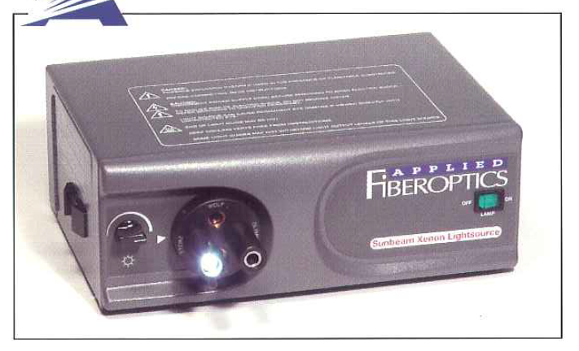
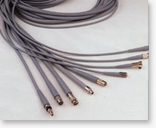
Future Work
The lighting should be as uniform as possible.
Non-uniform light will introduce variability in the data.
The temperature of the tungsten halogen lights are very high.
Uncomfortable for patients.
Use of fiber optic cable can mitigate can the problem.

Slide 41
Acknowledgements
I would like to thank the following people:
Dr. Chang-Hee Won for providing me the opportunity to work on this project and for guiding me through the project.
My Committee Members: Dr. Joseph Picone and Dr. Nancy Pleshko.
Dr. Karin Sorenmo, for providing the canine patient data.
Dr. Cushla McGoverin, for her constant help, support and encouragement.
Dr. Won and Firdous Saleheen, for their help in canine data acquisition.
The members of the CSNAP lab.
Amrita Sahu is supported by the University Fellowship from Temple University Graduate School.
This work was supported in part by the Tobacco Formula Fund of Pennsylvania Department of Health.

Slide 42


