Slide 1
Development of a fast and efficient algorithm for p300 event related potential detection in a mobile environment
A master’s thesis proposal by Elliot Franz
Advisor: Iyad Obeid, phd

Slide 2
Presentation overview
Background
EEG processing
Goals
Methodology
Data collection/processing
Preliminary work
Proposed work

Slide 3
1.) Background Overview
Brain Computer Interfaces (BCIs)
P300 Event Related Potential (ERP)
P300 Speller
EEG Hardware
Emotiv EPOC

Slide 4
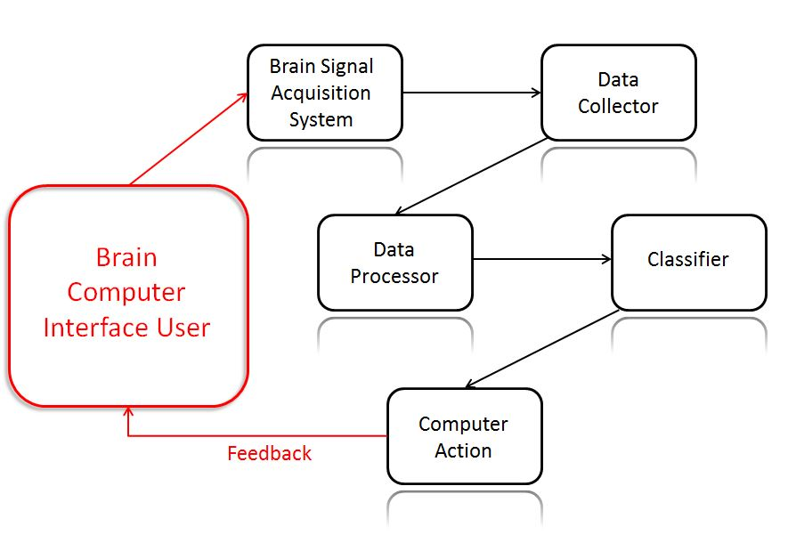
Brain computer Interfaces
What are BCIs?
Why BCIs?
How is brain data acquired?
Surface EEG, Intercranial EEG, Funtional MRI (fMRI)

Slide 5
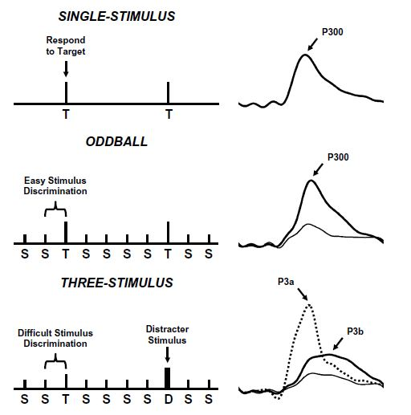
P300 Event Related Potential
What is P300?
Why P300 BCI?
How is
P300 elicited?
P3a vs P3b
Three protocols
Oddball
J. Polich, Clinical Neurphysiology. 2007

Slide 6
Factors which affect p300
A variety of biological factors affect the latency and the amplitude of the P300 ERP
Eating food
Body temperature
Exercise
Rarity of target
Inter-stimulus Interval (ISI)

Slide 7
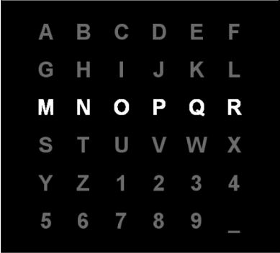
P300 Speller
H. Cecotti, et al. Pattern Analysis and Machine Intelligence. 2011

Slide 8
EEG Hardware
Electrodes
Material (e.g., Ag/AgCl, Saline)
Size/Shape (e.g., Cup, disk)
Signal enhancers (e.g., conductive jelly)
Wires
Amplifiers
Analog to Digital (A/D) converters

Slide 9
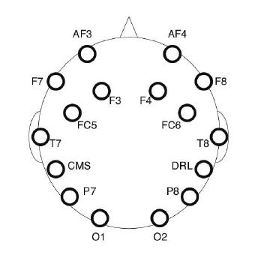
Emotiv EPOC
14 saline electrodes (plus 2 reference) EEG headset
Proprietary 2.4 GHz wireless
Unshielded wires
12 bit A/D converter
0.51 μV resolution
On board pre-filters
M. Duvinage, et al. Biomedical Engineering. 2012

Slide 10
Presentation overview
Background
EEG processing
Goals
Methodology
Data collection/processing
Preliminary work
Proposed work

Slide 11
2.) Eeg processing overview
Preprocessing
Electrode Selection
Spatial Filtering Algorithms
Classification Algorithms

Slide 12
preprocessing
Frequency filtering
0.1 to 15 Hz bandpass filtered
Time window (epoch selection)
200-350 ms is location of P300 peak
Downsampling
Dimensionality reduction
Removal of signal contaminants
Feature scaling

Slide 13
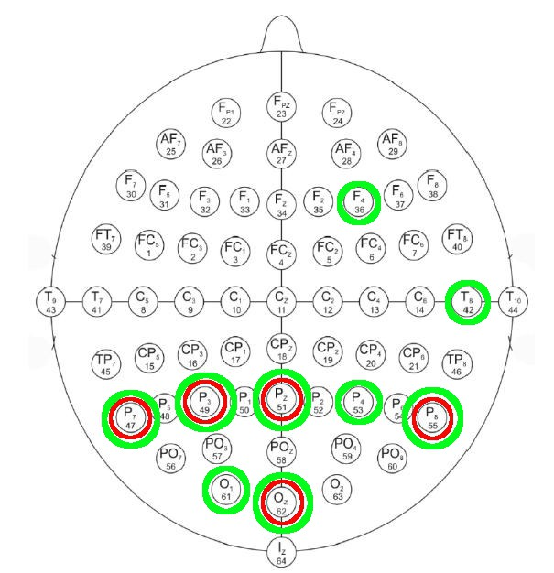
Electrode selection
Which electrodes are most salient for P300 detection?
Minimize classification
error (green)
Minimize Signal to
Signal plus Noise
(SSNR) ratio
(red circles)

Slide 14
Spatial filtering
Goal: Use information contained in neighboring electrodes to filter noise and isolate important signal components
Averaging, Independent Component Analysis (ICA), Principle Component Analysis (PCA), Singular Value Decomposition (SVD), xDAWN

Slide 15
Classification algorithms
Goal: Use features (data points in a given epoch) to determine whether or not the given epoch contains a P300
Binary classification problem
Pearson’s Correlation Method (PCM), Fisher’s Linear Discriminant Analysis (FLDA), Bayesian Linear Discriminant Analysis (BLDA), Support Vector Machines (SVM)

Slide 16
Accuracy Measure
Consider two different measures of accuracy:
Percent correct classification of all examples (number of targets and non-targets correctly identified divided by total)
Percent correct classification of targets (e.g., 12 examples are targets out of 72 total examples; classify 6 of 12 correctly for an accuracy of 50%, not 66 of 72 for 92%)

Slide 17
Presentation overview
Background
EEG processing
Goals
Methodology
Data collection/processing
Preliminary work
Proposed work

Slide 18
3.) goals
Test all combinations of spatial filtering and classification algorithms on the BCI dataset (metrics = speed and accuracy)
Test the following hypothesis on the BCI data and EPOC data: Given a low number of row/column intensifications of the P300 matrix, can we eliminate non-targets and still successfully classify spelled characters averaging less rare targets (less rare ~ 45%)?

Slide 19
Presentation overview
Background
EEG processing
Goals
Methodology
Data collection/processing
Preliminary work
Proposed work

Slide 20
4.) Methodology
BCI dataset
Using data from both subjects, train each combination of spatial filter and algorithm with 60 characters and test accuracy on the remaining 25
Emotiv EPOC
Collect P300 data following the same procedure (e.g., flashing duration, ISI) as the BCI data were collected
Train and test algorithms

Slide 21
Presentation overview
Background
EEG processing
Goals
Methodology
Data collection/processing
Preliminary work
Proposed work

Slide 22
5.) Data collection
All data collection for the EPOC will be done using the Test Bench acquisition software provided with the device
Collection from 8 parietal electrodes
The P300 matrix will be implemented in OpenViBE
Event tags (e.g., row or column flashing) will be recorded with Test Bench as well using a COM port emulator

Slide 23
Data processing
After data are collected from the EPOC using Test Bench, they will be converted to CSV file format and imported to MATLAB
Every combination of spatial filtering algorithm and classification algorithm will be tested on the EPOC and BCI data (subjects A and B, 60 training characters and 25 test characters each)

Slide 24
Data Processing Cont’d
MATLAB performance analytics and classification accuracy measures (e.g., computation time and percent of correctly identified rows and columns) will be used
The fastest and most accurate algorithm from both the EPOC and BCI dataset will be selected to test the experimental hypothesis:
“After a low number of intensification cycles, a percentage of the least likely rows and columns can be ruled out to improve speller throughput.”

Slide 25
Potential hurdles
There may be not be a single algorithm which is most accurate for the EPOC and BCI datasets
The algorithm chosen will need to be adjusted to ‘rank’ the rows and columns from most to least likely
It is possible that the algorithm will only be able to confidently eliminate a smaller percentage (e.g., 25%) of rows and columns
This testing is based on the knowledge that 50% rare stimuli elicit the same P300 response as 17% rare stimuli

Slide 26
Presentation overview
Background
EEG processing
Goals
Methodology
Data collection/processing
Preliminary work
Proposed work

Slide 27
6.) Preliminary work summary
Used 85 characters from Subject B of the BCI dataset
Divided into n=2 and n=15 repetitions
Preprocessed data
Grand averaging of 8 electrodes
Trained on 60, tested on remaining 25
Accuracy measure: Percent correct characters and rows and columns

Slide 28
Accuracy Measure
Consider two different measures of accuracy:
Percent correct classification of all examples (number of targets and non-targets correctly identified divided by total)
Percent correct classification of targets (e.g., 12 examples are targets out of 72 total examples; classify 6 of 12 correctly for an accuracy of 50%, not 66 of 72 for 92%)

Slide 29
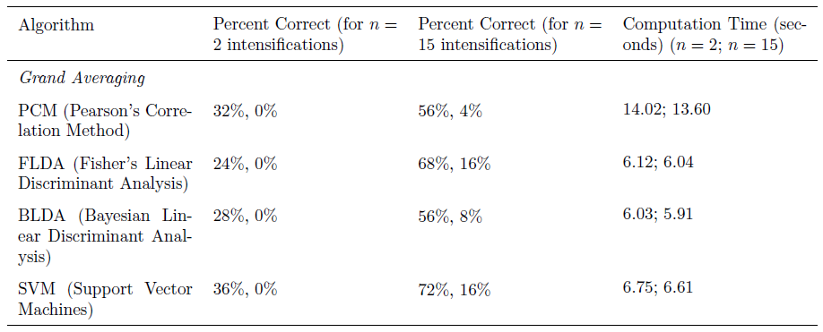
Bci dataset

Slide 30
Emotiv epoc
Connected and tested EPOC
Recorded 23 seconds of brain data
Installed OpenViBE
Currently working on OpenViBE P300 program implementation and COM port emulator for exporting of event tags

Slide 31
Presentation overview
Background
EEG processing
Goals
Methodology
Data collection/processing
Preliminary work
Proposed work

Slide 32
7.) Proposed work
Complete simulations with BCI dataset (evaluate all combinations of algorithms on both subjects)
Obtain P300 data using the Emotiv EPOC and subject acquired data to the same analysis as the BCI data
Test experimental hypothesis and establish a rejection threshold based on experimental results (e.g., can safely eliminate 25% of unlikely rows and columns after two rounds of intensifications)

Slide 33
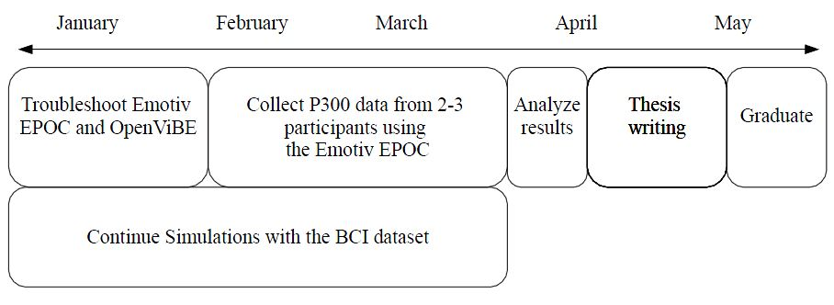
TimeLine

