Slide 1
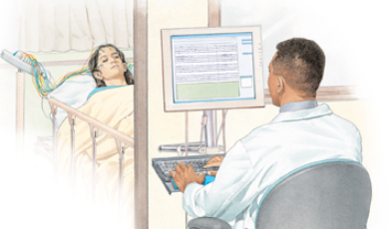
Automated Identification of Abnormal Adult EEGs
Silvia López de Diego
Neural Engineering Data Consortium
College of Engineering Temple University
Philadelphia, Pennsylvania, USA

Slide 2
Abstract
Interpretation of an EEG is a process that is still dependent on the subjective analysis of the examiner. The interrater agreement, even for relevant clinical events such as seizures, can be low. Even though the characteristics of a normal EEG are well defined, there are some factors, such as benign variants, that complicate this decision. However, neurologists can make this classification accurately by examining the initial portion of the signal. Therefore, in this thesis, we explore the hypothesis that high performance machine classification of an EEG signal as abnormal can approach human performance using only the first few minutes of an EEG recording.
The goal of this thesis is to establish a baseline for automated classification of abnormal adult EEGs using the TUH EEG Corpus. The data was partitioned into a training set (1,387 normal and 1,398 abnormal files), and an evaluation set (150 normal and 130 abnormal files). A system based on hidden Markov Models (HMMs) achieved an error rate of 26.1%. The addition of a Stacked Denoising Autoencoder (SdA) post-processing step (HMM-SdA) further decreased the error rate to 24.6%. The overall best result (21.2% error rate) was achieved by a deep learning system that combined a Convolutional Neural Network and a Multilayer Perceptron (CNN-MLP). Though performance still lags human performance (1% error rate for this task), we have established an experimental paradigm that can be used to explore this application and have demonstrated a promising baseline using state of the art deep learning technology.

Slide 3
Introduction

Slide 4
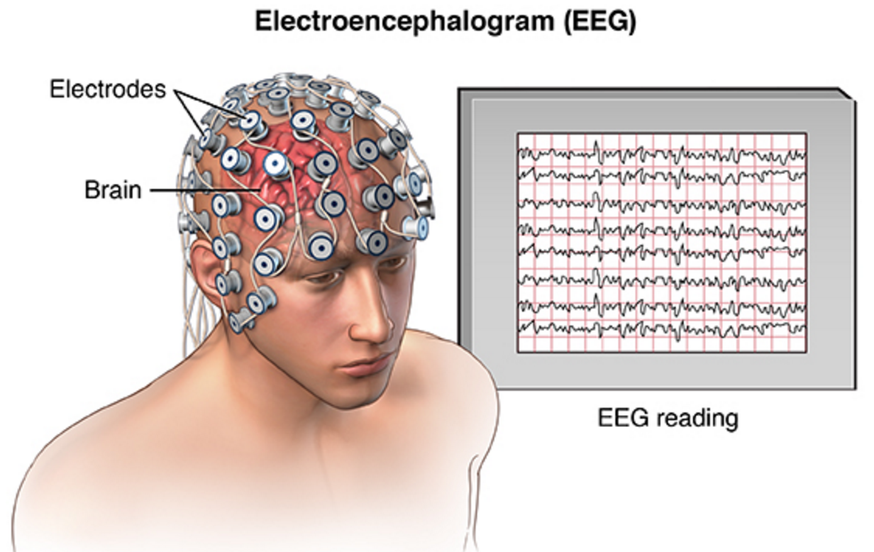
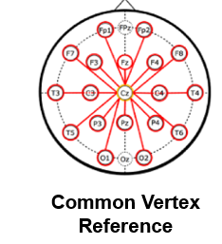
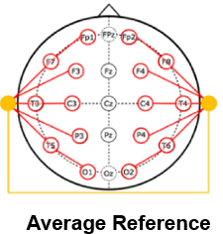
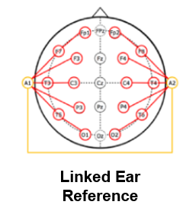
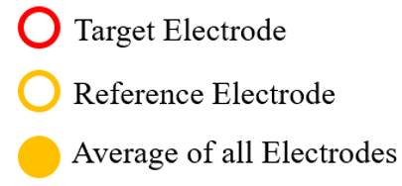
Electroencephalography (EEG)
Electroencephalography (EEG) refers to the recording of electrical activity along the scalp.
It is used to diagnose conditions such as sleep disorders and epilepsy
Because EEG is noninvasive and relatively cheap, it is still used despite the emergence of technologies such as Magnetic Resonance Imaging (MRI)

Slide 5
Manual Interpretation of EEGs
Manual interpretation of an EEG is performed by a board-certified neurologist. It takes several years to receive this certification.
Interrater agreement is low: the interpretation of an EEG depends somewhat on the training and subjective judgement of the examiner.
Increasing the interrater agreement for EEG interpretation is one of the advantages of an automated technique.
Patient Preparation
EEG Recording
EEG ranging from 22 minutes to several days is recorded
EEG is Interpreted
Certified physicians interpret EEG
Patients are prepared for the test
EEG Report is Produced
Report of findings (e.g. abnormality) is prepared

Slide 6
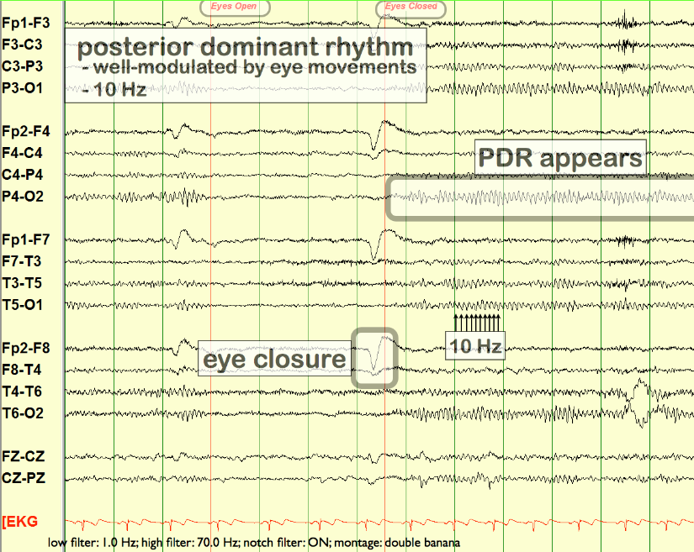
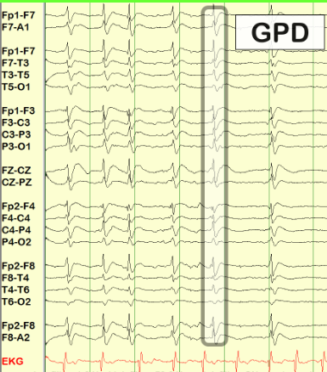
Manual Interpretation of EEGs
The EEG interpretation task can be subdivided into two tasks:
Recognition of transients: Events that include pathological and physiological waveforms, such as spike and sharp wave discharges
Analysis of background: General characteristics present in all EEG recordings that are usually observed when making a normal/abnormal classification
Example of EEG Background
Example of EEG Transient

Slide 7
Normal EEG Characteristics
The main characteristics of a normal EEG are the following:
Reactivity: Response to certain physiological changes or provocations.
Alpha Rhythm: Waves originated in the occipital lobe (predominantly), between 8-13 Hz and 15 to 45 μV.
Mu Rhythm: Central rhythm of alpha activity commonly between 8-10 Hz visible in 17% to 19% of adults.
Beta Activity: Activities in the frequency bands of 18-25 Hz, 14-16 Hz and 35-40 Hz.
Theta Activity: Traces of 6-7 Hz activity present in the frontal or frontocentral regions of the brain.

Slide 8
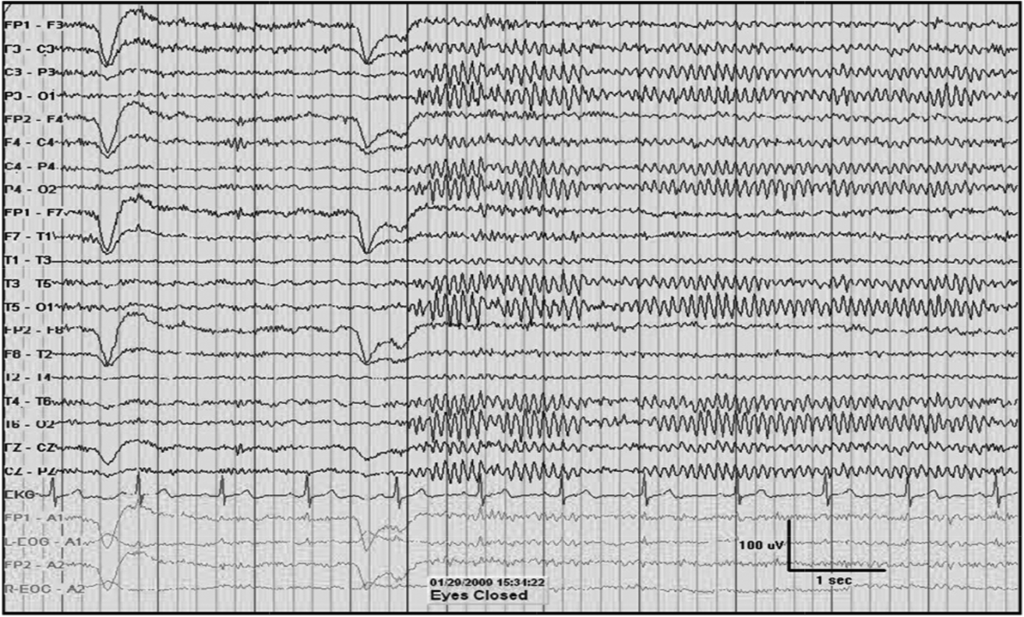
Normal EEG Characteristics

Slide 9
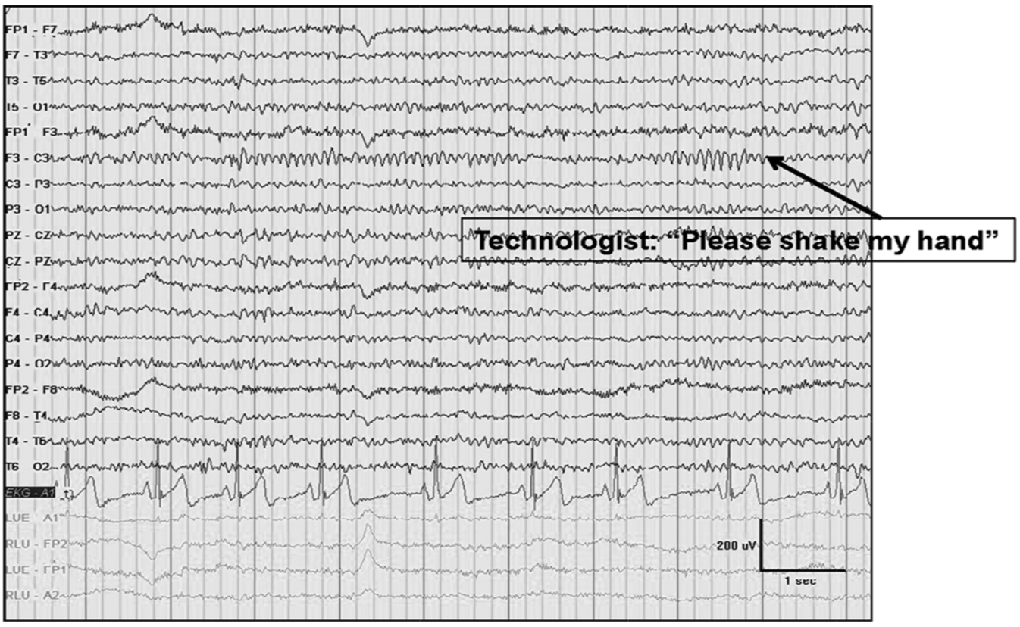
Normal EEG Characteristics

Slide 10
Normal EEG Characteristics
The main characteristics of a normal EEG are the following:
Reactivity: Response to certain physiological changes or provocations.
Alpha Rhythm: Waves originated in the occipital lobe (predominantly), between 8-13 Hz and 15 to 45 μV.
Mu Rhythm: Central rhythm of alpha activity commonly between 8-10 Hz visible in 17% to 19% of adults.
Beta Activity: Activities in the frequency bands of 18-25 Hz, 14-16 Hz and 35-40 Hz.
Theta Activity: Traces of 6-7 Hz activity present in the frontal or frontocentral regions of the brain.

Slide 11
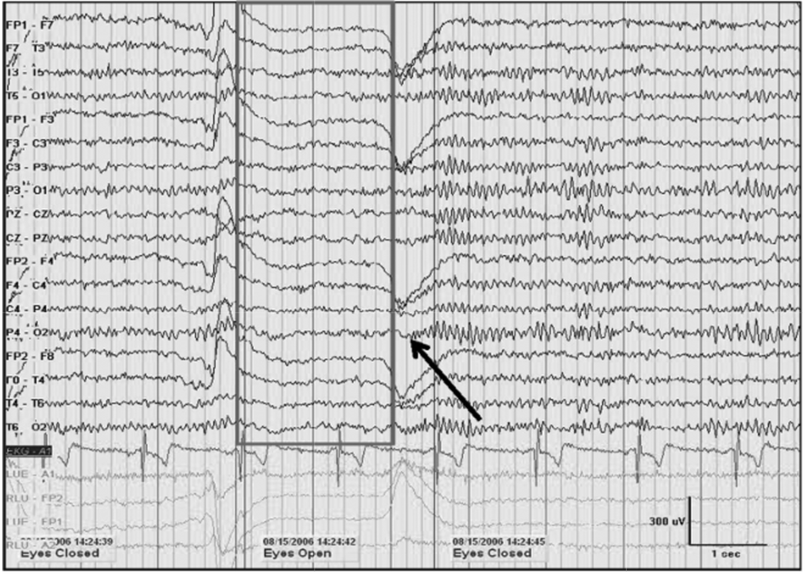

Slide 12
Normal EEG Characteristics
The main characteristics of a normal EEG are the following:
Reactivity: Response to certain physiological changes or provocations.
Alpha Rhythm: Waves originated in the occipital lobe (predominantly), between 8-13 Hz and 15 to 45 μV.
Mu Rhythm: Central rhythm of alpha activity commonly between 8-10 Hz visible in 17% to 19% of adults.
Beta Activity: Activities in the frequency bands of 18-25 Hz, 14-16 Hz and 35-40 Hz.
Theta Activity: Traces of 6-7 Hz activity present in the frontal or frontocentral regions of the brain.

Slide 13
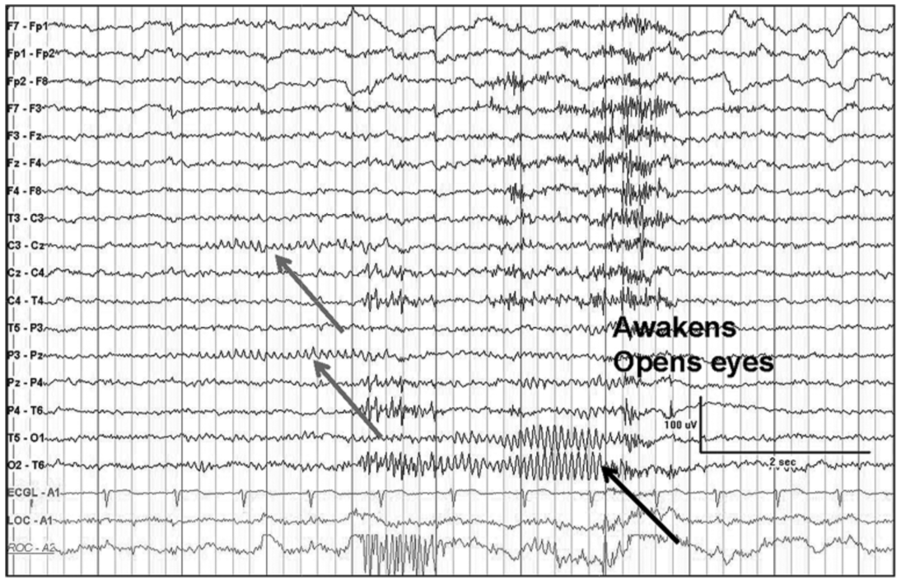
Normal EEG Characteristics

Slide 14
Normal EEG Characteristics
The main characteristics of a normal EEG are the following:
Reactivity: Response to certain physiological changes or provocations.
Alpha Rhythm: Waves originated in the occipital lobe (predominantly), between 8-13 Hz and 15 to 45 μV.
Mu Rhythm: Central rhythm of alpha activity commonly between 8-10 Hz visible in 17% to 19% of adults.
Beta Activity: Activities in the frequency bands of 18-25 Hz, 14-16 Hz and 35-40 Hz.
Theta Activity: Traces of 6-7 Hz activity present in the frontal or frontocentral regions of the brain.

Slide 15
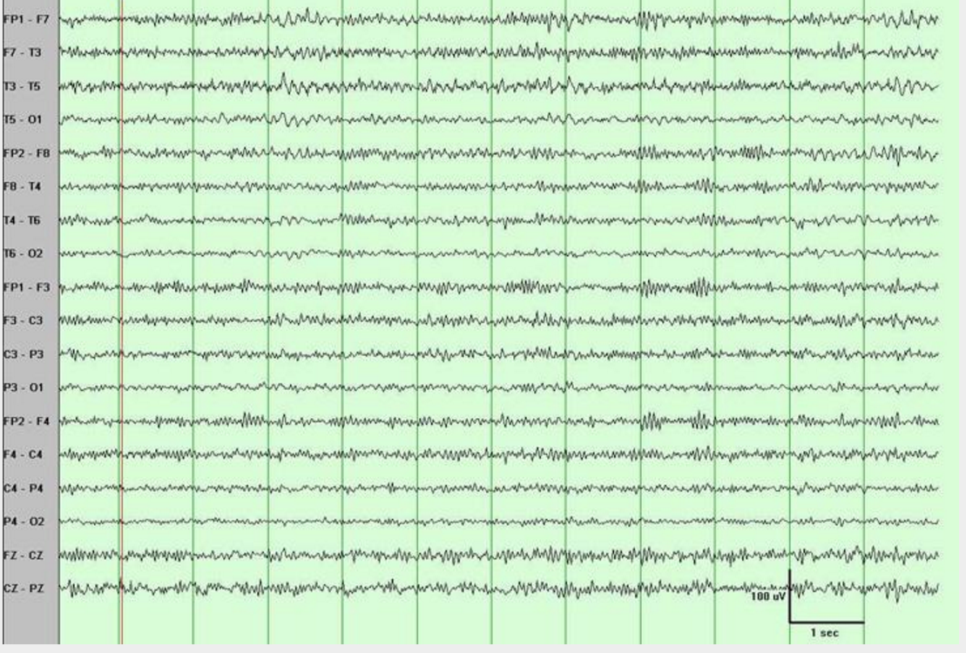
Normal EEG Characteristics

Slide 16
Normal EEG Characteristics
The main characteristics of a normal EEG are the following:
Reactivity: Response to certain physiological changes or provocations.
Alpha Rhythm: Waves originated in the occipital lobe (predominantly), between 8-13 Hz and 15 to 45 μV.
Mu Rhythm: Central rhythm of alpha activity commonly between 8-10 Hz visible in 17% to 19% of adults.
Beta Activity: Activities in the frequency bands of 18-25 Hz, 14-16 Hz and 35-40 Hz.
Theta Activity: Traces of 6-7 Hz activity present in the frontal or frontocentral regions of the brain.

Slide 17
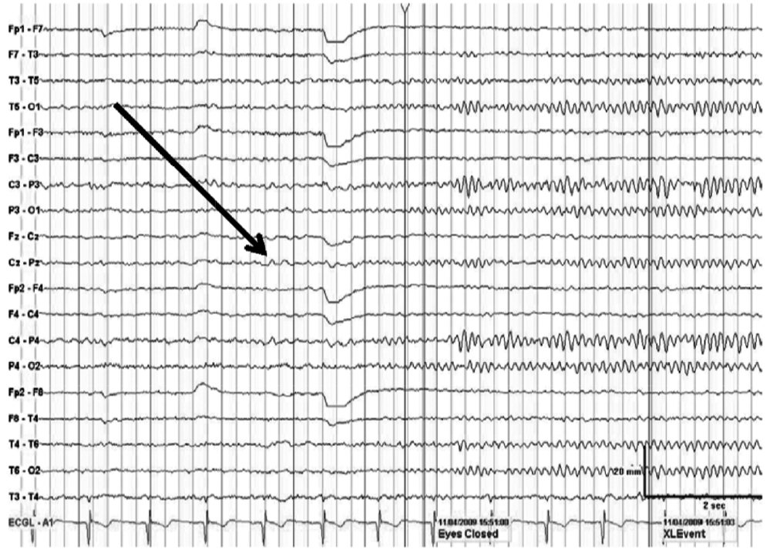
Normal EEG Characteristics

Slide 18
Normal EEG Characteristics
The main characteristics of a normal EEG are the following:
Reactivity: Response to certain physiological changes or provocations.
Alpha Rhythm: Waves originated in the occipital lobe (predominantly), between 8-13 Hz and 15 to 45 μV.
Mu Rhythm: Central rhythm of alpha activity commonly between 8-10 Hz visible in 17% to 19% of adults.
Beta Activity: Activities in the frequency bands of 18-25 Hz, 14-16 Hz and 35-40 Hz.
Theta Activity: Traces of 6-7 Hz activity present in the frontal or frontocentral regions of the brain.
The normal/abnormal classification depends heavily on the frequency, presence or distortion of this feature. Its emergence during the closed-eyes period is known as Posterior Dominant Rhythm (PDR).
We decided to focus on this characteristic.

Slide 19
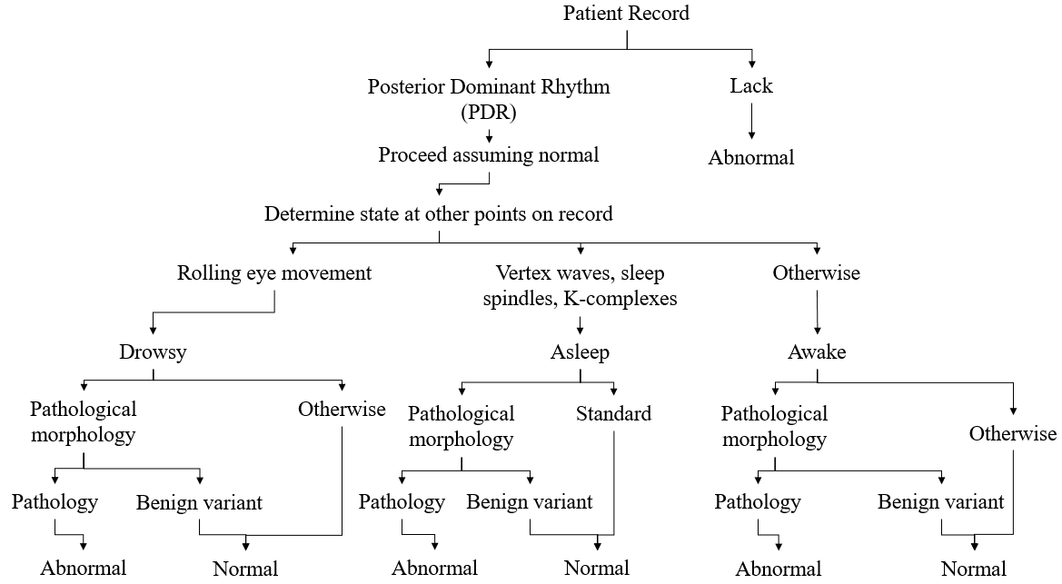
Abnormal EEG Classification

Slide 20
Automatic Abnormal EEG Classification
A general method for the classification of abnormal EEGs is a task that has not been extensively explored yet.
Previous studies have focused on the classification of very specific conditions, such as the classification of athletes with residual functional deficits after a concussion.
Most of these studies have not been conducted with clinical EEGs.
This study proposes the establishment of a general method that can be useful in a clinical setting such as a critical care unit.
To do this, the focus of the study will be the automatic analysis of the background EEG.
Output
Input
Model
Normal
Features
Abnormal

Slide 21
Background

Slide 22
A General Architecture
Output
Input
Model
Normal
Features
Abnormal
kNN
RF
HMM
Epoch-based HMM-SdA
Pilot Studies
Epoch-based HMM
CNN-MLP
Evaluated Systems

Slide 23
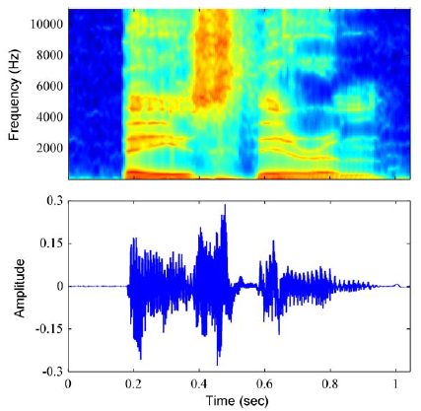
Classification of Sequential Data
EEGs, like speech signals, are the product of a physiological process that unfolds in time.
Machine learning approaches that treat the observations as i.i.d. would fail to exploit the sequential nature of the data.
This, added to the success that Hidden Markov Models (HMMs) have enjoyed in the area of speech recognition served as motivation for the selection of these models for the baseline system.

Slide 24
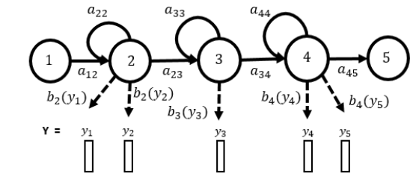
Hidden Markov Models (HMMs)
HMMs are a class of doubly stochastic processes in which discrete state sequences are modeled as Markov chains, but in this case, the system emits a visible observation, or symbol, in every state.
If $Y$ represents a sequence of feature vectors $Y=y_{1}, y_{2},…,y_{T}$, where $y_{t}$ is the vector observed at time $t$, and $w_{i}$ is the $i^{th}$ event in a dictionary, the problem becomes the finding of the most probable event:
$\hat{w}=$𝑎𝑟𝑔𝑚𝑎𝑥{𝑃(𝒀|𝒘)𝑃(𝒘)}

Slide 25
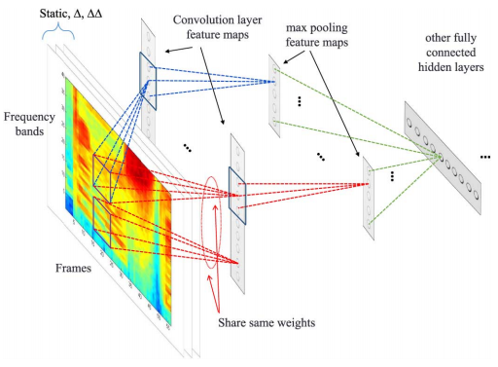
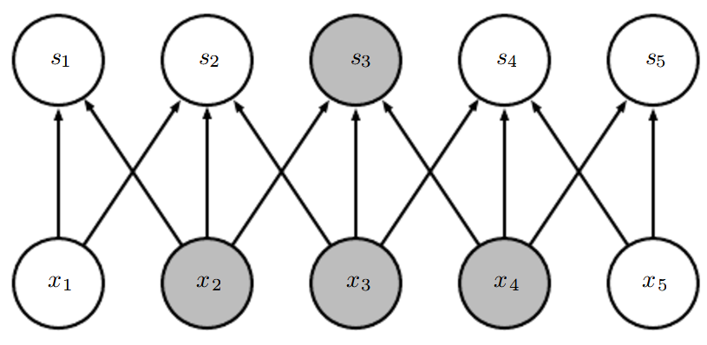
Deep Neural Networks (DNNs)
Advances in computer hardware and machine learning algorithms have facilitated the faster training of Deep Neural Networks (DNNs).
There have been a series of breakthroughs in the area of automatic speech recognition. Deep Learning has surpassed the performance of HMMs in several speech recognition tasks, such as Switchboard, in which the error rate was decreased to 6.9%.
For this task, an end-to-end Convolutional Neural Network (CNN) was implemented for EEG abnormal classification.
CNN Connectivity

Slide 26
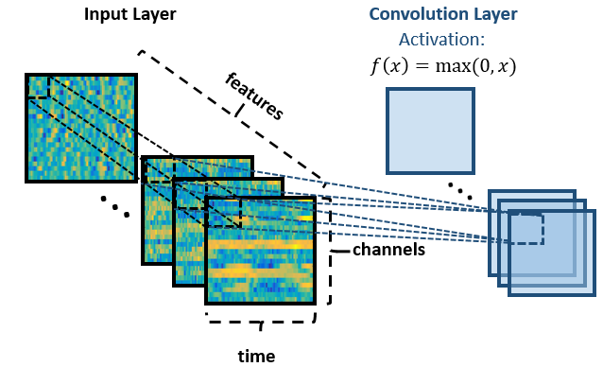
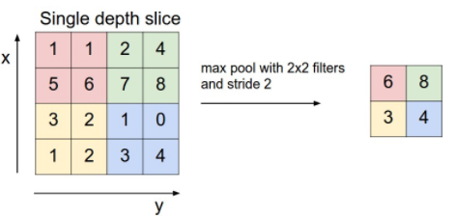
Advantages of CNNs for EEG Decoding
CNNs leverage sparse interactions and parameter sharing.
The locality in the units of convolutional layers allows more robustness against non-white noise. This translates into more robustness in the computation of feature maps for signals with many artifacts in selected frequency bands (e.g.: muscle artifact in beta and gamma ranges).
Pooling
Weight sharing allows the training of a more robust model. This, combined with pooling, minimizes the differences between input patterns when there are slight frequency shifts. In EEGs, these shifts could be the result of differences in patient ages.

Slide 27
Experimental Results

Slide 28
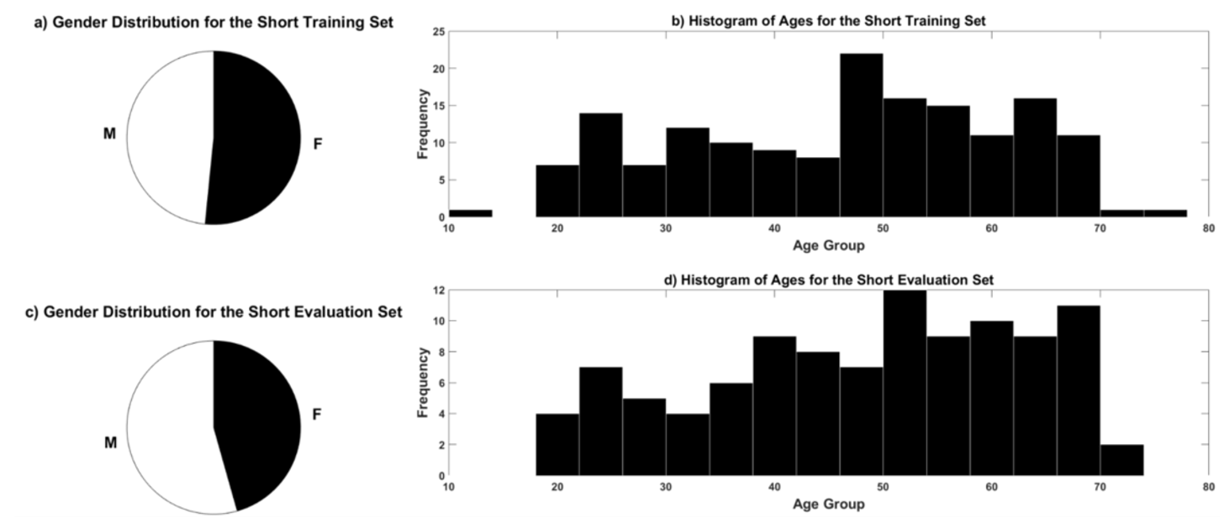
Data Preparation
The data used was a demographically balanced subset of the TUH EEG Corpus. A short and a full dataset were utilized:
Set | Normal | Abnormal
Training | 82 EEGs | 80 EEGs
Evaluation | 51 EEGs | 55 EEGs

Slide 29
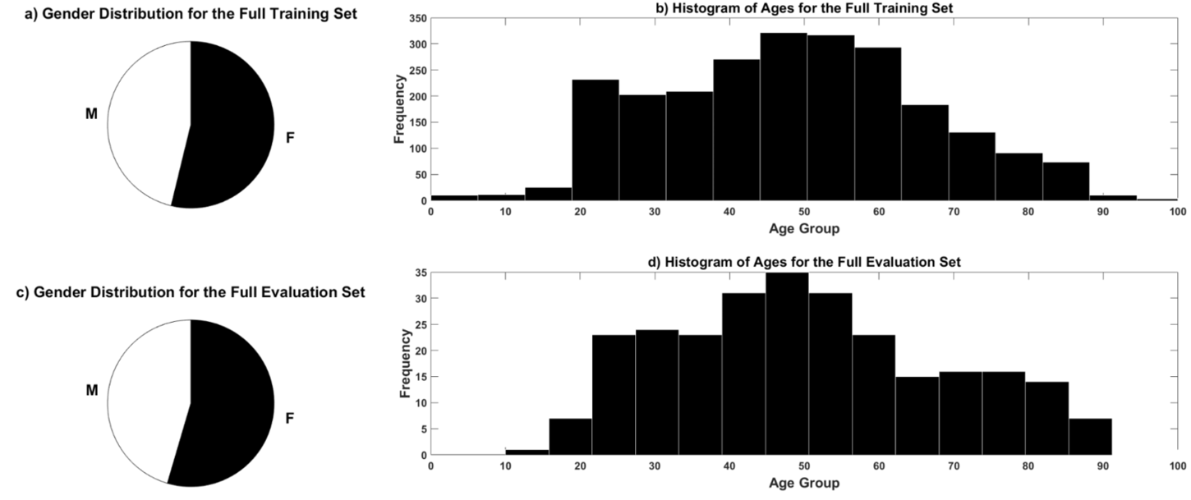
Data Preparation
The data used was a demographically balanced subset of the TUH EEG Corpus. A short and a full dataset were utilized:
Training
Description | Files |  | Patients |  | Hours
Abnormal | 1398 | 50.20% | 899 | 42.05% | 546.43
Normal | 1387 | 49.80% | 1239 | 57.95% | 518.29
Total | 2785 | 100.00% | 2138 | 100.00% | 1064.72
Evaluation
Description | Files |  | Patients |  | Hours
Abnormal | 130 | 46.43% | 105 | 41.50% | 48.98
Normal | 150 | 53.57% | 148 | 58.50% | 55.46
Total | 280 | 100.00% | 253 | 100.00% | 104.44

Slide 30
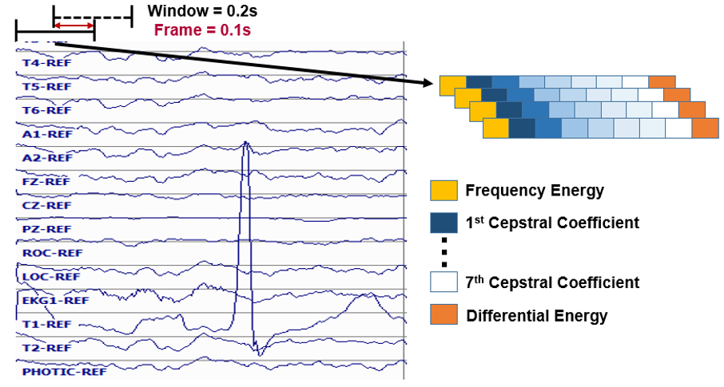
Feature Extraction

Slide 31
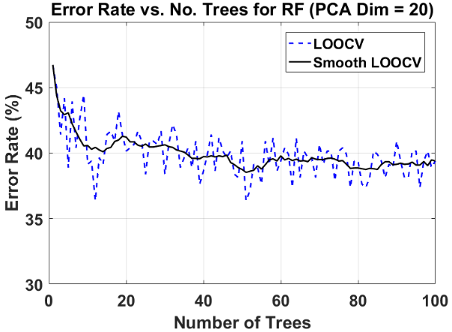
Random Forest and the Number of Trees
The performance of the systems higher than 20 trees are comparable to each other.
Taking performance and computational time for the classification into account, 50 trees was chosen for the rest of the experiments.

Slide 32
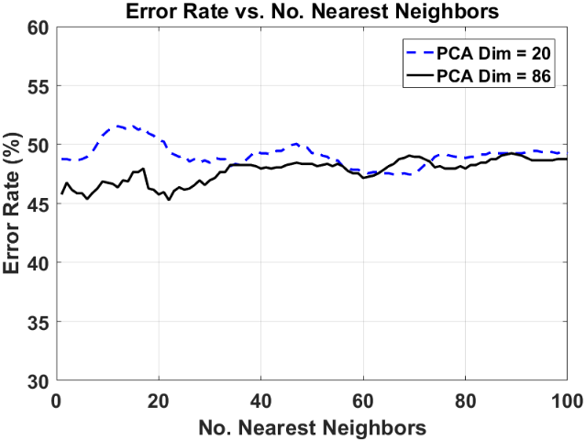
kNN: Tuning the System
The lowest k for the best operating interval was chosen.
This point corresponds to k = 20.

Slide 33
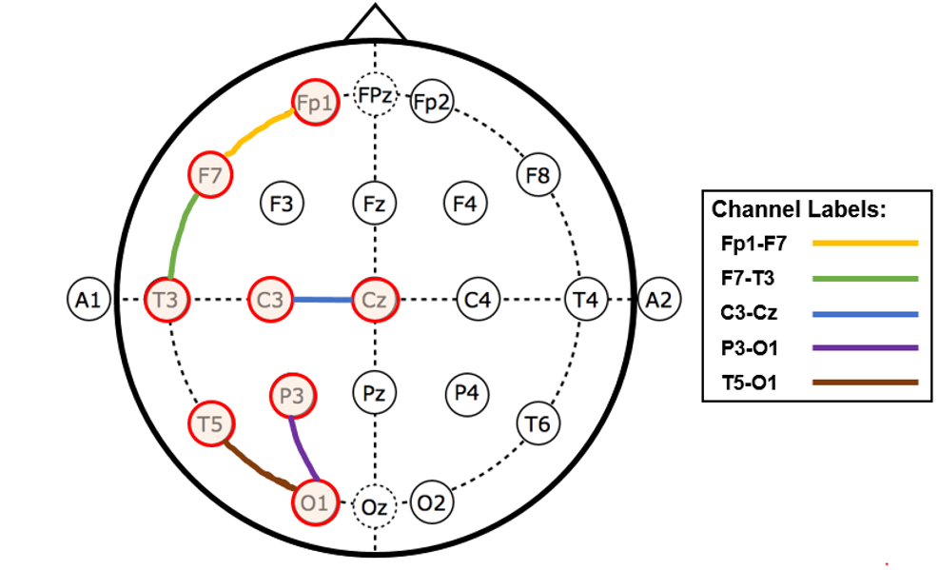
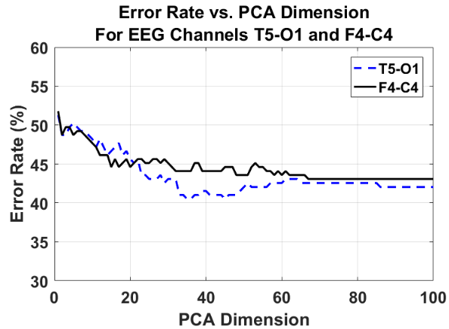
Channel Comparison
The system was evaluated for the highlighted channels.
The performance for the T5-O1 channel was better for all operating points with PCA dimensions higher than 20.
This correlates with the information learned from neurologists about their reliance on occipital channels for the classification of EEGs.

Slide 34
Summary of Pilot Studies
Error rates for the systems described thus far:
No. | System Description | Error
1 | kNN (k = 20) | 41.79%
3 | RF (Ntrees = 50) | 31.66%
Confusion Matrix for kNN:
Ref/Hyp | Normal | Abnormal
Normal | 50.49% | 49.50%
Abnormal | 34.00% | 66.00%

Slide 35
GMM-HMM Experiments
The optimized system was then tested with the same feature input as the pilot experiments for comparison.
The experiments can be summarized as follows:
Gaussian Mixture/HMM State Optimization (Short Dataset)
Signal Input Analysis (Short Dataset)
Channel Analysis (Short Dataset)
The implemented systems can be summarized as follows:
HMM
Epoch-Based-HMM-Majority Vote
Epoch-Based-HMM-SdA

Slide 36
GMM-HMM Optimization
Gaussian Mixture/HMM State Analysis Results:
# Gaussian Mixtures | # HMM States | Error Rate(%)
1 | 1 | 30.20%
1 | 2 | 34.90%
1 | 3 | 34.90%
2 | 1 | 23.60%
2 | 2 | 19.80%
2 | 3 | 22.60%
3 | 1 | 23.60%
3 | 2 | 17.90%
3 | 3 | 17.00%
4 | 1 | 17.90%
4 | 2 | 35.90%
4 | 3 | 22.60%

Slide 37
GMM-HMM Experiments: GM/HMM Analysis
Signal Input Analysis Results:
Input (min) | #Gaussians/#HMM States | Error Rate(%)
5 | 3/3 | 19.80%
10 | 3/3 | 17.00%
15 | 3/3 | 19.80%
20 | 3/3 | 20.80%
25 | 3/3 | 23.60%
Channel Analysis Results:
#Gaussians/#HMM States | Channel | Error Rate (%)
3/3 | Fp1-F7 | 35.85%
3/3 | T5-O1 | 17.00%
3/3 | F7-T3 | 23.59%
3/3 | C3-Cz | 18.87%
3/3 | P3-O1 | 20.76%

Slide 38
GMM-HMM Full Dataset Results
When the optimized system was tested on the full dataset, the error rate increased, as expected.
This shows that the pure HMM model has difficulty modeling this type of data.
Confusion Matrix for Epoch-Based HMM-SdA:
Ref/Hyp | Normal | Abnormal
Normal | 90.00% | 10.00%
Abnormal | 37.70% | 62.30%
Two epoch-based systems were developed to evaluate the impact of decoding of 1-second epochs.
The HMM-SdA system delivered the best performance out of the three systems, but still classified a large number of normal records as abnormal.
Summary of HMM Full Database Results:
System Description | Error Rate (%)
GMM-HMM (#GM = 3 #HMM States = 3) | 26.10%
Epoch-Based HMM-Majority Vote | 24.55%
Epoch-Based HMM-SdA | 22.14%

Slide 39
CNN-MLP: System Description
For simplicity, we define a convolutional layer ($L_{x}$) as:
2D Convolutional layer with ReLU activation
2D Convolutional layer with ReLU activation
Maxpooling (2, 2)
Dropout (25%)
We define a Fully connected layer ($F$) as:
Flattening Layer
Fully Connected MLP with ReLU activation
Dropout (50%)
Fully Connected MLP with Softmax activation

Slide 40
CNN-MLP: Network Depth Analysis
The shallowest network showed the worst classification error rate.
After 3 layers, the performance of the system started decreasing.
These results justify the use of deep networks for the abnormal EEG classification problem, but confirm that increasing the complexity of the model additionally requires more training samples.
A good compromise between complexity of the model and number of data samples was found for a network configuration with 3 convolutional layers.
Configuration | # Convolutional Layers | Error (%)
$$L_{1}+F$$ | 1 | 53.41%
$$L_{1}+L_{2}+F$$ | 2 | 22.94%
$$L_{1}+L_{2}+L_{3}+F$$ | 3 | 21.15%
$$L_{1}+L_{2}+L_{3}+L_{4}+F$$ | 4 | 25.81%

Slide 41
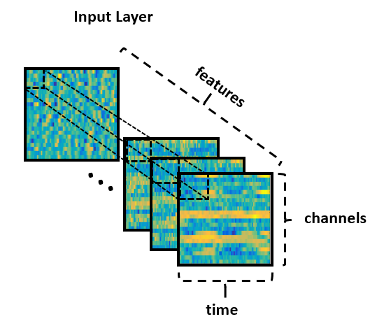
CNN-MLP: Window Duration Analysis
In practice, the analysis of EEGs is conducted through the observation of 10 seconds worth of data.
For the decoding of EEGs through a CNN, the best temporal resolution was achieved by feeding the system 7 seconds of data at a time.
Window Duration (secs) | # Convolutional Layers | Error (%)
3.0 | 3 | 55.53%
5.0 | 3 | 46.60%
7.0 | 3 | 21.15%
9.0 | 3 | 26.19%

Slide 42
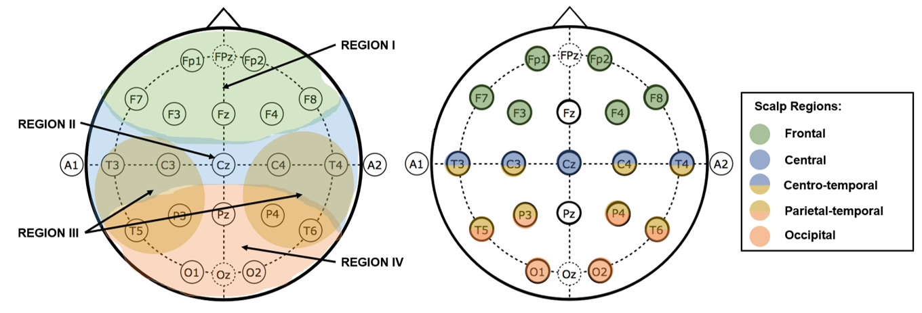
CNN-MLP: Locality Analysis
Features collected from the occipital region showed the best performance for deep learning.
Region | Channels | Error (%)
Region I | Fp1-F7, Fp1-F3, Fp2-F4, Fp2-F8 | 42.65%
Region II | T3-C3, C3-Cz, Cz-C4, C4-T4 | 30.11%
Region III | T3-T5, C3-P3, C4-P4, T4-T6 | 53.41%
Region IV | T5-O1, P3-O1, P4-O2, T6-O2 | 26.17%

Slide 43
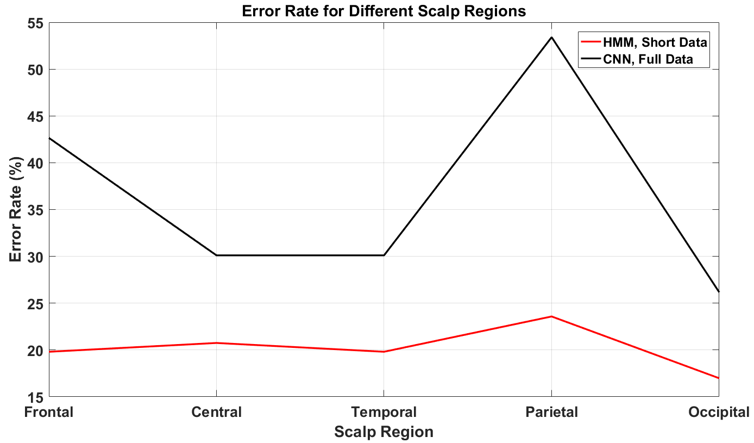
CNN-MLP: Locality Analysis

Slide 44
Summary of Results
System Description | Short Dataset Error (%) | Full Dataset Error (%)
kNN (k=20)* | 41.80 | N/A
RF (Nt=50)* | 31.70 | N/A
PCA-HMM #GM = 3 #HMM States = 3)* | 25.64 | 32.57
GMM-HMM (#GM = 3 #HMM States = 3)* | 16.98 | 26.07
Epoch-Based HMM-Majority Vote* | N/A | 24.55
Epoch-Based HMM-SdA* | N/A | 22.14
CNN-MLP** | N/A | 21.15
Note: * These systems operate with a single channel. ** This system operates with all EEG channels.

Slide 45
Conclusions and Future Work

Slide 46
Conclusions and Future Work
In this study we have shown that it is possible to automatically classify abnormal adult EEGs considering only the background information with an error rate of 21%.
CNN-MLP outperforms all HMM approaches for this task.
More complex systems operated better for this problem. However, they require a larger amount of training data.
The features that exhibited the most discriminative power for this task were the ones extracted from the occipital region of the scalp, which is consistent with the way in which specialized neurologists classify EEGs.
Since POSTS were one of the leading causes of confusion across models, identifying sleep state of the patient prior to classification would be good steps to reduce confusion and improve overall results.
Exploring hybrid HMM/deep learning algorithms, such as the ones that have been successful in acoustic modeling (LSTM-HMM) could introduce additional performance improvements.

Slide 47
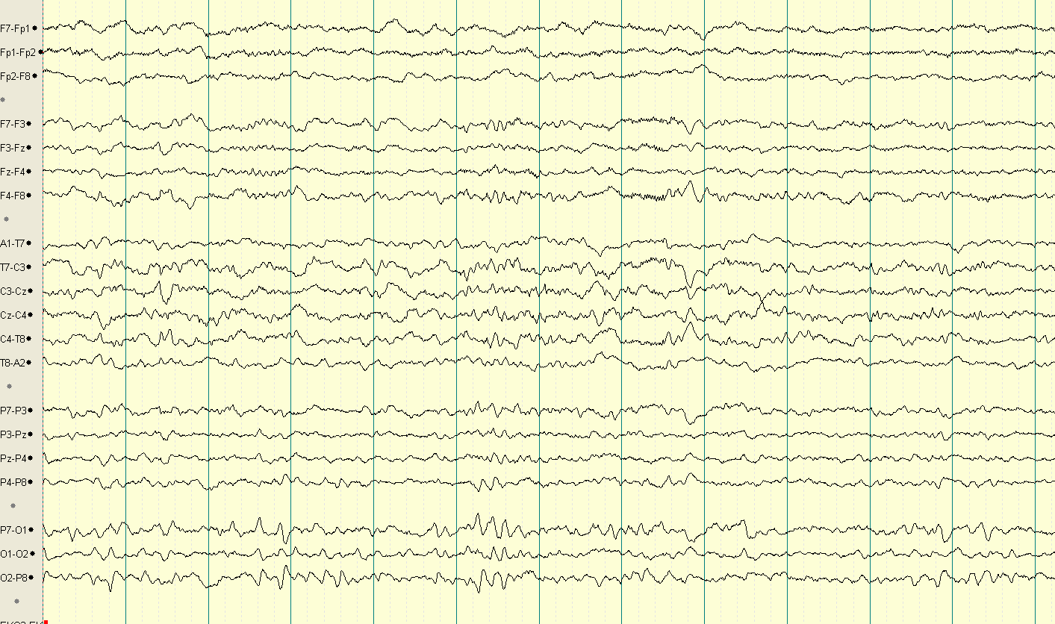
Conclusions and Future Work: Example
Normal
Abnormal

Slide 48
References
Azuma, H., Hori, S., Nakanishi, M., Fujimoto, S., Ichikawa, N., & Furukawa, T. A. (2003). An intervention to improve the interrater reliability of clinical EEG interpretations. Psychiatry and Clinical Neurosciences, 57(5), 485–489. http://doi.org/10.1046/j.1440-1819.2003.01152.x
Cao, C., Tutwiler, R. L., & Slobounov, S. (2008). Automatic classification of athletes with residual functional deficits following concussion by means of EEG signal using support vector machine. IEEE Transactions on Neural Systems & Rehabilitation Engineering, 16(4), 327–335. http://doi.org/10.1109/TNSRE.2008.918422
Ebersole, J. S., & Pedley, T. A. (2014). Current practice of clinical electroencephalography (4th ed.). Philadelphia, Pennsylvania, USA: Wolters Kluwer. Retrieved from http://www.amazon.com/Current-Practice-Clinical-Electroencephalography-Ebersole/dp/145113195X
Gales, M., & Young, S. (2007). The Application of Hidden Markov Models in Speech Recognition. Foundations and Trends® in Signal Processing, 1(3), 195–304. http://doi.org/10.1561/2000000004
Harati, A., Golmohammadi, M., Lopez, S., Obeid, I., & Picone, J. (2015). Improved EEG event classification using differential energy. In 2015 IEEE Signal Processing in Medicine and Biology Symposium (SPMB) (pp. 1–4). Philadelphia: IEEE. http://doi.org/10.1109/SPMB.2015.7405421
Harati, A., Lopez, S., Obeid, I., Jacobson, M., Tobochnik, S., & Picone, J. (2014). THE TUH EEG CORPUS: A Big Data Resource for Automated EEG Interpretation. In Proceedings of the IEEE Signal Processing in Medicine and Biology Symposium (pp. 1–5). Philadelphia, Pennsylvania, USA.
Lopez, S., Suarez, G., Jungries, D., Obeid, I., & Picone, J. (2015). Automated Identification of Abnormal EEGs. In IEEE Signal Processing in Medicine and Biology Symposium (pp. 1–4). Philadelphia, Pennsylvania, USA.
Goodfellow, I., Bengio, Y., & Courville, A. (2017). Deep Learning (1st ed.). Cambridge, MA, USA: MIT Press.
Sainath, T. N., Mohamed, A., Kingsbury, B., & Ramabhadran, B. (2013). Deep convolutional neural networks for LVCSR. In Proceedings of the IEEE International Conference on Acoustics, Speech and Signal Processing (pp. 8614–8618).

Slide 49
Biography: Silvia López de Diego
Silvia Lopez is currently an MS student in Temple University's Department of Electrical and Computer Engineering. Silvia earned a BS degree in Electrical engineering also from Temple University.
In 2013, she joined the Institute for Signal and Information Processing (ISIP) as an undergraduate research assistant, and contributed to the development of the TUH EEG Corpus, the largest publicly available clinical EEG database in the world. In 2015, she joined ISIP as a graduate research assistant to continue pursuing her interest in bioengineering applications of machine learning.
Silvia currently working on an NIH-funded project involving cohort retrieval of electronic medical records, and is developing technology for the automatic interpretation of EEG events.

Slide 50
Publications
Published:
Lopez, S., Gross, A., Yang, S., Golmohammadi, M., Obeid, I. & Picone, J. (2016). An Analysis of Two Common Reference Points for EEGs. IEEE Signal Processing in Medicine and Biology Symposium (pp. 1-4). Philadelphia, Pennsylvania, USA.
Yang, S., Lopez, S., Golmohammadi, M., Obeid, I., & J. Picone (2016). Semi-Automated Annotation of Signal Events in Clinical EEG Data. IEEE Signal Processing in Medicine and Biology Symposium (pp. 1-4). Philadelphia, Pennsylvania, USA.
Harati, A., Golmohammadi, M., Jacobson, M., Lopez, S., Obeid, I., Picone, J., & Tobochnik, S. (2016). Automatic Interpretation of EEGs for Clinical Decision Support. Proceedings of the American Clinical Neurophysiology Society (ACNS) Annual Meeting (p. 1). Orlando, Florida, USA.
Lopez, S., Suarez, G., Jungries, D., Obeid, I., & Picone, J. (2015). Automated Identification of Abnormal EEGs. IEEE Signal Processing in Medicine and Biology Symposium (pp. 1-4). Philadelphia, Pennsylvania, USA.
Golmohammadi, M., Lopez, S., Obeid, I., & Picone, J. (2015). EEG Event Detection on the TUH EEG Corpus. Big Data to Knowledge All Hands Grantee Meeting (p. 1). Bethesda, Maryland, USA.
Harati, A., Golmohammadi, M., Lopez, S., Obeid, I., & Picone, J. (2015). Improved EEG Event Classification Using Differential Energy. Proceedings of the IEEE Signal Processing in Medicine and Biology Symposium (pp. 1-4). Philadelphia, Pennsylvania, USA.
Harati, A., Lopez, S., Obeid, I., Jacobson, M., Tobochnik, S., & Picone, J. (2014). The TUH EEG CORPUS: A Big Data Resource for Automated EEG Interpretation. Proceedings of the IEEE Signal Processing in Medicine and Biology Symposium (pp. 1-5). Philadelphia, Pennsylvania, USA.
Submitted:
Golmohammadi, M., Ziyabari, S., Shah, V., Lopez, S., Obeid, I. & Picone, J. (2017). Deep Architectures for Automated Seizure Detection in Scalp EEGs. Advances in Neural Information Processing Systems.
Under Development:
Lopez, S., Picone, J. (2017). Convolutional Neural Networks for the Automated Interpretation of Abnormal Adult EEGs.
Lopez, S., Von Weltin, E., Ahsan, T., Capp, N., Obeid, I. & Picone, J. (2017). The TUH EEG Abnormal Corpus.
Shah, V., Lopez, S., Von Weltin, E., Obeid, I. & Picone, J. (2017). The TUH EEG Seizure Corpus: A Clinical Seizure Big Data Resource.

