Slide 1

Gesture Recognition in Tennis Biomechanics
A Thesis Defense by
Victor Espinoza
Temple University
College of Engineering

Slide 2
Introduction
Neural Instrumentation Lab
Gesture Recognition
Recognizing human action and using it to as a computer input
Training an algorithm in recognizing biomechanical patterns vs training a human
Notes:
Shout out

Slide 3
Motivation
Tennis Teaching Software
  If an algorithm is capable of recognizing such patterns in movement, then it is possible replicate and teach in the future.
Rise of data science in sports
Statistical study of tennis technique in present time as the sport evolves

Slide 4
Objectives
The purpose of this study is to create a gesture recognition system that interprets motion capture data of a tennis player to determine which biomechanical aspects of a tennis swing best correlate to a swing efficacy.
Extract biomechanical features that are correlated to a tennis ball’s trajectory and design a machine learning will be able to predict the tennis ball's trajectory from body tracking data.
Notes:
Gesture recognition has been used for kinect games, sign language and

Slide 5
Background

Slide 6
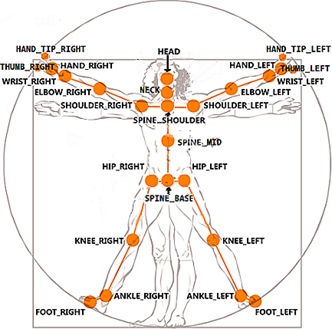
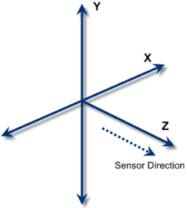
Microsoft Kinect v2
3 streams of data to track up to 6 bodies
Kinect ‘s Cartesian coordinates
25 joint centers
30 Hz

Slide 7
Kinect v2 cont’d
Low accuracy in feet and ankles
Marker-less approach will allow subjects to swing freely within sensor range (4m)
3 streams of data to track up to 6 human bodies
Humans do not require high accuracy to learn or teach biomechanical gestures
[1]

Slide 8
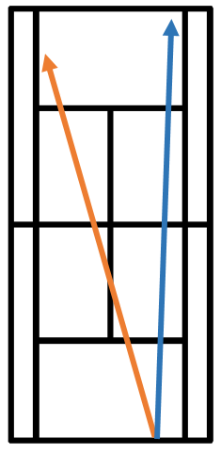
Tennis Baseline
This work covered the standard forehand tennis swing and its general trajectories
Forehand- cross court (orange) down the line (blue)

Slide 9
Methods

Slide 10
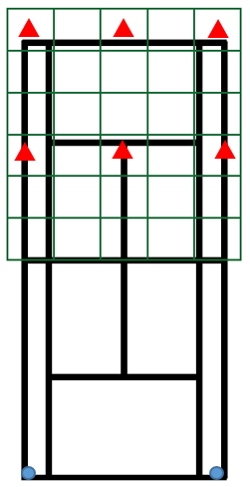
Protocol Design
Recruit healthy tennis athletes
All genders
Lefty or Righty
Grid to manually annotate record all resulting trajectories
Forehand
  6 targets (red), 10 attempts each
  Kinect(blue) will be recording while the subject faces the sensor
  Normalized topspin grip

Slide 11
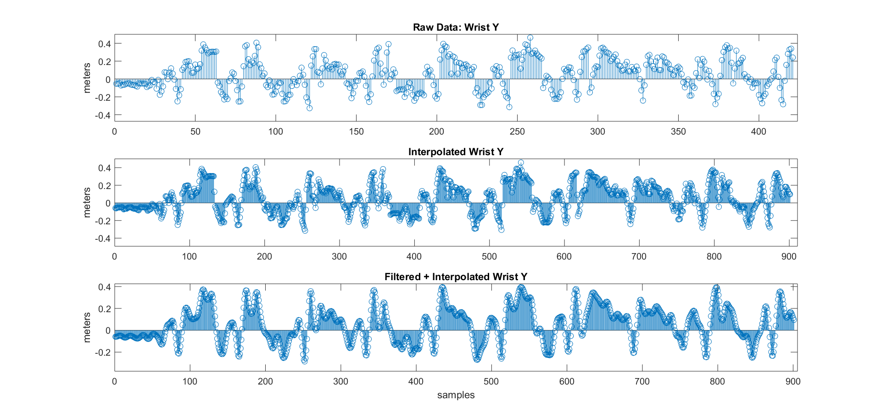
Signal Processing
The Kinect’s frame rate can fluctuate below the advertised 30 fps. This variable frame rate is not controllable by the user and mainly relies on the hardware components of the sensor and the user’s computer resources.
In order to compensate for frame rate fluctuation, raw skeletal tracking data will be interpolated and filtered
Algorithms designed in this work classifies recorded skeletal tracking data.

Slide 12
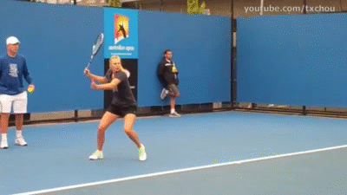
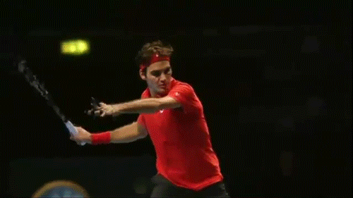
Swing Variance
Notes:
Swings vary in length / speed and technique

Slide 13
Swing Window
Dominant- side hand Y component
Different swing speeds across subject
Input = 25x 3x Swing window

Slide 14
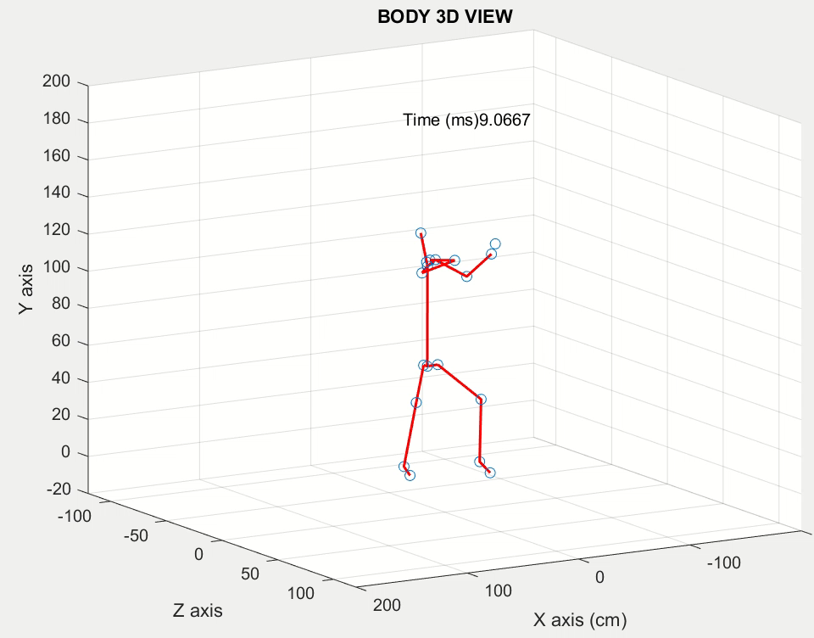
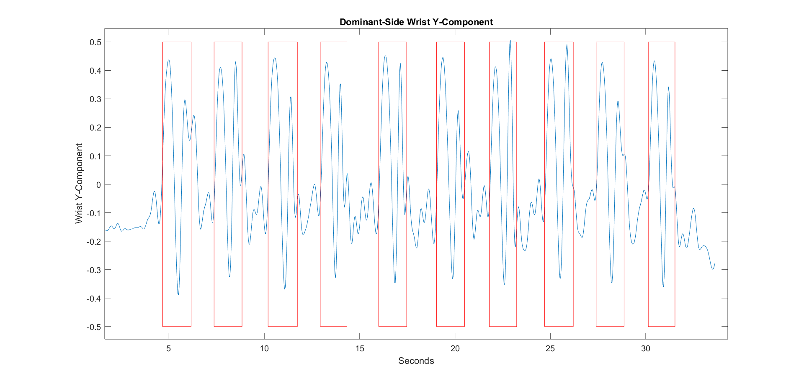
Swing Window (cont’d)

Slide 15
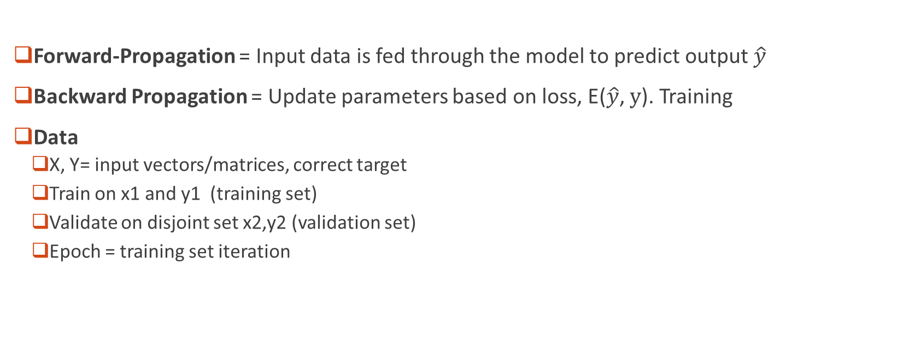
Deep Learning Introduction
Forward-Propagation = Input data is fed through the model to predict output $\hat{y}$
Backward Propagation = Update parameters based on loss, E($\hat{y}$, $y$). Training
Data
  X, Y= input vectors/matrices, correct target
  Train on x1 and y1 (training set)
  Validate on disjoint set x2,y2 (validation set)
  Epoch = training set iteration

Slide 16
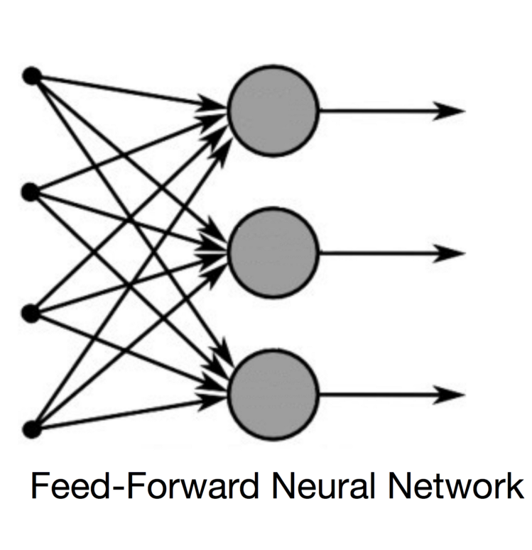
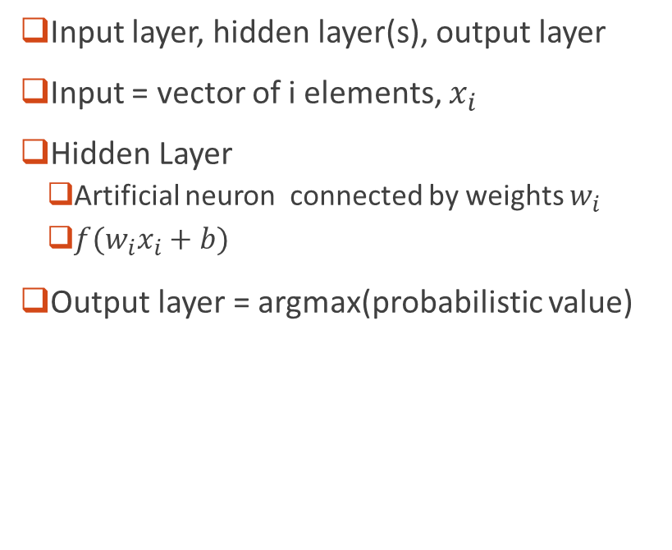


Feed-Forward Neural Network
Input layer, hidden layer(s), output layer
Input = vector of i elements, $x_{i}$
Hidden Layer
  Artificial neuron connected by weights $w_{i}$
  $f(w_{i}x_{i}+b)$
Output layer = argmax(probabilistic value)
$$x_{i}$$
$$w_{i}$$

Slide 17

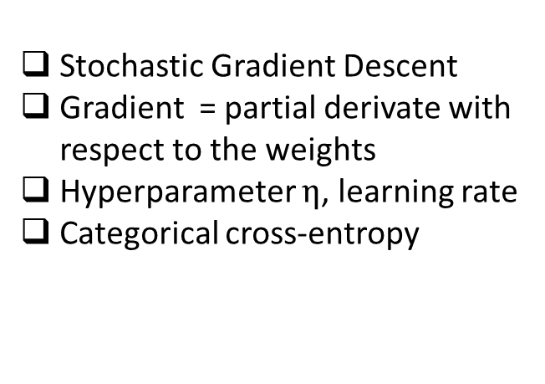
Training with SGD
$∇_{w}J\left(w\right) =\frac{d\left(L\left(y,\hat{y}\right)\right)}{dw}$
$w=w−η∇_{w}J\left(w\right)$
$L\left(y,\hat{y}\right)= \frac{1}{N}\sum_{i=0}^{N}{\sum_{j=0}^{J}{ylog⁡(\hat{y})}}$+$(1−y)log⁡(1−\hat{y})$
Stochastic Gradient Descent
Gradient = partial derivate with respect to the weights
Hyperparameter $η$, learning rate
Categorical cross-entropy
Notes:
J output nodes

Slide 18
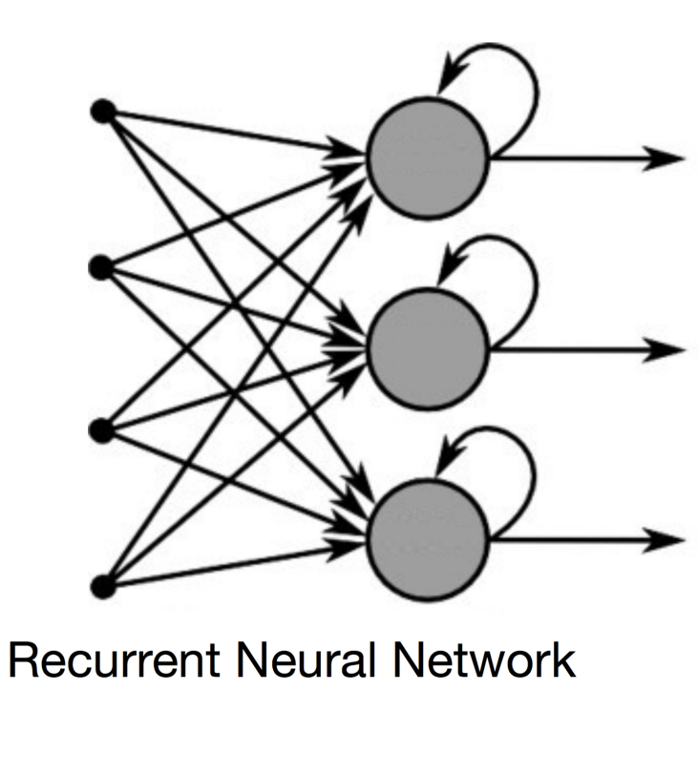
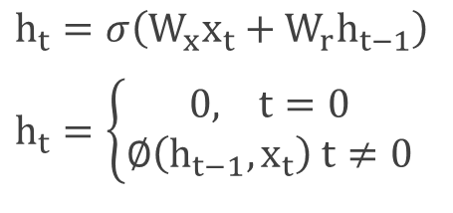
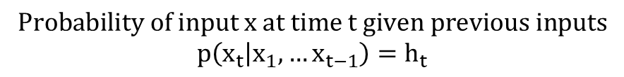
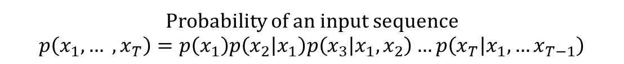
Recurrent Neural Networks
$h_{t}=σ\left(W_{x}x_{t}+W_{r}h_{t−1}\right)$
$h_{t}=\left\{\begin{aligned}0, t=0 \\ ∅\left(h_{t−1}, x_{t}\right) t≠0\end{aligned}\right.$
Probability of an input sequence
$$p\left(x_{1},… ,x_{T}\right)=p\left(x_{1}\right)p\left(x_{2} | x_{1}\right)p\left(x_{3} | x_{1},x_{2}\right)…p\left(x_{T} | x_{1},…x_{T−1}\right)$$
$$\text{Probability} \text{of} \text{input} \text{x} \text{at} \text{time} \text{t} \text{given} \text{previous} \text{inputs}$$
$$p\left(x_{t} | x_{1},…x_{t−1}\right)=h_{t}$$
Notes:
Prob of a seq = p(x1)p(x2|x1)p(x3|x1,x2), used in sequence modeling

Slide 19

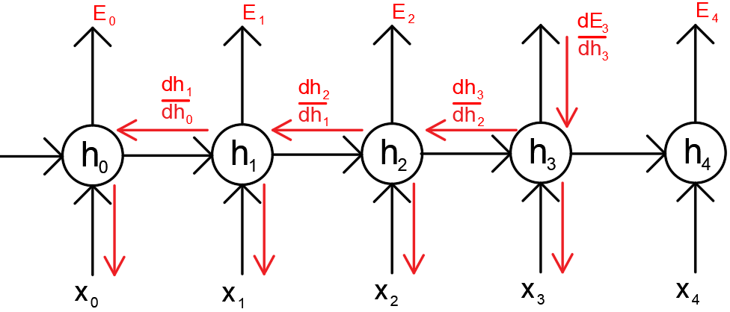
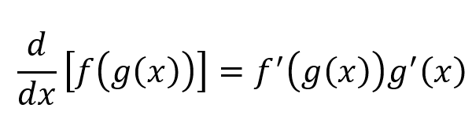
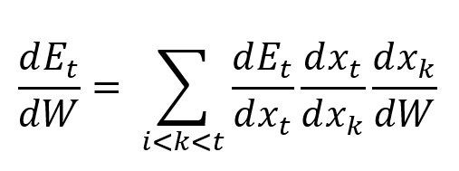
Back Propagation Through Time (BPTT)
The gradient of the sequence becomes
1. Exploding Gradient
2. Vanishing Gradient
Notes:
Error at t =3 is a function of x3 and its activation. Which is a function of the previous time step.

Slide 20
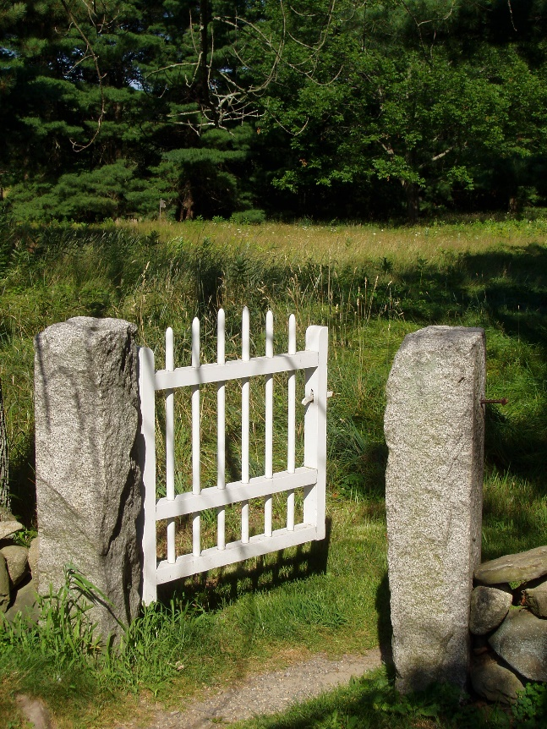
Gate-Augmented Approaches
Add a set of parameters and differentiable non-linearities
More selective overwriting the activation
Learn Longer temporal dependencies
More expensive to train due to more trainable parameters

Slide 21
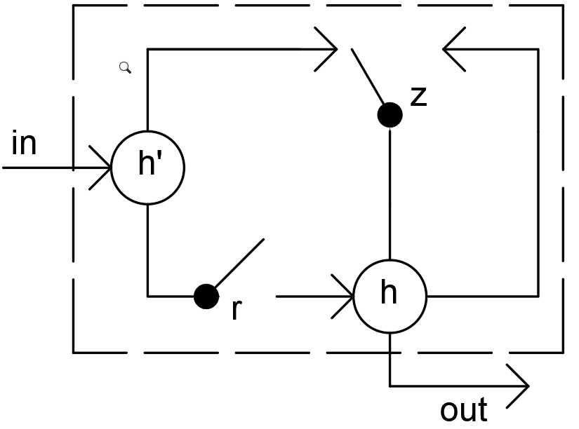
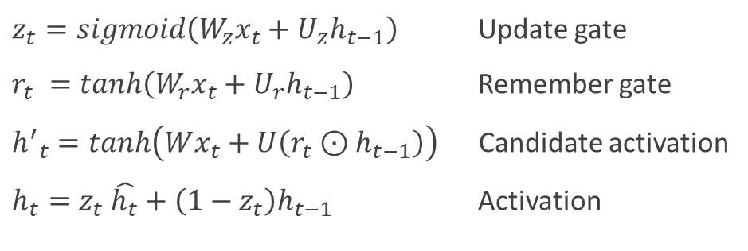
Gated Recurrent Units (GRU)
$z_{t}=sigmoid\left(W_{z}x_{t}+U_{z}h_{t−1}\right)$ Update gate
$r_{t} =\tanh\left(W_{r}x_{t}+U_{r}h_{t−1}\right)$ Remember gate
${h^{′}}_{t}=\tanh\left(Wx_{t}+U\left(r_{t}⊙h_{t−1}\right)\right)$ Candidate activation
$h_{t}=z_{t} \hat{h_{t}}+\left(1−z_{t}\right)h_{t−1}$ Activation
Notes:
New memory candidate c^
Reset gate r says how important is h_t-
Update gate z_t = how much of h_t-1 is important
Hidden state h_t = func of old h_t -1and new h’_t

Slide 22
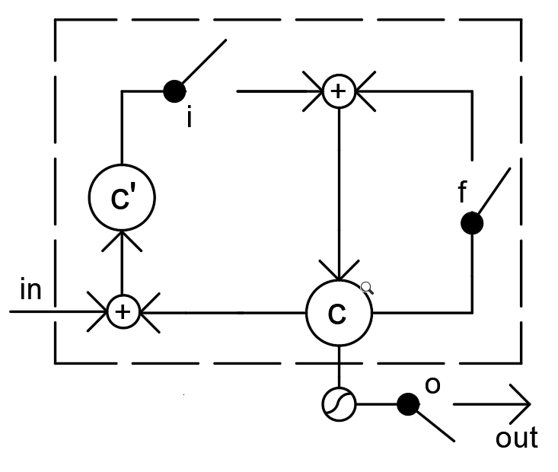
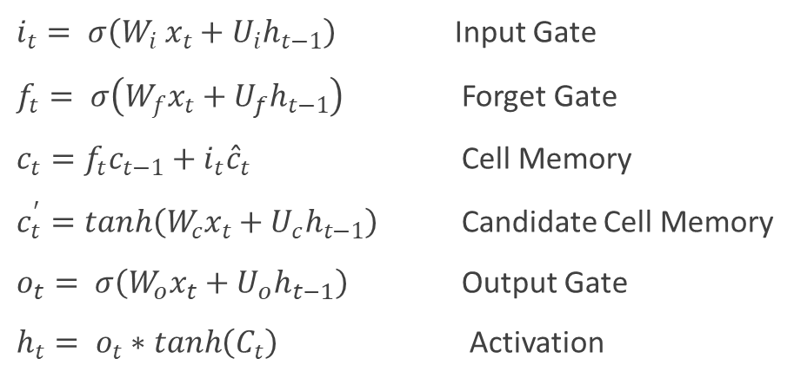
Long Short Term Memory (LSTM)
$i_{t}= σ\left(W_{i} x_{t}+U_{i}h_{t−1}\right)$ Input Gate
$f_{t}= σ\left(W_{f}x_{t}+U_{f}h_{t−1}\right)$ Forget Gate
$c_{t}=f_{t}c_{t−1}+i_{t}{\hat{c}}_{t}$ Cell Memory
$c_{t}^{′}=\tanh\left(W_{c}x_{t}+U_{c}h_{t−1}\right)$ Candidate Cell Memory
$o_{t}= σ\left(W_{o}x_{t}+U_{o}h_{t−1}\right)$ Output Gate
$h_{t}= o_{t}∗\tanh\left(C_{t}\right)$ Activation
Notes:
Input – does this new stuff matter?
Candidate memory = maybe, here it is
Forget gate= how much of old memory c_t-1 should be forgotten
Cell memory = input*candidate + forget*cell candidate
Output = how much of memory should we expose

Slide 23
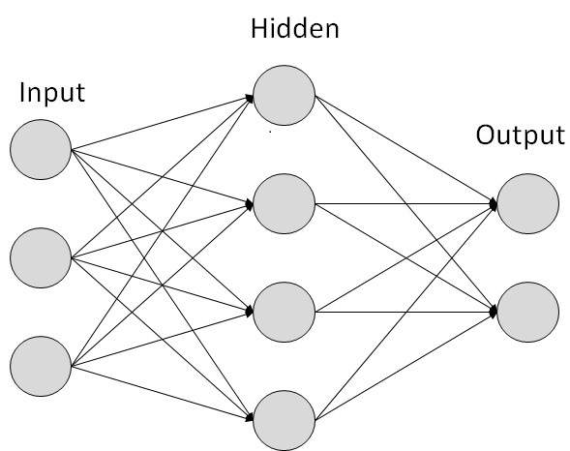
Three Models
Hidden Units = RNN, GRU, LSTM

Slide 24
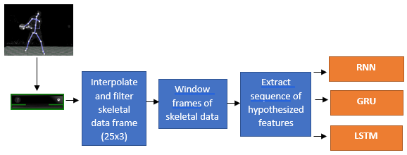
Work

Slide 25
Implementation

Slide 26
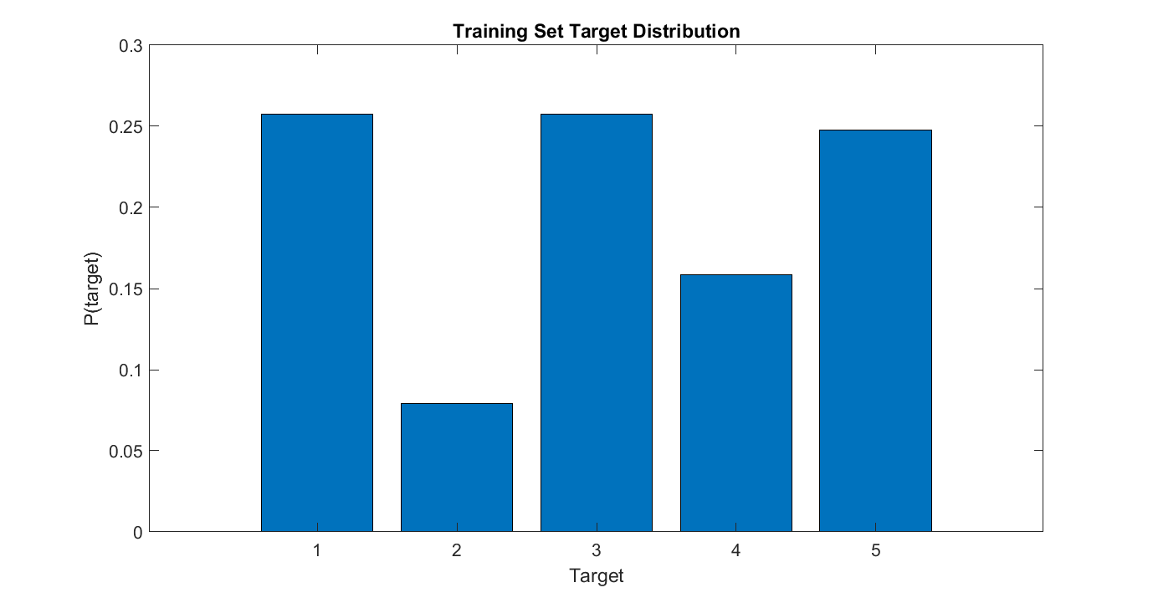
Training Data
14 subjects
14 righty
4:10 female to female subjects

Slide 27
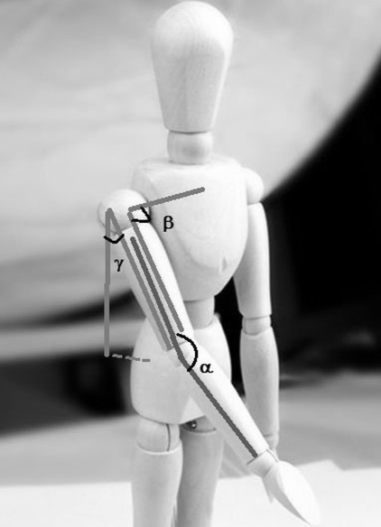
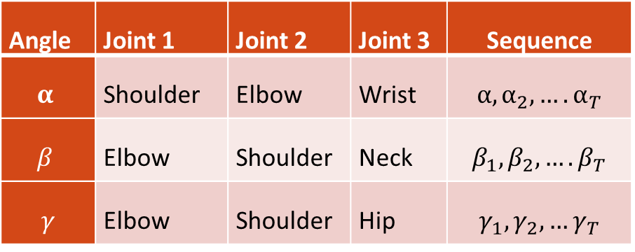
Hypothesized Features
Angle | Joint 1 | Joint 2 | Joint 3 | Sequence
$$α$$ | Shoulder | Elbow | Wrist | $$α, α_{2},….α_{T}$$
$$β$$ | Elbow | Shoulder | Neck | $$β_{1}, β_{2},….β_{T}$$
$$γ$$ | Elbow | Shoulder | Hip | $$γ_{1},γ_{2},…γ_{T}$$
[2]

Slide 28
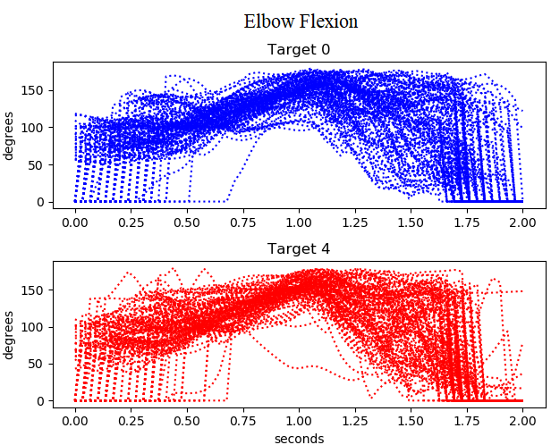
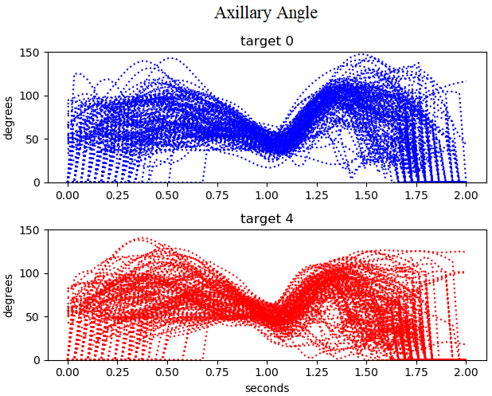
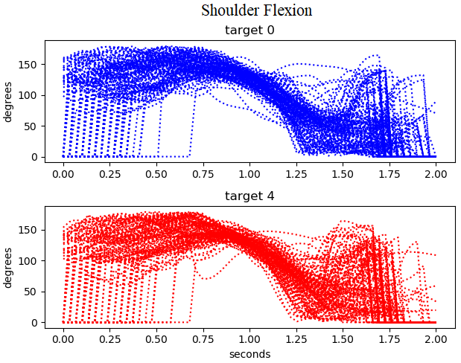
Hypothesized Features Visualization
α
β
ϒ
Notes:
SNM

Slide 29
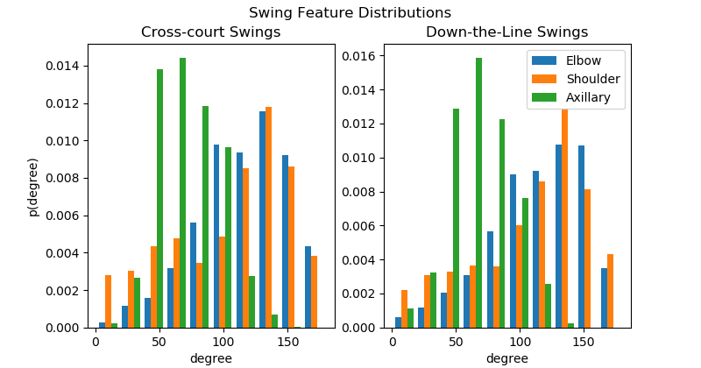
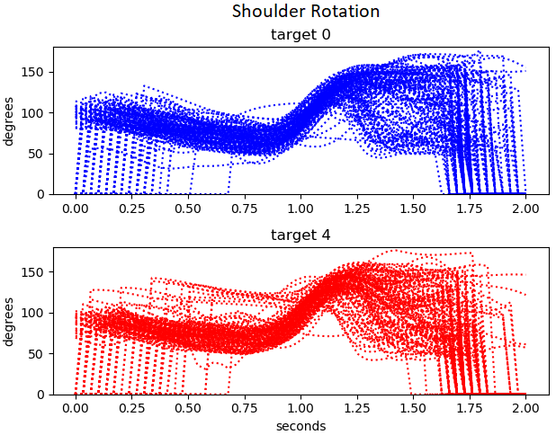
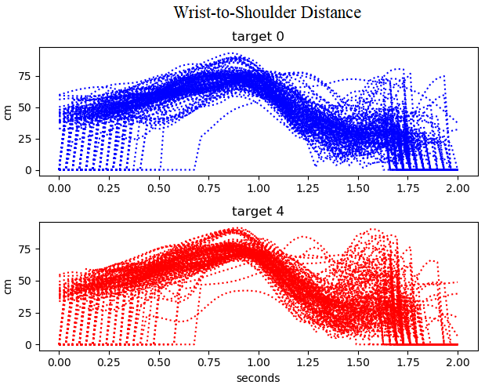
Hypothesized Features Visualization
Added more features

Slide 30
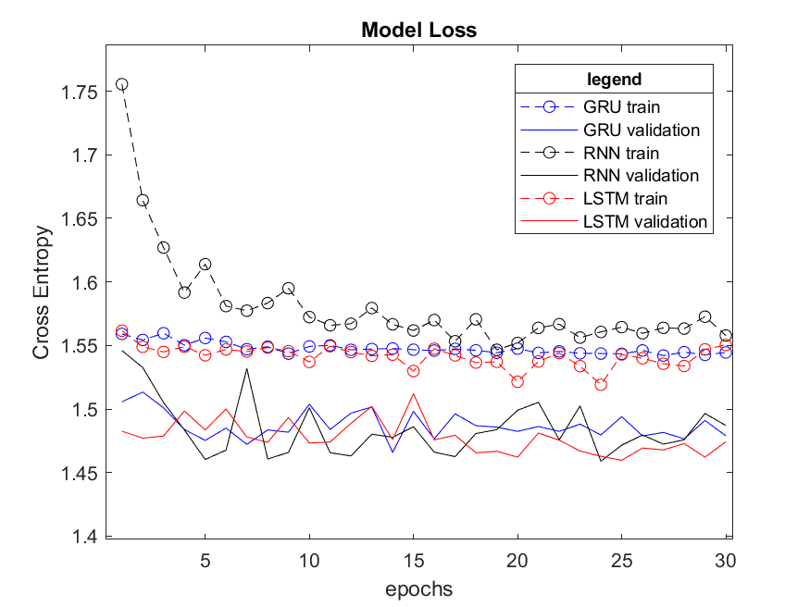
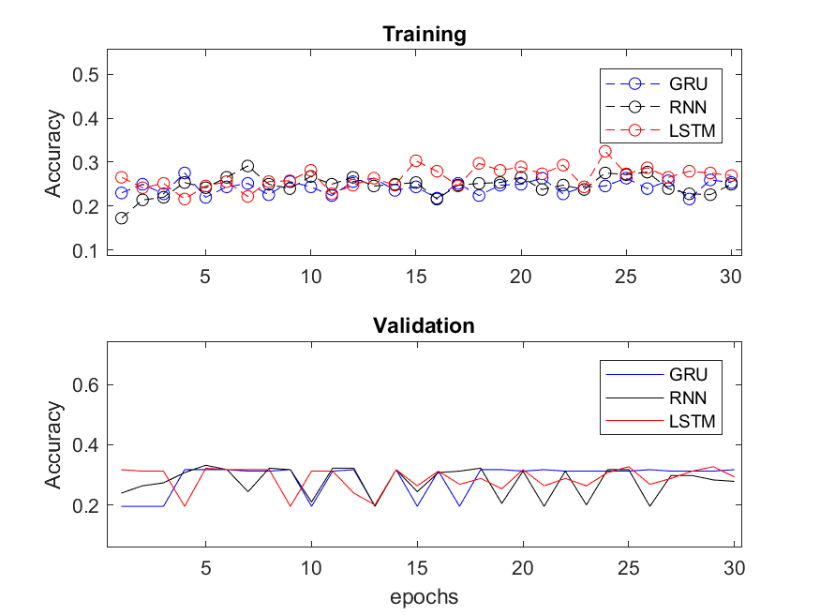
Results

Slide 31
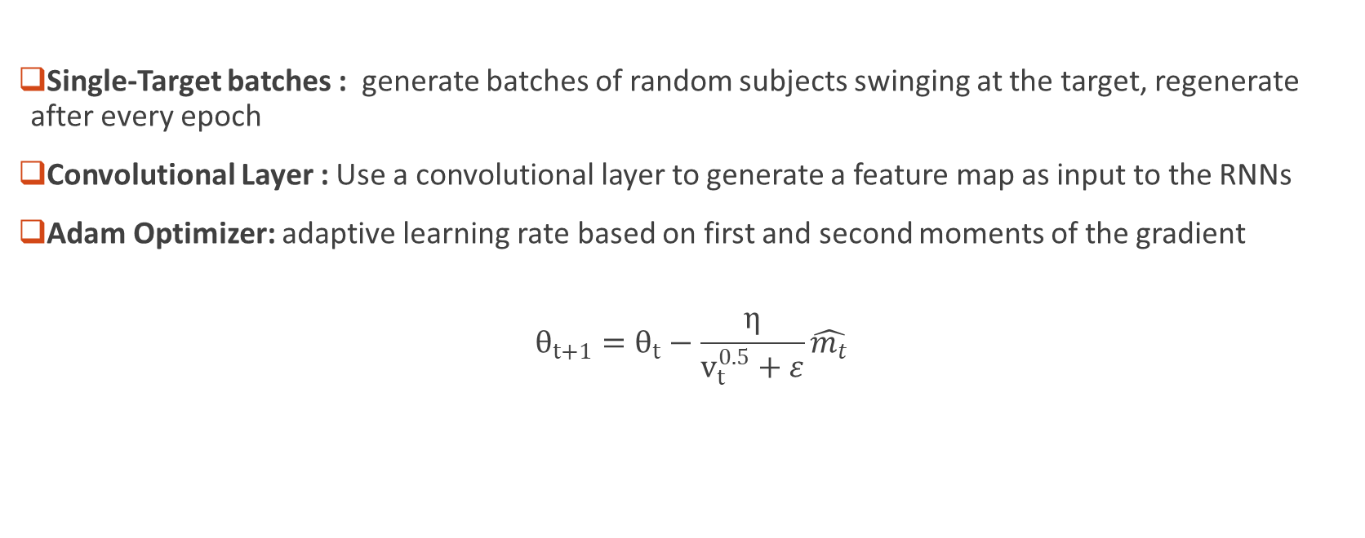
Optimization
Single-Target batches : generate batches of random subjects swinging at the target, regenerate after every epoch
Convolutional Layer : Use a convolutional layer to generate a feature map as input to the RNNs
Adam Optimizer: adaptive learning rate based on first and second moments of the gradient
$$θ_{t+1}=θ_{t}−\frac{η}{v_{t}^{0.5}+ε}\hat{m_{t}}$$
Notes:
Took a lot of different optimization methods.

Slide 32
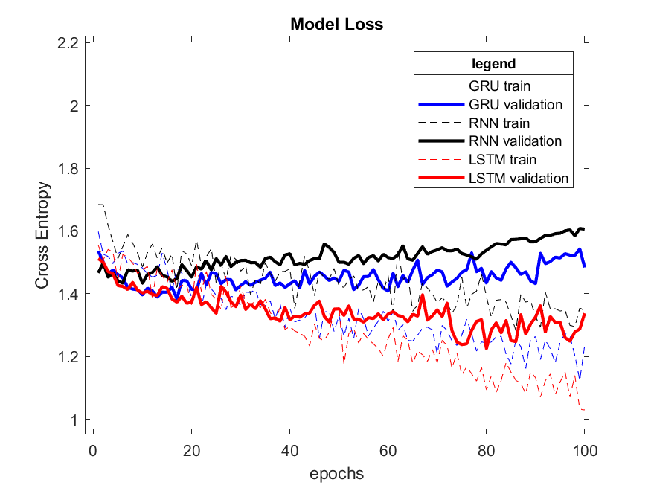
Loss Results

Slide 33
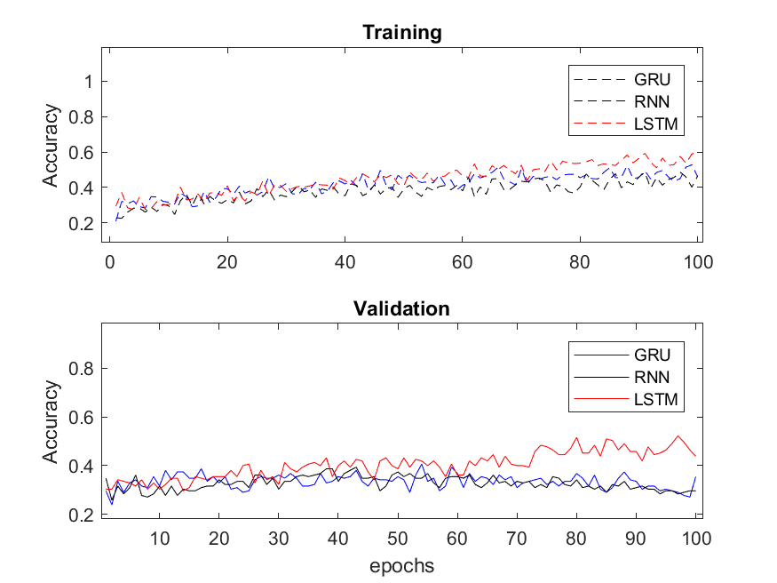
Accuracy Results

Slide 34
Results cont’d
1.30E+01 | 4.00E+00 | 2.30E+01 | 0.00E+00 | 7.00E+00
5.00E+00 | 0.00E+00 | 2.00E+00 | 0.00E+00 | 0.00E+00
1.30E+01 | 0.00E+00 | 1.90E+01 | 1.00E+00 | 2.00E+01
4.00E+00 | 1.00E+00 | 5.00E+00 | 1.00E+00 | 9.00E+00
6.00E+00 | 3.00E+00 | 1.20E+01 | 0.00E+00 | 7.00E+00
3.20E+01 | 3.00E+00 | 3.00E+00 | 4.00E+00 | 5.00E+00
6.00E+00 | 1.00E+00 | 0.00E+00 | 0.00E+00 | 0.00E+00
2.50E+01 | 2.00E+00 | 9.00E+00 | 6.00E+00 | 1.10E+01
6.00E+00 | 2.00E+00 | 4.00E+00 | 2.00E+00 | 6.00E+00
6.00E+00 | 3.00E+00 | 5.00E+00 | 1.00E+00 | 1.30E+01
2.80E+01 | 4.00E+00 | 1.10E+01 | 3.00E+00 | 1.00E+00
3.00E+00 | 2.00E+00 | 1.00E+00 | 1.00E+00 | 0.00E+00
8.00E+00 | 2.00E+00 | 2.90E+01 | 6.00E+00 | 8.00E+00
1.00E+00 | 0.00E+00 | 1.00E+01 | 3.00E+00 | 6.00E+00
2.00E+00 | 2.00E+00 | 7.00E+00 | 4.00E+00 | 1.30E+01
RNN
GRU
LSTM

Slide 35
Conclusion
LSTM outperformed the GRU and RNN model
There are some biomechanical features that are correlated to swing trajectory but were generated the by the convolutional feature map
Kinect was not reliable in depicting hypothesized features across subjects
Notes:
Long range time dependency?

Slide 36
References
[1] K. Otte et al., “Accuracy and Reliability of the Kinect Version 2 for Clinical Measurement of Motor Function,” PLOS ONE, vol. 11, no. 11, p. e0166532, Nov. 2016.
[2] H. Hiyadi, F. Ababsa, C. Montagne, E. H. Bouyakhf, and F. Regragui, “A depth-based approach for 3D dynamic gesture recognition,” in 2015 12th International Conference on Informatics in Control, Automation and Robotics (ICINCO), 2015, vol. 02, pp. 103–110.

