Slide 1
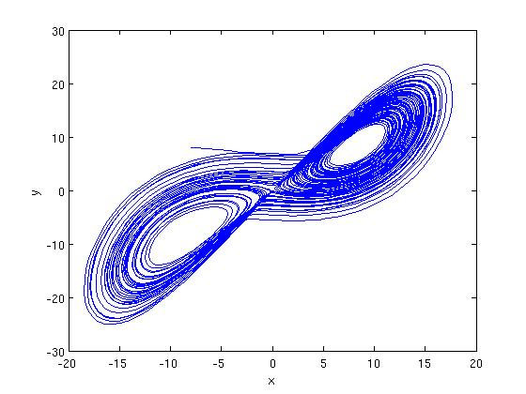
A NONLINEAR MIXTURE AUTOREGRESSIVE MODEL FOR SPEAKER VERIFICATION
Sundararajan Srinivasan (ss754@msstate.edu)
PhD Candidate
Dept. Electrical and Computer Engineering
Mississippi State University

Slide 2
Dissertation Contributions
Provides motivation for representing information in the nonlinear dynamics of speech at the modeling level.
Introduces a nonlinear model - mixture autoregressive (MixAR) model, and proposes a technique for integrating it into a speech processing/speaker verification framework.
Derives enhancements to the MixAR model training equations to facilitate convergence.
Demonstrates the efficacy of the MixAR model for speaker verification tasks using results from experiments on a variety of databases – from controlled synthetic data to standard and popular real speech databases.
Demonstrates superiority of MixAR over the most popular conventional model, Gaussian Mixture Model (GMM), for speaker verification tasks over a variety of noise and channel conditions.

Slide 3
Speaker Verification Overview
Speaker Recognition
Speaker Identification
Speaker Verification
Speaker Verification
Accept or Reject identity claim made by a speaker (a Binary Decision)
Applications: Secured access, surveillance, multimodal authentication.

Slide 4
Speaker Verification Performance Measures
Two Kinds of Errors
False Alarms: Imposter is accepted
Misses: True speaker is rejected
A threshold value determines operating point. By varying the value of threshold, one error can be reduced at the expense of the other.
Detection Error Tradeoff (DET) Curve: Graph with false alarms on x-axis and misses on y-axis.
Model A better than Model B if DET curve of A lies consistently closer to origin than that of B.
Scalar performance measures more convenient.
Equal Error Rate (EER): Point at which line with slope 1 and passing through origin intersects DET curve.
Weights false alarms and misses equally.

Slide 5
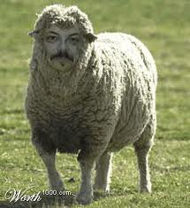
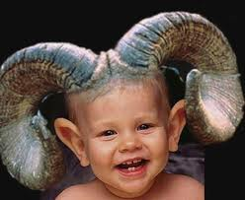
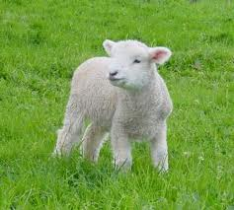
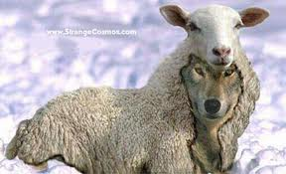
Menagerie of Speakers
Sheep: average good speaker
Goats: is this a baby? No, it’s a goat! - a miss.
Lambs: anyone can imitate a lamb’s bleat - false alarm.
Wolves: can pass themselves as sheep with a little cross-dressing - false alarm.

Slide 6
Features for Speech
Speaker Verification is a pattern classification problem.
Requires features to represent information in data from each class.
Speech Mel-Frequency Cepstral Coefficients (MFCCs)
Most popular in speech and speaker recognition applications.
Physically motivated based on auditory perception properties of the human ear.
Both absolute MFCCs as well as their dynamics are considered to be very useful in speech and speaker recognition.

Slide 7
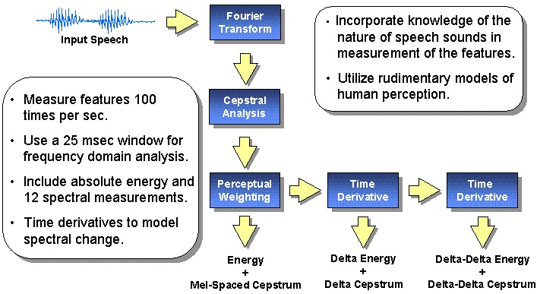
Speech MFCC Feature Extraction

Slide 8
Nonlinearities in speech
Traditional speech representation and modeling approaches were restricted to linear dynamics.
Recent studies indicate significant nonlinearities are present in speech signal that could be useful in speech and speaker recognition, especially under noisy and mismatched channel conditions.
Most research striving to utilize nonlinear information in speech use nonlinear dynamic invariants as additional features.
Nonlinear Dynamic Invariants are features that are unaffected (hence, invariant) by smooth invertible transformations (diffeomorphisms) of the signal. They typically measure the degree of nonlinearity in the signal.
Three invariants we studied:
-Lyapunov Exponents (LE),
-Correlation Fractal Dimension (CD),
-Correlation Entropy (CE).

Slide 9
Nonlinear Dynamic Invariants
We demonstrated usefulness of all three invariants for broad-phone classification.
To illustrate this for one case:
Lyapunov Exponents (LE): quantify nonlinearity by capturing sensitivity to initial conditions – hallmark of chaotic nonlinear systems.
where J is the Jacobian matrix at point p on the signal attractor.
How distinct is this feature for different broad-phone classes?
Kullback-Leibler Divergence Measure quantifies how different two distributions are:
Larger the value, more distinct and hence separable the classes are.

Slide 10
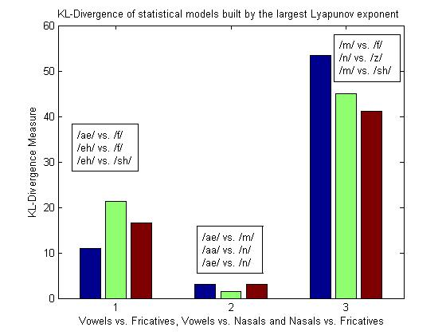
Invariants for Broad-Phone Classification
KL-Divergence of LE for Broad-Phone Discriminability using Sustained Phone Database Developed In-House
Demonstrates broad-phone classification is possible using nonlinear invariants.

Slide 11
Invariants for Speech Recognition
Can nonlinear invariants be used for more complicated and realistic speech processing tasks?
Continuous Speech Recognition Results using AURORA-4 Large Vocabulary Speech Recognition Corpus:
TABLE 3. Continuous Speech Recognition Results for Noisy Evaluation Data
 | WER (%)
 | Airport | Babble | Car | Restaurant | Street | Train
Baseline | 53.0 | 55.9 | 57.3 | 53.4 | 61.5 | 66.1
CD | 57.1 | 59.1 | 65.8 | 55.7 | 66.3 | 69.6
LE | 56.8 | 60.8 | 60.5 | 58.0 | 66.7 | 69.0
CE | 52.8 | 56.8 | 58.8 | 52.7 | 63.1 | 65.7
All | 58.6 | 63.3 | 72.5 | 60.6 | 70.8 | 72.5
Demonstrates performance degrades when nonlinear invariants are used under noisy conditions!

Slide 12
Motivation for Nonlinear Modeling of Speech
For simple broad-phone classification nonlinear invariants appear to have useful information.
For complex large vocabulary speech recognition tasks under noisy conditions, the use of nonlinear invariants degrades performance.
We conjecture that the failure of nonlinear invariants for natural speech processing is because of:
Difficulty in parameter estimation from short-time segments.
Inadequacy in representing the actual nonlinear dynamics.
Capturing nonlinearities at the modeling level is desirable; this is the motivation for the rest of this work.

Slide 13
Gaussian Mixture Modeling (GMM) – The Tradition
A random variable x drawn from a Gaussian Mixture Model has a probability density function defined by:
An equivalent formulation of a GMM:
where is a Gaussian r.v. with mean 0 and covariance .

Slide 14
GMM in speech processing systems and its limitations
GMM is the primary statistical representation for speech signals currently.
Can be easily incorporated into a Hidden Markov Model (HMM).
Found to be very successful in speech recognition but offers no improvement over GMMs in speaker recognition.
ML estimation with Expectation-Maximization algorithm is quick to converge (typically 3-4 iterations).
In speaker recognition, each Gaussian represents a different broad phone class of sounds produced by a speaker. Since the same phoneme is pronounced differently by different speakers, the GMMs of speakers are dissimilar.
Main Drawback: It is a model for a random variable, so cannot model dynamics in feature streams.
Old Solution: Use differential MFCC features to represent dynamics; append with absolute features, and model using GMM.
Drawbacks of this solution: Differential features are only a linear approximation to the nonlinear dynamics; Redundancy is present in combined features.
Proposed Solution: Use a nonlinear model to capture the static as well as nonlinear dynamic information in speech MFCC streams.

Slide 15
Mixture Autoregressive Model (MixAR) – A Nonlinear Model
A mixture autoregressive process (MixAR) of order p with m components, X={x[n]}, is defined as :

Slide 16
MixAR in Speech Processing
MixAR is distinct from other autoregressive and mixture autoregressive models found in speech literature.
This is the more general than all other mixture autoregressive models found in speech literature.
ML parameter estimation can be achieved using Generalized EM algorithm
Generalized EM: At each iteration, the likelihood is not maximized, but the algorithm moves along the direction of increasing likelihood.
Probabilistic mixing of AR processes implies nonlinearity in the model.
Hope to capture both static as well as dynamics in speech signals using absolute (static) MFCCs alone.
MixAR in Speech Processing – what to expect?
Use only static MFCCs with MixARs to perform as well as GMMs using static+differential features.
Remove feature redundancy = > Fewer parameters
Using nonlinear information in speech, MixAR performs better than GMM especially under noisy conditions.

Slide 17
MixAR Model Parameter Estimation
MixAR model parameters
Estimated recursively using the Generalized Expectation Maximization (GEM) algorithm.
E-step
where and
M-step
,
where
, and

Slide 18
MixAR Model Parameter Estimation
Weighting gate parameter update is only through numerical approximation (this is the reason for the name “Generalized” EM.)
and
The expression for Q-function for this EM algorithm is:
To implement the numerical approximation, I used secant method for estimating β:
Using this, the weighting gate parameter update equations are:
and

Slide 19
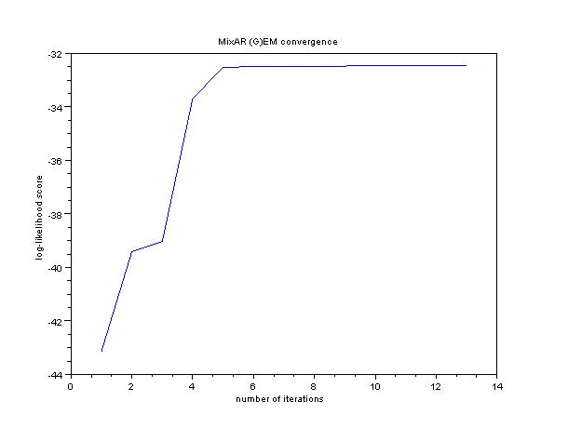
MixAR Model Parameter Estimation
MixAR GEM convergence example

Slide 20
Preliminary Experiment I
Two-Way Classification with Synthetic Data
Model for Class 1 data
(Linear Dynamics)
Model for Class 2 data
(Nonlinear Dynamics)
Classification Error Rate (%)
(number of parameters in
paranthesis)
MixAR can model nonlinear dynamics using only static features and achieve better classification than GMM.
# mix. | GMM Static | MixAR Static | GMM Static+∆ | MixAR Static+∆
2 | 36.0 (12) | 6.5 (20) | 10.0 (24) | 5.5 (40)
4 | 35.5 (24) | 6.0 (40) | 11.5 (48) | 4.5 (80)

Slide 21
Preliminary Experiment II
Two-Way Classification with Speech-Like Data
Two speakers from NIST 2001 database were chosen. For each speaker:
X1: Data with linear dynamics generated from trained HMMs (3 states, 4 Gaussian mixtures per state).
X2: Data with nonlinear dynamics generated from trained MixAR (32 mixtures) .
A range of signals with varying degrees of nonlinearity generated using:
Classification Error Rate (%)
(number of parameters in
paranthesis)
With increasing amounts of nonlinearity, MixAR does significantly better than GMM
α | GMM-8mix. Static+∆ | MixAR-4-mix. Static
0.0* | 1.5 (288) | 1.5 (240)
0.25 | 3.25 (576) | 3.5 (240)
0.50 | 10.25 (576) | 6.25 (240)
0.75 | 24.75 (576) | 9.75 (240)
1.0 | 26.75 (576) | 13.75 (240)

Slide 22
Preliminary Experiment III
Speaker Verification Experiments with Synthetic Data
All 60 speakers from development part of NIST2001 SRE Corpus were used.
Clean Data
Linear Data: generated from trained HMMs (3 states, 4 Gaussian mixtures per state).
Nonlinear Data: generated from trained MixAR (32-mix).
Noisy Data
Clean utterances corrupted with 5 dB car noise audio using FANT software.
Linear and Nonlinear data generated as above.
Results
No significant difference in performance between GMM and MixAR if data are either linear or clean. But if data are both noisy and nonlinear a significant difference in performance was found!

Slide 23
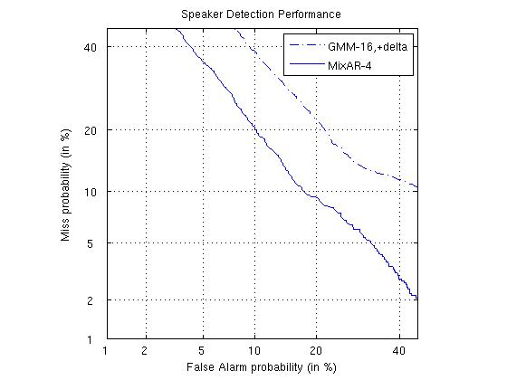
Preliminary Experiment III
Speaker Verification DET with Synthetic Data
For data that is both noisy and nonlinear, MixAR performs significantly better.

Slide 24
Speaker Verification Experiment with NIST 2001
All 60 speakers from development part of NIST2001 SRE Corpus were used.
EER performance for different feature combinations
Features | GMM (16-mix) | MixAR (8-mix)
Static (12) | 22.1 | 19.1
Static+E (13) | 33.1 | 41.1
Static+Δ (24) | 20.6 | 20.4
Static+Δ+ΔΔ (36) | 20.5 | 20.5
Adding delta features does not help MixAR but helps GMM.
MixAR with only static features does better than GMM with static+delta features.
Adding energy feature degrades performance.

Slide 25
Speaker Verification Experiment with NIST 2001
EER performance as a function of number of mixtures
# mix. | GMM Static+∆+∆∆ | MixAR Static
2 | 23.1 (216) | 24.1 (120)
4 | 21.7 (432) | 19.2 (240)
8 | 20.5 (864) | 19.1 (480)
16 | 20.5 (1728) | 19.2 (960)
MixAR with only static features does better than GMM with static+delta features.
MixAR uses fewer parameters to achieve better performance than GMM.

Slide 26
Speaker Verification Experiment with NIST 2001
DET curves for NIST-2001 development data
MixAR using fewer parameters and only static features does consistently better than GMM using more parameters and static+delta features.

Slide 27
Effect of MixAR Order
Increasing order leads to estimation problems due to numerical approximation involved in the M-step for gate coefficients.
However, we tried increasing the order from 1 to 2 to study the effects on verification performance on NIST-2001 development database.
EER performance as a function of MixAR order
# mix. | MixAR Order 1 | MixAR Order 2
8 | 19.1 | 19.2
Increasing MixAR order does not lead to improved performance (perhaps due to estimation problems).
Notes:
26

Slide 28
Speaker Verification Experiment with TIMIT
All 168 speakers in the core test set were used.
5 utterances were used to train each speaker model and the remaining 5 for evaluation.
EER performance as a function of number of mixtures
# mix. | GMM Static+∆+∆∆ | MixAR Static
4 | 3.6 (432) | 3.0 (240)
8 | 2.4 (864) | 1.8 (480)
16 | 2.4 (1728) | 1.7 (960)
MixAR using fewer parameters and only static features does better than GMM using more parameters and static+delta features.

Slide 29
Effect of Different Speech Noise Levels and Types
Speaker Verification Experiments with TIMIT under Noisy Conditions
Noise was added to TIMIT database at various SNR levels and speaker verification performance studied.
GMM (1728) | SNR (dB) | Car Noise | White Noise | Babble Noise
 | Clean | 2.4
 | 10 dB | 19.7 | 48.7 | 40.6
 | 5 dB | 31.2 | 50.0 | 44.7
 | 0 dB | 39.3 | 49.8 | 48.2
MixAR (480) | Clean | 1.8
 | 10 dB | 13.7 | 47.0 | 36.9
 | 5 dB | 23.2 | 47.6 | 42.8
 | 0dB | 33.9 | 48.5 | 47.6

Slide 30
Effect of Different Speech Noise Levels and Types
Speaker Verification DET with TIMIT+White noise

Slide 31
Effect of Different Speech Noise Levels and Types
Speaker Verification DET with TIMIT+Babble noise

Slide 32
Effect of Different Speech Noise Levels and Types
Speaker Verification DET with TIMIT+Car noise

Slide 33
Effect of Different Channel Conditions
Speaker Verification Experiments with similar speech data but different channel conditions
TIMIT (high quality speech audio)
vs.
NTIMIT (telephone-quality speech audio)
Database | GMM (1728) Static+∆+∆∆ MFCCs | MixAR (480) Static MFCCs Only
TIMIT | 2.4 | 1.8
NTIMIT | 21.0 | 20.9
MixAR using fewer parameters and only static features provides comparable performance to that of GMM using more parameters and static+delta features.

Slide 34
Effect of Different Channel Conditions
TIMIT (high quality speech audio) vs. NTIMIT (telephone-quality speech audio)

Slide 35
Effect of Training Data Duration
Speaker Verification Experiments with Variable Amounts of Training Data using NIST 2001 Development Database
Important to study if MixAR is applicable when training data is limited.
GMM (864) | Training Utterance Duration | EER
 | 120* | 20.5
 | 90 | 20.4
 | 60 | 20.4
 | 30 | 24.4
 | 15 | 29.5
MixAR (480) | 120* | 19.2
 | 90 | 21.5
 | 60 | 21.8
 | 30 | 21.8
 | 15 | 24.3
There is a 43.9% increase in EER for GMM when the training utterance duration reduces from about 120s to 15 s
The corresponding increase in EER for MixAR is only 26.56%.
MixAR can handle shorter training data durations better than GMM.
- This is perhaps due to the smaller number of parameters to be estimated for MixAR while GMM suffers parameter estimation problems when training data is limited.
Notes:
34

Slide 36
Effect of Evaluation Data Durtation
Speaker Verification Experiments with Variable Amounts of Evaluation Data using NIST-2001 development database
Does MixAR perform well when evaluation data is short?.
GMM (864) | Evaluation Utterance Duration | EER
 | 30* | 20.5
 | 15 | 21.8
 | 10 | 21.5
 | 5 | 24.4
 | 3 | 26.9
MixAR (480) | 30* | 19.2
 | 15 | 23.4
 | 10 | 23.1
 | 5 | 25.6
 | 3 | 25.6
For GMM, there is an increase in EER of 31.2% as the evaluation duration reduces from about 30s to 3s.
The corresponding reduction for MixAR is 33.3%.
MixAR appears to be slightly more affected by duration than GMM as the evaluation data duration is reduced.
Notes:
35

Slide 37
Summary and Conclusion
Outlined speaker verification problem and associated figures of merit.
Motivated use of nonlinear models in speech systems.
Introduced MixAR as a nonlinear statistical model into speaker verification systems.
Studied MixAR parameter estimation problem using Generalized EM algorithm.
Evaluated MixAR on a variety of noise and channel conditions and using several standard databases, and demonstrated superiority of MixAR over GMMs for speaker verification.
In almost all cases, MixAR used 2x fewer parameters to achieve performance exceeding or comparable to that of GMM.
Studied training and evaluation utterance duration effects on verification performance.

Slide 38
Future Scope of MixAR in Speech Systems
Study computational complexity of both MixAR and GMM, especially for the evaluation stage which needs to be performed near real-time while training is typically offline.
Extend the concept of universal background models (UBM) in GMMs to MixAR by deriving speaker adaptation techniques. This can help training models for speakers with very little data.
Design discriminative approaches to MixAR training parallel to those for GMM and note if performance of MixAR is improved.
Extend the applicability of MixAR to other speech processing problems – particularly speech recognition. This is perhaps the most important, though also, difficult step in establishing MixAR as a superior alternative to GMM.
Notes:
37

Slide 39
Brief Bibliography
X. Huang, A. Acero, and H. Hon, Spoken Language Processing: A Guide to Theory, Algorithm, and System Development, Prentice-Hall, 2001.
D. A. Reynolds, and W. M. Campbell, “Text-Independent Speaker Recognition,” pp. 763–781, book chapter in: Y. H. J. Benesty (editor), Handbook of Speech Processing, Springer, Berlin, Germany, 2008.
D. May, Nonlinear Dynamic Invariants For Continuous Speech Recognition, M.S. Thesis, Department of Electrical and Computer Engineering, Mississippi State University, USA, May 2008.
S. Prasad, S. Srinivasan, M. Pannuri, G. Lazarou and J. Picone, “Nonlinear Dynamical Invariants for Speech Recognition,” Proceedings of the International Conference on Spoken Language Processing, pp. 2518-2521, Pittsburgh, Pennsylvania, USA, September 2006.
M. Zeevi, R. Meir, and R. Adler, “Nonlinear Models for Time Series using Mixtures of Autoregressive Models”, Technical Report, Technion University, Israel, available online at: http://ie.technion.ac.il/~radler/mixar.pdf, October 2000.
C. S. Wong, and W. K. Li, “On a Mixture Autoregressive Model,” Journal of the Royal Statistical Society, vol. 62, no. 1, pp. 95‑115, February 2000.
S. Srinivasan, T. Ma, D. May, G. Lazarou and J. Picone, "Nonlinear Mixture Autoregressive Hidden Markov Models for Speech Recognition," Proceedings of the International Conference on Spoken Language Processing, pp. 960-963, Brisbane, Australia, September 2008.

Slide 40
Available Resources
Speech Recognition Toolkit:
Institute for Signal and Information Processing (ISIP) Speech Recognition System

Slide 41
Publications
S. Srinivasan, T. Ma, D. May, G. Lazarou and J. Picone, "Nonlinear Statistical Modeling of Speech," presentated at the 29th International Workshop on Bayesian Inference and Maximum Entropy Methods in Science and Engineering (MaxEnt), Oxford, Mississippi, USA, July 2009.
S. Srinivasan, T. Ma, D. May, G. Lazarou and J. Picone, "Nonlinear Mixture Autoregressive Hidden Markov Models for Speech Recognition," Proceedings of the International Conference on Spoken Language Processing (Interspeech), pp. 960-963, Brisbane, Australia, September 2008.
S. Prasad, S. Srinivasan, M. Pannuri, G. Lazarou and J. Picone, “Nonlinear Dynamical Invariants for Speech Recognition,” Proceedings of the International Conference on Spoken Language Processing (Interspeech), pp. 2518-2521, Pittsburgh, Pennsylvania, USA, September 2006.
Sundararajan Srinivasan, Bhiksha Raj and Tony Ezzat, "Ultrasonic Sensing for Robust Speech Recognition," Proceedings of the International Conference on Acoustics, Speech and Signal Processing (ICASSP), SP-P14.5, Dallas, USA, March, 2010.
Awaiting final proof-reading before submission
S. Srinivasan, T. Ma, G. Lazarou and J. Picone, “Nonlinear Mixture Autoregressive Modeling for Robust Speaker Verification,” IEEE Transactions on Audio, Speech and Language Processing (to be submitted November, 2010).
T. Ma, S. Srinivasan, G. Lazarou and J. Picone, “Continuous Speech Recognition using Linear Dynamic Models,” IEEE Signal Processing Letters (to be submitted November, 2010).

Slide 42
Thank You!
Questions?

