Slide 1
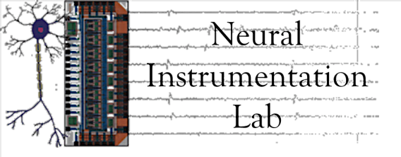
Dissociated Neuronal Networks and Micro electrode Arrays for Investigating Brain Functional Evolution and Plasticity
Ph.D. Dissertation Defense
Alessandro Napoli
Temple University
04/24/2014

Slide 2
Presentation Outline
Dissociated Cortical Neurons & MEAs
MEA Experiments
Research Questions
AIM 1: Quantifying dissociated neuronal network temporal evolution
AIM 2: Investigating long and short-term memory
Conclusions

Slide 3
Dissociated Cortical Neurons and Micro Electrode Array (MEA) Dishes

Slide 4
Micro Electrode Arrays (MEAs)
Micro Electrode Arrays (MEAs) are devices that contain multiple electrodes through which neural signals can be obtained or delivered to cultured neurons
Cells are placed inside glass Micro Electrode Array culture dishes

Slide 5
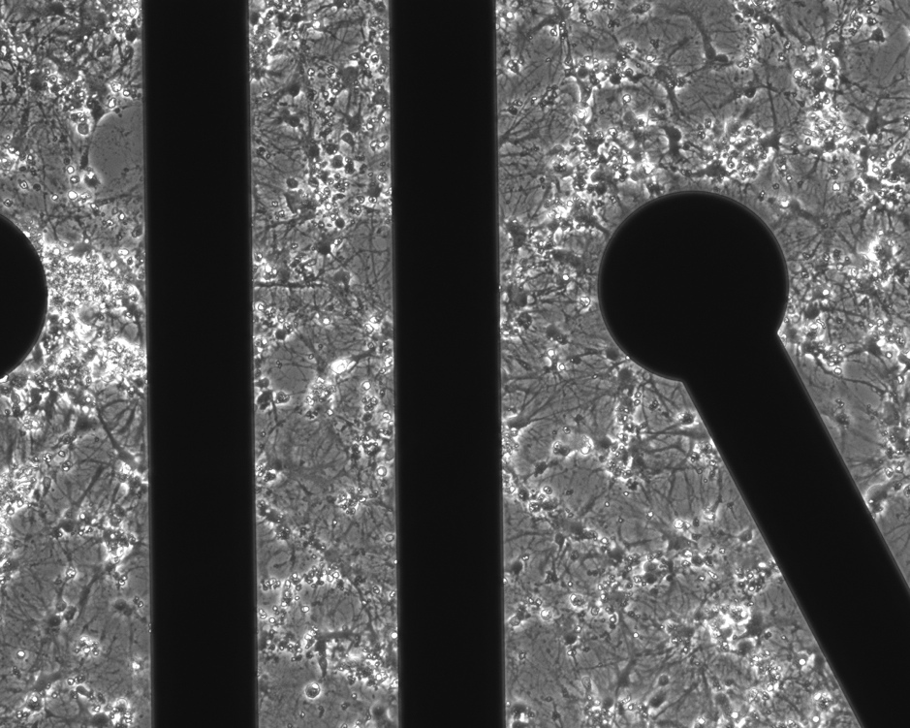
Cultured Neuronal Networks
Networks of tens of thousands of brain cells can be grown in-vitro on a Petri dish with multiple electrodes embedded in the substrate.
The neurons and supporting glial cells form a monolayer culture over the clear Micro Electrode Array (MEA) substrate.
The neurons in these cultures spontaneously branch out, establishing connections with their neighbors and start communicating.
Neural Processes
Electrode
Neurons
Notes:
Cells in cortical tissue are separated through enzymes and then cultured

Slide 6
Research Objective
Combining MEAs with novel electrophysiology experimental paradigms and statistical data analysis
INVESTIGATE
The mechanisms regulating brain development at the level of synaptic formation and neuronal network development

Slide 7
MEA Technology Benefits
Simplify experiments and acquisition systems
Build more realistic brain models
High controlled experimental conditions
Long-term studies (up to a few months)
Study neuronal network connectivity
Notes:
The activity of multiple neurons can be observed in parallel and network phenomena can be studied.
Inducing neural activity through electrical stimulation allows to study neurons response to external stimuli or sensory inputs.
Neural network responses under controlled stimulation can be used as motor commands to control external devices or robots.

Slide 8
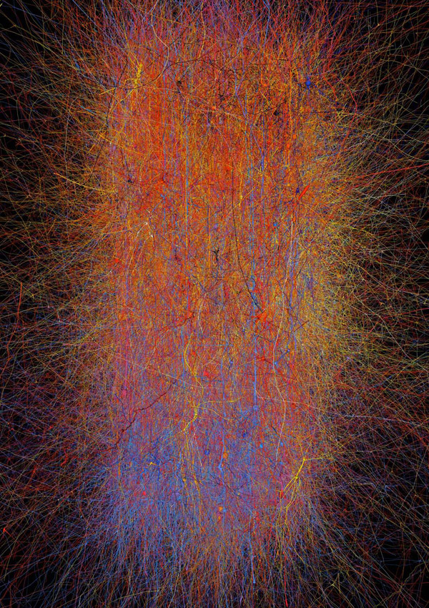
MEA Experiments
Hybrid Systems
More Realistic Brain Models
Bakkum, D., Shkolnik, A., Ben-Ary, G., Gamblen, P., DeMarse, T., & Potter, S. (2004). Removing some ‘A’ from AI: embodied cultured networks. Embodied Artificial Intelligence, 629-629.
How do you build a brain model?
There are roughly 86 billion neurons in a human brain, forming about a quadrillion synapses.
Notes:
Hybrid systems (closed-loop), in which artificial and natural intelligence are merged to exploit the benefits deriving from their combined use
Realistic brain models that can be used to investigate how the brain works and how it forms structural and functional connections

Slide 9
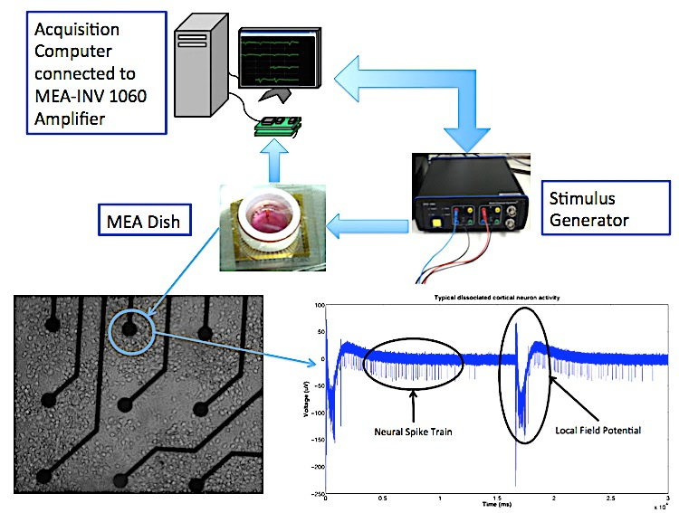
MEA Experimental Setup
Investigate learning-related changes in in-vitro experiments with greater detail than in living animals (in-vivo studies)

Slide 10
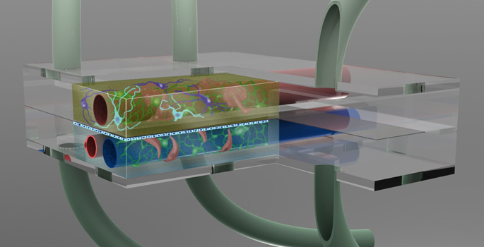
Designing More Realistic
Neural Models
disease models
Stroke and epilepsy drug screening
neuroscience
Learning and memory, neurovirology
neural network models
Understanding brain computation
neuro-anatomical models
Neurovascular units on a chip

Slide 11
MEA Experiment Main Limitations
The lack of appropriate statistical techniques to quantify neuronal activity
High variability in network responses is well-known. Lack of studies investigating to what extent this variability can be associated with plasticity and thus “memory” or “learning” phenomena
Notes:
Even though several studies have investigated spontaneous electrical activity and stimulus-evoked activity in dissociated neuronal cultures, many questions still need to be answered before these neuronal networks can be fully understood and integrated into larger and more complex systems
Lack of statistical tools: as a result, the ultimate goal of exploring the relationship between neural circuit topology and behavior is compromised

Slide 12
Research Questions
Can a mathematical technique capable of reliably quantifying and emphasizing the physiological evolution of dissociated neuronal networks be developed?
Are dissociated neurons capable of displaying memory phenomena? Aiming to assess whether such neurons respond to electrical stimuli with synaptic plasticity and modifications in a stable way?
Notes:
Such mathematical technique would need to be able to account for the high variability and background noise that are characteristic of MEA recordings.
In this context, memory is defined at the neuronal level as synaptic plasticity, namely the ability of such cells to form, modify and delete connections based on the delivered electrical stimuli. It is known that plasticity effects are responsible for driving neuronal processing such as memory formation and “intelligence”.

Slide 13
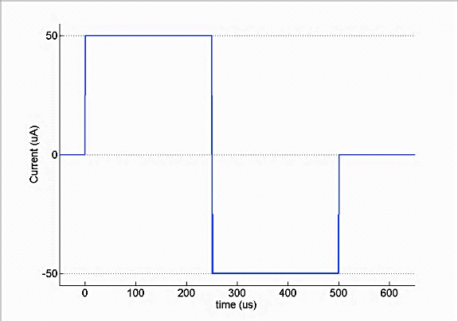
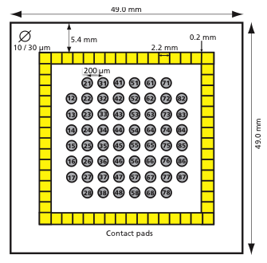
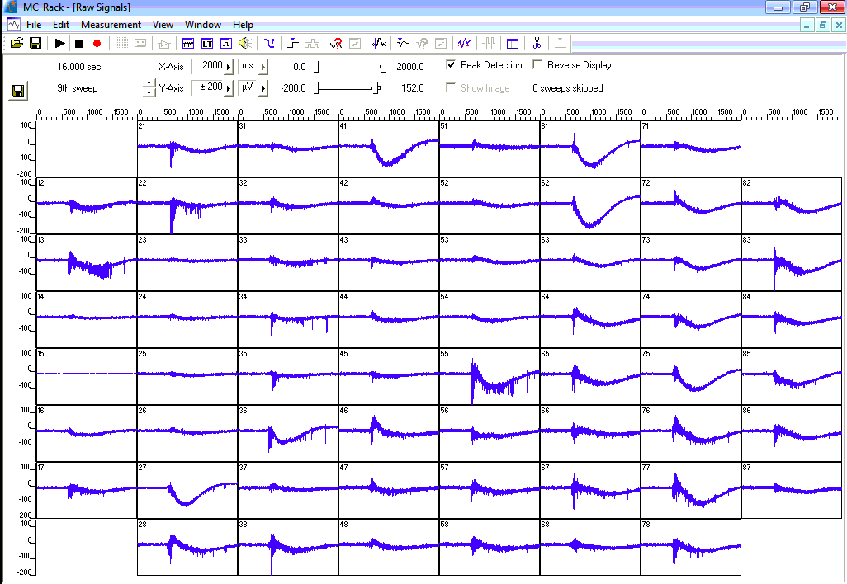
QUANTIFYING DISSOCIATED NEURONAL NETWORK TEMPORAL EVOLUTION
One pulse delivered to each electrode every 300 ms

Slide 14
Stimulus-Response Pairs
Analyze stimulus-evoked responses while accounting for natural variability in the data
Identify and study only the statistically significant network responses
Significant Responses
Stimulus
Background Activity

Slide 15
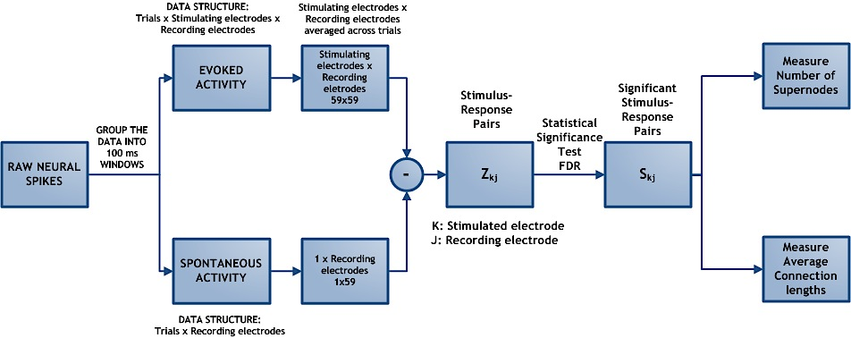
Signal Processing and Statistical Analysis
Notes:
Block Diagram of the Implemented Neuronal Spike Statistical Analysis. The raw neural spikes are divided into two groups, evoked activity and spontaneous activity, respectively stimulated and non-stimulated experimental sessions. Then the raw spikes were divided into 100 ms time windows (100 ms after stimulus onset for evoked spikes) and averaged across repetitions (time windows). The average spontaneous activity was subtracted from the average evoked activity and fed into the False discovery Rate (FDR) statistical analysis technique. The output of the FDR is the significant stimulus-response pairs. Using these significant pairs we computed their average connection lengths and the number of supernodes.

Slide 16
The False Discovery Rate (FDR)
The FDR is the expected proportion of erroneous rejections among all rejections.
Instead of controlling the error from a single erroneous rejection (false positive) FDR controls the proportion of type one errors.
V is the number of false discoveries
R is the total number of discoveries
Notes:
In large-scale multiple comparisons where hundreds or thou- sands of hypotheses are tested simultaneously, the goal is to separate the nonnull cases from the null cases.
Type one error: Rejecting a true null hypothesis. FALSE POSITIVE
Type two error: Failure to reject a false null hypothesis. FALSE NEGATIVE
Once defined like that FDR can be set to normal alpha values

Slide 17
False Discovery Rate
FDR identifies the significant stimulus-response pairs by testing simultaneously multiple hypotheses
For each stimulus-response pair we have two choices, whether the identified pair is
NULL HYPOTHESIS
H{0,kj} : Z_{kj} ~ N(µ0=0, σ2) = f0
Part of the ongoing network activity
Non-Significant
ALTERNATIVE HYPOTHESIS
H{1,kj} : Z_{kj} ~ f1(x)
Direct response to stimulation
Significant
Notes:
In our case experiments, we are interested in testing whether the spikes recorded at specific electrodes are evoked by the applied stimulus (alternative hypothesis) or such responses are only the result of the natural background activity of the network (null hypothesis).

Slide 18
Local FDR
H{0,kj} : While stimulating electrode k, electrode j does not respond.
Local FDR
Notes:
stimulus-response activity pairs, normalized by the network spontaneous activity
H_{{0,kj}} : Z_{kj} ~ N(µ₀=0, σ²) = f₀(Z_{kj})
H_{{1,kj}} : Z_{kj} ~ f₁(Zkj)
The statistic T_{kj}, referred to as “local FDR”. In other words, the local FDR function quantifies the relative likelihood of H0; values of T_{kj} close to 1 indicate a high likelihood of H0 whereas values closer to 0 indicate a low likelihood. The value of the parameter ϵ is estimated from the data before computing the local FDR functions.
If Tkj is close to 1, then the two distributions defined in the hypotheses are similar and the null hypothesis is selected. This indicates no significant relation between the stimulus, delivered to electrode k, and the neural response recorded at electrode j.
This technique therefore guarantees that the average false positive rate over all significant stimulus-response pairs will be less than 5%.

Slide 19
FDR Hypothesis Rejection
Rank the 59x59 𝑇_{i} local FDR functions from the smallest to the largest
The ordered functions are called 𝑇₁ , ... , 𝑇_{p} where p = 59x59
T_{i}’s are significant for
i < k
where

Slide 20
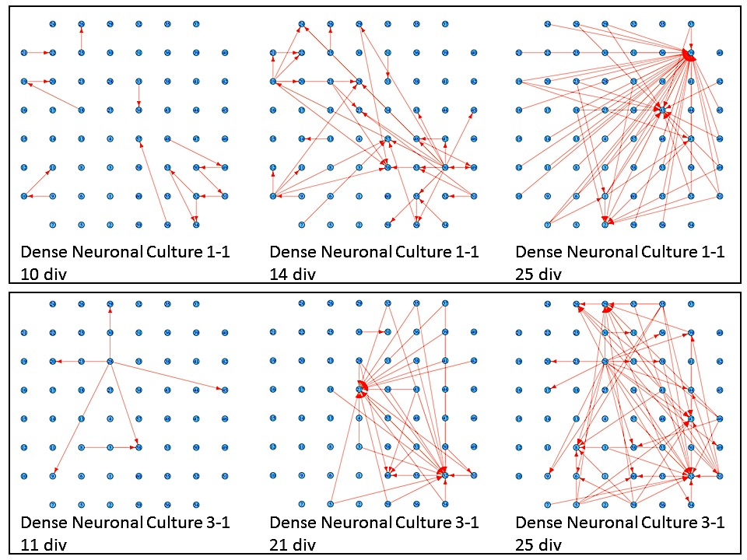
Results: Connectivity Graphs
Notes:
Figure shows typical connectivity graphs for two different cultures harvested from different brain tissues, on three separate days. Each red arrow indicates a statistically significant connection between a stimulated electrode and a recording one, as identified by the FDR analysis.
Figure suggests that neuronal connectivity tends to evolve over time, with increases in both the number of statistically significant stimulus/recording pairs as well as the average length of connections and the number of connections per active node.

Slide 21
Results: Average Connection Lengths
Notes:
150 ms window results. we used a dotted blue line to indicate missing experimental days while a solid black line was used to plot the actual data sample means.
From these graphs, it is noticeable how the average connectivity pair lengths increase over time and then reach a plateau, following the expected natural network temporal evolution. this behavior is observed to be consistent across cultures of different densities and across different time window durations (data not shown).
An increase in average connection length means that stimulus-evoked responses are recorded from electrodes that are physically further away from the stimulated electrode; evoked electrical activity is propagated more easily in the dish and for longer distances. The functional evolution in the studied neuronal networks seems to perfectly reflect the natural temporal evolution of neural circuit formation. In fact, neural circuit formation occurs in three distinct stages: 1) Immature synapses form between axons and dendrites. 2) Synapses undergo maturation, which involves the conversion of silent synapses to active ones. 3) Excess synapses are eliminated or pruned to refine the neuronal connections within the circuit.

Slide 22
Results: Average Supernode Number
Notes:
These results reveal consistent neuronal development within batches with more variable trends across batches.

Slide 23
Statistical Analysis
The time window duration controls the dynamics of stimulus-evoked responses included in the analysis
Dense Culture Connection Length Statistical Analysis
 | 50 ms | 100 ms | 150 ms
Across Batches | p = 0.0207 | p > 0.05 | p = 0.0107
Within Batches | p > 0.05 | p > 0.05 | p > 0.05
The window length selection is a crucial parameter to obtain optimal results
ANOVA test p-values across and within neuronal batches
Notes:
To quantify correlation between neuron batches I ran a series of ANOVA hypothesis tests on both connection lengths and number of supernodes within and across batches.
Supernodes scored non-significant independently of the time window duration.
We hypothesize that the observed variability in the analysis results is mainly due to the fact that. Common values of 100ms might not be optimal.
Furthermore, we tested the effects that different time windows had on the analysis results and whether the time window related changes were statistically significant.

Slide 24
Results: Effects of time window durations on connection lengths
ANOVA multiple comparison test to identify which group means were statistically different from each other
Notes:
the three group means and their 95% confidence intervals for every dense batch are shown. In batch 1 and batch 3, there are group means significantly different from the others. In batch 1 the second group mean (100 ms window) is significantly different from the other two group means, while in batch 3 is the third group mean to be significantly different from the others. It can be seen how differences between results generated using different time windows are significant in batch 1, where the 100 ms group mean is significantly different from the other two (p = 7.051 × 10− 4) and in batch 3 where 150 ms group mean is significantly different (p = 8.126 × 10−6).
This implies that different time windows generate significantly different results in two batches out of six.

Slide 25
Conclusions
Neuronal connectivity evolves over time, with changes in both the number of statistically significant stimulus/recording pairs
Cultures dissociated from the same brain tissue display more similar evolution trends than those collected from different brain tissues
The time window selection is a crucial parameter of the analysis
Notes:
We investigated the temporal evolution of neuronal activity in response to a constant electrical stimulation protocol over the first 5 weeks of neuronal development
As measured by the average length of connections and the number of connections per active node
We therefore propose that the FDR analysis combined with two metrics, the average connection length and the number of highly connected “supernodes” are valuable techniques for describing neuronal connectivity in MEA dishes
our results indicate that when analyzing stimulus-evoked responses recorded within 50 ms and 150 ms time windows from stimu- lus onset, cultures dissociated from the same brain tis- sue display trends in their temporal evolution that are more similar than those obtained with respect to differ- ent batches, as quantified by the statistical tests within and across batches.

Slide 26
INVESTIGATING LONG AND SHORT-TERM MEMORY FORMATION IN DISSOCIATED NEURONAL NETWORKS
Investigate whether dissociated neuron networks subjected to electrical stimulation can exhibit synaptic plasticity / memory phenomena:
Spatial changes
Temporal changes
Notes:
The ability to drive the network to respond in a desired way provides a valuable approach to study changes in functional connectivity induced by external stimuli.
The observed variability has often been attributed to the natural plasticity of the nervous system, but there are no studies that have specifically investigated to what extent this plasticity can be associated to in-vitro memory formation
Memory in this context is defined as the ability to learn and remember the applied stimulus paradigm.

Slide 27
MEA Electrode Spatial Grid Division
Every MEA dish will be divided into four quadrants
Q1 and Q3 stimulated
Q2 and Q4 never stimulated
Q1
Q2
Q4
Q3
Notes:
Q3 Experimental Quadrant. Q1 Test Quadrant.

Slide 28
Stimulation Protocol
The stimulation paradigm consists of a paired-pulse stimulus delivery
50 ms
800 μs

Slide 29
Stimulating Electrodes
Eight electrodes from Q1 and Q3 are used to deliver stimulation.
Two electrodes, one in each quadrant, are stimulated simultaneously.
A stimulation trial is completed when the eight electrodes have been stimulated and then repeated for an hour.
Paired Pulses
Notes:
Quadrant division was utilized to have on-dish control

Slide 30
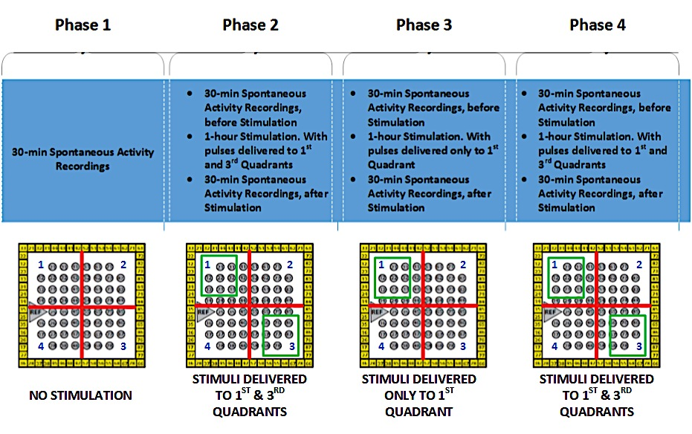
Stimulation Paradigm

Slide 31
Experimental Outcomes
Compare stimulus-evoked responses in different quadrants
Q3 responds to the resumed stimulation with a lower activity
Q3 responds with higher activity
Q3 shows no significant difference
Notes:
Q3 Experimental Quadrant. Q1 Test Quadrant.

Slide 32
Signal Processing
Array-Wide Spike Detection Rate (ASDR)
Spatial Statistical Analysis
Temporal Statistical Analysis
Raw MEA Recordings
Band-pass Filtering 300Hz-3kHz
Spike Detection
Bursting Parameters
Spatial Statistical Analysis
Temporal Statistical Analysis
Feature Extraction
Data Analysis
Notes:
Spike detection was carried out using a simple threshold mechanism. The threshold was individually set for each channel and chosen as -6 times each band-pass filtered signal’s standard deviation, as measured by MC_Rack software, within a 500 ms time window. To reduce the possibility of detecting duplicated spikes, a detection refractory period of 1 ms was used, during which no multiple detection events were accepted.

Slide 33
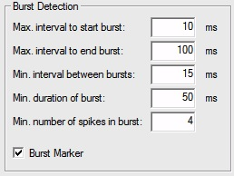
MEA Feature Extraction
Notes:
Burst activity is a peculiar behavior of the developing brain and plays an important role in establishing appropriate connections.
To detect the bursts, the software searches for instances where the interspike interval between spike trains is less than 10 ms. Events were included in a detected burst until the interspike interval became larger than 100 ms. A single bursting event included all the detected events whose interspike interval was less than 15 ms. A burst was not counted if its duration was less than 50 ms or if it contained four or fewer spikes.

Slide 34
Data Analysis
Given the high variability and randomness associated with the MEA recording
A statistical approach was necessary to investigate the network responses to electrical stimulation
Spatial Firing Variation Analysis
Temporal Firing Variation Analysis

Slide 35
Stimulus-Evoked Activity Changes
30-min Spontaneous Recording
1-hour Stimulation Session
30-min Spontaneous Recording
Nbase
Stim
Npost
Notes:
Compute the Array-wide Spike Detection Rate (ASDR) and Bursting Parameters
Measure changes in neuronal activity due to stimulation
To compare results between cultures with widely varying firing parameters, it was chosen to normalize the changes using the baseline parameters Nbase, and then to evaluate the statistical significance of changes in the means of ΔNind within and across experimental sessions, quadrants and experimental phases.

Slide 36
Spatial Firing Analysis
Pre-stimulation
Post-stimulation
Q1
Q2
N_Q1
N_Q2
N_Q3
N_Q4
N_Q1
N_Q2
N_Q3
N_Q4
Q4
Q3
Spatial
Changes

Slide 37
Changes across Experimental Sessions
Temporal Analysis: Overall Changes
Spatial Analysis: Local Changes
Q1
.
.
.
Statistical Significance was tested using ANOVA tests between groups within and across phases
Q4
Notes:
First subscript is experimental phase, second is experimental session within phase.
ANOVA assumptions:
Variables normally distributed
Samples Independent
Variances are equal
Responses for a given group are independent and identically distributed normal random variables

Slide 38
Local Changes within Phases
Spatial Changes between the four experimental sessions divided by quadrant
…
This can be used to compute spatial variations statistical significance within phases
Notes:
in every phase

Slide 39
RESULTS

Slide 40
Spike Count Spatial Analysis
Changes between quadrants within experimental phases
Firing activity on average was inhibited by stimulation
The local stimulation protocol did not evoke any localized changes in network activity
Notes:
Average Spike Count in each recording session.
Figure 4.5 shows the differences between the average spike counts post and pre-stimulation (normalized by the pre-stimulation average spike count) and grouped by quadrant.
The first significant result of this Aim is that the local stimulation protocol implemented in this work was not able to evoke any localized changes in network activity.
the suspension of stimulation in Q3 during experimental phase 3, and then its resumption in phase 4, did not induce any detectable activity changes, neither in that specific quadrant nor in the others.

Slide 41
Spike Count Spatial Analysis
Changes between experimental phases
There are no localized changes in network activity
Notes:
These are the means of the four experimental phases in each phase, measuring variations across phases.
The four panels represent the activity broken down in quadrant and show there are no spatial differences between quadrants. This is emphasized by the graph on the right where normalized differences of average spike count are shown.
Pre-stimulation: activity in phase3 larger than others. Standard errors are lower for average spikes after stimulation.
Differences: Q1 not significant. Phase 4 significantly different from others.

Slide 42
Average Number of Bursts Spatial Analysis
Notes:
Left: it can be seen that both pre and post-stimulation number of bursts display a similar behavior across quadrants. To better assess the changes due to the applied stimulation, the normalized differences of the mean number of bursts have been calculated and displayed in Figure 4.14, that shows how the normalized differences in average burst number across the four experimental phases. Such results demonstrate that across the four quadrants independently of the stimulation phase, the dish responded to electrical stimulation as a single neuronal ensemble. This again confirms what found when analyzing spike count results.

Slide 43
Spike Count Temporal Analysis
Short-term plasticity
Notes:
it can be seen that differences between average post and pre-stimulation spike counts had a decreasing trend in phase 2, reached a negative peak on the first experimental day of phase 3, after which activity differences started to become less negative throughout phases 3 and 4. During the last two experimental days of phase 4, the differences between post and pre-stimulation spike counts steadily reached their closest values to zero (highest values, that is smallest changes). This suggests that over repeated experimental sessions neurons became less sensitive to the stimulation delivery and that the long-term depression effects linked to electrical stimulation faded

Slide 44
Spike Count Temporal Analysis
Long-term plasticity
Notes:
The final network evolution characteristic measured in this work is how the average overall ASDR evolve across different experimental phases (long-term induced plasticity). Figure shows the overall ASDR mean changes across experimental phases. The first two panels from the top display results respectively for pre-stimulation, post-stimulation recordings. The bottom panel displays post-pre normalized differences. All differences between phases scored significantly different (one-way ANOVA test) and the decreased effects of the applied stimulation due to the fact that neuronal networks are habituating to the presented stimulation can be seen.

Slide 45
Average Number of Bursts Temporal Analysis
Notes:
Figure 4.17 shows the temporal analysis of the average number of detected bursts. Once again, these results confirm that the stimulation is inhibiting the network activity, as demonstrated by the negative changes in number of bursts. Moreover, the inhibitory effects reached their negative peak at the beginning of phase 3 before starting to become less negative towards the end of the experiments in phase 4.

Slide 46
Conclusions
The local stimulation protocol did not evoke any localized changes in network activity
The implemented stimulation protocol induced depression effects in the neuronal networks
The inhibitory effects of the stimulation decreased over time suggesting a habituation phenomenon
Notes:
This rejects the hypothesis that neurons that are closer to the stimulating electrodes respond with stronger activity.
and that localized stimulation evoked responses that extended well beyond the quadrants in which they were delivered
This also means that network connectivity is stronger than expected, that the neurons are so well-connected that even the application of localized stimulus pulses made the networks respond as a whole with activity that was widespread over all the electrodes. Another explanation could be that using the larger reference electrode as the negative one to deliver the stimulus voltage pulses might induce currents in the MEA dishes that are not localized as previously thought.
the trend that can be seen in pre-stimulation activity was not present in post-stimulation recordings
Such findings are enough to conclude that electrical stimulation is an important tool to interact with dissociated neuronal cultures, but localized stimuli are not enough to drive spatial synaptic potentiation or depression. On the contrary, the ability to modulate synaptic temporal plasticity was a feasible task to achieve by chronic network stimulation.

Slide 47
Conclusions
Daily network activity varied in a statistically significant manner suggesting that short-term plasticity phenomena took place
Long-term plasticity phenomena have been exposed by the different network responses to the same stimulation protocol delivered in phases 2 and 4
Notes:
Meaningful differences in activity between pre and post-stimulation sessions compared to changes within single sessions demonstrate that our stimulation protocol was successful in generating stimulus-evoked responses.
Network stimulus-evoked responses grew in phase 2, reaching their maximum in phase 3 before decreasing in phase 4

Slide 48
Future Directions
Investigate the effects of different stimulation protocols
Run experiments with more realistic neural models: adding astroglia or brain slices
Investigate the effects of genetic factors on neuronal functional development
Investigate the effects of drugs on neuronal development
Notes:
The results presented in this work demonstrate that external stimulation has a fundamental role in modulating the electrical activity of dissociated neuronal cultures.
Such findings are enough to conclude that electrical stimulation is an important tool to interact with dissociated neuronal cultures, but localized stimuli are not enough to drive spatial synaptic potentiation or depression. On the contrary, the ability to modulate synaptic temporal plasticity was a feasible task to achieve by chronic network stimulation.

Slide 49
Publications
A. Napoli and I. Obeid, “Combined Common Spatial Pattern and spectral filtering for EEG-based BCIs,” 2011 5th Int. IEEE/EMBS Conf. Neural Eng., pp. 449–452, Apr. 2011.
A. Napoli, M. Barbe, K. Darvish, and I. Obeid, “Assessing traumatic brain injuries using EEG power spectral analysis and instantaneous phase.,” Conf. Proc. IEEE Eng. Med. Biol. Soc., vol. 2012, pp. 4692–5, Jan. 2012.
A. Napoli, M. Barbe, K. Darvish, and I. Obeid, “Assessing traumatic brain injuries using EEG power spectral analysis and instantaneous phase.,” Conf. Proc. IEEE Eng. Med. Biol. Soc., vol. 2012, pp. 4692–5, Jan. 2012.
A. Napoli and I. Obeid, “Learning Cultured Neuronal Network Evolution Using False Discovery Rate Analysis,” 2013 39th Annu. Northeast Bioeng. Conf., pp. 25–26, Apr. 2013.
A. Napoli, M. Sobel, and I. Obeid, “Learning Cultured Neural Network Temporal Evolution using Graph Theory,” in Biomedical Engineering Society, 2012.
A. Napoli, J. Xie, and I. Obeid, “Investigating the role of chronic stimulation in dissociated cortical neuron development,” in Biomedical Engineering Society. Annual Meeting 2013, 2013.
A. Napoli, J. Xie, I. Obeid. “Understanding the temporal evolution of neuronal connectivity in cultured networks using statistical analysis ”. BMC Neuroscience, 2014, 15:17
A. Napoli, I. Obeid. “Investigating Human Primary Neuron Functional Evolution”. In preparation

Slide 50
References
T. B. Demarse, D. a Wagenaar, A. W. Blau, and S. M. Potter, “The Neurally Controlled Animat: Biological Brains Acting with Simulated Bodies.,” Auton. Robots, vol. 11, no. 3, pp. 305–310, Jan. 2001.
T. B. Demarse, D. a Wagenaar, A. W. Blau, and S. M. Potter, “The Neurally Controlled Animat: Biological Brains Acting with Simulated Bodies.,” Auton. Robots, vol. 11, no. 3, pp. 305–310, Jan. 2001.
A.-C. Camproux, F. Saunier, G. Chouvet, J.-C. Thalabard, and G. Thomas, “A Hidden Markov Model Approach,” Biophys. J., vol. 71, no. November, pp. 2404–2412, 1996.
D. Patnaik, S. Laxman, and N. Ramakrishnan, “Discovering excitatory relationships using dynamic Bayesian networks,” Knowl. Inf. …, vol. 29, no. 2, pp. 273–303, Sep. 2011.
D. A Wagenaar, J. Pine, and S. M. Potter, “An extremely rich repertoire of bursting patterns during the development of cortical cultures.,” BMC Neurosci., vol. 7, p. 11, Jan. 2006

Slide 51
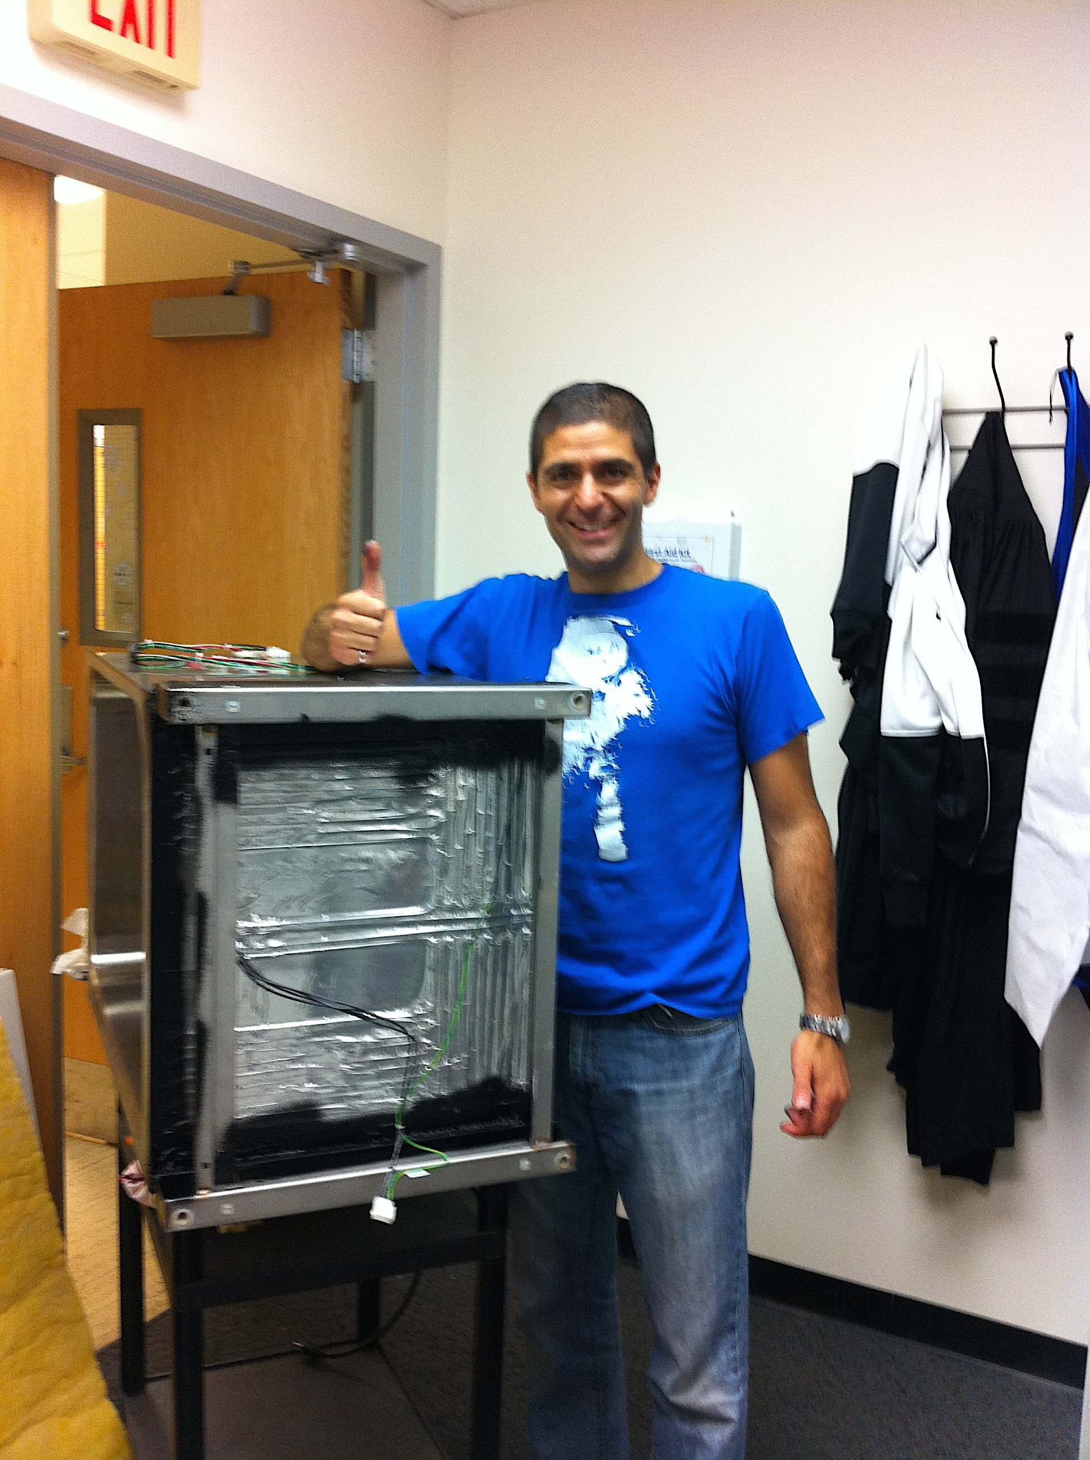

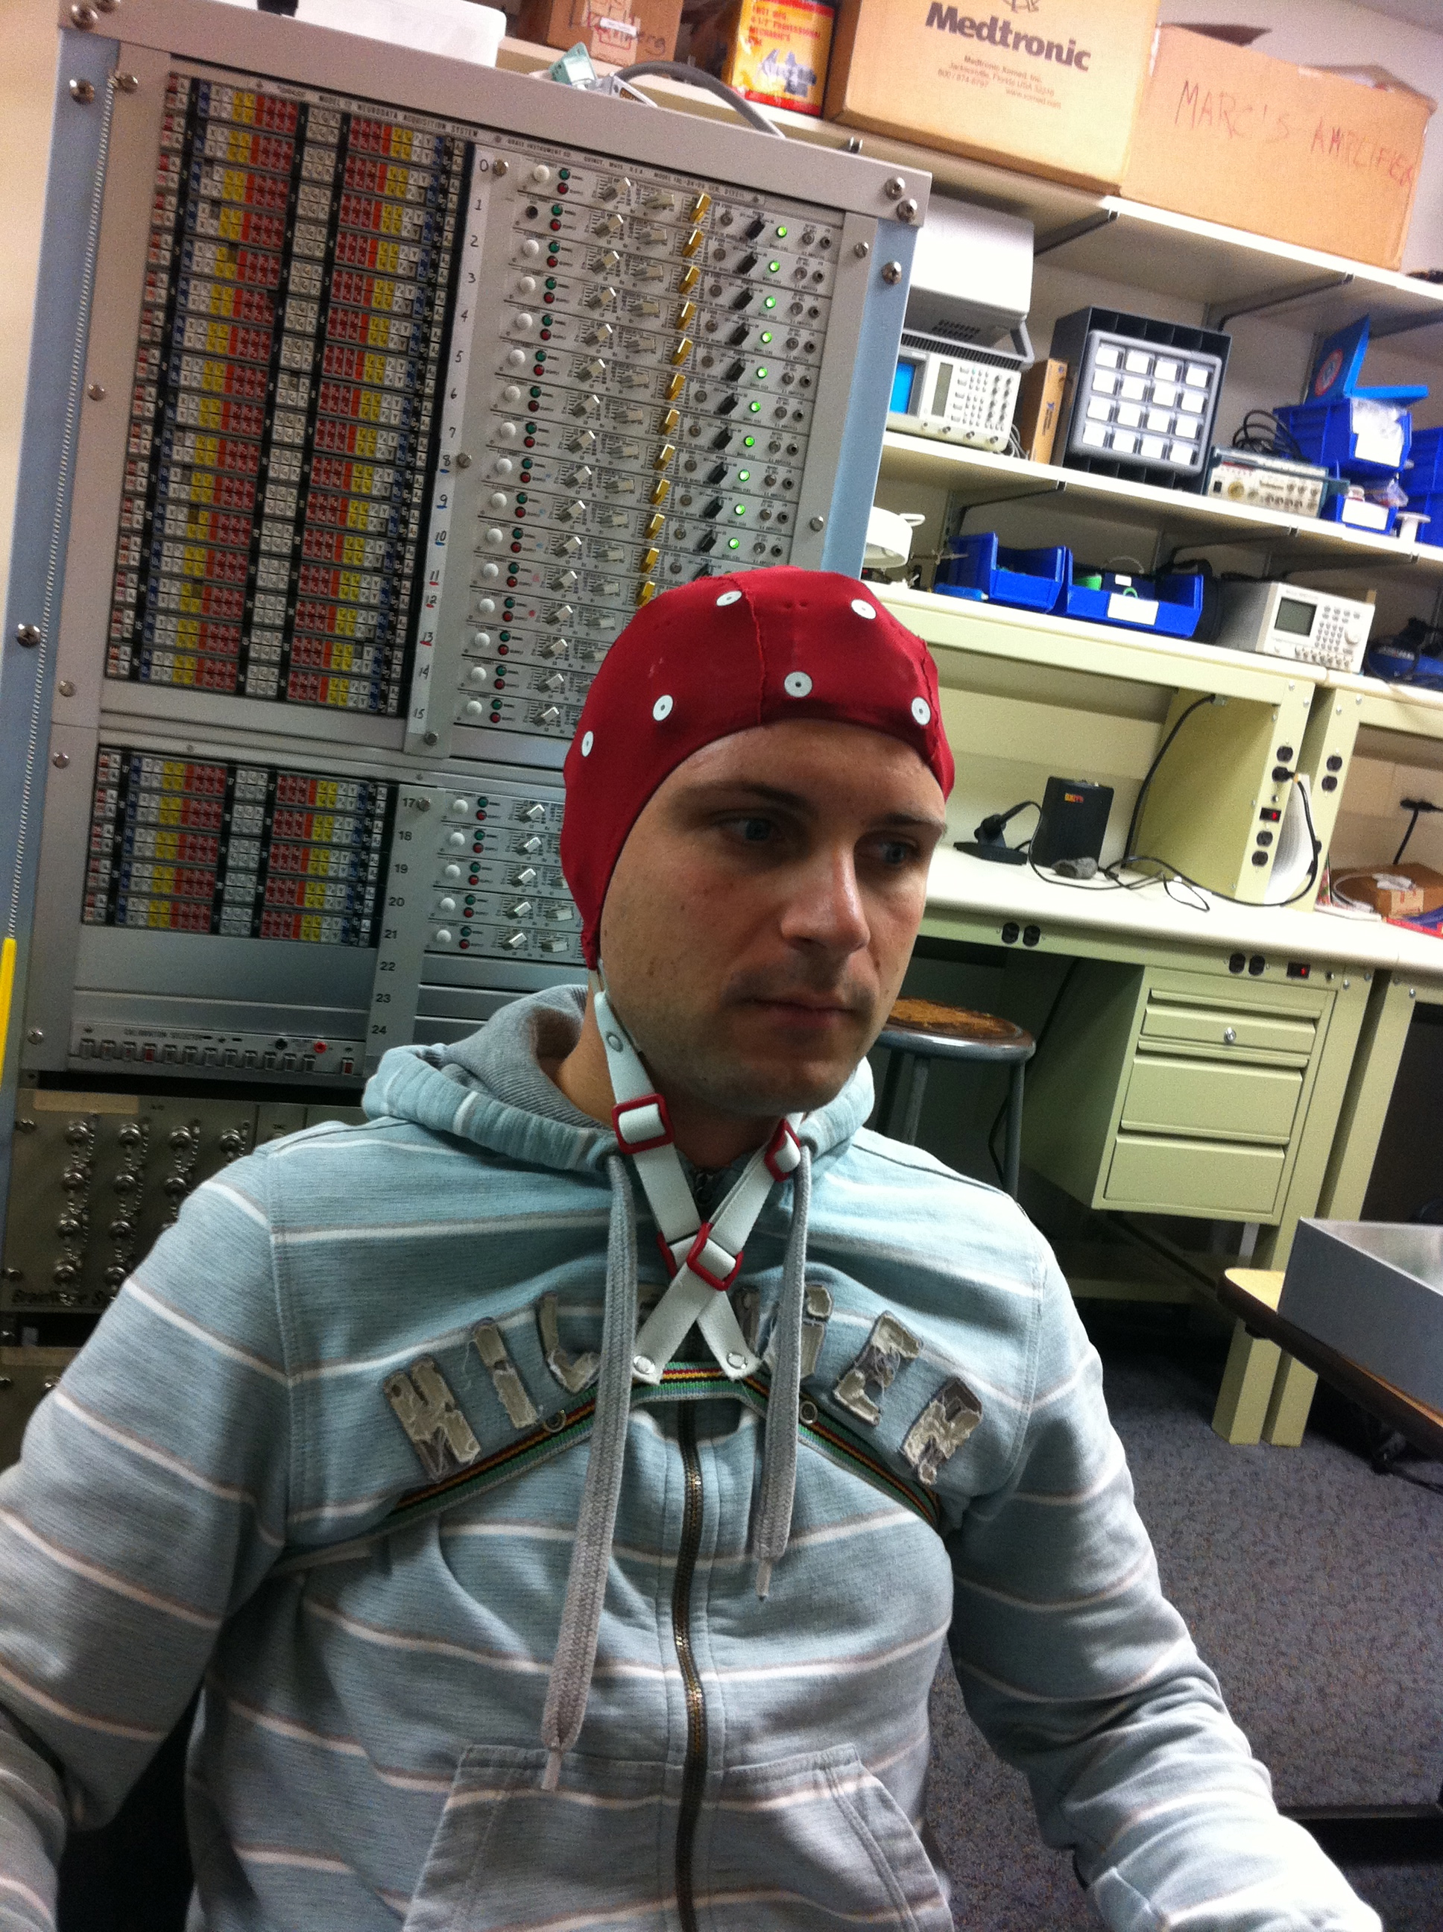
Thanks

Slide 52

Questions
… di piu’…

