Slide 1
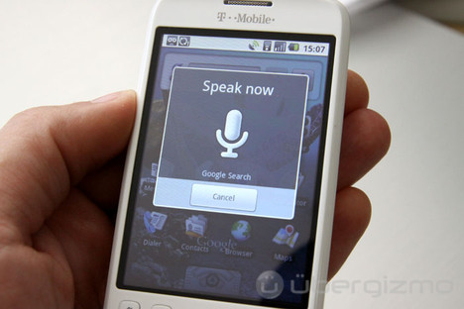
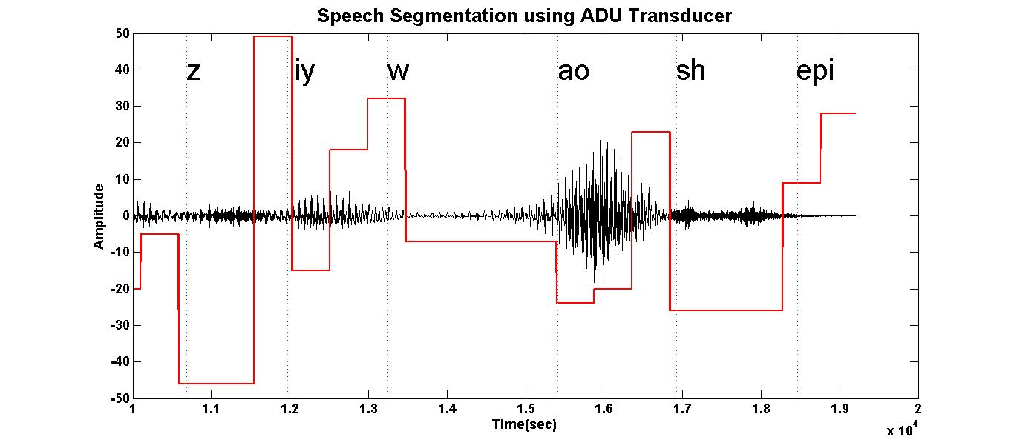
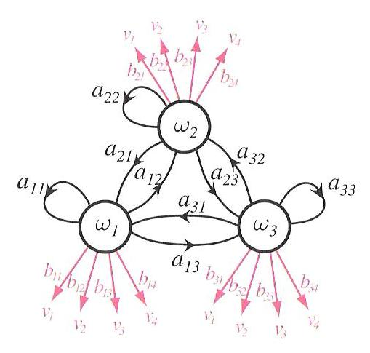

Nonparametric Bayesian Approaches
for Acoustic Modeling
Amir Harati
Institute for Signal and Information Processing
Temple University
Philadelphia, Pennsylvania, USA

Slide 2
Abstract
The goal of this dissertation is to apply nonparametric Bayesian approaches to the acoustic modeling problem in continuous speech recognition.
Three important problems are addressed: (1) statistical modeling of sub-word acoustic units; (2) semi-supervised training algorithms for nonparametric acoustic models; and (3) automatic discovery of sub-word acoustic units.
A Doubly Hierarchical Dirichlet Process Hidden Markov Model (DHDPHMM) with a non-ergodic structure is developed that allows mixture components to be shared across states.
A generative semi-supervised DHDPHMM and its approximation are developed that allow us to train acoustic models without having time alignments.
DHDPHMM gives state of the art results on a classification problem and demonstrates promising results on a recognition problem.
HDPHMM/DHDPHMM have been applied to the problem of automatic acoustic unit and lexicon discovery. The lexicon learning algorithm gives competitive results relative to more complex algorithms.
A spoken term detection by query system was developed that gives state of the art results on unsupervised training.

Slide 3

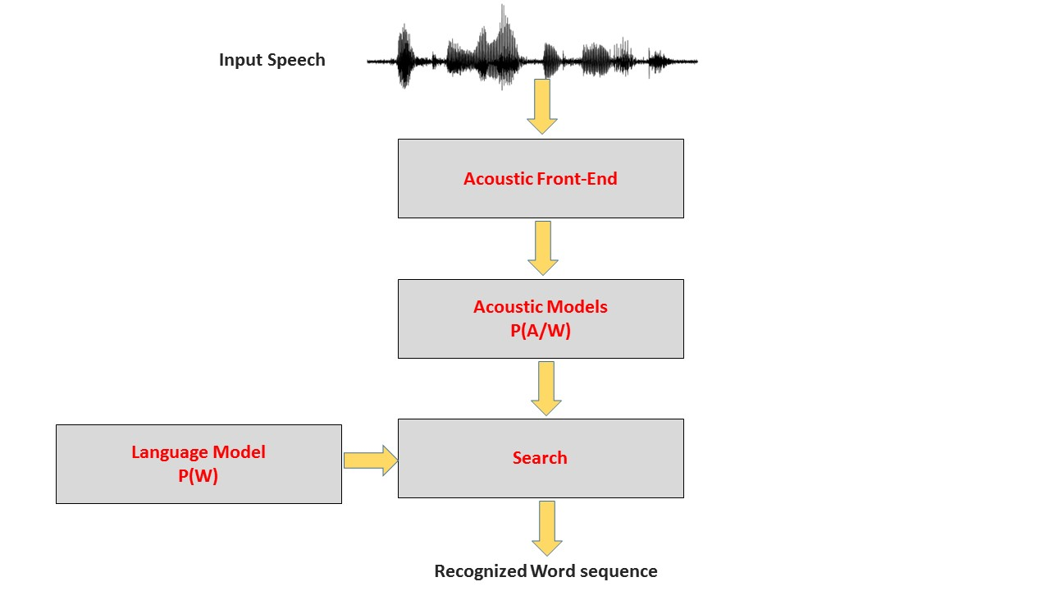
The Acoustic Modeling Problem
Goal: Find the optimal sequence
of words
P(W): Language model
P(A|W): Acoustic model
Sub-word acoustic units:
Sophisticated statistical models (HMM-GMM, deep learning)
Context dependent (CD) models
(/aa/ vs. /dx/-/aa/+/zh/)
Very complex models
(over 10M parameters)
Optimizing complexity is a
difficult problem.

Slide 4
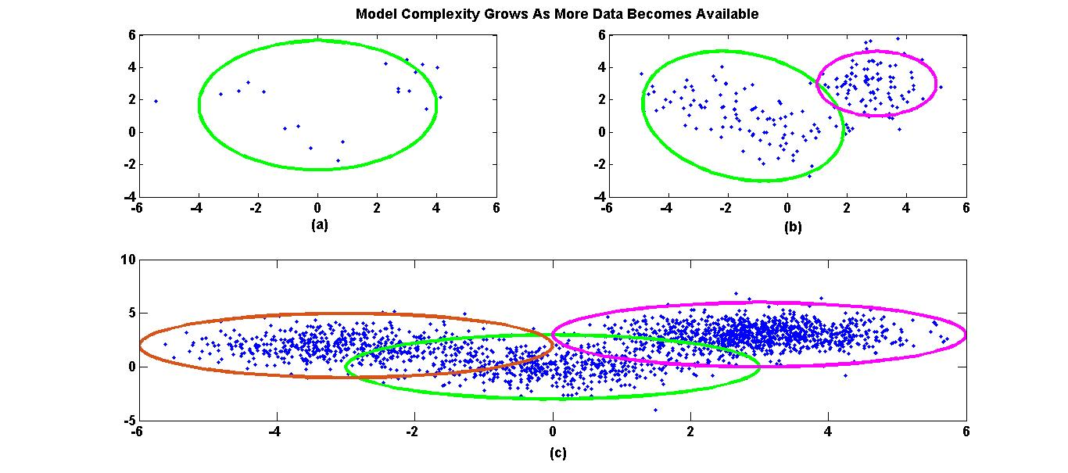
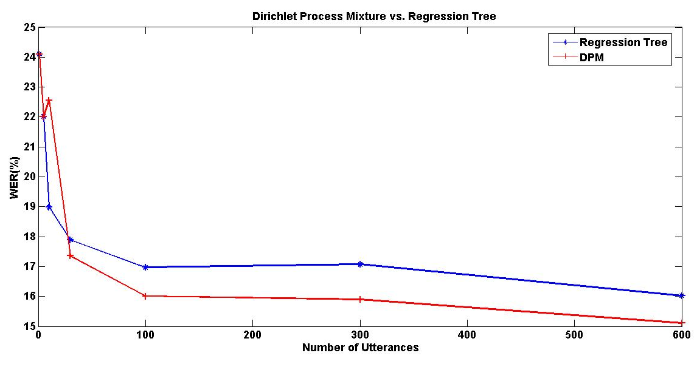
Preliminary Speaker Adaptation Experiment
“Right” complexity should be inferred from data.
Clusters found have meaningful acoustic interpretation
Liquids like /w/ and /r/ are assigned to the same cluster

Slide 5
Three Fundamental Problems
This dissertation addresses three fundamental problems in acoustic modeling:
Modeling sub-word units
Semi-supervised training algorithms for sub-word units
Data-driven discovery of the sub-word units and the lexicon

Slide 6
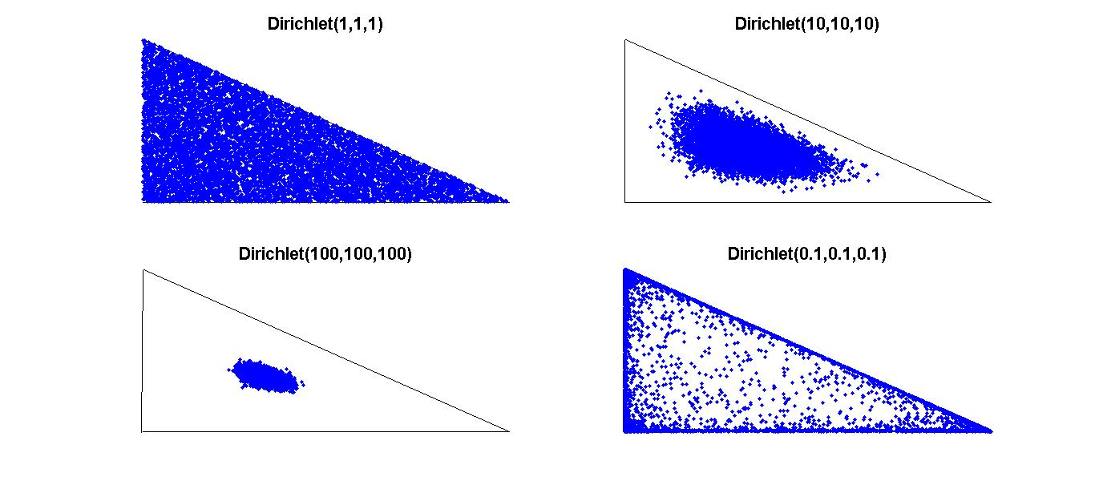

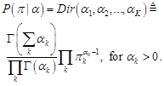
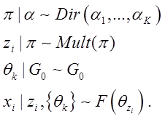
Nonparametric Bayesian Models
Mixture models:
Bayesian mixture model: define a prior over parameters.
Conjugate prior over π (multinomial distribution) is a Dirichlet distribution.
A generative mixture model is defined as:

Slide 7

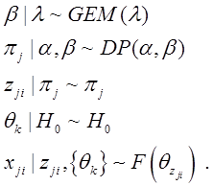
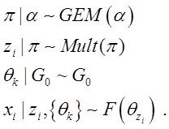
Nonparametric Bayesian Models
Extend to unlimited number of clusters.
Dirichlet distribution ➔ Dirichlet Process
Stick-breaking construction (AKA GEM):
Dirichlet Process Mixture (DPM):
Now consider grouped data (e.g. documents).
The goal is to model each group with a mixture model but also share components.
The result is an Hierarchical Dirichlet Process (HDP):

Slide 8
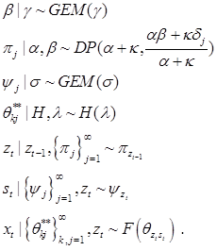

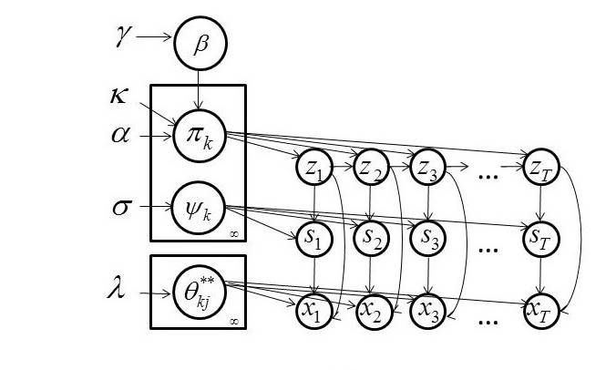
Nonparametric Bayesian Models
Hidden Markov Model (HMM):
A Markov chain where states are not observed.
An observed sequence is the output of a probability distribution associated with each state.
HDPHMM has an infinite number of states and each state output distribution is modeled by a DPM.

Slide 9
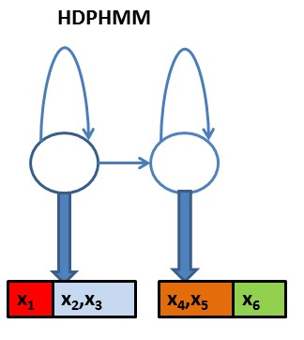
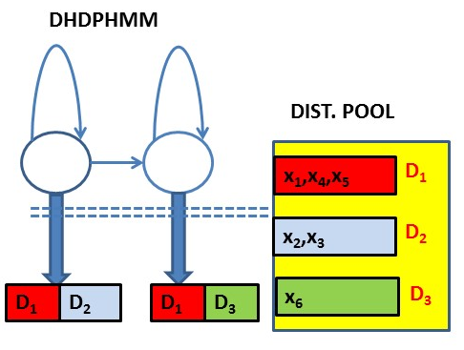
Doubly Hierarchical Dirichlet Process HMM
Problems with HDPHMM:
Due to an unbounded number of states, parameters for each state will be estimated poorly.
The model is restricted to an ergodic structure.
Non-emitting initial and final states are not supported.
Fox et al (2011) introduced a sticky parameter, κ, that biases the model toward models with fewer states.
Hypothesis: Model can be improved if we allow the model to share mixture components across different states.

Slide 10
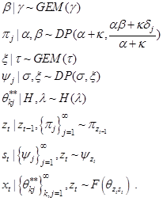
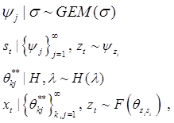
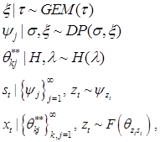
Sharing Mixture Components
An HMM segments the data.
In HDPHMM each state is modeled using a separate DPM.
Each state is also a group and can be modeled by HDP.
Doubly hierarchical Dirichlet process HMM (DHDPHMM):

Slide 11
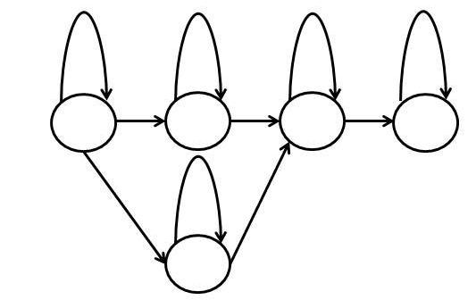

Non-ergodic Structure
Problems with HDPHMM:
Due to an unbounded number of states, parameters for each state will be estimated poorly.
The model is restricted to an ergodic structure.
Non-emitting initial and final states are not supported.
DHDPHMM learns an ergodic structure
Structure is defined by a transition distribution
Any structure is possible (e.g., Left-to-Right (LR) structure)
To obtain an LR structure we need to make sure the probability of transition to states left of state j is zero.

Slide 12


Non-emitting States
Problems with HDPHMM:
Due to an unbounded number of states, parameters for each state will be estimated poorly.
The model is restricted to an ergodic structure.
Non-emitting initial and final states are not supported.
Non-emitting states can be estimated:
ML approach:
Bayesian approach:

Slide 13



Inference Algorithm
Needed to obtain the posterior distributions over different parameters
Approximate the infinite number of states and mixture components
with L and L’
Simplified version:
  Sample the augmented state (z_{t},s_{t}):
  Sample β and ξ:
  Sample π_{k} and ψ_{k}:
  Sample θ_{kj}.
  Sample the hyperparameter and repeat for hundreds of iterations

Slide 14
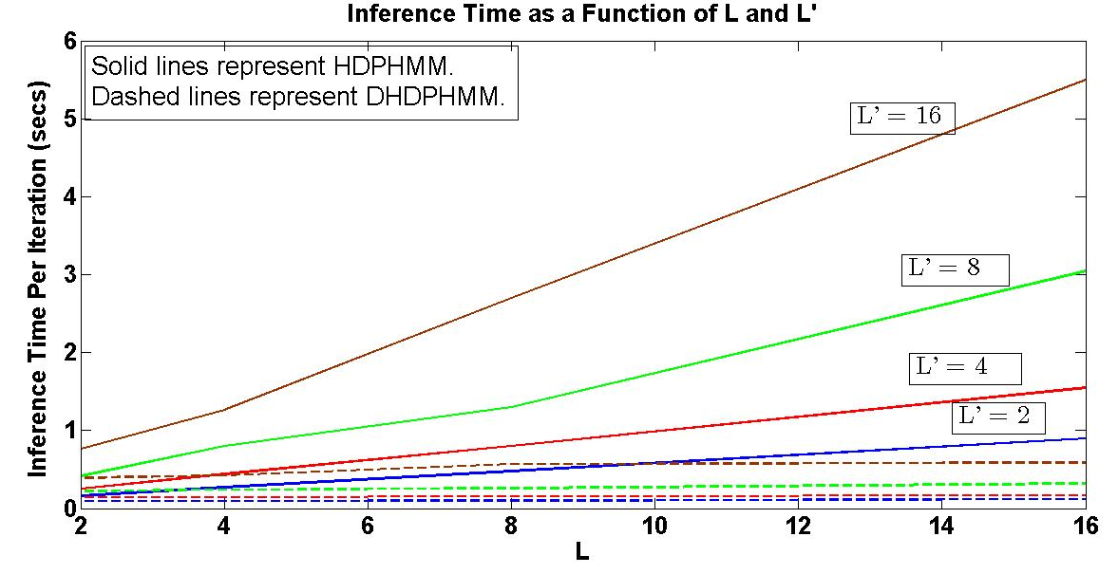
Scaling of Computation Time with Truncation Level

Slide 15
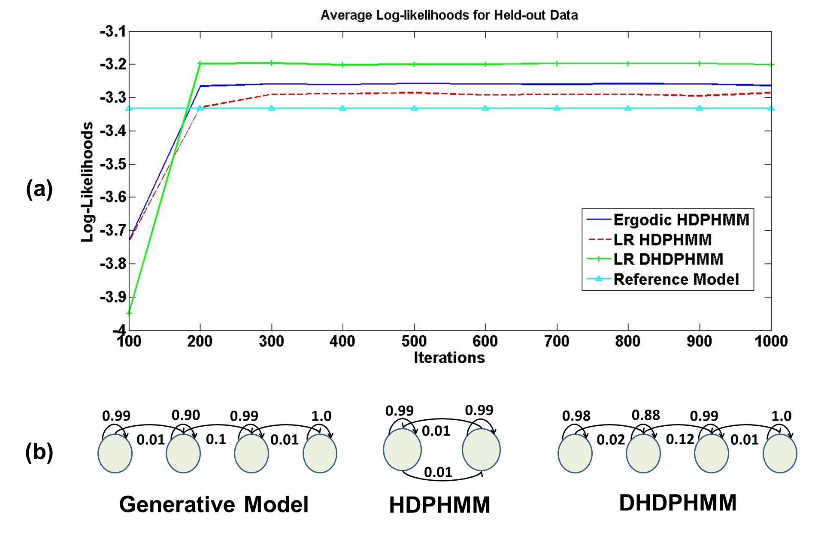
Experiments: Simulated Data

Slide 16
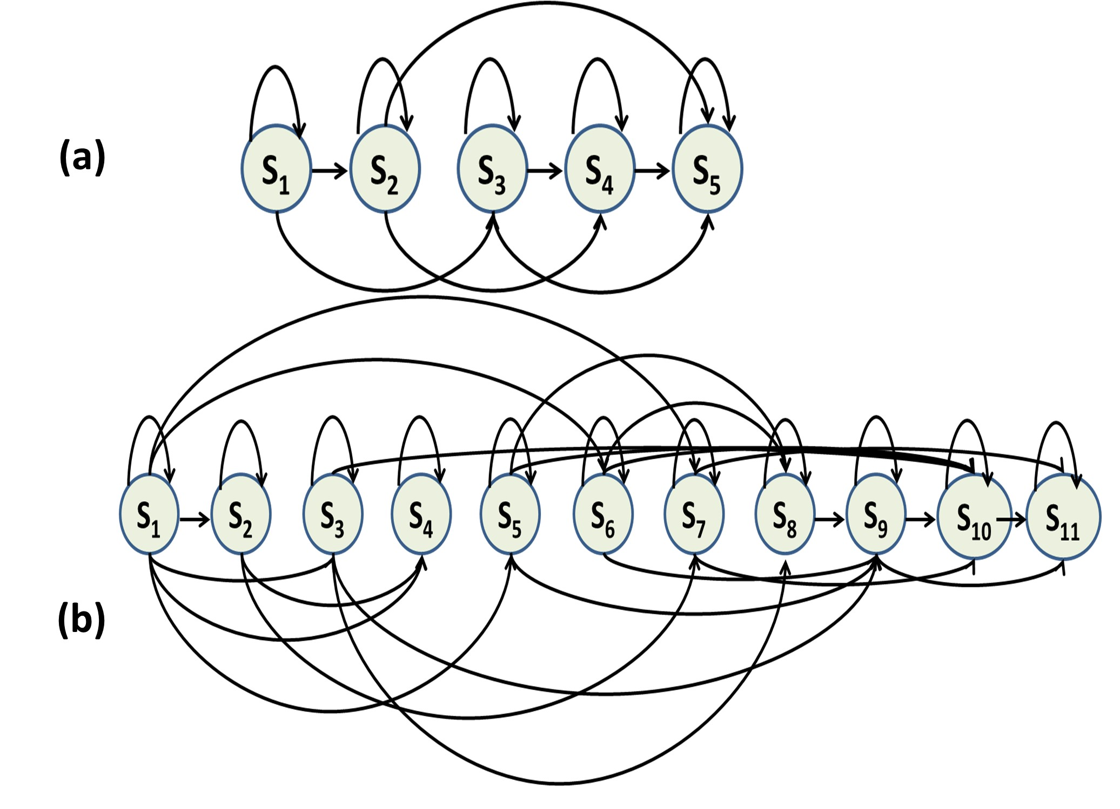
Experiments: Phoneme Classification
Model | Dev Set (% Error) | Core Set (% Error) | No. Gaussians
LR HDPHMM 1 | 23.52% | 24.40% | 4,628
LR HDPHMM 2 | 23.86% | 25.14% | 7,281
Ergodic DHDPHMM | 24.01% | 25.42% | 2,704
Strictly LR DHDPHMM | 39.03% | 38.43% | 2,550
LR DHDPHMM | 20.51% | 21.42% | 3,888
An automatically derived model structure is shown for a LR DHDPHMM model:
/aa/ with 175 examples
/aa/ with 2,256 examples

Slide 17
Experiments: Phoneme Classification
Model | Discrim. | Dev Set (% Error) | Core Set (% Error)
HMM (10 Gauss.) | No | 28.44% | 28.71%
HMM (20 Gauss.) | No | 26.16% | 27.33%
HMM (40 Gauss.) | No | 25.01% | 26.17%
HMM/MMI (20 Gauss.) (Gunawardana et al., 2005) | Yes | 23.20% | 24.60%
HCRF/SGD (Gunawardana et al., 2005) | Yes | 20.30% | 21.70%
Large Margin GMMs (Sha et al., 2006) | Yes | – | 21.10%
GMMs/Full Cov. (Sha et al., 2006) | No | – | 26.00%
SVM (Clarkson et al, 1999) | Yes | – | 22.40%
Data-driven HMM (Petrov et al., 2007) | No | – | 21.40%
Direct Segment Model (Zweig, 2012) | Yes | – | 21.70%
LR DHDPHMM | No | 20.51% | 21.42%

Slide 18
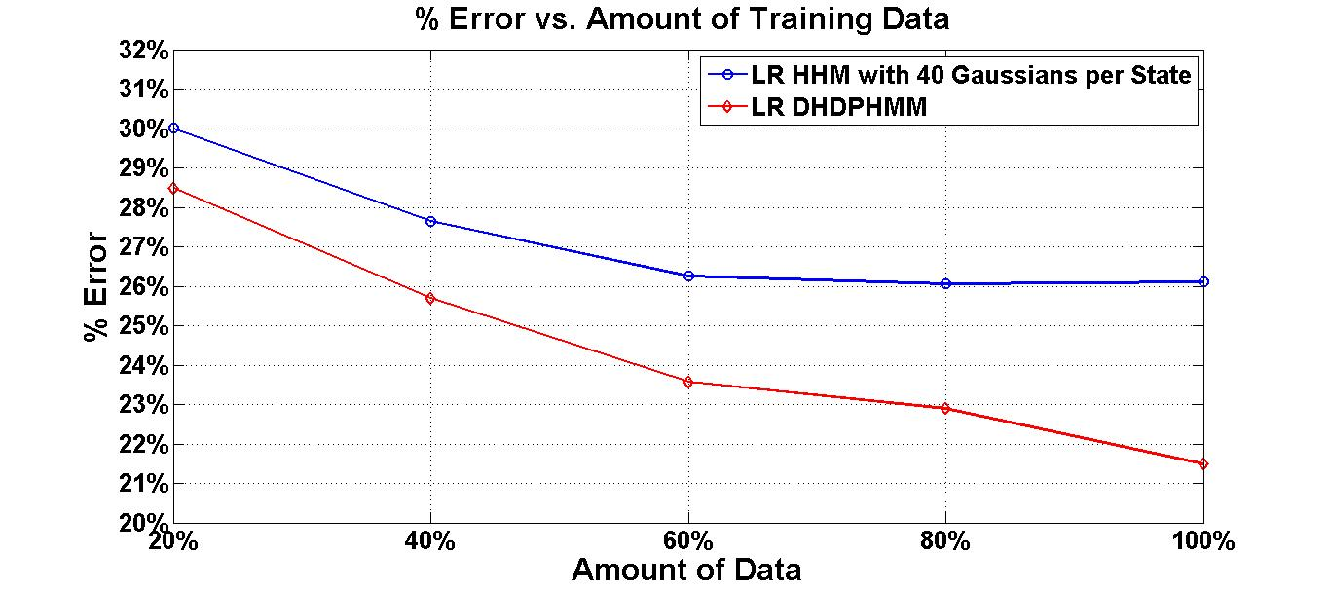
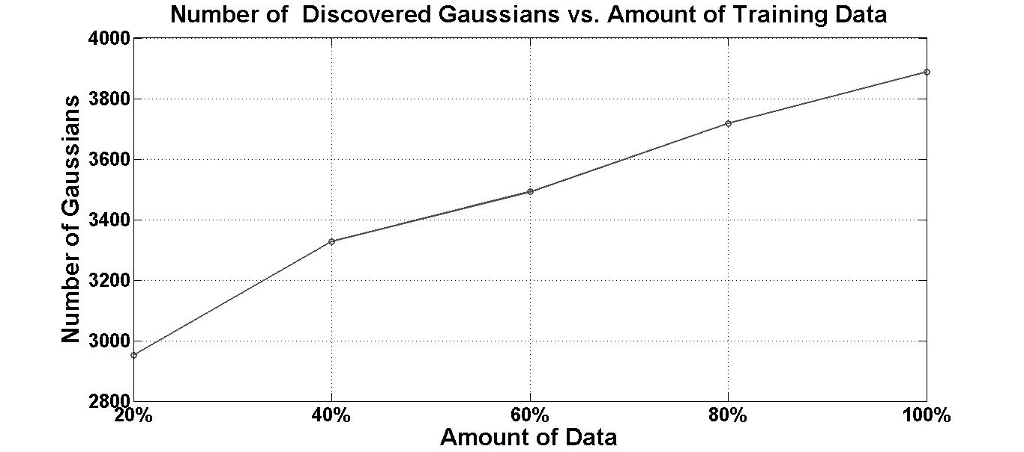
Experiments: Phoneme Classification

Slide 19
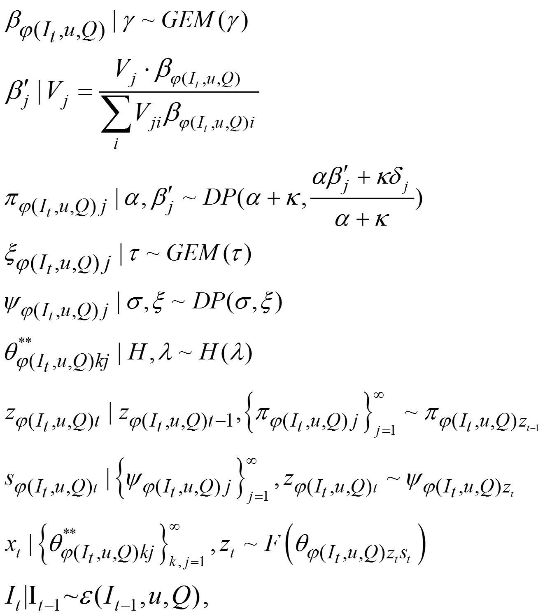
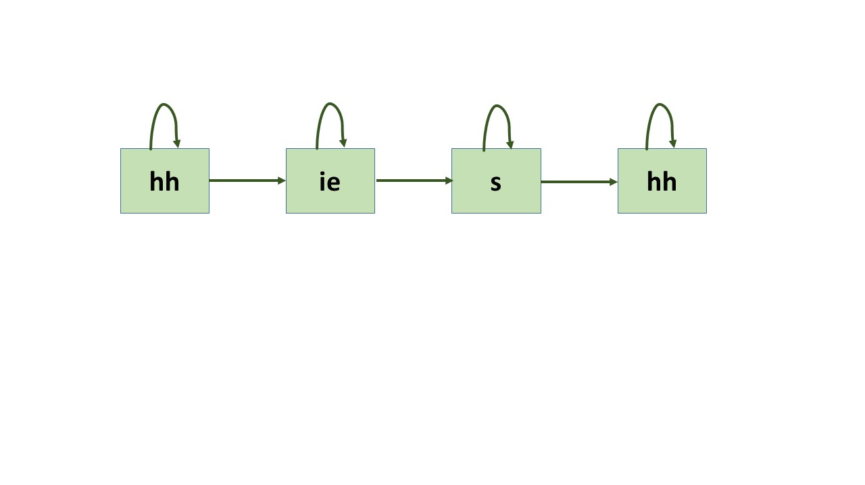

Semi-supervised Training
Boundaries between adjacent phonemes is not known
Composite HMMs are generated by concatenating phoneme models
For DHDPHMM not possible since the model is undefined
Example: /hh ie s hh/
A generative model:
However, the inference algorithm is not computationally efficient.

Slide 20
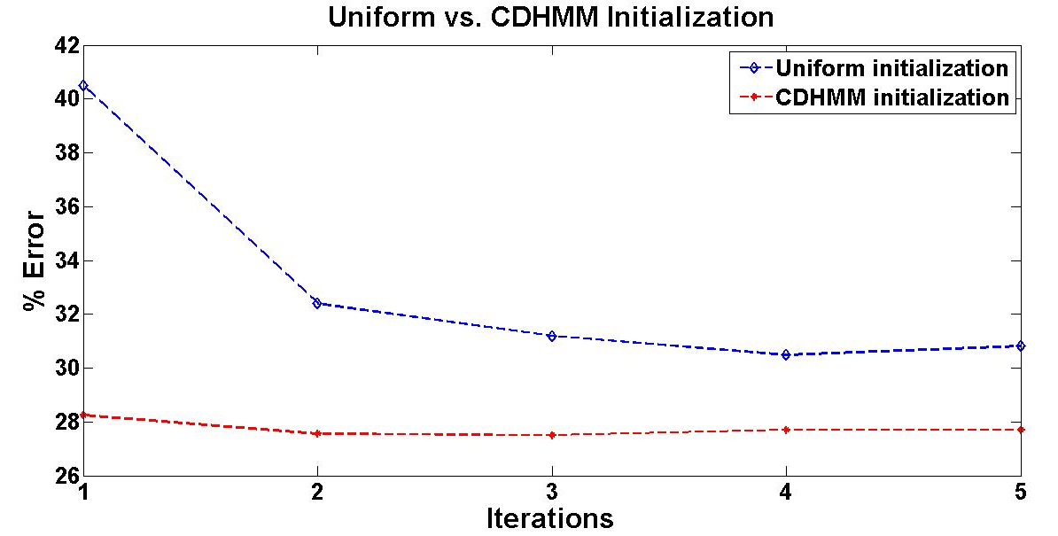
Experiments: Phoneme Recognition
The impact of the initialization of the approximation algorithm

Slide 21
Experiments: Phoneme Recognition
Model | Discrim. | Context | % Error
Baseline CI-HMM | No | No | 31.05%
Baseline CD-HMM | No | No | 27.93%
CD HMM 2 (Lee et al., 89) | No | Yes | 30.90%
CD HMM 3 (Young and Woodland, 94) | No | Yes | 27.70%
HMM MMI / Full Cov. (Kapadia et al. ,93) | Yes | No | 30.30%
CD HMM /DM (Watanabe et al., 2010) | Yes | Yes | 26.70%
Large Margin GMM (Sha and Saul, 2006) | Yes | No | 30.10%
CRF (Morris and Fosler-Lussier, 2008) | Yes | No | 29.90%
CNN/CRF (Palaz et al., 2013) | Yes | Yes | 29.90%
Direct Segmental Model (Zweig, 2012) | Yes | No | 33.10%
CI HCRF – ML initialized (Sung et al., 2009) | Yes | No | 29.00%
HMM-DNN (Hinton et al., 2012) | Yes | Yes | 20.00%
CI LR DHDPHMM | No | No | 29.02%
CD LR DHDPHMM | No | Yes | 27.51%

Slide 22
Acoustic Unit Discovery For Speech Recognition
We require some form of a sub-word acoustic unit.
In most state of the art systems, phonemes have been utilized.
To train a system using phonemes we need transcriptions and a lexicon to map these transcriptions into phonemes.
In the recognition phase, we use a lexicon to map the recognized phonemes into words.
In some applications, we don’t have transcriptions and/or a lexicon.
Phonemes are not necessarily the best option for all languages.
An alternative is to learn the acoustic units from the data.
Most approaches use a two step process: (1) segmentation and (2) clustering.
Segmentation is performed using a heuristic method such as detecting changes in the spectrum.
Clustering is often performed using K-MEANs or decision trees.

Slide 23

Acoustic Unit Discovery For Speech Recognition
Our Approach:
Instead of an initial segmentation/clustering, we first learn a transducer.
Clustering and segmentation is performed simultaneously.
The system is a simple unsupervised speech recognizer that finds the optimum sequence of sub-word units
The result is speaker independent and can generalize to new datasets.
Discovered units are relatively stationary (modeled by mixture of Gaussians).
We refer to the resulting units as Automatically Discovered Units (ADUs), and the transducer as an ADU transducer.
Two problems:
Learning: Use ergodic HDPHMM /DHDPHMM to train the transducer
Decoding : Use Viterbi, Forward-backward or Gibbs sampling to find the optimum path or probability distribution over it (posterior-gram):

Slide 24
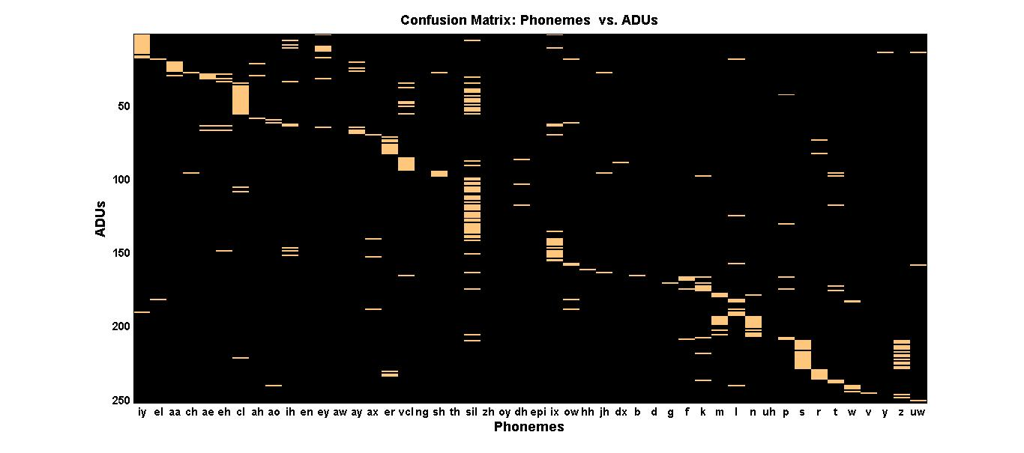
Relationship between ADUs and Phonemes
Algorithm | Recall | Precision | F-score
Dusan & Rabiner (2006) | 75.20 | 66.80 | 70.80
Qiao et al. (2008) | 77.50 | 76.30 | 76.90
Lee & Glass (2012) | 76.20 | 76.40 | 76.30
ADU Transducer | 86.51 | 68.50 | 76.62

Slide 25
Spoken Term Detection by Query
  Task: given a sample of a word (query), find all the occurrences in the dataset.
  Common Approach: leverage a state of the art speech recognizer.
  Drawback: requires a lot of resources that might not be available for a given language (e.g., lexicon, language model, transcribed data).
  Alternate Approach: use unsupervised learning.
Proposed Algorithm:
  Convert the target audio data into posteriorgrams using an ADU transducer.
  For each query, generate its posteriorgram representation.
  Use a subsequence DTW algorithm (Müller, 2007) to obtain a score for each utterance.
  Compare the final score for each utterance with a threshold and return it if the score is greater than the threshold.

Slide 26
Spoken Term Detection by Query
System | P@N | EER
GMM (Zhang & Glass, 2009) | 52.50% | 16.40%
DBM (Zhang et al., 2012) | 51.10% | 14.70%
Nonparametric Bayesian (Lee & Glass, 2012) | 63.00% | 16.90%
Semi-Supervised Triphones (Lee & Glass, 2012) | 75.90% | 11.70%
DHDPHMM ADU | 56.21% | 14.33%
HDPHMM ADU | 61.20% | 13.95%
Combined HDPHMM/DHDPHMM ADU | 64.91% | 11.83%
Query | Discovered
age | message
development | fulfillment
year | deer
year | here
year | behavior
surface | severe

Slide 27
Learning the Lexicon: RM Dataset
Experiment | Context | No. Mixtures | WER (%)
CI Baseline | No | 1 | 24.66
CI Baseline | No | 16 | 9.17
CD Baseline | Phone | 1 | 10.64
CD Baseline | Phone | 16 | 4.84
Direct algorithm | No | 1 | 20.34
Direct algorithm | No | 16 | 11.61
CD direct algorithm | Phone | 1 | 15.81
CD direct algorithm | Phone | 16 | 9.81
System | Context | Corpus | WER (%)
CI low-complexity (1 mix) (Bacchiani et al.,99) | No | RM | 19.70%
high complexity system(Bacchiani at al. , 99) | Word | RM | 11.40%
CD low-complexity (1mix) (Bacchiani et al., 99) | Phone | RM | 13.70%
CI prob. framework (Singh et al., 2002) | No | RM | 20.00%
CI phoneme baseline (Singh et al., 2002) | No | RM | 15.00%

Slide 28
Summary
  Speech Recognition:
  A new nonparametric Bayesian HMM named DHDPHMM has been developed. Through experimentation we have shown that the proposed model outperforms HDPHMM by 14% (21.42% vs. 24.40% error rate).
  It is shown that the performance of this model is better than a discriminatively trained HMM and is similar to other state of the art algorithms for a phoneme classification task (21.42% vs. 24.60%).
  A generative model for semi-supervised training of DHDPHMM is introduced. Through experimentation we have shown that CI DHDPHMM outperforms a baseline HMM trained using maximum likelihood or MMI (28.36% vs. 30.30%).
  Speech segmentation and acoustic unit discovery:
  Segmentation performance of an ADU transducer is shown to be better than an unsupervised baseline (76.62% vs. 70.80% F-score) and can be compared with state of art semi-supervised algorithms.
  A simple unsupervised STD by query algorithm based on an ADU transducer performs better than other unsupervised algorithms.
  A semi-supervised algorithm to learn a lexicon from acoustic observations and a parallel word-level transcription has been shown to learn ADUs that generalize and results in competitive performance at lower complexity.

Slide 29
Future Directions
Nested DHDPHMM: sharing mixture component across states is proven to be a useful extension of HDPHMM. Another level of generalization is to share components across models. This can be achieved with another level in the hierarchy. The resulting model can be used for direct context modeling among other applications.
Different Priors: We have used Dirichlet process priors in all models developed or used in this dissertation. It has been shown that DP impose certain learning constraints on the model therefore it is important to study other type of priors for problems discussed in this dissertation.
HDPHMM/DHDPHMM with HMM State: We can extend the HDPHMM model by using hierarchical HMMs (HHMMs) in the definition. This allows us to learn models with nonstationary states.
Other Potential Topics: Use larger and more difficult datasets, discriminative training, and hybrid DHDPHMM/DNN approaches.

Slide 30
References
Harati, A., Picone, J., & Sobel, M. (2013). Left-to-Right HDP-HMM with HDP Emission. Proceedings of the International Conference on Computational Science and Computational Intelligence (CSCI) (pp. 1–7). Las Vega, Nevada, USA.
Fox, E., Sudderth, E., Jordan, M., & Willsky, A. (2011). A Sticky HDP-HMM with Application to Speaker Diarization. The Annalas of Applied Statistics, 5(2A), 1020–1056.
Harati, A., Picone, J., & Sobel, M. (2012). Applications of Dirichlet Process Mixtures to Speaker Adaptation. Proceedings of the IEEE International Conference on Acoustics, Speech and Signal Processing (pp. 4321–4324). Kyoto, Japan.
Harati, A., Picone, J., & Sobel, M. (2013). Speech Segmentation Using Hierarchical Dirichlet Processes. Proceedings of the IEEE International Conference on Acoustics, Speech and Signal Processing (p. TBD). Vancouver, Canada.
Lefèvre, F. (n.d.). Non-parametric probability estimation for HMM-based automatic speech recognition. Computer Speech & Language, 17(2-3), 113–136.
Rabiner, L. (1989). A Tutorial on Hidden Markov Models and Selected Applications in Speech Recognition. Proceedings of the IEEE, 77(2), 879–893.
Sethuraman, J. (1994). A constructive definition of Dirichlet priors. Statistica Sinica, 639–650.
Young, S., & Woodland, P. C. (1994). State Clustering in HMM-Based Continuous Speech Recognition. Computer Speech & Language, 8(4), 369–383.
Bacchiani, M., & Ostendorf, M. (1999). Joint Lexicon, Acoustic Unit Inventory and Model Design. Speech Communication, 29(2-4), 99–114.
Lee, C., & Glass, J. (2012). A Nonparametric Bayesian Approach to Acoustic Model Discovery. Proceedings of the Association for Computational Linguistics (pp. 40–49). Jeju, Republic of Korea.
Teh, Y., Jordan, M., Beal, M., & Blei, D. (2006). Hierarchical Dirichlet Processes. Journal of the American Statistical Association, 101(47), 1566–1581.

Slide 31
Selected Publications
Published: 3 journals (1 author / 2 co-author), 7 peer-reviewed conference papers (6 author / 1 co-author), 2 conference presentations (2 co-author), 5 invited presentations (5 co-author), 4 patent disclosures
Relevant Journal papers:
Sahu, A., at al. (2014). Characterization of Mammary Tumors Using Noninvasive Tactile and Hyperspectral Imaging. IEEE Sensors Journal, 14(10), 3337–3344.
Harati, A., & Picone, J. (2014). Predicting Search Term Reliability for Spoken Term Detection Systems. International Journal of Speech Technology, 17(1), 1–9. (Download).
Parker, D., Picone, J., Harati, A., Lu, S., Jenkyns, M., & Polgreen, P. (2013). Detecting paroxysmal coughing from pertussis cases using voice recognition technology. PLoS ONE, 8(12), e82971.
Relevant Conference Papers:
Harati Nejad Torbati, A. H., Picone, J., & Sobel, M. (2014). A Left-to-Right HDP-HMM with HDPM Emissions. Proceedings of the Conference on Information Sciences and Systems (pp. 1–6). Princeton, New Jersey, USA.
Harati, A., Choi, S. I., Tabrizi, M., Obeid, I., Jacobson, M., & Picone, J. (2013). The Temple University Hospital EEG Corpus. Proceedings of the IEEE Global Conference on Signal and Information Processing. (pp. 29-32). Austin, Texas, USA. (Download).
Harati, A., Picone, J., & Sobel, M. (2013). Speech Segmentation Using Hierarchical Dirichlet Processes. Proceedings of INTERSPEECH (pp. 637-641). Lyon, France. (Download).
Harati, A., & Picone, J. (2013). Assessing Search Term Strength in Spoken Term Detection. Proceedings of the IEEE International Multi-Disciplinary Conference on Cognitive Methods in Situation Awareness and Decision Support (CogSIMA) (pp. 114-117). San Diego, California, USA.
Harati, A., Picone, J., & Sobel, M. (2012). Applications of Dirichlet Process Mixtures to Speaker Adaptation. Proceedings of the IEEE International Conference on Acoustics, Speech and Signal Processing (pp. 4321-4324). Kyoto, Japan.

Slide 32
Selected Papers In Review and Under Development
In Review / Under Development: 1 book, 3 journals, 3 peer-reviewed conference papers
Book:
A. Harati, T. Ma, S. Sundaram, G. Lazarou and J. Picone (2016). Nonlinear Statistics for Acoustic Modeling in Speech Recognition. Springer (under development).
Journal Papers:
Harati, A., & Picone, J. (2015). A Doubly Hierarchical Dirichlet Process Hidden Markov Model with a Non-Ergodic Structure. IEEE/ACM Trans. on Audio, Speech, and Language Proc. (in review).
Harati, A., & Picone, J. (2015). Semi-supervised training of DHDPHMM for Acoustic Modeling. IEEE/ACM Transactions on Audio, Speech, and Language Processing (under development).
Harati, A., & Picone, J. (2015). Nonparametric Bayesian Acoustic Unit Discovery and Lexicon Learning. IEEE/ACM Trans. on Audio, Speech, and Language Processing (under development).
Conference Papers:
Harati A., & Picone (2016). A Nonparametric Bayesian Spoken Term Detection By Query System. Proceedings of INTERSPEECH (under development).
Harati A., & Picone (2016). Automatic Acoustic Unit and Lexicon Discovery Using An HDPHMM Transducer. Proceedings of INTERSPEECH (under development).
Harati, A., & Picone, J. (2015). Doubly Hierarchical Dirichlet Process Mixture Model For Acoustic Modeling. IEEE Automatic Speech Recognition and Understanding Workshop, Scottsdale, Arizona, USA (under development).
Several first-tier journal and conference papers are under development for AutoEEGTM. Publication of this work was not possible until the patent disclosures were filed.

Slide 33
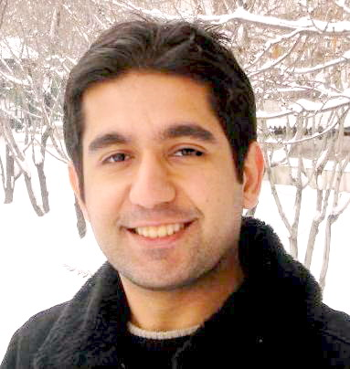
Biography
Amir Harati is a PhD candidate in the Department of
Electrical and Computer Engineering at Temple University.
He received his Bachelor’s Degree from Tabriz University
in 2004 and his Master’s Degree from K.N. Toosi University
in 2008, both in Electrical and Computer Engineering. He
has also worked as signal processing researcher for Bina-
Pardaz LTD in Mashhad, Iran, where he was responsible for
developing algorithms for geolocation using a variety of
types of emitter technology.
He is currently pursuing a PhD in Electrical Engineering at Temple University. The focus of his research is the application of nonparametric Bayesian methods in acoustic modeling for speech recognition. He is also the senior scientist on a commercialization project involving a collaboration between Temple Hospital and the Neural Engineering Data Consortium to automatically interpret EEG signals.
Mr. Harati has published several journal, numerous conference papers and is co-author of one book (in preparation). He is also co-inventor on four patents disclosures. He is a member of the IEEE and HKN (Eta Kappa Nu). Upon successful completion of his PhD, he will begin employment at Jibo, Inc. (www.jibo.com) as a speech recognition technologist.

Slide 34
Appendix
Backup Slides

Slide 35
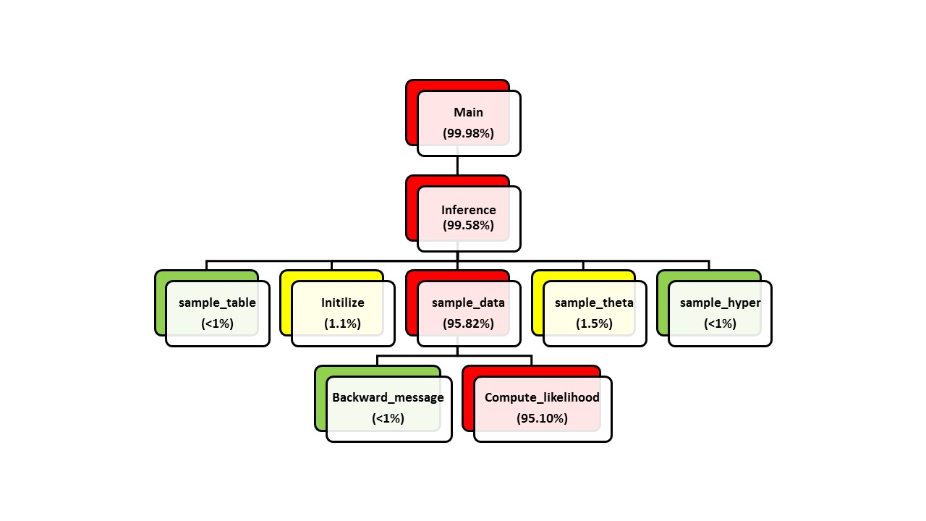
Computational Profile
A C++ toolkit (with a command line interface and an API) is available here¹.
HDPHMM, DHDPHMM, DPM and HDP are supported.
1. See http://www.isip.piconepress.com/projects/npb_acoustic_modeling/downloads/hdphmm/.

Slide 36
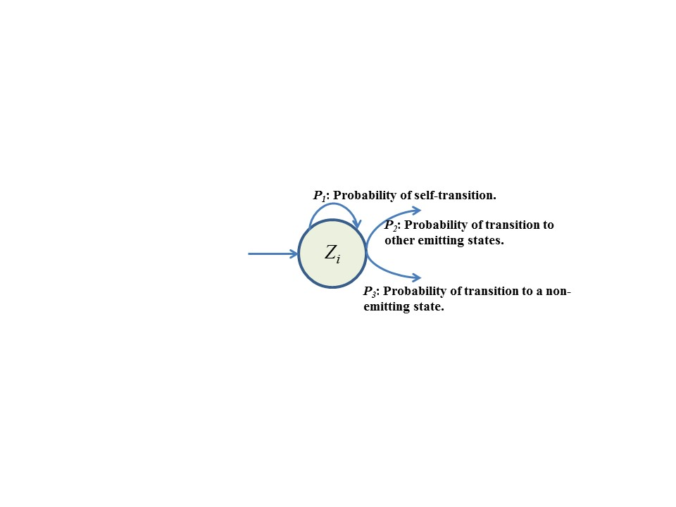
Non-emitting States
Problems with HDPHMM:
Due to an unbounded number of states, parameters for each state will be estimated poorly.
The model is restricted to an ergodic structure.
Non-emitting initial and final
states are not supported.
Non-emitting states are important
for modeling finite length sequences
and are also utilized in semi-supervised
training.
Two approaches:
Maximum likelihood (ML):
Bayesian:

Slide 37
Integrated Models
Using ML for non-emitting states:
Using Bayesian for non-emitting states:
Modified stick breaking algorithm:

Slide 38
Semi-Supervised Training
Approximate Algorithm:
Initialize the alignment using a heuristic method.
Use the alignment to generate a list of examples for each DHDPHMM.
Use examples generated in Step 2 to train each DHDPHMM using the modified block sampler.
Use models obtained in Step 3 to time align the labels to observations using the Viterbi algorithm (by first generating a composite HMM for each utterance).
If the maximum number of iterations is reached or a convergence criterion is met, exit. Otherwise, return to Step 2.

Slide 39
Segmentation
Recall: co-occurrences of segments and phoneme boundaries
Precision: Percent of declared boundaries that coincide with phoneme boundaries.
Algorithm | Recall | Prec. | F-score
Dusan & Rabiner (2006) | 75.20 | 66.80 | 70.80
Qiao et al. (2008) | 77.50 | 76.30 | 76.90
Lee & Glass (2012) | 76.20 | 76.40 | 76.30
ADU Transducer | 86.51 | 68.50 | 76.62

Slide 40
Learning the Lexicon
Learning the Lexicon:
If we define a new set of acoustic units (e.g. ADUs) we need to learn a lexicon to map words into these units.
Most approaches learn the lexicon and acoustic unit jointly.
We learn a lexicon in a separate step from learning the ADU transducer. This allows us to study the generalization property of ADU transducer.
Semi-Supervised Algorithm:
Generate the posteriorgram for all utterances using the ADU transducer.
Generate an approximate alignment between the words and ADU units.
Use the aligned transcription to extract all examples of each word.
Use DTW to compute the edit distance between every pair of examples.
For all k, accumulate the distance between the k^{th} example and all other examples.
Select the M examples with the minimum average distance as representatives for that word.
Use the lexicon and acoustic units generated in Step 6 to build a speech recognizer.
Use the speech recognizer built in Step 7 to force align the transcriptions.
Use the aligned transcriptions to extract all examples of each word.
Return to Step 4 until convergence.

Slide 41
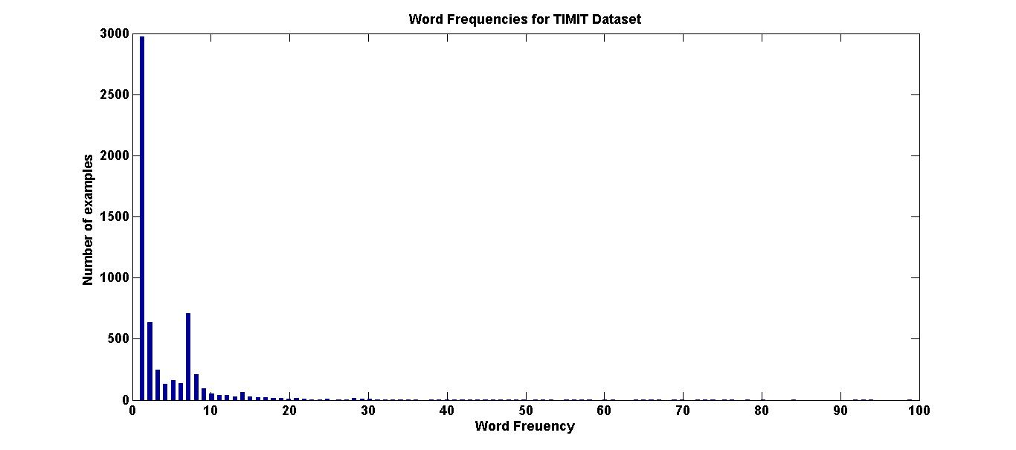
Learning the Lexicon: TIMIT

Slide 42
Learning the Lexicon: TIMIT
The results of closed loop training of a lexicon for TIMIT:
System | Lexicon Size | Perplexity | WER (%)
Reference Lexicon | 5,850 | 80 | 24.79
Reference Lexicon | 5,850 | 16 | 5.66
Supervised ADU, M=1 | 5,850 | 80 | 32.75
Supervised ADU, M=3 | 12,933 | 80 | 22.20
Supervised ADU, M=5 | 16,474 | 80 | 20.19
Supervised ADU, M=10 | 18,879 | 80 | 19.15
Supervised ADU, M=10 | 18,879 | 16 | 5.20
Supervised ADU, M=30 | 25,187 | 80 | 15.03
Supervised ADU, M=30 | 25,187 | 16 | 4.41
The results of open loop training of a lexicon for TIMIT:
Experiment | Test Subset | WER (%)
Baseline | full | 24.79
Baseline | test-94 | 24.04
Direct Learning | test-94 | 42.77
G2P | test-94 | 37.46
G2P | full | 37.03

Slide 43
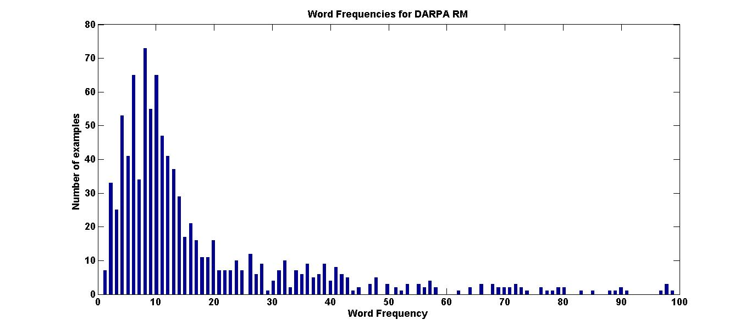
Learning the Lexicon: RM

Slide 44
Learning the Lexicon: RM
Word | Pronun. | ADU Pronunciation
Between | b ax t w iy n | u69 u13 u126 u6 u44 u191 u49 u14 u182 u42 u68 u200 u202 u224 u130 u225 u242 u208 u34 u66 u138 u107 u210
Bring | b eh r ih ng | u69 u13 u126 u6 u213 u197 u22 u34 u138 u107 u210
Been | b ih n | u66 u69 u13 u223 u123 u79 u46 u45 u138 u107 u210
Carry | k eh r iy | u235 u78 u42 u68 u200 u202 u48 u75 u89 u133 u22 u193 u58
We | w iy | u26 u142 u208 u193 u58
March | m aa r td ch | u184 u131 u160 u26 u120 u222 u201 u70 u152 u57 u42 u204 u188 u54 u16 u65
Mars | m aa r z | u131 u160 u26 u157 u120 u197 u222 u103 u177 u4 u54 u194 u65

Slide 45
Learning the Lexicon: RM
System | Context | Corpus | WER
CI low-complexity (1 mix) (Bacchiani et al.,99) | No | RM | 19.70
High complexity system(Bacchiani at al. , 99) | Word | RM | 11.40
CD low-complexity (1mix) (Bacchiani et al., 99) | Phone | RM | 13.70
CI prob. framework (Singh et al., 2002) | No | RM | 20.00
CI phoneme baseline (Singh et al., 2002) | No | RM | 15.00
CI Nonparametric Bayesian (Lee, 2014) | No | Jupiter | 17.00
CD Nonparametric Bayesian (Lee, 2014) | Phone | Jupiter | 13.40
CI phoneme baseline Jupiter(Lee, 2014) | No | Jupiter | 13.80
CD phoneme baseline Jupiter (Lee, 2014) | Phone | Jupiter | 10.00
Experiment | Context | Mix No. | WER (%)
CI Baseline | CI | 1 | 24.66
CI Baseline | CI | 16 | 9.17
CD Baseline | CD | 1 | 10.64
CD Baseline | CD | 16 | 4.84
Direct algorithm | CI | 1 | 20.34
Direct algorithm | CI | 16 | 11.61
direct + G2P | CI | 16 | 20.33
CD direct algorithm | CD | 1 | 15.81
CD direct algorithm | CD | 16 | 9.81

