Slide 1
Establishing shared features in electroencephalograms
PhD Preliminary Exam
Temple University
College of Engineering
Department of Electrical Engineering
Christian Ward
3 Dec 2015

Slide 2
Outline
Background
Motivation for EEG Research
EEG testing methods
Literature Review
Makeig
Peng
Wulsin
Field of Interest
Applications

Slide 3
Background
Motivation for this field of research
Current applications and tools

Slide 4
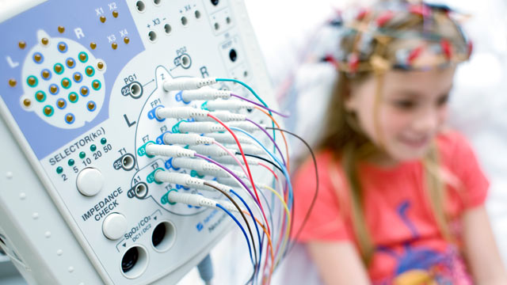
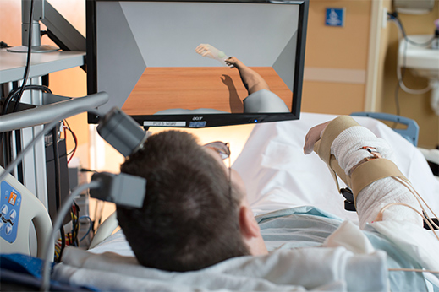
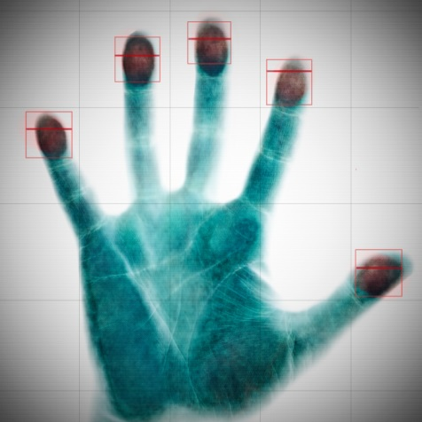
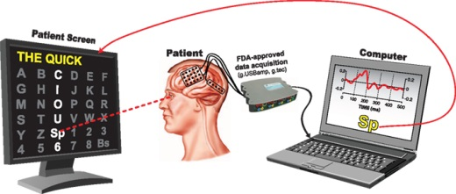
Motivation
Clinical Diagnosis
Functional Restoration
Biometric Security
Stimulus Feedback
TopLeft – MIT Technology Review. Paralyzed Man’s Arm Wired to Receive Brain Signals. 2015. http://www.technologyreview.com/news/542581/paralyzed-mans-arm-wired-to-receive-brain-signals/
BottomLeft – Peter Brunner et al. Rapid communication with a “P300” matrix speller using electrocorticographic signals (ECoG).” Neuroscience. 2011.

Slide 5
Applications
Detection of external and internal stimulus responses
P300, drug studies, behavioral studies, diagnostics
Control of external devices, feedback
Video games, muscle innervation, prosthesis and augmentation
Brain mapping of physical network
EEG, fMRI, and MEG
Prediction of shifts in brain state
Alertness, disease triggers, loss of function
Notes:
Be careful of mapping, easy to get tangential to direction of research

Slide 6
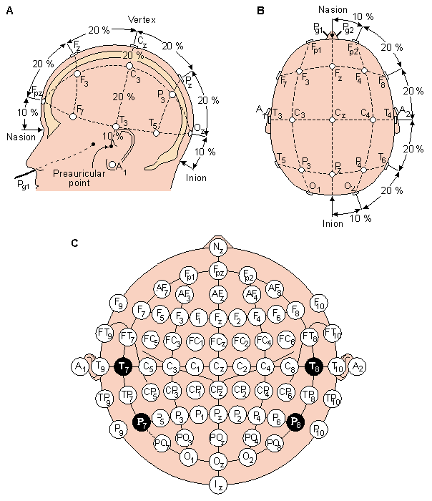
Testing Methods
EEG electrode mappings
10-20 system, pictured
Intracranial EEGs
Filtering techniques
Spatial filtering, known brain structures
Artifact removal – eye blinks, muscle contractions
Stimulus Triggers
Evoked Response Potentials (ERPs)
Medication or simulated stressors
Objective movement tasks
University of San Diego. BCI2000 Wikipedia. 2015. http://www.bci2000.org/wiki/index.php/User_Tutorial:EEG_Measurement_Setup.
Notes:
Control, quantify and time sync from stimulus triggers is difficult

Slide 7
Literature Review
Scott Makeig et al. Mining Event-Related Brain Dynamics
Hanchuan Peng et al. Feature Selection Based on Mutual Information: Criteria of Max-Dependency, Max-Relevance, and Min-Redundancy
D F Wulsin et al. Modeling electroenchephalography waveforms with semi-supervised deep belief nets: fast classification and anomaly measurement

Slide 8
Mining Brain Dynamics
Using surface EEG activity to resolve physical location of brain activity and categorizing the associated stimulus response.
Scott Makeig, et al. Mining Event-Related Brain Dynamics. TRENDS in Cog. Neuro. 2004.
Notes:
Makeig et al designed an inverse method in which surface EEG activity was used to infer the physical location of activations in the brain. Whereas other investigators focused on averaged ERPs, Makeig et al focused on individual responses to categorize brain activation.

Slide 9
Event-related Potentials (ERPs)
Triggered in response to auditory or visual stimulus in all subjects with relatively consistent temporal resolution within a subject
University of Waterloo. Event Related Potential Lab. 2015.
https://uwaterloo.ca/event-related-potential-lab/about-event-related-potential-lab/our-research
Notes:
Notice timeline on eample. 0 to 600ms, Makeig’s work -500ms to 1500ms! Full dynamic response over time

Slide 10
Event-related Spectral Perturbations (ERSPs)
Energy changes over the course of the temporal event across the frequency spectrum capture the dynamic environment of the brain
Scott Makeig et al. “Dynamic brain sources of visual evoked responses”. Science. 2002

Slide 11
Inter-trial Coherence (ITC)
Changes in the phase are unnoticed in the frequency energy levels, but signify a temporal component of the stimulus response.
Scott Makeig et al. “Dynamic brain sources of visual evoked responses”. Science. 2002

Slide 12
Data
Source EEG is 71 channels
69 for data following 10-20 layout
2 for ground/reference
ERSP and ITC
Calculated at specific electrodes of interest, determined from ICA results
ERP
Not time average over all stimuli responses
Scott Makeig, et al. Mining Event-Related Brain Dynamics. TRENDS in Cog. Neuro. 2004.

Slide 13
Independent Component Analysis (ICA)
ICA with Infomax specially made by the group called runica
Spatial filtering and data reduction leading to location mapping on the scalp
Results of ICA return 20 maximally independent components whose scalp maps resemble a dipole projection
Nader Karamzadeh. “Capturing dynamic patterns of task-based functional connectivity with EEG.” NeuroImage. 2013.
Notes:
Infomax – attempts to maximize the mutual information between the input values I and the output values O via learning. Typically used by maximizing entropy in ICA, so the inverse ensuring that entropy is high (randomness is at a max) making the two minimally dependent on each other and thus maximally independent

Slide 14
State space of event related dynamics
Categories of responses:
ERPs
Event-related desynchronizations (ERDs)
Event-related synchronizations (ERSs)
Partial phase-resetting (PPR)
“?” as of yet, an unlabeled feature
Scott Makeig, et al. Mining Event-Related Brain Dynamics. TRENDS in Cog. Neuro. 2004.

Slide 15
Conclusion
Improvements in cognitive neuroimaging and neuroscience now that brain dynamics can be categorized and mapped on a trial by trial basis
Potential to “index brain pathophysiology more accurately than conventional measures” and “may bring non-invasive and invasive electrophysiological research into [a] more direct relationship”.

Slide 16
Feature Selection Based on Mutual Information
Introduction of the minimal-redundancy-maximal-relevance (mRMR) criterion as a feature selector and comparison against peers
Hanchuan Peng et al. Feature Selection Based on Mutual Information: Criteria of Max-Dependecny, Max-Relevance, and Min-Redundancy. IEEE Trans. Pattern Analysis and Machine Intelligence. 2005
Notes:
This paper presents a novel optimization metric for evaluating feature utility.

Slide 17
Mutual Information
Insight into the activity of one random variable if the state of a different random variable is known
Can be extrapolated to multiple dependencies, but requires some data to build the probability models
$$I\left(x;y\right)=∫p\left(x,y\right)log \frac{p(x,y)}{p\left(x\right)p(y) }dxdy$$
Notes:
Parzen windows! Discrete to continuous

Slide 18
Feature Selectors
Maximal Dependency
To achieve the minimal classification error rate of m features from a given set S(x₁ … x_{m}), one needs the maximal statistical dependency of the targeted class (c).
$$\max{\{D=I(\left\{x_{i},i=1,…,m\right\};c)}\}$$
Maximal Relevance
Select m features from a set (S) with the highest relevance to the target class (c), generally interpreted as features with high mutual information with the target class.
$$\max{D\left(S,c\right), D=\frac{1}{\left|S\right|}\sum_{x_{i}∈S}{I(x_{i};c)}}$$
Notes:
To minimize the classification error of a set S of m features (x1 .. xm), one needs to maximize the mutual information between the targeted class c and the set S.

Slide 19
Feature Selectors, cont.
Minimal Redundancy
Select features with the least overlap among their mutual information, often without aid of the target class
$$\min{R\left(S\right), R=\frac{1}{{\left|S\right|}^{2}}\sum_{x_{i},x_{j}∈S}{I(x_{i};x_{j})}}$$
“Minimal-Redundancy-Maximal-Relevance”
Combination rating of the difference between relevance and redundancy, using redundancy as a penalty
$$\max{Φ\left(D,R\right),Φ=D−R}$$

Slide 20
Filters and Wrappers
Forward Wrapper
Add features along an optimization parameter
Backward Wrapper
Remove features along an optimization parameter
Filters do not directly optimize the minimum classification error rate, however they often generate sets that span classifiers robustly
Ex: mRMR & Max-Relevance

Slide 21
Classifiers and Data
Classifiers
Naïve Bayes (NB)
Support Vector Machines (SVM)
Linear Discriminant Analysis (LDA)
Testing Method
10-fold cross validation (10-fold CV)
Leave One Out Cross Validation (LOOCV)
Continuous Data
NCI – National Cancer Institute gene data
LYM – Lymphoma gene features
Discrete Data*
HDR – handwritten digits
ARR – Arrhythmia Data
*made discrete via a Parzen window
Notes:
Naïve Bayes – Given x how likely is y if we know the likelihood of x occurring in relation with other random variables
LDA – dot product to

Slide 22
Data
Hanchuan Peng et al. Feature Selection Based on Mutual Information: Criteria of Max-Dependency, Max-Relevance, and Min-Redundancy. IEEE Trans. Pattern Analysis and Machine Intel. 2005

Slide 23
Wrapper Effectiveness, Classifier Error
mRMR outperforms other features across nearly all classifiers and data sets, however the performance is not consistent
Hanchuan Peng et al. Feature Selection Based on Mutual Information: Criteria of Max-Dependecny, Max-Relevance, and Min-Redundancy. IEEE Trans. Pattern Analysis and Machine Intelligence. 2005
Notes:
Label numbers. Why not in that one case of NCI, LDA, mRMR? NEW SLIDE

Slide 24
Computational Effectiveness
mRMR’s time to compute features is a considerable improvement on continuous data. Using 40 features exceeds the number of classes in each data set and, in some cases, exceeds the number of training samples.
Hanchuan Peng et al. Feature Selection Based on Mutual Information: Criteria of Max-Dependecny, Max-Relevance, and Min-Redundancy. IEEE Trans. Pattern Analysis and Machine Intelligence. 2005

Slide 25
Conclusion
Given enough features mRMR always wins out, but with less features the results aren’t clear. The best feature selection does not indicate the best number of features.
Hanchuan Peng et al. Feature Selection Based on Mutual Information: Criteria of Max-Dependecny, Max-Relevance, and Min-Redundancy. IEEE Trans. Pattern Analysis and Machine Intelligence. 2005

Slide 26
Semi-supervised Deep Belief Nets
Performance of a raw data fed Deep Belief Network for real time feature detection compared to other common techniques
D F Wulsin et al. Modeling electroencephalography waveforms with semi-supervised deep belief nets: fast classification and anomaly measurement. J. Neural Eng.. 2011

Slide 27
Data Sets and Evaluation
Data Source
256Hz sample rate from 11 patients
Separated into channel-seconds pulled randomly from 13 2hr annotated segments
All data is normalized
raw256
Uses the original data source
feat16
KNN (k=3) selected hand-define features
pca20
Resolves first 20 eigenvectors that account for 92.75% of the variance
Detection performance stems from the F₁ measure
Speed is evaluated w.r.t. performance in seconds
$$F_{1}=2\frac{sensitivity∙precision}{sensitivity+precision}$$
Notes:
More notes about the data

Slide 28
Features
Background
Spike & Sharp Wave
GPED & Triphasic
PLED
Eye Blink
D F Wulsin et al. Modeling electroencephalography waveforms with semi-supervised deep belief nets: fast classification and anomaly measurement. J. Neural Eng.. 2011
Notes:
GPED – generalized periodic discharge
PLED – periodic lateralized epileptiform discharge

Slide 29
Classifiers
Decision Trees (DTs)
Using Gini diversity index where R is the data set and p the probabilities of each item in the set
Support Vector Machines (SVMs)
Using radial basis function kernel where x and x’ are two samples and σ is a free parameter
$$I_{G}=1 − \sum_{i=1}^{R}{p_{i}^{2}}$$
$$K\left(x,x^{′}\right)=exp⁡\left(−\frac{{\left\|x−x^{′}\right\|}^{2}}{2σ^{2}}\right)$$

Slide 30
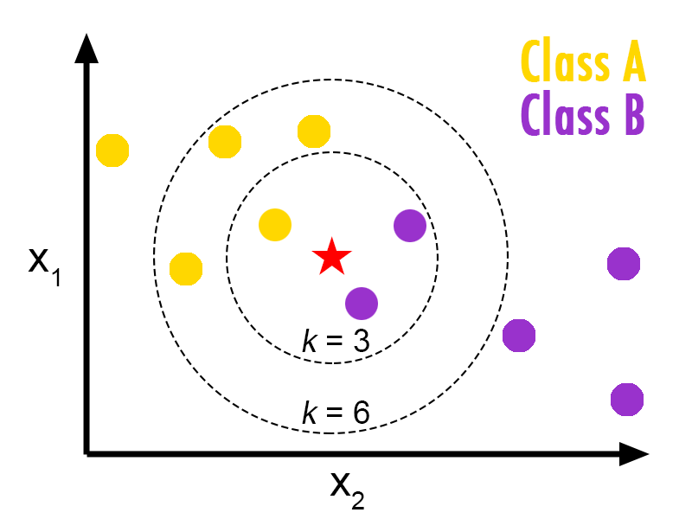
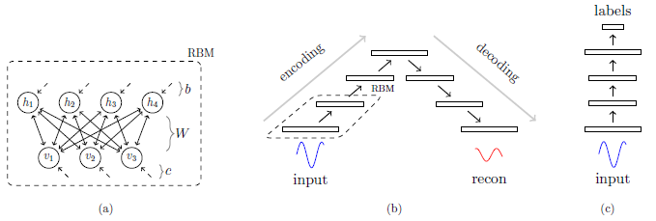
Classifiers, cont.
K-Nearest Neighbor (KNN)
Nonparametric clustering based upon
Deep Belief Networks (DBNs)
Layered neural network useful in supervised and unsupervised learning
LEFT: Burton DeWilde. Classification of Hand-written Digits. 2012. http://bdewilde.github.io/blog/blogger/2012/10/26/classification-of-hand-written-digits-3/
RIGHT: D F Wulsin et al. Modeling electroencephalography waveforms with semi-supervised deep belief nets: fast classification and anomaly measurement. J. Neural Eng.. 2011

Slide 31
Boltzmann Machines
$$E\left(v,h\right)=− \sum_{i}{a_{i}v_{i}}\sum_{j}{b_{j}h_{j}}\sum_{i}{\sum_{j}{v_{i}w_{i,j}h_{j}}}$$
Network of units providing ‘energy’ related to their state with respect to each node’s bias, a for visible and b for hidden, and their connectivity weights w
Notes:
Less it more! Find sort discription

Slide 32
Deployment of DBN via Layers
G.E. Hinton et al. Reducing the Dimensionality of Data with Neural Networks. 2006

Slide 33
Results, classification
Classification amongst all approaches appears comparable, slightly worse for PCA data
D F Wulsin et al. Modeling electroencephalography waveforms with semi-supervised deep belief nets: fast classification and anomaly measurement. J. Neural Eng.. 2011
Notes:
Are these results anticipated? Why do certain data sets struggle, why do specific classifiers struggle?

Slide 34
Results, speed
DBN consistently ranks second in speed behind DTs while SVM keeps out using modified data
D F Wulsin et al. Modeling electroencephalography waveforms with semi-supervised deep belief nets: fast classification and anomaly measurement. J. Neural Eng.. 2011
Notes:
Is faster better?

Slide 35
Conclusion
DBNs can operate faster with equal effectiveness as other implementations to provide real-time monitoring
D F Wulsin et al. Modeling electroencephalography waveforms with semi-supervised deep belief nets: fast classification and anomaly measurement. J. Neural Eng.. 2011

Slide 36
Research Questions

Slide 37
Questions
Is it possible to find universal features that span individuals? Stimuli? Brain states?
Do biological constraints lead to better features or do unsupervised approaches remove inherent bias?
Can EEG data be separated into partitions pertaining to subject identity, subject condition, and subject activity?
Features versus classifier, which drives success more effectively?
How could a DBN be designed to ‘learn’ without full retraining? Augmenting the learned layers as new data becomes available?

Slide 38
Applications

Slide 39
Potential Applications
Leverage the speed and effectiveness of DBNs to search large databases for ‘similar’ features given a sample signal
Would need an open data set to ‘learn’ how to evaluate not for features, but for qualities of those features
Can previously built layers be updated as more data becomes available to mitigate full re-training
Separate data into individual, intent, and response to understand the space each occupies in signal
Makeig found a way to resolve ERP data into a direct mapping of location, complete with characterization of stimulus response
Peng showed it is difficult to evaluate features alone, but is there a way to link annotated features or biology with the analysis to address redundancy in EEG data

Slide 40
Thanks
Questions?

Slide 41
Backward and Forward Selection Error
Attempts to ensure addition or removal of features does not make the classification error any worse during the search process. Ideally the chosen feature leads to the largest reduction in classification error.
$$for backward: e_{k−1}≤e_{k} as S_{k} is reduced to S_{k−1}$$
$$for forward: e_{k+1}≤e_{k} as S_{k} is increased to S_{k+1}$$
However, it is often not possible to reduce, or increment, the feature set without adding more error. Additionally, there may be a need to reach a certain number of features regardless of the error changes or necessary to compare two sets against each other.
Given two sets, S¹ and S², of n features comparing classification error does not provide the fullest insight into the better feature set. More often the set that is recursively more characteristic, where its subsets of feature groups perform better, e¹ < e², over the range of n features. A rating, ρ, is used to indicate how many subsets pass this criteria suggesting which full set is RM-characteristic.

Slide 42
Max Dependency, more detail
$$I\left(S_{m};c\right)=\int{\int{p\left(S_{m},c\right)log\frac{p\left(S_{m},c\right)}{p\left(s_{m}\right)p\left(c\right)}dS_{m}dc}}$$
$$I\left(S_{m};c\right)=\int{\int{p\left(S_{m−1},x_{m},c\right)log\frac{p\left(S_{m−1},x_{m},c\right)}{p\left(S_{m−1},x_{m}\right)p\left(c\right)}dS_{m−1}dx_{m}dc }}$$
$$I\left(S_{m};c\right)=\int{…}\int{p\left(x_{1},…,x_{m},c\right)log\frac{p\left(x_{1},…,x_{m},c\right)}{p\left(x_{1},…,x_{m}\right)p\left(c\right)}dx_{1}…dx_{m}dc}$$
The addition of the m^{th} feature depends on finding the largest increase in $I\left(S_{m};c\right)$ given the present feature set

Slide 43
Optimal First-Order Incremental Selection
Theorem: For the first-order incremental search, mRMR is equivalent to Max-Dependency. If mRMR cannot match the classification accuracy statistically it really can’t be used!
$I\left(S_{m};c\right)=H\left(c\right)+H\left(S_{m}\right)−H\left(S_{m},c\right)$
$I\left(S_{m};c\right)=H\left(c\right)+H\left(S_{m−1},x_{m}\right)−H\left(S_{m−1},x_{m},c\right)$
$J\left(S_{m}\right)=J\left(x_{1},…,x_{m}\right)$for scalar variables $x_{1},…,x_{m}.$
$$J\left(x_{1},x_{2},…,x_{m}\right)=\int{…} \int{p\left(x_{1},…,x_{m}\right)log\frac{p\left(x_{1},…,x_{m}\right)}{p\left(x_{1}\right)…p(x_{m})}dx_{1}…dx_{m}}$$
$J\left(S_{m},c\right)=J\left(x_{1},…,x_{m},c\right)$for scalar variables $x_{1},…,x_{m},c.$
$$J\left(x_{1},x_{2},…,x_{m},c\right)=\int{…} \int{p\left(x_{1},…,x_{m},c\right)log\frac{p\left(x_{1},…,x_{m,c}\right)}{p\left(x_{1}\right)…p\left(x_{m}\right)p(c)}dx_{1}…dx_{m}dc}$$
Notes:
H is entropy of the variables

Slide 44
Optimal First-Order Incremental Selection
$$H\left(S_{m−1};x_{m}\right)=H\left(S_{m}\right)=\sum_{i=1}^{m}{H\left(x_{i}\right)−J(S_{m})}$$
$$H\left(S_{m−1};x_{m},c\right)=H\left(S_{m},c\right)=H(c)+\sum_{i=1}^{m}{H\left(x_{i}\right)−J(S_{m},c)}$$
$$I\left(S_{m};c\right)=J\left(S_{m},c\right)−J(S_{m})$$
$$I\left(S_{m};c\right)=J\left(S_{m−1},x_{m},c\right)−J(S_{m−1},x_{m})$$
$$using\log\left(z\right)≤z−1 iff z=1$$
$$−J\left(x_{1},x_{2},…,x_{m}\right)=\int{…}\int{p\left(x_{1},…,x_{m}\right)log\frac{p\left(x_{1}\right)…p(x_{m})}{p(x_{1},…,x_{m})}dx_{1}…dx_{m}}$$
$$−J\left(x_{1},x_{2},…,x_{m}\right)≤\int{…}\int{p\left(x_{1},…,x_{m}\right)\left[\frac{p\left(x_{1}\right)…p(x_{m})}{p(x_{1},…,x_{m})}−1\right]dx_{1}…dx_{m}}$$
$$−J\left(x_{1},x_{2},…,x_{m}\right)≤\int{…}\int{p\left(x_{1}\right)…p\left(x_{m}\right)dx_{1}…dx_{m}}−\int{…}\int{p(x_{1},…,x_{m})dx_{1}…dx_{m}}$$
$$−J\left(x_{1},x_{2},…,x_{m}\right)=1−1=0$$
Notes:
1. Minimizing JðSmÞ only is equivalent to searching mutually exclusive (independent) features.2 This is
insufficient for selecting highly discriminative features.
2. Maximizing JðSm; cÞ only leads to Max-Relevance. Clearly, the difference between mRMR and Max- Relevance is rooted in the different definitions of dependency (in terms of mutual information). Equation (10) does not consider the joint effect of features on the target class. Onthe contrary, Max-Dependency((2) and (3)) considers the dependency between the data distribution in subspace Rm and the target class c. This difference is critical in many circumstances.
3. The equivalence between Max-Dependency and mRMR indicates mRMR is an optimal first-order implementation scheme of Max-Dependency.
4. Compared to Max-Dependency, mRMR avoids the estimation of multivariate densities pðx1; . . . ; xmÞ
and pðx1; . . . ; xm; cÞ. Instead, calculating the bivariate density pðxi; xjÞ and pðxi; cÞ could be much easier
and more accurate. This also leads to a more efficient feature selection algorithm.

Slide 45
Parzen Window
Given N samples of a variable x, the approximate density function p̂(x) has the following form:
Where δ(.) is the Parzan function, h is the window width, Σ is the covariance of z, and d is the dimension of x.
$$p̂\left(x\right)= \frac{1}{N}\sum_{i=1}^{N}{δ\left(x−x^{i},h\right)}$$
$$δ\left(z,h\right)={exp\left(−\frac{z^{T}Σ^{−1}z}{2h^{2}}\right)}/{\left\{{\left(2π\right)}^{\frac{d}{2}}h^{d}{\left|Σ\right|}^{\frac{1}{2}}\right\}}$$

Slide 46
Wrapper Effectiveness, Error Change
Data Set | Wrapper | NB |  | SVM |  | LDA
 |  | MaxRel - mRMR | mRMR, FWD-BKW | MaxRel - mRMR | mRMR, FWD-BKW | MaxRel - mRMR | mRMR, FWD-BKW
HDR | Forward | 3.25 | 0.10 | 2.05 | 0.60 | 2.75 | 0.05
 | Backward | 2.85 |  | 1.70 |  | 2.90
ARR | Forward | 0.95 | 0.00 | 1.66 | -0.30 | 1.66 | -0.23
 | Backward | 5.24 |  | 0.89 |  | 2.15
NCI | Forward | 13.34 | -1.67 | 3.33 | 8.34 | -1.66 | 8.33
 | Backward | 5.00 |  | 5.00 |  | 5.00
LYM | Forward | 1.04 | 2.08 | 4.17 | -1.05 | 4.17 | -1.05
 | Backward | 2.08 |  | 0.00 |  | 3.12
NCI – 9703 variables, 60 samples, 9 classes where 1/60 = 1.6667%

Slide 47
Wrapper Effectiveness, Missed Samples
Data Set | Wrapper | NB |  | SVM |  | LDA
 |  | MaxRel | mRMR | MaxRel | mRMR | MaxRel | mRMR
HDR | Forward | 129.00 | 64.00 | 110.00 | 69.00 | 136.00 | 81.00
 | Backward | 119.00 | 62.00 | 91.00 | 57.00 | 138.00 | 80.00
ARR | Forward | 79.00 | 75.01 | 87.99 | 81.02 | 82.99 | 76.02
 | Backward | 97.02 | 75.01 | 86.02 | 82.28 | 86.02 | 76.99
NCI | Forward | 16.00 | 8.00 | 15.00 | 13.00 | 19.00 | 20.00
 | Backward | 12.00 | 9.00 | 11.00 | 8.00 | 18.00 | 15.00
LYM | Forward | 6.00 | 5.00 | 6.00 | 2.00 | 6.00 | 2.00
 | Backward | 5.00 | 3.01 | 3.01 | 3.01 | 6.00 | 3.01
1/2000 = 0.05% 1/420 = 0.23809% 1/60 = 1.6667% 1/96 = 1.041%

Slide 48
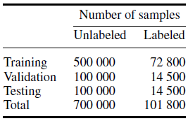
Wulsin Data Details

Slide 49
Classifier Search Parameters

Slide 50
DBM & RBM details
$$p\left(v,h\right)=\frac{1}{Z}e^{−E\left(v,h\right)}$$
Probability of a given set of visible and hidden states weighted according to all possible pairs of states.
The probability of the two given states, data versus model, drive the updates of the weights connecting them. The learning rate must be specified by the user.
$$Z=\sum_{v,h}{e^{−E\left(v,h\right)}}$$
$$p\left(v\right)=\frac{1}{Z}\sum_{h}{e^{−E\left(v,h\right)}}$$
$$\frac{∂\log{p(v})}{∂w_{ij}}={\left\langle v_{ih_{j}}\right\rangle }_{data}−{\left\langle v_{ih_{j}}\right\rangle }_{model}$$
$$∆w_{ij}=ε{\left\langle v_{ih_{j}}\right\rangle }_{data}−{\left\langle v_{ih_{j}}\right\rangle }_{model}$$

Slide 51
RBM learning
$$p\left(h_{j}=1 | v\right)=σ(b_{j}+\sum_{i}{v_{i}w_{ij}) }$$
Generating unbiased data is easy in that it requires a random visible or hidden layer, to make the corresponding.
Generating unbiased data from the model is difficult since it requires the model to be agitated to produce a resultant visible or hidden state that matches the given configuration.
$$p\left(v_{j}=1 | h\right)=σ(a_{i}+\sum_{j}{v_{j}w_{ij}) }$$
$$σ\left(x\right)=1/{(1+exp\left(−x\right))}$$

Slide 52
Are the raw256 and feat16 data sets unique enough?
Via the Wilcoxan-Mann-Whitney test, the null hypothesis that the differences between the median RMSE values of background and non-background datasets are not significant can be rejected.

Slide 53
Why are Wulsin’s F1 scores so poor?
Closed data set, 11 subjects
Using only a very small portion of all recorded data
Randomly subsampled one thousand 2 minute segments across all channels from 13 2hr blocks where activity was prevalent
The annotations comes from 50 random 2 min segments annotated over all channels
The Appraiser Bias Problem
“Human labeling of specific waveforms is itself a very difficult task, and the inter-rater reliability among board certified neurophysiologists is usually low [18, 21, 22]. For computational simplicity, we constrained our classifiers to only examine individual channel-seconds, when in reality experts incorporate much greater spatial and temporal information in their markings. These factors kept our expectations modest for the ultimate recall and precision of our classifiers.”

