Slide 1
Applications and Statistical Modeling of Electroencephalograms using Identity Vectors
PhD Dissertation Defense 4th April 2019 Christian Ward
Notes:
Thank you Doctor Obeid for the introduction, and thank you to everyone for coming out this morning. The title of my dissertation is Applications and Statistical Modeling of Electroencephalograms using Identity Vectors. Sounds wonderful and rolls off the tongue, but simply my interest was in how we can sort and catalogue EEG information.

Slide 2
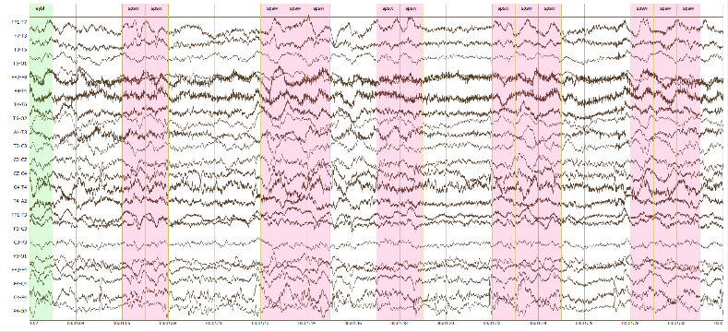
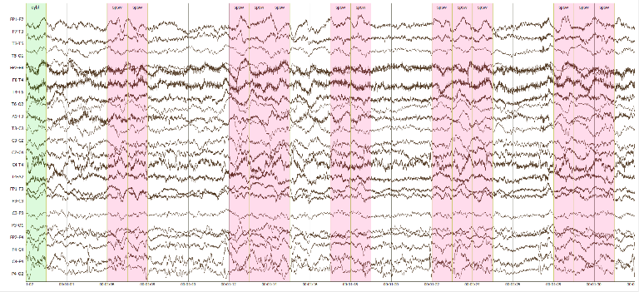
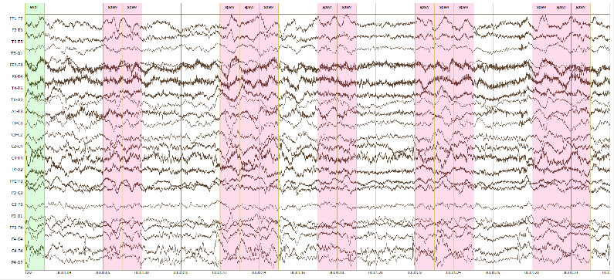
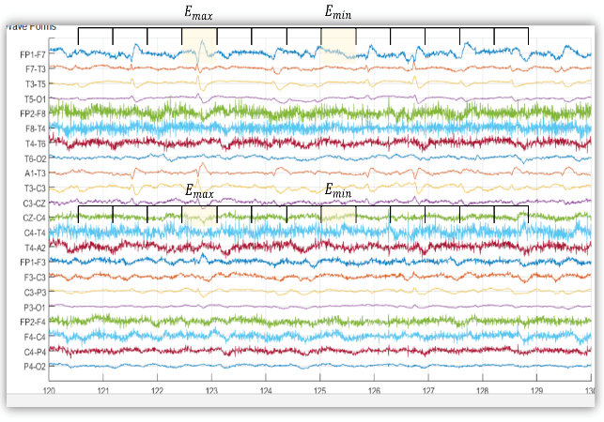
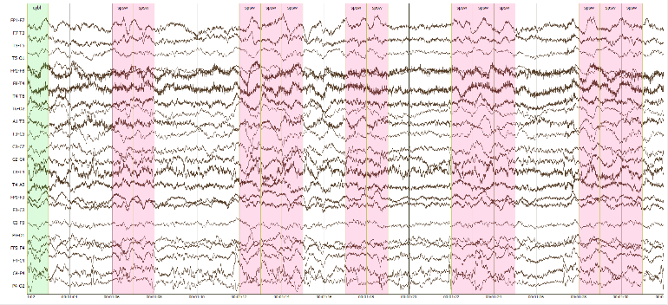
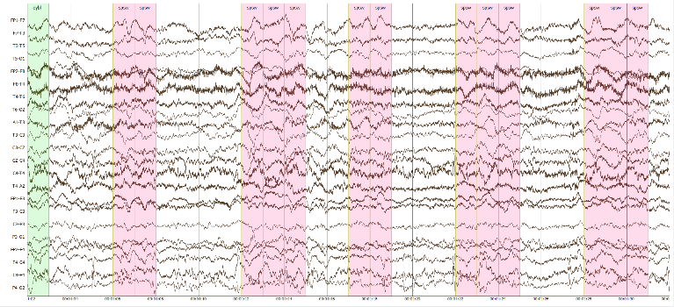
Introduction
Develop a way to organize EEG data on multiple levels that allows the data to be indexed against known and unknown recordings.
A
80%
B
40%
Z
C
70%
Notes:
EEGs are complex signals generated by our brains so organizing them isn’t straightforward. In fact, the task can be quite difficult given EEGs represent all the activity going on within us. The major goal of my research, were it to become my career, would be to develop a way to organize EEG data on multiple levels that allows data to be indexed against known and unknown recordings. Similar to how a search engine can return related topics to a given query, the same should be possible for EEGs. If given 3 known recordings and a new recording, can we tell how similar, or dissimilar, Z is from A, B, and C? This could be applicable if each of these are distinct people and we need to find more recordings from Z or if Z is a seizure patient and we wish to locate patients with similar seizure events. The limit would ideally be the context of the query and not our limited understanding of the recordings.

Slide 3
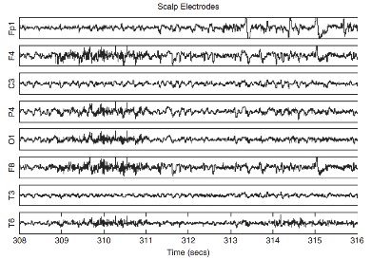
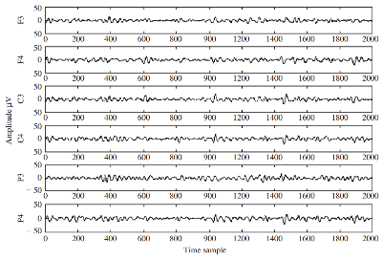
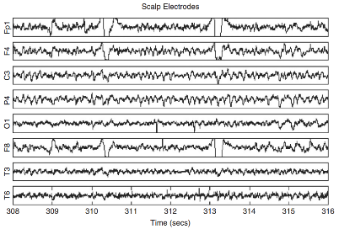
Introduction
Step One: Develop a robust biometric verification system that has the potential to scale based solely on the organizational structure of the data in the database.
Which one is mine?
Which one is similar?
Notes:
To achieve such a complete system as a PhD student was not tenable. So instead, I worked on addressing a solution by developing a bio-metric subject verification system. If given three recordings can I tell which one is mine and then how similar other recordings are to mine. This an active area within the EEG research community, but has not yet reached maturity.

Slide 4
Outline
Introduction
Landscape of EEGs
Motivation
Methods
Research Aims
Experiments
Significance
Future Impact
Notes:
Hopefully that provides a ‘big picture’ of my talk. The details of it are presented here as an outline. Following this introduction I will provide a brief review of EEGs in general and use that to speak on the deeper motivations of this work. The given background and motivation were drawn upon to produce the three research aims which were addressed in a series of 5 experiments. Upon presenting some experimental results I’ll touch on the significance of this work and layout what impact this has for the future.
That said, this is a public presentation so please ask questions as you see fit. Which will at the very least remind me to drink some water now and then.

Slide 5
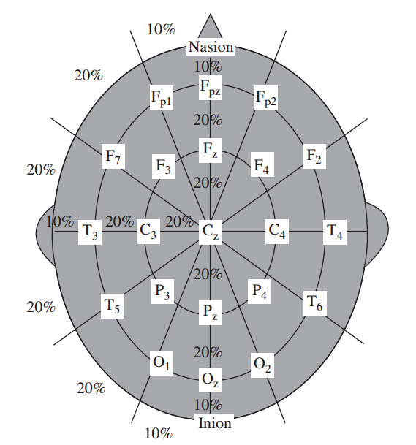
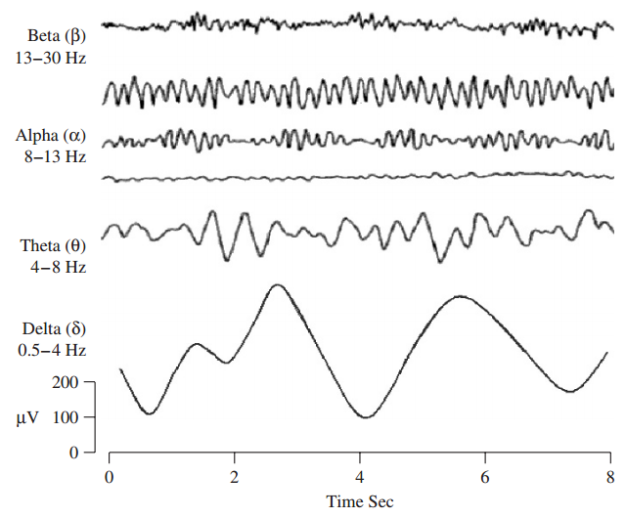
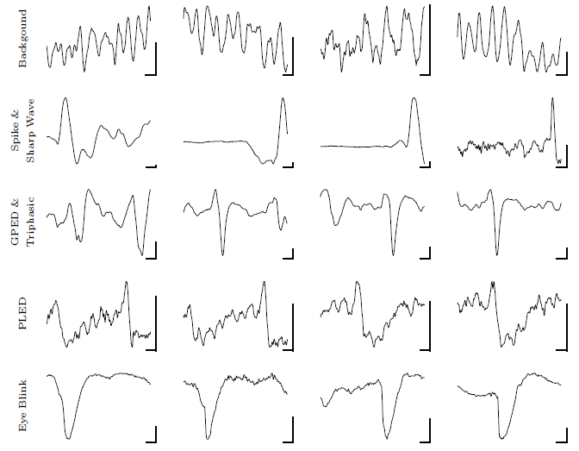
Landscape of EEGs –
Locations
Signals
Waveforms
Sanei, Saeid, and Jonathon A. Chambers. EEG signal processing. John Wiley & Sons, 2013.
D.F. Wulsin, et al. \Modeling electroencephalography waveforms with semi-supervised deep belief nets: fast classification and anomaly measurement," Journal of Neural Engineering 8-3 (2011).
Notes:
EEGs are representations of our brain activity. Typically they are recording by placing a cap on one’s heads with electrodes organized similar to those in the graphic for the purposes of medical diagnostic testing. Each of these electrodes captures a signal which contains a variety of information based upon its frequency and recognizable waveforms. Sometimes these waveforms are artifacts, muscle activation or eye blinks or recording errors, that don’t relate to the targeted phenomena. We’ve been studying our brains for many years at this point so we’ve begun to understand how frequency and waveforms can be interpreted.

Slide 6
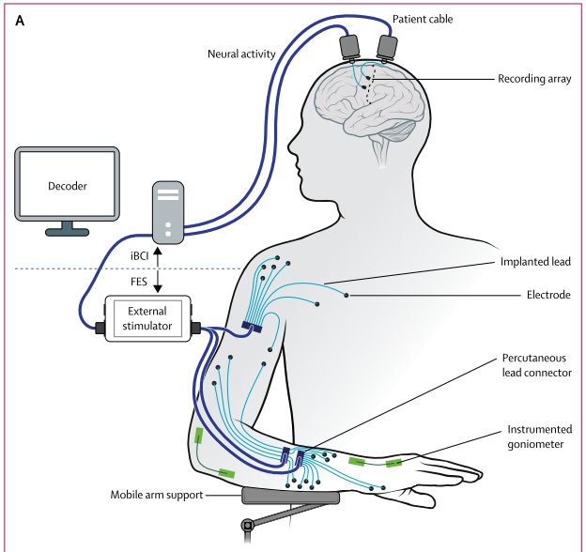
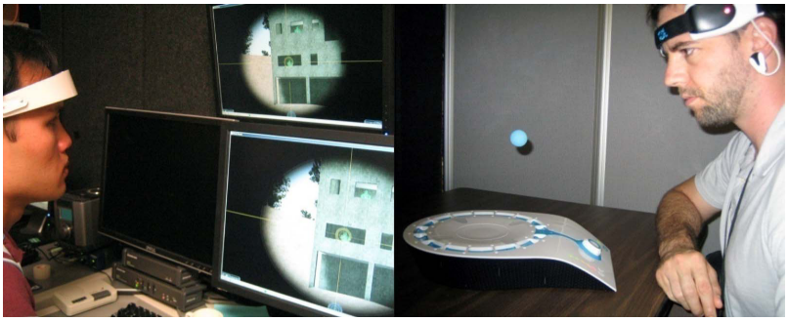
Landscape of EEGs - BCIs
Lance, B. J., Kerick, S. E., Ries, A. J., Oie, K. S., & McDowell, K. (2012). Brain–computer interface technologies in the coming decades. Proceedings of the IEEE, 100(Special Centennial Issue), 1585-1599.
Ajiboye, A. B., Willett, F. R., Young, D. R., Memberg, W. D., Murphy, B. A., Miller, J. P., ... & Peckham, P. H. (2017). Restoration of reaching and grasping movements through brain-controlled muscle stimulation in a person with tetraplegia: a proof-of-concept demonstration. The Lancet, 389(10081), 1821-1830.
Notes:
Perhaps one of the most buzzworthy developments is the realm of brain computer interfaces which you may have seen in movies or news highlights. We’ve been able to move beyond detecting and assessing information related to seizures or sleep behaviors which were about reading information from the brain toward using and responding to information from the brain.

Slide 7
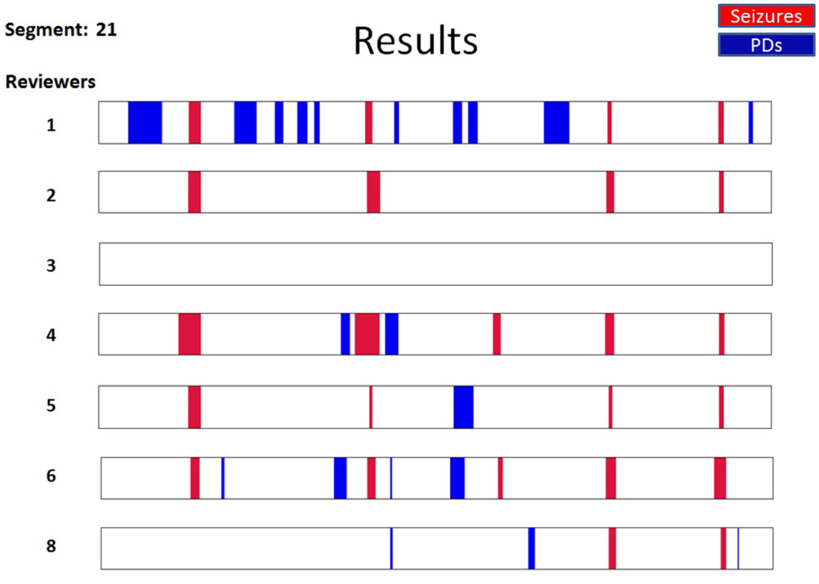
Landscape of EEGs – Annotations
Halford, J. J., Shiau, D., Desrochers, J. A., Kolls, B. J., Dean, B. C., Waters, C. G., ... & Sinha, S. R. (2015). Inter-rater agreement on identification of electrographic seizures and periodic discharges in ICU EEG recordings. Clinical Neurophysiology, 126(9), 1661-1669.
Notes:
Of course, seizure detection may be the most associated term with EEGs and for good reason. They are a vital tool used by clinicians around the world to help detect and treat seizures, epilepsy and a variety of other neurological conditions. However, as clinicians are humans they are not perfect as seen when 8 doctors were asked to examine the same section of EEG recording. Doctor 1 labeled everything with gusto wile doctor 3 was having a bad day. The rest fell somewhere in between, but they all reached similar conclusions about the state of the recording and thus the patient.

Slide 8
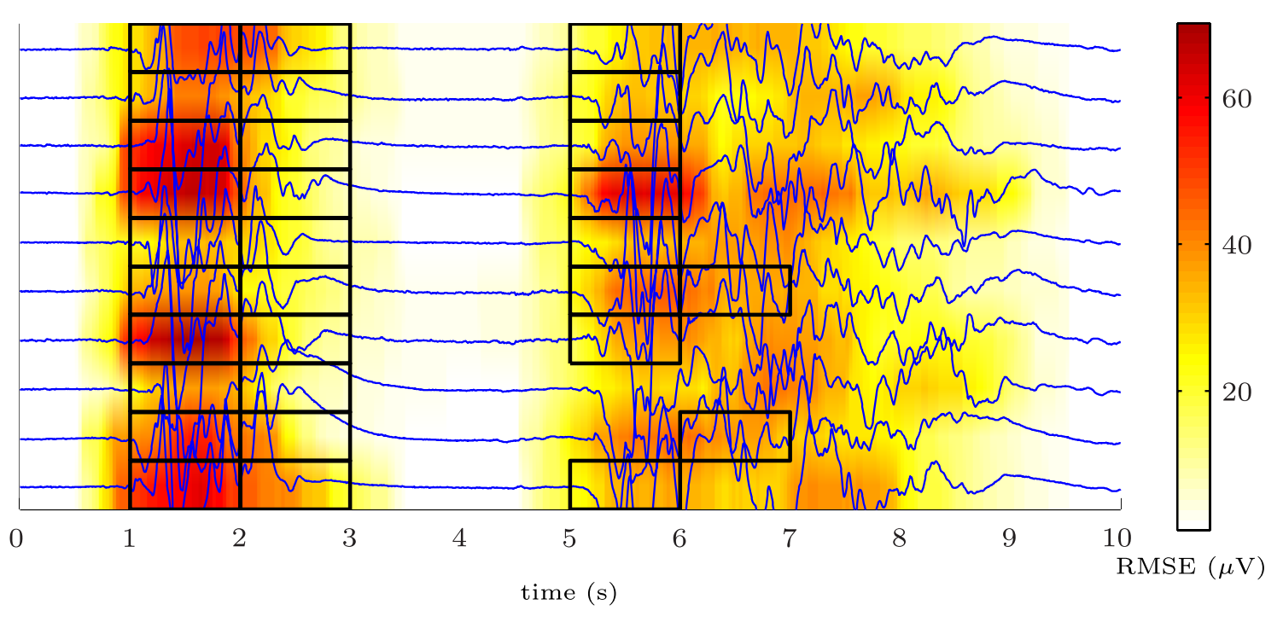
Landscape of EEGs – Automation
D.F. Wulsin, et al. \Modeling electroencephalography waveforms with semi-supervised deep belief nets: fast classification and anomaly measurement," Journal of Neural Engineering 8-3 (2011).
Notes:
However, translating a clinicians knowledge to a machine a la data science and machine learning requires a high level of confidence in those providing the fundamental understanding of regions of interest. So when clinicians fail to agree difficulties arise in developing technology to help them. After all, clinicians cannot possibly review the entirety of each patients recording given their job entails much more than labeling EEG recordings. This is large component of what the overall EEG signal processing community, and the NEDC here at temple, is working to solve. The algorithms built are frequently only as strong the consensus between clinicians.

Slide 9
Motivation
Each condition has its own algorithms, datasets, and features
Clinicians cannot provide enough data
We want to develop cohort retrieval
Our understanding of EEGs is closer to the start than the end
Notes:
This leads to a number of active problems within the EEG research community, which serve as motivation to my research.
1 – The variety of brain functions and applications has lead to a wide array of algorithms, datasets, and features in the research world. An algorithm to detect seizures may not be helpful in processing BCI data. Likewise, datasets used for subject matching and similarity scoring cannot be used for seizure algorithm testing. And of course, the raw signals from the recordings are often modified to highlight facets that are related to task meaning that each study is often using different parts of the original signals.
2 – As indicated clinicians are finding critical phenomena, but don’t readily agree for all events. This makes it difficult to determine what is and isn’t important and how their labels should be used to inform the development of machine learning that automates annotation.
3 – As the amount of data available grows, it will be necessary to sort and search through it. This has been given the label of cohort retrieval within the research group at Temple and aligns with the direction of my work.
4 – As this is a PhD I wish to contribute new insight or information not just in terms of engineering, but also contribute to the scientific community as our understanding of EEGs is more nascent than it is mature despite all the years of research.

Slide 10
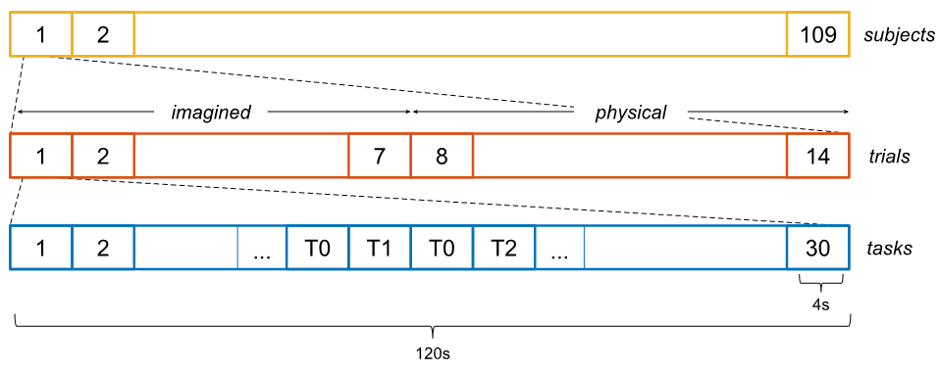
Motivation – Data
PhysioNet EEG MMI Dataset
109 subjects following prompts
14 trials, 2 resting 12 active
Split into all and active trial sets
TUH EEG Corpus
AutoEEG v0.6.0 – a curated set of 12 subjects
AutoEEG v1.0.0 – 50 Abnormal, 50 Normal, and 411 Seizure subjects
Cross Validation
Super Channels
PhysioNet Data Layout
Notes:
One of the main ways I can address the various inconsistencies of previous research is to use a diverse set of publically available data. Once such dataset, already frequently used by the EEG community, is the PNET dataset. It is built from 109 subjects performing motion tasks in accordance with a computer prompted protocol.
To add to this, I drew on the ever expanding TUH EEG Corps to provide abnormal, normal, and seizure recordings. This allowed me to touch upon the dominant research avenues of motion/bci, seizure, and bio-metrics by using all four datasets.

Slide 11
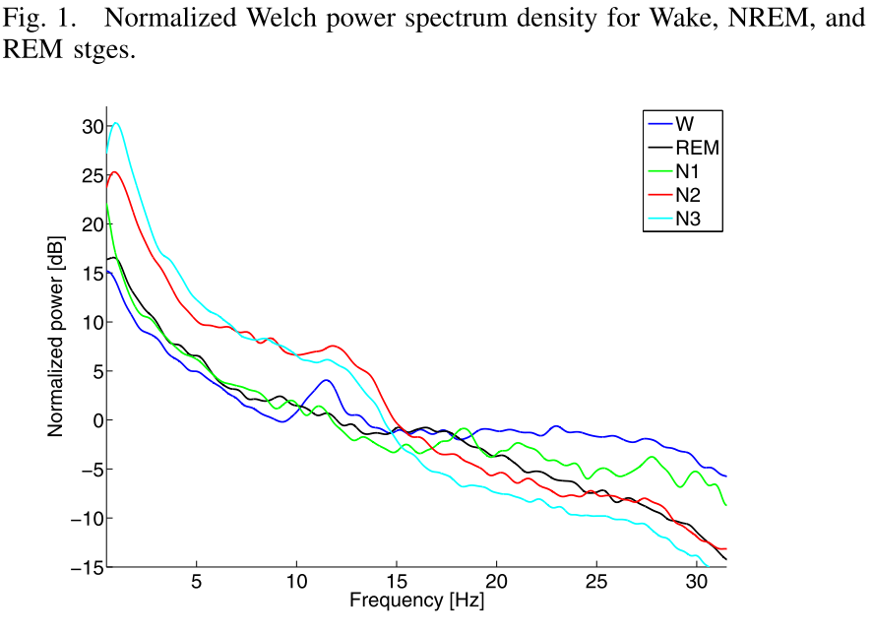
Motivation – Features
Power Spectral Density (PSD)
${PSD}_{i}={\left|\text{FFT}\left(O, α_{\text{freq}}\right)\right|}^{2}$
Spectral Coherence (COH)
$S_{i,j}\left(f\right)=\text{cross}\text{−}\text{spectral} \text{density}$ of the PSD
${\text{COH}}_{i,j}\left(f\right)=\frac{{\left|S_{i,j}\left(f\right)\right|}^{2}}{S_{i,i}\left(f\right)⋅S_{j,j}\left(f\right)}$
Cepstral Coefficients (CEP)
8 bandpass filtered FFT coefficients
9 0.9s 1st derivate coefficients
9 0.3s 2nd derivate coefficients
Radha, M., Garcia-Molina, G., Poel, M., & Tononi, G. (2014, August). Comparison of feature and classifier algorithms for online automatic sleep staging based on a single EEG signal. In 2014 36th Annual International Conference of the IEEE Engineering in Medicine and Biology Society (pp. 1876-1880). IEEE.
Notes:
As features are also frequently changing, each dataset was converted into three forms. PSD features are common within the EGG community for a variety of tasks and COH are to a lesser extend (often focused on motion/BCI classification). CEP features were features developed by the NEDC and are new to the field.
All three rely on converting the raw data from the time domain to the frequency domain and then assessing its energy for PSD, relationship to other electrodes for COH, or its energy and changes to that energy over time for the CEP features.

Slide 12
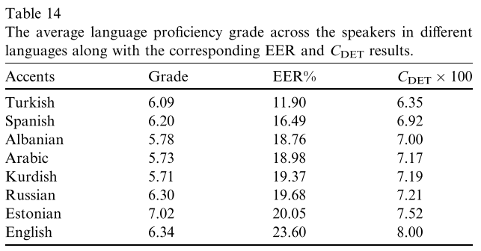
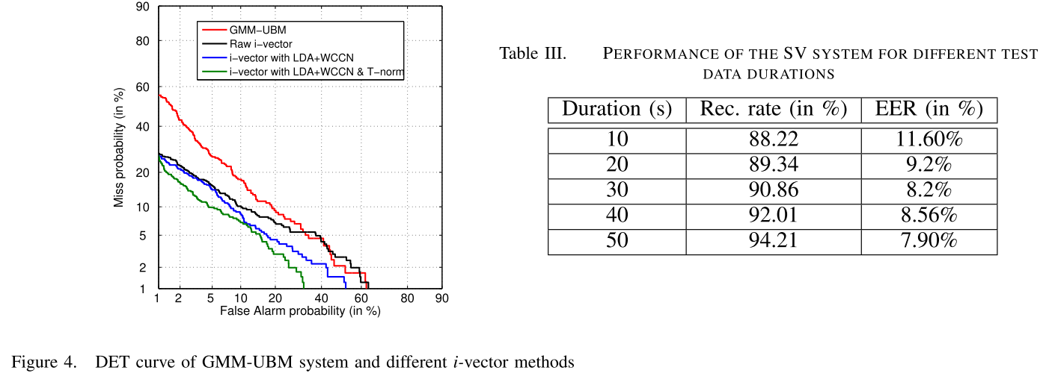
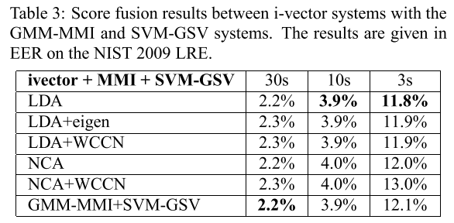
Motivation – Identity Vectors
Subject
Language
Accent
Dey, S., Barman, S., Bhukya, R. K., Das, R. K., Haris, B. C., Prasanna, S. R. M., & Sinha, R. (2014, February). Speech biometric based attendance system. In 2014 twentieth national conference on communications (NCC) (pp. 1-6). IEEE.
Dehak, N., Torres-Carrasquillo, P. A., Reynolds, D., & Dehak, R. (2011). Language recognition via i-vectors and dimensionality reduction. In Twelfth annual conference of the international speech communication association.
Behravan, H., Hautamäki, V., & Kinnunen, T. (2015). Factors affecting i-vector based foreign accent recognition: A case study in spoken Finnish. Speech Communication, 66, 118-129..
Notes:
Lastly I would need to address what algorithms could be used across all these datasets and features. Fortunately I didn’t need to produce something wholly new, I only need to listen to doctor Picone’s suggestions and borrow from the speech community. The speech recognition community addressed subject verification, or for them speaker verification, using a technique called Identity Vectors. It’s inception produced improvements in subject verification tasks, and was later shown to be applicable to detecting the language of the speakers and then the accent of a speaker.
This was very encouraging as the potential level of detail mirrored the goals of cohort retrieval: being able to search across different hierarchies of the data – subject, condition, gender, age, etc

Slide 13
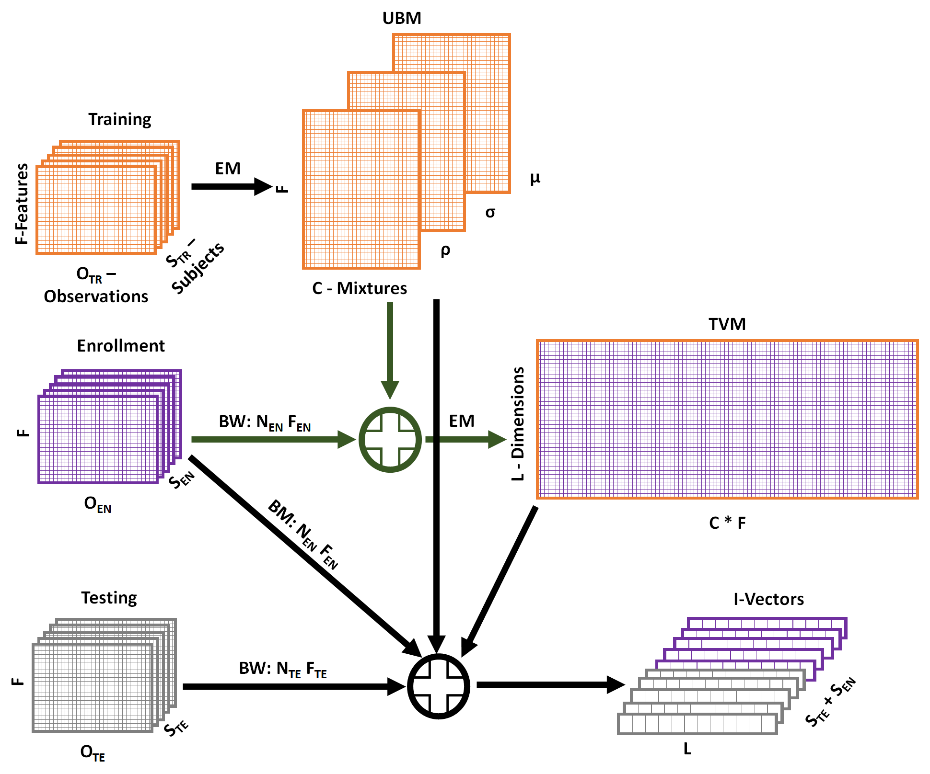
Methods
$$\vec{M}\tilde{=}\vec{m}+T∗\vec{w} \\ \vec{M}=\text{BW}\left(N,F\right) \\ \vec{m}=\left[\begin{matrix}μ_{1} \\ ⋮ \\ μ_{C}\end{matrix}\right] \\ T=\left[\begin{matrix}T_{1,1} & ⋯ & T_{1,CF} \\ ⋮ & ⋱ & ⋮ \\ T_{L,1} & ⋯ & T_{L,CF}\end{matrix}\right] \\ \vec{w}=\left[\begin{matrix}w_{1} \\ ⋮ \\ w_{L}\end{matrix}\right]$$
Notes:
What I-Vectors are takes a bit more to explain. At their core they are a dimension reduction technique built around generic models of larger datasets. Given a training dataset a universal background model is constructed that best models the mathematical space. This UBM is then combined with an enrollment dataset to produce a total variability matrix that will control the mixtures within the UBM.
Once the UBM and TVM have been generated, the enrollment dataset (typically the known data) and the testing dataset (the unknown data) are converted into I-Vectors through probability estimations based on the UBM and a transformation to a new dimensional space by the TVM. This allows the sets of I-Vectors to be compared to each other via cosine similarity/cosine distance.
Most often, the L dimensions of the TVM are substantially smaller than the F*C dimensions of the UBM. In fact, each of the subjects in testing and enrollment is reduced from F*O dimensions down to just L dimensions meaning once the UBM and TVM are built, this process becomes less computational complex.

Slide 14
Methods – Universal Background Model
Notes:
Now of course, we all want to know what these models are and how they’re built. First, the UBM is constructed from the training data by using expectation maximization to fit optimal Gaussian mixture models. Here the results of building a 1,2 and 4 mixture GMM on the same dataset is shown. We can see how eventually the model learned, roughly, where the original distributions were centered.

Slide 15
Methods – Universal Background Model
$$p\left(\vec{o} | λ\right)=\sum_{i=1}^{C}{ρ_{i}g\left(\vec{o} | {\vec{μ}}_{i},Σ_{i}\right)}$$
$g\left(\vec{o} | {\vec{μ}}_{i},Σ_{i}\right)=\frac{1}{{\left(2π\right)}^{F/2}{\left|Σ_{i}\right|}^{1/2}}\text{exp}\left\{−\frac{1}{2}{\left(\vec{o}−{\vec{μ}}_{i}\right)}^{′}Σ_{i}^{−1}\left(\vec{o}−{\vec{μ}}_{i}\right)\right\}$
$$λ=\left\{ρ_{i},{\vec{μ}}_{i},Σ_{i}\right\}, i=1,…,C, \sum_{i=1}^{C}{ρ_{i}=1}$$
$$λ_{c=1,…,C}\left\{\begin{aligned}{\vec{μ}}_{c} \\ Σ_{c} \\ {\vec{ρ}}_{c}\end{aligned}\right.$$
Reynolds, D. (2015). Gaussian mixture models. Encyclopedia of biometrics, 827-832.
Notes:
How it achieves this, mathematically, is by using the observations (o) to build means, (mu) variances (sigma), and weights (rho) for each mixture (c/C) within the UBM. Thus the process always starts with a UBM consisting of a single mixtures, as the previous slide showed.

Slide 16
Methods – Universal Background Model
$$p\left(O | λ\right)=\prod_{t=1}^{O}{p\left({\vec{x}}_{t} | λ\right), p\left(O | \overline{λ}\right)≥p\left(O | λ\right)}$$
$${\overline{ρ}}_{i}=\frac{1}{O} \sum_{t=1}^{O}{\text{Pr}\left(i | {\vec{o}}_{t},λ\right)}$$
$${\overline{μ}}_{i}=\frac{\sum_{t=1}^{O}{\text{Pr}\left(i | {\vec{o}}_{t},λ\right){\vec{x}}_{t}}}{\sum_{t=1}^{O}{\text{Pr}\left(i | {\vec{o}}_{t},λ\right)}}$$
$${\overline{σ}}_{i}^{2}=\frac{\sum_{t=1}^{O}{\text{Pr}\left(i | {\vec{o}}_{t},λ\right){\vec{x}}_{t}^{2}}}{\sum_{t=1}^{O}{\text{Pr}\left(i | {\vec{o}}_{t},λ\right)}}−{\vec{μ}}_{i}^{−2}$$
$$\text{Pr}\left(i | {\vec{o}}_{t},λ\right)=\frac{ρ_{i}g\left({\vec{o}}_{t} | {\vec{μ}}_{i},Σ_{i}\right)}{\sum_{k=1}^{C}{ρ_{k}g\left({\vec{o}}_{k} | {\vec{μ}}_{k},Σ_{k}\right)}}$$
Reynolds, D. (2015). Gaussian mixture models. Encyclopedia of biometrics, 827-832.
Notes:
This first mixture is optimized by evaluating all of the observations and updating them based on the likelihood of the observations given the current UBM. This a vector quantization approach the updates based upon the weight and likelihoods of the samples against each mixture. The goal being to increase the likelihood of the individual mixtures ability to model the full space of the data. So for a single mixture, it attempts to find the ideal mean and variance. This initial mixture is then split into two by offsetting the original mixture by +/- the squareroot of the largest feature variance. This process is thus iterative and assured to always match or exceed the previous UBM. For my work I did not set a threshold for control, but rather ran it for 20 iterations before producing the next mixture size. Maximum Likelihood Parameter Estimation – adapting a set of vectors X to the given UBM lambda. The approach assures a monotonic increase in the likelihood of the test vectors for the updated UBM via vector quantization. Thresholds or limits can be used, to control this process but in this work the EM algorithm would run 20 times before moving to the next mixture size. To step to the next mixture size 2-> 4, the mean associated with the largest variance in each mixture is shifted +/- sqrt( that variance ) with the weights cut in half and the variances duplicated to new mixtures.

Slide 17
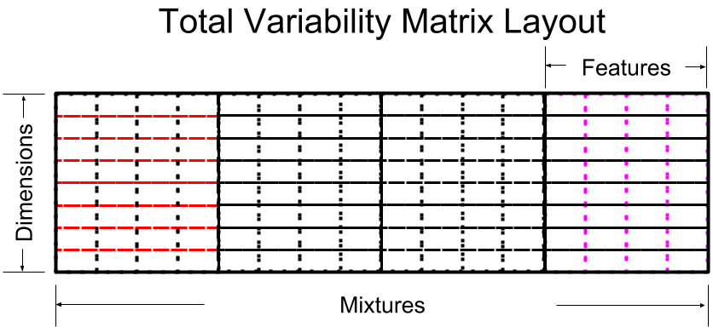
Methods – Total Variability Matrix
Notes:
The other major component is the TVM, which is a transformation matrix that maps the C mixtures and F features into a smaller L dimensional space used by the resultant I-Vectors.

Slide 18
Methods – Total Variability Matrix
0th Order BW:
$${\vec{N}}_{c}=\sum_{t=1}^{O_{TR}}{P\left(c | {\vec{o}}_{t},λ\right)}$$
1st Order BW:
$${\vec{F}}_{c}=\sum_{t=1}^{O_{TR}}{P\left(c | {\vec{o}}_{t},λ\right)}{\vec{o}}_{t}$$
1st Order mean centered: $${\tilde{\vec{F}}}_{c}={\vec{F}}_{c}−{\vec{N}}_{c}{\vec{μ}}_{c}$$
Restructured:
$$N=\left[\begin{matrix}{\vec{N}}_{1} & & \\ & ⋱ & \\ & & {\vec{N}}_{C}\end{matrix}\right] \\ \hat{\vec{F}}=\left[\begin{matrix}{\tilde{\vec{F}}}_{1} \\ ⋮ \\ {\tilde{\vec{F}}}_{C}\end{matrix}\right]$$
Notes:
That’s the slightly prolonged elevator pitch, which hopefully provides a bit of context to the nature of this presentation. The remaining sections are outlined here. The next topic will be a brief introduction to the landscape of EEGs to place the context of this work within the EEG research community. Understanding the intersection of these topics is then used to explain the motivation for the research in greater detail. These details were then used to construct the three research aims which provided guidance for the experiments.
The experiments and associated techniques, datasets and evaluation metrics lead to the results of said experiments. The interpretation of this experiments is touched up as they are introduced, but their significance links the results back to the RAs and the original motivation/questions. Finally I conclude with what this means for future research with regards to EEGs and the developed techniques introduced by the work.
What is: N -> likelihood of given observation e from the UBM lambda for a given mixture c, 0th order BW statistic
F -> mean of given observation given its likelihood for said UBM mixture, 1st order BW statistic
t to O represent each `sample’ in the set matrix of observations e
Therefore
F hat is mean centered supervector distribution using the mean of the ubms from each mixture against the proportional shifts of F

Slide 19
Methods – Total Variability Matrix
$$\vec{w}={\left(I+T^{t}Σ_{λ}^{−1}NT\right)}^{−1}T^{t}Σ_{λ}^{−1}\hat{\vec{F}} \\ A=N{\vec{w}}^{−1} \\ K=\hat{\vec{F}}∗{\left({\vec{w}}^{−1}T^{H}Σ_{λ}^{−1}\hat{\vec{F}}\right)}^{H}$$
$$T=\left[\begin{matrix}T_{1,1} & ⋯ & T_{1,L} \\ ⋮ & ⋱ & ⋮ \\ T_{F∗C,1} & ⋯ & T_{F∗C,L}\end{matrix}\right]=\left[\begin{matrix}A_{1}^{−1}∗K_{1} \\ ⋮ \\ A_{C}^{−1}∗K_{C}\end{matrix}\right]$$
Reynolds, D. (2015). Gaussian mixture models. Encyclopedia of biometrics, 827-832.
Notes:
Once the statistics from the training dataset are found, an initial estimate of the TVM (T) is generated from the variances of the UBM. This is necessary as an initial estimate to again start VQ based EM to resolve a suitable TVM. In some instances both an initial w and T can be generated or, as in our case, the initial T is used to generate a w for the first iteration. Then the likelihoods (N) are paired with the inverted IV w and applied against the weighted mean shifts of F to produce matrix K. Together A and K operate as the values and percentages that modify the existing TVM into a new one that maps into a stronger or equally likely model of the training data statistics and UBM.

Slide 20
Methods – Identity Vector
$$\vec{w}=\left(\vec{M}−\vec{m}\right)T^{−1} \\ \vec{M}=\left[\begin{matrix}\vec{μ_{o_{1}}} \\ ⋮ \\ \vec{μ_{o_{C}}}\end{matrix}\right], \vec{m}=\left[\begin{matrix}{\vec{μ}}_{1} \\ ⋮ \\ {\vec{μ}}_{C}\end{matrix}\right] \\ \cos\left(Θ_{{\vec{w}}_{1},{\vec{w}}_{2}}\right)=\frac{{\vec{w}}_{1}^{t}{\vec{w}}_{2}}{\left\|{\vec{w}}_{1}\right\|∗\left\|{\vec{w}}_{2}\right\|}$$
Notes:
The I-Vectors are eventually produced by using the TVM in conjunction with the means from the UBM and a subject specific set of means learned from the observation data (epochs in the testing dataset). These can then be evaluated by taking the product of two I-Vectors normalized by their magnitude.

Slide 21
Methods – Gaussian Mixture Model
$$D_{GMM}={\vec{\text{llk}}}_{test,models}−{\vec{\text{llk}}}_{test,ubm} \\ {\vec{\text{llk}}}_{test,ubm}=\text{Pr}\left(i | o_{test},λ_{ubm}\right) \\ {\vec{\text{llk}}}_{test,models}=\text{Pr}\left(i | o_{test},λ_{models}\right) \\ \text{Pr}\left(i | {\vec{x}}_{t},λ\right)=\frac{ρ_{i}g\left({\vec{x}}_{t} | {\vec{μ}}_{i},Σ_{i}\right)}{\sum_{k=1}^{C}{ρ_{k}g\left({\vec{x}}_{k} | {\vec{μ}}_{k},Σ_{k}\right)}}$$
Notes:
The evaluation of the GMM-UBMs follows a similar process based on the likelihoods of the observations for the testing data. Here each subject is given a GMM which is used to differentiate it from not only the other subjects, but also the underyling UBM.

Slide 22
Methods – Mahalanobis Distance
$$d_{s_{en},s_{te}}=\left({\vec{O}}_{s_{te}}^{}−{\vec{μ}}_{s_{en}}^{}\right)Σ^{−1}{\left({\vec{O}}_{s_{te}}^{}−{\vec{μ}}_{s_{en}}^{}\right)}^{T} \\ A_{s_{en}}=O_{s_{en}}^{}−{\vec{μ}}_{s_{en}}^{} \\ Σ=\frac{1}{S_{en}−1}\sum_{s=1}^{S_{en}}{{\left|A_{s}−μ_{A}\right|}^{2}}$$
La Rocca, D., Campisi, P., Vegso, B., Cserti, P., Kozmann, G., Babiloni, F., & Fallani, F. D. V. (2014). Human brain distinctiveness based on EEG spectral coherence connectivity. IEEE transactions on Biomedical Engineering, 61(9), 2406-2412.
Notes:
Mahalanobis classifier used by La Rocca. Uses enrollment data to build means of each subject and generate a pooled covariance matrix. Then evaluates this against the observations in the testing data to produce distances between the known models from enrollment and unknown testing data.

Slide 23
Methods – Metrics
$$\text{CRR}\text{ = }\left(\frac{1}{S}\sum_{s=1}^{S}{D_{sort}\left[1,s\right]}\right)\text{×}\text{100} \\ \text{EER} ≝\left(FPR=FNR\right) \\ FPR= \frac{FP}{S} \\ FNR=1−CRR \\ \text{C} \text{Metric}\text{ = }CRR−EER$$
Notes:
Be sure to note that the EER calculation takes into account the order (weight) of the TP and FN when resolving the ultimate value. Thus a TP with a distance larger than another’s FN increases the EER. Essentially this really shows how well separation is occurring independent of a given subject matching with the right target.

Slide 24
Research Aims
Research Aim 1: Can an I-Vector based classification perform as well as, or better than, other applicable techniques?
Research Aim 2: Under what conditions does an I-Vector based system perform best?
Research Aim 3: What characteristics of EEG data do I-Vector take advantage of in their discrimination? Is this process inherently well suited for addressing EEG classification?
Notes:
Read the slide.

Slide 25
Experiments
Experiment 1: I-Vector Development
Experiment 2: Protocol Replication
Research Aim 1
Research Aim 2
Experiment 3: Parameter Sweeps
Research Aim 2
Experiment 4: Algorithm Benchmarks
Research Aim 1
Experiment 5: UBM-TVM Relationship
Research Aim 3
Notes:
From these research aims, a series of experiments was devised to develop, test, validate and understand how I-Vectors fit within the EEG processing and subject verification landscape.

Slide 26
Experiment 1: I-Vector Development
Notes:
The aim of the preliminary experiments was to see if the technique worked. Here, when building I-Vectors for each trial from data containing only the 12 motion trials or the full 14, the performance of I-Vectors is quite strong compared to their GMM-UBM counterpart. This was encouraging and indicated the technique had been developed correctly for EEGs, as it was compared against a more commonly used GMM-UBM technique. However, a comparison to a similar public experiment was necessary.

Slide 27
Experiment 2: Protocol Replication
Ward, C., & Obeid, I. (2019). Application of identity vectors for EEG classification. Journal of neuroscience methods, 311, 338-350.
Notes:
First we verified our reconstruction of their experiment produced similar results. The mCCR Mahal results indicate we were very close. The individual distribution of each channel is shown in the bar plots on the left. With the PSD features being optimal for all the tested algorithms, they were the ones used for the UBM and epoch sweep.

Slide 28
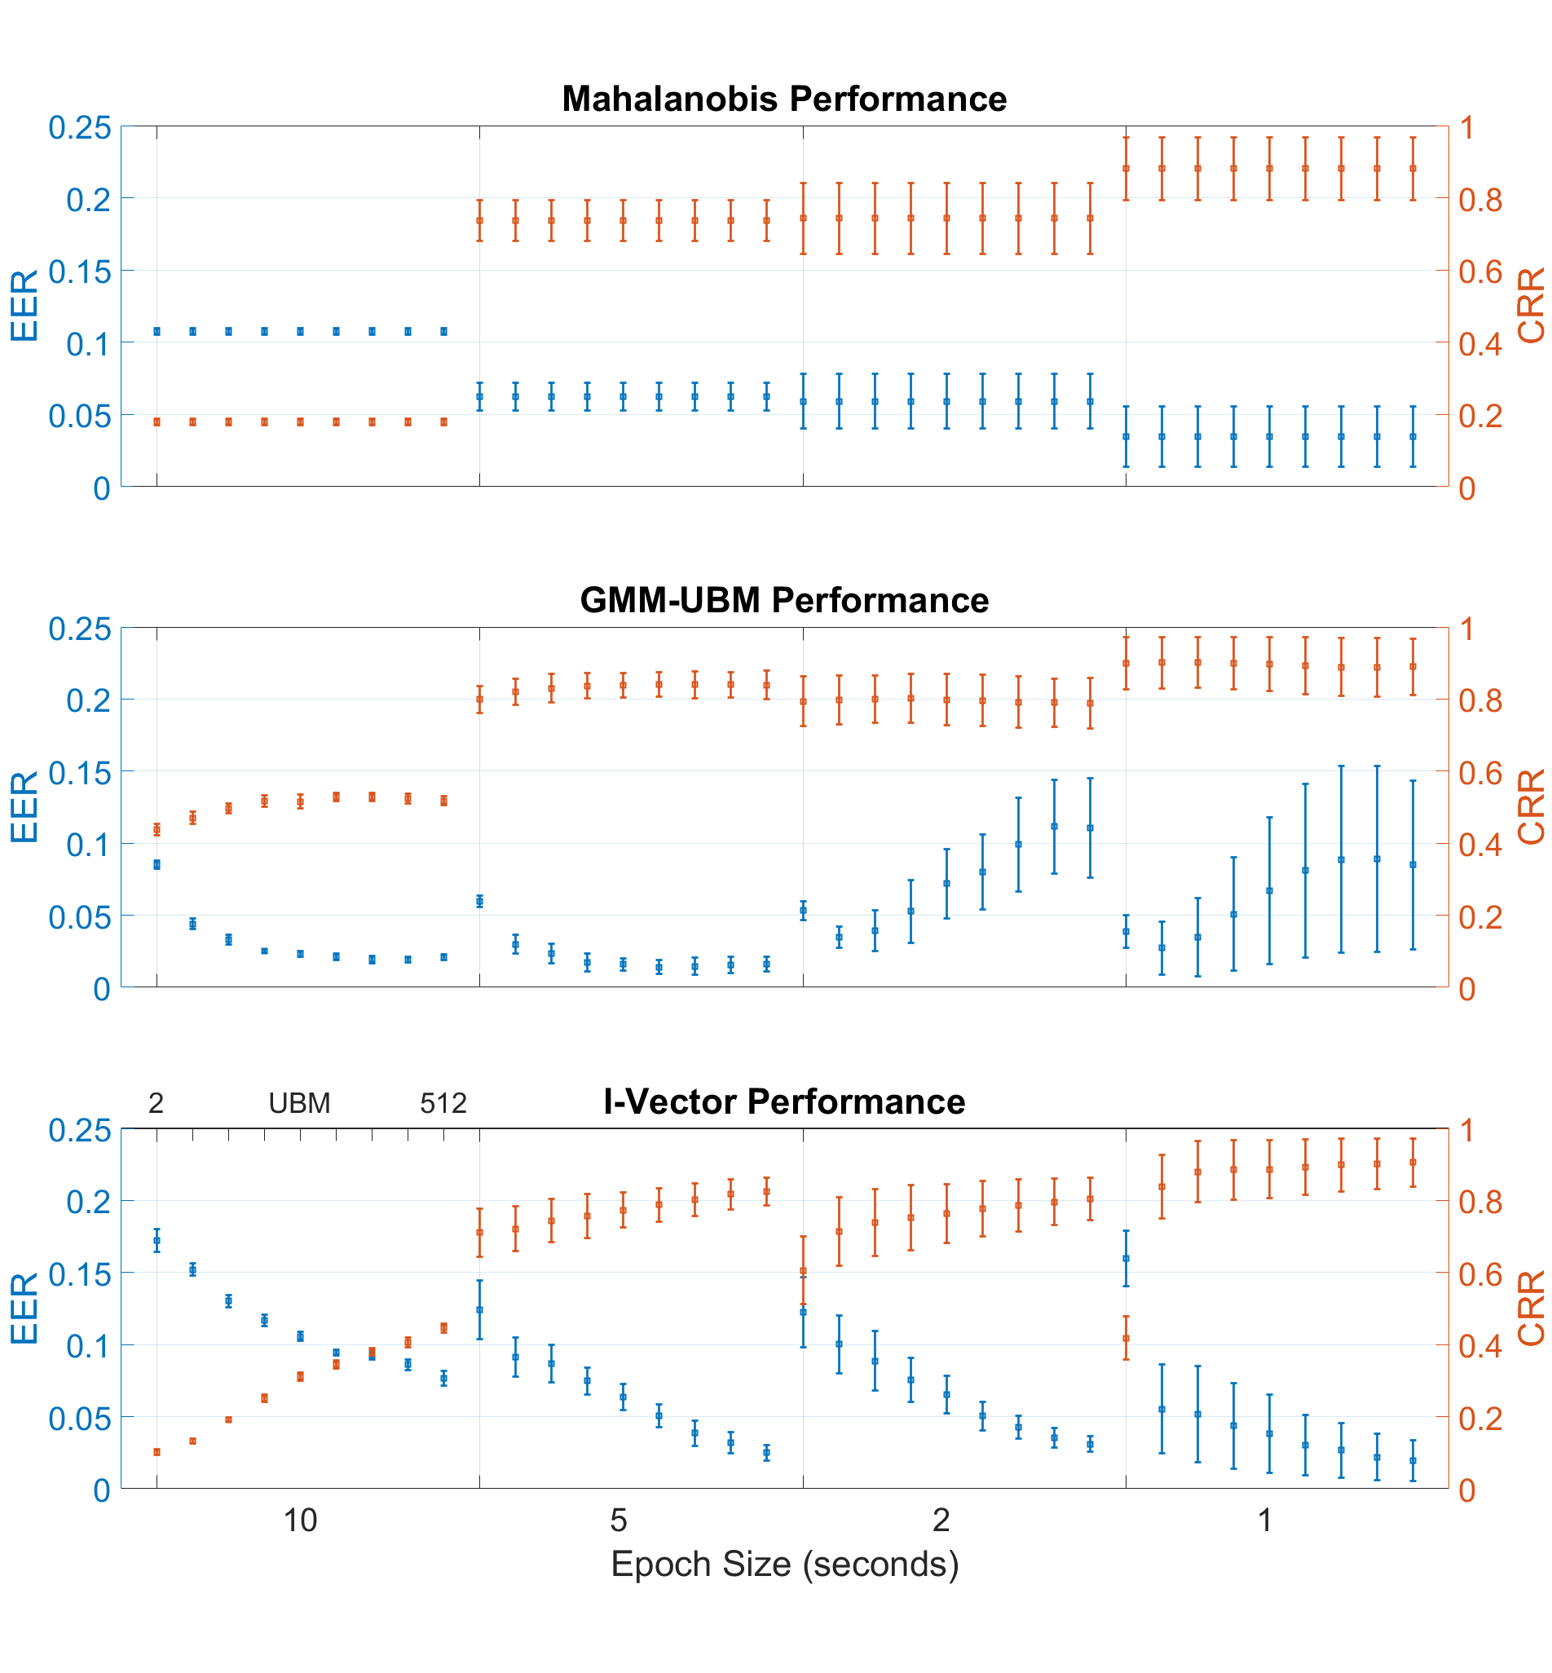
Ward, C., & Obeid, I. (2019). Application of identity vectors for EEG classification. Journal of neuroscience methods, 311, 338-350.
Notes:
Here each algorithm was evaluated using the full 14 trials of the PNET data over a range of UBM mixtures and epoch durations ( 10, 5, 2, and 1 seconds ). The GMM-UBM and I-Vector performance surpassed that of the Mahalanobis classifier, and the I-Vector matched and slightly exceeded the performance of the GMM-UBMs for best performance overall when using the epochs with a 2s duration. This was published in 2018/2019 in a paper that touched on both RA1, parameter sweeps, and RA2 comparative performance. However, a deeper dive on the parameters was necessary.

Slide 29
Experiment 3: Parameter Sweeps
Features: CEP, PSD, COH
Epoch Duration: 10s, 2s
Dataset: PNET (Mot), TUHEEG (Abn, Nrm, Szr)
Test Epochs: Sets of 1, 2, 4, 6, 14
UBM Mixture: 2, 4, 8, 16, 32, 64, 128, 256, 512, 1024, 2048
TVM Dimension: 25, 50, 75, 100, 200
LDA Dimension: 15, 30, 45, 60, 75, 100
Notes:
There were a number of parameters to evaluate making the core experiments complicated in terms of their variations. However, from the results of the baseline experiments the epoch duration was prune to include only 10s and 2s epochs. Despite the strength of the PSD features, all three feature sets remained in play as the datasets were expanded to include TUHEEG data. The number of epochs (samples) given for the testing data (the target data we wanted to match) became controlled as well. This left the parameters for the UBMs, TVMs, and LDA dimensions. With all this data it was necessary to refine the CRR and EER as the performance metrics and convert them to a metric that combine both, called the C Metric. As a reminder the C Metric subtracts the EER from the CRR and a threshold of 0.75 was given as a reference point across these experiments.

Slide 30
Experiment 3: Parameter Sweeps
Notes:
As an example, the results of the TUH Abn, Nrm and Szr datasets are shown over a range of ubm mixtures for the listed tvm dimensions before being processed down to 15 dimensions by LDA. All of the data was drawn from the 10s duration epochs with one epoch being given to the testing data. These are mean values over the 6 iterations of cross validation for each individual experiment. And boy this is a lot to process, I quickly realized maybe I can’t optimize everything at once so hey : “This is a lot, but let’s focus on resolving epoch duration and the number of epochs in the testing data. Hopefully a smaller range of UBMs, TVMs, and LDAs.”

Slide 31
Experiment 3: Parameter Sweeps
Notes:
TUH Seizure Data – same number of testing epochs but red 10s v blue 2s duration shows very different behavior. However, 6 testing epochs at 2s duration is best performer overall and ‘in class’ still not above 0.75 however.

Slide 32
Experiment 3: Parameter Sweeps
Notes:
TUH Seizure Data – 4/6/14 count testing datasets at 2s duration epochs finally see performance over 0.75 with 14 epochs in the testing data for a variety of UBM-TVM combinations. Other data? Well nrm and abn similar to each other and ‘easier’ than seizure data given initial test. PNET Mot was ‘tested’ in baseline experiment so we’ve seen that before and it was also a bit ‘easier’ to classify.

Slide 33
Experiment 3: Parameter Sweeps
Features: CEP, PSD, COH
Epoch Duration: 10s, 2s
Dataset: PNET (Mot), TUHEEG (Abn, Nrm, Szr)
Test Epochs: Sets of 1, 2, 4, 6, 14
UBM Mixture: 2, 4, 8, 16, 32, 64, 128, 256, 512, 1024, 2048
TVM Dimension: 25, 50, 75, 100, 200
LDA Dimension: 15, 30, 45, 60, 75, 100
Features: CEP, PSD, COH
Epoch Duration: 10s, 2s
Dataset: PNET (Mot), TUHEEG (Abn, Nrm, Szr)
Test Epochs: Sets of 1, 2, 4, 6, 14 --> 12
UBM Mixture: 2, 4, 8, 16, 32, 64, 128, 256, 512, 1024, 2048
TVM Dimension: 25, 50, 75, 100, 200
LDA Dimension: 15, 30, 45, 60, 75, 100 -> 5, 15, 20, 25, 45, 50, 70, 75, 100, 150, 195

Slide 34
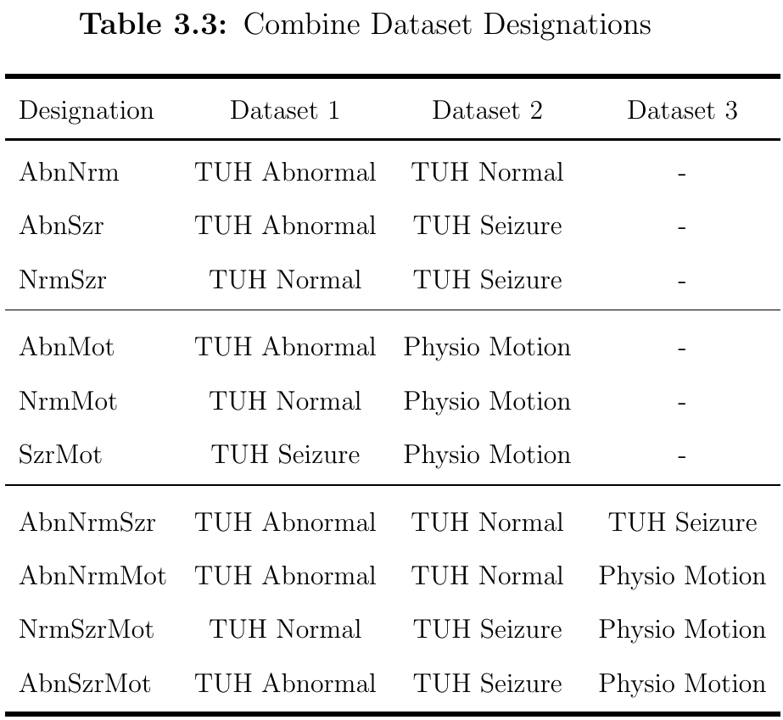
Experiment 4: Algorithm Benchmarks
Features: CEP, PSD, COH
Datasets
Parameters
Epoch Duration: 2s
Testing Epochs: 12
UBM mixtures: 32, 64, 128
TVM Dims: 25, 50, 75, 100, 200
LDA Dims: 5, 15, 20, 25, 45, 50, 70, 75, 95, 100, 150, 195
Notes:
For the comparative experiments the focus was on the performance between the algorithms, but variation was still allowed within the ‘optimal’ parameters over the datasets

Slide 35
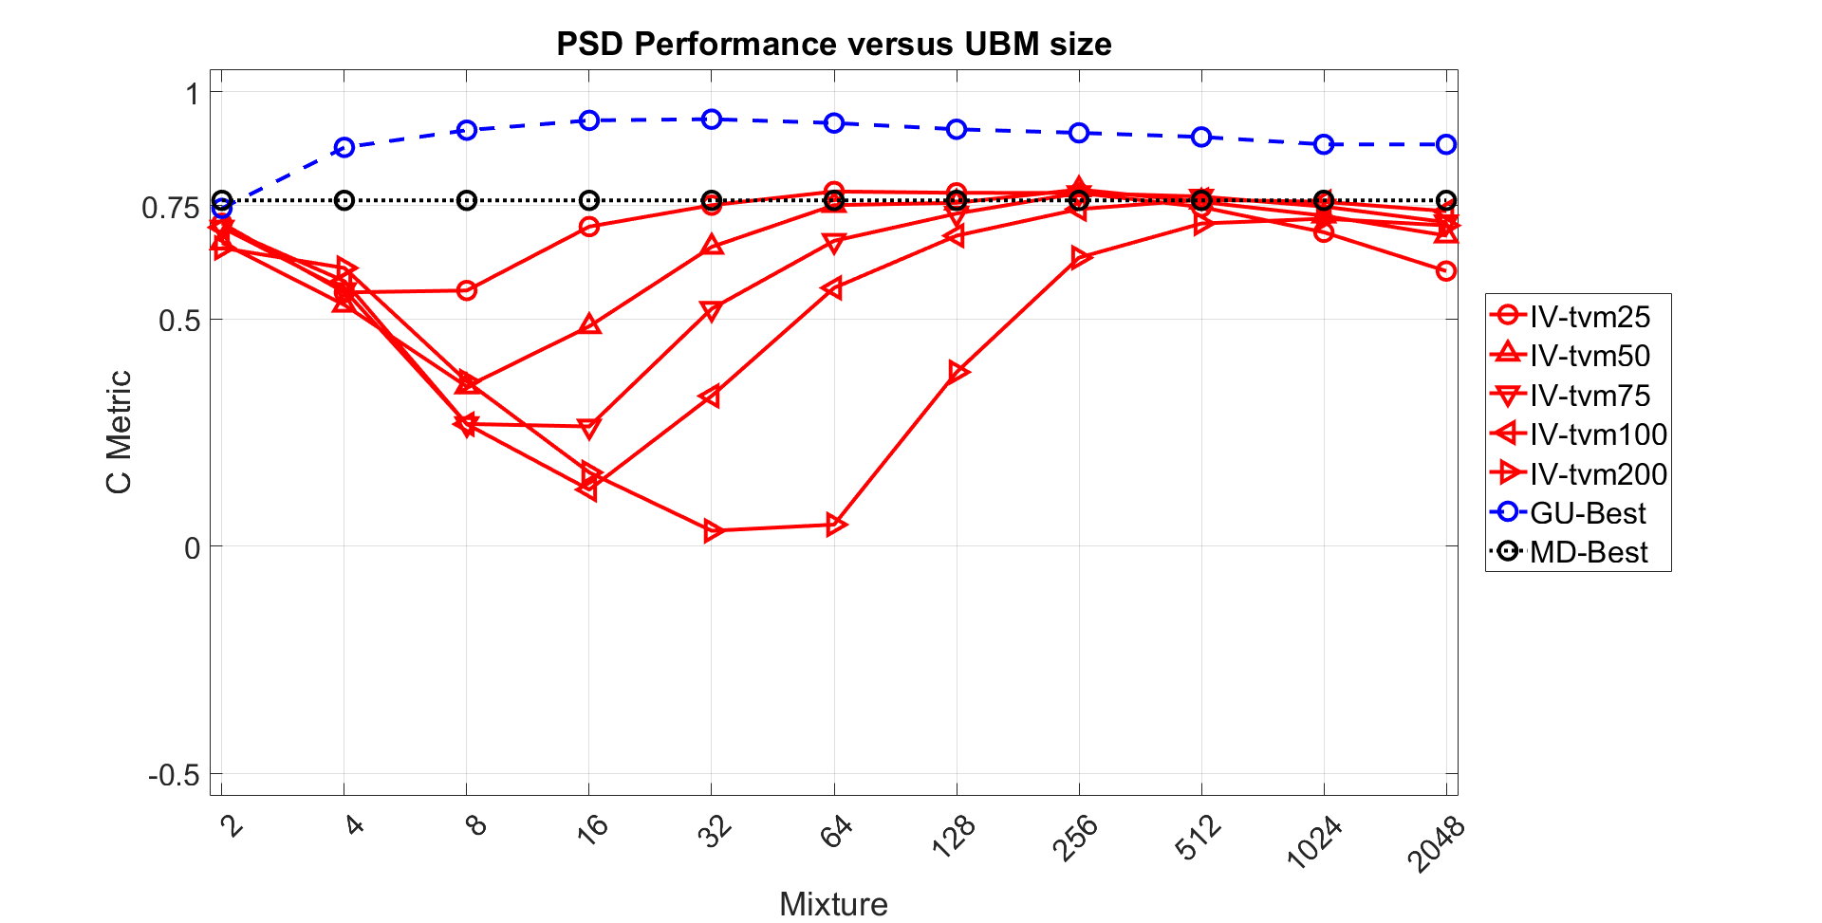
Experiment 4: Algorithm Benchmarks
Notes:
Results of the TUHEEG Abnormal, Normal, Seizure dataset over all the UBM mixtures without LDA.

Slide 36
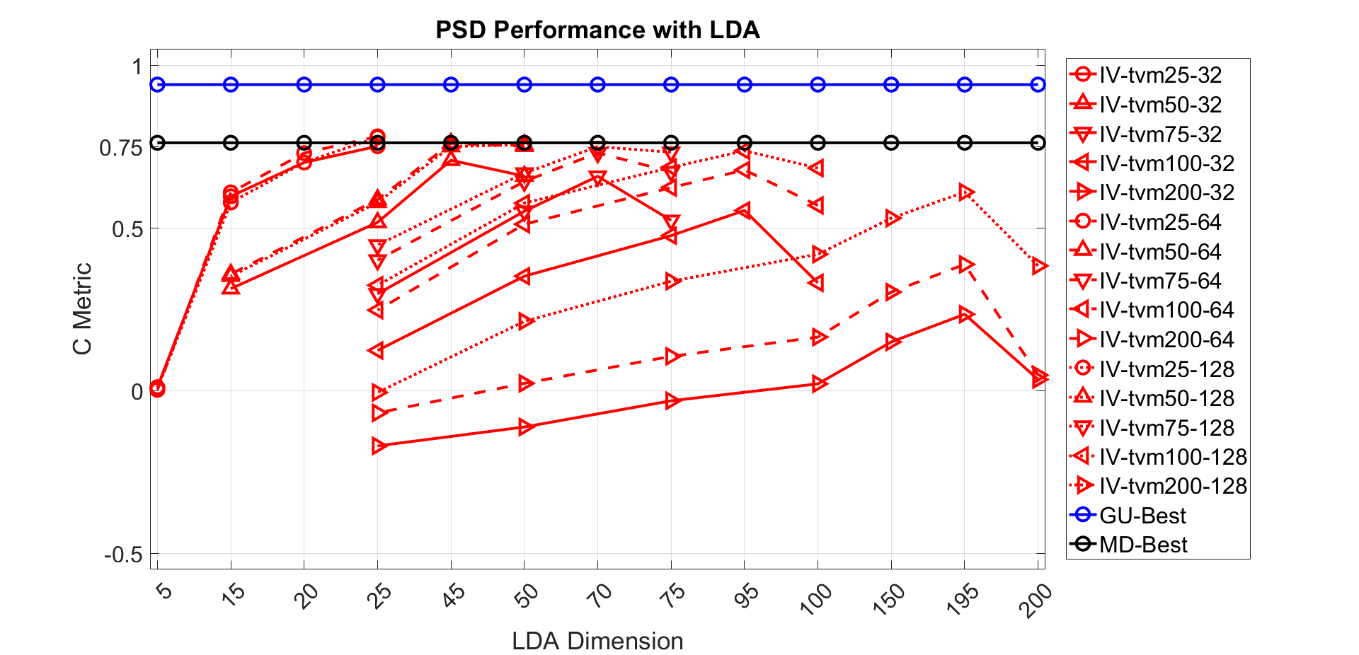
Experiment 4: Algorithm Benchmarks
Notes:
The use of LDA on the TUHEEG Abnormal, Normal, and Seizure dataset over the specified UBM range. Here LDA is seen to improve the performance of the 75, 100, and 200 dimension TVMs. While is not often not enough to improve their performance beyond the MD or GMM-UBM algorithms, it shows that further performance gains can still be had from I-Vectors by continuing to restrict their dimensions. LDA is one such tool and research in speech has tested a variety of techniques to improve the basic version of the I-Vector process presented in this work.

Slide 37
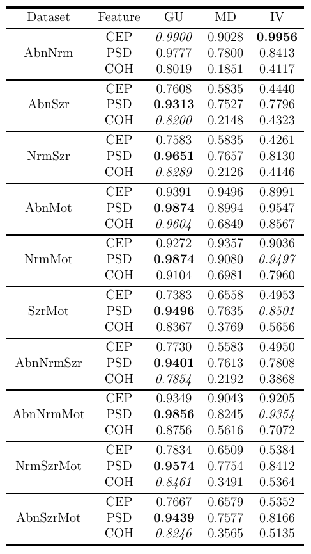
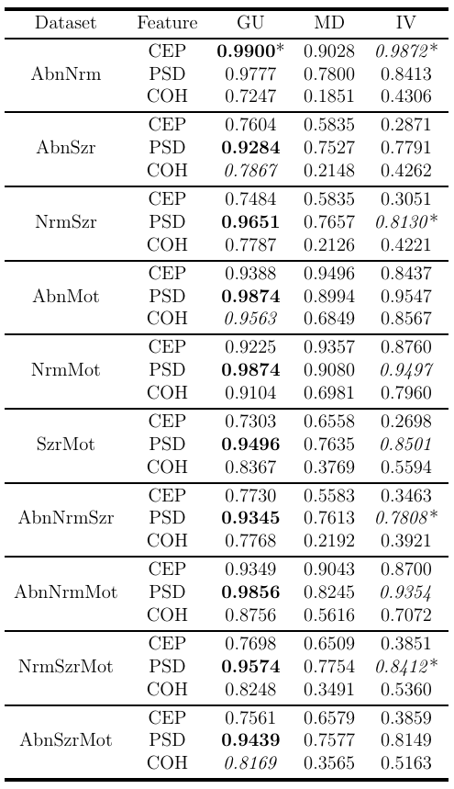
Experiment 4: Algorithm Benchmarks
Left: All UBM Mixtures without LDA
Right: Optimal UBM Mixtures with LDA
Notes:
For the comparative experiments the focus was on the performance between the algorithms, but variation was still allowed within the ‘optimal’ parameters over the datasets

Slide 38
Experiment 4: Algorithm Benchmarks
Performance: GMM-UBM > I-Vector > Mahalanobis
Dimensions: I-Vector < Mahalanobis < GMM-UBM
I-Vector – L dimensions
Mahalanobis – F dimensions
GMM-UBM – F * C Dimensions
LDA Improved larger TVMs C Metric
Optimal Parameters
PSD, 12 epochs, 2s duration, 256 mixture UBM, 25 dimension TVM, no LDA
Notes:
At this point the system was built and worked well, but it didn’t outperform the GMM-UBM. Not the best news, since the hope was with all this parameter tuning a performance sweet spot could be found to top the comparative techniques. A sweet spot was found, but it became apparent that it shifted given the data or amount of data and the features. The parameter sweeps did not go far enough, but limits had to be outlined at the start. However, the I-Vector performance was built on substantially smaller feature vectors. While larger UBMs often improved performance the use of larger TVMs did not increase performance substantially.

Slide 39
Experiment 5: UBM-TVM Relationship
UBM
TVM
L - Dimensions
F - Features
µ
σ
C * F
ρ
C - Mixtures
Distances Between Mixtures
Notes:
There wasn’t any assurance I-Vectors would be superior, but there was a thought they could be informative to the larger task at hand: cohort retrieval/similarity of recordings and possibly annotations. To that end, they would need to be broken down in their fundamental tools to determine what classification value/performance was added by the TVM against the UBM. The only true link between them were the mixtures and the `distances’ between those mixtures in each model.

Slide 40
Experiment 5: UBM-TVM Relationship
UBM Distance: Fréchet Distance
$$D=\text{norm}{\left({\vec{μ}}_{1}−{\vec{μ}}_{2}\right)}^{2}+ \\ \text{tr}\left({σ_{1}+σ_{2}−2\left(σ_{1}∗σ_{2}\right)}^{\frac{1}{2}}\right)$$
TVM Distance: Cosine Similarity of `Impulse’ Response ${\vec{T}}^{IR}=T_{CF,L}∗\begin{matrix}1_{1} \\ ⋮ \\ 1_{L}\end{matrix}$ $T^{IR}=\left[\begin{matrix}t_{1,1} & … & t_{C,1} \\ ⋮ & ⋱ & ⋮ \\ t_{1,F} & … & t_{C,F}\end{matrix}\right]$ $D=\text{cos}\left(Θ_{{\vec{T}}_{1},{\vec{T}}_{2}}\right)$
Notes:
Frechet Inception Distance – similarity between two multivariate distributions based upon their covariances, it is symmetric And an ‘impulse response’ from the TVM, broken down into

Slide 41
Experiment 5: UBM-TVM Relationship
Notes:
However, the TVM alone wouldn’t be enough. It would need to grounded by the UBMs learned from the training data. This allowed different datasets to be linked based on the similarity of their UBM mixtures. Here the more similar mixtures of the two UBMs are found via the dark blue and more distant mixture pairs by bright yellows. This provides a mapping between the base and target UBM showing what mixtures overlap in the feature space based upon their means and variances.

Slide 42
Experiment 5: UBM-TVM Relationship
Notes:
Here is a fully flagged mapping of mixture pairings between the base and target datasets. The mixtures predominately fall in the upper left section, furthest divergent and the most aligned appear in the lower left furthest aligned. Notice the void of closest aligned. However, the relationships of interest occurred when the classifications agreed or disagreed about the best and worst pairings. Of which we see five in this figure.

Slide 43
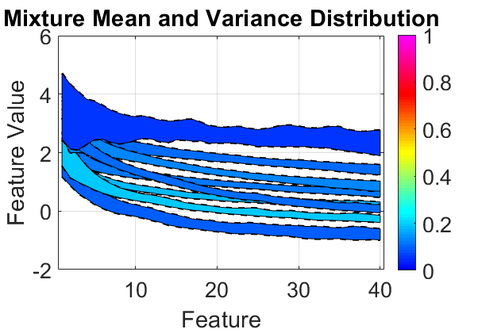
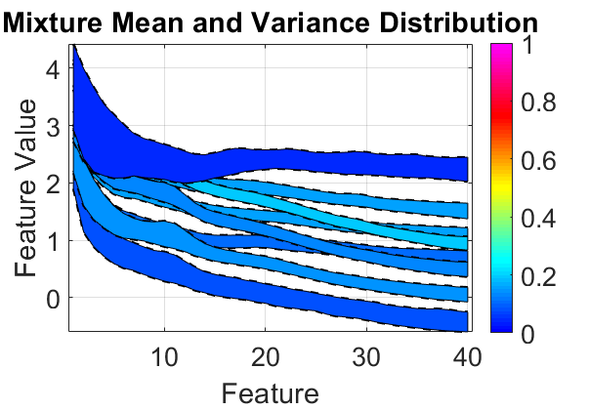
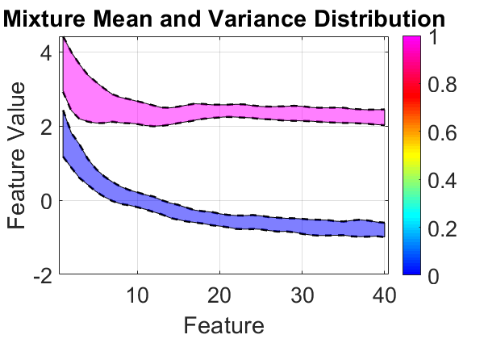
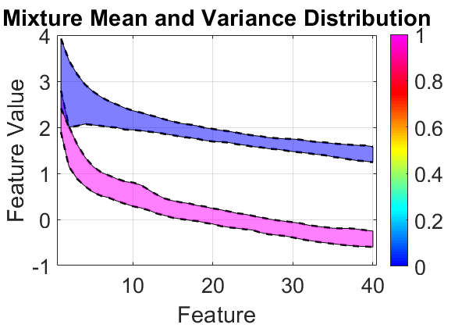
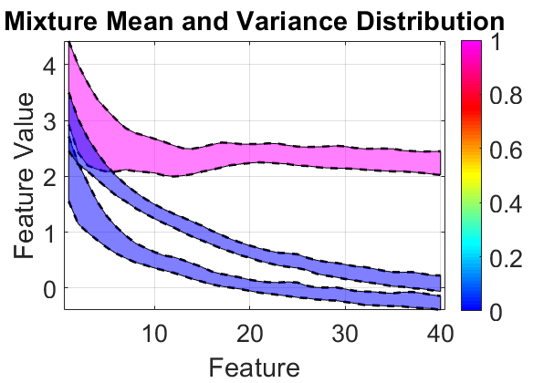
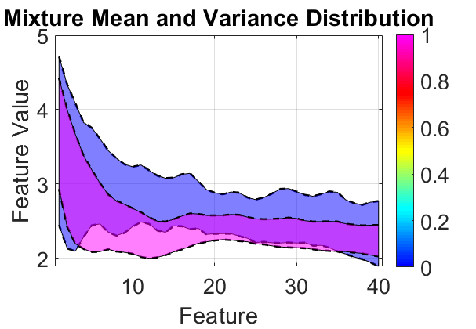
Experiment 5: UBM-TVM Relationship
Furthest-Divergent
Furthest-Aligned
Closest-Aligned
Furthest-Aligned
AbnNrm Base (blue)
AbnMot Target (pink)
Notes:
Base: AbnNrm Target: AbnMot
Of course, those flagged relationships are rather abstract, but if we look at the mixtures in the base (right) and target (left) datasets we, as humans, are likely to notice a few stand out. So intuitively we would think what we see is what the technique should see, right? Let’s see what it labeled as closest and aligned -> and it’s the two most distinct mixtures from each dataset (pink from the target and blue from the base) Then we have furthest divergent -> Same target mixture, but different base mixtures. This makes sense as the feature space of the base mixtures is occupied by rather distinct mixtures for the target (bumps around 10hz, motion data!) This too is a decision surface as these mixtures are divergent and thus in contrast across their TVMs. Lastly where the furthest aligned pairings -> Now we see a new target mixture, with a bump, and a new base mixture. And again a pairing using the same unique mixture (mixture 8 ) from the target dataset against two base mixtures, but these are two different mixtures than the furthest divergent results, further solidifying the case for the importance of this target mixture label base and target

Slide 44
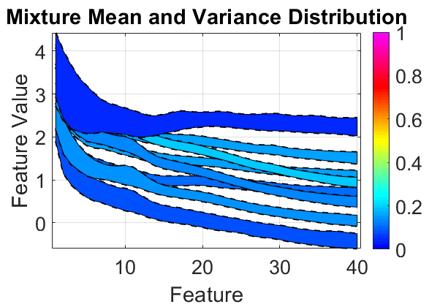
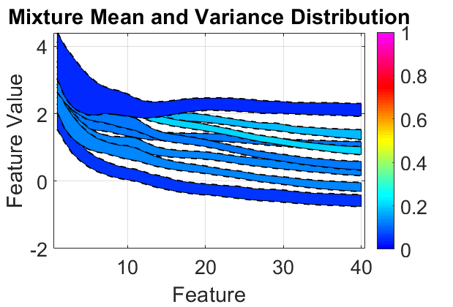
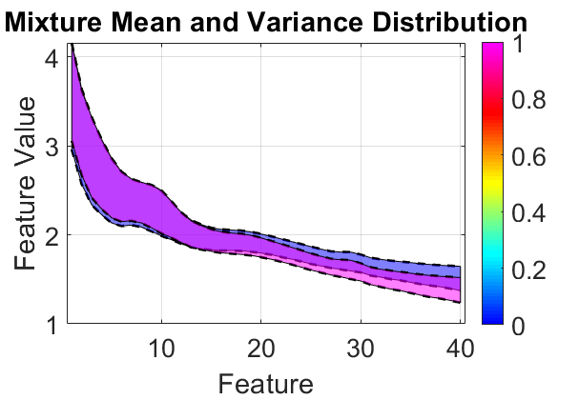
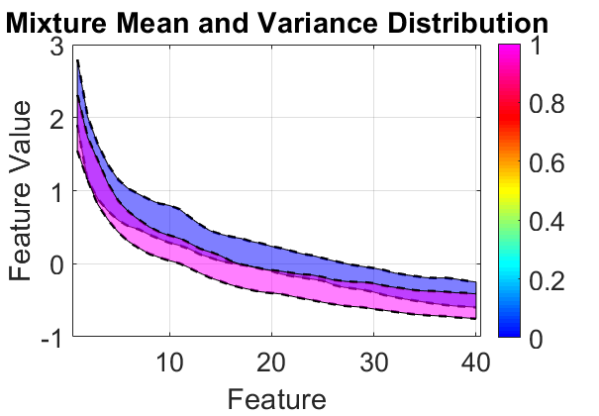
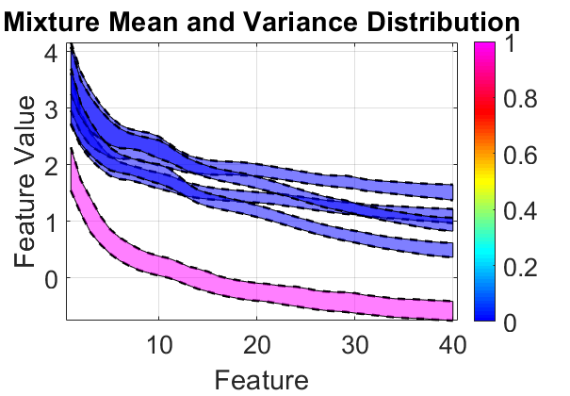
Experiment 5: UBM-TVM Relationship
Closest-Divergent
Closest-Aligned
Furthest-Divergent
AbnMot Base (blue)
NrmMot Target (pink)
Notes:
Base: AbnMot Target: NrmMot CA -> FD -> CD This can then be repeated for a slightly different dataset, AbnMot versus NormMot, where the base and target UBMs appear very similar. Thus the mixtures of interest are assumed to come from the differences between the Abn and Nrm datasets. As seen prior, this motion mixture appears in both datasets and is aligned for both TVMs. The next mixtures, labeled as FD, resolves to pit 4 base mixtures in opposition to one target mixture. Thus not only are these mixtures far apart (perhaps indicating an artefact), they are actually used in different ways by each TVM. This suggests they aren’t both artefacts, and at least one (base/target) is critical for differentiation between the datasets. Lastly (CD), we see the target mixture from the FD is used again and pitted against its UBM space counterpart which confirms the importance of the target mixture was being a decision surface for two datasets. UBM alone would not have uncovered this interaction.

Slide 45
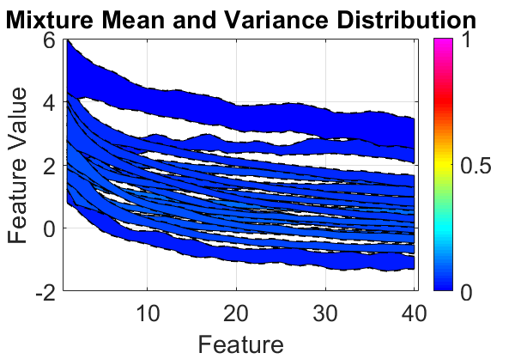
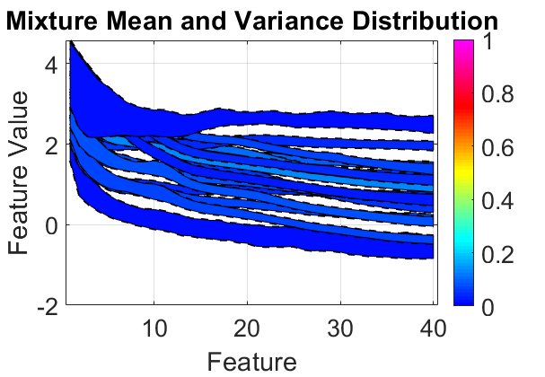
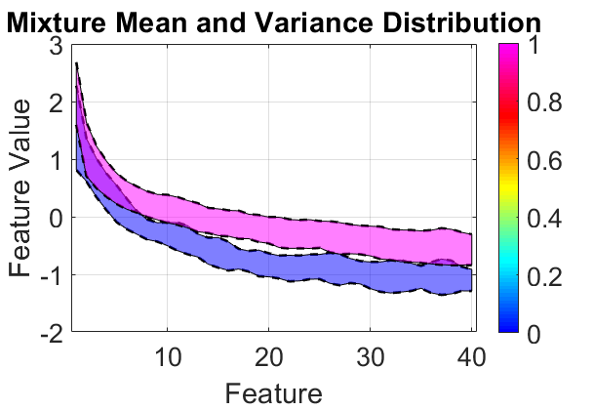
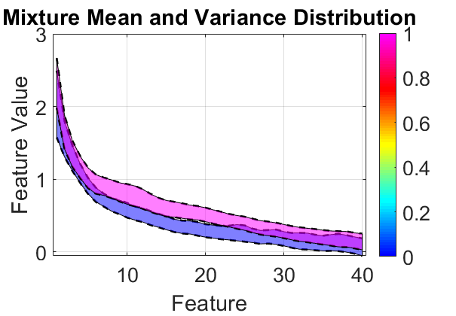
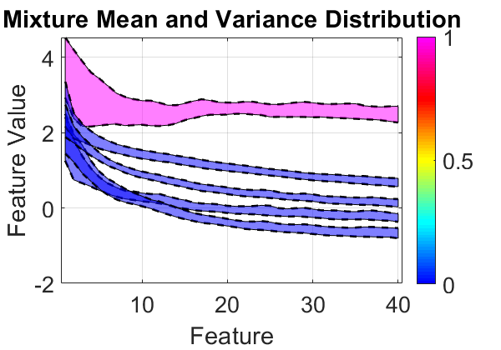
Experiment 5: UBM-TVM Relationship
Closest-Aligned
Closest-Aligned
Furthest-Divergent
AbnNrm Base (blue)
AbnMot Target (pink)
Notes:
Base: AbnNrm Target: AbnMot 16 mixtures CA-> CA> FD The behavior isn’t limited to a given mixture size, although the smaller mixture sizes are easier to interpret (at least for me). Here we can revisit the AbnNrm and AbnMot, to review what doubling the mixtures does to the TVM-UBM relationship. The first CA
find again that the distinct motion mixture is found and used for another set of CA comparisons.

Slide 46
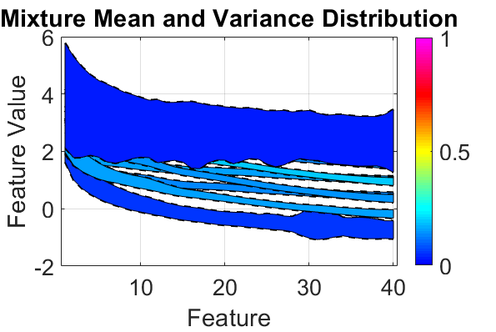
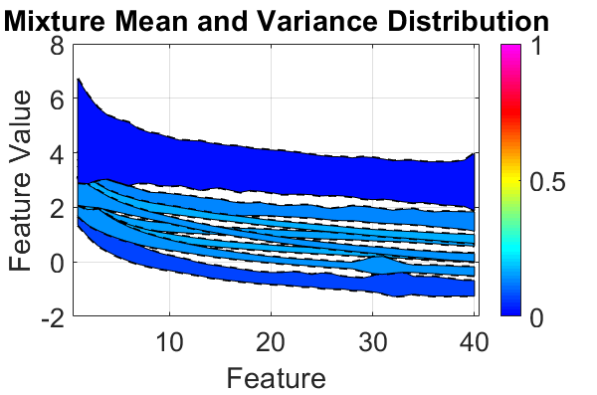
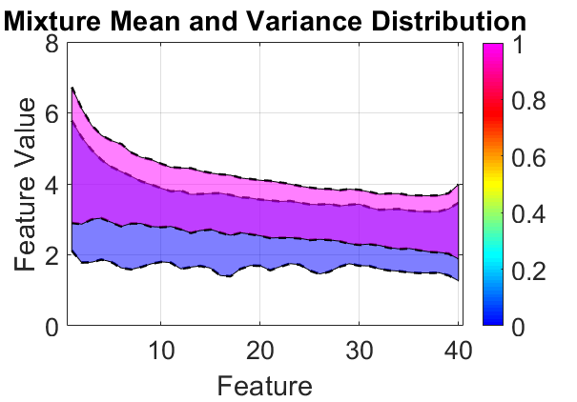
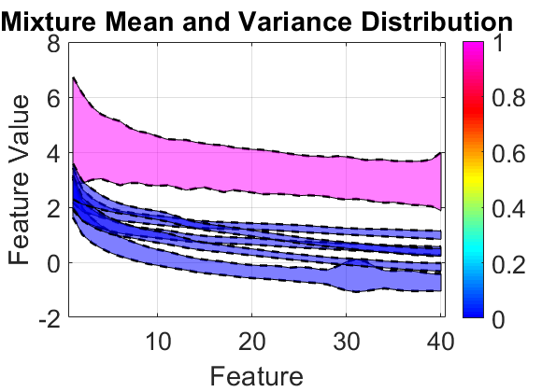
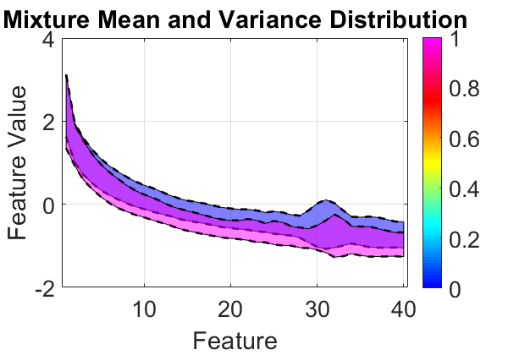
Experiment 5: UBM-TVM Relationship
Furthest-Aligned
Closest-Divergent
Closest-Aligned
SzrMot Base (blue)
NrmSzr Target (pink)
Notes:
Base: SzrMot Target: NrmSzr 8 mixtures CA-> CD> FA

Slide 47
Significance
I-Vectors are an acceptable technique for addressing subject verification on EEG data
They are competitive with other techniques in terms of performance and offer a low dimensional space evaluation once modeled
The TVMs hold the potential to provide transparent data clustering and labeling

Slide 48
Future Efforts
Apply TVM learned labels to annotated data to determine overlap with experts
Generate I-Vectors on Trial and Channel level to see if performance is maintained
Apply advanced speech techniques to further I-Vector performance

Slide 49
Notes:
Eight neurologists trying to read the same seizure recording. What is right and what is wrong? Seven of either agree about overall condition (seizure/brain disorder) but how they got there is unique.

Slide 50
Research Aims – RA1
Research Aim 1: Can an I-Vector based classification perform as well as, or better than, other applicable techniques?
Mahalanobis Distance
Gaussian Mixture Model-Universal Background Model
Identity Vectors w/ Cosine Distance
Performance Metrics
Notes:
Eight neurologists trying to read the same seizure recording. What is right and what is wrong? Seven of either agree about overall condition (seizure/brain disorder) but how they got there is unique.

Slide 51
Research Aims – RA2
Research Aim 2: Under what conditions does an I-Vector based system perform best?
Datasets – PhysioNet & TUH EEG
Features – CEP, PSD, COH
Epochs – 10s, 5s, 2s, 1s
UBM mixtures – 2,4,…,1024,2048
TVM Dimension – 15…200
LDA Dimension – 5…195
Notes:
Eight neurologists trying to read the same seizure recording. What is right and what is wrong? Seven of either agree about overall condition (seizure/brain disorder) but how they got there is unique.

Slide 52
Research Aims – RA3
Research Aim 3: What characteristics of EEG data do I-Vector take advantage of in their discrimination? Is this process inherently well suited for addressing EEG classification?
Notes:
Eight neurologists trying to read the same seizure recording. What is right and what is wrong? Seven of either agree about overall condition (seizure/brain disorder) but how they got there is unique.

Slide 53
Landscape of EEGs – Seizures
D.F. Wulsin, et al. \Modeling electroencephalography waveforms with semi-supervised deep belief nets: fast classification and anomaly measurement," Journal of Neural Engineering 8-3 (2011).
Notes:
Applying ML algorithms to EEG classification problems has produced algorithms that chase the performance of clinicians. In the work of Wulsin 2011, a classifier showed it could detect areas of interesting that aligned with a clinician’s assessment for artifacts, features of seizures, and general high energy waveforms. In these examples the black boxes represent the clinician’s annotation and the darker regions the algorithms weighted guess. This work used a supervised deep belief network, a variation of a neural network, to learn from labeled datasets how to detect each class of features. This is not /always/ an option, but the majority of work with EEGs relies on annotated data to train the algorithms and to verify the resultant classifications.

Slide 54
Landscape of EEGs – Sleep
Tatum IV, W. O. (Ed.). (2014). Handbook of EEG interpretation. Demos Medical Publishing.
Notes:
When dealing with sleep studies, cross talk across channels still exists but the waveforms are less intense and sporadic. The arrow indicates a sleep spindle, these along with k-complexes, are two waveforms unique to restful stages of sleep. So these waveforms are different from those occurring in seizures, and also those shown previously in terms of artifacts and other transient events.

Slide 55
Landscape of EEGs – Clinicians
Terminology
Annotation
Gaspard, N., Hirsch, L. J., LaRoche, S. M., Hahn, C. D., Westover, M. B., & Critical Care EEG Monitoring Research Consortium. (2014). Interrater agreement for critical care EEG terminology. Epilepsia, 55(9), 1366-1373.
Gerber, P. A., Chapman, K. E., Chung, S. S., Drees, C., Maganti, R. K., Ng, Y. T., ... & Kerrigan, J. F. (2008). Interobserver agreement in the interpretation of EEG patterns in critically ill adults. Journal of Clinical Neurophysiology, 25(5), 241-249.
Notes:
For assess seizures and sleep disorders, clinicians (neurologist/epileptologist) are the primary source of identifying/labeling/diagnosis seizures. This skill is part of their training and combine with other diagnostic information they make excellent decisions for their patients. However, the consistency among them in terms of their fluency of terminology, and agreement of annotations (labeling the events) is far from perfect.

Slide 56
Channels – Original to Slim
Notes:
La Rocca used 56 channels, cut 8. thus PSD 56 channels, COH 1540 (56*55)/2, CEP 22! Slim, everything based on TCP montage so down to 19 channels PSD, 22 channels COH and 22 channels CEP

Slide 57
Experiment 5: UBM-TVM Relationship
Notes:
A similar analysis can be carried out for the TVMs of the base and target datasets. However, the distance this time is the cosine similarity of each TVMs impulse response. The impulse response are the offsets produced by a TVM when given an I-Vector of ones. The weights represent the frequency of the largest coefficients within each TVM. This results in the UBM illustrating where the mixtures are in the EEG feature space and the TVM how those same mixtures are aligned in the EEG feature space. This provides four major labels which are, unfortunately, relative to the datasets and not directly tied to their distance values. Here the UBM distances, in the feature space, are either closest, C, or furthest, F. The TVM similarity is either aligned, A, or divergent, D. All together this gives labels for the four quadrants mapped by the distances. Bottom Right – Closest Aligned. Top Right – Closest Divergent. Bottom Left – Furthest Aligned. Top Left – Furthest Divergent. This provides a way to infer what the mixtures represent based upon their distances.

Slide 58
La Rocca’s Results

Slide 59
La Rocca’s Results

Slide 60
La Rocca’s Results

Slide 61
I-Vector Development

Slide 62
I-Vector Development

Slide 63
Baum Welch Statistics
0th Order BW:
$${\vec{N}}_{c}\left(s\right)=\sum_{t=1}^{O_{TR}}{P\left(c | {\vec{o}}_{t},λ\right)}$$
1st Order BW:
$${\vec{F}}_{c}\left(s\right)=\sum_{t=1}^{O_{TR}}{P\left(c | {\vec{o}}_{t},λ\right)}{\vec{o}}_{t}$$
2nd Order mean centered: $$V_{c}\left(s\right)=\text{diag}\left(\sum_{t=1}^{O_{TR}}{\begin{aligned}P\left(c | {\vec{o}}_{t},λ\right)⋅ \\ {\vec{o}}_{t}{\vec{o}}_{t}^{t}\end{aligned}}\right)$$
1st Order mean centered: $${\tilde{\vec{F}}}_{c}={\vec{F}}_{c}−{\vec{N}}_{c}{\vec{μ}}_{c}$$
2nd Order mean centered: $${\tilde{V}}_{c}\left(s\right)=\text{diag}\left(\sum_{t=1}^{O_{TR}}{\begin{aligned}P\left(c | {\vec{o}}_{t},λ\right)⋅ \\ \left({\vec{o}}_{t}−{\vec{μ}}_{c}\right){\left({\vec{o}}_{t}−{\vec{μ}}_{c}\right)}^{t}\end{aligned}}\right)$$

Slide 64
Baum Welch Statistics
Restructured:
$$N\left(s\right)=\left[\begin{matrix}{\vec{N}}_{1}\left(s\right) & & \\ & ⋱ & \\ & & {\vec{N}}_{C}\left(s\right)\end{matrix}\right] \\ \hat{\vec{F}}\left(s\right)=\left[\begin{matrix}{\tilde{\vec{F}}}_{1}\left(s\right) \\ ⋮ \\ {\tilde{\vec{F}}}_{C}\left(s\right)\end{matrix}\right] \\ \hat{V}\left(s\right)=\left[\begin{matrix}{\tilde{V}}_{1}\left(s\right) & & \\ & ⋱ & \\ & & {\tilde{V}}_{C}\left(s\right)\end{matrix}\right]$$
Updated covariance (optional):
$$Σ={\left(\sum_{s=1}^{S}{N\left(s\right)}\right)}^{−1} \\ \left(\sum_{s=1}^{S}{\hat{V}\left(s\right)−\text{diag}\left(KT^{t}\right)}\right)$$

Slide 65
UBM Training – Stable UBMs
AbnNrm @ 8 mix
AbnNrm @ 16 mix

Slide 66
Parameter Sweeps – Initial TUHEEG

Slide 67
Parameter Sweeps - PNET

Slide 68
Algorithm Benchmarks– AbnNrmSzr

Slide 69
Algorithm Benchmarks– AbnNrmMot

Slide 70
Algorithm Benchmarks– LDA (AbnNrmSzr)

Slide 71
UBM-TVM: AbnNrm – AbnMot mix 16

Slide 72
UBM-TVM: SzrMot– NrmSzr mix 8

Slide 73
UBM-TVM: NrmSzrMot – NrmMot @ 8
Closest-Aligned
Closest-Divergent
Furthest-Aligned

Slide 74
UBM-TVM: NrmSzrMot – NrmMot @ 8
NrmSzrMot - Base
NrmMot - Target

Slide 75
UBM-TVM: NrmSzrMot – NrmMot @ 32

Slide 76
UBM-TVM: NrmSzrMot – NrmMot @ 32
Closest-Divergent
Closest-Divergent
Furthest-Aligned

Slide 77
What was my contribution to science?
I established I-Vectors as an acceptable technique for subject verification on EEG data. In doing so I was able to develop a technique that showed how, via mixtures, the classification occurred which provided insights otherwise obscured by the UBM on the nature of the EEG data itself.

