Slide 1
Strategies for Sparsity-based Time-Frequency Analyses
Shuimei Zhang
Department of Electrical and Computer Engineering
Temple University, Philadelphia, USA
Advanced
Signal
Processing
Laboratory
http://asplab.net

Slide 2
Outline
Introduction
Signal Model
Atomic Norm-based TFR Reconstruction
AAO-based TFR Reconstruction
Future Work: Radar Waveform Recognition

Slide 3
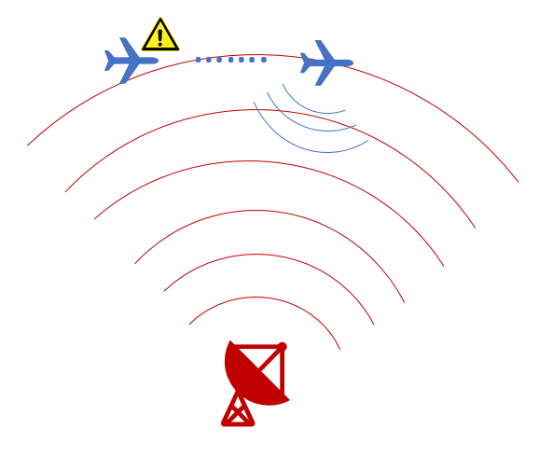
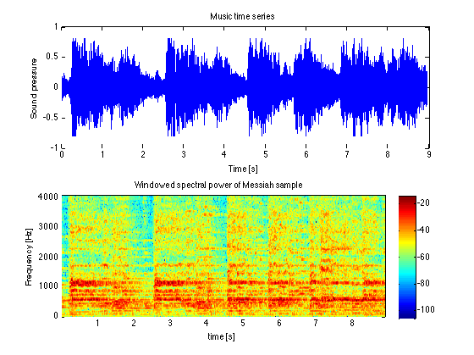

Introduction
Most real-world signals are nonstationary in nature such as electroencephalogram (EEG), music, radar.
EEG¹
Music²
Radar³
1 https://www.biofeedback-tech.com/articles/2016/5/26/eeg-fourier
2 https://atmos.uw.edu/~breth/classes/AS552/matlab/lect/html/music.html
3 https://www.mathworks.com/help/phased/examples/signal-parameter-estimations-in-a-radar-warning-receiver.html

Slide 4
Introduction
Nonstationary random process: violate any of the properties that define a wide-sense stationary process (WSS)¹
Nonstationarity relates to the variation over time of the statistics of the signal.
Time domain
Frequency domain
Time-Frequency domain
Linear frequency modulated signal
WSS: mean and auto-correlation function do not depend on the absolute time

Slide 5
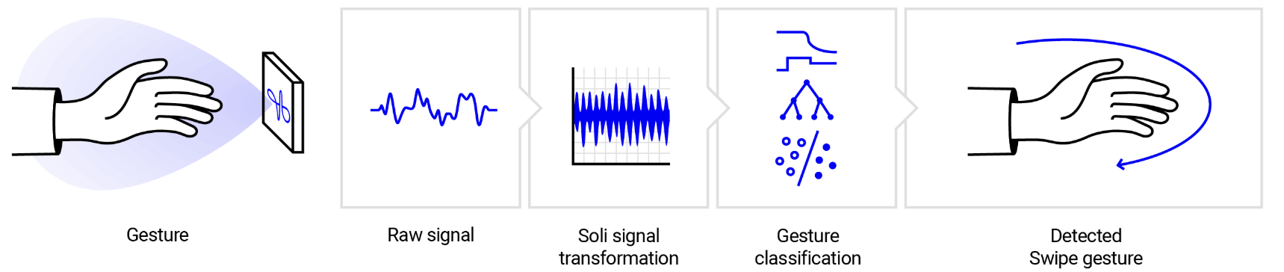
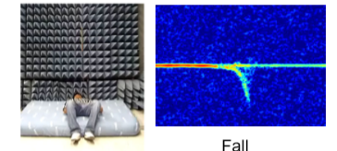
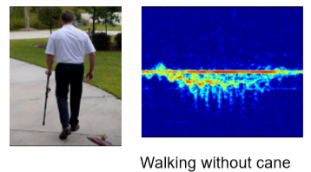
Introduction
Google Soli: https://atap.google.com/soli/technology/
Q. Wu, Y. D. Zhang, W. Tao, and M. G. Amin, “Radar-based fall detection based on Doppler time-frequency signatures for assisted living,” IET Radar, Sonar & Navigation, special issue on Application of Radar to Remote Patient Monitoring and Eldercare, vol. 9, no. 2, pp. 164-172, Feb. 2015.

Slide 6
Introduction
Nonstationary signal
time-frequency representation (TFR)
Linear
Short-time Fourier transform (STFT)
Wavelet transform
Bilinear
Wigner-Ville distribution
Time-frequency kernel and Cohen’s class

Slide 7
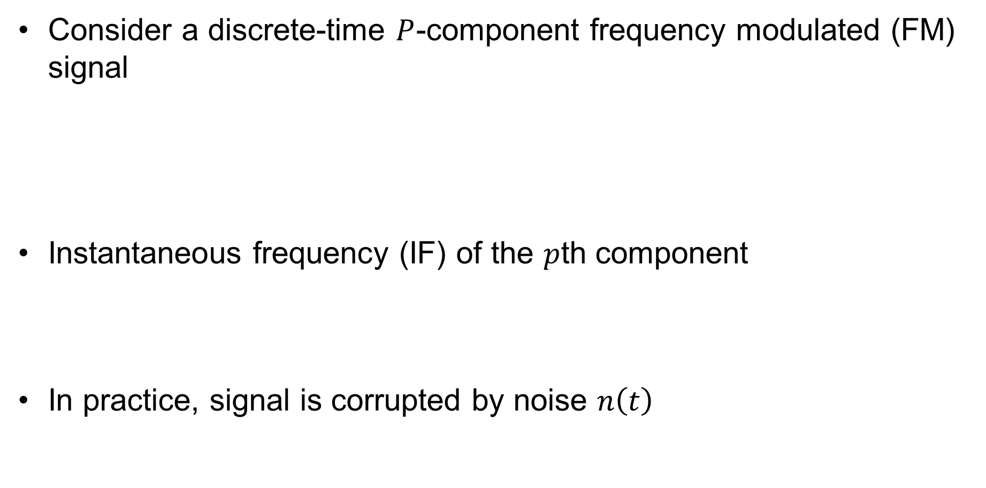
Signal Model
Consider a discrete-time $P$-component frequency modulated (FM) signal
Instantaneous frequency (IF) of the $p$th component
In practice, signal is corrupted by noise $n\left(t\right)$
amplitude
phase law

Slide 8
Signal Model
Instantaneous autocorrelation function (IAF):
Wigner-Ville distribution (WVD):
Ambiguity function (AF):

Slide 9
Signal Model
WVD provides high time-frequency (TF) concentration for linear FM signals.
Cross-terms are unavoidable due to bilinear nature in the cases of nonlinear or multiple components.
Cross-terms appear in the middle-way of auto-terms in the TF domain.
Waveform (real part)
Time-frequency distribution
Cross-terms
Auto-terms
2-D FFT
FFT (f, τ )
Ambiguity function
IAF
Auto-terms
Cross-terms
FFT (θ, t)

Slide 10
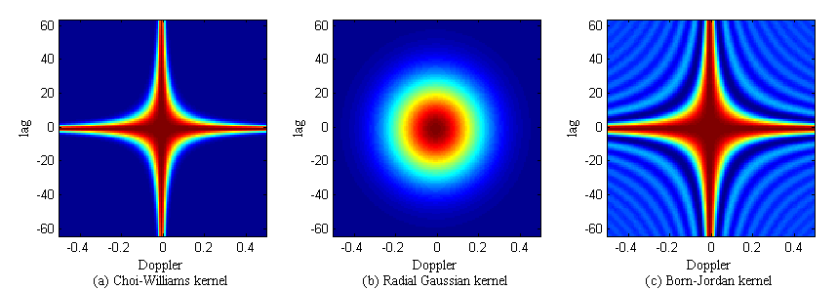
Signal Model
Auto-terms are located around the origin of the ambiguity domain, and cross-terms tend to be away from the origin.
Time-frequency kernel is a low-pass filter in the ambiguity domain.
  Data-independent: e.g., Choi-Williams distribution (CWD)
  Data-dependent: e.g., adaptive optimal kernel (AOK)
CWD
AOK

Slide 11
Signal Model
In practice, missing samples frequently occur.
Examples:
Light-of-sight obstruction
Multipath fading
Removal of impulsive noise or jammer
Burst missing samples!
(Missing samples appear as clusters)

Slide 12

Effects of Missing Samples
$$S_{1}\left(t\right)+S_{2}(t)$$
IAF
AF
WVD
AOK
No
Missing
Random
Missing
Burst
Missing

Slide 13

Effects of Amplitude Difference
$$S_{1}\left(t\right)+{0.5S}_{2}(t)$$
IAF
AF
WVD
AOK
No
Missing
Burst
Missing
Another challenge is the amplitude difference of the signal components. It is diﬃcult to identify the auto-term associated with the weak signal component from the residual artifacts of the cross-terms.

Slide 14
Proposed Methods
Robust TFR in Impaired Observing Environments
eg: burst missing samples, noisy environments, amplitude difference
Atomic Norm-based TFR Reconstruction Method
AAO-based TFR Reconstruction Method
Application: radar waveform recognition
IAF Interpolation
Recover Burst Missing Samples
Time-Frequency Kernel
Suppress Cross-Terms
Sparse Reconstruction
High-Resolution TFR

Slide 15
Atomic Norm-based TFR Reconstruction Method
S. Zhang and Y. D. Zhang, "Robust time-frequency analysis of multiple FM signals with burst missing samples," IEEE Signal Processing Letters, vol. 26, no. 8, pp. 1172-1176, Aug. 2019.

Slide 16
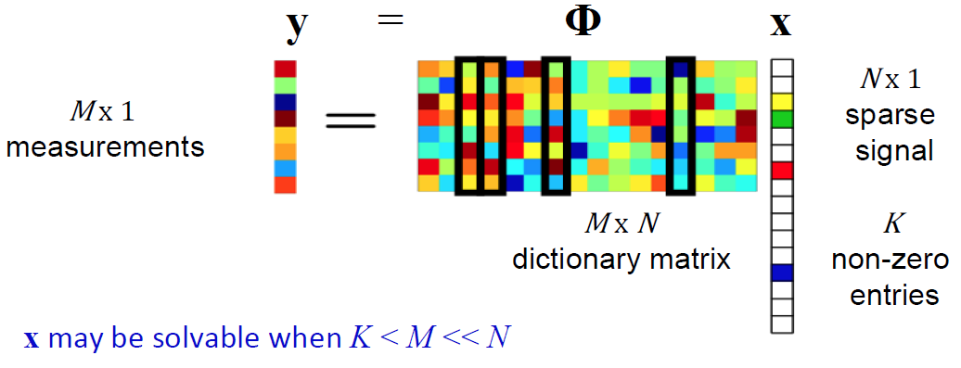
Compressive Sensing
The required number of samples for reconstructing a signal can be greatly reduced if it is sparse in a known discrete basis.

Slide 17
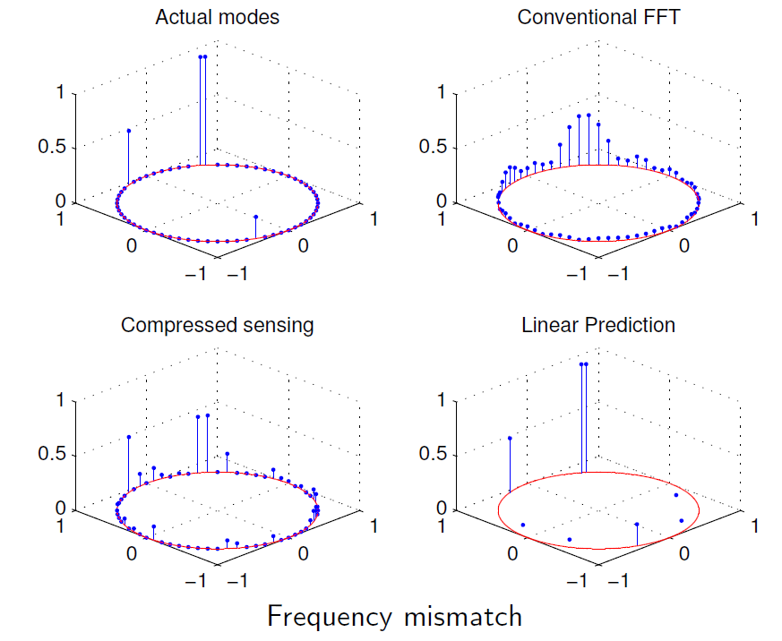
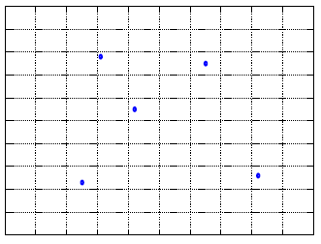
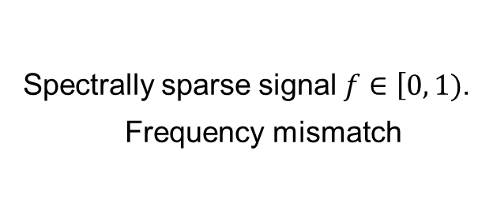
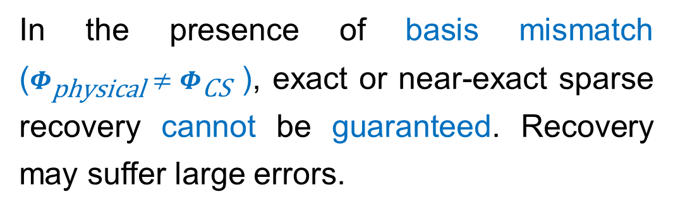
Basis Mismatch
Compressive sensing
Known discrete dictionary
VS
Real world signal
Sparse in a continuous dictionary
In the presence of basis mismatch ($Φ_{\text{physical}}≠Φ_{\text{CS}}$ ), exact or near-exact sparse recovery cannot be guaranteed. Recovery may suffer large errors.
Spectrally sparse signal $f∈\left[0, 1\right.)$.
Frequency mismatch
source: Y. Chi, 2014 ICASSP tutorial

Slide 18
Going Off The Grid
Parameter estimation without discretization with theoretical guarantees.
The atomic norm was first proposed in [1] as a general framework for designing tight convex relaxations to promote simple signal decompositions.
People seeks to use a minimal number of atoms to represent a given signal from an atomic set composed of an ensemble of signal atoms.
Atomic Norm Minimization
Signal Recovery
Covariance Matrix Estimation
[1] V. Chandrasekaran, B. Recht, P. A. Parrilo, A. S. Willsky, “The convex geometry of linear inverse problems,” Foundations of Computational Mathematics 12 (6) (2012) 805–849.

Slide 19
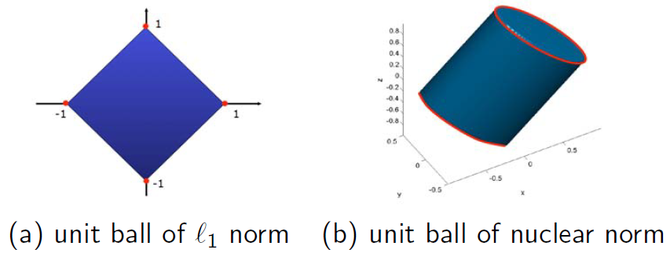

Atomic Norm
Special cases of the atomic norm
Sparse signals: an atom for sparse signals is a normalized vector of sparsity one, and the atomic norm is $l_{1}$ norm
Low-rank matrices: an atom for low-rank matrices is a normalized rank-one matrix; and the atomic norm is nuclear norm
The set of atoms is graphed in red. Image credit: Y. Chi, 2014 ICASSP tutorial

Slide 20


Atomic Norm-based TFR Reconstruction
In general, radar signals exhibit low occupancy in the TF domain, thus casting them as sparse in the joint-variable representations.
Consider $P_{t}$ non-zero entries in $g_{t}$. The IAF is the IDFT of WVD
IAF slice
TF slice
Lag vector: $τ={\left[τ_{1}, τ_{2},⋯, τ_{Q}\right]}^{T}$
IAF slice
IDFT
TF slice

Slide 21
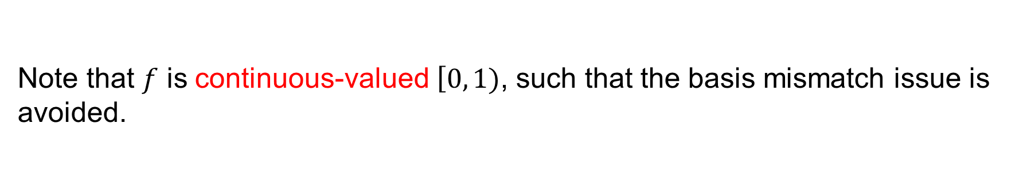

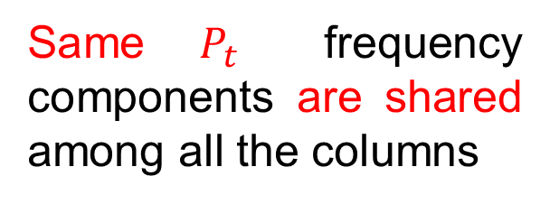
Atomic Norm-based TFR Reconstruction
Construct a Hankel matrix from IAF slice $y_{t}$
Step 1: Define an atom for representing $H_{t}$ as
Atomic set is
Same $P_{t}$ frequency components are shared among all the columns
Note that $f$ is continuous-valued $\left[0, 1\right.)$, such that the basis mismatch issue is avoided.

Slide 22


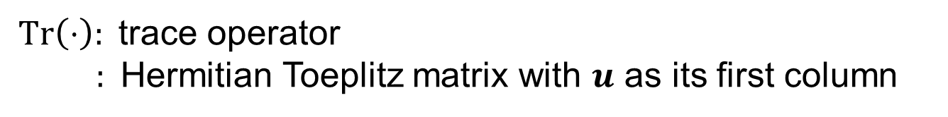
Atomic Norm-based TFR Reconstruction
Step 2: Define the atomic norm of $H_{t}$ as
Step 3: Formulate a convex program to minimize the atomic norm
The convex hull of $𝒜$
$Tr\left(⋅\right):$ trace operator
: Hermitian Toeplitz matrix with $u$ as its first column
Vandermonde decomposition lemma: exists

Slide 23
Atomic Norm-based TFR Reconstruction
In the presence of noise,
$z^{t}$: noisy IAF slice at time instant $t$ (observed) $Ω_{t}$: observation pattern
$y^{t}$: clean IAF slice at time instant $t$ (to be estimated) $ε_{t}:$ noise level

Slide 24
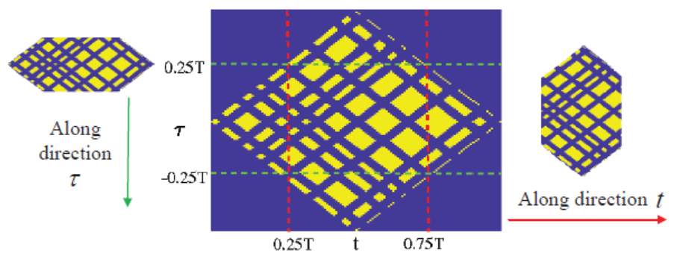
Atomic Norm-based TFR Reconstruction
Stage 1: IAF Interpolation via atomic norm minimization
Stage 2: cross-term mitigation via kerneled IAF
AOK

Slide 25
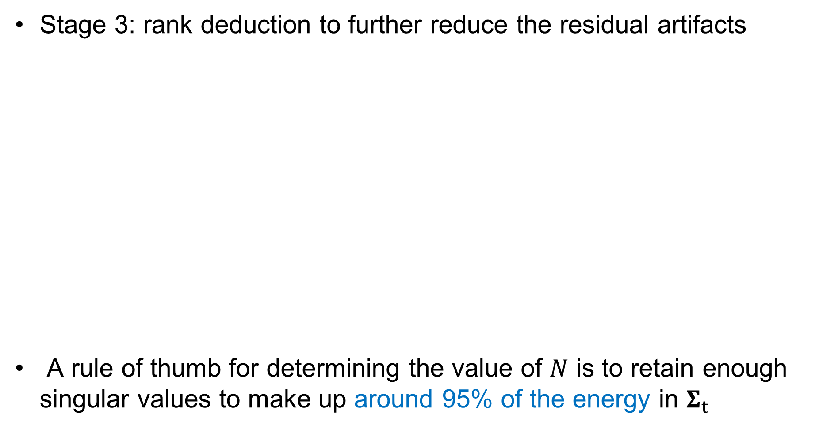

Atomic Norm-based TFR Reconstruction
Stage 3: rank deduction to further reduce the residual artifacts
A rule of thumb for determining the value of $N$ is to retain enough singular values to make up around 95% of the energy in $Σ_{t}$
Singular value decomposition
IAF slice from ${\hat{R}}_{rr}^{2}\left(t, τ\right)$
Only keep first $N$ principal singular values from $Σ_{t}$

Slide 26
Atomic Norm-based TFR Reconstruction
High-resolution TFR via sparse reconstruction
We choose orthogonal matching pursuit (OMP) to solve the sparse reconstruction problem, since it allows us to specify the sparsity at each time instant.
TF slice
IAF slice
IDFT dictionary matrix

Slide 27
Simulation Setting
Two-component linear FM (LFM) and nonlinear FM (NLFM) with different amplitudes
Unless otherwise specified
T = 128
48 missing samples (4 missing samples each burst, 12 bursts)
No noise considered
Mean square error (MSE) comparison: 50 simulation runs

Slide 28
Simulation Results: Two-Component LFM
No missing: baseline IAF and WVD
Burst missing
Stage1: IAF interpolation (Atomic norm)
Stage2: cross-term mitigation
(Atomic norm + AOK)

Slide 29
Simulation Results: Two-Component LFM
Stage3: further improvement
(Atomic norm + AOK + rank deduction)
For comparison
(AOK + OMP)
Atomic norm
+
AOK
+
rank deduction
+
OMP
Proposed method perfectly recovered both the two LFM signal components.
Proposed TFR

Slide 30
Simulation Results: Two-Component NLFM
No missing: baseline IAF and WVD
Burst missing
Stage1: IAF interpolation (Atomic norm)
Stage2: cross-term mitigation
(Atomic norm + AOK)

Slide 31
Simulation Results: Two-Component NLFM
Stage3: further improvement
(Atomic norm + AOK + rank deduction)
For comparison
(AOK + OMP)
Atomic norm
+
AOK
+
rank deduction
+
OMP
Proposed method provides much more consistent TFR
Proposed TFR

Slide 32
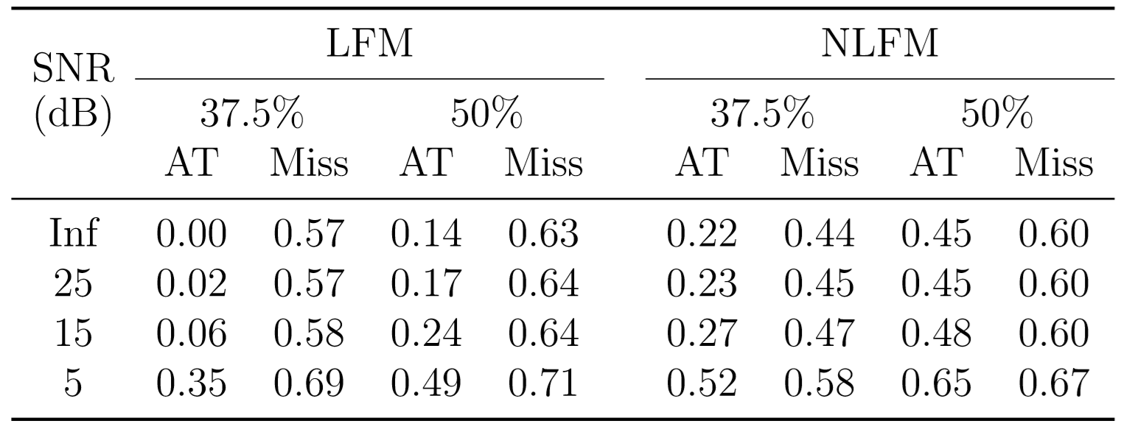
Simulation Results: Noisy Environments
TABLE. MSE comparison between the baseline IAF and the IAF obtained with atomic norm-based IAF (AT), and the incomplete data (Miss)
Proposed method consistently reduces the MSE of the reconstructed IAF. Better performance for LFM in high SNRs.

Slide 33
AAO-based TFR Reconstruction Method
S. Zhang and Y. D. Zhang, “Low-rank Hankel matrix completion for robust time-frequency analysis,” submitted to IEEE Transactions on Signal Processing.

Slide 34
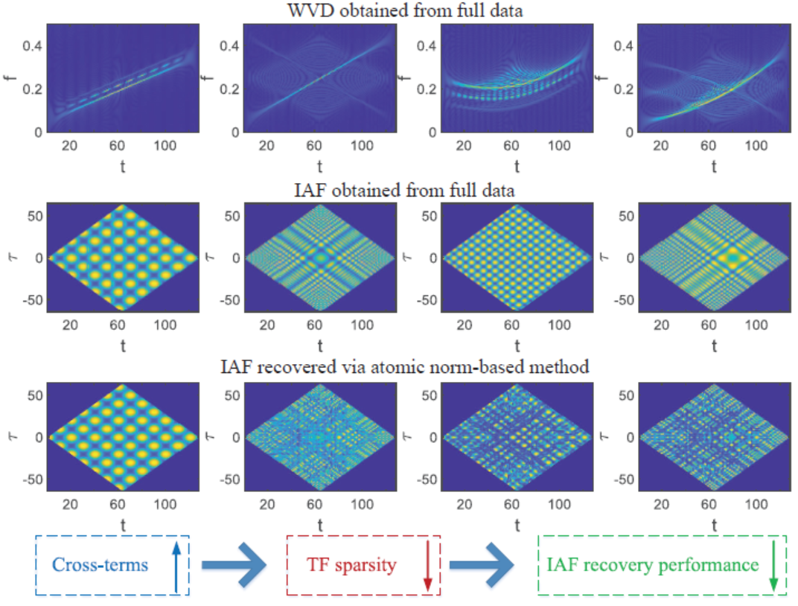
Issues in Atomic Norm based Method
Requirement: High-sparsity of the signal representations in the time-frequency domain or the ambiguity function domain
High-occupancy cross-terms
eg: Nonparallel FM or NLFM
Invalid high-sparsity assumption

Slide 35
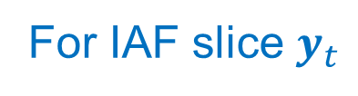
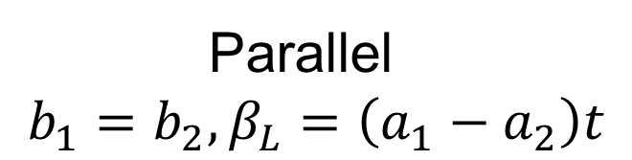
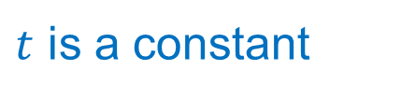
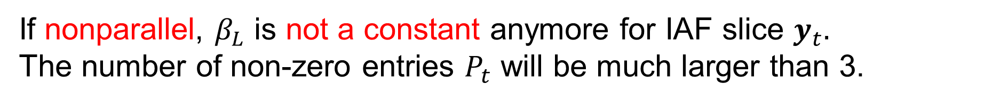
Issues in Atomic Norm based Method
Two-component LFM
Parallel
$$b_{1}=b_{2}, β_{L}=\left(a_{1}−a_{2}\right)t$$
For IAF slice $y_{t}$
At time instant t
$t$ is a constant
If nonparallel, $β_{L}$ is not a constant anymore for IAF slice $y_{t}.$
The number of non-zero entries $P_{t}$ will be much larger than 3.

Slide 36
Issues in Atomic Norm based Method
Two-component NLFM
where

Slide 37

Issues in Atomic Norm based Method
If parallel, we will have $b_{1}=b_{2}, c_{1}=c_{2}.$
High-occupancy cross-terms exists even if the two NLFM are parallel, not to mention nonparallel case

Slide 38
AAO-based TFR Reconstruction
IAF interpolation
via annihilating ﬁlter based low-rank Hankel matrix (ALOHA)
Cross-term mitigation via AOK
High-resolution TFR reconstruction via OMP
A limited set of FM signals:
atomic norm-based TFR
A general class of FM signals:
AAO-based TFR

Slide 39
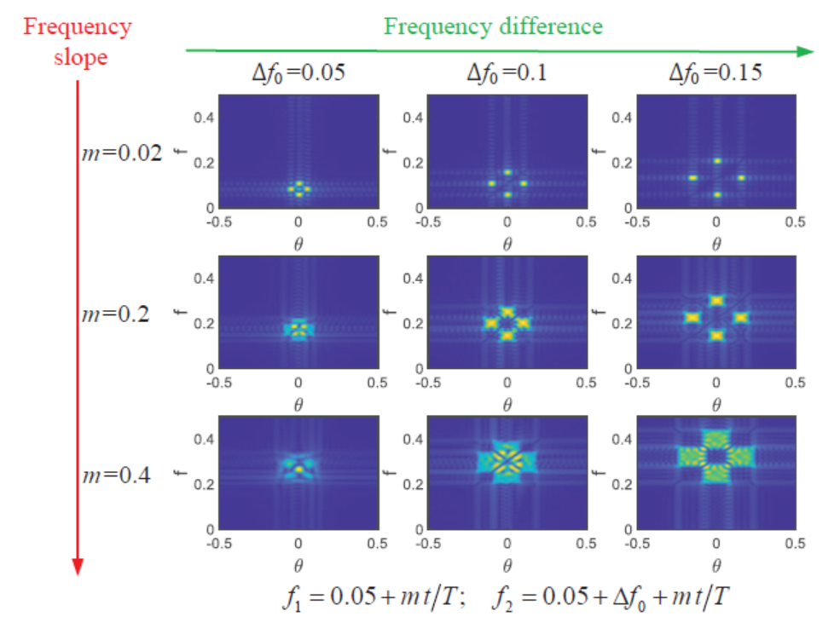
AAO-based TFR Reconstruction
Auto-terms does not drastically vary within a short time window
Cross-terms oscillate with fast phase variation over time
Proper selected IAF patch can lead to a sparse spectrum, i.e., Doppler-frequency (DF) is sparse.
DF obtained from the IAF patch

Slide 40

AAO-based TFR Reconstruction
The associated spectrum of IAF patch $Y∈C^{M×N}$
There exists a corresponding annihilating filter^{1,2}
Low rankness of a structured matrix in the spectral domain
Sparsity in the primary space
Fundamental duality
1 K. H. Jin and J. C. Ye, “Annihilating filter-based low-rank Hankel matrix approach for image inpainting,” IEEE Trans. Image Process., vol. 24, no. 11, pp. 3498–3511, Nov. 2015.
2 J. C. Ye, J. M. Kim, K. H. Jin, and K. Lee, “Compressive sampling using annihilating filter-based low-rank interpolation,” IEEE Trans. Inf. Theory, vol. 63, no. 2, pp. 777–801, Feb. 2016.

Slide 41
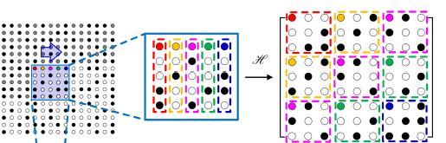

AAO-based TFR Reconstruction
Construct a block Hankel matrix from IAF patch $Y∈C^{M×N}$

Slide 42
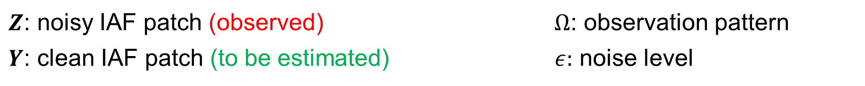
AAO-based TFR Reconstruction
Problem formulation
Nuclear norm normalization
$Z$: noisy IAF patch (observed) $Ω$: observation pattern
$Y$: clean IAF patch (to be estimated) $ε:$ noise level

Slide 43
AAO-based TFR Reconstruction
We can reformulate this problem into the augmented Lagrangian form
The problem can be solved in an alternating direction method of multiplier (ADMM)-based technique

Slide 44
AAO-based TFR Reconstruction
ADMM

Slide 45
AAO-based TFR Reconstruction
Patch Size Selection Principle
Desired IAF patch size Sparse IAF spectrum (DF domain)
Dynamic Range
Frequency Difference
Variation of the IFs should be kept small in the selected patch

Slide 46
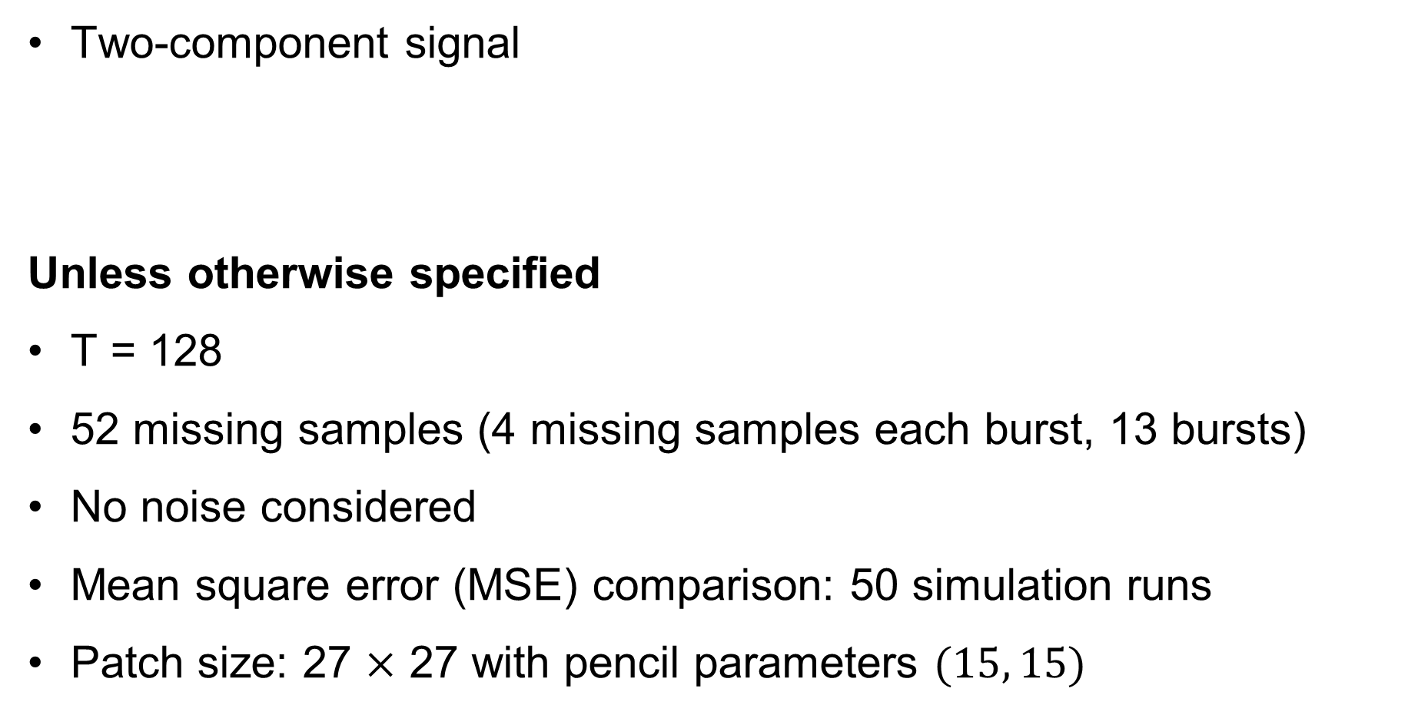
Simulation Setting
Two-component signal
Unless otherwise specified
T = 128
52 missing samples (4 missing samples each burst, 13 bursts)
No noise considered
Mean square error (MSE) comparison: 50 simulation runs
Patch size: 27 $×$ 27 with pencil parameters $(15, 15)$

Slide 47
Simulation Results: Two Parallel NLFM
No missing: baseline IAF and WVD
Burst missing
Atomic norm-based Method
Proposed AAO Method

Slide 48
Simulation Results: One Sine and One LFM
No missing: baseline IAF and WVD
Burst missing
Atomic norm-based Method
Proposed AAO Method

Slide 49
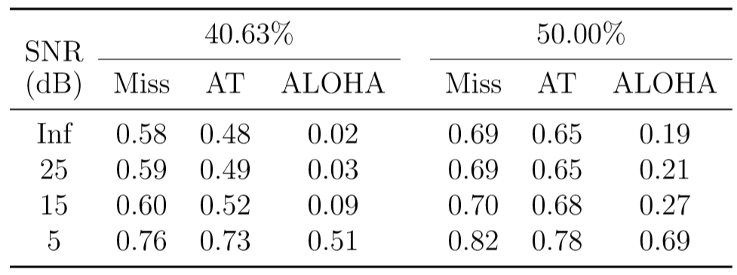
Simulation Results: One Sine and One LFM
TABLE. MSE comparison between the baseline IAF and the IAF obtained with the incomplete data (Miss), atomic norm-based IAF (AT), and the proposed ALOHA-based IAF
The proposed AAO method provides much lower MSE between the baseline IAF and the reconstructed IAF, especially in high SNR cases.

Slide 50
Future Work: Radar Waveform Recognition
Preliminary results accepted for presentation:
S. Zhang, A. Ahmed, and Y. D. Zhang, “Sparsity-based time-frequency analysis for automatic radar waveform recognition,” IEEE International Radar Conference, Washington DC, April 2020.
.

Slide 51
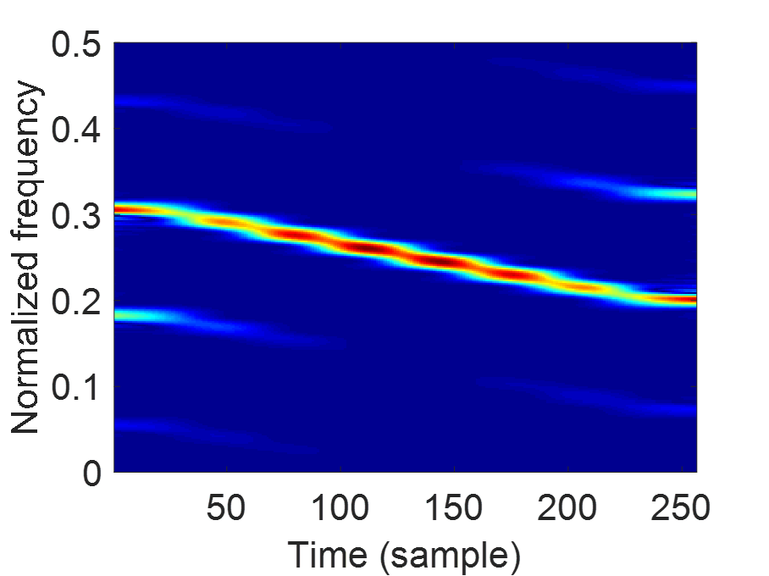
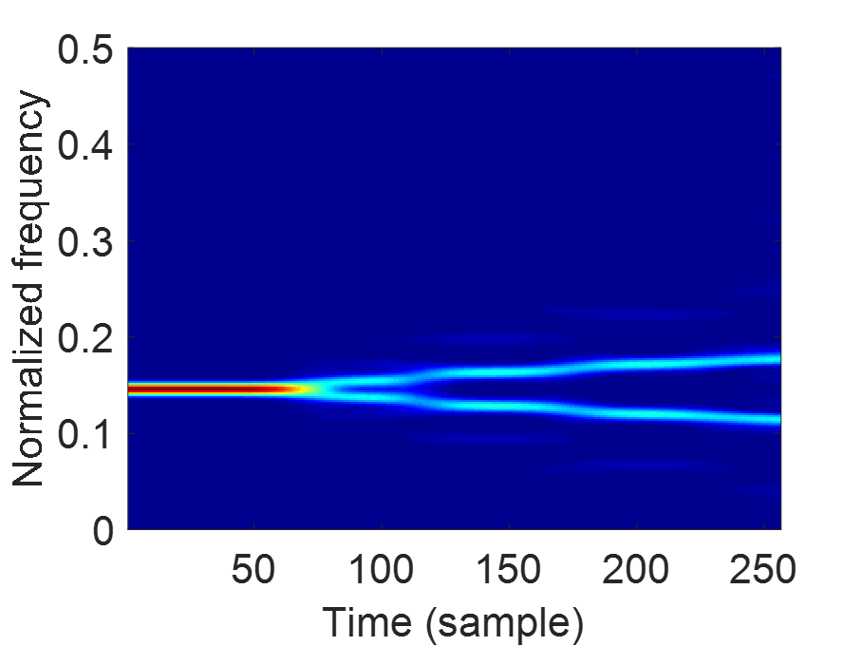
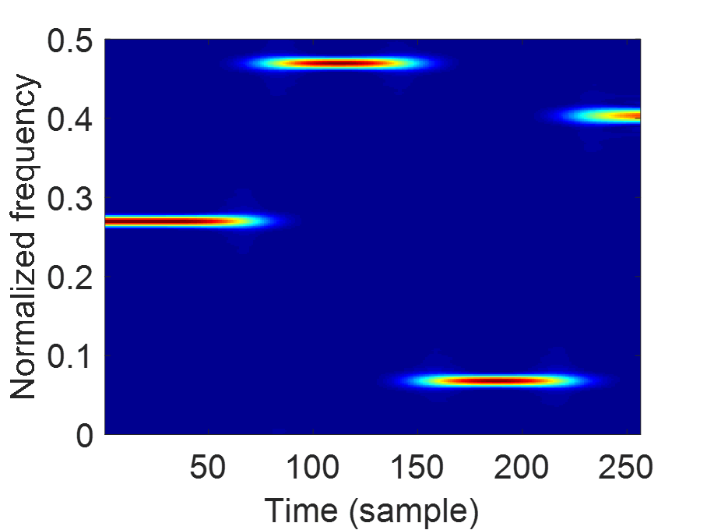
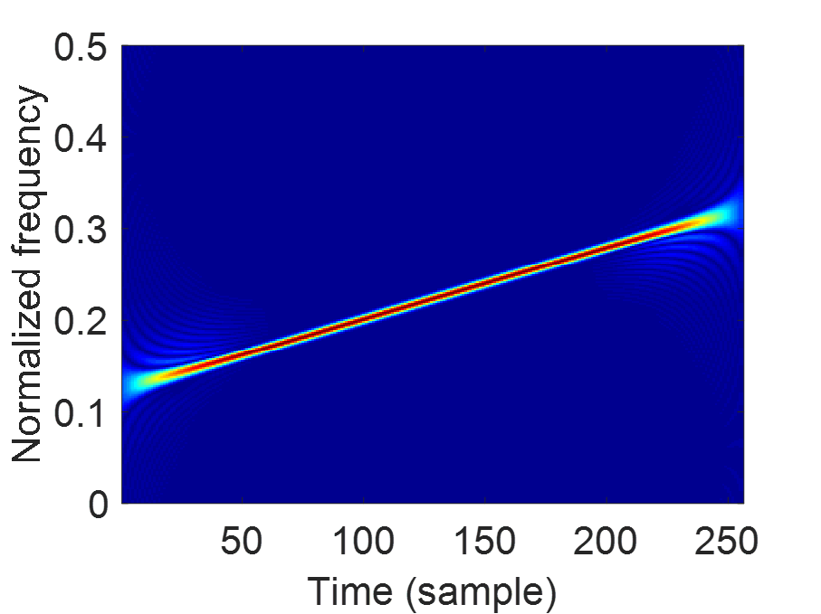
Radar Waveform Recognition
Automatic radar waveform recognition plays an important role in electronic warfare, such as radar emitter identiﬁcation and threat detection, especially for low probability of intercept (LPI) radar.
P2 Code
T1 Code
Costas
LFM
Common LPI radar waveforms

Slide 52
Radar Waveform Recognition
Feature extraction and classifier design are two key procedures for radar waveform recognition.
The noise will introduce the artifacts in the TFR, which prohibits the effective feature extraction.
Provide enhanced TFR
IAF denoising: atomic norm minimization
Cross-term mitigation: CWD
High resolution TFR: sparse reconstruction via OMP
Improved feature extraction

Slide 53
Signal Denoising via Atomic Norm Minimization
Problem formulation
Hankel matrix obtained from noisy IAF slice $z^{t}$ (observed)
Hankel matrix obtained from clean IAF slice $y^{t}$ (to be estimated)

Slide 54
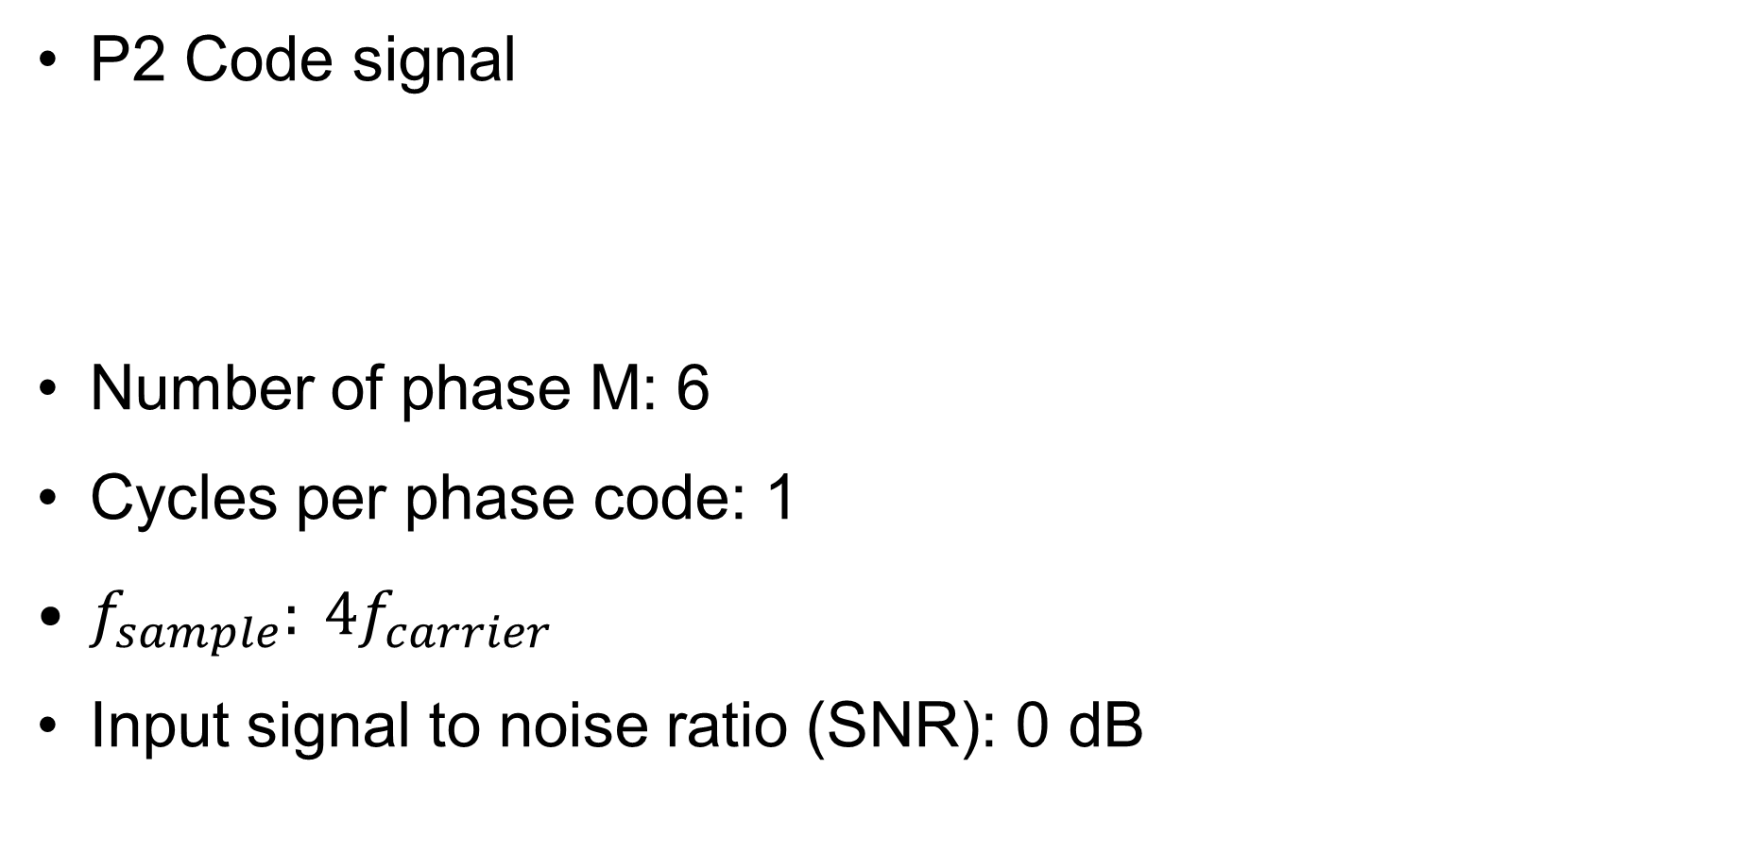
Simulation Setting
P2 Code signal
Number of phase M: 6
Cycles per phase code: 1
$f_{sample}: 4f_{carrier}$
Input signal to noise ratio (SNR): 0 dB

Slide 55
Simulation Results: P2 Code Signal
Waveform
IAF
WVD
CWD
No
noise
0dB
SNR

Slide 56
Simulation Results: P2 Code Signal
Denoised IAF
Denoised CWD
Proposed TFR
(Atomic nom + CWD +OMP)
Proposed method not only mitigates the effects of the noise, but also provides a high-resolution TFR, thereby signiﬁcantly improving the feature representation of the radar signals.

Slide 57
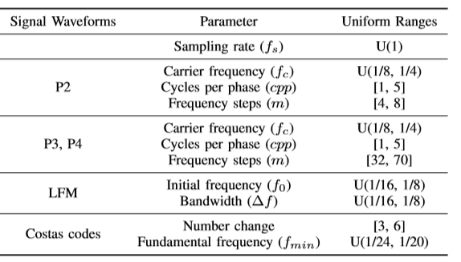
Simulation Results: Waveform Recognition
TABLE. List of the parameters of simulated signals
1000 samples (input SNR = 0dB) for each class
75% for training, 25% for testing

Slide 58
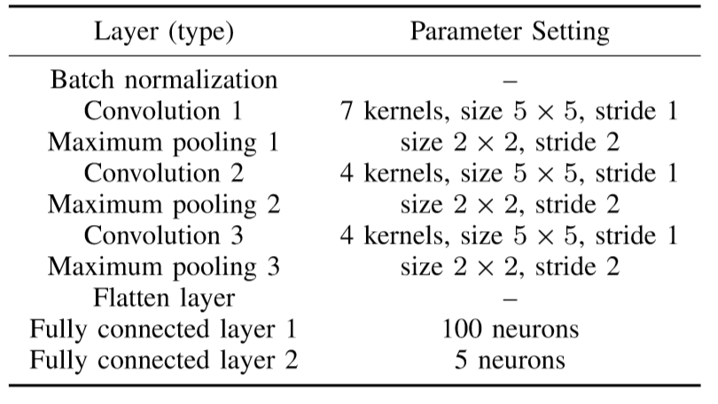
Simulation Results: Waveform Recognition
TABLE. List of the parameters of the CNN structure

Slide 59
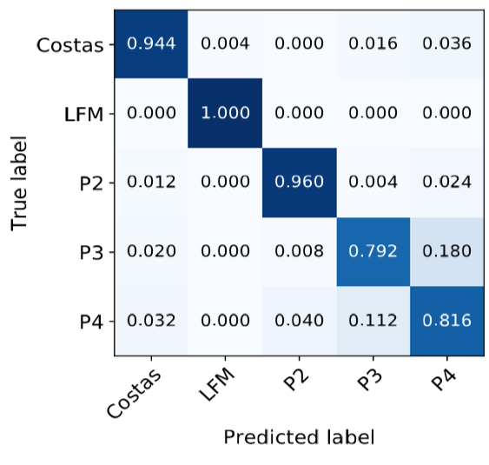
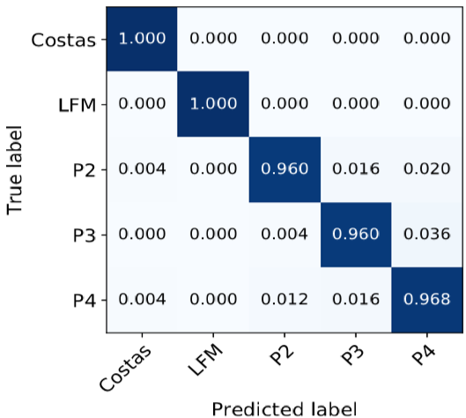
Simulation Results: Waveform Recognition
CWD-based TFR
Proposed TFR
(Atomic nom + CWD +OMP)
Proposed method helps to improve average classification accuracy from 90.24% to 97.76%

Slide 60
Future Work
Develop a more general and effective pre-processing algorithm for radar waveform recognition
Explore the ALOHA-based IAF denoising algorithm
Utilize the data independent kernel
Explore other state-of-the-art deep learning techniques such as residual network (ResNet) to further illustrate the effectiveness of the proposed pre-processing algorithms

Slide 61
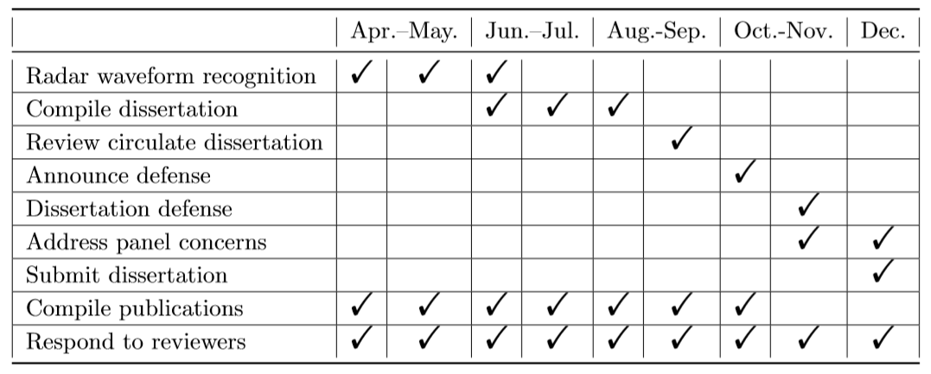
Future Work
TABLE. Timeline for future work

Slide 62
Publications
I have mainly worked on the following projects:
Sparsity based time-frequency analysis
Accepted: 1 Journal Paper, 1 Conference Paper
Under Review: 1 Journal Paper
Under Preparation: 1 Journal Paper
Source localization in a scalable UAV network
Accepted: 3 Conference Paper
Spectrum sharing among radar, communications, and radio astronomy
Accepted: 1 Journal Paper, 5 Conference Papers
Under Review: 1 Journal Paper (Minor Revision)

Slide 63
Journal Papers
Accepted:
S. Zhang, Y. Gu, and Y. D. Zhang, “Robust astronomical imaging in the presence of radio frequency interference,” Journal of Astronomical Instrumentation, vol. 8, no. 1, pp. 1–15, March 2019.
S. Zhang and Y. D. Zhang, “Robust time-frequency analysis of multiple FM signals with burst missing samples,” IEEE Signal Processing Letters, vol. 26, no. 8, pp. 1172–1176, Aug. 2019.
Under Review
A. Ahmed, S. Zhang, and Y. D. Zhang, “Antenna selection strategy for transmit beamforming-based joint radar-communication system ,” submitted to Digital Signal Processing (Minor Revision)
S. Zhang and Y. D. Zhang, “Low-rank Hankel matrix completion for robust time-frequency analysis,” submitted to IEEE Transactions on Signal Processing

Slide 64
Conference Papers
S. Zhang, Y. Gu, B. Wang, and Y. D. Zhang, “Robust astronomical imaging under coexistence with wireless communications,” Asilomar Conference on Signals, Systems, and Computers, Paciﬁc Grove, CA, Oct. 2017.
S. Zhang, Y. Gu, W. C. Barott, and Y. D. Zhang, “Improved radio astronomical imaging based on sparse reconstruction,” SPIE Compressive Sensing Conference, Orlando, FL, April 2018.
S. Zhang, Y. Gu, C-H. Wong, and Y. D. Zhang, “Dimension-reduced radio astronomical imaging based on sparse reconstruction,” IEEE Sensor Array and Multichannel Signal Processing Workshop, Sheﬃeld, U.K., July 2018.
S. Zhang, A. Ahmed, and Y. D. Zhang, “Sparsity-based collaborative sensing in a scalable wireless network,” SPIE Compressive Sensing Conference, Baltimore, Maryland, April 2019.
A. Ahmed, S. Zhang, and Y. D. Zhang, “Multi-target motion parameter estimation exploiting collaborative UAV network,” IEEE International Conference on Acoustics, Speech, and Signal Processing, Brighton, U.K., May 2019.

Slide 65
Conference Papers
S. Zhang, A. Ahmed, and Y. D. Zhang, “Robust source localization exploiting collaborative UAV network,” Asilomar Conference on Signals, Systems, and Computers, Paciﬁc Grove, CA, Nov. 2019.
A. Ahmed, S. Zhang, V. S. Amin, and Y. D. Zhang, “Spectrum sharing strategy for radio frequency-based medical services,” IEEE Signal Processing in Medicine and Biology Symposium, Philadelphia, PA, Dec. 2019.
S. Zhang, A. Ahmed, and Y. D. Zhang, “Sparsity-based time-frequency analysis for automatic radar waveform recognition,” IEEE International Radar Conference, Washington DC, April 2020.
A. Ahmed, S. Zhang, and Y. D. Zhang, “Optimized sensor selection for joint radar-communication systems,” IEEE International Conference on Acoustics, Speech, and Signal Processing, Barcelona, Spain, May 2020.
S. Zhang, A. Ahmed, Y. D. Zhang, and S. Sun, “DOA Estimation Exploiting Interpolated Multi-Frequency Sparse Array,” IEEE Sensor Array and Multi channel Signal Processing Workshop, Hangzhou, China, June 2020.

Slide 66

Advanced
Signal
Processing
Laboratory
http://asplab.net

