Slide 1
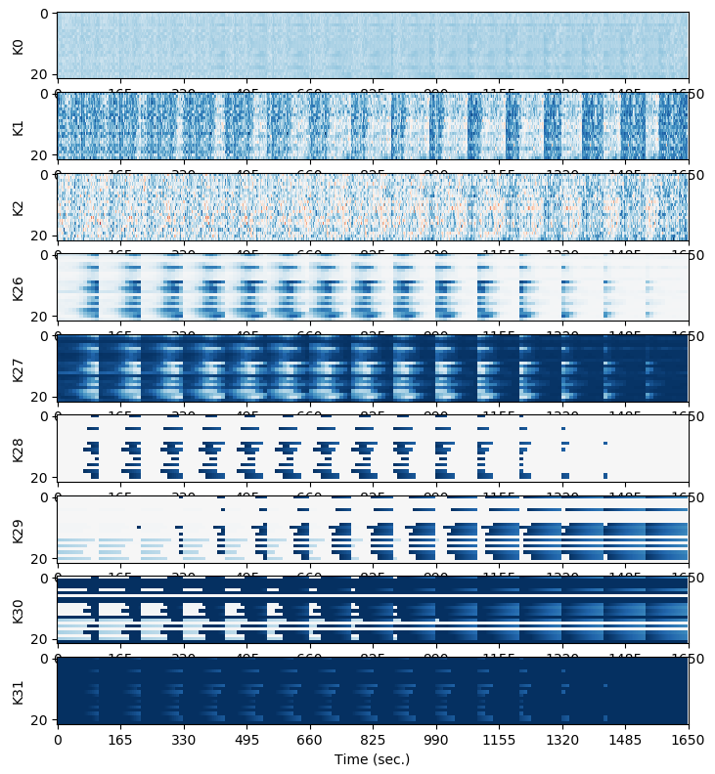
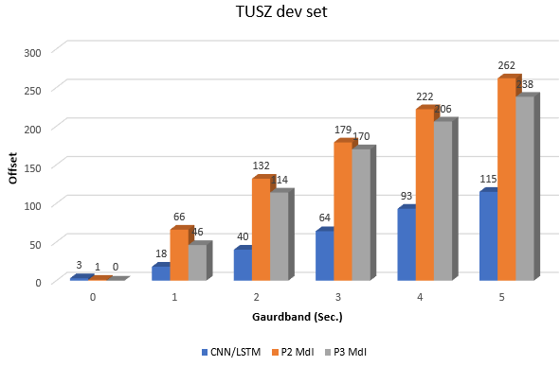
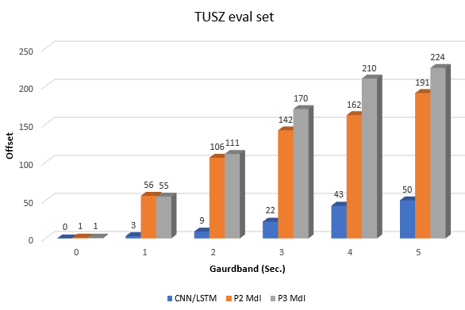
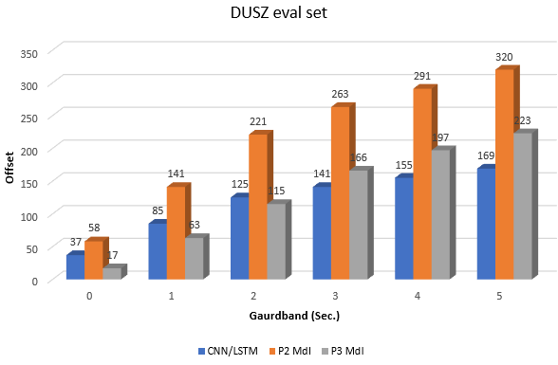
Improved Segmentation for Automated Seizure Detection Using Channel-Dependent Posteriors
PhD Dissertation Defense:
Vinit Shah
Neural Engineering Data Consortium
College of Engineering Temple University

Slide 2
Abstract
Segmentation: defined as the ability to detect start and stop times within a fraction of a second.
Accurate segmentation is a critical part of the seizure detection problem: accurate segmentation usually results in correct classification.
A multiphase model is proposed that mimics manual interpretation:
Phase 1 (P1): learns to detect epileptiform activities related to seizures;
Phase 2 (P2): rescores seizures associated with these activities;
Phase 3 (P3): aggregates information and applies a heuristic postprocessor.
P1 Architecture: channel-dependent long short-term memory (LSTM) network that outputs class posteriors.
P2 Architecture: hybrid convolutional neural networks (CNNs) followed by a small LSTM network.
The multiphase model:
improves seizure detection performance by 10.77% absolute in sensitivity and reduces false alarms by 1.11 per 24 hours;
detects 106 seizure segment boundaries within 2 seconds of the reference annotations compared to 9 segments for the baseline system.

Slide 3
EEGs and Epileptic Seizures
EEG signals contain information in both the temporal and spatial domain.
EEGs can be analyzed by constructing auxiliary signals called rhythms that represent bandpass filtered versions of the signal.
Seizures are identified by observing the evolution of abnormal epileptiform events such as spike and wave discharges/complexes, and generalized polyspikes.
Typical seizures result in low amplitude high frequency signals which evolve by a progressive decrease in frequency and increase in amplitude.
Rhythm | Freq.(Hz) | Amp.(μv) | Activity
Delta | 0.5-4 | 20-200 | Deep Sleep
Theta | 4-7 | 20-100 | Creativity, Intuition
Alpha | 8-13 | 20-60 | Relaxation
Beta | 13-30 | 2-20 | Memory
Gamma | 30-100 | 20-70 | Cognition, Learning
Onset
Offset

Slide 4
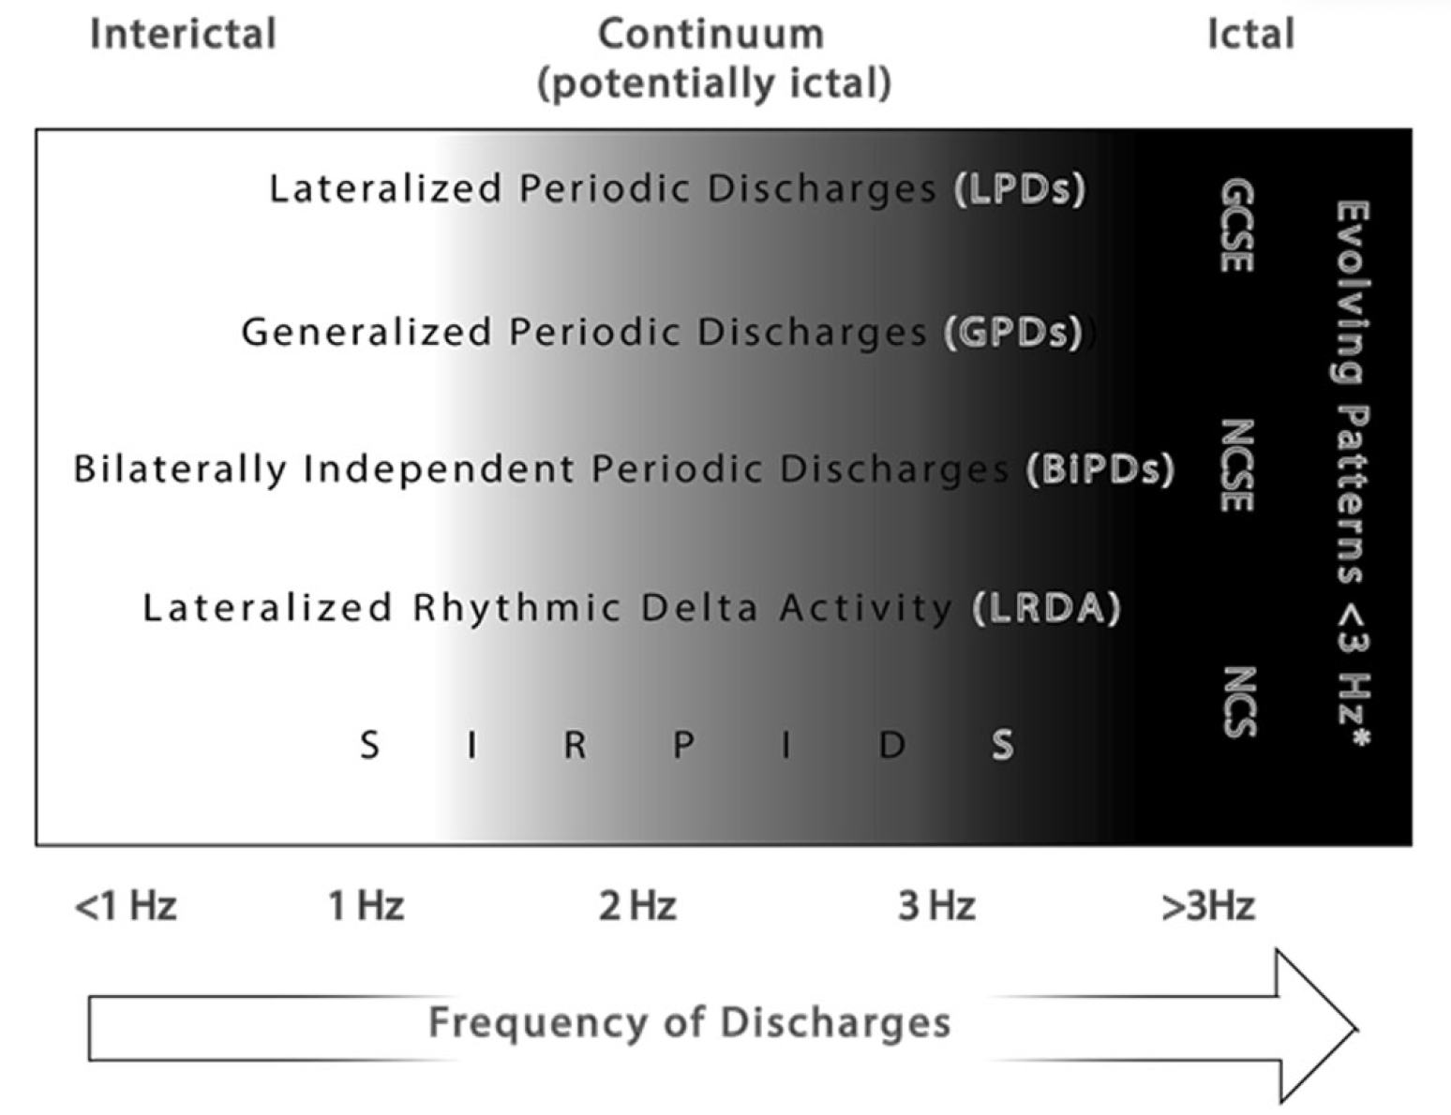
Why Is Annotation Difficult?
2.5 Hz / 10 sec rule: epileptiform events such as spike and wave discharges at least 2.5 Hz in frequency lasting for 10 seconds is considered a seizure.
Periodic epileptiform discharges evolving at lower frequencies are difficult to confirm as seizures.
These require additional information about clinical correlates such as a patient’s history, medications and mental status. Video plays a key role.
Annotations of periodic discharges and seizures have poor interrater agreement among expert clinicians.
Periodic discharges such as LPDs and GPDs are heterogeneous and multifactorial (attributed to a variety of causes such as metabolic, infectious or epileptic disorders).
This makes some sort of generalized rule for seizure detection difficult.

Slide 5
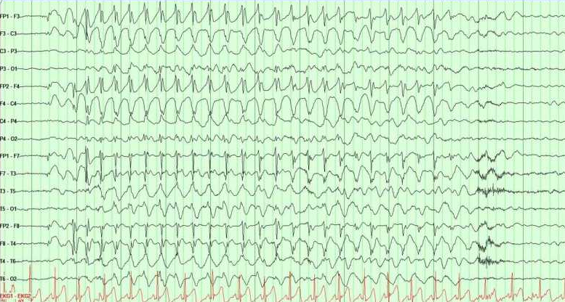
Why Is Annotation Difficult?
Any EEG signal morphology that includes seizure events can be categorized as:
Metamorphic: shows clear phases of evolution;
Isomorphic:
no clear phases of evolution;
evolve very slowly;
no clear onset and/or offset.
Isomorphic Absence Discharges
“Generalized spike and wave patterns slower than 3/s; and evolving discharges that remain slower than or equal to 4/s does not imply that these patterns are not ictal, but simply that they may or may not be” (American Clinical Neurophysiology Society, 2012)
Artifacts, burst attenuation/suppression and post-ictal slowing makes the interpretation process even more difficult.

Slide 6
Hypothesis: A Two-Phase Approach That Mimics Humans
Seizure segmentation remains an under-researched problem due to difficulties associated with:
(1) signal noise and signal artifacts;
(2) lack of standardized rules for poorly defined signal morphologies;
(3) low inter-rater agreement (IRA) among experts;
(4) lenient evaluation metrics.
Often, algorithms designed to solve the seizure detection problem analyze the signal (or its derived features) in a single iteration. Such models are expected to learn the traits of a seizure event without any knowledge of the important components of these events such as spike and wave discharges.
We developed a multiphase seizure detection model to learn the underlying components of a seizure in the first phase and seizures in the second phase.
Posteriors of the first phase model (P1) are utilized to create new types of features which embed history of the detected epileptiform events.
These augmented history features help the second phase (P2) learn deficiencies of P1 and further localize the detected events.
Notes:
Difficulties related to the annotation and in turn segmentation can be attributed to four challenges..

Slide 7
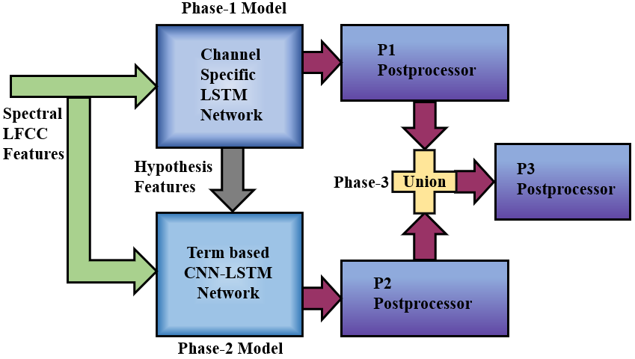
System Overview
A channel-specific LSTM network where each channel is processed independently is used in P1.
Posteriors from P1 are added to traditional LFCC features to learn spatio-temporal dependencies in P2.
Detections are aggregated in P3 by averaging probabilities from P1 and P2.
Each phase of the model is postprocessed heuristically to reduce the FA rate.

Slide 8
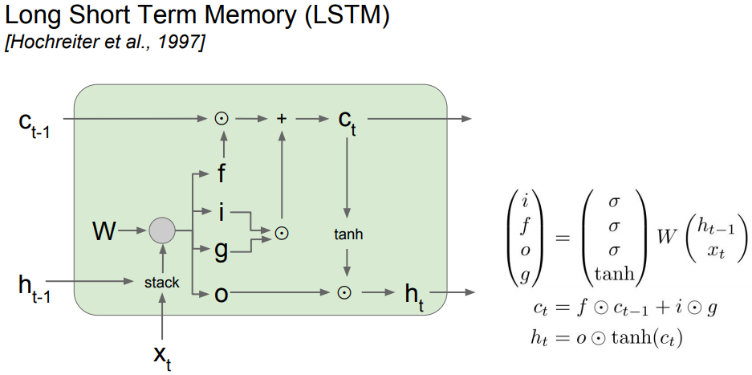
Long Short-Term Memory Networks
Recurrent neural networks (RNNs) suffer from vanishing or exploding gradient problems during backpropagation because gradients get repeatedly multiplied by weights (numbers) less than one.
Gradients can also explode due to multiplication by weights greater than 1.
Long short-term memory (LSTM) networks are designed to avoid the vanishing/exploding gradient problem by introducing additional gates (e.g., forget gate) that have constantly changing values for weights.
These gates control the information flow by adjusting the magnitude of the weights that are applied to the input of the gate.

Slide 9
P1: Channel-Based LSTM Network
P1 uses an LSTM network to learn epileptiform activities associated with a seizure event.
We use a 3-layer LSTM network with size (256, 64, 16).
Input layer includes a 7‑second window (70 frames with LFCC feature vectors) with a context size of 10 frames on each side.
Training is performed in 3 stages:
Exploration of error space (high learning rates)
Stagnate with back-off (plateaued cross-validation and training loss difference)
Annealing stage (gradual reduction in learning rate)

Slide 10
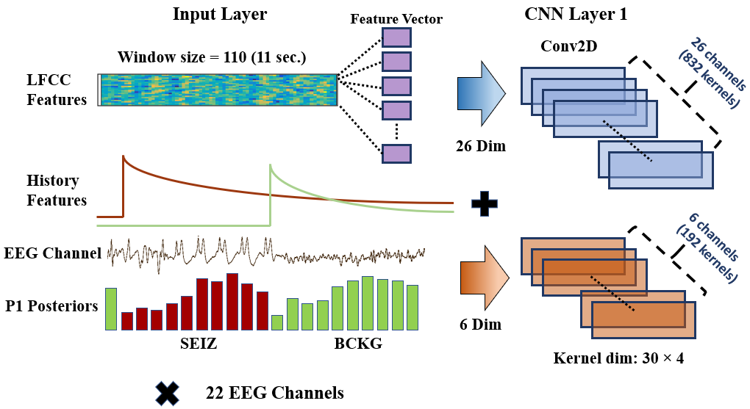
Feature Augmentation
Posteriors from P1 are used to create three new features for each class in P2:
Confidence of each epoch being epileptic;
Distance of the current frame (in time) from the previously observed seizure onset;
Distance of the current frame (in time) from the previously observed seizure offset.
Estimated seizure/background classes are captured for each epoch (1 sec) and further interpolated each frame (0.1 secs).

Slide 11
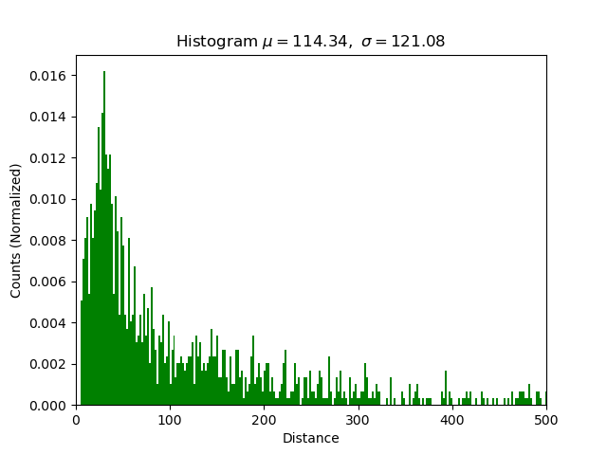
P2: Scaling Onset-Offset Features
The onset-offset features contain information such as duration and recurrence rate of a seizure.
From these features, our P2 model indirectly learns the distribution of the frequency of the recurrent seizures.
We scale these features via an exponential function:
$${\hat{Δ}}_{w}^{(n)}weighted={\hat{φ}(d)}^{−{\hat{Δ}}_{w}^{(n)}}+ eps$$
This scaling function also bounds the distance between two seizures to the range [0, 1]
Histogram of Distances Between Adjacent Seizures
P2 struggles to learn the history once the rate of change of decay reaches a very small value (${\breve{Δ}}_{dt}=1\text{e}\text{-05}$).
Majority of the recurrent seizures are separated by 200 seconds or less.

Slide 12
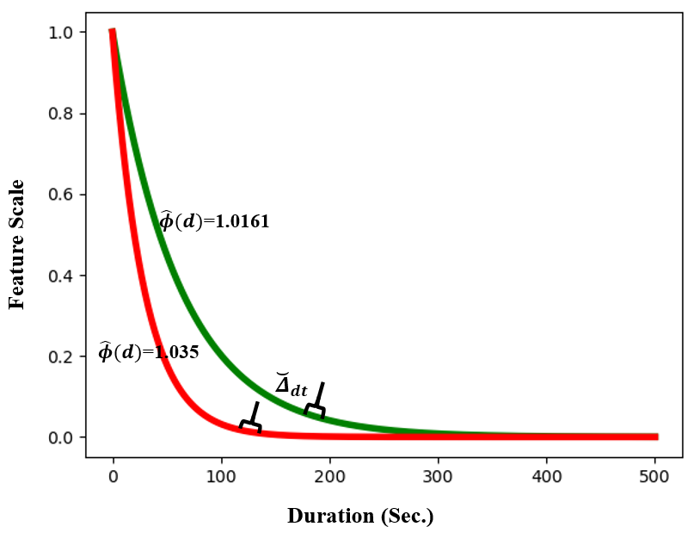
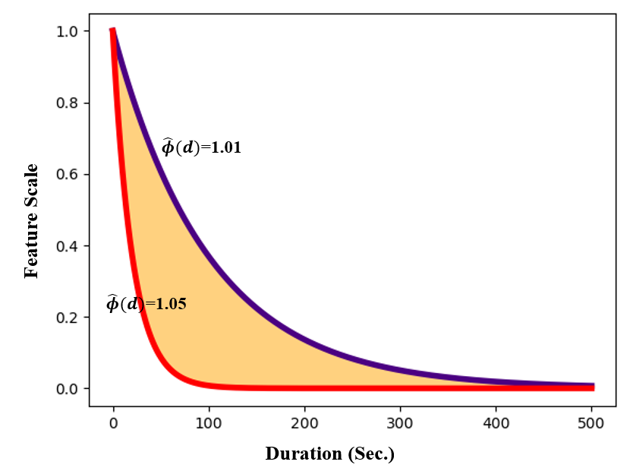
P2: Scaling Onset-Offset Features
Three methods to estimate $\hat{φ}\left(d\right)$:
(1) Heuristic: once a seizure event is observed, we can predict the following seizure by observing 2 mins. of inter-ictal activity.
(2) Data-dependent: Plot the distribution of distances between onsets and offsets. Select samples up to 80th percentile and select the corresponding duration value (187 sec).
(3) Data-driven: an intermediate neural network is trained to learn the distribution of recurrent seizures.
Scaling function is analogous to the forgetting factor of the recursive least squares (RLS) filters.
Estimated $\hat{φ}\left(d\right)$values for (1) and (2) are 1.035 and 1.0161, respectively.
$\hat{φ}\left(d\right)$ is a distribution function for (3). We model this distribution function in the range [1.01, 1.05] using a CNN-MLP network.
P2 data-dependent
P2 heuristic
Range for the data-driven approach

Slide 13
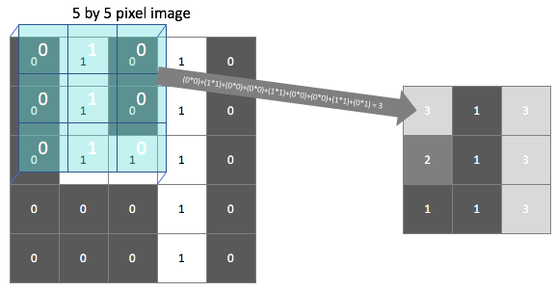
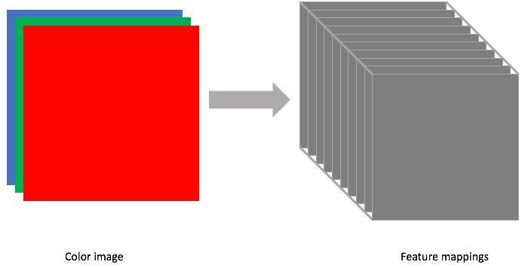
Convolutional Neural Networks (CNNs)
CNNs are designed to classify structured data which are optimized by learning local correlations.
CNNs are trained by optimizing convolutional kernels. Outputs are called feature maps.
Initial layers of the network are designed to learn low-level properties of the data (e.g., for images, edges, curves and color gradients).
The kernels at the later stages learn relationships between these low-level properties that identify more abstract patterns in the data.
CNN Kernels and Feature Maps
CNN Channels
Convolutional channels are optimized independently in a CNN layer which adds an additional dimension (depth) to the CNN kernels.
For a color image, we use kernels with three channels (e.g., red, green, blue).

Slide 14
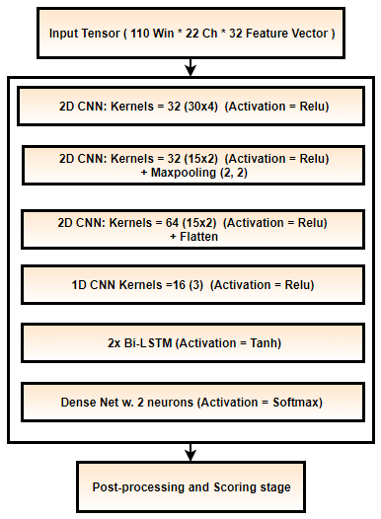
P2: CNN + LSTM Hybrid Model
During P2 we learn temporal and spatial information using CNNs followed by LSTMs.
P2 is designed to mimic the human interpretation process.
CNN channels are assigned to learn each feature dimension independently.
We use a window of 11 secs x 22 channels x 32 features as input.
The kernel uses a 3-second temporal context and 4 channels (the minimum allowed seizure duration is 3 seconds).
192 out of 1024 kernels are assigned to learn only posteriors and onset/offset features.
Two small LSTM networks followed by a dense layer are used to classify a seizure event.

Slide 15
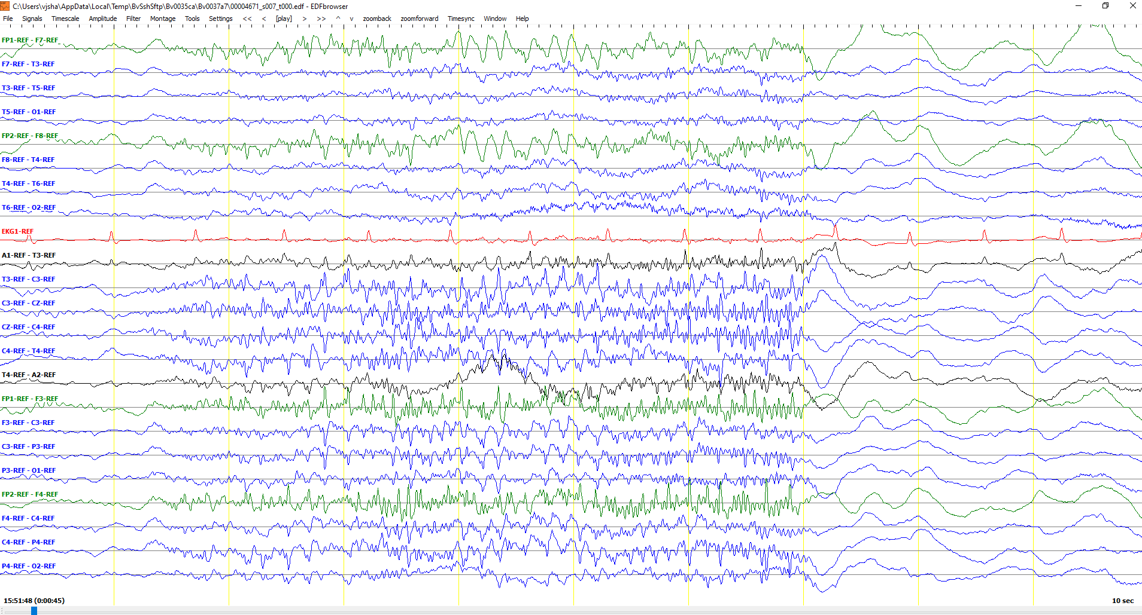
CNN Feature Maps for an Easy Seizure
During the first layer, each feature dimension (channel) of the CNN network is optimized independently.
We can visualize what is learned by plotting the feature maps associated with each kernel:
An Easy Brief Seizure

Slide 16
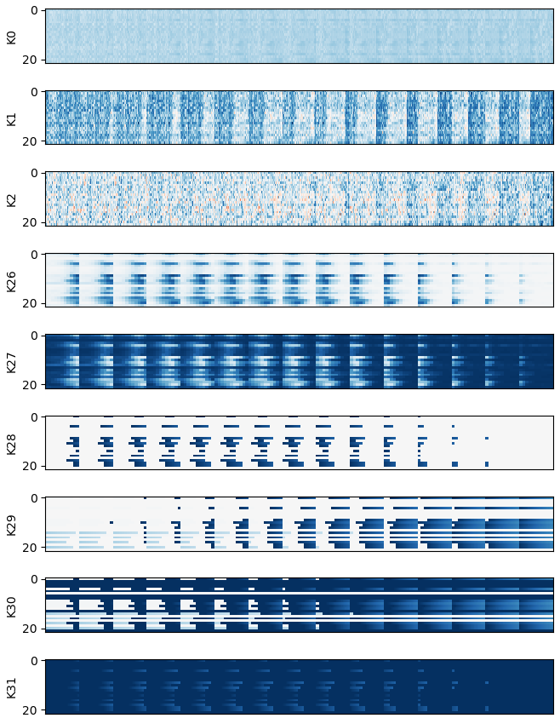
CNN Feature Maps for an Easy Seizure
Seizure
Feature maps generated by the CNN kernels for a 7-second brief seizure are shown.
Kernels associated with spectral features (K0-K25) and posterior features (K26-K31) both show periodic patterns associated with a seizure event learned by the model.
The vertical strip-like patterns are clustered and well-aligned with the seizure event for all CNN channels.
Feature maps generated by Kernels K26 and K27 are opposite of each other because they correspond to the seizure and background classes, respectively.
LFCC
Posterior
Onset
Offset

Slide 17
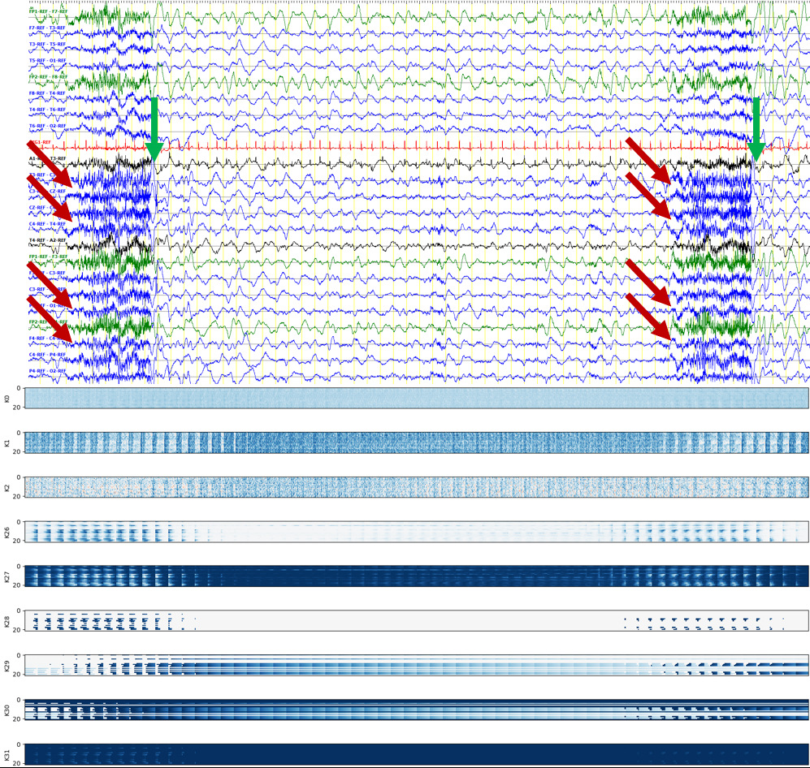
CNN Feature Maps for an Easy Seizure
A 60-second long window with two marked seizures.
Seizures lasting for 6-7 seconds are marked with red arrows (onsets) and green arrows (offsets).
Feature maps generated for the corresponding segment show clear clusters of patterns learned by the kernels.
Background feature maps are well- separated.

Slide 18
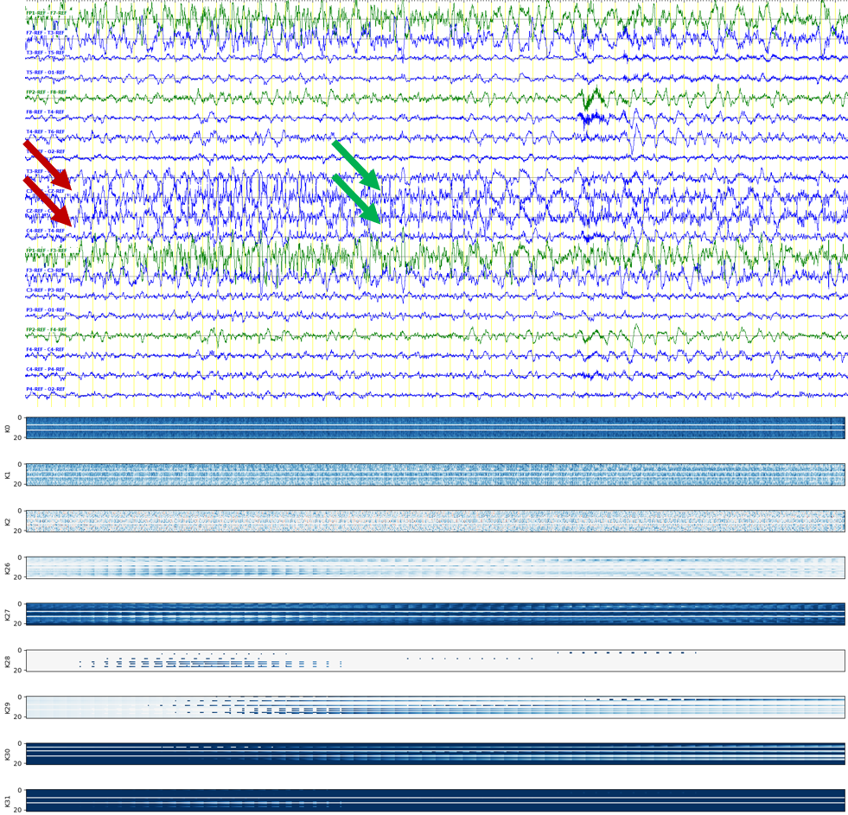
CNN Feature Maps for a Subtle Seizure
A focal slowly evolving seizure.
Kernels associated with conventional features (K0, K1) show very small changes in the projected feature maps.
Posterior kernels learn a few patterns but are not well-aligned with the seizure onset.

Slide 19
Annotated Seizure Databases
Two seizure databases: Temple Univ. (TUSZ) and Duke Univ. (DUSZ).
All models trained in this study use v1.2.1 of the TUSZ training set. The models are evaluated on TUSZ’s v1.2.1’s dev set and eval set.
DUSZ is used as a blind evaluation set.
These databases contain diverse sets of patients and seizure types (in terms of duration, epilepsy type, etc.).
TUSZ v1.2.1 Statistics
Description | Train | Devtest | Blindeval
Patients | 264 | 50 | 50
Sessions | 581 | 239 | 229
Files | 1989 | 1015 | 985
No. Seizure Events | 1254 | 679 | —
Seizure Dur. (sec.) | 78,838 | 58,322 | —
Total Dur. (sec.) | 1,188,313 | 617,102 | 647,948

Slide 20
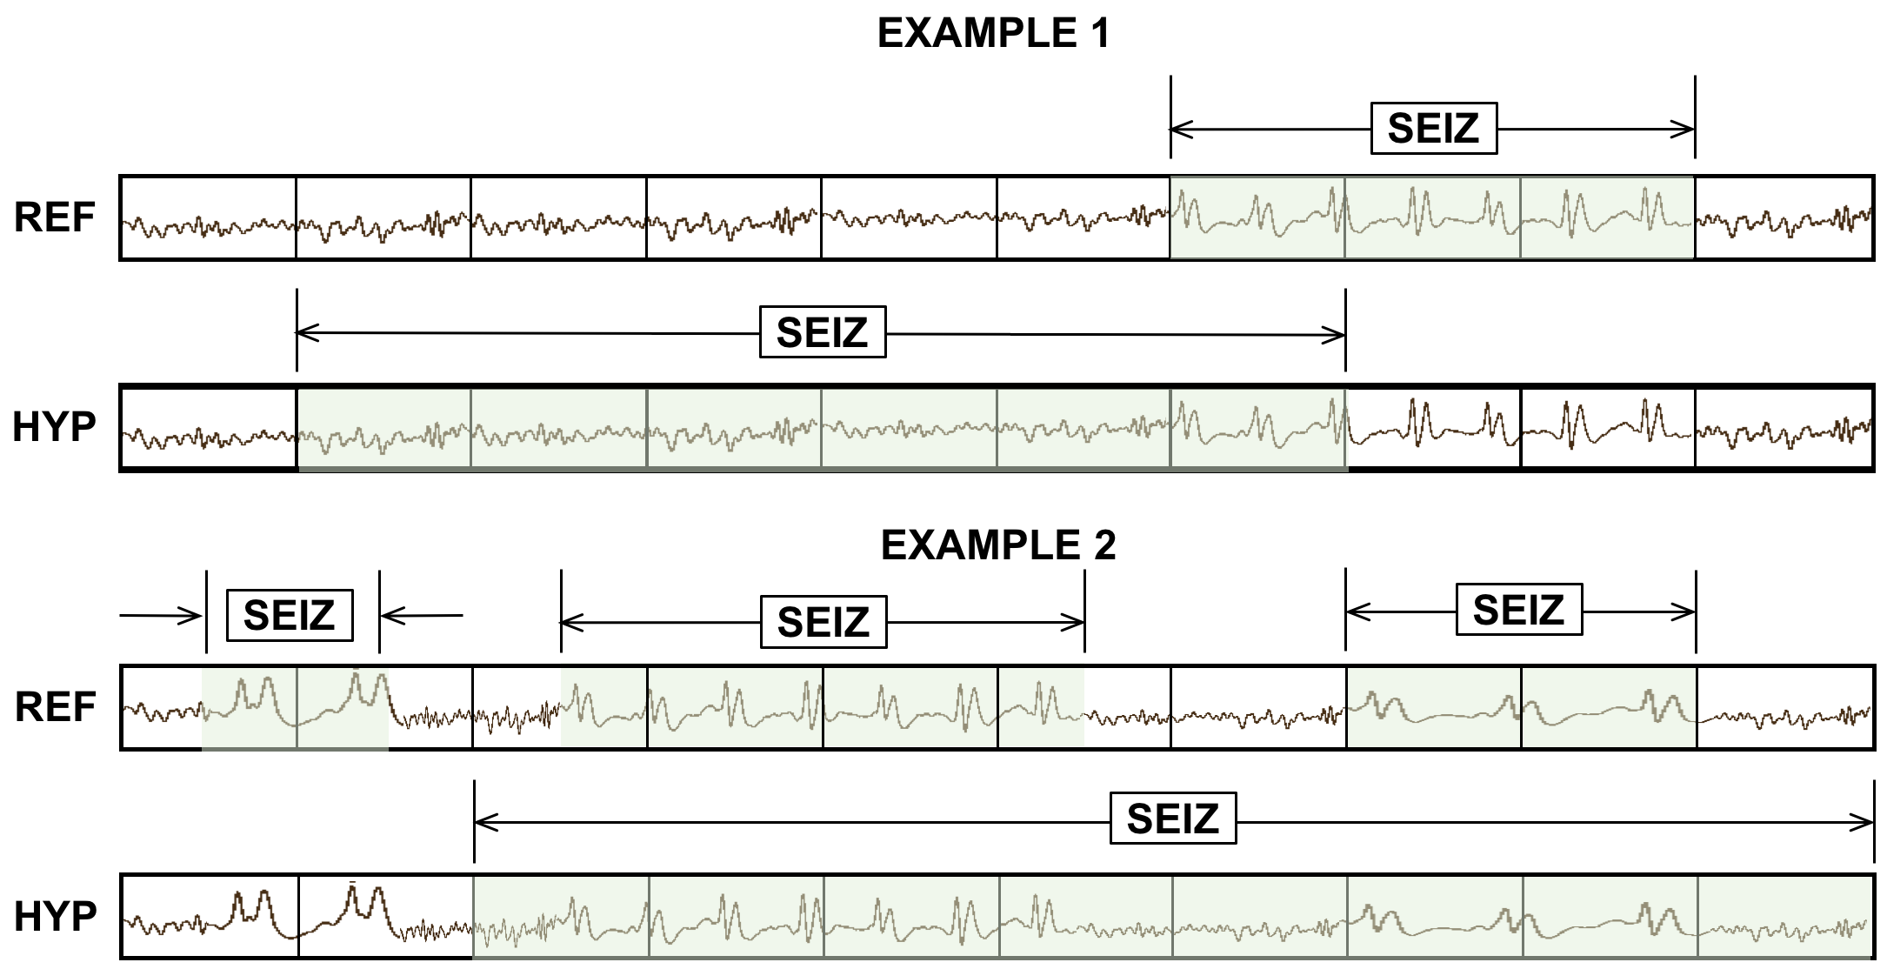
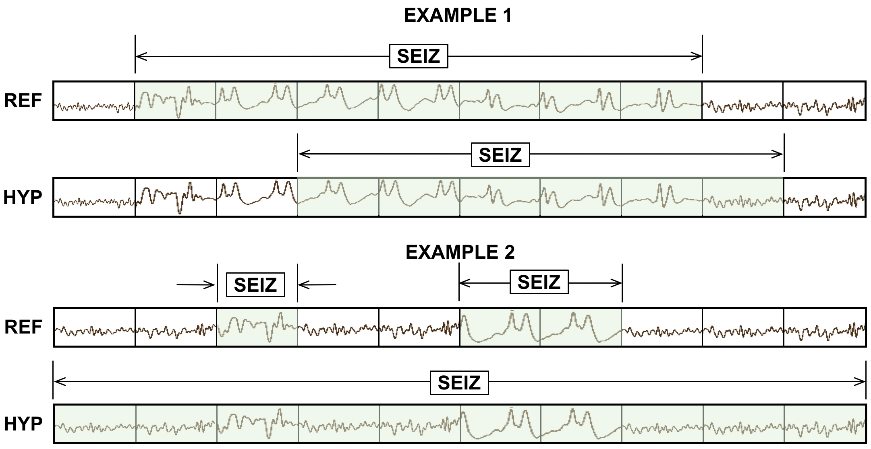
Evaluation Metrics
We use two scoring metrics to evaluate performance:
Any-Overlap method (OVLP)
Time-Aligned Event Scoring (TAES)
OVLP counts an event as correct if the reference and hypothesis overlap.
Otherwise, an event is counted as a miss or FA.
OVLP Method
TAES Method
TAES takes partial overlaps into account and penalizes the target for the portions where the event was partially missed or detected outside the reference boundaries.
TAES is the most appropriate metric since it weighs events with different durations equally and incorporates fractional overlaps.

Slide 21
Performance of the P2 Variants using OVLP
We evaluate variants of P2 on all three seizure databases:
P2 heu yields consistent sensitivity (41%) while maintaining low FAs (~10-16).
P2 dep yields very low sensitivities whereas P2 drv yields FAs. The differences between variants are statistically insignificant.
Database | Measure | P2 heu | P2 dep | P2 drv
TUSZ Dev | Sensitivity | 41.16% | 28.02% | 38.24%
 | Specificity | 95.29% | 97.62% | 94.41%
 | FAs/24 hrs | 11.69 | 5.77 | 14.08
 | Measure | P2 heu | P2 dep | P2 drv
TUSZ Eval | Sensitivity | 42.02% | 21.20% | 34.14%
 | Specificity | 96.09% | 98.35% | 96.40%
 | FAs/24 hrs | 10.02 | 4.136 | 9.22
 | Measure | P2 heu | P2 dep | P2 drv
DUSZ Eval | Sensitivity | 41.75% | 37.44% | 40.60%
 | Specificity | 85.71% | 92.72% | 81.03%
 | FAs/24 hrs | 16.4 | 7.73 | 23.06

Slide 22
Results on TUSZ Dev – Sensitivity and FA Rate
Each phase of the model is postprocessed by some heuristics that set thresholds for duration, event probability, etc.
Metric | Measure | CNN/LSTM | Ch. LSTM P1 | CNN/LSTM P2 | MultiPhase P3
OVLP | Sensitivity | 30.83% | 39.46% | 41.16% | 40.29%
 | Specificity | 97.10% | 95.20% | 95.29% | 97.56%
 | FAs/24 hrs | 6.74 | 11.62 | 11.69 | 5.77
TAES | Sensitivity | 11.33% | 32.57% | 32.87% | 32.59%
 | Specificity | 95.58% | 85.48% | 89.28% | 90.72%
 | FAs/24 hrs | 7.62 | 27.44 | 20.85 | 17.03

Slide 23
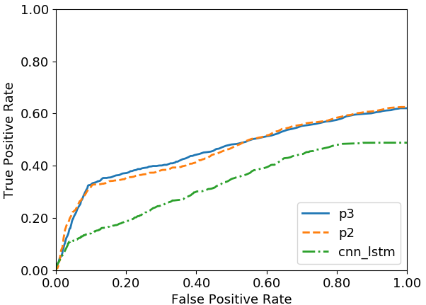
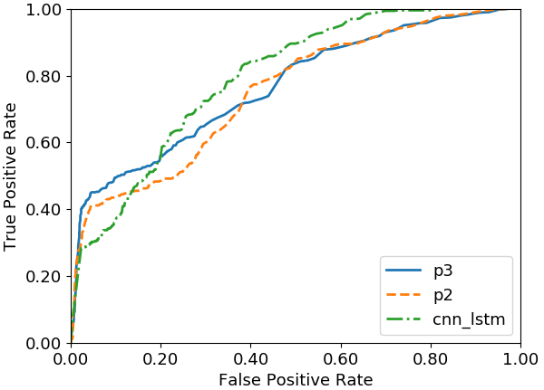
Results on TUSZ Dev – ROC Curves
TAES
OVLP
TAES sensitivities remain low due to the partial overlap calculation.
Performance of P3 tends to remain high because it combines P1 and P2’s high confidence detections.
A low FA rate in the area of interest in ROC curve ([0,0.2]).
For TAES, there is a significant difference in performance between P2/P3 and the baseline model.
According to OVLP, the baseline network is better at higher FA rate.
P2 and P3 performance holds for all evaluation sets.

Slide 24
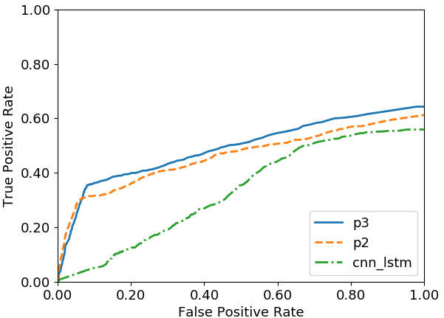
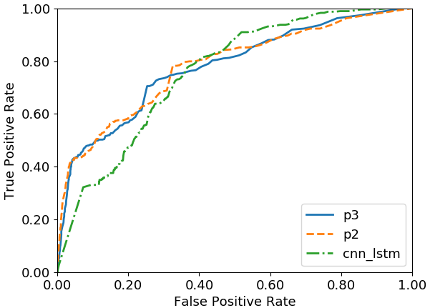
Results on TUSZ Eval
Metric | Measure | CNN/LSTM | Ch. LSTM P1 | CNN/LSTM P2 | MultiPhase P3
OVLP | Sensitivity | 33.11% | 36.39% | 42.02% | 42.96%
 | Specificity | 92.54% | 96.55% | 96.09% | 95.53%
 | FAs/24 hrs | 19.89 | 8.74 | 10.02 | 11.45
TAES | Sensitivity | 5.01% | 30.97% | 30.27% | 35.55%
 | Specificity | 90.43% | 93.05% | 93.87% | 91.79%
 | FAs/24 hrs | 19.89 | 13.98 | 12.75 | 17.22
TAES
OVLP

Slide 25
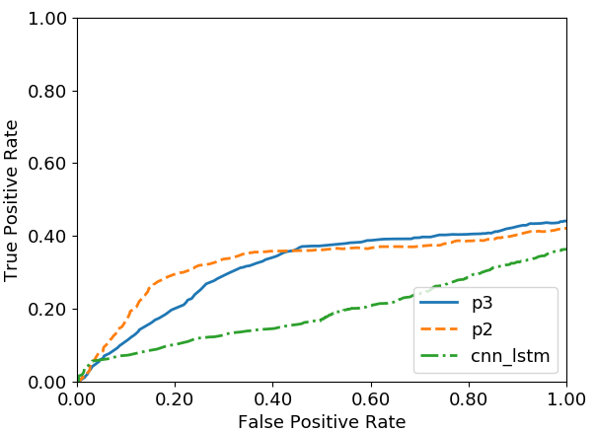
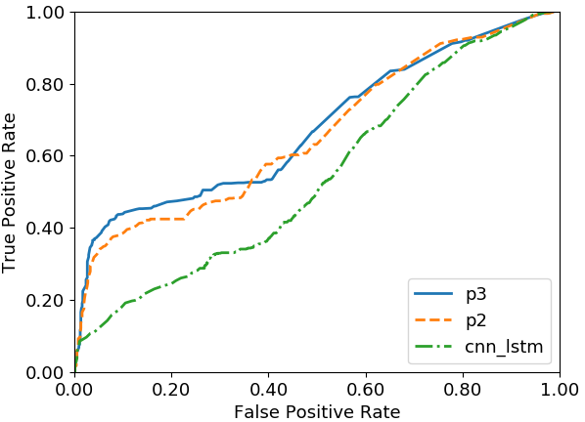
Results on DUSZ Eval
Metric | Measure | CNN/LSTM | Ch. LSTM P1 | CNN/LSTM P2 | MultiPhase P3
OVLP | Sensitivity | 33.71% | 42.32% | 41.75% | 43.75%
 | Specificity | 70.72% | 86.93% | 85.71% | 91.01%
 | FAs/24 hrs | 40.4 | 14.26 | 16.4 | 9.33
TAES | Sensitivity | 19.77% | 36.47% | 35.46% | 37.13%
 | Specificity | 45.46% | 46.43% | 64.57% | 54.03%
 | FAs/24 hrs | 43.75 | 33.03 | 22.45 | 26.92
TAES
OVLP
The multiphase model maintains its performance for open set testing.

Slide 26
An Analysis of Segmentation Performance
Performance for seizure boundaries were evaluated by calculating the number of event boundaries detected within a margin of 5 seconds.
P2 and P3 consistently outperform the baseline model.
For example, the multiphase model evaluated on a TUSZ evaluation set detects 106 segment boundaries within a 2-second margin of error.

Slide 27
An Analysis of Segmentation Performance
Baseline CNN-LSTM
Multiphase Model
Score/Duration (sec.) | TUSZ Dev Sens. | TUSZ Eval Sens. | Duke Eval Sens.
0 – 10 | 10.71% | 9.75% | 0%
10 - 30 | 28.49% | 16.83% | 15.13%
30 - 120 | 32.09% | 45.87% | 34.76%
120 - 300 | 56.25% | 43.39% | 59.30
> 300 | 37.93% | 54.54% | 53.84%
Score/Duration (sec.) | TUSZ Dev Sens. | TUSZ Eval Sens. | Duke Eval Sens.
0 – 10 | 27.82% | 0% | 0%
10 - 30 | 27.31% | 14.28% | 16.44%
30 - 120 | 53.42% | 58.62% | 44.46%
120 - 300 | 48.57% | 69.23% | 69.76%
> 300 | 51.72% | 83.33% | 69.23%
Poor TAES performance of the multiphase model is associated with its ability to detect brief seizures and slowly evolving prolonged seizures.
The TAES metric tends to penalize these events heavily in terms of false alarm and miss rates.
Both models perform poorly on short duration seizures (0-30 seconds).
The multiphase system performs slightly better than the baseline system on longer seizure events (> 300 seconds).

Slide 28
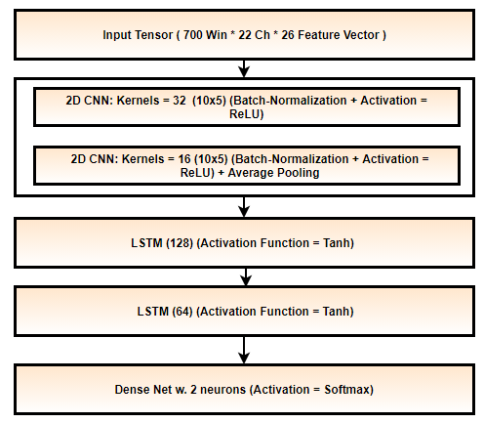
Dynamic Neural Network with Static Unrolling
Dynamic neural networks are used to train models on variable length sequences.
Segments of the multiphase model are postprocessed using a 4-layer CNN-LSTM network.
Segments are sampled via a static unrolling method where a seizure segment is split into multiple segments with minimal overlap.
Performance Comparison:
absolute 1.31% increase in sens. with a reduction of 0.14 FAs on TUSZ dev;
5.25% increase in sens. with an increase of 5.09 FAs on TUSZ eval set;
2.85% increase in sens. with reduction of 1.47 FAs on DUSZ eval set.

Slide 29
Statistical Significance Tests
Sensitivity ($α$ = 0.95)
Model (mean %, std %) | Baseline | P2-N | P2-H | P2-DP | P2-DD
Baseline (30.5816, 0.840) | – | p < 0.001 | p = 0.030 | p = 0.186 | p < 0.001
P2-N (12.868, 4.816) |  | – | p < 0.001 | p < 0.001 | p < 0.001
P2-H (35.459, 4.219) |  |  | – | p = 0.377 | p = 0.377
P2-DP (32.8025, 3.208) |  |  |  | – | p = 0.022
P2-DD (37.293, 1.067) |  |  |  |  | –
Specificity ($α$ = 0.80)
Model (mean %, std %) | Baseline | P2-N | P2-H | P2-DP | P2-DD
Baseline (93.146, 3.528) | – | p = 0.093 | p = 0.142 | p = 0.137 | p = 0.540
P2-N (95.86, 0.640) |  | – | p = 0.745 | p = 0.260 | p = 0.001
P2-H (96.0, 0.671) |  |  | – | p = 0.440 | p = 0.003
P2-DP (96.472, 0.876) |  |  |  | – | p = 0.003
P2-DD (94.165, 0.685) |  |  |  |  | –
Statistical significance using the T-test:
(1) LFCC features (Baseline, P2-N)
(2) posterior derived features along with LFCC features (P2-H, P2-DP, P2-DD).
Posterior-derived features improve performance.
P2-H, P2-DP & P2-DD are not statistically different.

Slide 30
Feature Importance Analysis
We zero-pad or permute sets of feature dimensions to learn importance of the LFCC and posterior derived features for P2.
Feature dimensions we zero-pad are:
Event confidences
Onset/Offset features
All posterior derived features
All LFCC features
We swap the onset/offset feature dimensions of the feature vector to understand their importance in modeling recurring seizures.
P2 relies heavily on the event confidences yielding 27.73% sensitivity and 5.07 FAs when other posterior derived features are zero padded.
Onset/Offset features contribute to 11.09% sens with 7.6 FAs.
LFCC features contribute very little to the overall performance yielding 0.29% sens with 2.11 FAs.
Feature Description | Sens. (%) | FAs/24Hr
LFCC + Post | 41.16 | 11.69
Z padded Conf | 11.09 | 7.60
Z padded Onset/Offset | 27.73 | 5.07
Z padded Post. | 0.29 | 2.11
Z padded LFCC | 33.57 | 7.32
Onset/Offset Swapped | 31.67 | 10.42

Slide 31
Conclusion and Future Plans
A multiphase model is introduced which estimates epileptiform features for individual channels in the first phase and temporal-spatial context in the second phase.
Embedding the history of detected events into the second phase of the model as features improves the model’s ability to detect seizures and align its segment boundaries.
Compared to the previous baseline model, seizure detection performance improves by 10.77% absolute in sensitivity with a reduction of 1.11 FAs.
Improvements in performance are statistically significant.
This new model design can detect ~35% of seizures within a 5-second margin of the reference annotation.
Muscle artifacts are a major error modality and contribute to 34% of the total errors. Efficient source separation algorithms will be implemented to filter these spurious activities.
P3 can be replaced with a more efficient Mixture of Experts model which will be able to weigh outputs of P1 and P2 based on a seizure’s morphology.

Slide 32
Published Work
Published: 2 book chapters, 2 referred journal papers, 4 peer-reviewed conference papers, 1 peer-reviewed conference abstract, 2 conference abstracts
Book Chapter(s):
Golmohammadi, M., Shah, V., Obeid, I., & Picone, J. (2020). Deep Learning Approaches for Automatic Analysis of EEGs. In I. Obeid & J. Picone (Eds.), Machine Learning Applications in Medicine and Biology (1st ed., p. 45). New York City, New York, USA: Springer-Verlag.
Shah, V., Golmohammadi, M., Obeid, I., & Picone, J. (2021). Objective Evaluation Metrics for Automatic Classification of EEG Events. In I. Obeid, I. Selesnick, & J. Picone (Eds.), Biomedical Signal Processing: Innovation and Applications (1st ed., pp. 223–256). New York City, New York, USA: Springer.
Peer-Reviewed Journal Paper(s):
Shah, V., von Weltin, E., Lopez, S., McHugh, J. R., Veloso, L., Golmohammadi, M., … Picone, J. (2018). The Temple University Hospital Seizure Detection Corpus. Frontiers in Neuroinformatics, 12, 1–6.
Islam, M. S., Shah, V., Gidde, S., Hutapea, P., Song, S. H., Picone, J., & Kim, A. (2020). A Machine Learning Enabled Wireless Intracranial Brain Deformation Sensing System. IEEE Transactions on Biomedical Engineering, 1–8.
Peer-Reviewed Conference Papers:
Golmohammadi, M., Ziyabari, S., Shah, V., Obeid, I., & Picone, J. (2018). Deep Architectures for Spatio-Temporal Modeling: Automated Seizure Detection in Scalp EEGs. Proceedings of the IEEE International Conference on Machine Learning and Applications (ICMLA) (pp. 745–750). Orlando, Florida, USA.
Shah, V., Obeid, I., Picone, J., Ekladious, G., Iskander, R., & Roy, Y. (2020). Validation of Temporal Scoring Metrics for Automatic Seizure Detection. In I. Obeid, I. Selesnick, & J. Picone (Eds.), Proceedings of the IEEE Signal Processing in Medicine and Biology Symposium (SPMB) (pp. 1–5). Philadelphia, Pennsylvania, USA.
Shah, V., Golmohammadi, M., Ziyabari, S., von Weltin, E., Obeid, I., & Picone, J. (2017). Optimizing Channel Selection for Seizure Detection. In I. Obeid & J. Picone (Eds.), Proceedings of the IEEE Signal Processing in Medicine and Biology Symposium (pp. 1–5). Philadelphia, Pennsylvania, USA: IEEE.

Slide 33
Published Work (Cont.)
Golmohammadi, M., Ziyabari, S., Shah, V., Obeid, I., & Picone, J. (2017). Gated Recurrent Networks for Seizure Detection. In I. Obeid & J. Picone (Eds.), Proceedings of the IEEE Signal Processing in Medicine and Biology Symposium (pp. 1–5). Philadelphia, Pennsylvania, USA: IEEE.
Peer-Reviewed Conference Abstracts:
Lin, R., Marquez, D., Jacobson, M., Castaldi, H., Buckman, S., Shah, V., & Picone, J. (2020). Accuracy of Automated Machine Learning Software in Identifying EEGs with Prolonged Seizures. In Annual Meeting of the American Academy of Neurology (AAN) (p. P6.002). Toronto, Canada.
Ziyabari, S., Shah, V., Obeid, I., & Picone, J. (2018). Curriculum Learning Based on Sample Selection Using Posterior Probabilities. In 26th Conference on Intelligent Systems for Molecular Biology (p. 1). Chicago, Illinois, USA.
Shah, V., Anstotz, R., Obeid, I., & Picone, J. (2018). Adapting an Automatic Speech Recognition System to Event Classification of Electroencephalograms. In I. Obeid & J. Picone (Eds.), Proceedings of the IEEE Signal Processing in Medicine and Biology Symposium (SPMB) (p. 1).

Slide 34
Acknowledgments
Committee Members
Dr. Joseph Picone
Dr. Iyad Obeid
Dr. Yimin Zhang
Dr. Pallavi Chitturi
Dr. Mercedes Jacobson
Dr. Georgios Lazarou
Faculty Members
Dr. Dennis Silage
Dr. Fauzia Ahmad
My colleagues, family and friends

