Slide 1
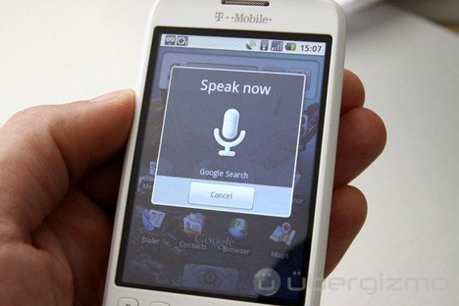
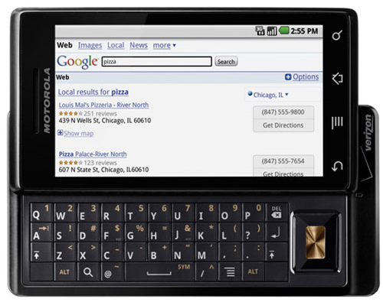
Applications of Dirichlet Process Models to Speech Processing and Machine Learning
Amir Harati and Joseph Picone
Institute for Signal and Information Processing
Temple University
Philadelphia, Pennsylvania, USA

Slide 2
Abstract
Balancing unique acoustic or linguistic characteristics, such as a speaker's identity and accent, with general behaviors that describe aggregate behavior, is one of the great challenges in applying nonparametric Bayesian approaches to human language technology applications. The Dirichlet Process Model (DPM) is a relatively new model that provides an elegant framework in which individual characteristics can be balanced with aggregate behavior without diluting the quality of the individual models. Unlike Gaussian Mixture models (GMMs), which tend to smear multimodal behavior through averaging, the DPM model attempts to preserve unique behaviors through use of an infinite mixture model. In this talk, we present some exploratory research on applying these models to the acoustic modeling component of the speaker adaptation problem and to speaker independent speech recognition. DPM-based models are shown to provide up to 10% reduction in WER over maximum likelihood linear regression (MLLR) on a speaker adaptation task based on the Resource Management database.
Back again… March 25, 2009…

Slide 3
Nonparametric Bayesian Approaches
Generalization of any data-driven statistical model is a challenge.
How many degrees of freedom?
Solution: Infer complexity from the data (nonparametric model).
Clustering algorithms tend not to preserve perceptually meaningful differences.
Prior knowledge can mitigate this (e.g., gender).
Models should utilize all of the available data and incorporate it as prior knowledge (Bayesian).
Our goal is to apply nonparametric Bayesian methods to acoustic processing of speech.

Slide 4
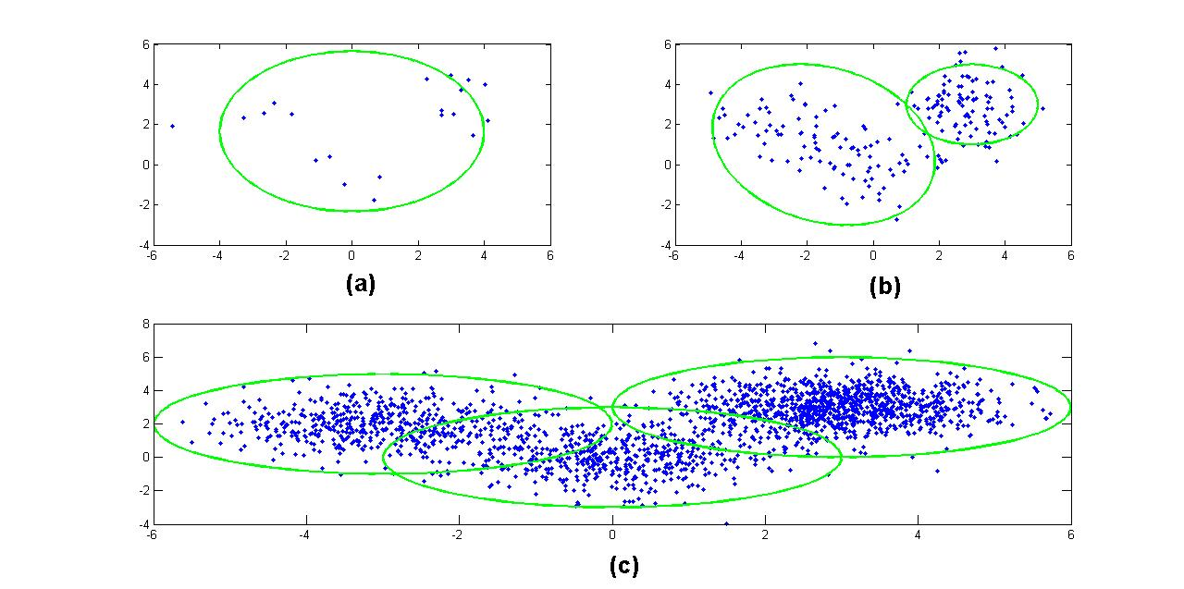
Nonparametric Bayesian Approaches
Bayes Rule:
Bayesian methods are sensitive to the choice of a prior.
Prior should reflect the beliefs about the model.
Inflexible priors (and models) lead to wrong conclusions.
Nonparametric models are very flexible -- the number of parameters can grow with the amount of data.
Common applications: clustering, regression, language modeling, natural language processing

Slide 5
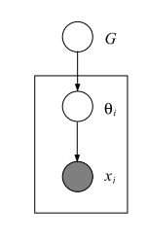
Generative Models
A generative approach to clustering:
Randomly pick one of K clusters
Generate a data point from a parametric model of this cluster
Repeat for N >> K data points
Probabilities of each generated data point:
Each data point can be regarded as being generated from a discrete distribution over the model parameters.

Slide 6
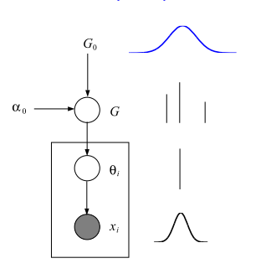
Bayesian Clustering
In Bayesian model-based clustering, a prior is placed on the model parameters.
Θ is model specific; usually we use a conjugate prior.
For Gaussian distributions, this is a normal-inverse gamma distribution. We name this prior G₀ (for Θ).
The prior on π is multinomial and therefore we use a symmetric Dirichlet distribution as its prior with concentration parameter α₀ .

Slide 7
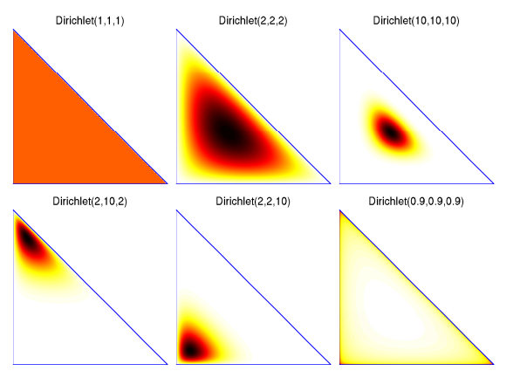
Dirichlet Distribution
(Φ,Σ) is a measurable space where Σ is the sigma algebra.
A measure μ over (Φ,Σ) is a function from Σ->R⁺ such that:
For a probability measure μ(Φ)=1.
A Dirichlet distribution is a distribution over the K-dimensional probability simplex.
The concentration parameter, α, and is inversely proportional to the variance.

Slide 8
Finite Mixture Distributions
A generative Bayesian finite mixture model is somewhat similar to a graphical model.
Parameters and mixing proportions are sampled from G₀ and the Dirichlet distribution respectively.
Θ_{i} is sampled from G, and each data point x_{i} is sampled from a corresponding probability distribution (e.g. Gaussian).

Slide 9
Finite Mixture Distributions
How to determine K?
Using model comparison methods.
Going nonparametric.
If we let K➔∞, can we obtain a nonparametric model? What is the definition of G in this case?
The answer is a Dirichlet Process.

Slide 10
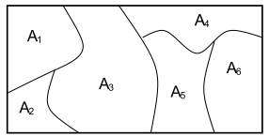
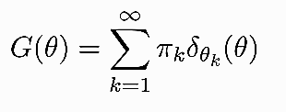
Dirichlet Processes
A Dirichlet Process (DP) is a random probability measure over (Φ,Σ) such that for any measurable partition over Φ we have
DP has two parameters: the base distribution (G₀) functions similar to a mean, and α is the concentration parameter (inverse of the variance).
We write :
DP is discrete with probability one:

Slide 11
Stick-Breaking Prior
Stick-breaking construction represents a DP explicitly:
Consider a stick with length one.
At each step, the stick is broken. The broken part is assigned as the weight of corresponding atom in DP.
If π is distributed as above we write:

Slide 12
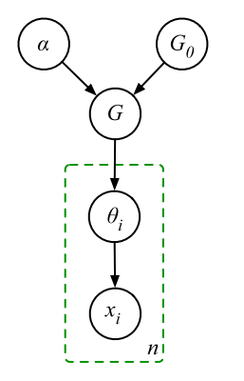
Dirichlet Process Mixture (DPM)
DPs are discrete with probability one so they cannot be used as a prior on continues densities.
However, we can draw a parameter of a mixture model from a draw from a DP.
This model is similar to the finite model, with the difference that G is sampled from a DP and therefore has infinite atoms.
One way of understanding this model is by imagining a Chinese restaurant with infinite number of tables. The first customer (x₁) sits at table one. Other customers, either sit in one of the tables already occupied or initiate their own table.
In this metaphor, each table corresponds to a cluster. This “sitting process” is governed by a Dirichlet process. Customers sit at tables with a probability proportional to the people around them and initiates a new table with probability proportional to α.
The result is a model that number of clusters grow logarithmically with the amount of data.

Slide 13
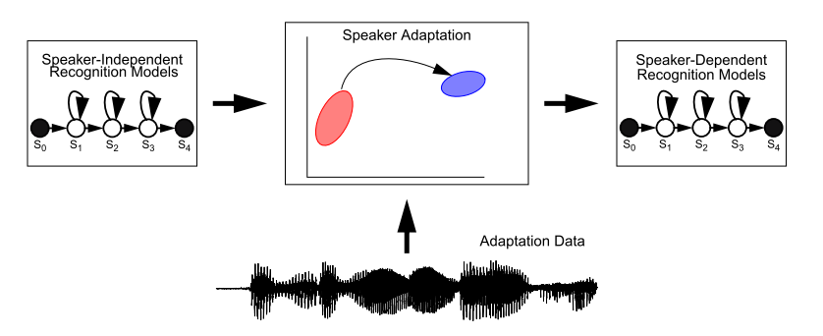
Applications to Speaker Adaptation
Goal is to approach speaker dependent performance using speaker independent models and a limited number of mapping parameters.
The classical solution is to use a binary regression tree of transforms constructed using a Maximum Likelihood Linear Regression (MLLR) approach.
Transformation matrices are clustered using a centroid splitting approach.

Slide 14
Integrating DPM into a Speaker Adaptation System
Train speaker independent (SI) model.
Collect all mixture components and their frequencies of occurrence (to regenerate samples based on frequencies).
Generate samples from each Gaussian mixture component and cluster them using a DPM model.
Cluster generated samples based on DPM model and using an inference algorithm.
Construct a bottom-up merging of clusters into a tree structure using DPM and a Euclidean distance measure.
Assign distributions to clusters using a majority vote scheme.
Compute a transformation matrix using ML for each cluster of Gaussian mixture components (only means).

Slide 15
Inference Algorithms
In a Bayesian framework, parameters and variables are treated as random variables; and the goal of analysis is to find the posterior distribution for these variables.
Posterior distributions cannot be computed analytically; instead we use a variety of Markov Chain Monte Carlo (MCMC) sampling or variational methods.
Computational concerns currently favor variational methods. For example, Accelerated Variational Dirichlet Process Mixtures (AVDP) incorporates a kd-tree to accelerate convergence. This algorithm also use a particular form of truncation in which we assume the variational distributions are fixed to their prior after a certain level of truncation.
In Collapsed Variational Stick Breaking (CVSB), we integrate out the mixture weights. Results are comparable to Gibbs sampling.
In Collapsed Dirichlet Priors (CDP), we use a finite symmetric Dirichlet distribution approximation of a Dirichlet process. For this algorithm, we have to specify the size of Dirichlet distribution. Its performance is also comparable to Gibbs sampler.
All three approaches are freely available in MATLAB. This is still an active area of research.

Slide 16
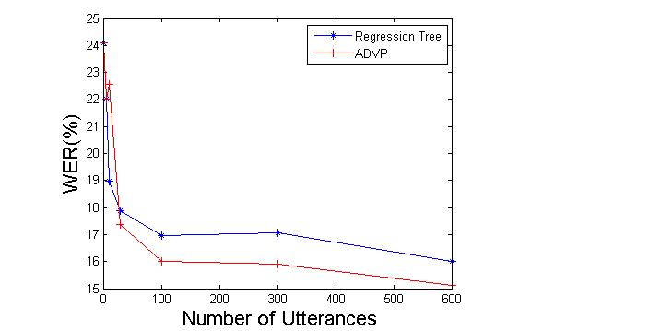
Speaker Adaptation Experiments with Monophones
Experiments used DARPA’s Resource Management (RM) corpus (~1000 word vocabulary).
Monophone models used a single Gaussian mixture model.
12 different speakers with 600 training utterances per speaker.
Word error rate (WER) is reduced by more than 10%.
The individual speaker error rates generally follow the same trend as the average behavior.
DPM finds an average of 6 clusters in the data while the regression tree finds only 2 clusters.
The resulting clusters resemble broad phonetic classes (e.g., distributions related to the phonemes “w” and “r”, which are both liquids, are in the same cluster.

Slide 17
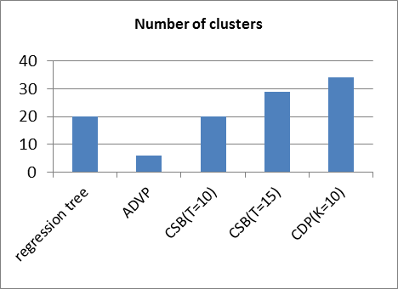
Experiments with Crossword Triphones
Crossword triphone models use a single Gaussian mixture model.
Individual speaker error rates follow the same trend.
The number of clusters per speaker did not vary significantly.
The clusters generated using DPM have acoustically and phonetically meaningful interpretations.
ADVP works better for moderate amounts of data while CDP and CSB work better for larger amounts of data.

Slide 18
Summary and Future Directions
A nonparametric Bayesian framework provides two important features:
number of clusters can grow with the data;
parameter sharing, model and state-tying is a generalization of existing approaches.
Our future goal is to use hierarchical nonparametric approaches (e.g., HDP-HMMs) for acoustic models:
acoustic units are derived from a pool of shared distributions with arbitrary topologies;
models have arbitrary numbers of states, which in turn have arbitrary number of mixture components;
model complexity is guided by the data complexity;
nonparametric Bayesian approaches are also used to segment data and discover new acoustic units.

Slide 19
Brief Bibliography of Related Research
[1] A. Harati, M. Sobel and J. Picone, "Applications of Dirichlet Process Mixtures to Speaker Adaptation," Proceedings of the IEEE International Conference on Acoustics, Speech, and Signal Processing, pp. 4321-4324, Kyoto, Japan, March 2012.
[2] J. Paisley, “Machine learning with Dirichlet and beta process priors: Theory and Applications”, Ph.D. Dissertation, Duke University, May 2010.
[3] P. Liang, M. I. Jordan, and D. Klein. In T. O'Hagan and M. West “Probabilistic grammars and hierarchical Dirichlet processes”, The Handbook of Applied Bayesian Analysis, Oxford University Press, 2010.
[4] D. M. Blei and M. I. Jordan, “Variational inference for Dirichlet process mixtures,” Bayesian Analysis, vol. 1, pp. 121–144, 2005.
[5] K. Kurihara, M. Welling, and N. Vlassis, “Accelerated variational Dirichlet process mixtures,” Advances in Neural Information Processing Systems, MIT Press, Cambridge, Massachusetts, USA, 2007 (editors: B. Schölkopf and J.C. Hofmann).
[6] K. Kurihara, M. Welling, and Y. W. Teh, “Collapsed variational Dirichlet process mixture models,” Proceedings of the 20th International Joint Conference on Artificial Intelligence, Hyderabad, India, Jan. 2007.

Slide 20
Biography
Joseph Picone received his Ph.D. in Electrical Engineering in 1983 from the Illinois Institute of Technology. He is currently Professor and Chair of the Department of Electrical and Computer Engineering at Temple University. He recently completed a three-year sabbatical at the Department of Defense where he directed human language technology research and development.
His primary research interests are currently machine learning approaches to acoustic modeling in speech recognition. For over 25 years he has conducted research on many aspects of digital speech and signal processing. He has also been a long-term advocate of open source technology, delivering one of the first state-of-the-art open source speech recognition systems, and maintaining one of the more comprehensive web sites related to signal processing. His research group is known for producing many innovative educational materials that have increased access to the field.
Dr. Picone has previously been employed by Texas Instruments and AT&T Bell Laboratories, including a two-year assignment in Japan establishing Texas Instruments’ first international research center. He is a Senior Member of the IEEE, holds several patents in this area, and has been active in several professional societies related to human language technology.

