Slide 1
DARPA RE-NET Program Review
12-13 February 2014
Big Data Archive for EEG Brain Machine Interfaces
Iyad Obeid and Joseph Picone
The Neural Engineering Data Consortium
Temple University
Notes:
1

Slide 2
Program Overview and Approach
Goal: Release 20,000+ clinical EEG recordings from Temple University Hospital (2002-2013)
Includes physician EEG reports and patient medical histories
Three tasks:
Software Infrastructure and Development:
convert data from proprietary formats to an open standard (EDF)
Data Capture:
copy files from 1500+ CDs and DVDs
Release Generation:
Deidentify data
Resolve physician reports and EEGs
Clean up data

Slide 3
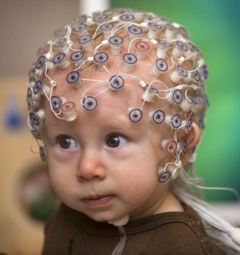
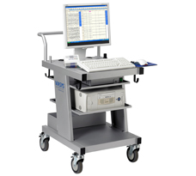
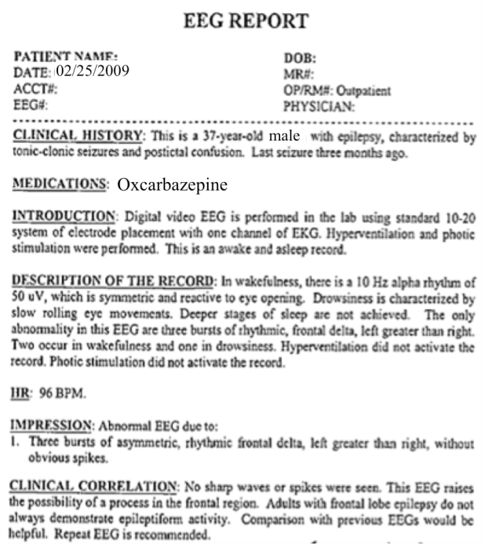
The Clinical Process
  A technician administers a 30−minute recording session.
  An EEG specialist (neurologist) interprets the EEG.
  An EEG report is generated with the diagnosis.
  Patient is billed once the report is coded and signed off.

Slide 4
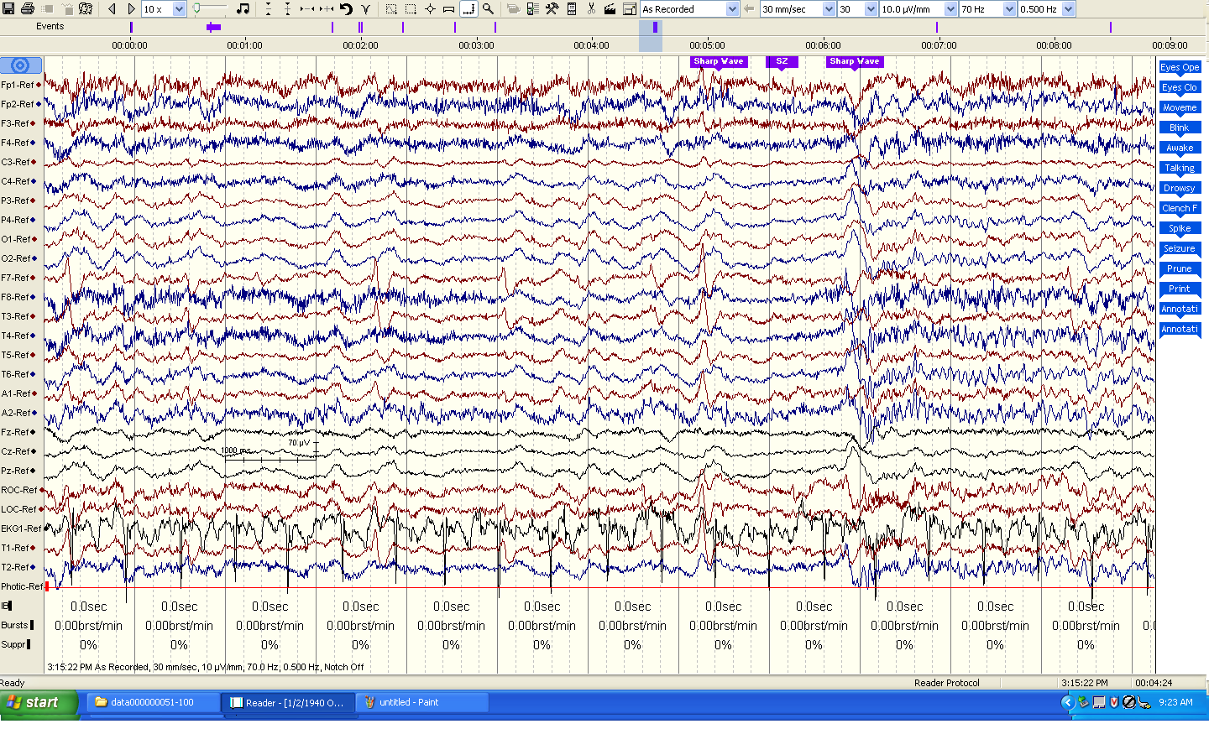
Task 1: Software and Infrastructure Development
Major Tasks:
Inventory the data (EEGs and physician reports)
Develop a process to convert data to an open format
Develop a process to deidentify the data
Gain necessary system accesses to the source forms of the reports
Status and Issues:
Efforts to automate .e to .edf conversion failed due to incompatibilities between Nicolet’s NicVue program and ‘hotkeys’ technology.
Accessing physician reports required access to 5 different hospital databases and cutting through lots of red tape (e.g., it took months to get access to the primary reporting system).
No automated methods for pulling reports from the back-end database.
EDF files were not “to spec” according to open source “EDFlib” so additional EDF conversion software had to be written.
Patient information appears in EDF annotations.
Notes:
For each TA, task, or sub task worked during the month provide a set of slides that go beyond the Gantt chart and communicate the important details associated with the following:
technical approach(es)
program plan and organization
accomplishments to date that I can show my leadership
to protect your program from being cut when cut directives are passed down from above
to motivate funding extension / expansion of existing or follow-on programs
risk areas
explanation and justification for deviations from negotiated schedule and spending plan
Clearly indicate on each slide if funding from another federal agency (NIH) has been used to support anything presented.
Clearly indicate on each slide if any content on it is pre-publication sensitive. Material that is not sensitive could be presented or shared by me with the public.

Slide 5
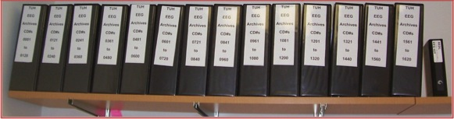
Task 2: Data Capture
Major Tasks:
Copy data from media to disk
Convert EEG files to EDF
Capture Physician Reports
Label Generation
Status and Issues:
22,000+ EEG sessions have been captured from 1570+ CDs/DVDs.
Approximately 15% of the media were defective and needed multiple reads or some form of repair.
Raw data occupies about 2 TBytes of space including video files.
Conversions to EDF averaged 1 file per minute with most of the time spent writing data to disk. The process generates three files: an EEG file in EDF format, an impedance report, and a test report that contains preliminary findings.
Multiple EDF files per session due to the way physicians annotate EEGs.
Notes:
For each TA, task, or sub task worked during the month provide a set of slides that go beyond the Gantt chart and communicate the important details associated with the following:
technical approach(es)
program plan and organization
accomplishments to date that I can show my leadership
to protect your program from being cut when cut directives are passed down from above
to motivate funding extension / expansion of existing or follow-on programs
risk areas
explanation and justification for deviations from negotiated schedule and spending plan
Clearly indicate on each slide if funding from another federal agency (NIH) has been used to support anything presented.
Clearly indicate on each slide if any content on it is pre-publication sensitive. Material that is not sensitive could be presented or shared by me with the public.

Slide 6
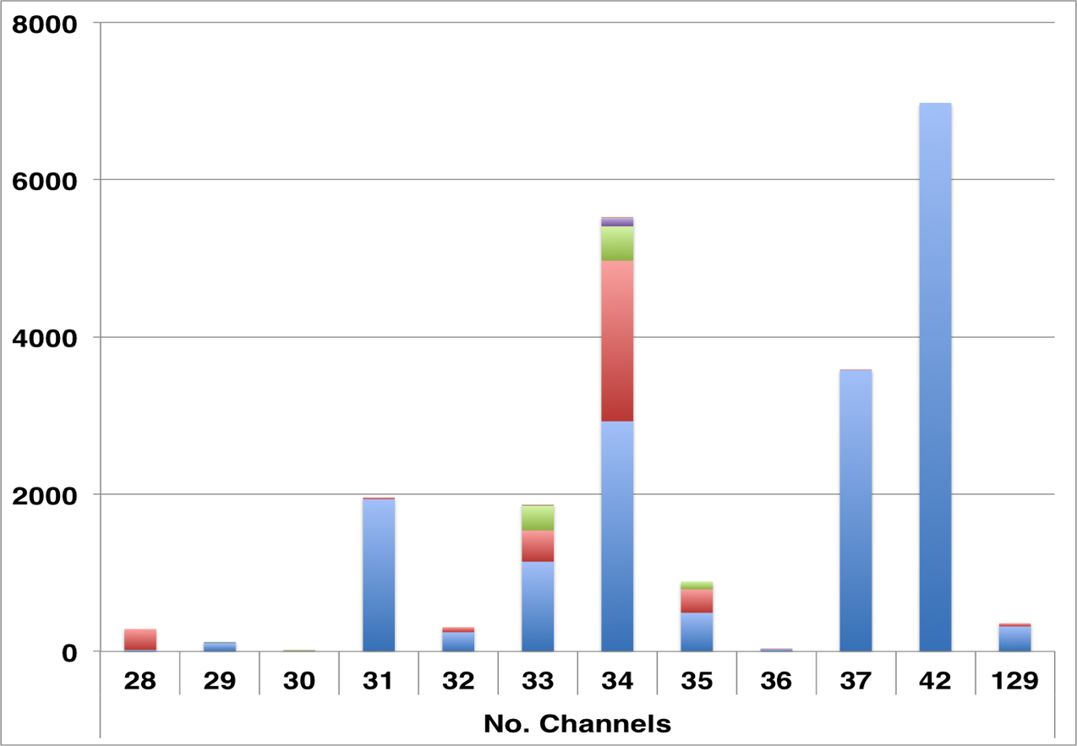
Task 2: TUH-EEG at a Glance
Number of Sessions: 22,000+
Number of Patients: ~15,000 (one patient has 42 EEG sessions)
Age: 16 years to 90+
Sampling: 16-bit data sampled at 250 Hz, 256 Hz or 512 Hz
Number of Channels:
variable
Number of Channels: ranges from [28, 129] (one annotation channel per EDF file)
Analysis of EEG Reports will follow in January’2014.
Over 90% of the alternate channel assignments can be mapped to the 10-20 configuration.
Notes:
Format as appropriate.

Slide 7
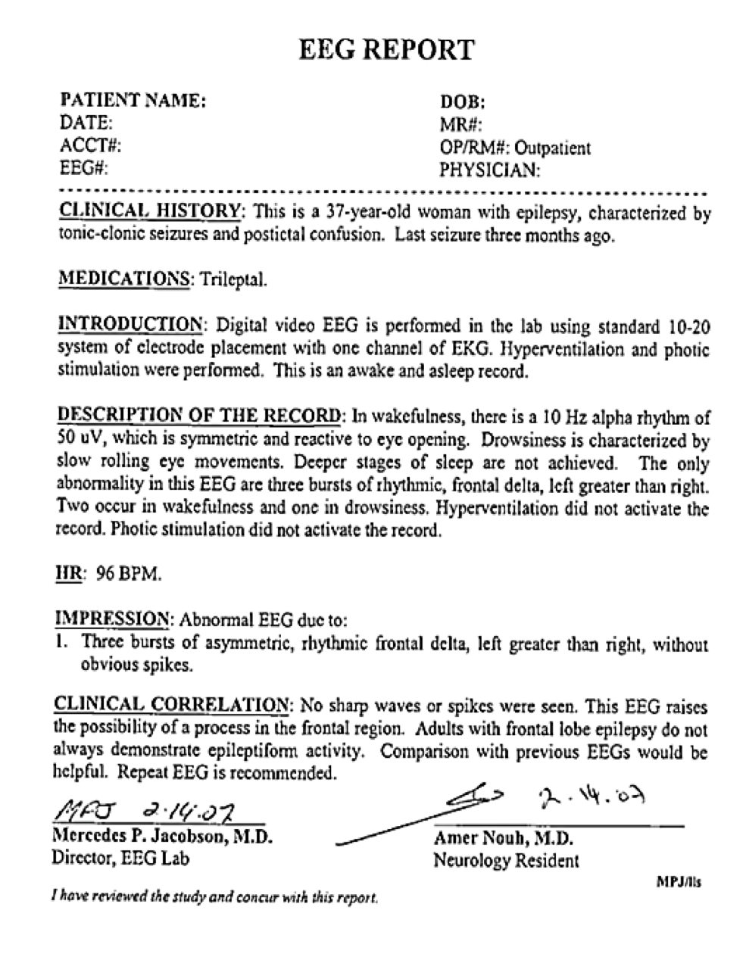
Task 2: Physician Reports
Two Types of Reports:
Preliminary Report: contains a summary diagnosis (usually in a spreadsheet format).
EEG Report: the final “signed off” report that triggers billing.
Inconsistent Report Formats: The format of reporting has changed several times over the past 12 years.
Report Databases:
MedQuist (MS Word .rtf)
Alpha (OCR’ed .pdf)
EPIC (text)
Physician’s Email (MS Word .doc)
Hardcopies (OCR’ed pdf)
Notes:
Provide a description of the proposed technical risk associated with the previous task.
Describe the challenges encountered and the steps taken to mitigate these challenges.
Describe any new or unexpected challenges encountered.
Describe any challenges encountered, strategies taken to mitigate, needs from PM to overcome this challenge.

Slide 8
Task 2: Challenges and Technical Risks
Missing Physician Reports:
It is unclear how many EEG reports in the standard format will be recovered from the hospital databases.
Coverage for 2013 was good – less than 5% of the EEG Reports were missing (and we are still trying to locate these working with hospital staff).
Coverage pre-2009 could be problematic.
Our backup strategy is to use data available from preliminary reports, which contain basic classifications of normal/abnormal and when abnormal, a preliminary diagnosis.
OCR of Physician Reports:
The scanned images are noisy, resulting in OCR errors.
Takes 2 to 3 minutes per image to manually correct.
Notes:
Provide a description of the proposed technical risk associated with the previous task.
Describe the challenges encountered and the steps taken to mitigate these challenges.
Describe any new or unexpected challenges encountered.
Describe any challenges encountered, strategies taken to mitigate, needs from PM to overcome this challenge.

Slide 9
Task 3: Release Generation
Major Tasks:
Deidentify and randomly sequence files so patient information can’t be traced.
Quality control to verify the integrity of the data.
Release data incrementally to the community for feedback.
Status and Issues:
Patient’s name can appear in the annotations and must be redacted; format is unpredictable.
Initially, we will only release standard 20-minunte EEGs. Long-term monitoring or ambulatory EEGs will be released separately once we understand the data.
Regularization of the physician reports.
Notes:
For each TA, task, or sub task worked during the month provide a set of slides that go beyond the Gantt chart and communicate the important details associated with the following:
technical approach(es)
program plan and organization
accomplishments to date that I can show my leadership
to protect your program from being cut when cut directives are passed down from above
to motivate funding extension / expansion of existing or follow-on programs
risk areas
explanation and justification for deviations from negotiated schedule and spending plan
Clearly indicate on each slide if funding from another federal agency (NIH) has been used to support anything presented.
Clearly indicate on each slide if any content on it is pre-publication sensitive. Material that is not sensitive could be presented or shared by me with the public.

Slide 10
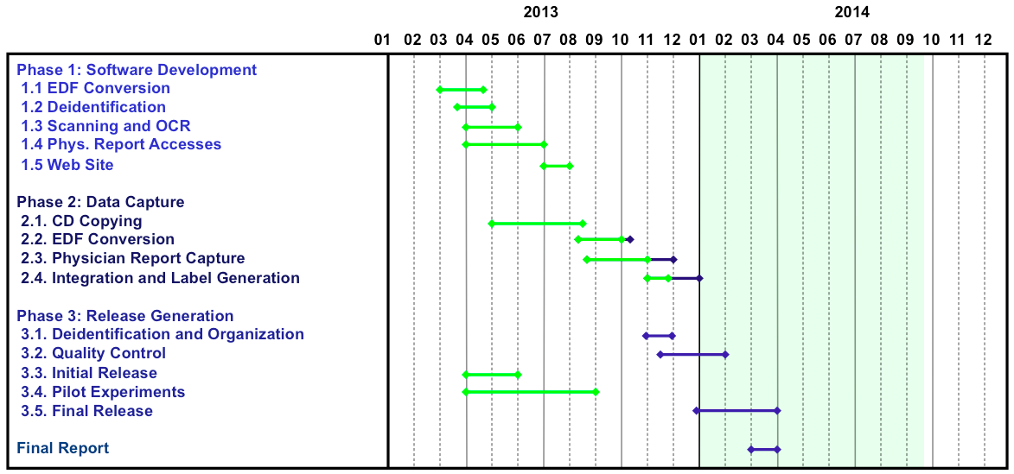
Status and Schedule

Slide 11
Preliminary Findings – TUH EEG
Data processing:
  Classification of 12 categories that appear in EEG annotations
  103 files that had at least one instance of one of these 12 markers
  16 channels sampled at 250 Hz using a 16-bit A/D converter
  Used simple aggregate features: mean, variance and peak value
Three algorithms: (1) a K nearest neighbor (kNN); (2) a neural network (NN) and (3) a random forest (RF)
Training: “Leave-one-out” cross-
validation approach
Testing: closed and open-set testing
Results: performance on closed-set
testing for RF is extremely encouraging
and underscores the need for big data.
Pilot PRES Experiments: preliminary results on PRES detection are encouraging also (21% error), but sensitivity and specificity are low.
Alg. | Setting | Closed |  | Open
 |  | Raw | Norm | Raw | Norm
kNN | K=3 | 27.9% | 61.5% | 63.5% | 49.0%
NN | N=5 | 39.4% | 61.5% | 64.4% | 69.2%
RF | T=20 | 0.0% | 49.0% | 62.5% | 57.7%

Slide 12
Accomplishments and Results
22,000+ EEG signals online and growing
(about 3,000 per year).
Approximately 2,000 EEGs from 2012 and 2013 have been resolved and prepared for deidentification/release.
Anticipated pilot release in January 2014.
Need community feedback on the value of the data and the preferred formats for the reports.
Expect additional incremental releases through 2Q’2014.
Acquired 1,400 more EEGs from the last half of 2013 (newer data can be processed much faster).

Slide 13
Observations
Recovering the EEG signal data was challenging due to software incompatibilities and media problems.
Recovering the EEG reports is proving to be challenging and involves five different sources of material and several generations of formats.
Dealing with the channel selection issues will be a challenge (common to ignore channel labels and deal with each channel independently).

Slide 14
Publications and Dissemination Activities
Publications
Harati, A., Choi, S. I., Tabrizi, M., Obeid, I., Jacobson, M., & Picone, J. (2013). The Temple University Hospital EEG Corpus. Proceedings of the IEEE Global Conference on Signal and Information Processing. Austin, Texas, USA.
Ward, C., Obeid, I., Picone, J., & Jacobson, M. (2013). Leveraging Big Data Resources for Automatic Interpretation of EEGs. Proceedings of the IEEE Signal Processing in Medicine and Biology Symposium. New York City, New York, USA.
Related Dissemination Activities
Advancing Neural Engineering Through Big Data, 1st IEEE Global Conference on Signal and Information Processing, Austin, Texas, December 4, 2013 (NSF-Funded).
IEEE Signal Processing in Medicine and Biology, Temple University, Philadelphia, Pennsylvania, December 6, 2014 (NSF-Funded).

Slide 15
Additional Publicly Released Background Slides
The Temple University Hospital EEG Corpus
The NEDC Community Survey
The Neural Engineering Data Consortium
Automatic Interpretation of EEGs

Slide 16

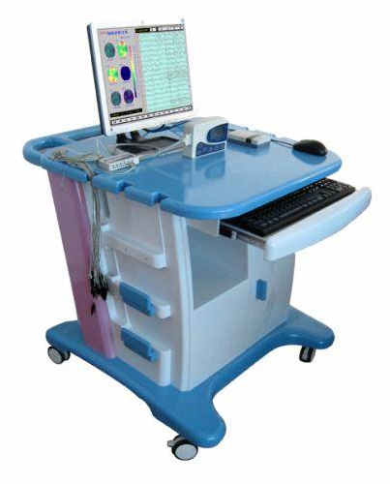
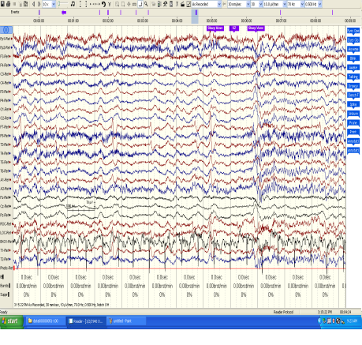
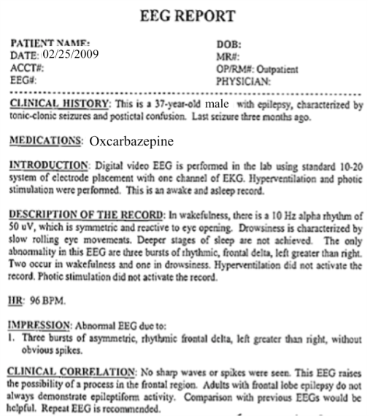
The Temple University Hospital EEG Corpus
Synopsis: The world’s largest publicly available EEG corpus consisting of 20,000+ EEGs collected
from 15,000 patients, collected over 12 years. Includes physician’s diagnoses and patient medical
histories. Number of channels varies from 24 to 36. Signal data distributed in an EDF format.
Impact:
  Sufficient data to support application of state of the art machine learning algorithms
  Patient medical histories, particularly drug treatments, supports statistical analysis of correlations between signals and treatments
  Historical archive also supports investigation of EEG changes over time for a given patient
  Enables the development of real-time monitoring
Database Overview:
  21,000+ EEGs collected at Temple University Hospital from 2002 to 2013 (an ongoing process)
  Recordings vary from 24 to 36 channels of signal data sampled at 250 Hz
  Patients range in age from 18 to 90 with an average of 1.4 EEGs per patient
  Data includes a test report generated by a technician, an impedance report and a physician’s report; data from 2009 forward inlcudes ICD-9 codes
  A total of 1.8 TBytes of data
  Personal information
  has been redacted
  Clinical history and medication history are included
  Physician notes are captured in three fields: description, impression and correlation fields.

Slide 17


Slide 18
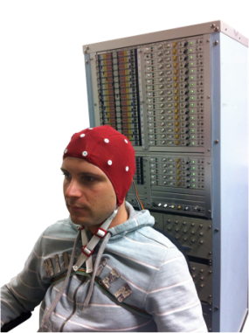
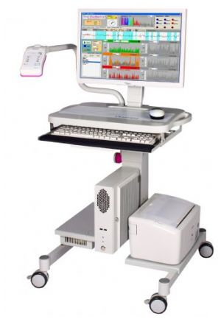
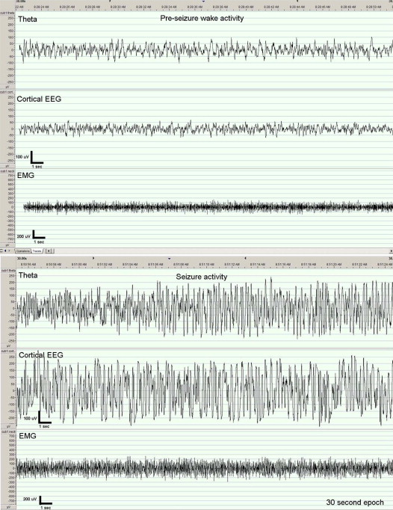

The Neural Engineering Data Consortium
Mission: To focus the research community on a progression of research questions and to
generate massive data sets used to address those questions. To broaden participation by making
data available to research groups who have significant expertise but lack capacity for data generation.
Impact:
  Big data resources enables application of state of the art machine-learning algorithms
  A common evaluation paradigm ensures consistent progress towards long-term research goals
  Publicly available data and performance baselines eliminate specious claims
  Technology can leverage advances in data collection to produce more robust solutions
Expertise:
  Experimental design and instrumentation of bioengineering-related data collection
  Signal processing and noise reduction
  Preprocessing and preparation of data for distribution and research experimentation
  Automatic labeling, alignment and sorting of data
  Metadata extraction for enhancing machine learning applications for the data
  Statistical modeling, mining and automated interpretation of big data
  To learn more, visit www.nedcdata.org

Slide 19
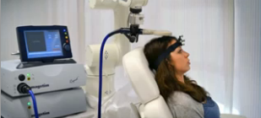
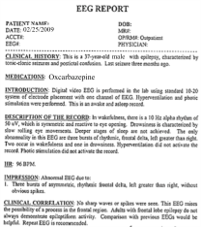
Automated Interpretation of EEGs
Goals: (1) To assist healthcare professionals in interpreting electroencephalography (EEG) tests,
thereby improving the quality and efficiency of a physician’s diagnostic capabilities; (2) Provide
a real-time alerting capability that addresses a critical gap in long-term monitoring technology.
Impact:
  Patients and technicians will receive immediate feedback rather than waiting days or weeks for results
  Physicians receive decision-making support that reduces their time spent interpreting EEGs
  Medical students can be trained with the system and use search tools make it easy to view patient histories and comparable conditions in other patients
  Uniform diagnostic techniques can be developed
Milestones:
  Develop an enhanced set of features based on temporal and spectral measures (1Q’2014)
  Statistical modeling of time-varying data sources in bioengineering using deep learning (2Q’2014)
  Label events at an accuracy of 95% measured on the held-out data from the TUH EEG Corpus (3Q’2014)
  Predict diagnoses with an F-score (a weighted average of precision and recall) of 0.95 (4Q’2014)
  Demonstrate a clinically-relevant system and assess the impact on physician workflow (4Q’2014)

