Slide 1



Active Deep Learning-Based Annotation of Electroencephalography Reports for Patient Cohort Identification
The Big Data to Knowledge (BD2K)
Guide to the Fundamentals of Data Science
Speaker: Prof. Sanda M. Harabagiu, University of Texas at Dallas
December 2, 2016

Slide 2

Sanda Harabagiu, PhD
Professor, Department of Computer Science, University of Texas at Dallas
Director, Human Language Technology Research Institute
Research interests:
  Natural language processing with applications to medical informatics
  Big Data methods for multimodal medical information retrieval
co-PI on an NIH BD2K grant titled “Automatic discovery and processing of EEG cohorts from clinical records”

Slide 3
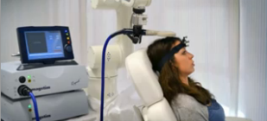
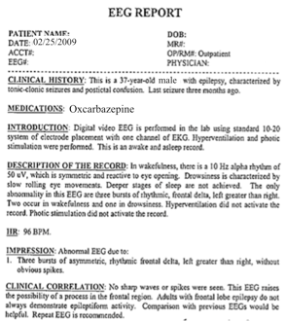
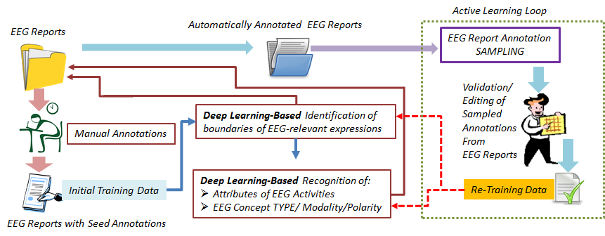
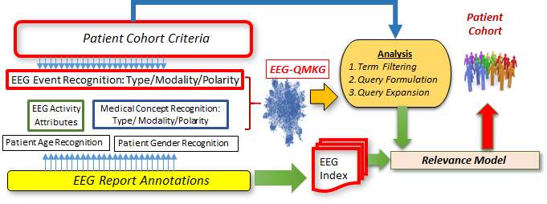

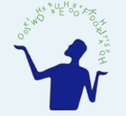
Fundamentals in Data Science:
Active Deep Learning-Based Annotation of Electroencephalography Reports for Patient Cohort Identification
Today
Sanda Harabagiu, PhD and Travis Goodwin
Human Language Technology Research Institute
University of Texas at Dallas

Slide 4
Abstract
Data wrangling is defined as the process of mapping data from an unstructured format to another format that enables automated processing.
Electronic medical records (EMRs) collected at every hospital in the country contain a staggering wealth of biomedical knowledge. EMRs can include unstructured text, temporally constrained measurements (e.g., vital signs), multichannel signal data (e.g., EEGs), and image data (e.g., MRIs).
This information could be transformative if properly harnessed. When processing the clinical text from EMRs, state-of-the-art natural language processing (NLP) methods need to consider new forms of deep learning to face the challenges posed by the complexity and volume of Big Data repositories of medical records.
By combining the advantages of active and deep learning, we show how a large collection of electroencephalography (EEG) reports is annotated to capture a variety of clinical concepts and their attributes. The automatic identification of EEG-specific medical concepts allows us to produce a novel representation of EEG knowledge, namely the EEG-Qualified Medical Knowledge Graph (EEG-QMKG).
the EEG-QMKG is a probabilistic graphical model enabling (a) medical inference, e.g. estimation of likelihoods of clinical correlations, interpretations of the EEG tests or (b) discovery of patient cohorts.

Slide 5
BACKGROUND: Clinical Text Mining
Research in medical text mining can be segmented into:
  Mining biomedical literature (e.g. medical journals, medical textbooks and other scholarly research reports)
  Mining clinical notes (e.g. radiology reports, progress notes, surgical notes, hospital discharge summaries, etc)
Focus and Goals:
      Biomedical NLP tends to focus on extracting proteins, genes, pathways, biomedical events and relations. Opportunity for translational work in biomedical natural language processing—getting results from biological domain into the clinical domain.
      Clinical NLP focuses on building profiles of individual patients by extracting a broad class of medical conditions (e.g. diseases, injuries, medical symptoms) and responses (e.g. diagnoses, procedures, treatments and drugs) with the goal of improving patient care.
SPECIAL CASE: Computerized Clinical Decision Support (CDS)
  aims to aid decision making of health care providers and the public by providing easily accessible health-related information at the point and time it is needed.
  Natural Language Processing (NLP) is instrumental in using free-text information to drive CDS, representing clinical knowledge and CDS interventions in standardized formats, and leveraging clinical narrative. (“What can Natural Language Processing do for Clinical Decision Support?” by Dina Demner-Fushman, Wendy W. Chapman and Clement J. McDonald)
      An outpatient reminder system
      Inpatient reminder and diagnostic decision support systems
      Decision support centered on computerized provider order entry (CPOE)

Slide 6
The Classic Natural Language Processing of EMRs
Key issues:
Medical natural language is ambiguous and economic!!!
Lessons from the past: The 2010 i2b2/VA challenge focused on the identification of medical concepts in the form of:
  Medical problems (e.g. disease, injury)
  Medical tests (e.g. diagnostic procedure, lab test)
  Treatments (e.g. drug, preventive procedure, medical device)
Identification of Medical Concepts
Evaluate Classifier
Identification of Assertions
Train Classifier
Select Features
Other considerations:
Extracting medical concepts involves two decisions
  Boundary classification: Identify the first and last words of each concept
  Type classification: Is the concept a problem, test, or treatment?

Slide 7
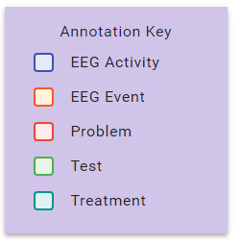
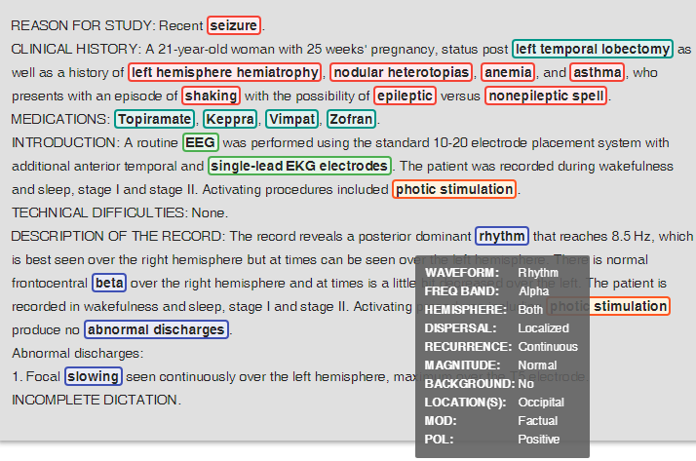
Why annotating Big Data is different?
  Many more types of medical concepts: annotations schemas are complex
  Too many classifiers to be trained
  Difficulty in optimal feature selection
  Deep learning provides ½ of solution
  Active learning provides the other ½ of
  solution
The automatic annotation of the big data of EEG reports
was performed by a Multi-task Active Deep Learning (MTADL)
paradigm aiming to perform concurrently multiple annotation
tasks, corresponding to the identification of:
(1) EEG activities and their attributes;
(2) EEG events;
(3) medical problems;
(4) medical treatments;
(5) medical tests
along with their inferred forms of modality and polarity.
Possible modality values are:
“factual”,
“possible”, and
“proposed”.
-indicate that clinical concepts are actual findings,
possible findings and findings that may be true
at some point in the future.
Each medical concept can have either a “positive” or a
“negative” polarity.

Slide 8
Data: EEG Reports
American Clinical Neurophysiology Society (ACNS) Guidelines for writing EEG reports
Clinical History: patients age, gender, relevant medical conditions and medications
Introduction: EEG technique/configuration
  “digital video EEG”, “standard 10-20 system with 1 channel EKG”
Description: describes any notable waveform activity, patterns, or EEG events
  “sharp wave”, “burst suppression pattern”, “very quick jerks of the head”
Impression: interpretation of whether the EEG indicates normal or abnormal brain activity, as well as a list of contributing epileptiform phenomena
  “abnormal EEG due to background slowing”
Clinical correlation: relates the EEG findings to the over-all clinical picture of the patient
  “very worrisome prognostic features”

Slide 9
Big Data Annotation Schema for EEG reports
EEG reports also contain a substantial number of mentions of EEG activities and EEG events, as they discuss the EEG test. The ability to automatically annotate all clinical concepts from the EEG reports entailed the development of an annotation schema that was created after consulting numerous neurology textbooks and inspecting a large number of EEG reports from the corpus.
What medical concepts we want to annotate?
medical problems [PROB], treatments [TR], tests [TEST],
EEG activities [ACT], and EEG events [EV] mentioned in multiple sections of any EEG report
Example 1: CLINICAL HISTORY: Recently [seizure]_{PROB}-free but with
[episodes of light flashing in her peripheral vision]_{PROB} followed by [blurry vision]_{PROB}
and [headaches] _{PROB}
MEDICATIONS: [Topomax]_{TR}
DESCRIPTION OF THE RECORD: There are also bursts of irregular, frontally predominant
[sharply contoured delta activity]_{ACT}, some of which seem to have an underlying
[spike complex]_{ACT} from the left mid-temporal region.

Slide 10
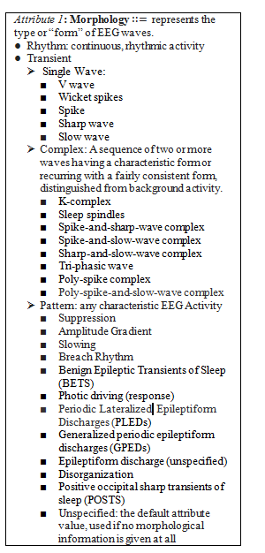
Annotating EEG activities
  We noticed that EEG activities are not mentioned in a continuous expression (see Example 1.
  To solve this problem, we annotated the anchors of EEG activities and their attributes.
  Since one of the attributes of EEG activities, namely, morphology, best defines these concepts, we decided to use it as an anchor.
  We considered three classes of attributes for EEG activities, namely:
    general attributes of the waves, e.g. the morphology, the frequency band;
    temporal attributes and
    spatial attributes.
All attributes have multiple possible values associated with them.

Slide 11
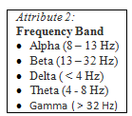

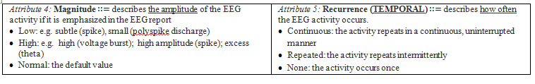
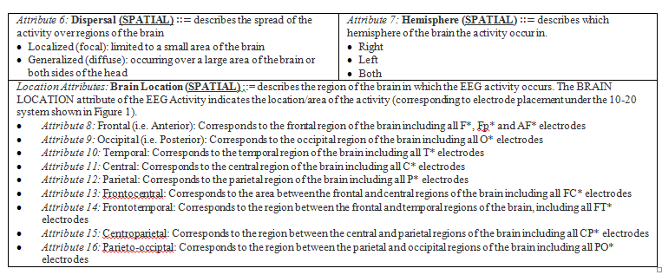
More attributes of EEG activities

Slide 12
Case Study: Manual annotations of EEG Reports
CLINICAL HISTORY: 58 year old woman found [unresponsive]<TYPE=MP, MOD=Factual, POL=Positive>, history of [multiple sclerosis]<TYPE=MP, MOD=Factual, POL=Positive>, evaluate for [anoxic encephalopathy]<TYPE=MP, MOD=Possible, POL=Positive>.
MEDICATIONS: [Depakote]<TYPE=TR, MOD=Factual, POL=Positive>, [Pantoprazole]<TYPE=TR, MOD=Factual, POL=Positive>, [LOVENOX]<TYPE=TR, MOD=Factual, POL=Positive>.
INTRODUCTION: [Digital video EEG]<TYPE=Test, MOD=Factual, POL=Positive> was performed at bedside using standard 10.20 system of electrode placement with 1 channel of [EKG]<TYPE=Test, MOD=Factual, POL=Positive>. When the patient relaxes and the [eye blinks]<TYPE=EV, MOD=Factual, POL=Positive> stop, there are frontally predominant generalized [spike and wave discharges]<MORPHOLGY=Transient>Complex>Spike and slow wave complex, FREQUENCYBAND=Delta, BACKGROUND=No, MAGNITUDE=Normal, RECURRENCE=Repeated, DISPERSAL=Generalized, HEMISPHERE=N/A, LOCATION={Frontal}, MOD=Factual, POL=Positive> as well as [polyspike and wave discharges]<MORPHOLGY=Transient>Complex>Polyspike and slow wave complex, FREQUENCYBAND=Delta, BACKGROUND=No, MAGNITUDE=Normal, RECURRENCE=Repeated, DISPERSAL=Generalized, HEMISPHERE=N/A, LOCATION={Frontal}, MOD=Factual, POL=Positive> at 4 to 4.5 Hz.

Slide 13
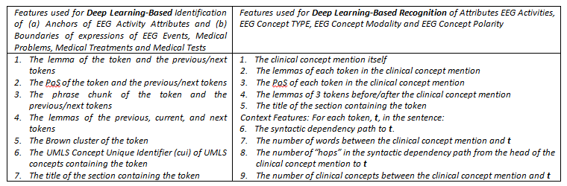
How can we use deep learning for producing annotations
A. Preprocessing the EEG reports
We used the GENIA tagger for tokenization, lemmatization, Part of Speech (PoS) recognition,
and phrase chunking.
Stanford CoreNLP was used for syntactic dependency parsing.
B. Feature Representations for Deep Learning operating on the EEG Big Data
Brown Cluster features generated from the entire TUH EEG corpus were used.
Brown clustering is an unsupervised learning method that discovers hierarchical clusters of
words based on their contexts.
We also used in the feature vector representation of medical knowledge available from
the Unified Medical Language System (UMLS)

Slide 14
Deep Learning Architectures - 1
  Deep Learning architecture for the identification of:
  (1) EEG activity anchors and (2) boundaries of expressions of:
                EEG events,
                medical problems;
                medical tests and
                medical treatments (e.g. medications).
We trained two stacked Long Short-Term Memory (LSTM)
networks:
-one for detecting EEG Activity anchors and
-one for detecting the boundaries of all other clinical concepts
-we represent each sentence as a sequence of tokens [w₁, w₂,..., w_{N}], and train
both LSTMs to assign a label b_{i}∈{ “I”, “O”, “B”} to each token w_{i} such that it will receive
a label b_{i}=”B” if the token w_{i} is at the beginning of a mention of a clinical concept,
a label b_{i}=”I” if the token w_{i} is inside any mention of a clinical concept and
a label b_{i}=”O” if the token w_{i} is outside any mention of a clinical concept.
Notes:
The features are: acinar forming cells with high nuclear/cytoplasmic ratio with large nucleoli; it even shows bright red crystals and blue mucin. )
When it is this classic, a first year resident with 2 months in training can diagnose it. Except it is not always this easy. There are many different grades, variants and sometimes there are only a few glands, hence biopsies are like 1 mm threads of tissue.

Slide 15
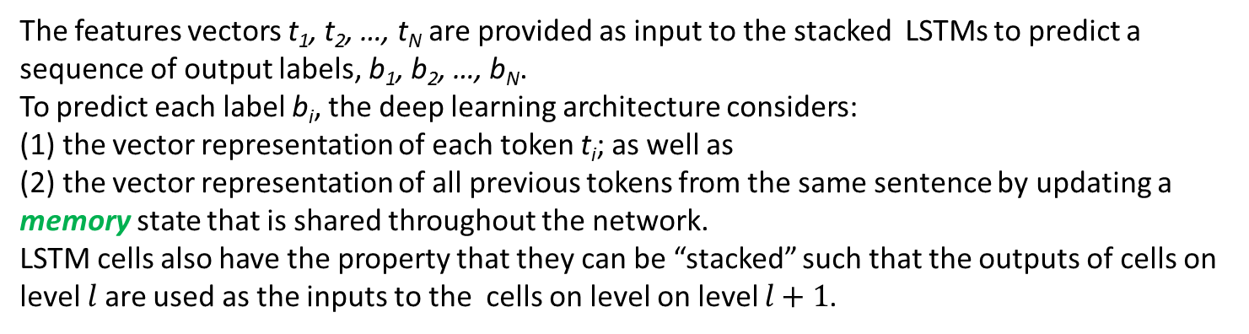
How does it work?
The features vectors t₁, t₂, …, t_{N} are provided as input to the stacked LSTMs to predict a sequence of output labels, b₁, b₂, …, b_{N}.
To predict each label b_{i}, the deep learning architecture considers:
(1) the vector representation of each token t_{i}; as well as
(2) the vector representation of all previous tokens from the same sentence by updating a memory state that is shared throughout the network.
LSTM cells also have the property that they can be “stacked” such that the outputs of cells on level $l$ are used as the inputs to the cells on level on level $l+1$.

Slide 16
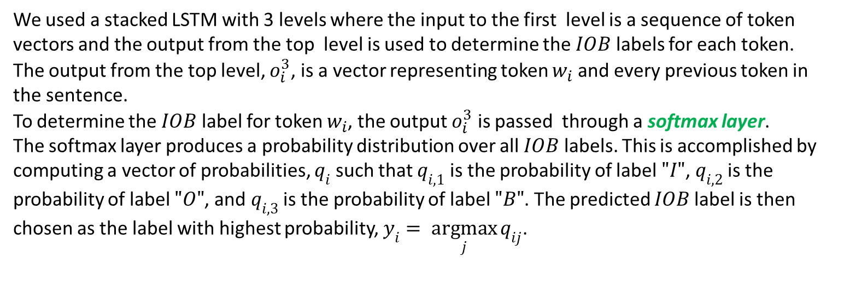
How does it predict boundaries?
We used a stacked LSTM with 3 levels where the input to the first level is a sequence of token vectors and the output from the top level is used to determine the $IOB$ labels for each token.
The output from the top level, $o_{i}^{3}$, is a vector representing token $w_{i}$ and every previous token in the sentence.
To determine the $IOB$ label for token $w_{i}$, the output $o_{i}^{3}$ is passed through a softmax layer.
The softmax layer produces a probability distribution over all $IOB$ labels. This is accomplished by computing a vector of probabilities, $q_{i}$ such that $q_{i,1}$ is the probability of label $"I"$, $q_{i,2}$ is the probability of label $"O"$, and $q_{i,3}$ is the probability of label $"B"$. The predicted $IOB$ label is then chosen as the label with highest probability, $y_{i}= \underset{j}{argmax}{q_{ij}}$.

Slide 17
Deep Learning Architectures - 2
  Deep Learning with a ReLU Network for the Annotation of Attributes of EEG Activities, the Type of other Clinical Concepts and the recognition of Modality and Polarity in EEG Reports
-we use two Deep Rectified Linear Networks (DRN) for multi-task attribute detection, modality…
Given a feature vector x_{a} representing a clinical concept from an EEG report, the DRN learns
a multi-task embedding of the concept, denoted as e_{a}.
To learn the multi-task embedding, the feature vector x_{a} is passed through 5 fully connected
Rectified Linear Unit (ReLU) layers.
Notes:
The features are: acinar forming cells with high nuclear/cytoplasmic ratio with large nucleoli; it even shows bright red crystals and blue mucin. )
When it is this classic, a first year resident with 2 months in training can diagnose it. Except it is not always this easy. There are many different grades, variants and sometimes there are only a few glands, hence biopsies are like 1 mm threads of tissue.

Slide 18
How does it work?
The ReLU layers provide two major benefits
that allow the network to function properly:
ReLUs allow for a deep-net configuration
ReLUs learn sparse representations,
allowing them to perform de facto internal
feature selection.
The vanishing gradient problem affects deep
networks by causing them to lose information
used to update the weights in the network
rapidly as the network gains depth, but ReLUs
in particular avoid this problem.
-the 16 attributes of the EEG activities are identified and annotated in the EEG reports
by feeding the shared embedding into a separate softmax layer for each attribute.
EEG Activities have 18 attributes (16 EEG Activity-specific attributes + modality and polarity),
the DRN for learning EEG Activity attributes contains 18 softmax layers for 18 predictions.
In contrast, the DRN for learning the medical concept type and its modality and polarity
has only 3 softmax layers
Notes:
The features are: acinar forming cells with high nuclear/cytoplasmic ratio with large nucleoli; it even shows bright red crystals and blue mucin. )
When it is this classic, a first year resident with 2 months in training can diagnose it. Except it is not always this easy. There are many different grades, variants and sometimes there are only a few glands, hence biopsies are like 1 mm threads of tissue.

Slide 19
Deep Learning and Active Learning
Architecture of the Multi-Task Active Deep Learning for annotating EEG Reports

Slide 20
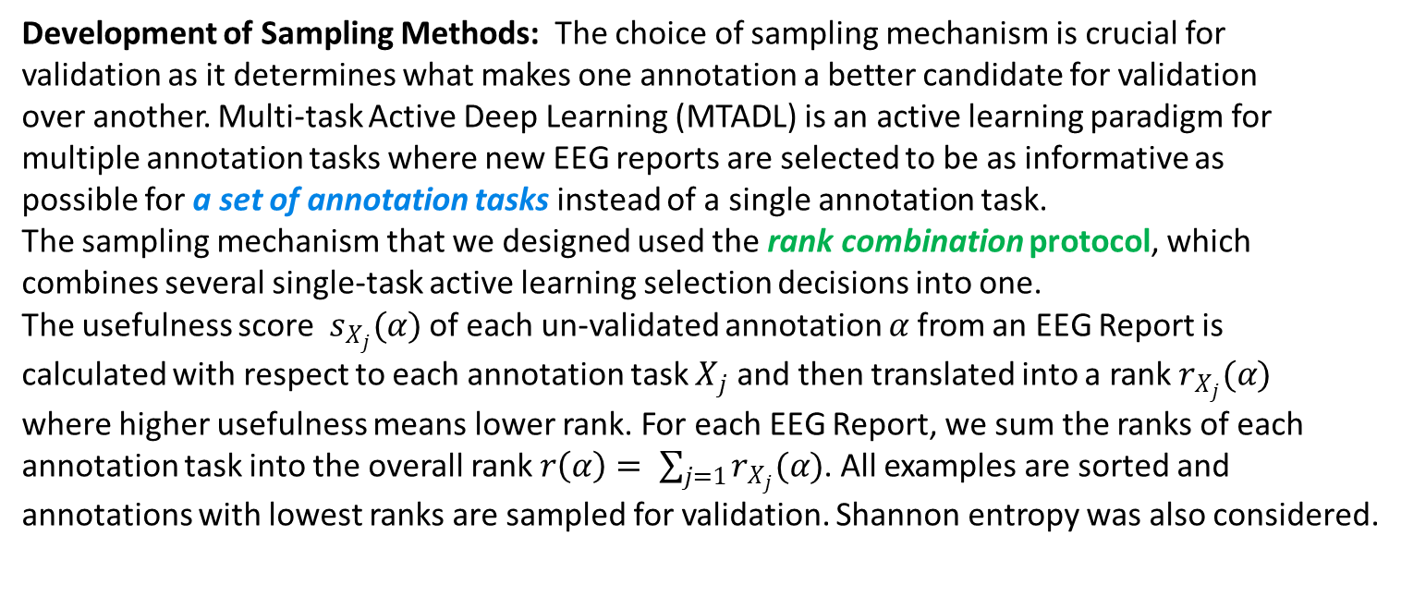
How can active deep-learning be implemented?
Our Multi-task Active Deep Learning (MTADL) paradigm, required the following 5 steps:
STEP 1: The development of an annotation schema;
STEP 2: Annotation of initial training data;
STEP 3: Design of deep learning methods that are capable to be trained on the data;
STEP 4: Development of sampling methods for Multi-task Active Deep Learning system
STEP 5: Usage of the Active Learning system which involves:
  Step 5.a.: Accepting/Editing annotations of sampled examples
  Step 5.b.: Re-training the deep learning methods and evaluation the new system.
Development of Sampling Methods: The choice of sampling mechanism is crucial for
validation as it determines what makes one annotation a better candidate for validation
over another. Multi-task Active Deep Learning (MTADL) is an active learning paradigm for
multiple annotation tasks where new EEG reports are selected to be as informative as
possible for a set of annotation tasks instead of a single annotation task.
The sampling mechanism that we designed used the rank combination protocol, which
combines several single-task active learning selection decisions into one.
The usefulness score $s_{X_{j}}(α)$ of each un-validated annotation $α$ from an EEG Report is
calculated with respect to each annotation task $X_{j}$ and then translated into a rank $r_{X_{j}}(α)$
where higher usefulness means lower rank. For each EEG Report, we sum the ranks of each
annotation task into the overall rank $r\left(α\right)= \sum_{j=1}{r_{X_{j}}(α)}$. All examples are sorted and
annotations with lowest ranks are sampled for validation. Shannon entropy was also considered.

Slide 21
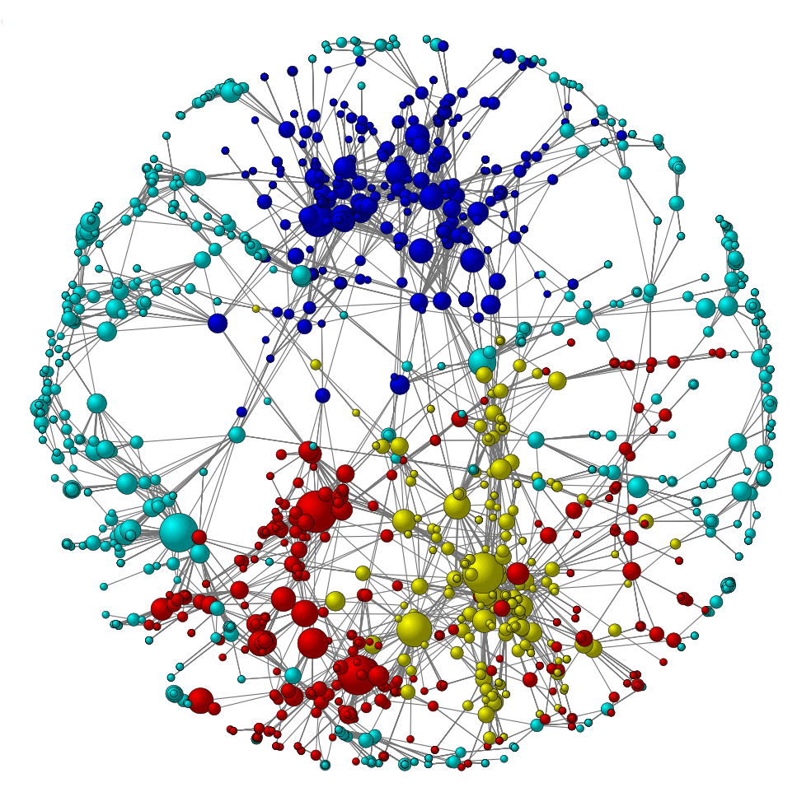
How well does it work? What can we do with these annotations?
EEG Qualified Medical Knowledge Graph (EEG-QMKG)
Medical Question Answering for
Clinical Decision Support
Learning curves for all annotations, shown over the first 100 EEG Reports annotated and evaluated (F₁ measure).
Medical Probabilistic Inference:
- e.g. Posterior distribution of clinical correlations given an EEG description
Semantically Rich Index of Clinical EEG
Patient Cohort Retrieval
EEG Report Annotations

Slide 22
Building a Semantically Rich Index of Clinical EEG
EEG Report Annotations
Attribute 1
….
Attribute 16
term ID
….
term ID
If EEG Activity
Medical Concept ID
….
Medical Concept ID
Concept Type
….
Concept Type
alpha
….
Sharp and slow wave
term ID
….
term ID
Medical Concept
DICTIONARY
  Where are the modality and polarity attributes?
term ID
term ID
…
term ID
….
term ID
…
term ID
term ID
term ID
term ID
term ID
….
term ID
alpha
beta
…
hypertension
….
lovenox
…
seizure
sharp
slow
spike
stroke
….
wave
EEG Report ID
POSITIVE
POLARITY
Report Section
Report Section Position
  How do we search for relevant patients?
  Need an inverted index: build tiered lists
TERM DICTIONARY
Medical Concept ID
Concept Modality
NEGATIVE
POLARITY
EEG Report ID
Report Section
Report Section Position
Medical Concept ID
Concept Modality

Slide 23
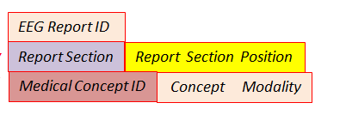
Building a Searchable Index of Clinical EEG
Tiered Inverted Lists
term ID
term ID
…
term ID
….
term ID
…
term ID
term ID
term ID
term ID
term ID
….
term ID
alpha
beta
…
hypertension
….
lovenox
…
seizure
sharp
slow
spike
stroke
….
wave
Next
EEG Report ID
POSITIVE
POLARITY
Report Section
Report Section Position
Medical Concept ID
Concept Modality
Next
TERM DICTIONARY
NEGATIVE
POLARITY
EEG Report ID
Report Section
Report Section Position
Medical Concept ID
Concept Modality
Attribute 1
….
Attribute 16
term ID
….
term ID
If EEG Activity
Medical Concept ID
….
Medical Concept ID
Concept Type
….
Concept Type
alpha
….
Sharp and slow wave
term ID
….
term ID
Medical Concept
DICTIONARY

Slide 24


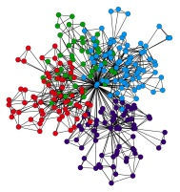
Building a Multimodal Index of Clinical EEG
Tiered Inverted Lists
Next
term ID
term ID
…
term ID
….
term ID
…
term ID
term ID
term ID
term ID
term ID
….
term ID
alpha
beta
…
hypertension
….
lovenox
…
seizure
sharp
slow
spike
stroke
….
wave
EEG Report ID
EEG Signal Fingerprint ID
POSITIVE
POLARITY
Report Section
Report Section Position
Medical Concept ID
Concept Modality
EEG Signal
fingerprints
Next
TERM DICTIONARY
NEGATIVE
POLARITY
EEG Report ID
EEG Signal Fingerprint ID
Report Section
Report Section Position
Medical Concept ID
Concept Modality
Attribute 1
….
Attribute 16
term ID
….
term ID
If EEG Activity
Medical Concept ID
….
Medical Concept ID
Concept Type
….
Concept Type
alpha
….
Sharp and slow wave
term ID
….
term ID
Medical Concept
DICTIONARY

Slide 25
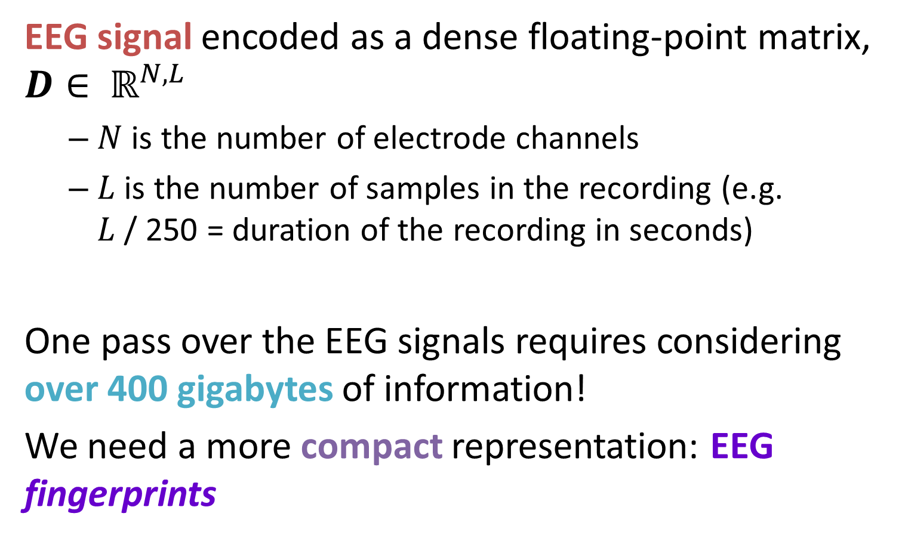
“Fingerprinting” EEG Signals
EEG signal encoded as a dense floating-point matrix, $D∈ ℝ^{N, L}$
  $N$ is the number of electrode channels
  $L$ is the number of samples in the recording (e.g. $L$ / 250 = duration of the recording in seconds)
One pass over the EEG signals requires considering over 400 gigabytes of information!
We need a more compact representation: EEG fingerprints

Slide 26
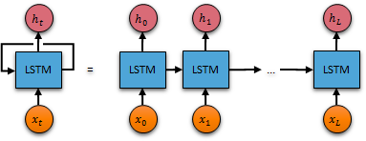
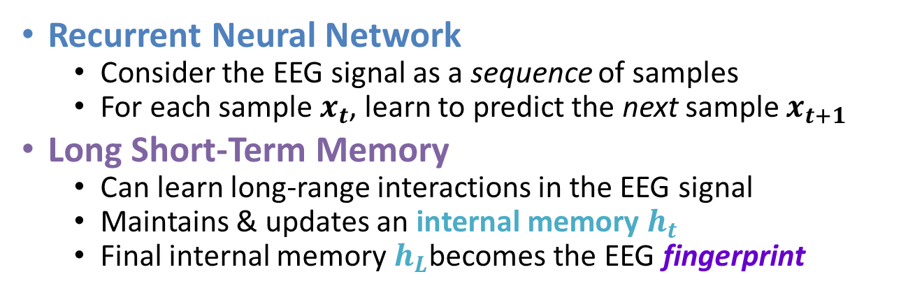
Learning EEG Fingerprints
Deep neural learning
  Process EEG signals in a matter of hours rather than weeks
  Reduce each EEG signal from 20 MB to a few hundred bytes
Recurrent Neural Network
  Consider the EEG signal as a sequence of samples
  For each sample $x_{t}$, learn to predict the next sample $x_{t+1}$
Long Short-Term Memory
  Can learn long-range interactions in the EEG signal
  Maintains & updates an internal memory $h_{t}$
  Final internal memory $h_{L}$becomes the EEG fingerprint

Slide 27
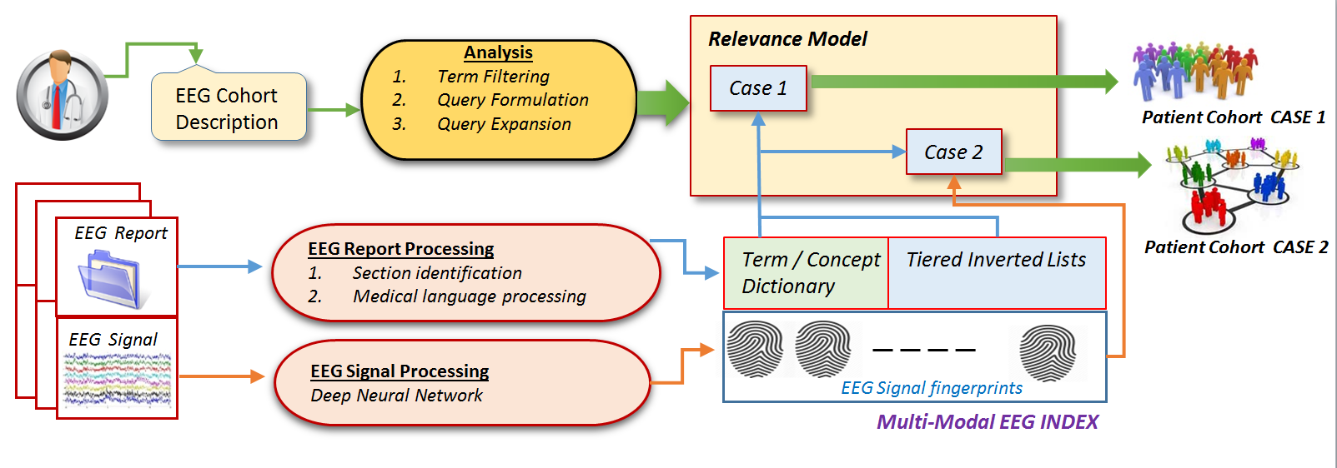
Retrieving Relevant Patient Cohorts
The Patient Cohort Criteria are expressed in natural language.
Q_{annotated}: Patients taking [topiramate]_{MED} ([Topomax]_{MED}) with a diagnosis
of [headache]_{PROB} and [EEGs]_{TEST} demonstrating [sharp waves]_{ACT}, [spikes]_{ACT}
or [spike/polyspike and wave activity]_{ACT}

Slide 28
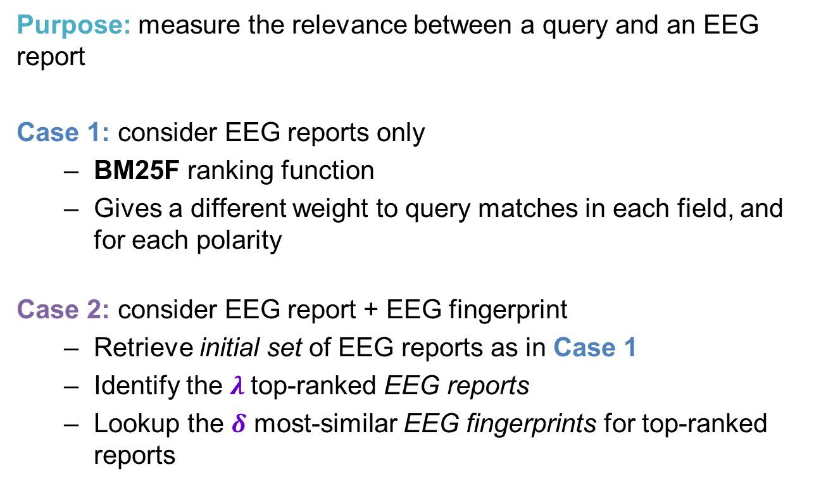
Methods: Relevance Model
Purpose: measure the relevance between a query and an EEG report
Case 1: consider EEG reports only
  BM25F ranking function
  Gives a different weight to query matches in each field, and for each polarity
Case 2: consider EEG report + EEG fingerprint
  Retrieve initial set of EEG reports as in Case 1
  Identify the $λ$top-ranked EEG reports
  Lookup the $δ$ most-similar EEG fingerprints for top-ranked reports

Slide 29
Evaluation: Queries
Asked neurologists to provide patient cohort descriptions (queries)
 | Patient Cohort Description (Queries)
1. | History of seizures and EEG with TIRDA without sharps, spikes, or electrographic seizures
2. | History of Alzheimer dementia and normal EEG
3. | Patients with altered mental status and EEG showing nonconvulsive status epilepticus (NCSE)
4. | Patients under 18 years old with absence seizures
5. | Patients over age 18 with history of developmental delay and EEG with electrographic seizures

Slide 30
Evaluation: Patient Cohort Quality
For each patient cohort criteria expressed as a natural language query:
  Identified the 10 most relevant EEG reports
  Random sample of 10 EEG reports retrieved between ranks 11 and 100.
Asked neurologists to judge whether each EEG report was “relevant”:
  1: the patient described in the report definitely belongs to the cohort
  0: the patient described in the report does not belong to the cohort
Measured using standard information retrieval metrics:
  Mean Average Precision (MAP)
  Normalized Discounted Cumulative Gain (NDCG)
  Precision at rank 10 (P@10)

Slide 31
Multi-Modal Index improving the quality of patient cohorts
Relevance Model | MAP | NDCG | P @ 10
Baseline 1: BM25 | 52.05% | 66.41% | 80.00%
Baseline 2: LMD | 50.37% | 65.90% | 80.00%
Baseline 3: DFR | 46.22% | 59.35% | 70.00%
MERCuRY: Case 1 (a) | 58.59% | 72.14% | 90.00%
MERCuRY: Case 1 (b) | 57.95% | 70.34% | 90.00%
MERCuRY: Case 2 (a) | 70.43% | 84.62% | 100.00%
MERCuRY: Case 2 (b) | 69.87% | 83.21% | 100.00%
(a) With medical concept dictionary (b) Without medical concept dictionary

Slide 32
Summary
Deep Neural Learning for Big Data Can Be Transformative:
Active Learning can take advantage of the modern, successful deep learning new approaches, if adequate sampling mechanisms are considered.
Neural Learning enables a large number of annotation tasks to be performed jointly, and thus provides rich semantic information that is captured in a global manner, across vast clinical resources.
Deep Learning Can Play An Important Role:
Data wrangling is critical because there is a lack of adequately annotated data, and many applications will not support the development of annotated big data resources.
Searching these newly annotated data will also have to consider all the modalities in which clinical information is organized. Thus multi-modal indexes that are produced by novel deep learning representations are essential.
Annotations produced with deep neural learning in vast clinical data will enable the generation of probabilistic representations of medical knowledge, giving a new impetus to probabilistic medical inference.

Slide 33
Acknowledgements
Automatic Discovery of EEG Cohorts:
Research reported in this poster was supported by National Human Genome Research Institute of the National Institutes of Health under award number 1U01HG008468.
The TUH EEG Corpus:
The annotations were produced on the Temple University Hospital corpus.
Disclaimers:
Any opinions, findings, and conclusions or recommendations expressed in this material are those of the author(s) and do not necessarily reflect the views of the National Science Foundation.
The content is solely the responsibility of the authors and does not necessarily represent the official views of the National Institutes of Health.

Slide 34


Biography: Dr. Sanda Harabagiu
Dr. Sanda Harabagiu received her Ph.D. in Computer Engineering in 1997 from the University of Southern California and a Ph.D. in Computer Science from the University of Rome, Italy. She is currently a professor in the Department of Computer Science at University of Texas at Dallas and the Director of the Human Language Technology Research Institute. She has been on the faculty of University of Texas, Austin and Southern Methodist University.
Her primary research interests are natural language processing and information retrieval, with an application to medical informatics. She is well known for her research in Textual Question Answering. In 2006 she co-edited a book entitled “Advances in Open Domain Question Answering”.
Dr. Harabagiu’s research funding sources over the years have included NSF, DoD, IARPA, DARPA, NIH as well as the private sector. She is a past recipient of the National Science Foundation CAREER award. Prof. Harabagiu is a member of AMIA, AAAI, IEEE and ACM. See www.hlt.utdallas.edu/~sanda to learn more about her research and teaching.

Slide 35
Brief Bibliography
[1] R. Maldonado, T.R. Goodwin and S.M. Harabagiu, (2017), “Active Deep Learning-Based Annotation of Electroencephalography Reports for Cohort Identification”, Proceedings of the 2017 Joint Summits on Clinical Research Informatics, American Medical Informatics Association (AMIA –CRI 2017)
[2] T.R. Goodwin and S.M. Harabagiu, (2016) “ Multi-modal Patient Cohort Identification from EEG Report and Signal Data”, Proceedings of the Annual Symposium of the American Medical Informatics Association (AMIA 2016) 1794-1803.
[4] Obeid, I., & Picone, J. (2016). The Temple University Hospital EEG Data Corpus. Frontiers in Neuroscience, Section Neural Technology, 10, 00196. Data is available at https://www.isip.piconepress.com/projects/tuh_eeg/.
[5] T.R. Goodwin and S.M. Harabagiu, (2016) “ Medical Question Answering for Clinical Decision Support”, Proceedings of the Conference on Information and Knowledge Management (CIKM-2016).
[6] T.R. Goodwin and S.M. Harabagiu, (2017), “Deep Learning from EEG Big Data for Inferring Underspecified Information”, Proceedings of the 2017 Joint Summits on Clinical Research Informatics, American Medical Informatics Association (AMIA –CRI 2017).

Slide 36

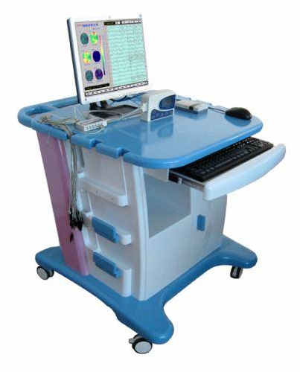
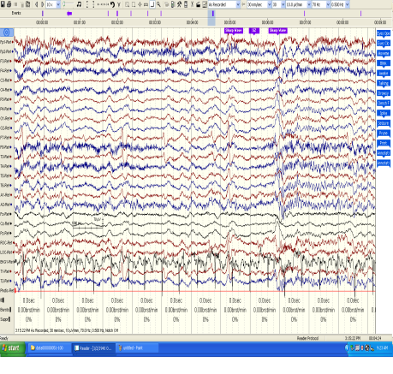
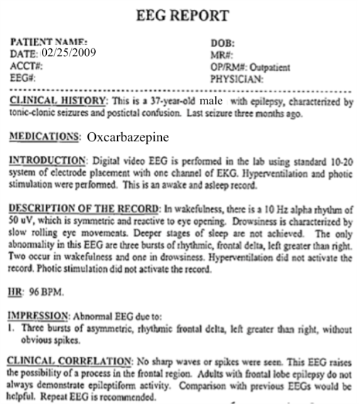
The Temple University Hospital EEG Corpus
Synopsis: The world’s largest publicly available EEG corpus consisting of 28,000+ EEGs collected
from 15,000 patients, collected over 14 years. Includes EEG signal data, physician’s diagnoses
and patient medical histories. A total of 1.4 Tbytes of data.
Impact:
  Sufficient data to support application of state of the art machine learning algorithms
  Patient medical histories, particularly drug treatments, supports statistical analysis of correlations between signals and treatments
  Historical archive also supports investigation of EEG changes over time for a given patient
  Enables the development of real-time monitoring
Database Overview:
  28,000+ EEGs collected at Temple University Hospital from 2002 to 2016 (an ongoing process)
  Recordings vary from 24 to 36 channels of signal data sampled at 250 Hz
  Patients range in age from 18 to 90+ with an average of 1.6 EEGs per patient
  72% of the patients have one session; 16% have two sessions; 12% have three or more sessions
  Data includes a test report generated by a technician, an impedance report and a physician’s report
  Personal information
  has been redacted
  Clinical history and medication history are included
  Physician notes are captured in three fields: description, impression and correlation fields.

