Slide 1
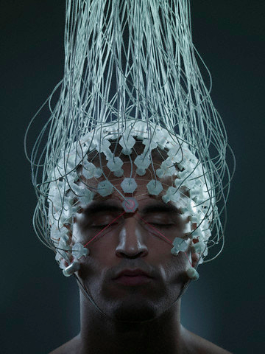
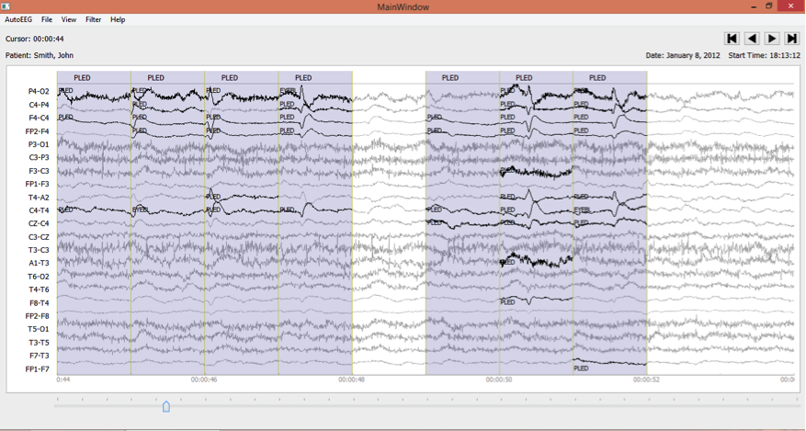
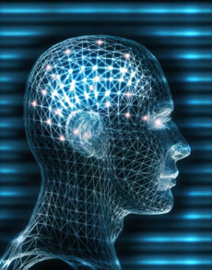

The Temple University Hospital (TUH)
Electroencephalogram (EEG) Corpus:
An Unencumbered Big Data Resource
J. Picone and I. Obeid
Neural Engineering Data Consortium
Temple University

Slide 2
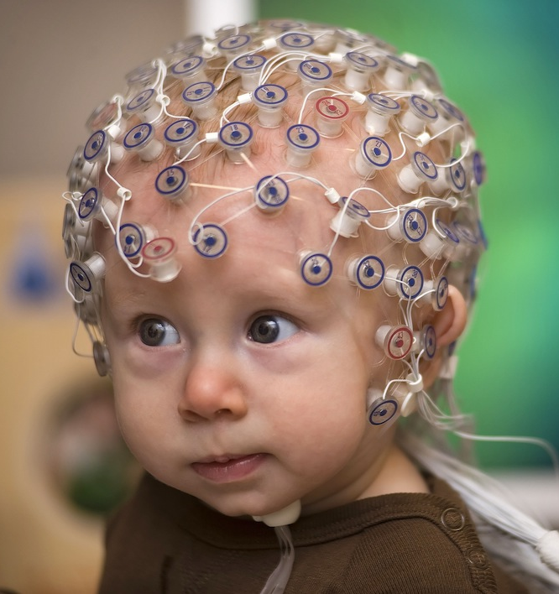
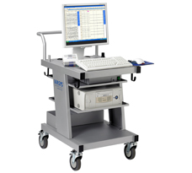
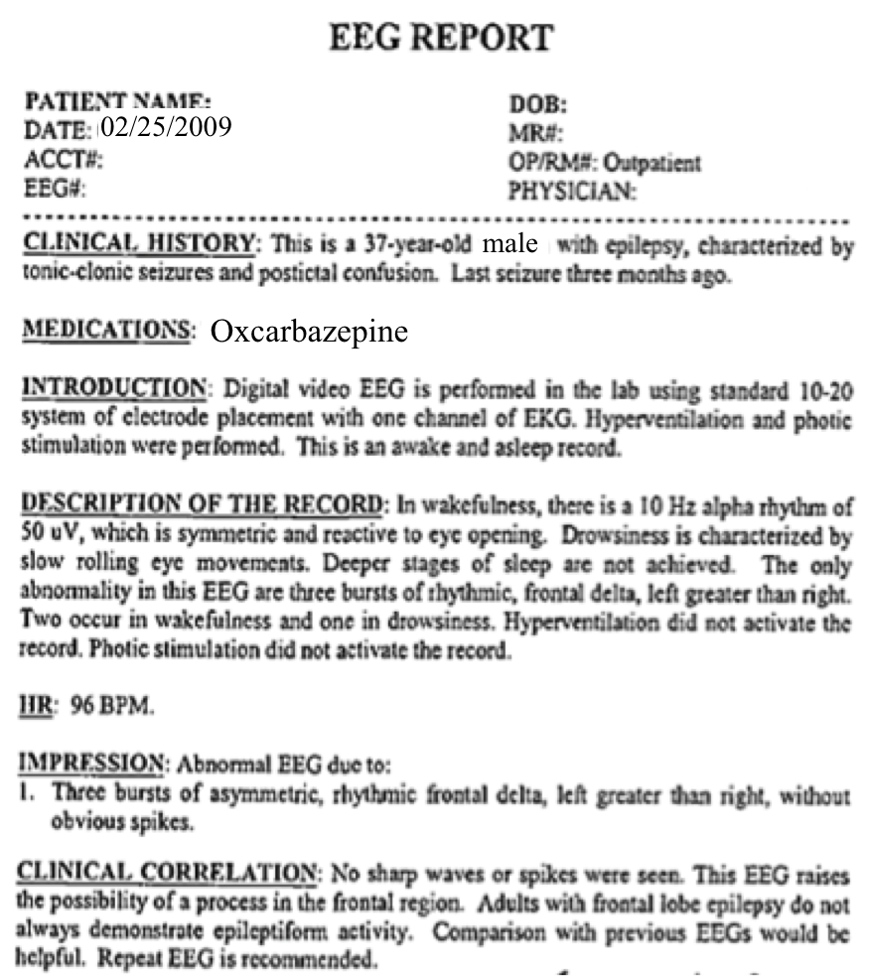
Manual Interpretation of EEGs
  A technician administers a 30−minute recording session.
  An EEG specialist (neurologist) interprets the EEG.
  An EEG report is generated with the diagnosis.
  Patient is billed once the report is coded and signed off.

Slide 3
Automatic Interpretation
Machine learning is used to map signals to event and epoch labels.
Algorithms typically require “truth-marked” data for supervised learning.
Such data is very difficult to create for clinical applications.

Slide 4
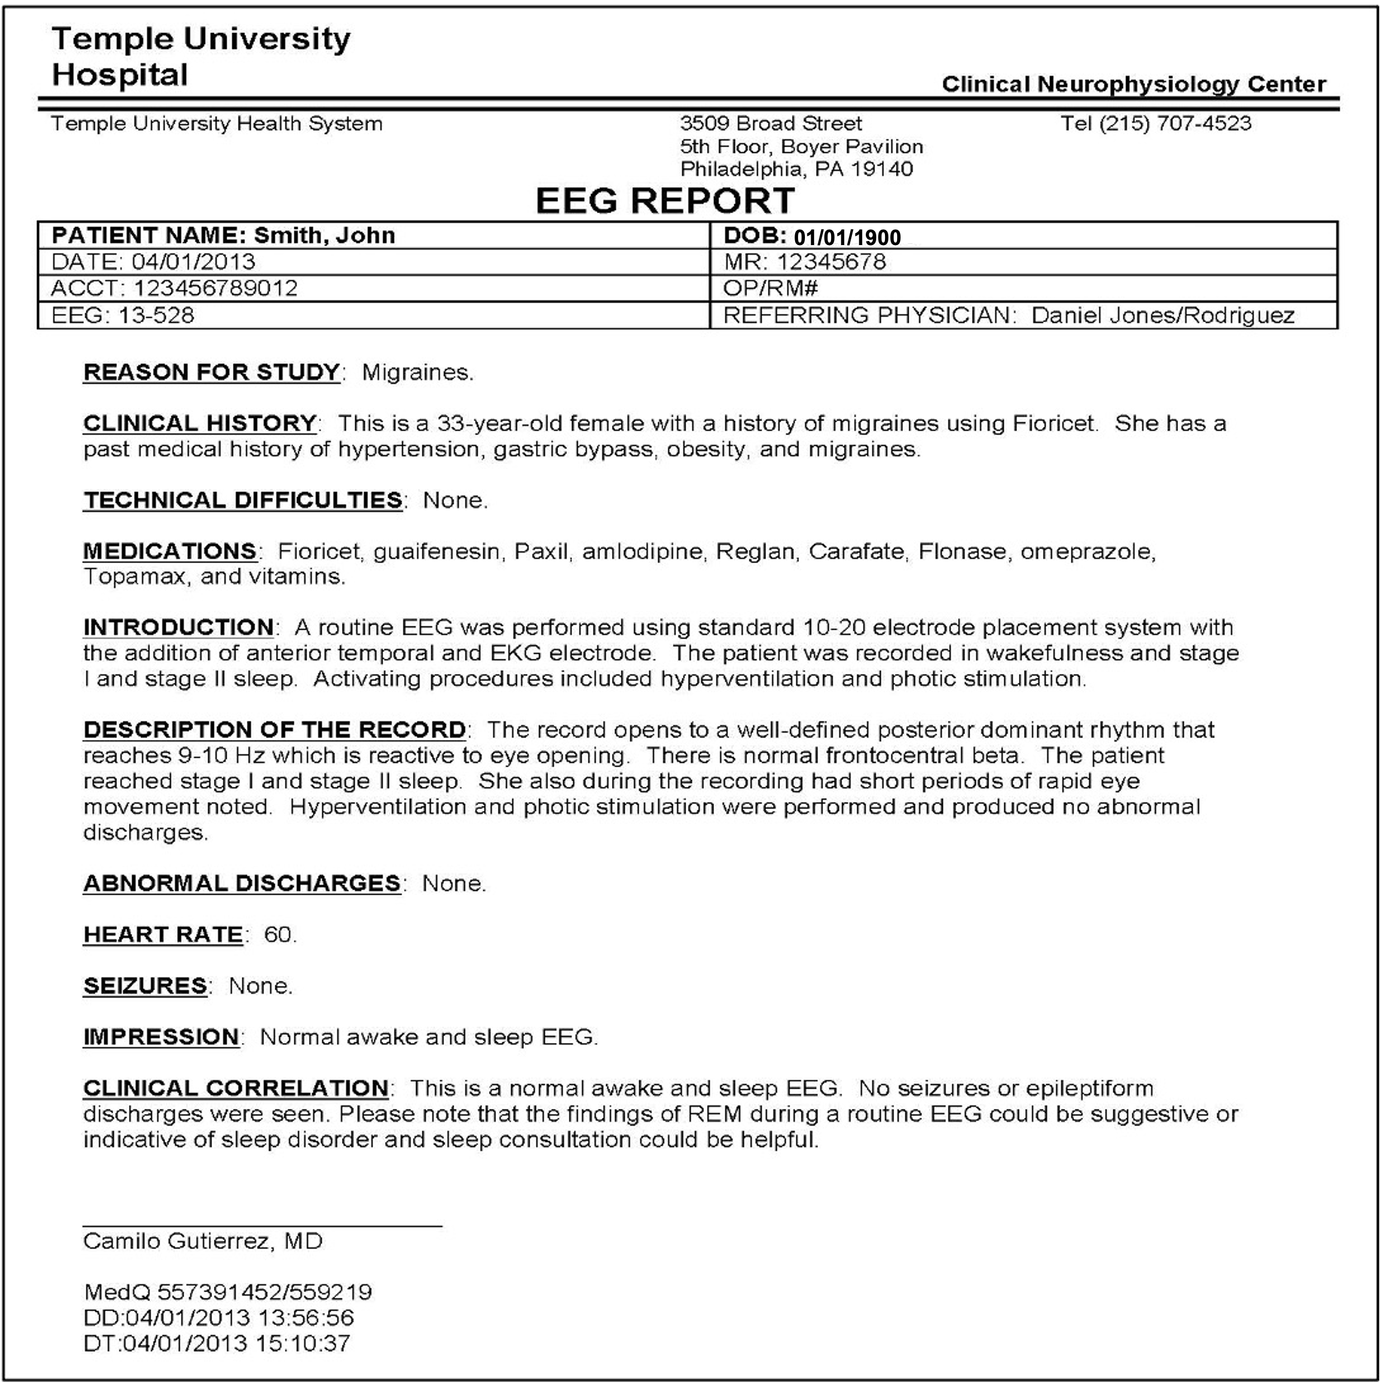
EEG Reports
Two Types of Reports:
Preliminary Report: contains a summary diagnosis (usually in a spreadsheet format).
EEG Report: the final
“signed off” report that
triggers billing.
Inconsistent Report Formats:
The format of reporting
has changed several times
over the past 17 years.
Report Databases:
MedQuist (MS Word .rtf)
Alpha (OCR’ed .pdf)
EPIC (text)
Physician’s Email
Hardcopies (OCR’ed pdf)

Slide 5
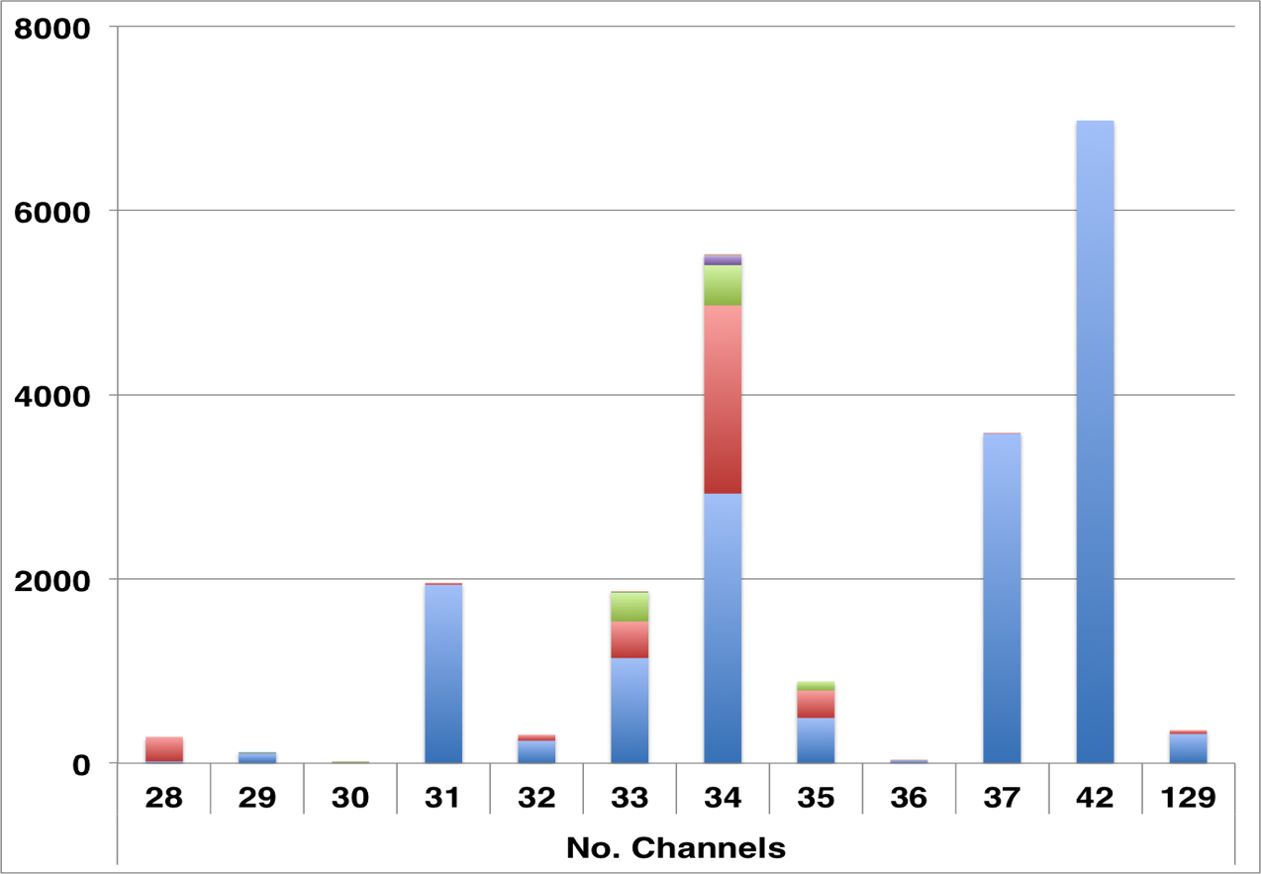
The TUH EEG Corpus
Number of Sessions:
30,000+
Number of Patients:
22,500+
Frequent Flyer: 42 sessions
Age Range (Years):
16 to 90+
Sampling:
Rates : 250, 256 or 512 Hz
Resolution: 16 bits
Data Format:
European Data Format (EDF)
Number of Channels:
Variable
Variations in channels and electrode labels are very real challenges
Number of channels ranges from [28, 129] (one annotation channel per EDF file)
Over 90% of the alternate channel assignments can be mapped to the
standard 10-20 configuration.

Slide 6
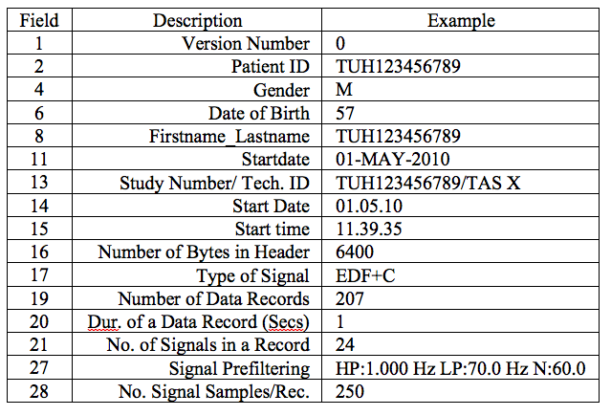
The TUH EEG Corpus – v1.0.0
Corpus is growing at a rate of about 3,000 EEGs per year.
Two general types of EEGs:
  Short-term: 20 to 30 minutes
  Long-term: 18 to 36 hours
Since 2018, reports are held in Epic and are better indexed.
A sample EDF header.
Data has been carefully deidentified (e.g., removal of medical record number, patient name and exact birthdate)
“Pruned EEGs” are being used.

Slide 7
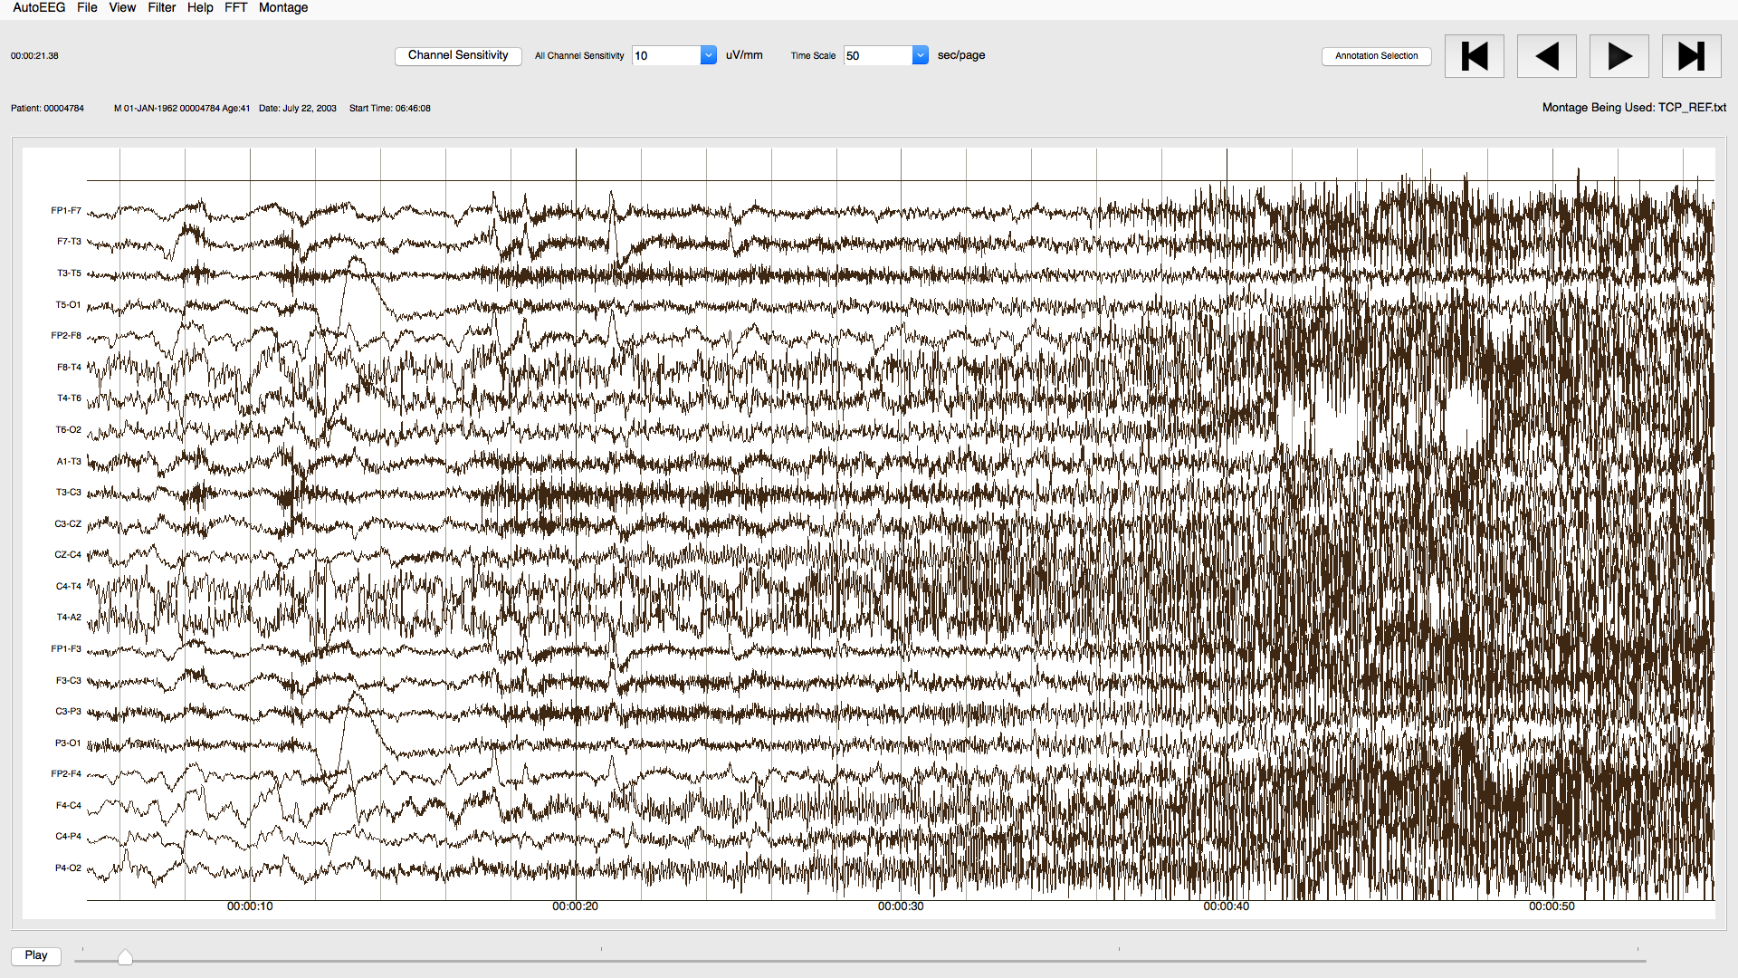
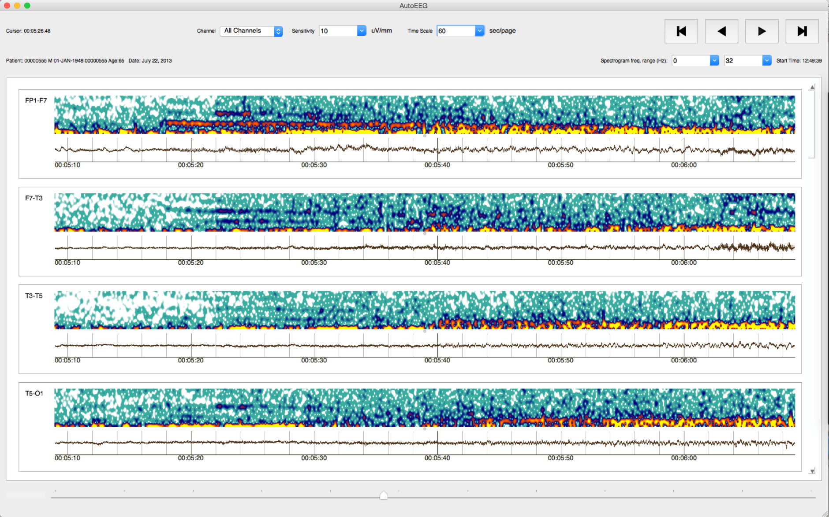
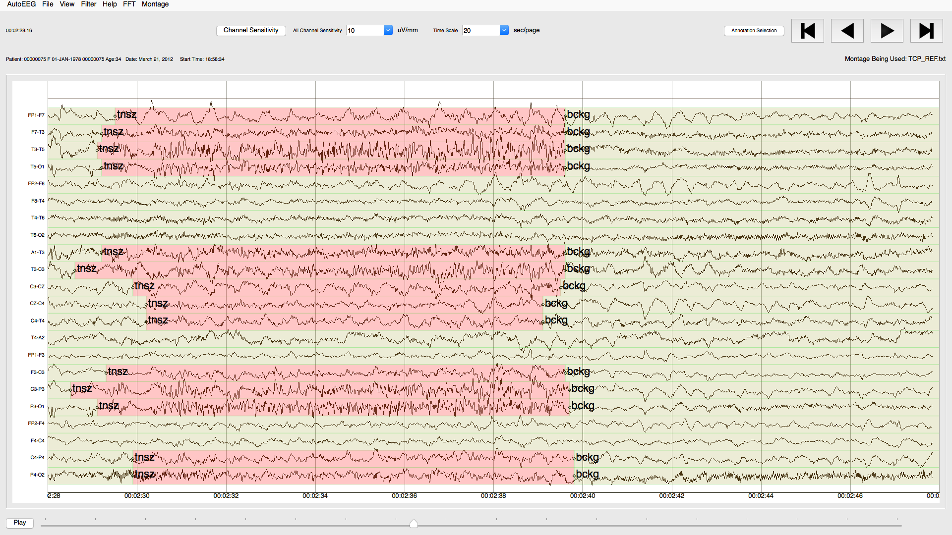
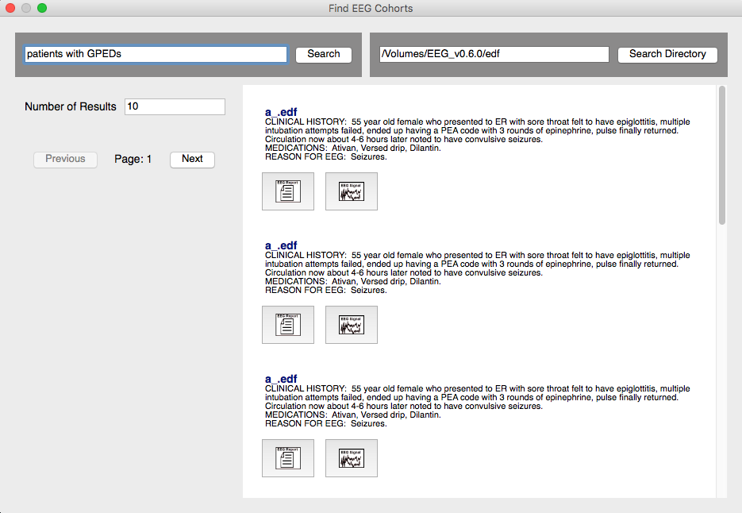
Manual Annotations
  We distribute a powerful Python-based visualization and annotation tool:

Slide 8
Cohort Retrieval
Queries can be submitted that search signals and reports.
A simple query building interface is supported.
Search results are displayed in a way that link signals and reports.
Users can easily review and select the top-ranked results.
The user interface is being co-developed with feedback from expert neurologists.

Slide 9
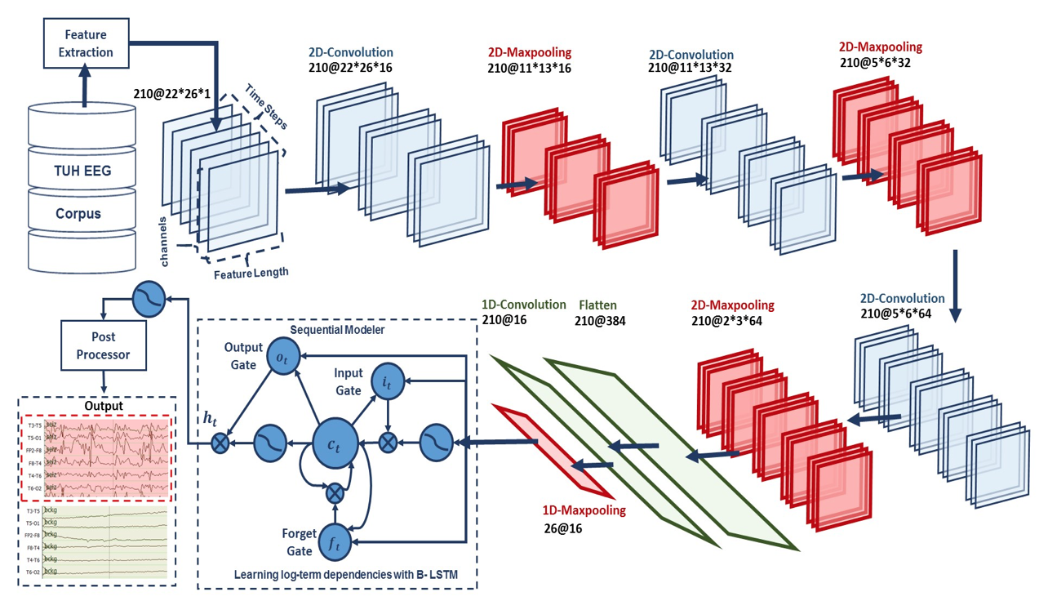
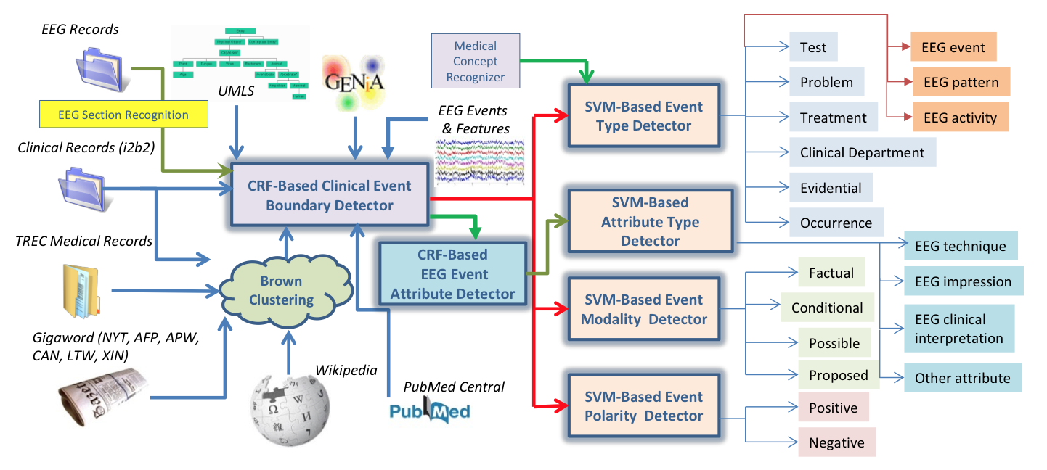
Overview: Two Main Components
AutoEEG: hyper-real-time automated identification and localization of EEG signal events
Identification of the temporal and spatial location of EEG signal events such as spikes.
Two levels of deep learning are used (CNN followed by LSTM), followed by a postprocessor that uses a statistical language model.
MERCuRY: Multi-modal EncephalogRam patient Cohort discoverY
Automated identification of EEG activities, EEG events and patterns as well as their attributes in EEG reports.
Identification of medical concepts that describe the clinical picture and therapy of the patients.

Slide 10
Related Resources
Data:
Abnormal: Over 2,000 EEGs classified as normal or abnormal. The eval set includes about 150 patients with normal EEGs and 105 patients with abnormal EEGs.
Artifact: Over 300 EEGs that have been carefully annotated for artifacts (e.g., chewing, slowing) appearing during non-seizure intervals. Used to train deep learning background models.
Epilepsy: Over 100 patients with a confirmed patient history of epilepsy and 100 ‘normal’ patients (no history of epilepsy).
Events: A small corpus that has been labeled for events such as SPWS, PLED and GPED. Over 150 files in eval and over 350 files in train.
Seizure: A very large dataset (over 6,000 files) manually annotated for seizure events. Includes train, dev_test and a blind eval set. This data is being used for an IBM/Temple Kaggle-style challenge.
Software Resources:
Our web site also contains standardized scoring software, an impressive Python visualization tool, and various libraries to support manipulation of annotation files.

Slide 11
Summary
The TUH EEG Corpus:
  Represents a unique opportunity to advance EEG analysis using state of the art machine learning.
  Under development since 2012, a new release containing all data from 2002-2016 will occur in Summer 2019.
  Data through May 2019 will follow in Fall 2019, bringing the total corpus size to over 35,000 sessions.
  Over 2,000 sites have subscribed to our resources.
To access our resources:
  Sign up:
  https://www.isip.piconepress.com/projects/tuh_eeg/html/downloads.shtml
  Receive a username and password via an email.
  Access resources at:
  https://www.isip.piconepress.com/projects/tuh_eeg/downloads/

Slide 12
Brief Bibliography
Obeid, I., & Picone, J. (2018). The Temple University Hospital EEG Data Corpus. In Augmentation of Brain Function: Facts, Fiction and Controversy. Volume I: Brain-Machine Interfaces (1st ed., pp. 394–398). Lausanne, Switzerland: Frontiers Media S.A. (Download).
Shah, V., von Weltin, E., Lopez, S., McHugh, J. R., Veloso, L., Golmohammadi, M., … Picone, J. (2018). The Temple University Hospital Seizure Detection Corpus. Frontiers in Neuroinformatics, 12, 1-83. (Download).
Golmohammadi, M., Shah, V., Obeid, I., & Picone, J. (2019). Deep Learning Approaches for Automatic Analysis of EEGs. In S.-M. Chan & W. Pedrycz (Eds.), Deep Learning: Algorithms and Applications (1st ed., p. 45). New York, New York, USA: Springer-Verlag. (Download).
Obeid, I., & Picone, J. (2018). Machine Learning Approaches to Automatic Interpretation of EEGs. In E. Sejdik & T. Falk (Eds.), Biomedical Signal Processing in Big Data (1st ed., p. 70). Boca Raton, Florida, USA: CRC Press. (Download).
Houser, D., Golmohammadi, M. M., Anstotz, R., Campbell, C., Obeid, I., Picone, J., … Jhala, N. (2018). The Temple University Hospital Digital Pathology Corpus. Proceedings of the IEEE Signal Processing in Medicine and Biology Symposium (pp. 1–7). Philadelphia, Pennsylvania, USA. (Download).

Slide 13
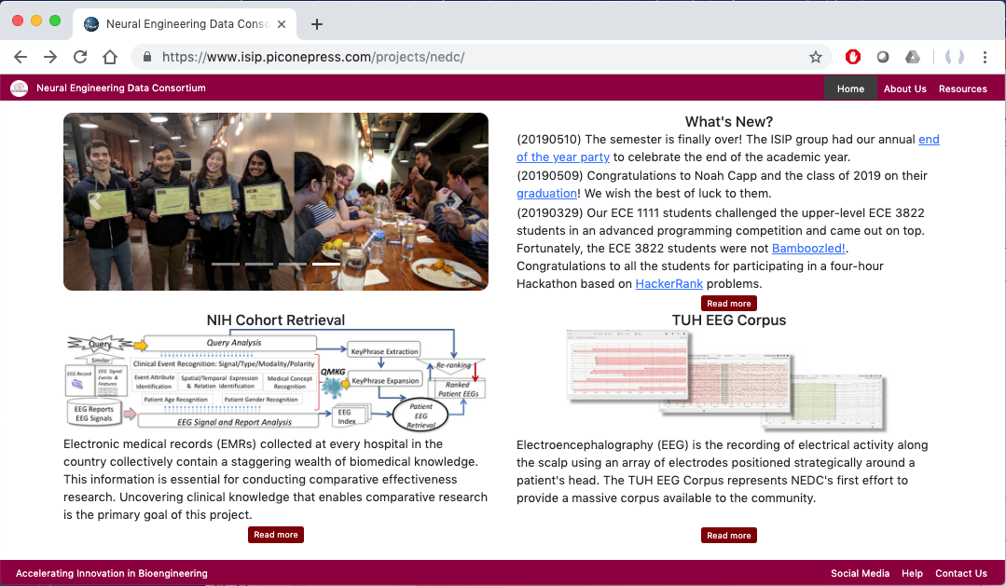
What Can NEDC Do For You?
The easiest way to transfer data is to snail mail a USB disk drive to us.

Slide 14
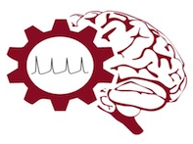
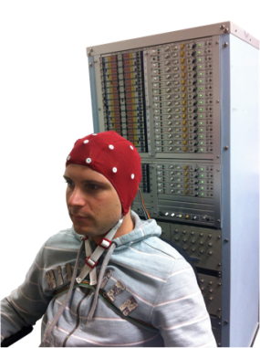
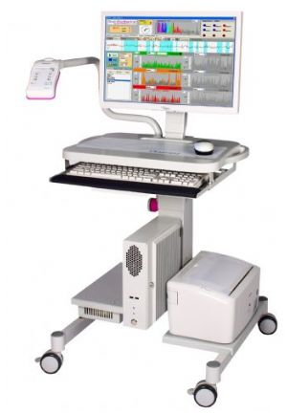
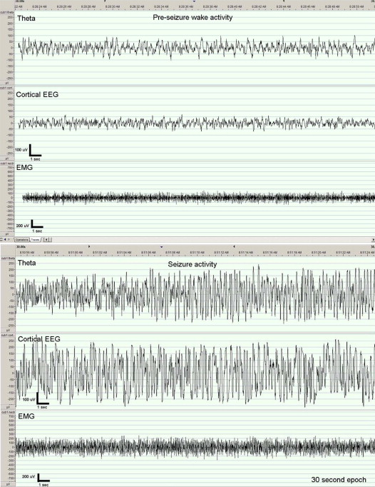
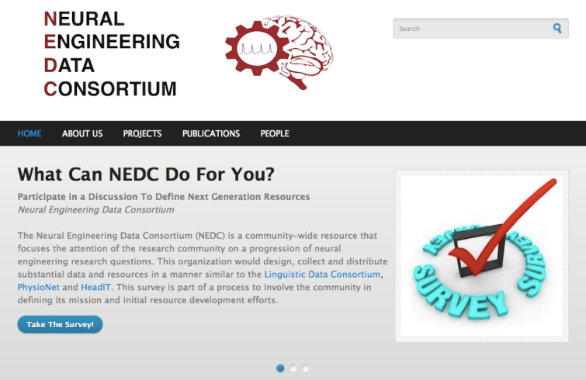
The Neural Engineering Data Consortium
Mission: To focus the research community on a progression of research questions and to
generate massive data sets used to address those questions. To broaden participation by making
data available to research groups who have significant expertise but lack capacity for data generation.
Impact:
  Big data resources enables application of state of the art machine-learning algorithms
  A common evaluation paradigm ensures consistent progress towards long-term research goals
  Publicly available data and performance baselines eliminate specious claims
  Technology can leverage advances in data collection to produce more robust solutions
Expertise:
  Experimental design and instrumentation of bioengineering-related data collection
  Signal processing and noise reduction
  Preprocessing and preparation of data for distribution and research experimentation
  Automatic labeling, alignment and sorting of data
  Metadata extraction for enhancing machine learning applications for the data
  Statistical modeling, mining and automated interpretation of big data
  To learn more, visit www.nedcdata.org

Slide 15

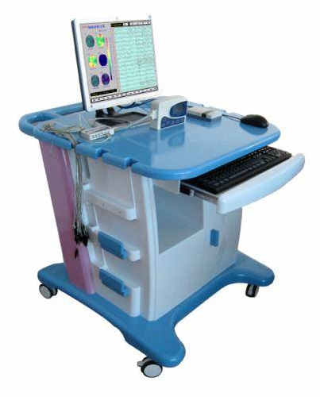
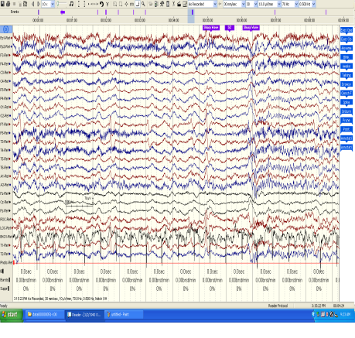
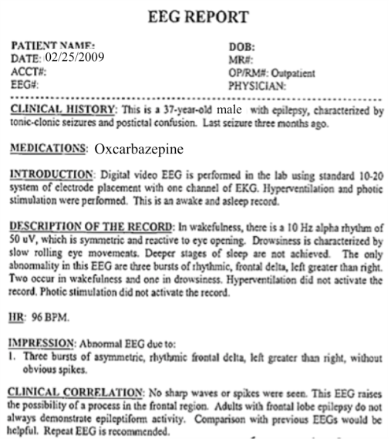
The Temple University Hospital EEG Corpus
Synopsis: The world’s largest publicly available EEG corpus consisting of 30,000+ EEGs collected
from 22,000+ patients, collected over 17 years. Includes physician’s diagnoses and patient medical
histories. Signal data distributed in an EDF format.
Impact:
  Sufficient data to support application of state of the art machine learning algorithms
  Patient medical histories, particularly drug treatments, supports statistical analysis of correlations between signals and treatments
  Historical archive also supports investigation of EEG changes over time for a given patient
  Enables the development of real-time monitoring
Database Overview:
  21,000+ EEGs collected at Temple University Hospital from 2002 to 2013 (an ongoing process)
  Recordings vary from 24 to 36 channels of signal data sampled at 250 Hz
  Patients range in age from 18 to 90 with an average of 1.4 EEGs per patient
  Data includes a test report generated by a technician, an impedance report and a physician’s report; data from 2009 forward inlcudes ICD-9 codes
  A total of 1.8 TBytes of data
  Personal information
  has been redacted
  Clinical history and medication history are included
  Physician notes are captured in three fields: description, impression and correlation fields.

