Slide 1
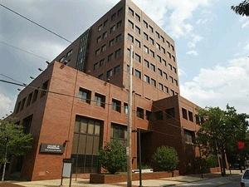
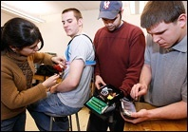
THE DEPARTMENT OF
ELECTRICAL AND COMPUTER ENGINEERING
Outline:
• Biography
ECE at a Glance
Future Directions
Joseph Picone, PhD
Professor and Chair, Department of Electrical and Computer Engineering
College of Engineering
Temple University

Slide 2
My Journey To Temple
Urban-located public universities are enjoying unprecedented success in a down market and will continue to thrive in the coming years.
Diverse Work Experience
Industry: Texas Instruments and AT&T Bell Laboratories
Academia: Mississippi State University
Government: Extended sabbatical at the National Security Agency where I directed all human language technology research and development.
Significant Research Success
Founded the Institute for Signal and Information Processing whose sponsors included the National Science Foundation and NSA.
On the leading edge of the open source movement (e.g., developed the first state of the art public domain speech recognition system).
Participated in several large research center initiatives that were focused on creating large economic impact (e.g., an intelligence economy).
Long-term Commitment to Education
Web–based educational tools and courses (www.isip.piconepress.com)
Senior design and entrepreneurship

Slide 3
ECE @ Temple
Faculty By Rank:
Three degree options: EE, CpE, BioE
Students By Degree Option (08-09):
Track | Full | Assoc | Assist | Total
TT | 6 | 4 | 2 | 12
NTT | 0 | 1 | 0 | 1
Adj. |  |  |  | 9
Staff |  |  |  | 2
TOTAL |  |  |  | 24
Degree | Enrolled | Graduated
BS: EE CpE BioE | 210 195 15 0 | 23 18 5 0
MS: EE CpE BioE | 60 58 0 2 | 20 19 0 1
PhD: EE CpE BioE | 10 7 0 3 | 1 1 0 0
Total: | 280 | 44
Faculty By Area of Specialization:
Area | Full | Assoc | Assist
Biomedical |  | 1 | 1
Intelligent Systems | 3 | 1 | 1
Controls | 3 | 1 | 1
Devices and Materials | 1 | 1
Energy | 1

Slide 4
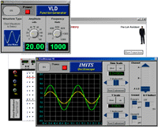
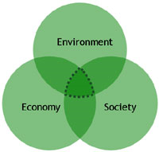
Future Plans
Five-Year Plan:
Increase research expenditures to $5M/yr.
Increase faculty size to 18 (50% growth)
Increase total space to 30,000 sqft (3x increase)
Moderate growth in UG enrollment (10% per year)
Major growth in the PhD program (50 students in 2015)
Approach: Think Big!
Differentiation through focus and collaboration
Pursue major research center and institute initiatives
Improve relationships with local industry
Create regional partnerships with major state universities
Potential areas of focus: What is unique to Temple?
Renewable energy
Environment and sustainability
Intelligence and cybersecurity

