Slide 1
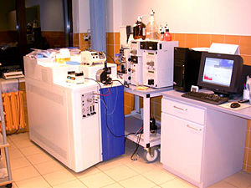
MASS SPECTROMETRY
FURTHER INVESTIGATIONS
Ilyana Mushaeva and Amber Moscato
Department of Electrical and Computer Engineering
Temple University

Slide 2
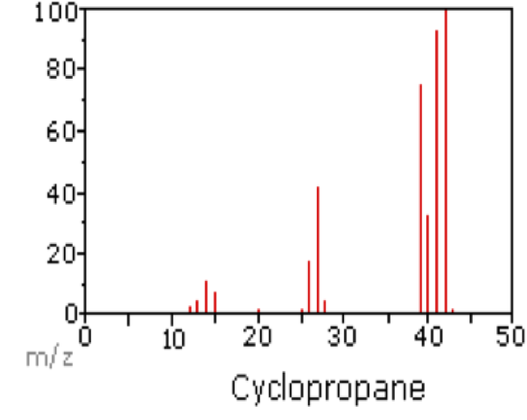
How is the Mass Spectrum Analyzed?
C = 12 m/z
CH = 13 m/z
= 14 m/z
= 15 m/z
= 26 m/z
= 27 m/z
= 28 m/z
= 39 m/z
= 40 m/z
= 41 m/z
= 42 m/z
= 43 m/z
has m/z of 42, so why does a peak at 43 exist?
The M+1 peak exists because Carbon has 3 Isotopes (same element with different neutrons and amu).
Carbon-13 is rare, but shows up in this spectrum. Generally, these peaks are neglected because Carbon 12 is more common (98%).

Slide 3
Signal Processing in Relation to MS/MS
Database of Protein Sequences can be used as a pattern recognition technique to determine the proteins we are working with.
Software exists that evaluates protein sequences from a database to determine which peptides (amino acid links) could be present.
Can a model be constructed using cross correlation or filtering techniques?
Problem: The possible number of proteins in existence form an exponential of and for every protein, there is another that can break it down!

Slide 4
Database for Detection?
Searching a database allows for a decrease in falsely determined peaks.
Generate an ROC curve, which provides a visual for correctly detected peaks vs. falsely detected peaks (cross correlation technique).
ID proteins from peptide (amino acids)

Slide 5
The Data
PeakIntensity = 53401376.000000
PeakMass = 593.510742
Why is this precursor selected?
Is it Metastable and needs further analysis?

Slide 6
The Data
Fragments resulting from MS of Precursor

Slide 7
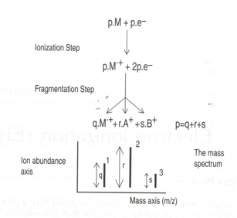
The Ionization Process
The Ionization Process – when an electron is accelerated through an electric field, it gains kinetic energy.
Electrons accelerate through an Electric Field of 70 V and gain kinetic energy of 70 eV.
They interact with neutral molecules to remove an electron from it.
These two electrons exit, leaving behind the Molecular Ion (highest mass-to-charge ratio).
Fragment Ions are formed when there is an excess of energy within the Molecular Ion. This explains why the fragments contain smaller masses.

Slide 8
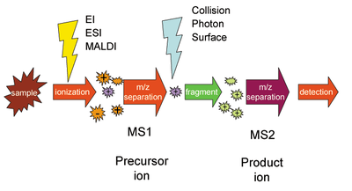
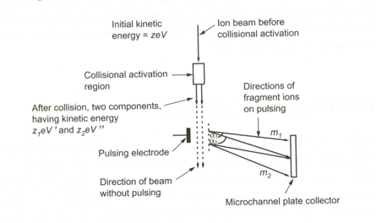
Tandem Mass Spectrometry
There is an initial kinetic energy within the Precursor Ion.
Enters the Collision Induced Dissociation Region (Precursor Ion collides with a Neutral gas) and fragments (products) result.
The fragment ions are deflected at angles as a result of an electric field, which is varied depending on individual Ion masses.
Metastable Ions are those that contain the kinetic energies, and enter a Time of Flight analyzer.

Slide 9
Brief Bibliography
I. Kaltashov and S. Eyles. Mass Spectrometry in Biophysics. Wiley-Interscience. 2005.
M. Baldwin. Protein Identification by Mass Spectrometry available at http://www.mcponline.org/content/3/1/1.full
C. G. Herbert and R. A. W. Johnstone. Mass Spectrometry Basics. CRC Press LLC. 2003.
Understanding Chemistry. Available at
http://www.chemguide.co.uk/analysis/masspecmenu.html#top
S.A. Trauger and W. Webb. Peptide and protein analysis with mass spectrometry. The Scripps Research Institute. 2002. Available at
http://masspec.scripps.edu/publications/public_pdf/78_art.pdf

