Slide 1
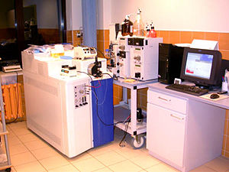
MASS SPECTROMETRY
SOFTWARE DESIGN
Ilyana Mushaeva and Amber Moscato
Department of Electrical and Computer Engineering
Temple University

Slide 2
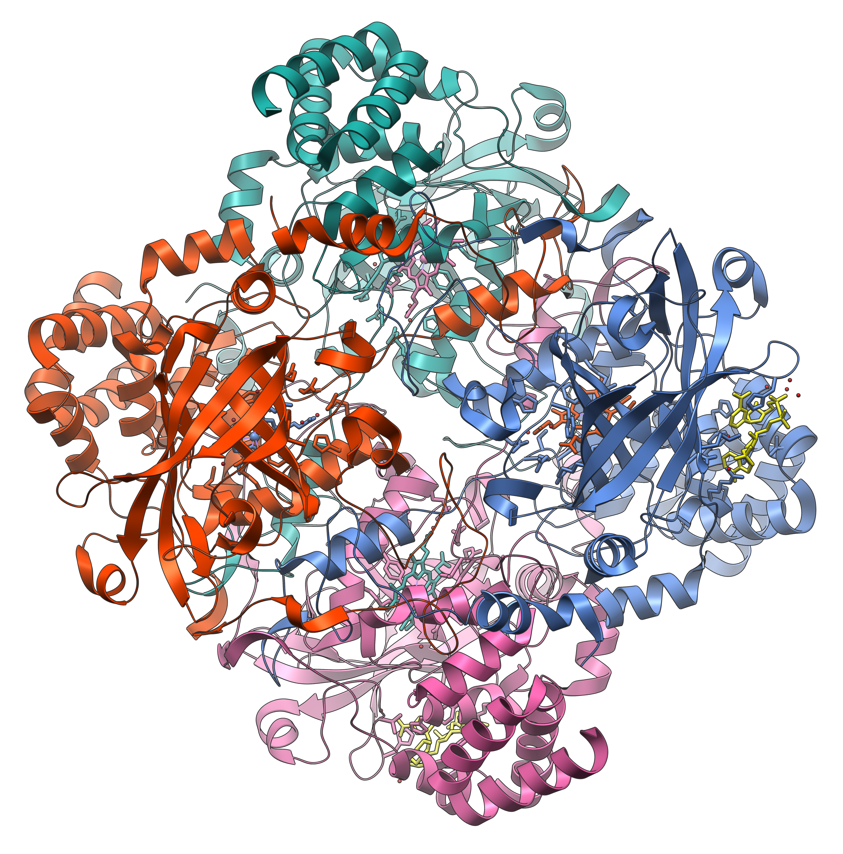
Human Catalase
An enzyme (protein that changes the rate of chemical reactions) found in all living organisms.
Its function is to decompose Hydrogen Peroxide (bodily toxin) into Water and Oxygen molecules:
A protein composed of four peptide chains, over 500 Amino Acids long.
Molecular Mass (weight) of 59,800 amu.
This is what our data contains.
2 H₂O₂ → 2 H₂O + O₂

Slide 3
Spectrum Breakdown
Amino Acids
Peptides
Proteins
Letters
Words
Sentences
Mass Spectrometry is used to determine protein types
Spectrometry

Slide 4
Spectrum Breakdown

Slide 5
The Software Structure

Slide 6
Results After Running Program
sp_thresh = 0.9;
sp_wait = 1.3
sp_type = 'really good';
f1_amino_acids
f2_peptides
f3_proteins
file1_spectrum1
file2_spectrum2
file3_spectrum3
file4_spectrum4
file5_spectrum5
file6_spectrum6
This is the results file
Processing Configuration File...
Processing Models File...
Processing Results File...
More Information
Number of files read from input list:
6
Loading cfg_file
Reading results_file
Loading models_file
Files processed
Debug_level output
Reading input_list
Number of files read

