Slide 1
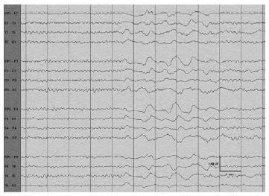
An Introduction to EEG
Masih Tabrizi, Joseph Picone
Institute for Signal and Information Processing
Temple University
Philadelphia, Pennsylvania, USA

Slide 2
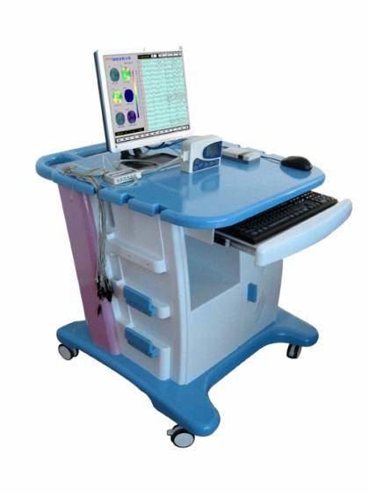
Abstract
Electrical activity in the cortex can be recorded by surface electrodes. Electro Encephalography (EEG) machine records potential difference between two electrodes. EEG helps us to diagnose all disease that effects on cortex such as epilepsy using signals that are consistent with epilepsy diagnosis.
Clinically speaking epilepsy is abrupt cessation of brain function. Therefore during seizure, because of abnormal firing neurons that creates abnormal potential particular EEG channels record abnormal signals.
Use of EEG is not limited to diagnose epilepsy. By using EEG signals, stroke, syncope, migraine, and coma can be prognosticated.

Slide 3
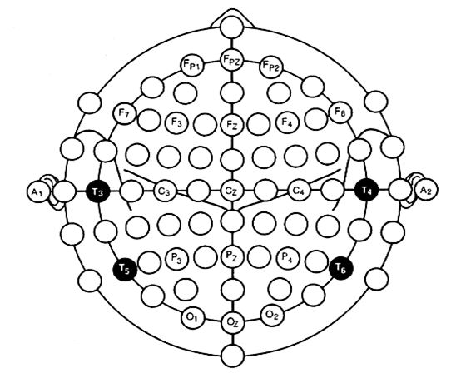
Basic introductions to EEG machine, montages
EEG focuses on the part of the brain that controls conscious activities. Whenever a subject decides to do something those parts light up and create potential difference on different parts of cortex (EEG helps us to diagnose all disease that effects on cortex) and that potential can be recorded using surface electrode.
EEG records potential difference between two electrodes
Bipolar montage or Referential montage.
Electrode placement (10-20 system)
EKG

Slide 4
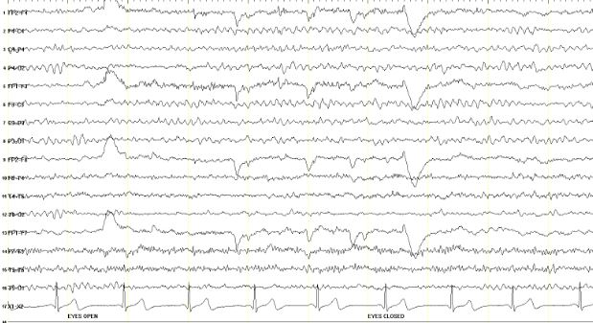
Alpha, beta, theta, and delta rhythms
Alpha rhythm: Has 8-13 Hz, less than 15 µV amplitude, blocks with eye opening.
Beta rhythms: more than 13 Hz, normally observed within 18- to 25 Hz with the amplitude of less than 20 µV.
Theta rhythms: 4-7 Hz frequencies less than 15 µV, frontal or frontocentral head regions.
Delta rhythms are frequencies consist of less than 4 Hz activity.

Slide 5
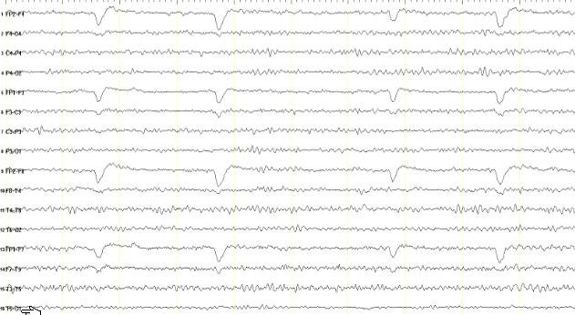
Extra Cerebral Artifacts
Various generators of non-physiological and physiological artifacts may deceive the interpreter:
Eye artifacts: Higher amplitude activity in Fp1, Fp2, F7, F8
Muscle artifact (EMG): Anterior muscles of the scalp produce EMG artifact on Fp1, Fp2, F4, F3, F7, F8
EKG

Slide 6
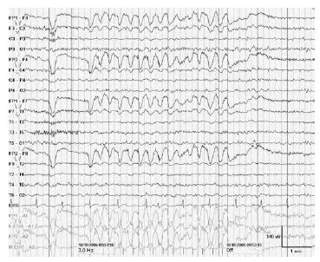
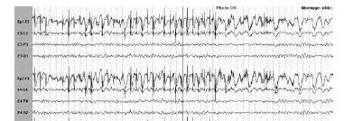
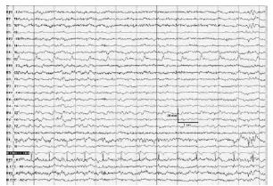
Extra Cerebral Artifacts
Eye movement artifact
EMG Artifact
EKG Artifact

Slide 7
Normal EEG
The most important factors that a subject must have to be considered as normal are:
Anterior-posterior gradient
Beta frequencies in anterior regions with low amplitude
Over occipital region normally we should observe alpha rhythm with higher amplitude.
2. Posterior dominant rhythm
Posterior head regions has alpha frequency 8-12 Hz
3. Having symmetric activity
Having asymmetric activity represents abnormality:
More than 1 Hz and more than 50% amplitude represent abnormality
4. Normal sleep architecture
No anterior-posterior gradient
Spindle , k complex, POSTS, and v wave

Slide 8
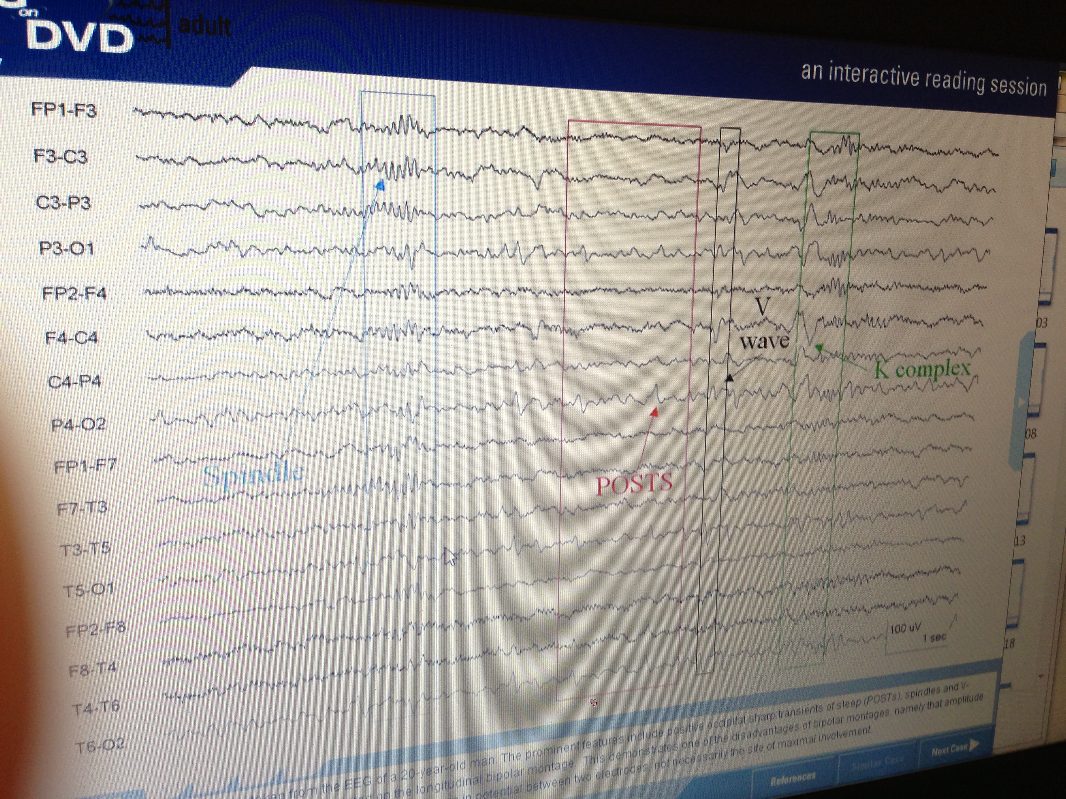
Sleep Architecture
Transients of Sleep
Spindle (12-14 Hz),
K complex(less than 4 Hz),
POSTS(less than 8 Hz),
V wave (4-13 Hz).

Slide 9
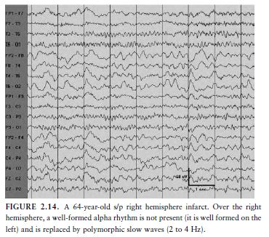
Symmetry Activities
Asymmetric activity represents abnormalities
More than 1 Hz
More than 50% amplitude

Slide 10
Abnormal EEG
Slowing (less than 8 Hz, higher amplitude)
Diffused (or generalized)
Focal abnormalities
Intermittent or continuous
Focal: Temporal, Frontal …

Slide 11
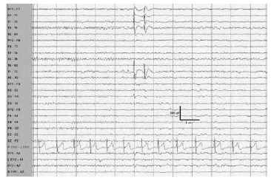
Abnormal EEG
Epileptiform Abnormalities
Interictal epileptiform discharges (IED): Waveforms that shows epilepsy
Frontal, anterior temporal, and midline IEDs have the highest correlation with seizures.
Commonly identified IEDs are spikes and sharp waves

Slide 12
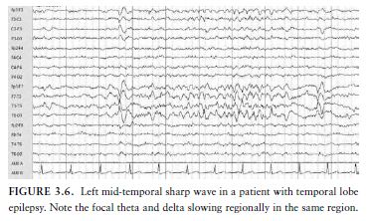
Abnormal EEG
Sharp waves: 70 to 200 m sec
Spikes: very frequently negative polarity and 20 to 70 m sec.
Combinations of IEDs often occur in the same patient at different times.

Slide 13
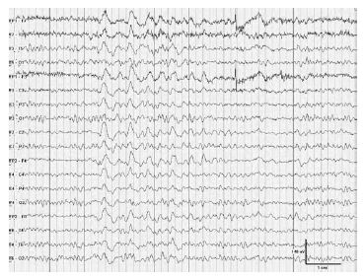
Activation procedures
Activation procedures: They let us to trigger (induce) abnormalities mostly seizures.
Hyperventilation
Perform for 3 to 5 minutes to create cerebral vasoconstriction
Normally produces theta and delta in frontal, high amplitude, and effects within 1 minute.

Slide 14
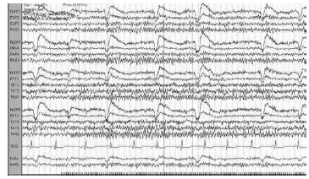
Activation procedures
Intermittent photic stimulation
Greatest in the occipital location
Alpha rhythm in occipital regions, when the eyes are closed

Slide 15
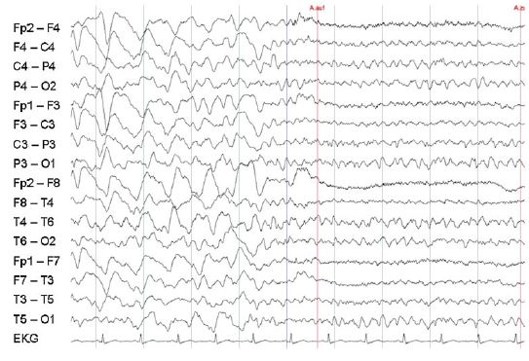
PRES
Posterior reversible encephalopathy syndrome (PRES)
Also known as reversible posterior leukoencephalopathy syndrome (RPLS)
Characterized by headache, visual disturbances, seizures, and radiological findings of edema (swelling) .
Diffuse theta slowing is the most frequent finding on EEG recordings.

Slide 16
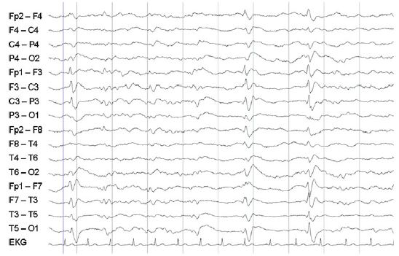
PRES
Posterior reversible encephalopathy syndrome (PRES)
Also known as reversible posterior leukoencephalopathy syndrome (RPLS)
They may also have delta slowing and rhythmic delta activity.
Epileptic activity of occipital sharp-slow wave but no spikes.

Slide 17
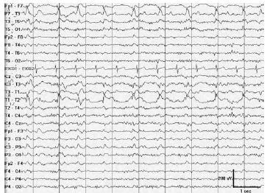
MCA infarct
PLED: Periodic Lateralized Epileptiform Discharge
Acute infarct
If infarct is not acute we have slowing in corresponding regions

Slide 18
Summary
EEG is the most valuable tool in the evaluation of patients with a seizure disorders and stroke.
Both spikes and sharp waves are referred to as interictal epileptiform discharges
Strokes in arteries can be seen on EEG signals.
Most important findings in normal EEG:
Anterior-posterior gradient
2. Posterior dominant rhythm
3. Having symmetric activity
4. Normal sleep architecture

Slide 19
Brief Bibliography, References
[1] Hand book of EEG interpretation ;William O. Tatum, Aatif M. Husain, Selim R. Benbadis, Peter W. Kaplan.
[2] Posterior Reversible Encephalopathy Syndrome: A Review , Pedraza, R; et al
[3] Posterior reversible encephalopathy syndrome (PRES): electroencephalographic findings and seizure patterns, Oliver Kastrup; et al

Slide 20
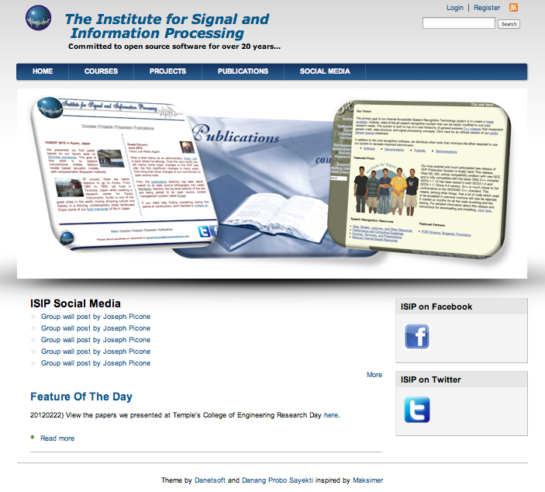
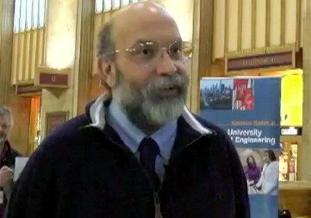
Biography
Joseph Picone received his Ph.D. in Electrical Engineering in 1983 from the Illinois Institute of Technology. He is currently a professor in the Department of Electrical and Computer Engineering at Temple University. He has spent significant portions of his career in academia (MS State), research (Texas Instruments, AT&T) and the government (NSA), giving him a very balanced perspective on the challenges of building sustainable R&D programs.
His primary research interests are machine learning approaches to acoustic modeling in speech recognition. For almost 20 years, his research group has been known for producing many innovative open source materials for signal processing including a public domain speech recognition system (see www.isip.piconepress.com).
Dr. Picone’s research funding sources over the years have included NSF, DoD, DARPA as well as the private sector. Dr. Picone is a Senior Member of the IEEE, holds several patents in human language technology, and has been active in several professional societies related to HLT.

