Slide 1
Status of EEG data
EEG
EEG Report
Process of reorganizing

Slide 2
1. EEG
Defective CD/DVD: ~50, in progress of checking
Uncollected CD/DVD: ?
Uncollected online data: need HDD from TUH or reorganize the drive we have. (2013)
Online data: need to be archived by us or by technician, in progress

Slide 3
New for EEG data converting
System Development Kit(SDK)-Saurav
.e to .edf conversion: new problem found(?)
-raw signal saved
-current montage saved
Calibration part in earlier signal pattern should be ignored(?)

Slide 4
EEG Report
Medical Record Department scans every document and save in the Hospital database as an image file for each paper.
Alpha Imaging system is the main database system.
Access has been denied, but Dr. Jacobson can request the EEG patient document to the main database system. Michael can help to contact the main database system person.

Slide 5
Format of the report
EEG report: final and summary
EEG preliminary report: after 2008, electronic copy existing and Steve’s excel sheet contains the summary of 2011,2012, and partial 2013.
EEG preliminary report: paper copy in electronic form ➔ searching in progress
Test & Impedance report: generated by NicVue and xlsx conversion is possible

Slide 6
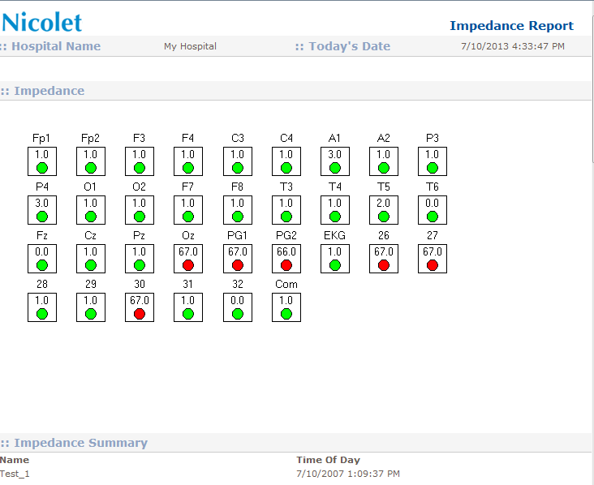
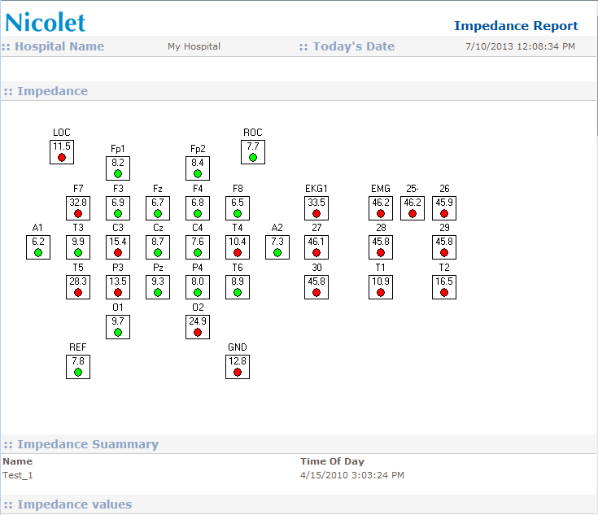
Problem Format of the report
Impedance report: some of the files are not converted to xlsx because of this difference:

Slide 7
Problem Format of the report
EEG report is in image format, .tif.
Conversion is about 80% accuracy without the image tiled on side
Still need to do eye-investigation for the text file from the conversion.
Possible attempt: check the field required for the decision and focus to recover that parts only

Slide 8
3. Process reorganizing
HDD reorganizing:.
EEG 000 (~700 GB) + EEG 001(~700GB)
;Image of the report may be contained in
doc folder separately
;Organized by name (plan) of them
EEG 002 (even) and EEG 003 (odd) contains all information from original to data before de-identification

Slide 9
Final directory structure (before de-identification)
Directory structure:
EEG002>tuh_eeg>data>tuhxxxxxxxx>sxxx>cd########_yyyymmdd
>tuhxxxxxxxx_date_sxxx.e
>tuhxxxxxxxx_date_sxxx.NPA
>tuhxxxxxxxx_date_sxxx> all others
EEG002>tuh_eeg>data>tuhxxxxxxxx>sxxx>edf
>tuhxxxxxxxx_date_sxxx_cxxx.edf
>tuhxxxxxxxx_date_sxxx_rxxx.edf

Slide 10
Final directory structure (before de-identification)
EEG002>tuh_eeg>data>tuhxxxxxxxx>sxxx>report
>tuhxxxxxxxx_date_sxxx_t.mhtml
>tuhxxxxxxxx_date_sxxx_z.mhtml
>tuhxxxxxxxx_date_sxxx_t.xlsx
>tuhxxxxxxxx_date_sxxx_z.xlsx
>tuhxxxxxxxx_date_sxxx_r.tif
>tuhxxxxxxxx_date_sxxx_r.txt

Slide 11
Final directory structure (after de-identification)
Directory structure:
EEG002>tuh_eeg>data>tuhxxxxxxxx>sxxx>edf
>tuhxxxxxxxx_date_sxxx_cxxx.edf
>tuhxxxxxxxx_date_sxxx_rxxx.edf
EEG002>tuh_eeg>data>tuhxxxxxxxx>sxxx>report
>tuhxxxxxxxx_date_sxxx_t.xlsx
>tuhxxxxxxxx_date_sxxx_z.xlsx
>tuhxxxxxxxx_date_sxxx_r.txt

