Slide 1
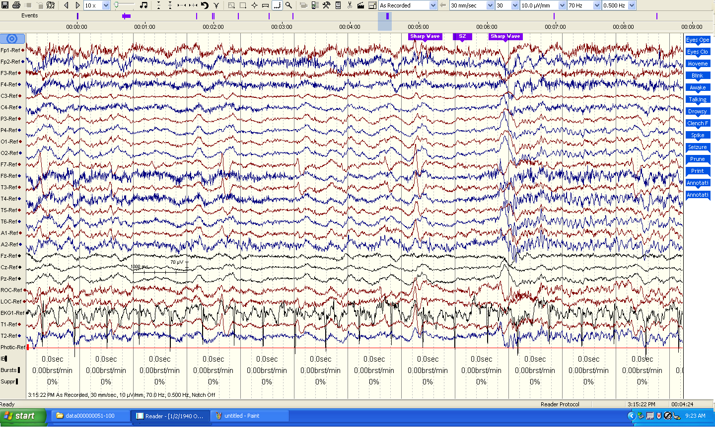
Notable Events
Diagnoses
Sharp Wave
PRES (90%)
Abnormal Asymmetry
Stroke (55%)
Seizure

