Slide 1
Kaldi
Andreson Guimaraes Moura
Jonatas Macedo Soares

Slide 2
What is Kaldi
Open-source toolkit for speech recognition
Important Features
Integration with Finite State Transducers
Extensive linear algebra support
Extensible design
Complete recipes
The toolkit supports:
Feature Extraction
mfcc, plp, cmvn
Acoustic Modeling
Conventional models (gmm, sgmm)
Phonetic Decision Trees
Efficient for arbitrary context sizes
Language Modeling
Any language model that can be represented as an FST
Decoders
C++ class that implements the core decoding algorithm

Slide 3
Data
Resource Management
Clean speech in a medium-vocabulary task consisting of commands to a (presumably imaginary) computer system.
About 3 hours of training data
TIDigits
Men, women, boys and girls reading digit strings of varying lengths
Sampled at 20 kHz

Slide 4
Overview
Run.sh
Data preparation:
Data directory
Lang directory
Feature extraction:
steps/make_mfcc.sh --nj 8 --cmd "run.pl" data/train exp/make_feat/train/ mfcc
Monophone training

Slide 5
Data preparation
local/rm_data_prep.sh /data/isip/data/rm/LDC1993S3A/package/rm_comp/
local : Contains the dictionary for the current data.
train : The data segmented from the corpora for training purposes.
test_* : The data segmented from the corpora for testing purposes.

Slide 6
Data directory
cmvn.scp
feats.scp
reco2file_and_channel
segments <utterance-id> <recording-id> <segment-begin> <segment-end>
spk2utt
text <recording-id> <extended-filename>
Contains the transcriptions of each utterance
utt2spk <utterance-id> <speaker-id>
wav.scp

Slide 7
Lang
utils/prepare_lang.sh data/local/dict '!SIL' data/local/lang data/lang
data/local/dict
extra_questions.txt
lexicon.txt
nonsilence_phones.txt
optional_silence.txt
silence_phones.txt

Slide 8
Lang directory
L.fst
L_disambig.fst
oov.int
oov.txt
phones/
phones.txt
topo
words.txt

Slide 9
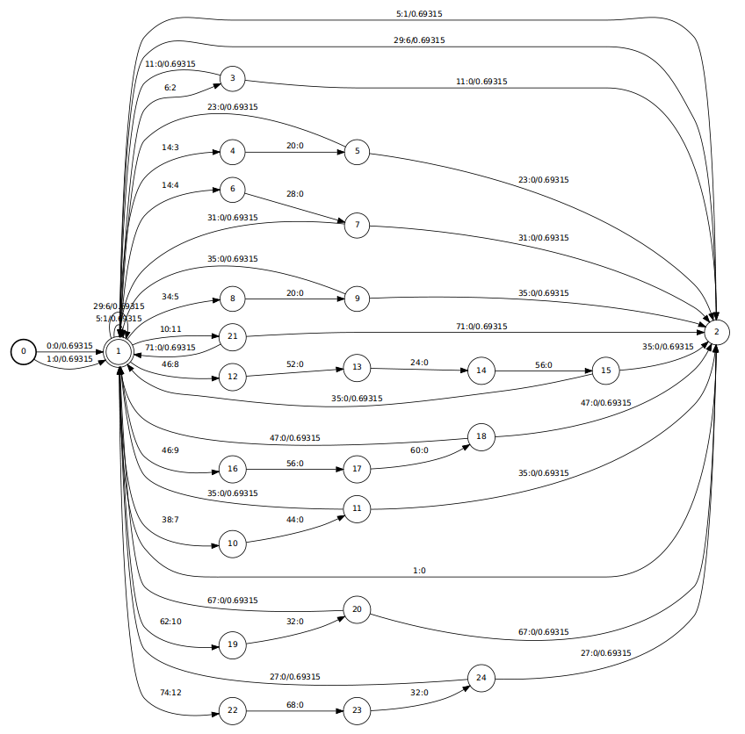
L.fst

Slide 10
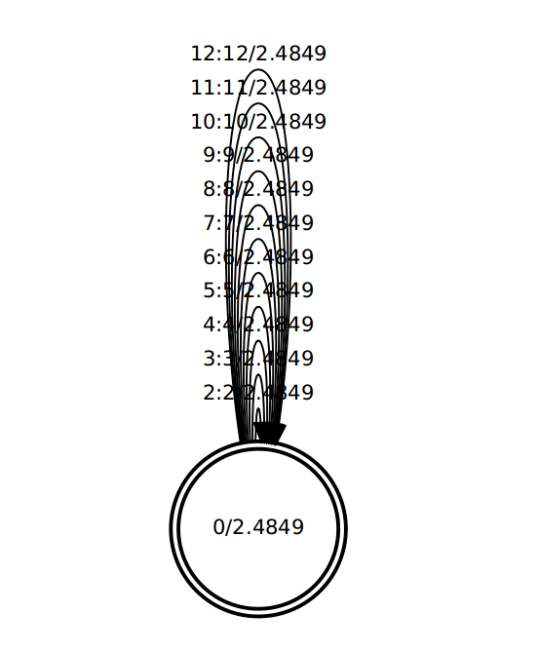
G.fst
local/rm_prepare_grammar.sh

Slide 11
Monophone training
run steps/train_mono.sh --nj 4 --cmd "run.pl" data/train data/lang exp/mono
utils/mkgraph.sh --mono data/lang exp/mono exp/mono/graph
steps/decode.sh --config conf/decode.config --nj 20 --cmd "run.pl" exp/mono/graph data/test exp/mono/decode

Slide 12
Results
Amir's result on Owlsnest | Our result on Owlsnest | Our result on the computer
%WER 8.73 [ 1094 / 12533, 109 ins, 321 del, 664 sub ] exp/mono/decode/wer_3_3.5 | %WER 8.73 [ 1094 / 12533, 109 ins, 321 del, 664 sub ] exp/mono/decode/wer_3_3.5 | %WER 8.77 [ 1099 / 12533, 164 ins, 237 del, 698 sub ] exp/mono/decode/wer_3_0.0
Amir’s result | Our result
%WER 0.37 [ 4 / 1084, 2 ins, 2 del, 0 sub ] exp/mono/decode/wer_7_0.0 | %WER 0.37 [ 4 / 1084, 2 ins, 2 del, 0 sub ] exp/mono/decode/wer_7_0.0
Results on RM
Kaldi documentation:
%WER 8.74 [ 1095 / 12533, 143 ins, 226 del, 726 sub ] exp/mono/decode/wer_2
Results on TIDigits

