Slide 1
Summer research: Weekly Meeting
Francisco Parente, June 22nd 2015

Slide 2
Previous Goals
Perform the baseline experiment;
Annotate awake, asleep, and drowsy in 100 distinct patients;
Start to work on the scripts to recognize Sleep and Non-Sleep States.

Slide 3
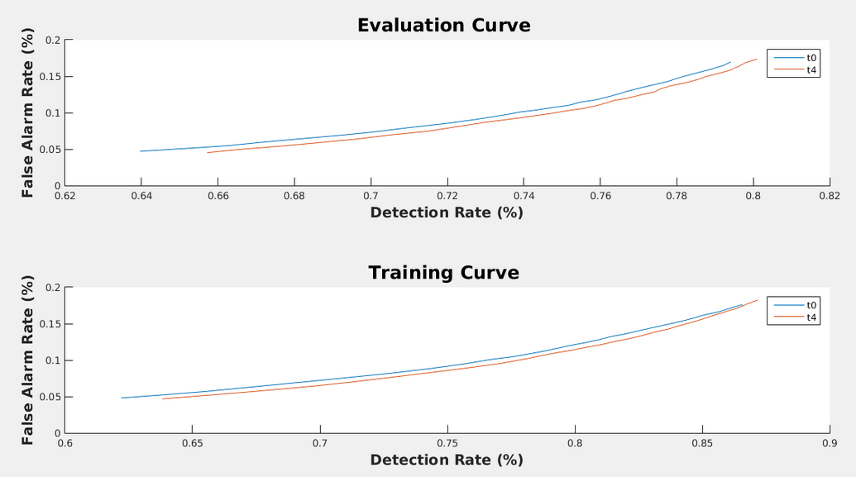
accomplishments
The baseline experiment was replicated successfully.

Slide 4
accomplishments
Study EEGs in order to be able to recognize sleep stages visually, annotating awake, asleep and drowsy.
Lucas Santana and I had to recognize sleep stages visually, annotating awake,
asleep and drowsy. Also, I have collected 500 sessions of patients' EEGs for
Dave in order to perform enough annotations.

Slide 5
Plans for THIS week
Start to work on the scripts to recognize sleep and non-sleep states;
Download and install the Annotator in order to annotate the EEGs (using Dave's observations);
Prepare a presentation to show the features available in EEGLab and EDFbrowser.

