Slide 1
Summer research: Weekly Meeting
Francisco Parente, June 29th 2015

Slide 2
Previous Goals
Download and install the Annotator in order to annotate the EEGs using Dave's notes;
Start to work on the scripts to recognize sleep and non-sleep states;
Prepare a presentation to show the features available in EEGLab and EDFbrowser.

Slide 3
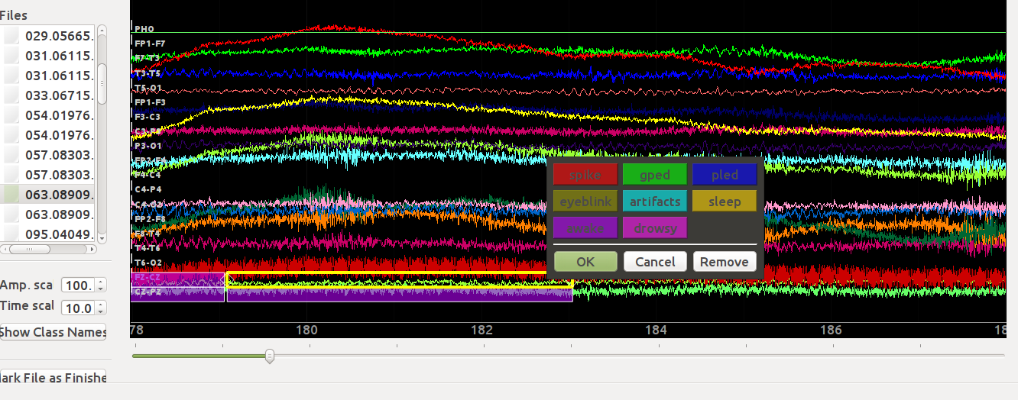
accomplishments
Downloaded and installed the Annotator, annotating the .edf files as shown below:
Prepared a demonstration about EEGLab and EDFbrowser.

Slide 4
Plans for THIS week
Annotate the EEGs using Dave's notes;
Work on the scripts to recognize sleep and non-sleep states;
Accomplish assignments for the MPLPC project.

