Slide 1
Weekly Presentation
Fabricio Teles Dutra Goncalves
06/29/2015

Slide 2
Goals
Fix all problems regarding memory leak in interpolation code.
Integrate the parsing montage code to interpolation code.
Work on feature generation in Kaldi/EEG.
Analyze the files with missing channels and check which channels are missing.

Slide 3
Accomplishments
Parsing montage and interpolation code completely integrated.
All memory leaks fixed.
EDF files with missing channels analyzed.
3,711 files are missing A1 and A2.
1,229 of those files contain SP1 and SP2 standing for sphenoidal electrodes.
2,458 files contain labels such as “EEG 20”, “EEG 21”, “EEG 22”.
24 files do not contain any different label standard.

Slide 4
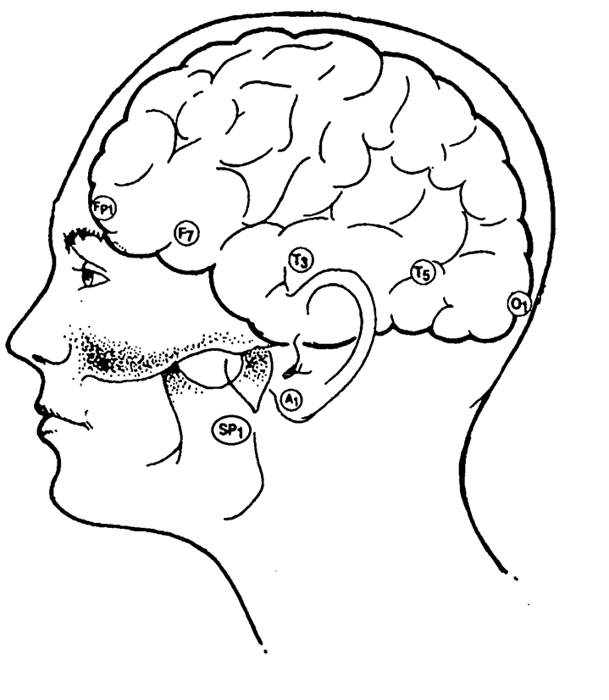
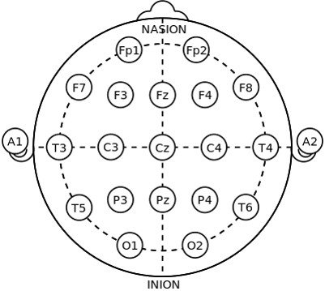
Accomplishments (cont.)

Slide 5
Next Week
Finish to restructure the code for interpolation and check_montage based on the code design review.
Convert HTK format files to Kaldi format files.
Do training with the existing feature files using Kaldi approaches.

