Slide 1
Weekly Report
By: Devin Trejo
Week of June 29, 2015-> July 5, 2015

Slide 2
Previous Goals
Get isip2.piconepress.com responding to http requests.
Finalize a hardware configuration for the cluster
Resolve python dependencies and run exp22 on the cluster to test hardware resource draw for training.
Budget Management
NEDC Corpus

Slide 3
Accomplishments
ISIP Website: No real accomplishment
The website still is awaiting Dave Hart security approval. There is a ticket submitted to help push him along and get to our issue.
He is holding us up. Picone needs the computer visible outside the network to forward a domain (isip2.piconepress.com) to the static ip 129.32.60.54. To make the computer visible outside the network we need security approval.

Slide 4
Accomplishments (cont.)
Kernel Currupted.
Good news is I installed the cluster environment in little over a day
RDC IDMAP – UID consistently and SSH access
After a fresh install I tried running exp_0022 again but I'm still running into module errors:
File "/data/isip/tools/common/anaconda/lib/python2.7/site-packages/numpy/core/__init__.py", line 14, in <module>
File "/data/isip/exp/tuh_eeg/exp_0022/scripts/gen_feats_deltas.py", line 32, in <module>
File "/data/isip/research/auto_eeg/python/current/modules/htkmfc.py", line 15, in <module>
File "/data/isip/tools/common/anaconda/lib/python2.7/site-packages/numpy/__init__.py", line 170, in <module>
File "/data/isip/tools/common/anaconda/lib/python2.7/site-packages/numpy/add_newdocs.py", line 13, in <module>
File "/data/isip/tools/common/anaconda/lib/python2.7/site-packages/numpy/lib/__init__.py", line 8, in <module>
File "/data/isip/tools/common/anaconda/lib/python2.7/site-packages/numpy/lib/type_check.py", line 11, in <module>
File "/data/isip/tools/common/anaconda/lib/python2.7/site-packages/numpy/core/__init__.py", line 14, in <module>
File "/data/isip/exp/tuh_eeg/exp_0022/scripts/rescore_p1_elab.py", line 21, in <module>
ImportError: No module named autoeeg
File "/data/isip/exp/tuh_eeg/exp_0022/scripts/rescore_p1_conf.py", line 23, in <module>
ImportError: No module named autoeeg
File "/data/isip/exp/tuh_eeg/exp_0022/scripts/rescore_p1_det.py", line 22, in <module>
ImportError: No module named autoeeg

Slide 5
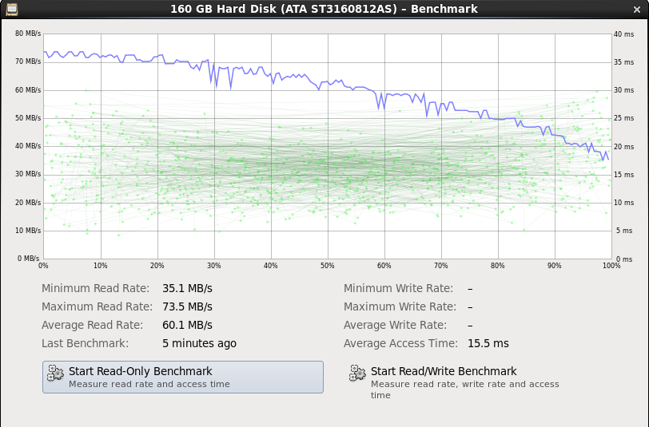
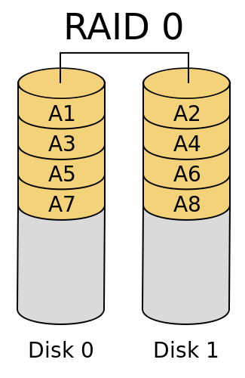
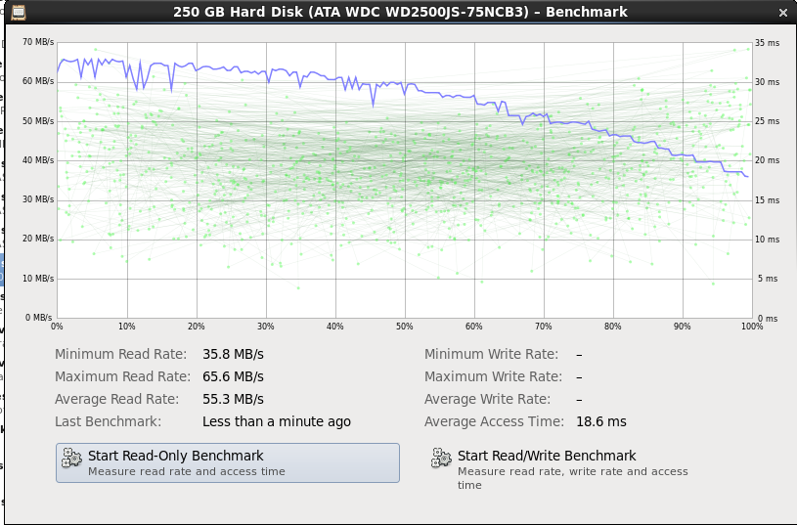
Accomplishments (cont.)
I looked at IO performance on the cluster. Raid0 vs dsk2 comparison

Slide 6
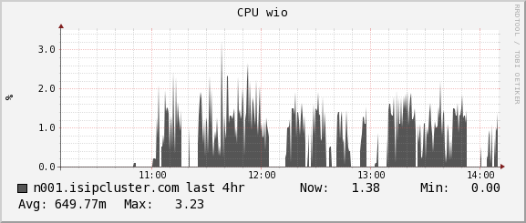
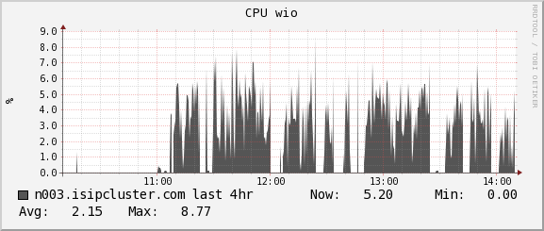
Accomplishments (cont.)
Result:

Slide 7
Accomplishments (cont.)
WE2 WorkShop
Worked with Silvia/Gabriella in preparing for Monday's WE2 workshop.
Budget
Did a first impression analysis on compensation wages.

Slide 8
New Goals
WE2 Workshop
Isip security cleared and domain name responding on world wide web.
Purchase hardware for cluster!?
Create a list of compensation budget management issues that need to be address.
Finish 2014 NEDC Corpus.

