Slide 1
Weekly Presentation
Fabricio Teles Dutra Goncalves
07/20/2015

Slide 2
Goals
Design review for Fe class.
Do training with the existing feature files using Kaldi approaches.
Perform experiments with interpolation functionality.
Create first draft of poster (Generation of Missing EEG Channels Using Spatial Interpolation).

Slide 3
Accomplishments
Training was done with the existing HTK feature files using Kaldi approach
Scripts were created to help with data preparation and feature extraction of segments
We got 6.51% of error rate after running recognition over training data
Performed experiment regarding interpolation functionality
Recognition was run using evaluation data from experiment 22
A channel from each evaluation EDF file was replaced by new interpolated signals
Error Rate:
 | Original Channels | Interpolated Channels
Error Rate | 33.23% | 33.80%

Slide 4
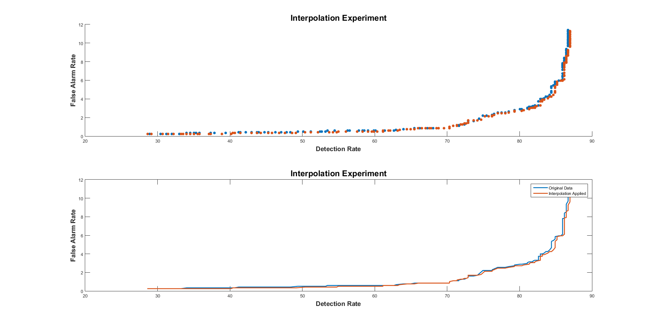
Accomplishments (cont.)
Interpolation Experiment DET Curve

Slide 5
Next Week
Run Recognition in Kaldi using evaluation EEG data.
Document all the work we had to get the data prepared for Kaldi and to get training running.
Perform experiments with interpolation functionality.
Finish the poster and print it.

