Slide 1
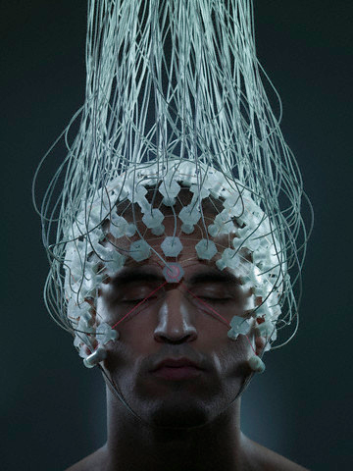
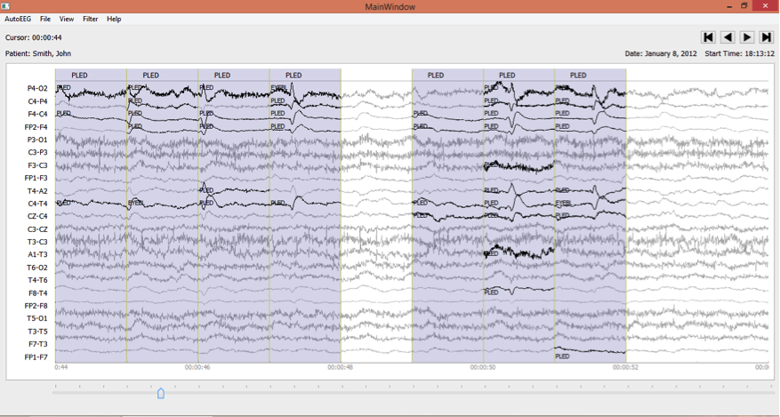
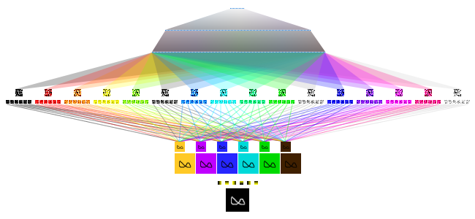

Signal Modeling
Using
Deep Neural Networks
Seyedeh Saeedeh Khoshgoftar Ziyabari
saeedeh@temple.edu
Neural Engineering Data Consortium
College of Engineering
Temple University
February 2016

Slide 2
Abstract
Deep neural networks are becoming a fundamental component of high performance speech recognition systems.
Performance of deep learning based systems (DNN) has recently exceeded that of their Gaussian mixture model (GMM) counterparts in acoustic modeling.
In this talk, we will review high performance deep learning systems that are used for signal modeling:
  Deep Neural Network (DNN)
  Convolutional Neural Network (CNN)
  Joint DNN/CNN
  Recurrent Neural Network (RNN)
  Joint RNN/CNN
  Using Deep Learning for analysis of EEG data
Notes:
IBM Speech Recognition Approaches:

Slide 3
Artificial Neural Networks
Artificial neural networks are inspired by biological neural networks.
Artificial neural networks are generally presented as systems of interconnected neurons which exchange messages.
The connections have numeric weights (W) that can be tuned based on experience, making neural nets adaptive to inputs and capable of learning.
g: activation function (ReLU, Sigmoid, and tanh)
Notes:
The activation function is a nonliear function which maps input to output.

Slide 4
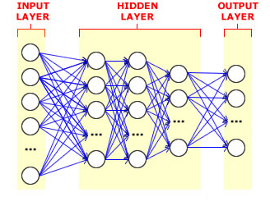
Deep Neural Networks (DNN)
Deep neural networks are a network with two or more hidden layers:

Slide 5
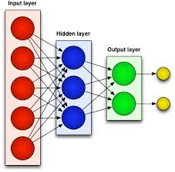
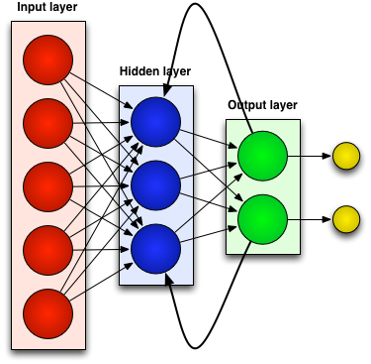
Types of Deep Neural Networks
Feed-forward Neural Network:
  Connections between the units do not form a cycle.
  Convolutional Neuron Network (CNN): is formed by
  a stack of distinct layers that transform the input
  volume into an output volume through a differentiable
  function in order to find the set of locally connected
  neurons.
  Deep Belief Network (DBN): graphical models which learn to extract a deep hierarchical representation of the training data.
Recurrent Neural Network (RNN):
  Connections between units form a cycle. This
  creates an internal state of the network which
  allows it to exhibit dynamic temporal behavior.

Slide 6
DNN Training
Training: find network parameters that minimize the error between true training labels and estimated labels.
Feed Forward Training:
  Back-Propagation:
    minimizing the loss function with respect to network parameters by using optimization methods like stochastic gradient decent (SGD), gradient decent (GD) and Hessian free.
    A commonly used loss function is cross-entropy:
N: the number of training examples.
y: the prediction of the network.
y_{l}: true label.
Recurrent Neural Network:
  Back-propagation Through Time: As the parameters that are supposed to be learned (U, V and W) are shared by all time steps in the network, the gradient at each output depends not only on the calculations of the current time step, but also the previous time steps.
Notes:
The w will be update according to the difference value between actual value and the desire target distribution.
DNN are train to optimize a objective function
Training is optimizing the a given objective function.

Slide 7
Convolutional Neural Network (CNN)
A CNN architecture is formed by a stack of distinct layers that transform the input volume into an output volume through a differentiable function in order to find the set of locally connected neurons. A few distinct types of layers are commonly used.
  Convolutional layer:
    The layer's parameters consist of a set of filters (weights).
    During the forward pass, each filter is convolved across the input, computing the dot product between the entries of the filter and the input is producing an activation map of that filter.
  Pooling layer: It is a form of nonlinear downsampling. Pooling partitions the input into a set of non-overlapping rectangles and, for each such sub-region, outputs the maximum/average value.
Notes:
Pooling reduce the spectral variance .
Neural network with specialized connectivity structure
•Stack multiple stages of feature extractors
•Higher stages compute more global, more invariant features

Slide 8

DNN VS CNN
DNN forgets the input topology while CNN does not.
Unlike DNN, CNN reduces translation variance with fewer parameters.

Slide 9
Joint CNN/DNN:
To improve speech recognition performance of DNN we usually use these techniques:
  Feature-space Maximum Likelihood Linear Regression Features (fMLLR): a popular speaker-adaptation technique that is a set of linear transformation matrices that transforms the model parameters and maximizes the likelihood of the adaptation data.
  Speaker identity vector (I-Vector): encapsulates relevant information about speaker’s identity in a low-dimensional feature vector.
These techniques cannot be applied to CNN as it require features which obey a frequency (and time) locality property which fMLLR and I-Vector do not have.
Since these techniques cannot be applied to CNN, a joint CNN/ DNN has been introduced.
  Issue: They do not have frequency and time locality property.
Notes:
FMLLR is a popular speaker-adoption technique used to reduced variability of speech due to different speakers.
is commonly used features for speaker verification and speaker recognition applications as they encapsulate relevant information about speaker’s identity in a low-dimensional feature vector.
The performance of system will be increase by using speaker adopted features which do not display locality in frequency.
I-vector is commonly used features for speaker verification and speaker recognition applications as they encapsulate relevant information about speaker’s identity in a low-dimensional feature vector.

Slide 10
Joint DNN/CNN Structure
The joint CNN/DNN uses full weight sharing (FWS) with 2 convolutional layers.
The filter size for the first layer is 9*9 and 4*3 for the second layer.
4 fully connected neuron network with 1024 units and 512 output.
A Joint CNN/DNN Architecture
Notes:
Limit and full weight sharing:
As behavior of speech feature in Low and high frequency is different. They chose two different weight for a signal.
It can not work well for many layer of convolutional layers.
Each limited filter spans is small so extra convolution on the output of this region would not helpful.
As the locality between the these regions are removed we can not perform convolution with filter output across different local region.

Slide 11
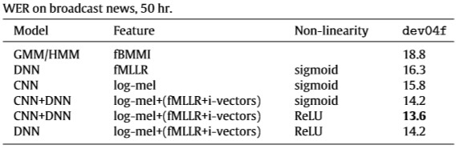
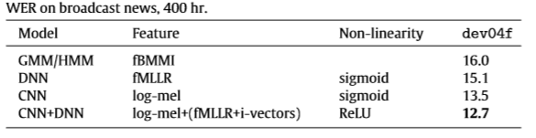
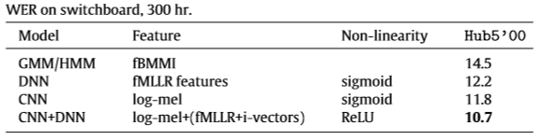
Joint CNN/DNN Performance
Notes:
As you can see here we have an interesting tables which the compares the performance of different deep learning structures with each other.

Slide 12
The IBM Joint DNN/CNN
The first layer is specific (CNN or DNN), the remaining layers are shared.
10.5% WER on 300 hours of Switchboard.
CNN
DNN
IBM’s Joint CNN/DNN Model
Notes:
IBM research group have been focused on IBM recently.

Slide 13
Recurrent Neural Network (RNN)
Neural networks are referred to as “recurrent” when they receive inputs, update the hidden states depending on the previous computations, and make predictions for every element of a sequence.
Neural networks with memory as they retain information of what has been processed so far.
Powerful dynamic systems for sequence tasks.
They can maintain a state vector that implicitly contains information about the history of all the past elements of the sequence.
Notes:
How it will be trained.

Slide 14
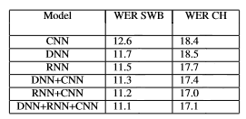
A Joint RNN/CNN Proposed By IBM
First layer is a recurrent neural network (RNN.
This is followed by 4 non-recurrent hidden layers.
Comparison of word error rates for CNN, DNN, RNN and joint models:
RNN

Slide 15
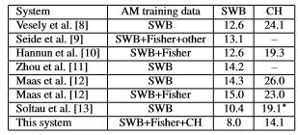
Performance Analysis of a Joint RNN/CNN System
Class-base language model which consists of two separate components:
The first is a n -gram which models the sequence of classes.
The second is a class map with associated word counts.
The error rate of the proposed RNN/CNN model is 8% on SWB and 14.1% Call Home (CH) after using the class-based exponential model.

Slide 16
Electroencephalograms (EEGs)
Electroencephalograms (EEGs) are used in a wide range of clinical settings to record electrical activity along the scalp.
EEGs are the primary means by which neurologists diagnose brain-related illnesses such as epilepsy and seizures.
Manual review of an EEG by a neurologist is time-consuming and tedious.
A clinical decision support tool that automatically interprets EEGs can reduce time to diagnosis, reduce error and enhance real-time applications such as ICU monitoring.
EEG classification using Convolutional Deep Belief Network (CDBN) and Compare the result with the other state- of- art feature extraction methods.
Notes:
As the electroencephalographic (EEG) data is high dimensional and multichannel, convolutional deep belief network is applied to the feature learning of EEG data.

Slide 17
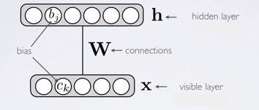
Restricted Boltzmann Machines (RBM)
It is one type of unsupervised learning neural network.
Unsupervised learning means only use input (training set) for learning.
Automatically extract meaningful features for your data which is more explicit .
It is a non-directional graphical model:
    Consists of visible and hidden layers.
    Finds a distribution over the input vector (x) and model the distribution of those vectors of the training data using the hidden layer (h) .
Notes:
For instance what class the input belongs to or make it more easier to make prediction about our data what we may interested to know.
Add a data-dependent regularization to training.
Modeling of distribution over x involves some some latent varibales in hidden units.

Slide 18
Restricted Boltzmann Machines (RBM)
Energy of configuration:
    h_{j}: Hidden unit
    x_{k}: visible unit
    c_{k}: hidden node bias
    b_{j}: visible node bias
    W: connection matrix
Probability distribution:
    Z: normalization function
Notes:
Training : the double expectation should be calculated that it hard to compute so the alternative solution was proposed by hinton on 2002 which is called contrastive divergence
P(hj=1|x)>u[0,1]-> 1 otherwise 0
P(h_{j} = 1|x) = sigmoid(W’_{j} x + b_{j}) = 1/(1+e^{-net(hi)})
b_{i} : hidden node bias
P(x_{k} = 1|h) = sigmoid(W‘_{k} h + c_{k}) = 1/(1+e^{-net(xi)})
c_{k} : visible node bias

Slide 19
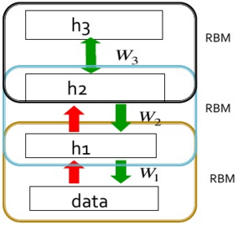
Deep Belief Networks (DBN)
Deep Belief Network (DBN): stack several RBMs together.
DBNs can be trained by a greedy layer-wise approach:
  Train first layer using your data without the labels (unsupervised).
  Freeze the first layer parameters and start training the second layer using the output of the first layer as the unsupervised input to the second layer.
  Use the outputs of the final layer as inputs to a supervised layer/model and train the last supervised layer(s) (leave early weights frozen).
  Unfreeze all weights and fine tune the full network by training with a supervised approach, given the pre-processed weight settings.
Notes:
One answer is greedy layer-wise training
Train first layer using your data without the labels (unsupervised)
2.Then freeze the first layer parameters and start training the second layer using the output of the first layer as the unsupervised input to the second layer
3Use the outputs of the final layer as inputs to a supervised layer/model and train the last supervised layer(s) (leave early weights frozen)
Unfreeze all weights and fine tune the full network by training with a supervised approach, given the pre-processed weight settings

Slide 20
Convolutional Deep Belief Networks (CDBN)
A Convolutional Deep Belief Network (CDBN) is composed of multiple layers of convolutional restricted Boltzmann machine.
A convolutional restricted Boltzmann machine(CRBM) is a combination of a restricted Boltzmann machine (RBM) and convolutional neural network concepts.
It contains L and K groups of visible and hidden layers respectively.
CRBM
CRBM

Slide 21
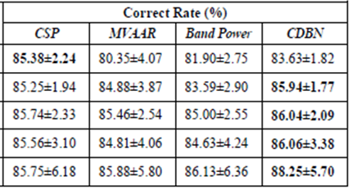
Convolutional Deep Belief Networks (CDBN)
Convolutional Deep Belief Networks have the best performance for feature learning in EEG signal processing:
Mean Classification Accuracy For Different Features

Slide 22
Conclusions and Future Work
Compared and contrasted the different types of feed forward neural networks including convolutional neural networks (CNN) and deep belief networks (DBN) and joint models (CNN/DNN).
A recurrent neural network (RNN) and joint model network (RNN/CNN) were introduced.
Future work:
  Plans to implement CNN and DBN for EEG analysis.
  The performance of join structures such as CNN/RNN and CNN/DNN on both of the speech recognition and EEG classification task will be explored.

Slide 23
Brief Bibliography
[1] G. Hinton, L. Deng, D. Yu, G. E. Dahl, A. Mohamed, N. Jaitly, A. Senior, V. Vanhoucke, P. Nguyen, T. N. Sainath, and B. Kingsbury, “Deep Neural Networks for Acoustic Modeling in Speech Recognition,” IEEE Signal Process. Mag., no. November, pp. 82–97, 2012.
[2] O. Abdel-Hamid, A. R. Mohamed, H. Jiang, and G. Penn, “Applying convolutional neural networks concepts to hybrid NN-HMM model for speech recognition,” in ICASSP, IEEE International Conference on Acoustics, Speech and Signal Processing - Proceedings, 2012, pp. 4277–4280.
[3] Y. LeCun and Y. Bengio, “Convolutional Networks for Images, Speech, and Time-Series,” Handb. brain theory neural networks, p. 255, 1995.
[4] Y. LeCun, L. Bottou, Y. Bengio, and P. Haffner, “Gradient-based learning applied to document recognition,” Proc. IEEE, vol. 86, no. 11, pp. 2278–2323, 1998.
[5] Y. LeCun, F. J. Huang, and L. Bottou, “Learning methods for generic object recognition with invariance to pose and lighting,” Proc. 2004 IEEE Comput. Soc. Conf. Comput. Vis. Pattern Recognition, 2004. CVPR 2004., vol. 2, pp. 97–104, 2004.
[6] T. N. Sainath, B. Kingsbury, G. Saon, H. Soltau, A. rahman Mohamed, G. Dahl, and B. Ramabhadran, “Deep Convolutional Neural Networks for Large-scale Speech Tasks,” Neural Networks, vol. 64, pp. 39–48, 2015.
[7] B. Kingsbury, T. Sainath, and H. Soltau, “Scalable minimum Bayes risk training of deep neural network acoustic models using distributed hessian-free optimization,” Proc. Interspeech, pp. 1–4, 2012.
[8] T. N. Sainath, B. Kingsbury, A. R. Mohamed, G. E. Dahl, G. Saon, H. Soltau, T. Beran, A. Y. Aravkin, and B. Ramabhadran, “Improvements to deep convolutional neural networks for LVCSR,” in 2013 IEEE Workshop on Automatic Speech Recognition and Understanding, ASRU 2013 - Proceedings, 2013, pp. 315–320.
[9] G. E. Dahl, T. N. Sainath, and G. E. Hinton, “Improving deep neural networks for LVCSR using rectified linear units and dropout,” in ICASSP, IEEE International Conference on Acoustics, Speech and Signal Processing - Proceedings, 2013, pp. 8609–8613.
[10] G. Saon, H.-K. J. Kuo, S. Rennie, and M. Picheny, “The IBM 2015 English Conversational Telephone Speech Recognition System,” Interspeech 2015, pp. 3–7, 2015.
[11] Y. Ren and Y. Wu, “Convolutional deep belief networks for feature extraction of EEG signal,” 2014 Int. Jt. Conf. Neural Networks, pp. 2850–2853, 2014.
[12] H. Lee, R. Grosse, R. Ranganath, and A. Y. Ng, “Convolutional deep belief networks for scalable unsupervised learning of hierarchical representations,” Proc. 26th Annu. Int. Conf. Mach. Learn. ICML 09, vol. 2008, pp. 1–8, 2009.

