Slide 1
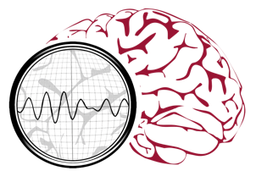
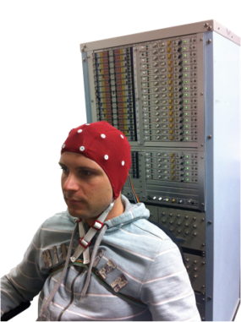
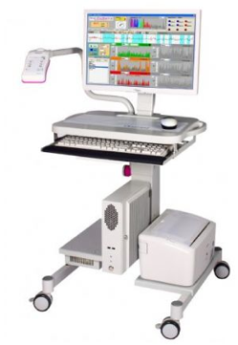
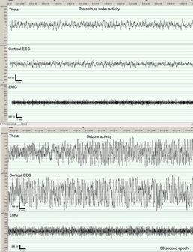
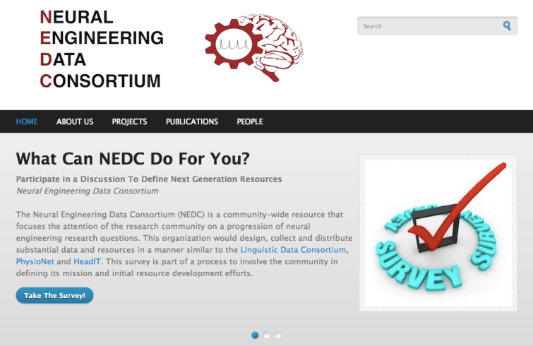
The Neural Engineering Data Consortium
Mission: To focus the research community on a progression of research questions and to
generate massive data sets used to address those questions. To broaden participation by making
data available to research groups who have significant expertise but lack capacity for data generation.
Impact:
  Big data resources enables application of state of the art machine-learning algorithms
  A common evaluation paradigm ensures consistent progress towards long-term research goals
  Publicly available data and performance baselines eliminate specious claims
  Technology can leverage advances in data collection to produce more robust solutions
Expertise:
  Experimental design and instrumentation of bioengineering-related data collection
  Signal processing and noise reduction
  Preprocessing and preparation of data for distribution and research experimentation
  Automatic labeling, alignment and sorting of data
  Metadata extraction for enhancing machine learning applications for the data
  Statistical modeling, mining and automated interpretation of big data
  To learn more, visit www.nedcdata.org

Slide 2
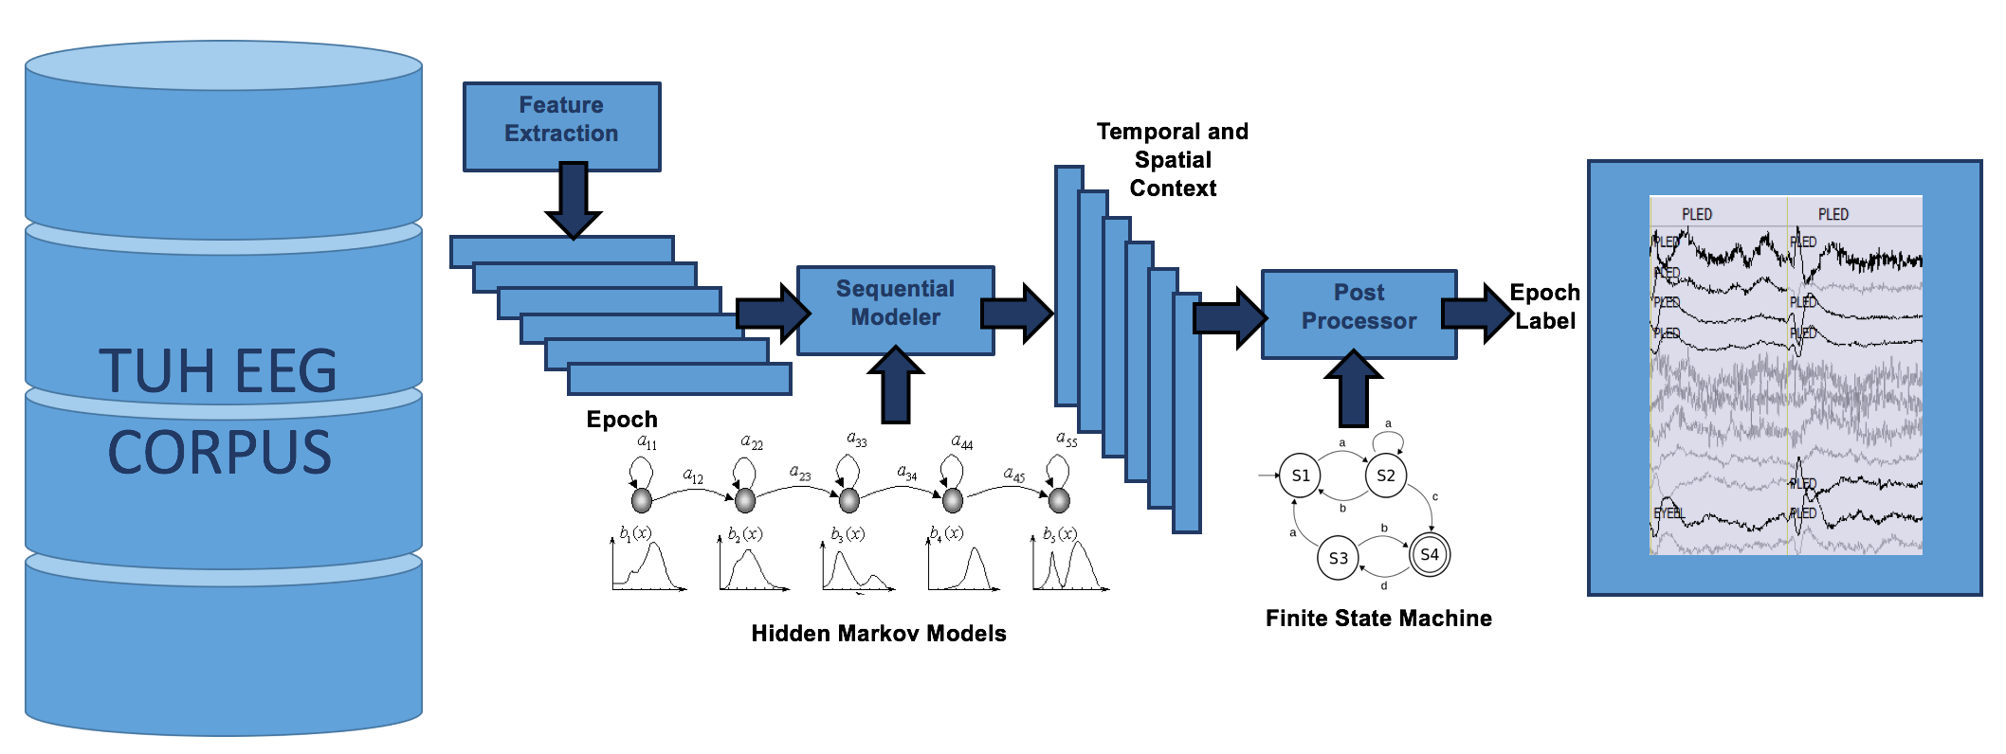
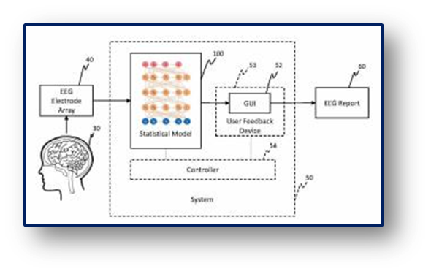
Biosignal Analytics Inc.
Mission: We are dedicated to improving the quality of healthcare through the use of automated
interpretation technology based on state of the art machine learning algorithms. We leverage big data resources to train sophisticated models capable of self-organizing information and discovering underlying structure.
Impact:
  Reduces time required for clinicians to make appropriate treatment decisions
  Automated seizure detection with real-time alerts of seizure events during long-term and continuous EEG monitoring are beneficial in optimizing treatment using antiepileptic drugs.
  High performance real-time detection of critical EEG events in an ICU setting will increase the use of brain monitoring in critical care.
  Transforming big and fast data into actionable information.
  Enabling dense data such as EEGs to be searchable by content.
  Powerful sequential modeling based on unique big data resources.
Expertise:
  Machine learning applied to healthcare applications that demand cost-effective and robust solutions.
  Automated analysis of dense data such as EEGs, MRIs and other biological signals.
  Normalization of and Information extraction from unstructured text.
  Unification of dense data and text into a single comprehensive decision support structure.
  User-centric design that maximizes the return on investment through productivity enhancement.
  To learn more, visit www.biosignalanalytics.com

