Slide 1
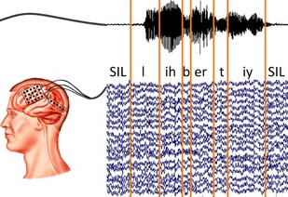
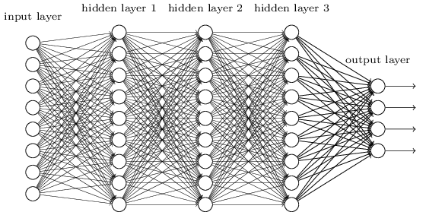
Kaldi Adaptation for EEG event classification
EEG Segments
Vinit Shah & Joseph Picone
Neural Engineering Data Consortium
Temple University

Slide 2
Outline
Introduction to EEGs and various seizure morphologies
Seizure data and feature extraction
Comparison between Kaldi and AutoEEG models
Performance of the DNN systems
Error analysis on results

Slide 3
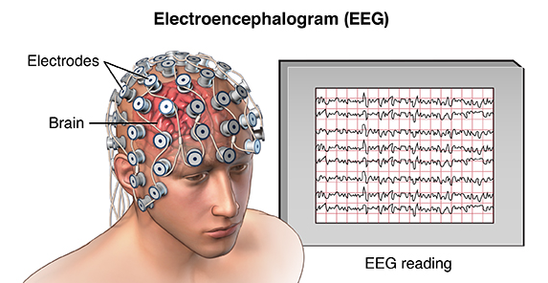
What is an EEG ?
Electroencephalography (EEG) is a popular tool used to diagnose brain related illnesses.
Scalp Electroencephalogram (EEG) monitoring is a non-invasive and convenient method to assess electrical activity from brain.
Interpretation of EEGs is challenging, and its accurate annotation requires extensive training
For diagnosis, clinicians also use information such as patient’s video recordings, medical history, age, environmental & physiological changes.

Slide 4
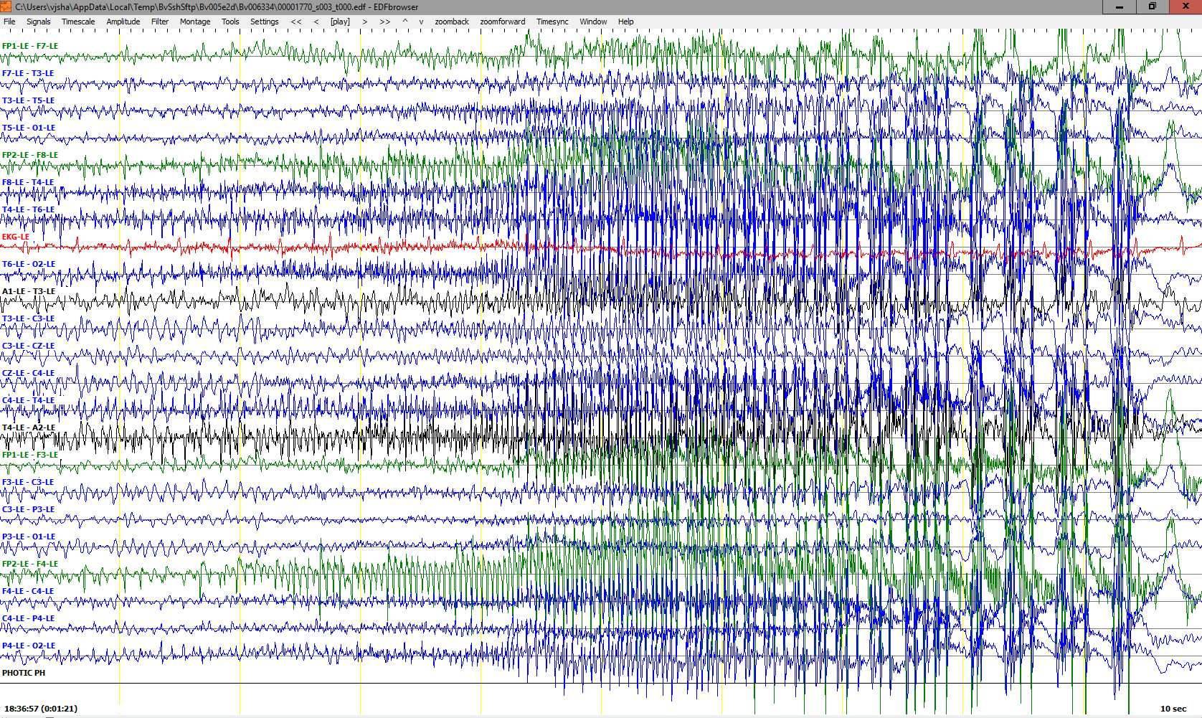
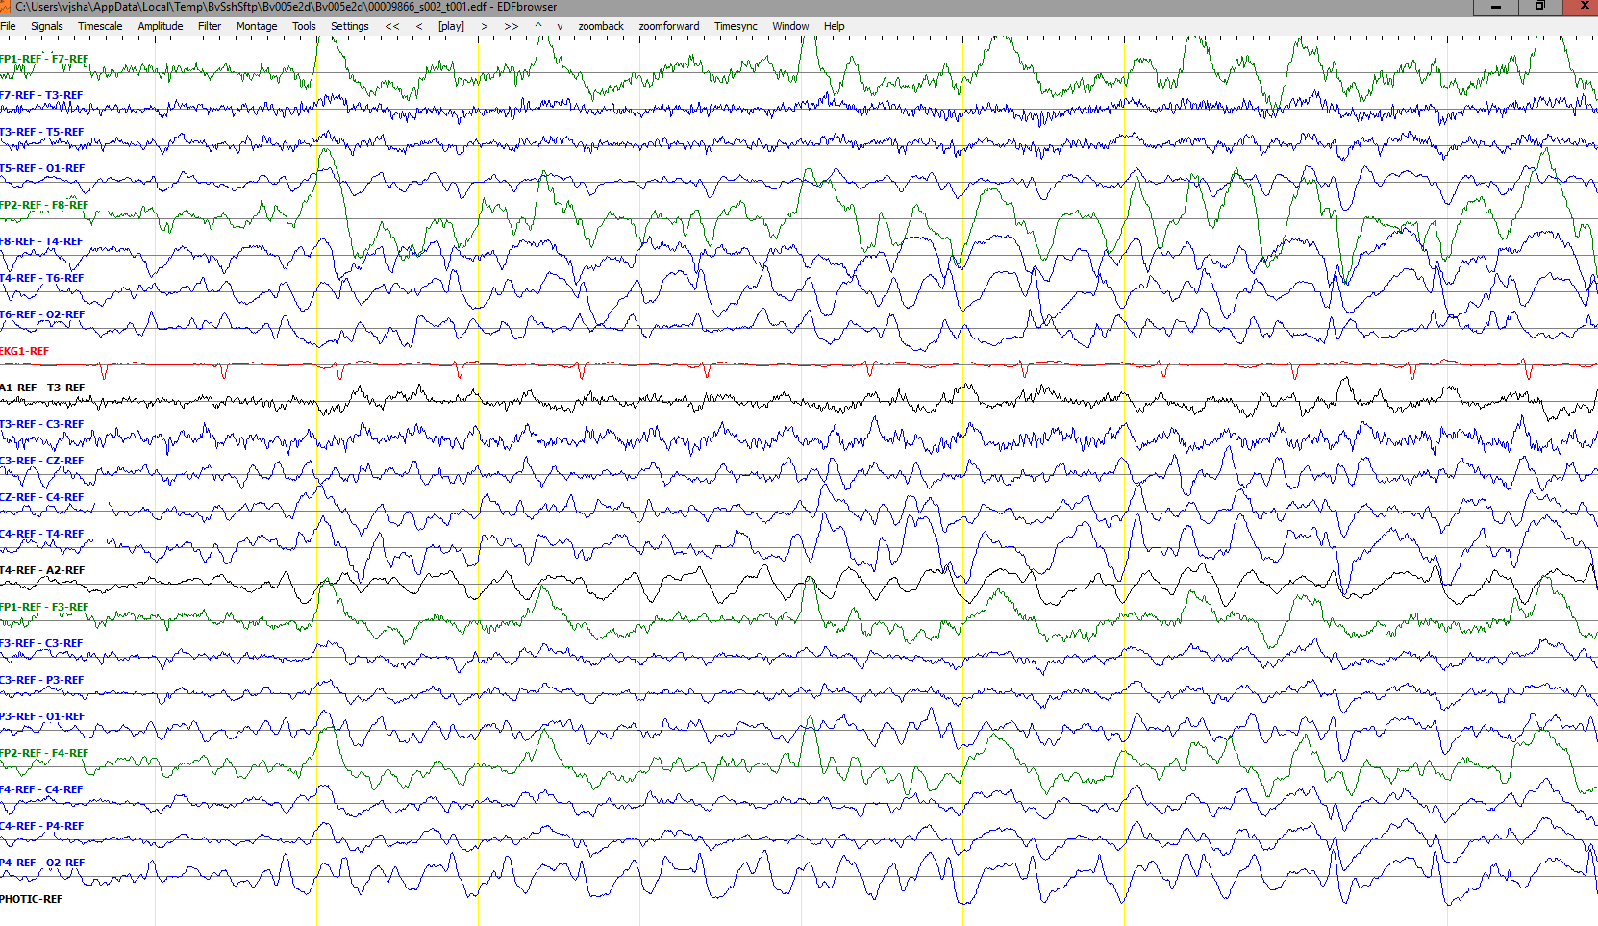
Seizure morphologies
Electrographic seizures can be detected either by observing epileptiform activities or by observing artifacts related to specific types of seizures.
There are multiple types of seizures (i.e. tonic-clonic/grand mal, absence/petit mal, complex-partial)
Interpretation of focal seizures require temporal as well as sufficient level of spatial information.
Typically interpreters look for epileptiform activity such as spike and wave discharges and its evolution over time.
Easy seizures show clear evolution in signal’s frequency and amplitude.

Slide 5
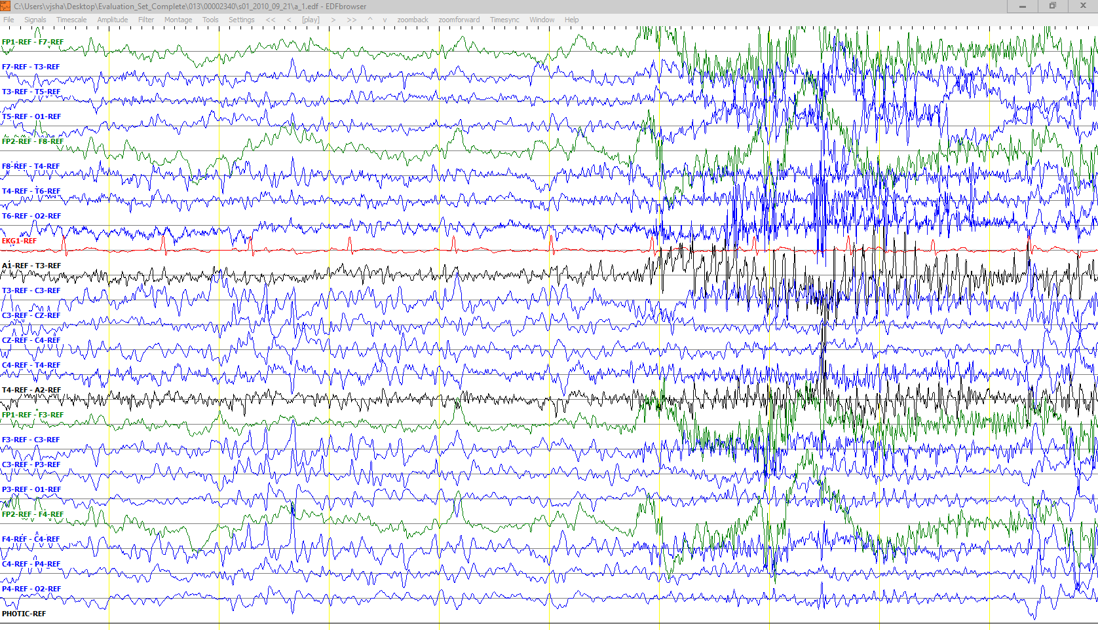
Inconclusive segments
Some EEG records are very challenging and show wide spread epileptiform features along with artifacts (i.e. Shivers). Obscured patterns as such could also make interpretation inconclusive.
There are specific rules implemented by American Clinical Neurophysiology Society (ACNS) for diagnosis of patients with epilepsy.
Accurate onset and offset detection of an ictal is, in many cases, subjective which encourages us to use Any-Overlap method for scoring.
Shivers
Epileptiform Activity

Slide 6
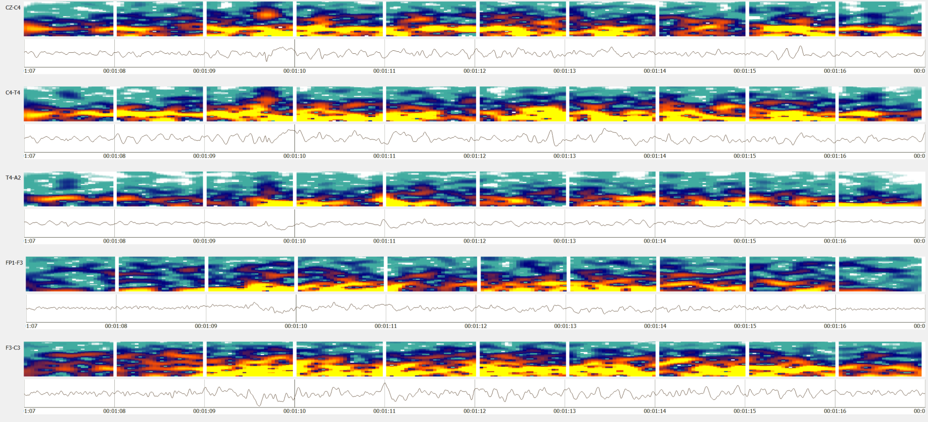
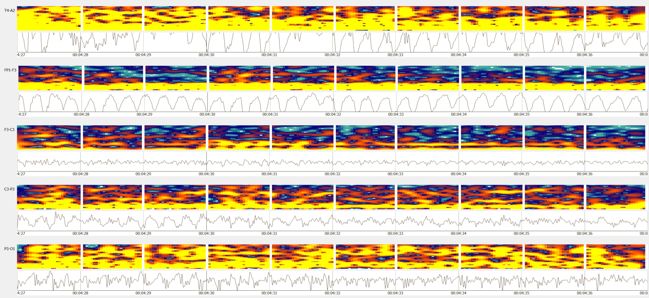
Spectral properties of an ictal
Seizures usually occur within the range of 2.5 to 25 Hz.
Seizure duration can last from 3 seconds (absence seizures) to up to days (refractory status epilepticus).
Generalized seizures are easy to spot due to their high energy on specific frequency bands.
Waxing-waning patterns (i.e. Bursts) can be mistakenly identified as ictal.

Slide 7
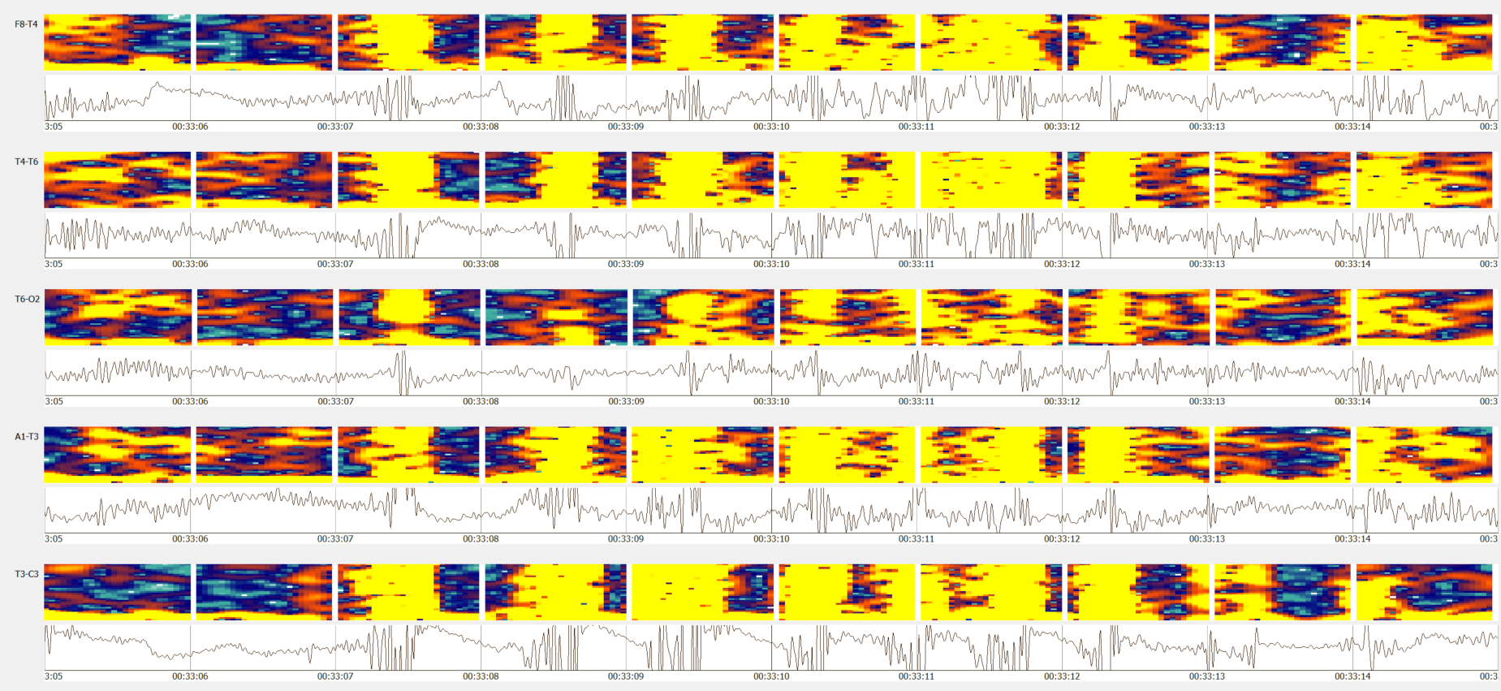
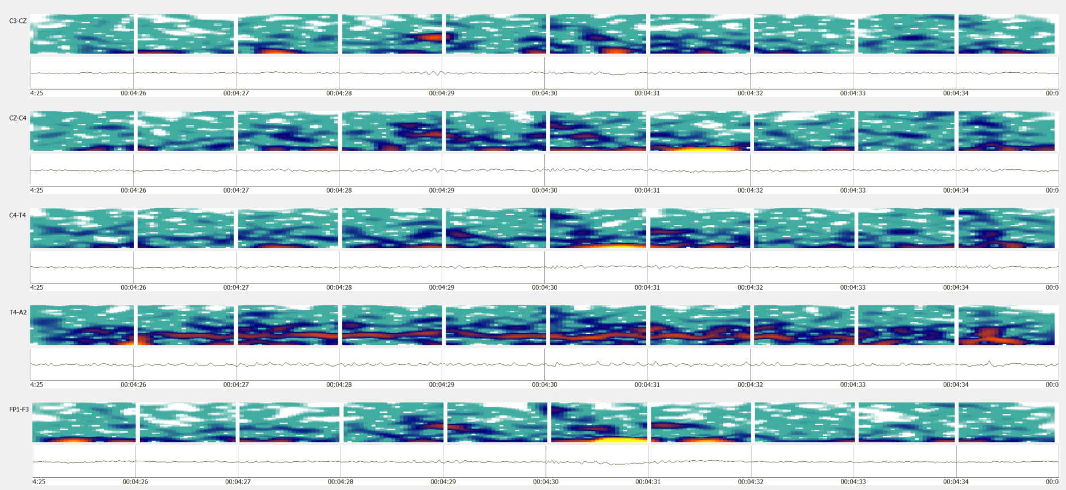
Spectral properties of an ictal
Activities such as chewing resembles features of grand mal and could also be a sign of a complex-partial seizure.
This is usually cross verified from the context/history of the record.
Medication makes it harder to detect seizures.
Subtle seizures such as extremely focal, low energy seizures are wide spread in ICU patients due to their medication.

Slide 8
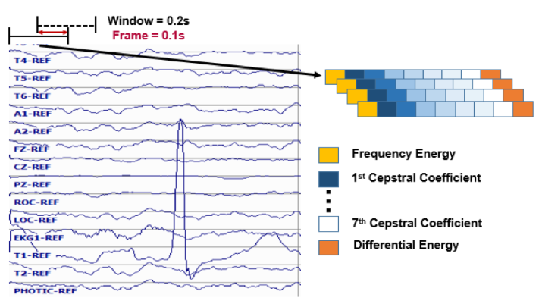
Seizure Data and Feature extraction
TUH EEG Seizure Corpus (v1.2.1) is used to develop our ML models.
The database contains diverse patterns with different type of seizures.
Seizure Corpus | Version 1.2.1
Dataset | Training set |  | Evaluation set
 | w/seiz | Total | w/seiz | Total
Patients | 119 | 265 | 38 | 50
Sessions | 182 | 583 | 98 | 239
Epochs (sec.) | 76,517.40 (6.39%) | 1,196,381 (100.00%) | 55,764.93 (9.02%) | 618,096 (100.00%)
Features are calculated from the signal using a window of 0.2 seconds and a frame of 0.1 seconds.
Nine base features comprised of frequency domain energy, 1st through 7th cepstral coefficients, and a differential energy term are computed.
Using these base features, first and second derivative features are calculated, forming feature vectors of dimension 26.

Slide 9
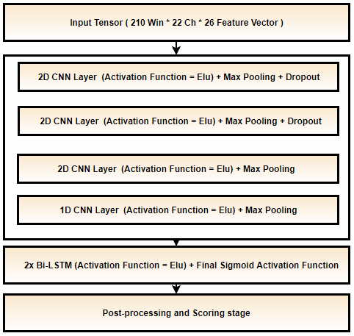
Baseline systems
We have developed three Baseline systems over the period of last three years:
CNN-LSTM system
Channel based LSTM networks
Kaldi’s multipass system with P-norm and MLP networks.
CNN-LSTM Architecture:
Each sample is 21 sec. long window for all 22 channels.
Trained with constant learning rate with kernel size of (3, 3).
Heuristic postprocessing approaches are applied which includes setting a threshold for output hyp. probabilities and filtering seizure events of certain duration.
Adam is used as an optimizer.
CNN-LSTM Model

Slide 10
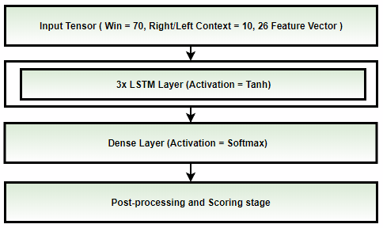
Baseline systems
Channel based LSTM Architecture:
Each sample is 7 sec. long window with right/left context (splice width) of 11 frames (1.1 sec.).
Each channel is processed individually so that the model only learns spike/sharp and wave discharges.
Trained with annealing learning rate after CV loss is stagnated for 3 consecutive epochs.
SGD optimizer with nestrov momentum is used.
A small CNN-LSTM-MLP model is used for postprocessing which is followed by a heuristic postprocessing.
LSTM Model

Slide 11
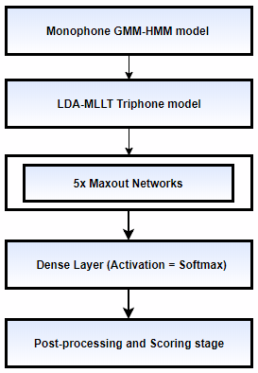
Baseline systems
Kaldi baseline systems:
Kaldi multipass systems with P-norm (Dan’s DNN (nnet2) implementation)
Kaldi multipass systems with MLP networks (TF implementation).
Kaldi P-norm fast:
Fixed Affined Component / LDA is applied to decorrelate splice window of 11 (left/right context of 5).
Training is performed for 20 epochs with annealing learning rate with last 5 epochs with constant minimum lr.
P-norm Input dim = 2000 & Output dim = 400.
Preconditioned SGD is used which is a matrix valued learning rate.
Kaldi DNN (TF):
Tensorflow’s MLP network with 3 hidden layers is implemented.
Priors, decision tree and alignments from Kaldi’s LDA-MLLT systems are used for acoustic modeling.

Slide 12
Evaluation metric
Any Overlap method (OVLP):
Any overlap method is a permissive method which looks for the detection of an event within a proximity of the reference.
This metric tend to produce higher sensitivities since only isolated events are considered as false alarms.
Multiple overlapping events detected in bursts are also counted as detection.
Performance measures are calculated in terms of Sensitivity and Specificity (or false alarms per 24 hours):
Sensitivity = ( True Positives / (True Positives + False Negatives) )
Specificity = (True Negatives / (True Negatives + False Positives) )
False Alarm rate = Rate of ( ( # Target False Positives / Total duration ) × (60 × 60 × 24) )

Slide 13
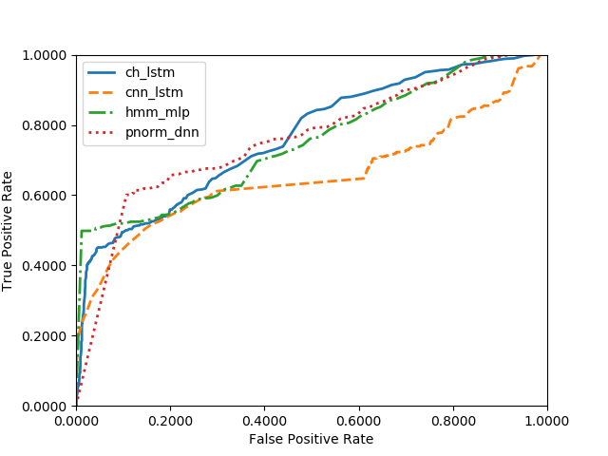
Performance
Note that Kaldi models use word boundaries during event classification.
Kaldi’s optimal performance is still at ~50% sensitivity with 2.58 FAs.
Channel based LSTM network outperforms other models.
DNN models | Sensitivity (%) | FA/24 Hours
CNN-LSTM | 30.83 | 6.74
LSTM | 40.29 | 5.77
Kaldi P-Norm | 60.09 | 25.7
Kaldi MLP | 49.83 | 2.58
ROC curve shows the performance of each baseline system for the target/seizure class.
Performance of all systems is very close to each other which can be observed via overlapping ROC throughout the graph.
The region of interest is at lower false alarm rate where HMM-MLP systems outperforms other systems.

Slide 14
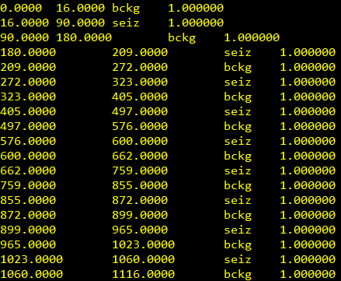
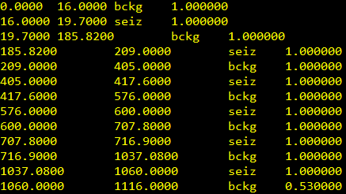
Decoding and Error Analysis
Kaldi lattices were used during decoding.
Lattice-1best, lattice-push and lattice-to-post were used to obtain decoding results. Each of which uses word boundaries.
Kaldi has a crude energy based automatic segmentation approach which is not adequate for segmentation of EEGs.
Hypothesis Transcriptions
Reference Transcriptions

Slide 15
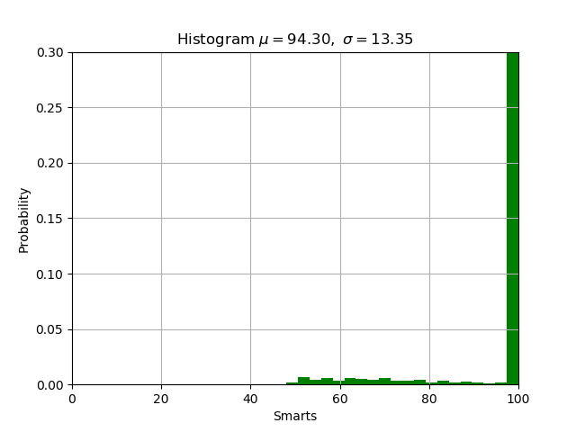
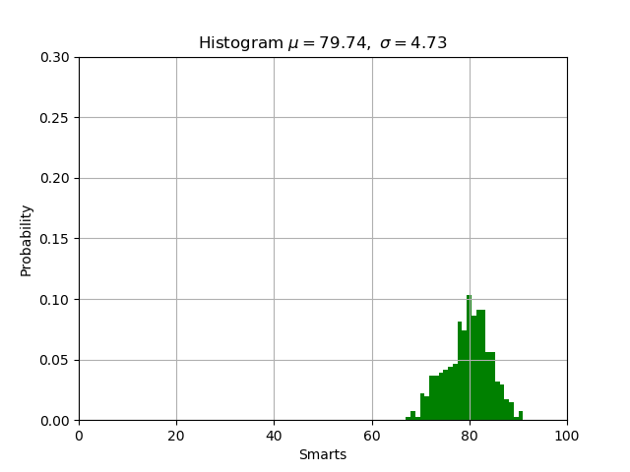
Decoding and Error Analysis
Performance of the DNN-HMM models on seizures with different durations is quite similar.
Decoded transcription probabilities (Hyp.) are very high compared to any non-Kaldi models we have developed.
Due to the binary classification problem, LM seems to flip the correctly detect classes at the beginning and end of the record.
Posterior Hyp distribution
P-Norm DNN (Kaldi)
LSTM network (AutoEEG)

Slide 16
Thank You !

