Slide 1
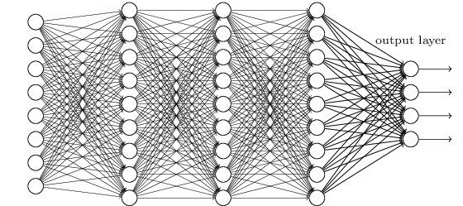
Channel Binding Topologies and CCA as a Preprocessing step in the Application of Seizure Detection
A Dissertation Proposal by:
Vinit Shah
Neural Engineering Data Consortium
Temple University
Philadelphia, Pennsylvania, USA

Slide 2
Abstract
Electroencephalograms (EEGs) are the primary tools for the diagnosis of seizure in hospitals; interpretation of which requires expertise.
Lack of “Automated Seizure Detection Tools” slows down the diagnostic process. As a results, diagnostic actions can be delayed from a half to several days.
Local EEG signals are correlated on spatial domain. Various EEG events can be explained based on their polarities, morphologies, evolution of events on temporal and/or spatial domain, etc.
The events which are of least interest in the application of seizure detection are artifacts and noise.
Canonical Correlation Analysis (CCA) is able to collect linearly-dependent correlated multivariate features to collect the spatial domain information efficiently.
Channel selection as the input of CCA requires knowledge related to cerebral cortex-lobe’s functionality and electrode positioning. Few possible topologies are proposed with their limitation.
Channel Topology + DCCA features + ML algorithms can further increase the performance level of a seizure detection system.

Slide 3
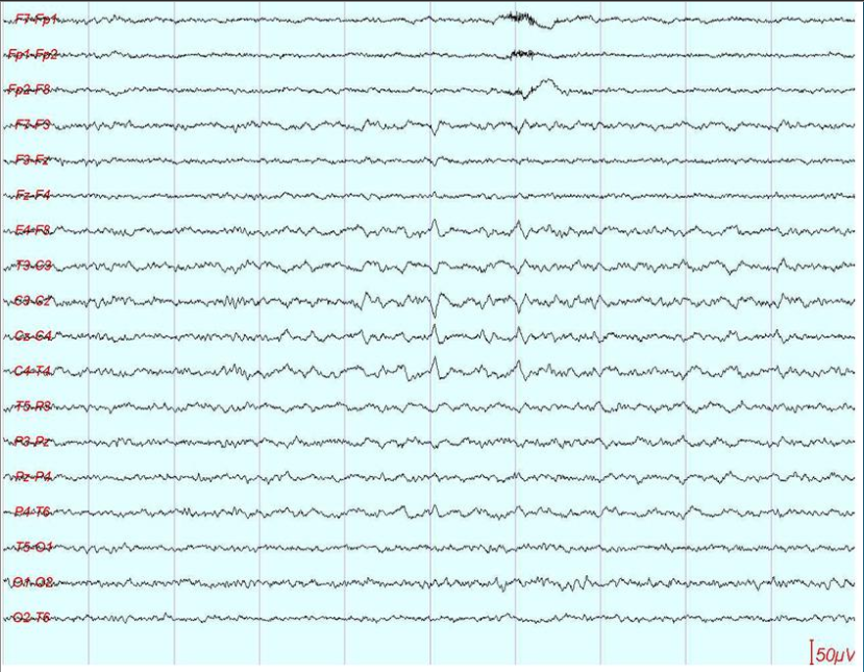
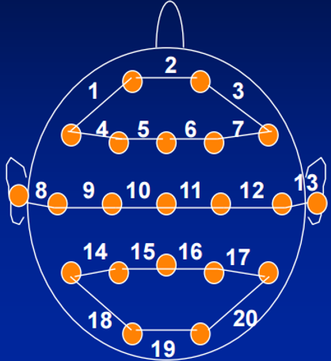
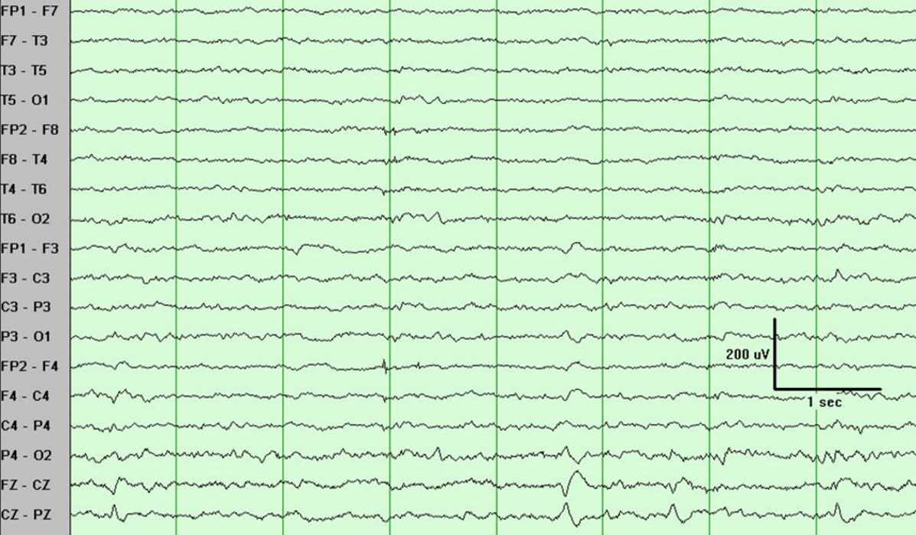
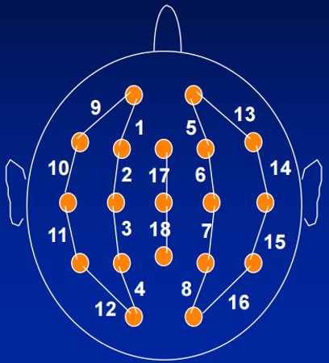
Introduction
Electroencephalography (EEG) is a popular tool used to diagnose brain related illnesses.
The 10-20 system is a universally accepted method for the placement of electrodes for any EEG test or experiment.
Neurophysiologists use various montage and channel selection strategies to observe specific seizure events. For example, Transverse montages help in observation of vertex waves where as Longitudinal montages help detect the parasagittal events more effectively.
Similar approach should be used as a preprocessing step to improve representation of input information to the ML recognition systems.

Slide 4
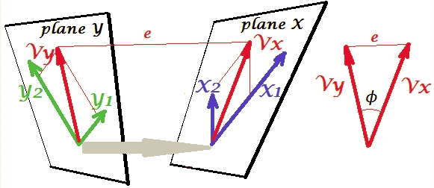
Canonical Correlation Analysis (CCA)
Canonical Correlation Analysis is a multivariate generalization of the ordinary Pearson Correlation.
EEG events show some correlation within the sets of channels which can be considered as variables.
In multivariate case, sets of channels can contain dependent (two adjacent channels) as well as independent variables and its relevant events (channels from separate hemispheres, 60 Hz noise, etc.)
In CCA, we look for the maximum variance on overlap between dependent variables.
The goal is to maximize the correlation between two multivariate sets X & Y.

Slide 5
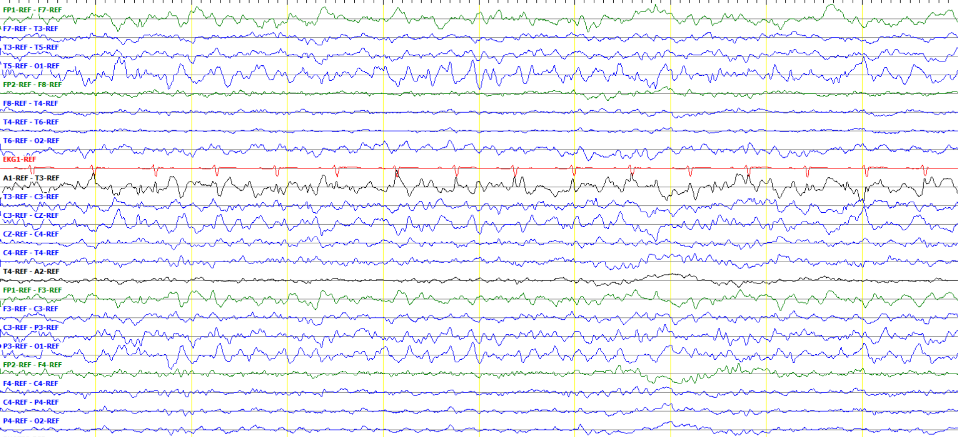
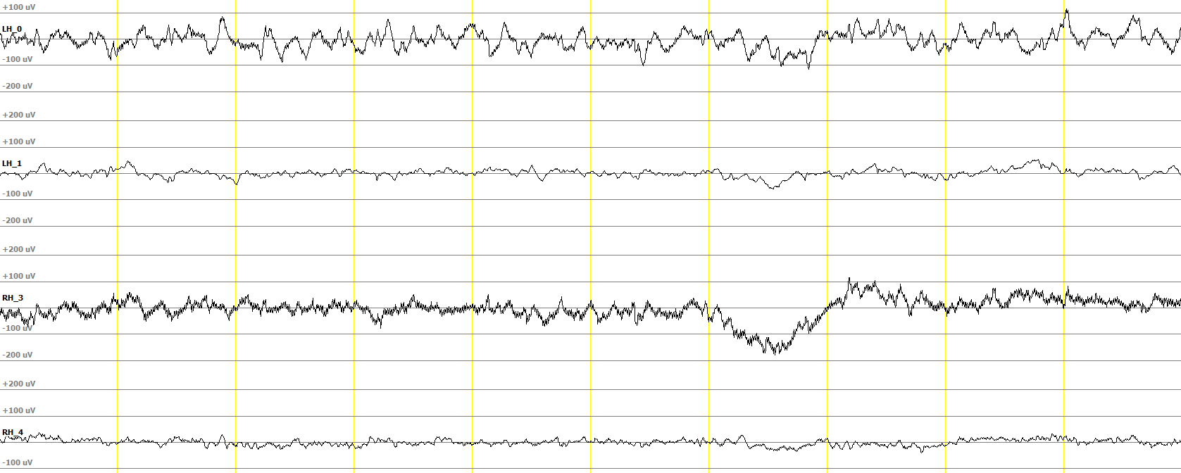
CCA in Action
Left Hemis-pheric Ictal
Ictal
(1st Comp)
Left Hemisphere Components
Right Hemisphere Components

Slide 6
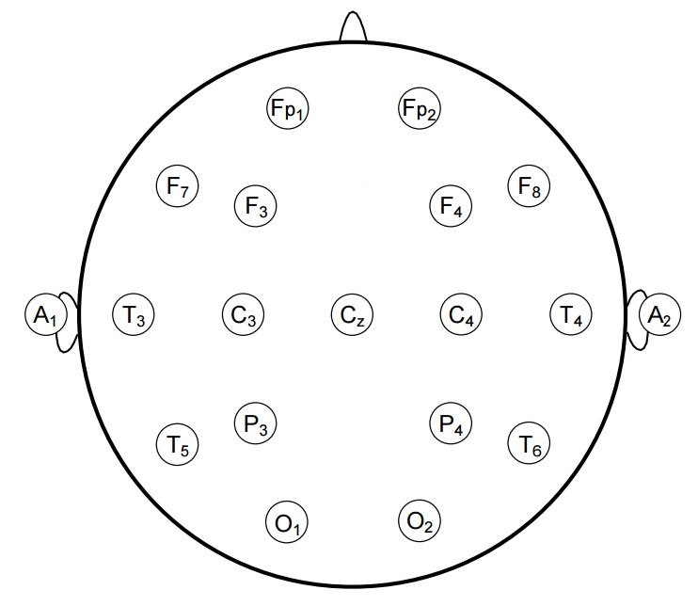
Topology
Unipolar montage is an easy choice to select canonical variates for CCA. Two obvious topologies are shown in the left figure.
Vertex referential montage is good choice to remove the reference channel noise.
Although bipolar montage can help us reduce noise and better understand localizing the event, information collected from such montage channels cannot be exploited efficiently due to repeating channels. (i.e. T3-T5, T5-O1)
Raw channels
Vertex montage

Slide 7
Topology
So far, we defined the topologies based on the spatial location of electrodes and expert knowledge can further increase the level of information extraction.
During CCA pre-processing, we considered processing information from both hemisphere separately. The issues with this approach could be:
The “Temporal Lobe Seizures” occur on both sides of temporal lobes and this information can be used during CCA step.
The edge electrodes (such as Frontal Polar) might not have any other electrodes to check correlation with. So, it is susceptible to miss the information related to “Frontal Lobe Seizures”.
The occipital lobes from both hemispheres should be used during the pre-processing step. Events occurring on one occipital electrode is likely to observe on the other side of the hemisphere.

Slide 8
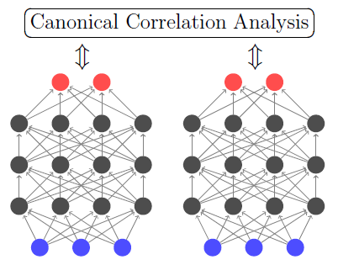
Deep CCA
More efficient algorithm for learning correlated features is Deep CCA which computes representations of the two sets by passing them through multiple stacked layers of nonlinear transformation.
DCCA tries to jointly learn parameters for both canonical variates such that correlation is as high as possible.
Variate X
Variate Y

Slide 9
Proposed architectures
Two approaches are proposed:
(1) using raw feature generated by DCCA
(2) LFCC features on the CCA preprocessed data
Raw EEG signals
HMM
Apply Topology
Deep CCA
RBM
CCA
LFCC features
LSTM
KNN

Slide 10
Timeline
February-March
Set up primary CCA and DCCA experiments with raw and LFCC features using HMM baseline system.
Start writing dissertation.
March-May
Design an efficient topology for channel selection for CCA stage. Investigate on types of montage, channel configurations, influence of reference channels, etc… which can improve overall performance of the system.
June-September
Implement the LSTM, RBM and KNN experiments for the classification of seizure detection problem. The systems shall be implemented using Kaldi, Tensorflow/Theano python libraries.
Finish and proofread the Dissertation for possible updates.
Defend the dissertation.

