Slide 1
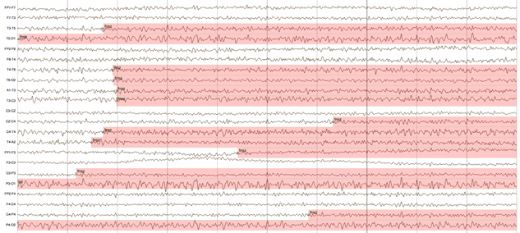
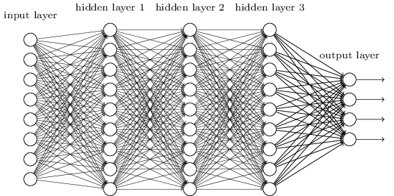

EEG Event Denoising
using Hybrid Machine Learning Architectures
Vinit Shah and Joseph Picone
Neural Engineering Data Consortium
Temple University

Slide 2
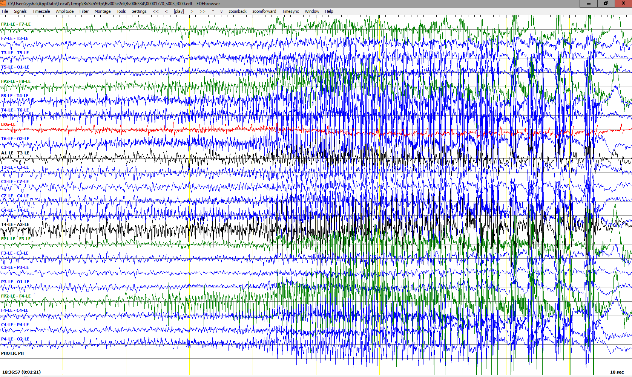
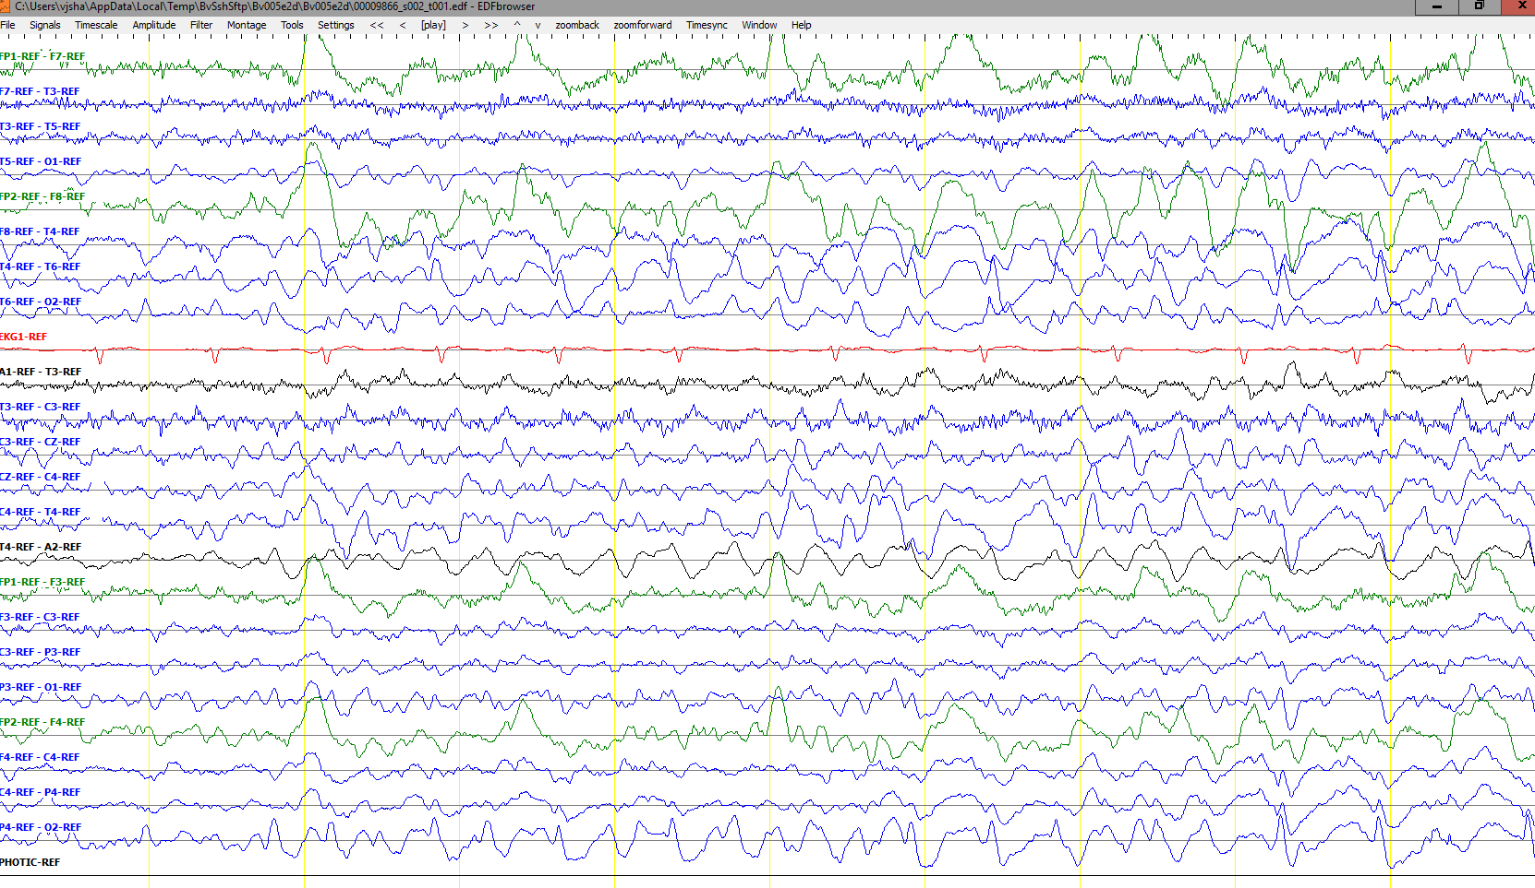
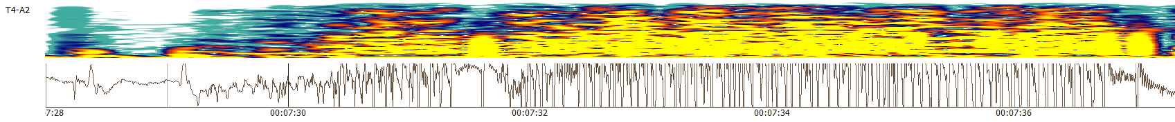
Seizure Morphologies
Electrographic seizures can be detected either by observing epileptiform activities or by observing artifacts related to specific types of seizures.
There are multiple types of seizures (i.e. tonic-clonic/grand mal, absence/petit mal, complex-partial)
Interpretation of focal seizures require temporal as well as sufficient level of spatial information.
Typically interpreters look for epileptiform activity such as spike and wave discharges and its evolution over time.
Easy seizures show clear evolution in signal’s frequency and amplitude.

Slide 3
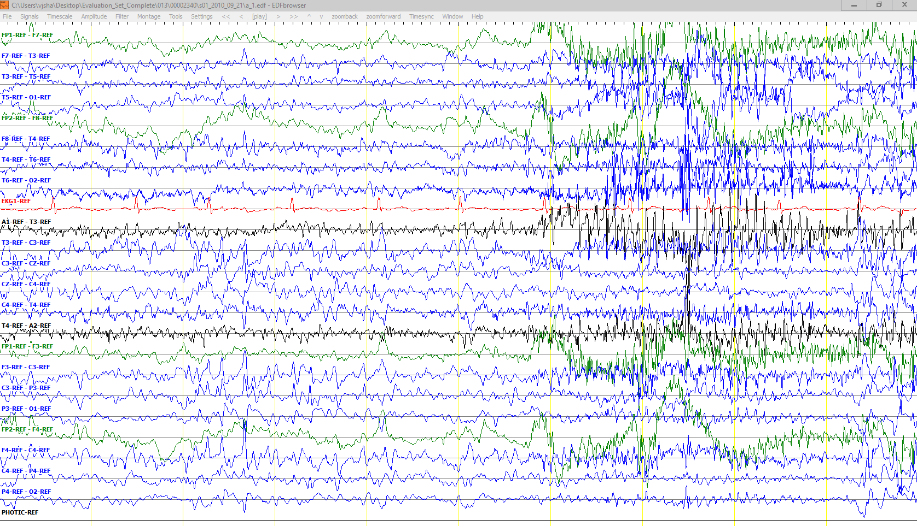
Inconclusive Segments
Some EEG records are very challenging and show wide spread epileptiform features along with artifacts (i.e. Shivers). Obscured patterns as such could also make interpretation inconclusive.
There are specific rules implemented by American Clinical Neurophysiology Society (ACNS) for diagnosis of patients with epilepsy.
Accurate onset and offset detection of an ictal is, in many cases, subjective which encourages us to use Any-Overlap method for scoring.
Shivers
Epileptiform
Activity

Slide 4
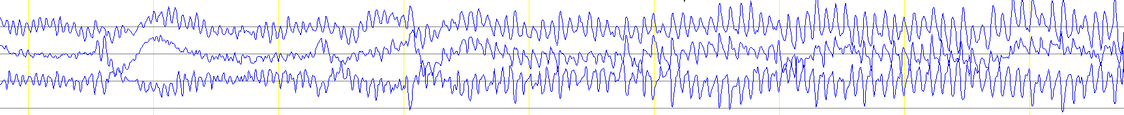
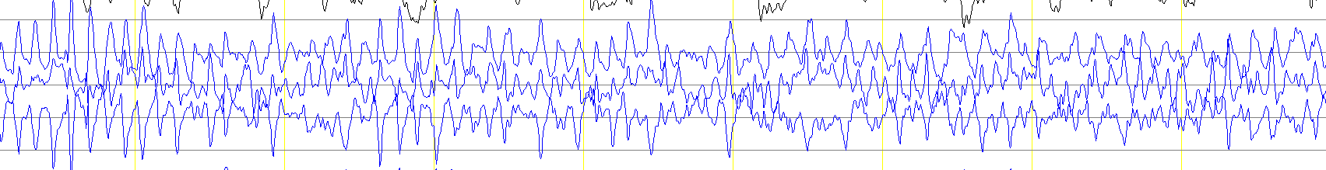
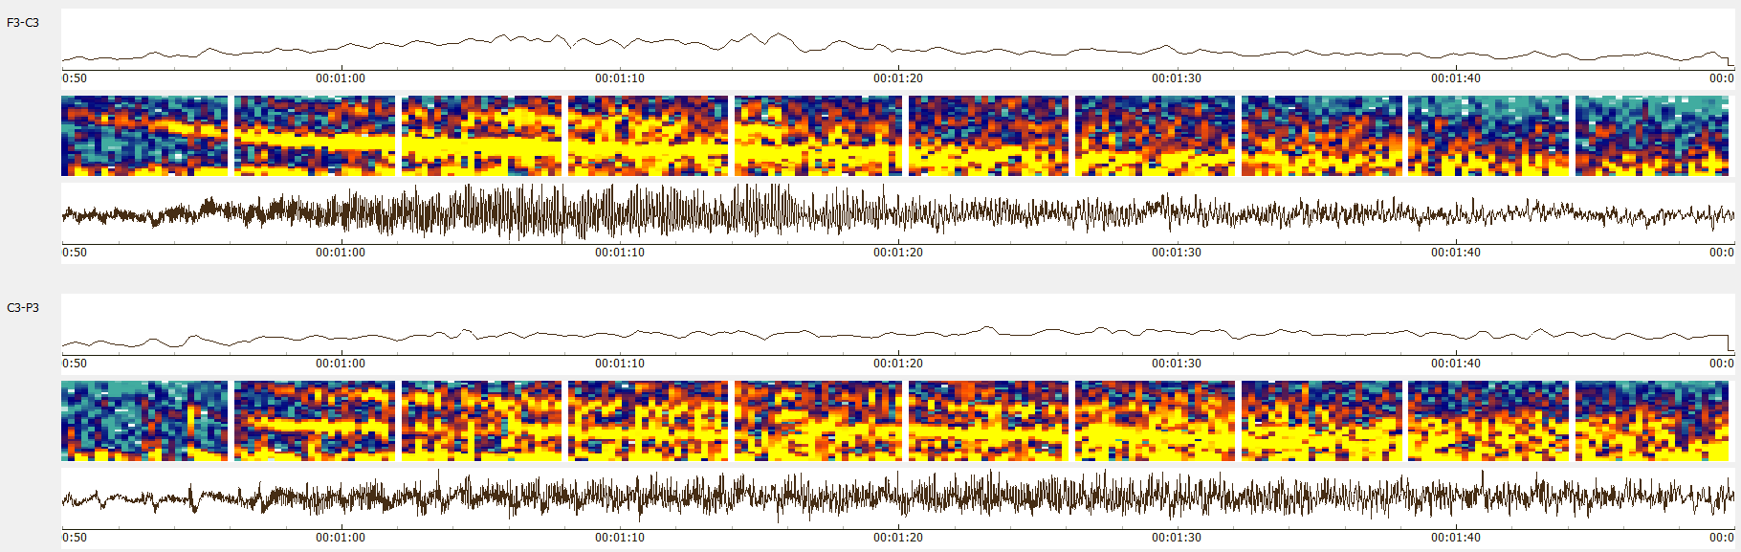
Spectral Properties of Seizure
Typical seizures start with low amplitude and fast frequencies.
These patterns start appearing from specific focal region of the brain.
Late seizures show low frequency and high amplitude until fading back to the baseline/background.

Slide 5
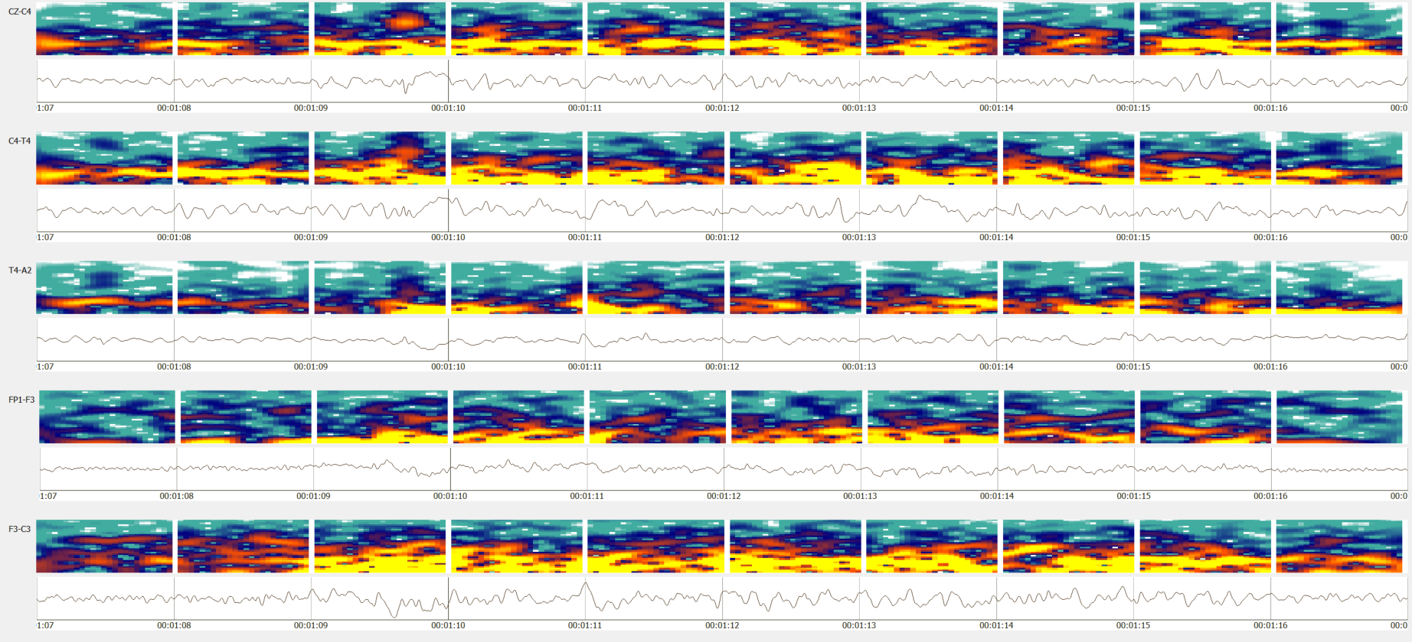
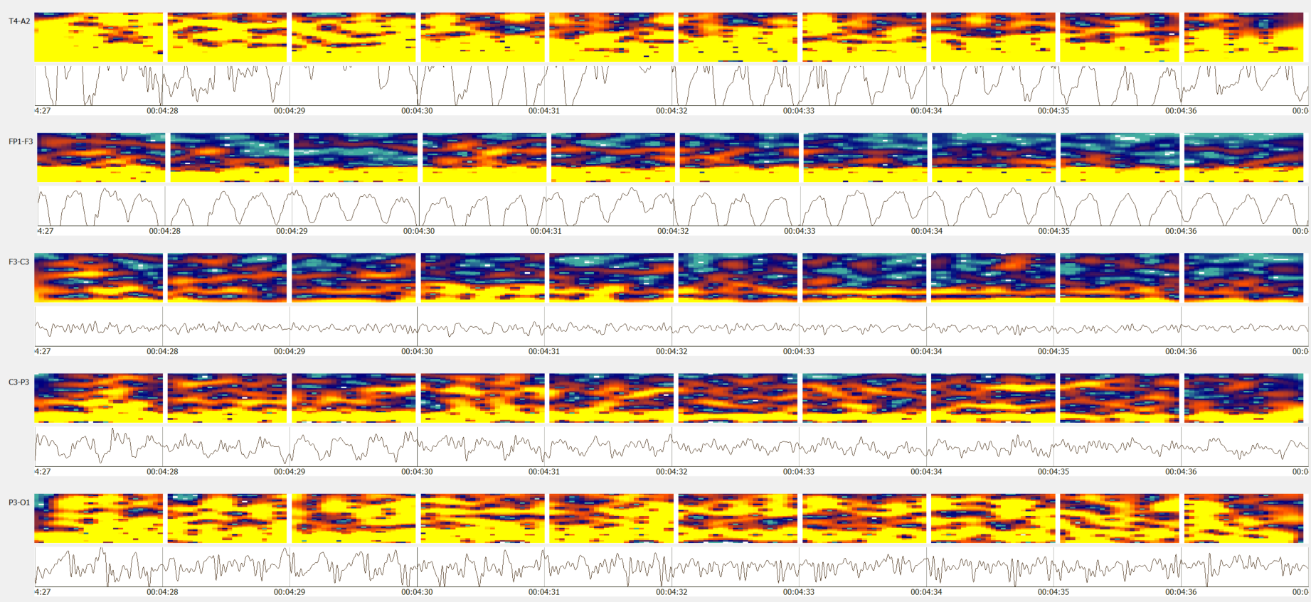
Spectral Properties of Seizure
Seizures usually occur within the range 2.5 - 25 Hz.
Seizure duration can range from 3 seconds to days.
Seizure occur in a convulsive or non-convulsive manner.
Generalized seizures are easy to spot due
to their high energy
in specific
frequency bands.
Waxing-waning patterns (e.g., bursts) can be mistakenly identified as seizures.

Slide 6
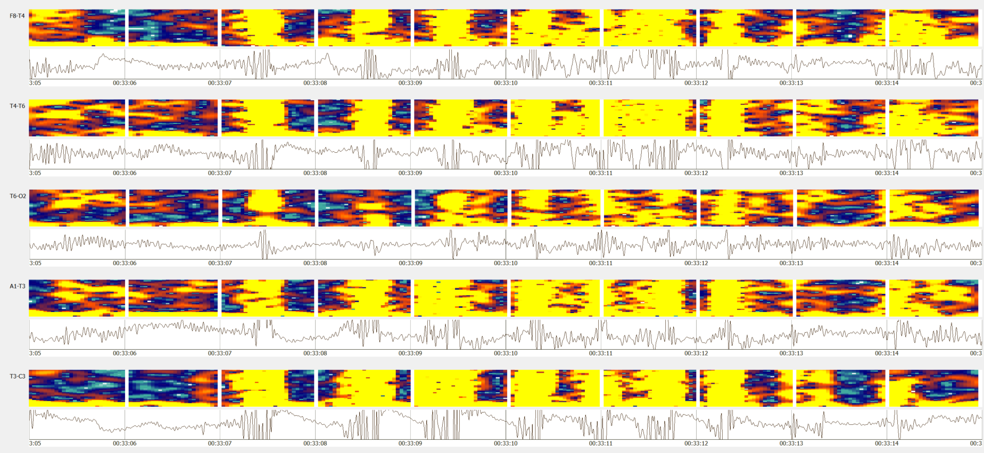
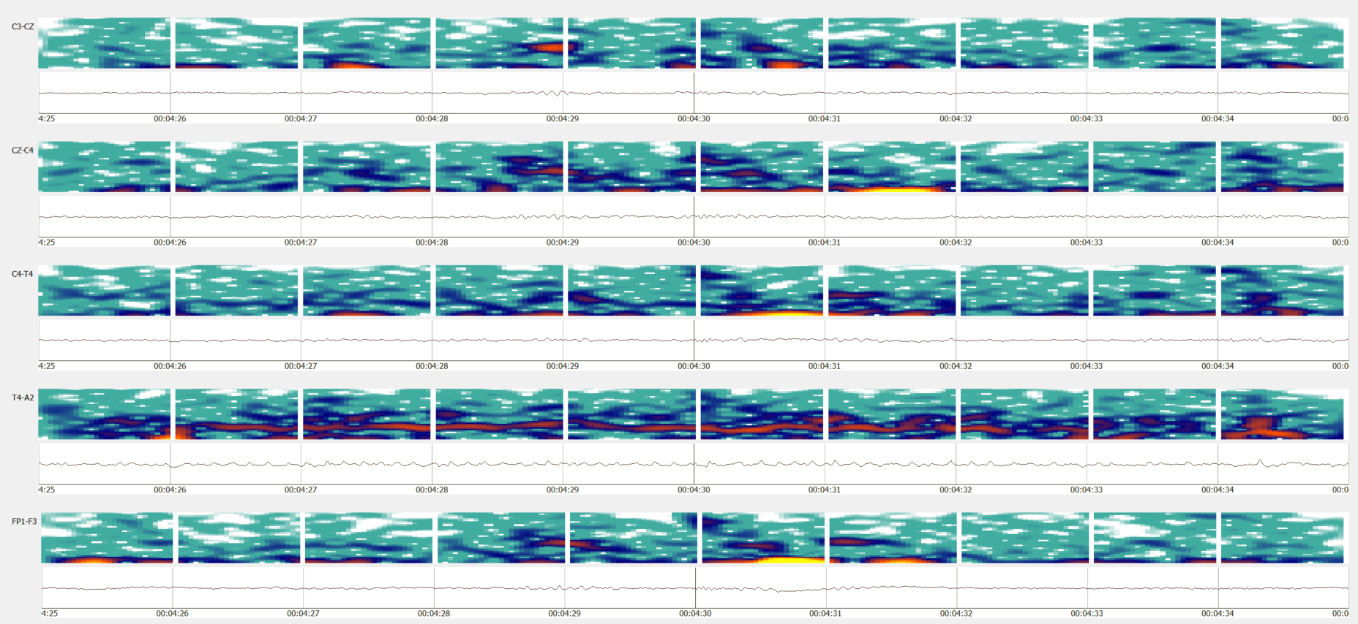
Artifacts and Medications Pose Challenges
Artifacts such as chewing resemble features of tonic-clonic and complex-partial seizures.
This is usually disambiguated from the context/history of the record.
Medication makes the interpretation process difficult.
Subtle seizures such as low energy focal seizures are widespread in ICU patients due to medication effects.

Slide 7
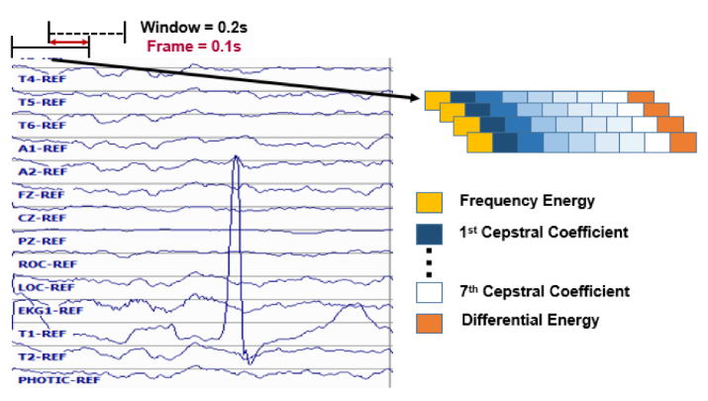
Feature Extraction (LFCC)
Standard frequency domain features are used:
  10 frames per second
  0.2 second sliding analysis window with 0.1 second (50%) overlap.
  9 base features including energy, differential energy, and 7 cepstral coefficients.
  1st and 2nd derivatives of cepstral coefficients are calculated to learn evolution and long-term dependency of the waveform.
  Feature vector dimension: 26.

Slide 8
Seizure Detection Algorithms
Machine learning approaches developed for detecting seizure are:
  HMM-SdA system
  CNN-MLP neural networks
  Deep Residual network
  IPCA-LSTM network
  HMM-LSTM network
  Seq2Seq LSTM LM model
  Sentiment Analysis LSTM model
Established baseline systems:
  CNN-LSTM system
  Channel-based LSTM networks

Slide 9
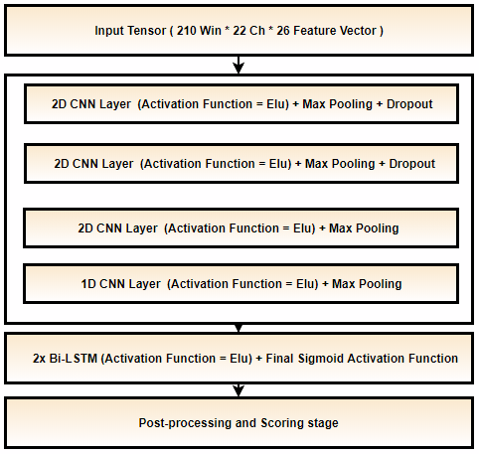
Baseline System: CNN-LSTM
CNN-LSTM Architecture:
  Each sample is a 21 sec. long window for all 22 channels.
  Trained with constant learning rate with a kernel size of (3, 3).
  Heuristic postprocessing approaches are applied which include a threshold for output probabilities and seizure events of a certain duration.
  An Adam optimizer is used.
CNN-LSTM Model

Slide 10
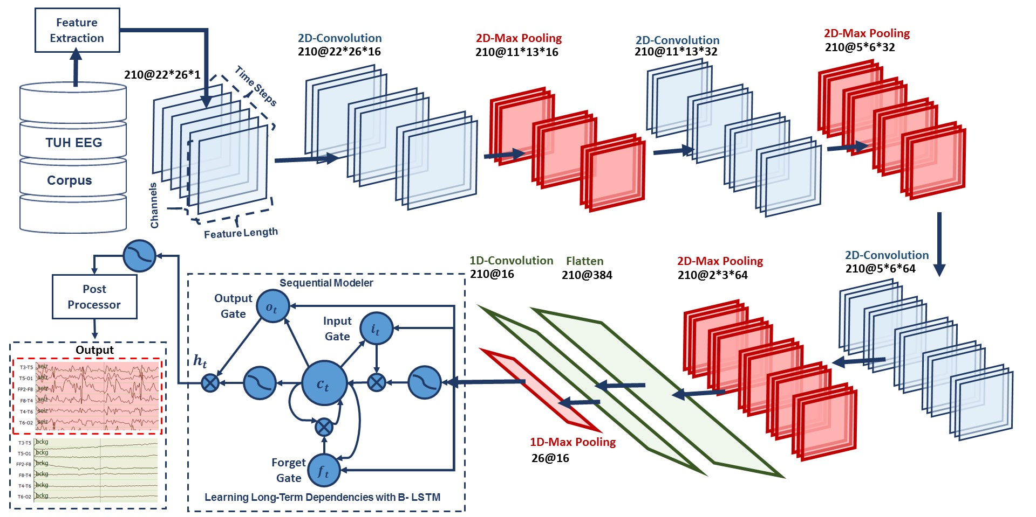
Baseline System: CNN-LSTM
CNN-LSTM Architecture:
  First phase of the system, CNNs, learn spatial and temporal correlations.
  CNN features are passed to the LSTM network to learn long term temporal dependencies of the waveform.

Slide 11
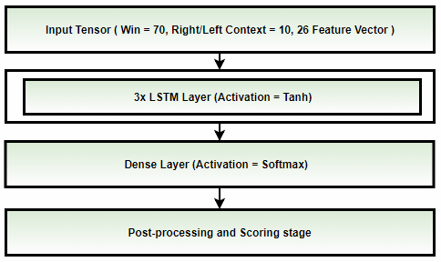
Baseline System: LSTM
Channel based LSTM Architecture:
  Each sample is a 7 sec. long
  window with right/left context
  (splice width) of 11 frames
  (1.1 sec.).
  Each channel is processed
  individually so that the model
  only learns spike/sharp and wave
  discharges.
  Trained with annealing learning
  rate after CV loss is stagnated
  for 3 consecutive epochs.
  SGD optimizer with nestrov
  momentum is used.
  A small CNN-LSTM-MLP model is used for postprocessing followed by heuristic postprocessing.
LSTM Model

Slide 12
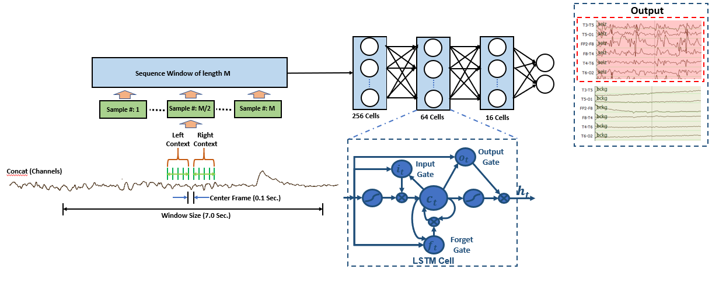
Baseline System: LSTM
Channel based LSTM network Architecture:
  3-layer LSTM layers only learns the temporal dependencies of the waveform from the features.
  Spatial information is learnt in the following CNN-LSTM-MLP network and heuristic postprocessor.

Slide 13
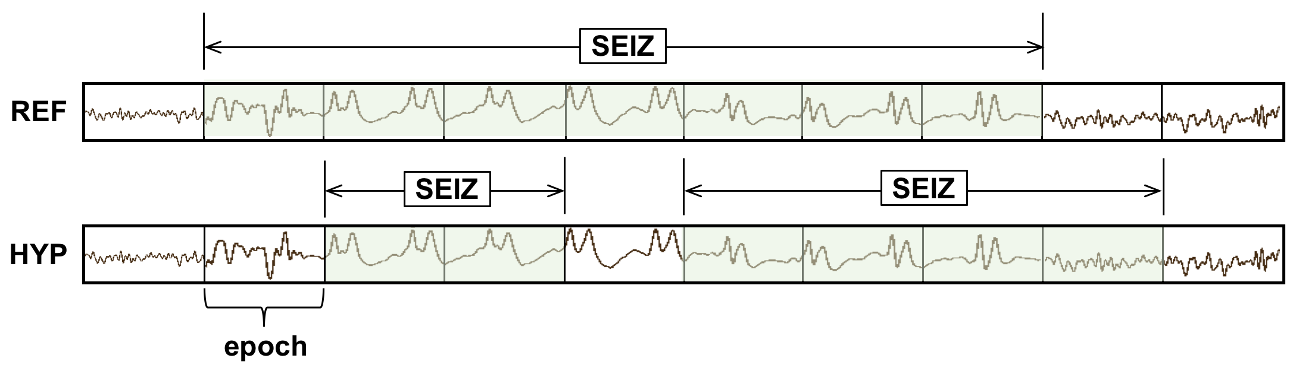
Evaluation Metrics
Various evaluation metrics with specific rules are developed to score EEG events. These metrics are:
  Average Term-Weighted Value (ATWV)
  Dynamic Programming Alignment (DPAlign)
  Epoch scoring (EPOCH)
  Any Overlap scoring (OVLP)
  Time Aligned Event Scoring (TAES)
Any Overlap method (OVLP):
  Any overlap method is a permissive method which looks for the detection of an event within a proximity of the reference.
  This metric tend to produce
  higher sensitivities
  since only isolated
  events are considered
  as false alarms.
  Multiple overlapping events
  detected in bursts are also counted as detection.

Slide 14
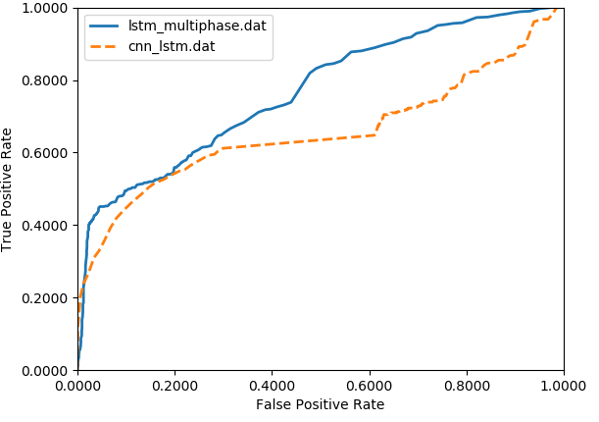
Performance
Performance measures are calculated in terms of Sensitivity and Specificity (or false alarms per 24 hours):
  Sensitivity = ( True Positives / (True Positives + False Negatives) )
  Specificity = (True Negatives / (True Negatives + False Positives) )
  False Alarm rate = Rate of ( ( # Target False Positives / Total duration ) × (60 × 60 × 24) )
Channel-based LSTM model outperforms CNN-LSTM model by a small margin.
Baseline Models | Sensitivity (%) | FA/24 Hours
CNN-LSTM | 30.8% | 6.7
LSTM | 40.3% | 5.8
Performance on TUSZ Devtest set
ROC curve shown is for the target/seizure class.
The region of interest should lower FA range (< 10 FAs/24 hours).

Slide 15
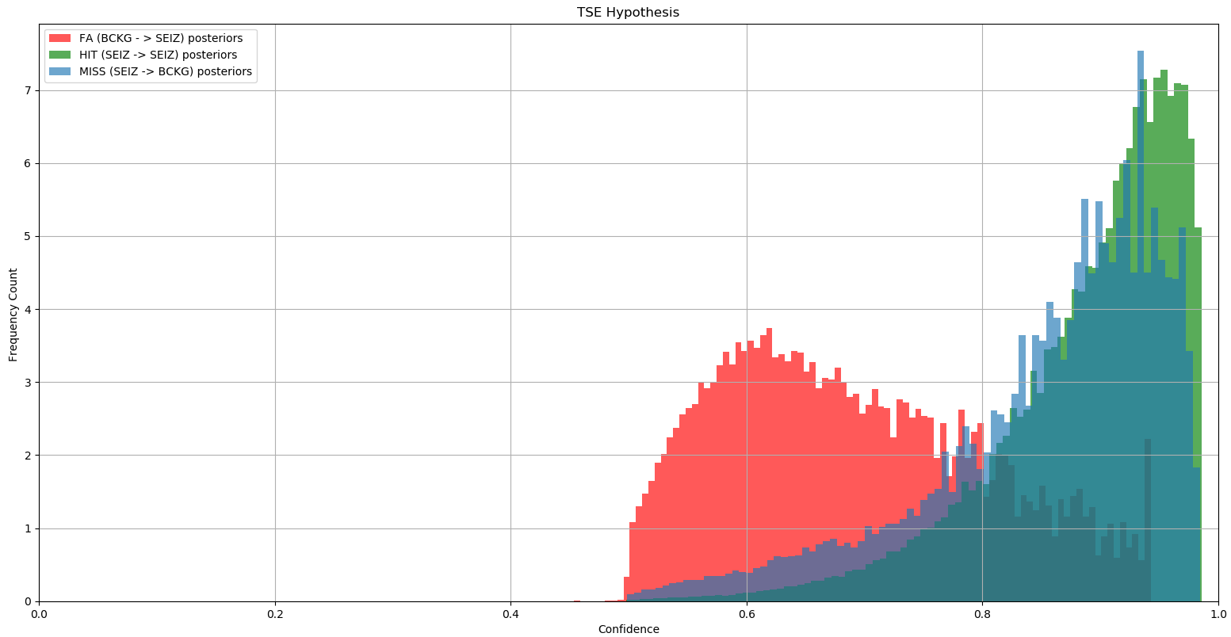
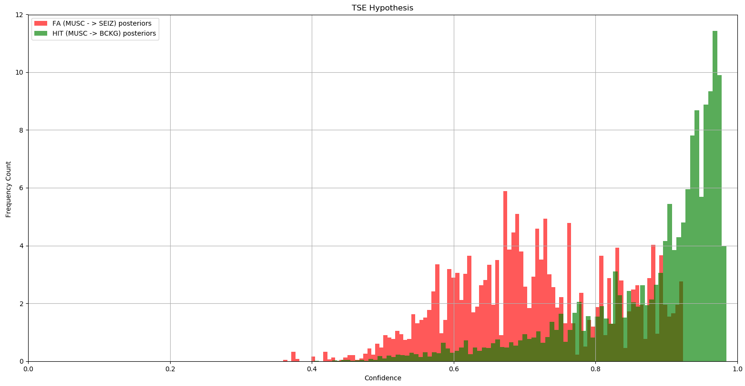
Error Analysis
Majority of the false positives
associated with CNN-LSTM model
detections were due to slowing and
artifacts whereas channel-based LSTM model’s primary error modalities were inter/post ictal continuum (IIC/PIC) and artifacts.
Muscle artifacts contribute to about ~30% of the total false alarms.
Posterior distribution collected from seizure detection software decoded on seizure and artifact databases show clear distinct region where muscle artifacts are likely to be confused with seizure events.
These isolated low confidence regions suggest a possibility of improvement for the recognition system on artifacts.

Slide 16
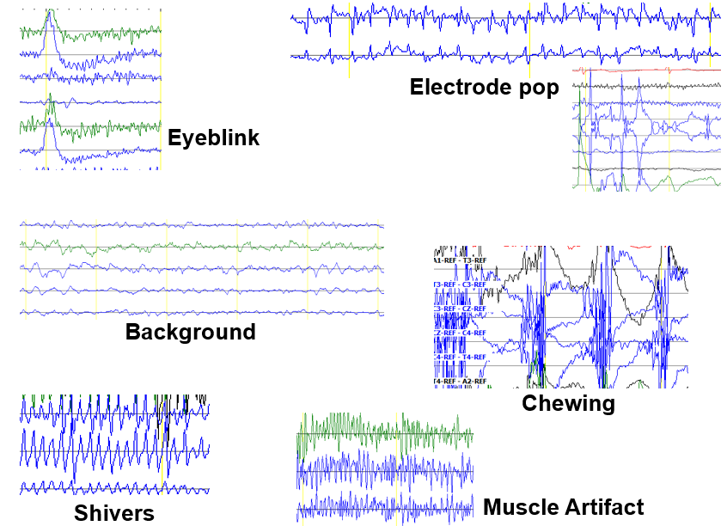
Artifact Reduction
EEG artifacts can be observed
on a focal region as well as on
a single/individual channel.
Some of the notorious artifacts which are widespread and can completely mask cerebral activities include muscle,
chewing and eye flutter artifacts.
Artifact reduction implemented for dimensionality reduction and denoising are:
  Canonical Correlation Analysis (CCA)
  Independent Component Analysis (ICA)
  Conventional Beamforming

Slide 17

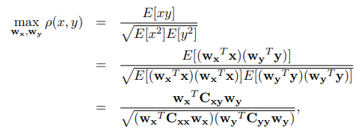
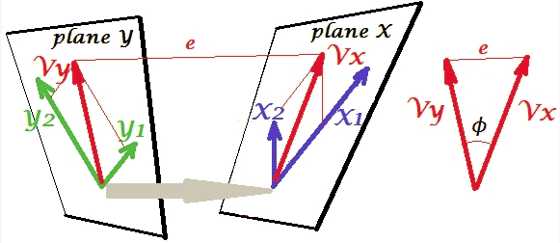
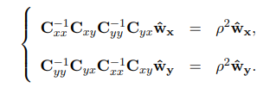
Canonical Correlation Analysis (CCA)
Canonical Correlation Analysis is a multivariate generalization of the ordinary Pearson Correlation.
EEG events show some correlation within the sets of channels which can be considered as variables.
CCA can also be used to filter individual signals by making lagged version of the same signals.
We use CCA to filter muscle artifact on individual channels.
The goal is to maximize the correlation between two canonical variates X & Y.
Notes:
Note here that, when talking about dependent variables, we are not talking about causal relationships of the variates. We are not doing dimensionality reduction on time domain but rather within and among sets.

Slide 18
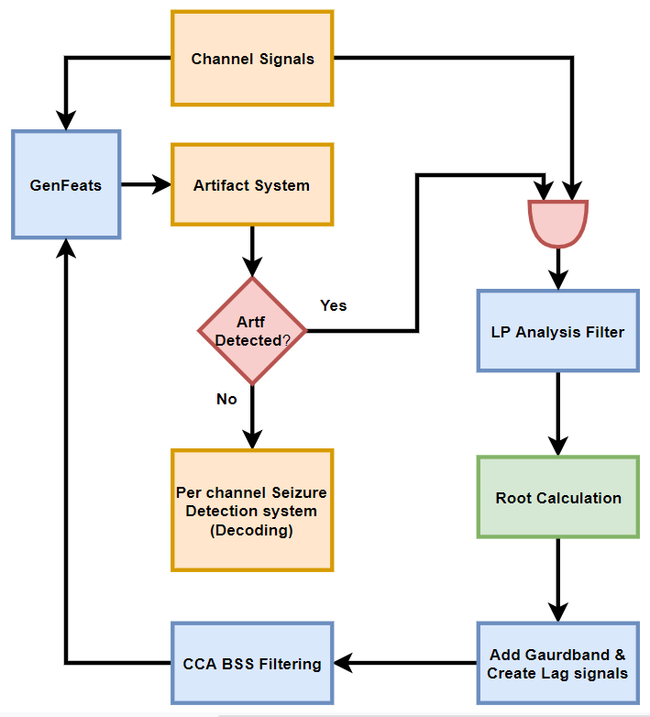
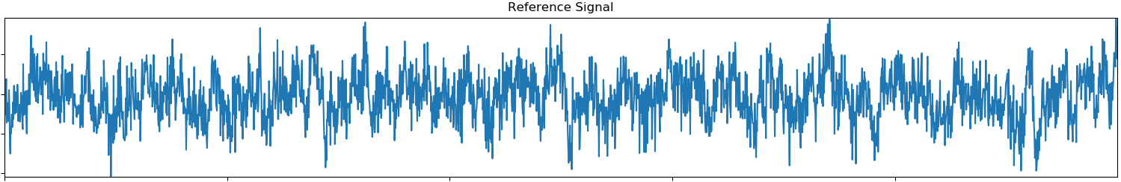
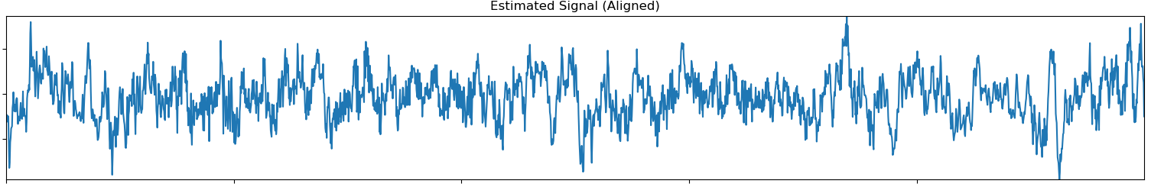
Canonical Correlation Analysis (CCA)
We select the segments where artifacts are detected and estimate the underlying N prominent frequencies using LPC estimation.
Lagged version of the signals are then created to filter uncorrelated noise such as muscle artifact via CCA.
The CCA filtered signal removes majority of the muscle artifact while preserving the sharpness/shape of the signal which plays a crucial role during the interpretation process.

Slide 19
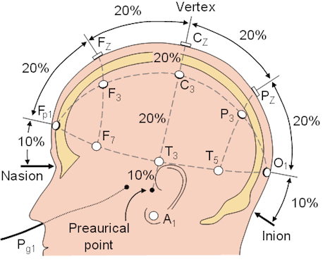
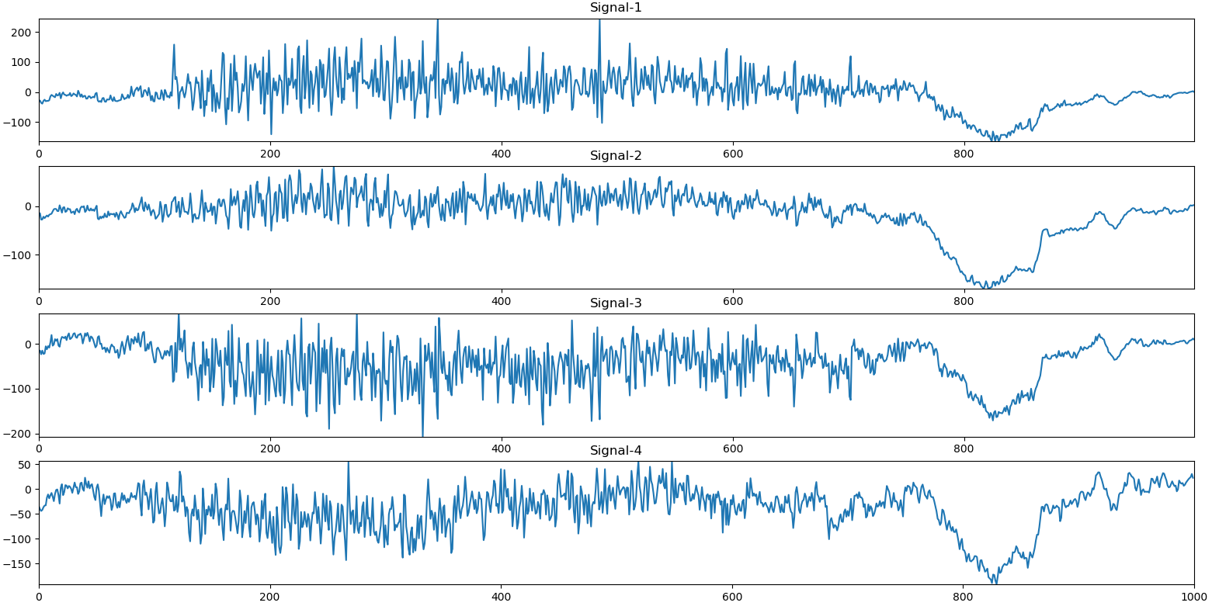
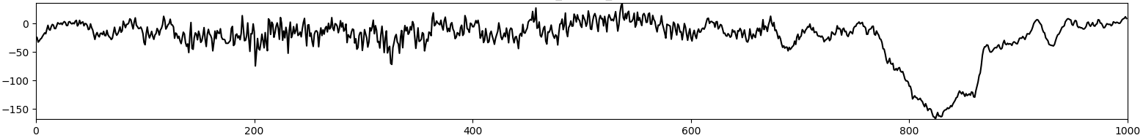
Conventional Beamforming
We use conventional delay and sum beamforming algorithm to filter out the noise components of the signal.
Capturing electrical activities at the surface electrodes is analogous to multiarray transmitter antenna to a single receiver.
Delays in the signals are approximated by the phase shifts in the frequency domain.
This approach reduces focal set of EEG signals to one filtered version of the signal.

Slide 20
Conclusion and Future Work
Seizure detection neural network algorithms, though impressive in their performance, still need significant improvement to meet clinical acceptance of 75% sensitivity with 1 FAs/Hr.
Future plans include implementation of artifact rejection algorithm to reduce amount of data to process and to filter out spurious events which could trigger false alarms.
More advanced adaptive algorithms such as Weiner filter adaptive beamforming techniques will be investigated to estimate and denoise source signals efficiently.

Slide 21
Acknowledgements
Research reported in this publication was most recently supported by the National Science Foundation Partnership for Innovation award number IIP-1827565 and the Pennsylvania Commonwealth Universal Research Enhancement Program (PA CURE).
Several grants over the years have supported the database development project. Significant contributors include National Human Genome Research Institute of the National Institutes of Health award number U01HG008468, DARPA Microsystems Technology Office award number D13AP00065, National Science Foundation Division of Computer and Network Systems award number CNS-1305190, the Temple University Office of the Vice-Provost for Research and the Temple University College of Engineering.
Any opinions, findings, and conclusions or recommendations expressed in this material are those of the author(s) and do not necessarily reflect the official views of any of these organizations.

Slide 22
References
Golmohammadi, M., Ziyabari, S., Shah, V., Obeid, I., & Picone, J. (2018). Deep Architectures for Spatio-Temporal Modeling: Automated Seizure Detection in Scalp EEGs. Proceedings of the IEEE International Conference on Machine Learning and Applications (ICMLA), 1–6. https://doi.org/http://dx.doi.org/10.1109/ICMLA.2018.00118
Capp, N., Campbell, C., Elseify, T., Obeid, I., & Picone, J. (2018). Optimizing EEG Visualization Through Remote Data Retrieval. Proceedings of the IEEE Signal Processing in Medicine and Biology Symposium, 1–2. https://doi.org/10.1109/SPMB.2018.8615613
Krauss, G. L., & Fisher, R. S. (2011). The Johns Hopkins Atlas of Digital EEG: An Interactive Training Guide (2nd ed.). https://www.amazon.com/Johns-Hopkins-Atlas-Digital-EEG/dp/0801897335
Adel, H., Souad, M., Alaqeeli, A., & Hamid, A. (2012). Beamforming techniques for multichannel audio signal separation. International Journal of Digital Content Technology and Its Applications. https://doi.org/10.4156/jdcta.vol6.issue20.72
Golmohammadi, M., Shah, V., Obeid, I., & Picone, J. (2019). Deep Learning Approaches for Automatic Analysis of EEGs. In I. Obeid & J. Picone (Eds.), Deep Learning: Algorithms and Applications (1st ed., p. 76). https://www.isip.piconepress.com/publications/unpublished/books/2019/springer/deep_learning/
Li, Y. O., Adali, T., Wang, W., & Calhoun, V. D. (2009). Joint blind source separation by multiset canonical correlation analysis. IEEE Transactions on Signal Processing. https://doi.org/10.1109/TSP.2009.2021636
Beelen, T. van. (2013). EDFbrowser. Retrieved from Teuniz website: http://www.teuniz.net/edfbrowser/
De Clercq, W., Vergult, A., Vanrumste, B., Van Paesschen, W., & Van Huffel, S. (2006). Canonical correlation analysis applied to remove muscle artifacts from the electroencephalogram. IEEE Transactions on Biomedical Engineering. https://doi.org/10.1109/TBME.2006.879459

Slide 23
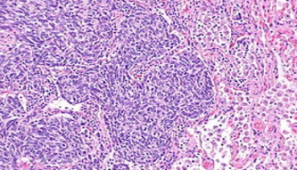
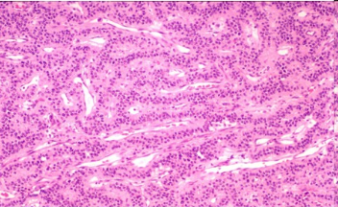
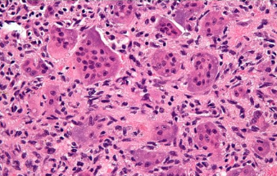
The
Temple University Hospital
Digital Pathology
Corpus
Nabila Shawki and Joseph Picone
Neural Engineering Data Consortium
Temple University

Slide 24
Abstract
Digital pathology, often referred to as whole slide imaging (WSI), is a relatively new field that will benefit from big data and machine learning.
In the United States alone, millions of pathology slides are created and interpreted by a human expert each year, suggesting that there is ample data available to support machine learning research.
The relevant corpora, however, contain only hundreds of images which is insufficient in developing a deep learning method. There is also the added hindrance of the lack of publicly accessible data.
The goal of our digital pathology corpus is to place a large amount of clinical pathology slides obtained from Temple University Hospital into the public domain to support the development of automatic interpretation technology.
The goal of this ambitious project is to create a corpus of 1M images within a period of 3 years.
We have currently released over 56,000 images from over 3000 clinical cases.
The data is open source:
https://www.isip.piconepress.com/projects/nsf_dpath/
Join our listserv: nedc_tuh_dpath@googlegroups.com.

Slide 25
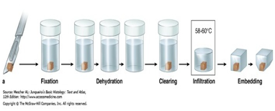


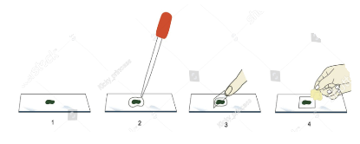







Digital Pathology and its Advantages
In recent days, image based information extraction is used extensively for virtual microscopy which is a practice called digital pathology of converting glass slides in a digital format.
Slides are converted from analog to digital using digital slide scanner
Slide and tissue preparation
Slides are then stored on remote servers where they are automatically uploaded in the public domain.
Slides can be accessed remotely where multiple pathologists can analyse specimen concurrently.
This process is simplified by retrieving WSIs through simple keyboard search of medical records.

Slide 26
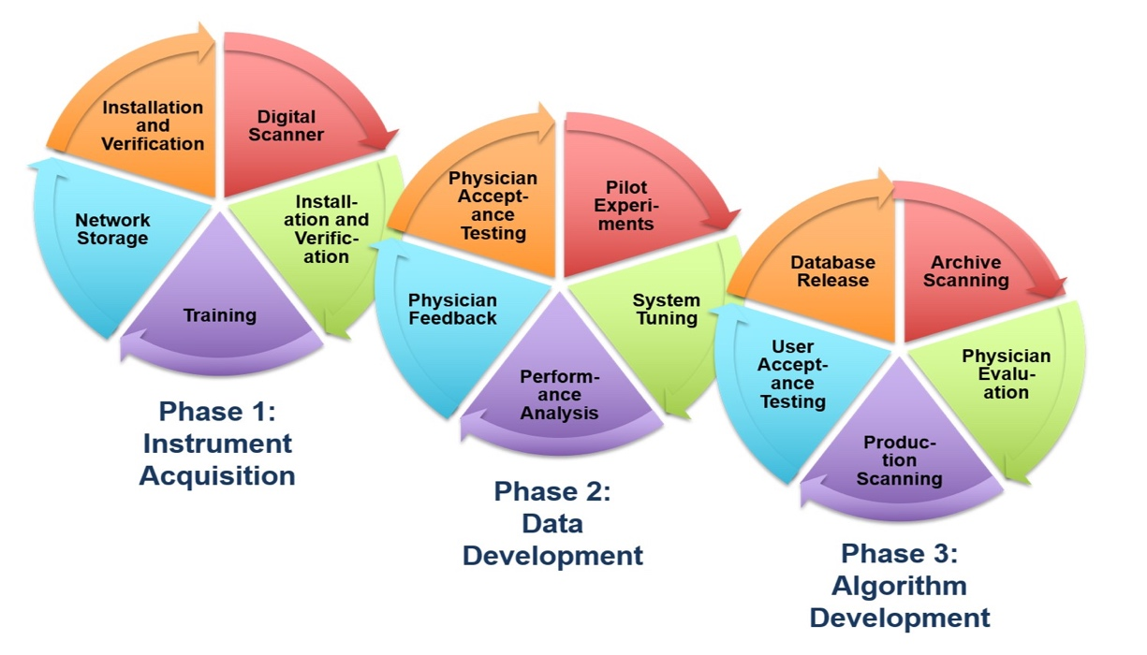
NSF Major Research Instrumentation (NSF MRI) Grant
Three goals:
Integration of digital imaging
into Temple University
Hospital’s clinical operation.
Establishment of a public
database of pathology slides.
Development of an image classification
system to automatically annotate pathology slides.
Three-year plan:
Infrastructure development (complete).
Data Development: 1M slides requiring 1 Petabyte of storage (underway).
Algorithm Development: Our baseline image classification system uses a CNN network to classify 1000 WSIs with 99% sensitivity.

Slide 27
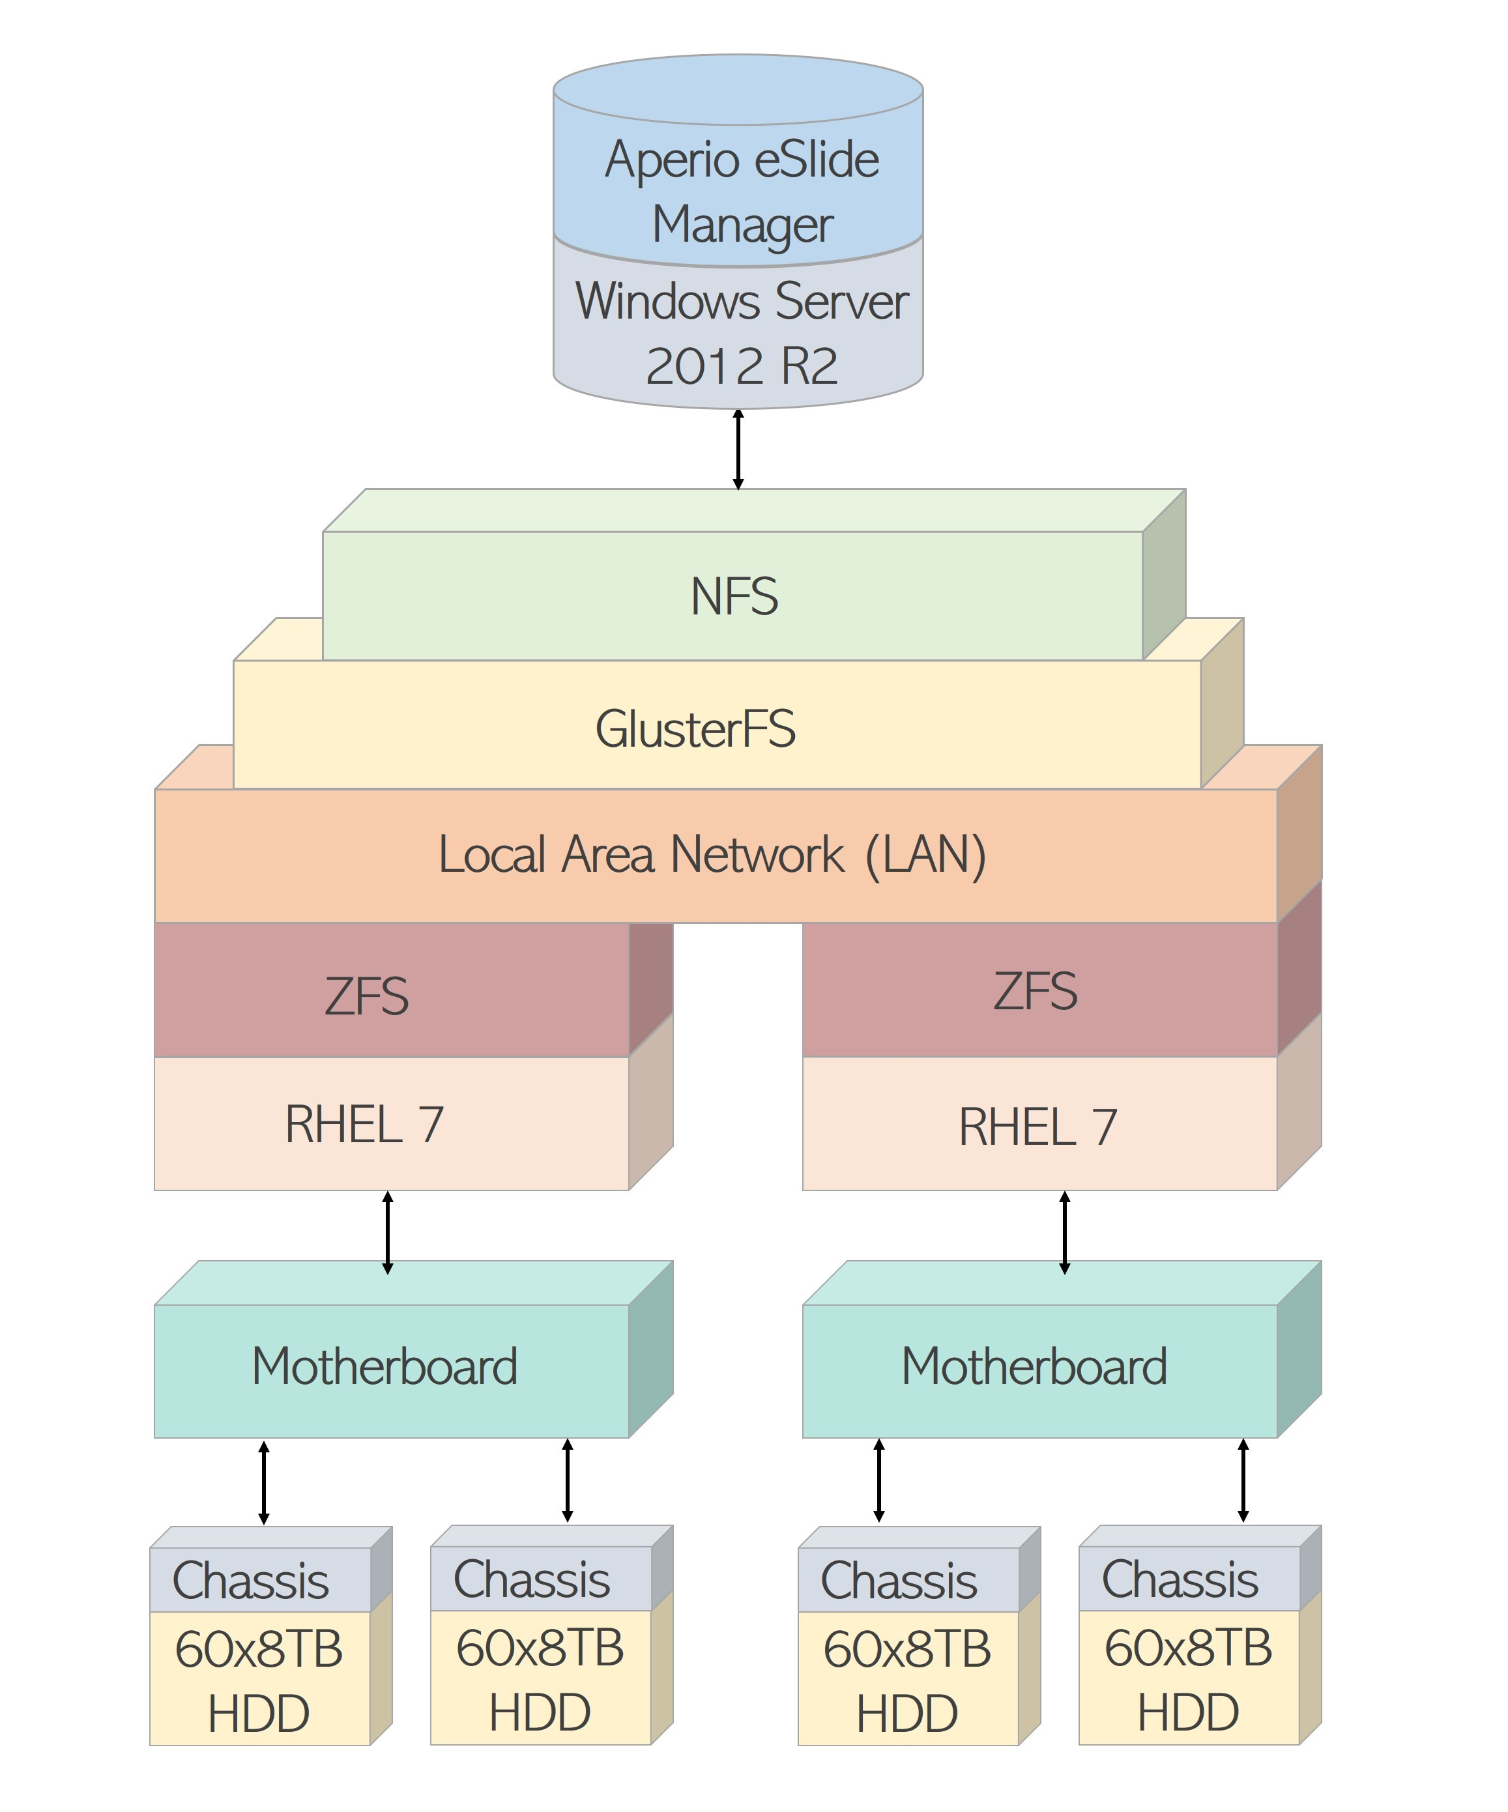
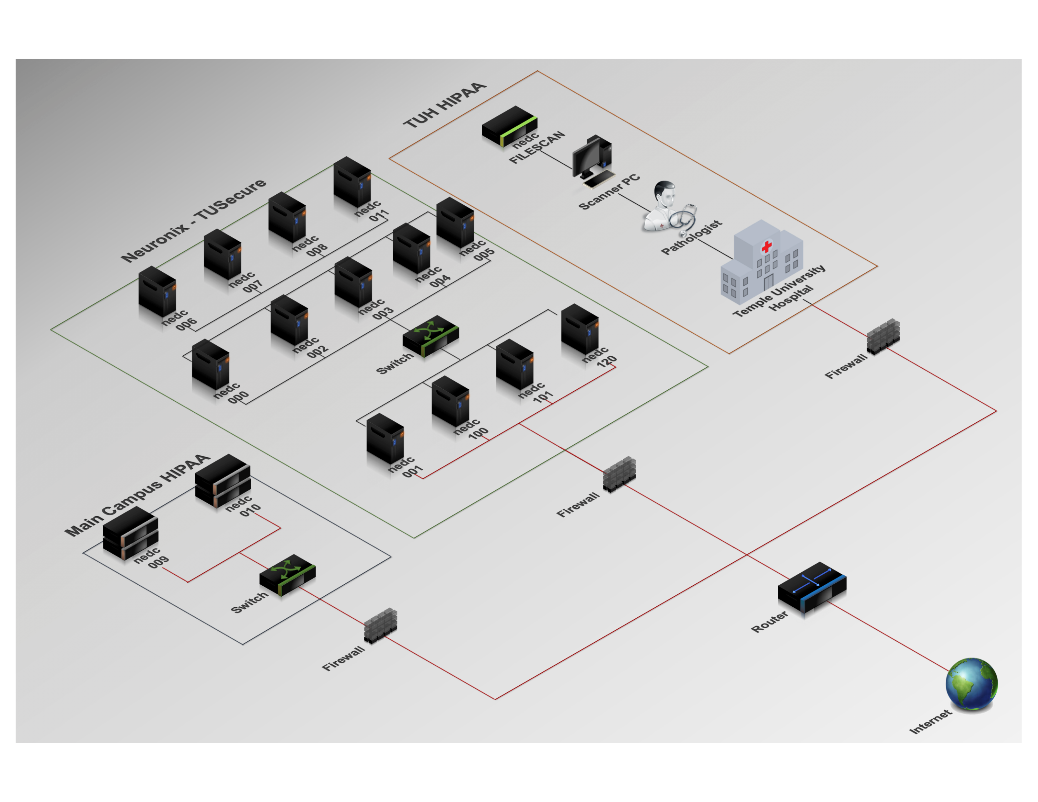
Computing Infrastructure
A 1M image database requires over a petabyte (PB) of disk space. It requires significant allocation of computing resources.
We improved and expanded our cluster, Neuronix, to support the corpus in two ways: computation and storage.
We implemented a multilayer filesystem with multiple machines for storage.
We use Slurm, an opensource workload manager, as our scheduler and resource manager.
For networking, ZFS (Zettabyte File System) connects the disks together into a single filesystem.
Gluster connects the filesystems from multiple machines into a single mountpoint.
Three secure networks: Temple Hospital’s HIPAA network, Temple Main Campus HIPAA network and Temple University’s main network.

Slide 28
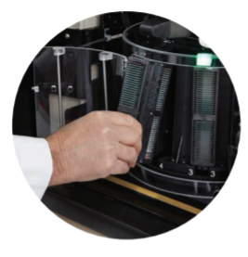
Digital Slide Scanner
Slides are scanned using a Leica Aperio AT2 high volume scanner.
Maximum resolution: 40x
Includes a Z-stacking feature (up to 25 layers) for 3D scans.
Generates .svs files because the images are too big for JPEG’s.
The AT2 scanner can hold and scan a total of 400 slides arranged into 10 carousels of 40 slides each.
The scanning period is approx. 8 hours where the scanning rate is around 50 slides per hour.
The scanning operation runs overnight, and the scanned slides are organized using eSM the following day.
Scanning is not completely automated since focus points have to be set manually in many cases.

Slide 29
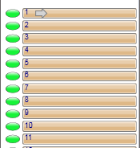
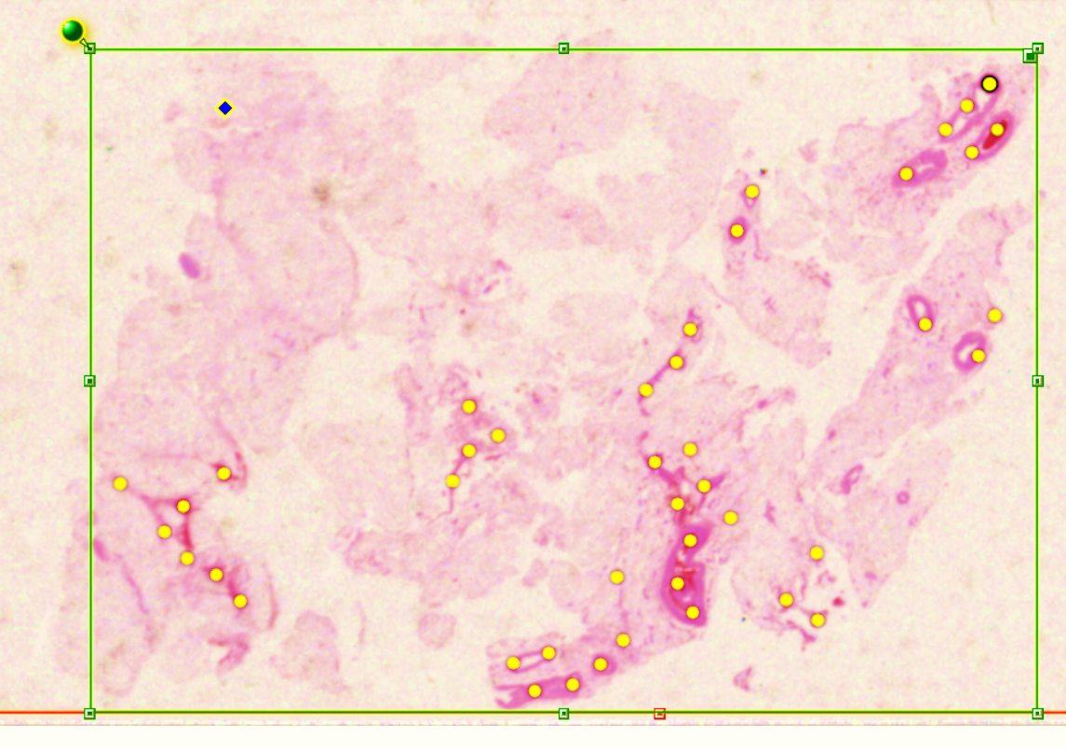
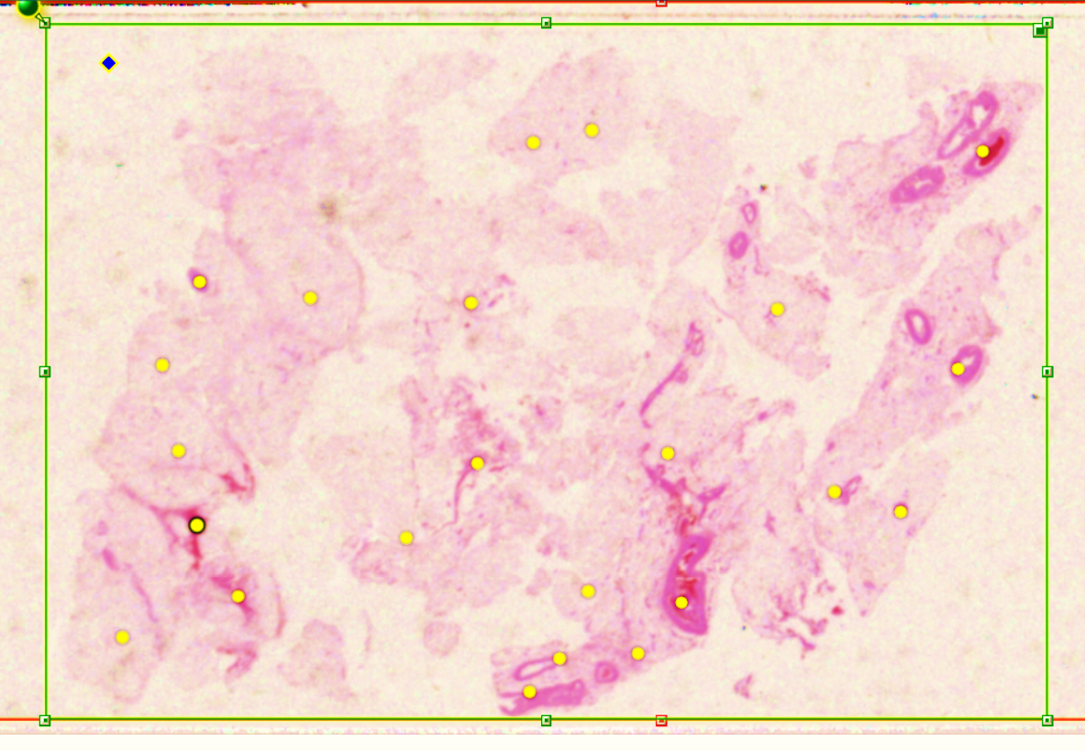
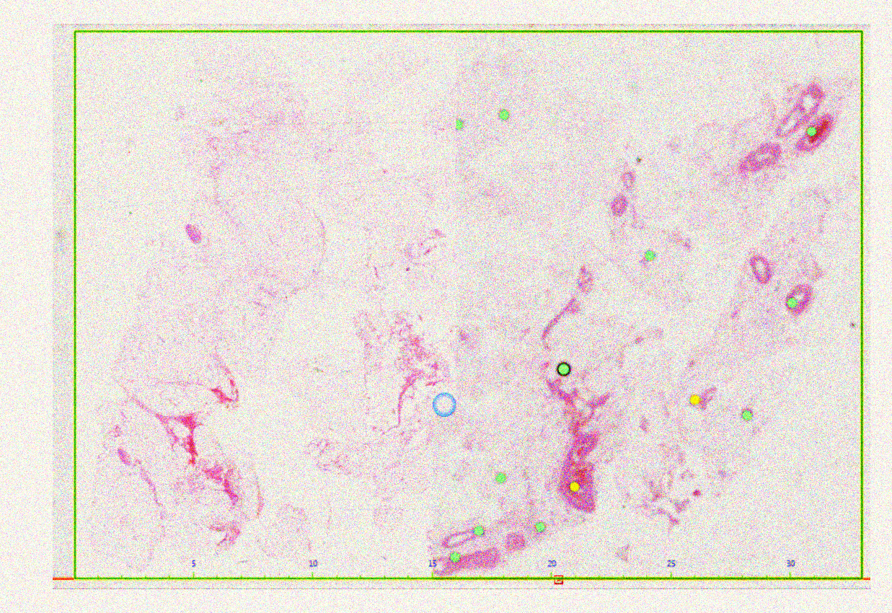
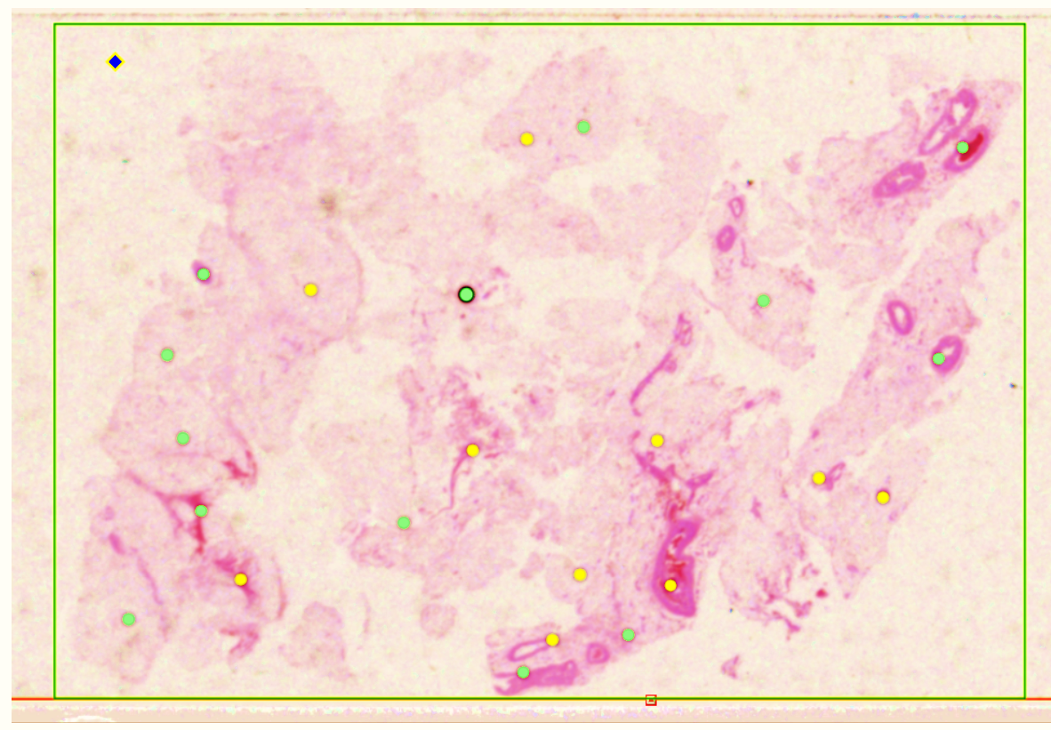
Image Digitization
Pre-scan snapshots are taken prior to scanning process.
Focus points are placed on each snapshot to specify the area of the slide to be scanned.
In some cases, focus points must be manually added, and the boundaries are adjusted.
After the pre-scan is adjusted, the slides are scanned at high resolution.
The resulting images are databased using Aperio’s eSM software.

Slide 30
SVS File Format
After scanning the slide as a digital image,
the image is stored in a proprietary file format
known as an .svs file.
This file contains the raw image data and
some metadata captured during the
scanning process.
An .svs file is a layered TIFF which uses
JPEG 2000 compression to compress the
actual image.
The .svs file also contains a thumbnail, which
is a low-quality image of the slide, and the label
image which is a low-resolution picture of the slide’s label.
Digital slides are scanned at a higher resolution which exceeds the allowable dimensions of a JPEG file.
Therefore, we are using .svs files as the primary filetype for the corpus because it is efficient and handles full resolution images.
Slides can be viewed using Aperio’s ImageScope software, which is freely available, or using several open-source tools. Python supports .svs.

Slide 31
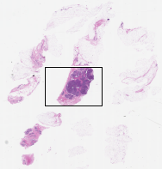
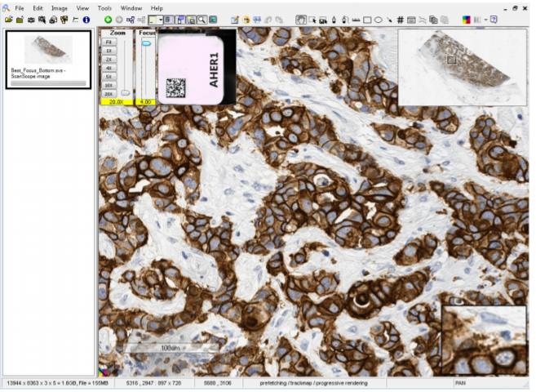
Key Imagescope Features
The Imagescope provides convenient features such as panning, autopanning, scrolling, and Z-stacking.
Z-stacking: a process of extracting information of an image at different focus distances to give a resulting image with greater depth of field.
Z-stacking is used to create a 3D image that is similar to what pathologists can do with their analog microscopes.
The Focus Slider is used to view Z-stacked images.
This feature has not been extensively explored yet in the Department of Pathology at Temple University Hospital.
The resulting image is very large (Gigabytes) and a challenge for machine learning.
Focus Slider

Slide 32
Data Organization
The slides are uploaded to the eSM where they are organized into 3 data groups:
  Clinical
  Research
  Educational
where the Research option was chosen as the initial method of data organization.
The top level of the research category contains broad tissue type categories called cases.
Within each case the data is further categorized into the patient’s MRN and then into the specimen ID of each slide.
Directory Components:
Field | Description | Template | Example
database name | 4-letter acronym | NNNN | tudp
version | v<major>.<minor>.<sub> | vx.x.x | v1.0.0
file type | type of data stored | fff | svs
case | 6-letter code for the type of specimen | cccccc | gastro
sequential ID | 6-digit directory ID (zero-padded) | ###### | 001234
patient ID | 8-digit (zero-padded) patient ID | ######## | 00123456
date | date specimen was collected | yyyy_mm_dd | 2015_03_05
specimen type | 4-digit code for the specimen type | tt##_ | 0s19_
sequence number | 5-digit sequence number | ##### | 12345
Filename Components:
Field | Description | Template | Example
specimen type | 4-digit code for the specimen type | tttt_ | 0s19_
sequence number | 5-digit sequence number | ##### | 12345
block level ID | 2-letter code followed by 3-digit sequence | ll### | 0a001
patient ID | 8-digit (zero-padded) patient ID | ######## | 00123456
block cut type | 3-letter code followed by a 4-digit sequence | bbb#### | lvl0001
sequence number | 3-digit sequence | s### | s000
file extension | three-letter filename extension | .ext | .svs
Full Pathname: tudp/v1.0.0/svs/gastro/001234/00123456/2015_03_05/
0s19_12345/0s19_12345_0a001_12345678_lvl0001_s000.svs

Slide 33
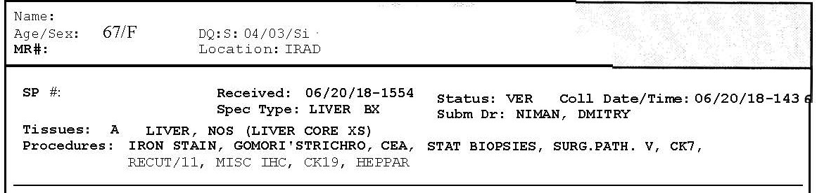
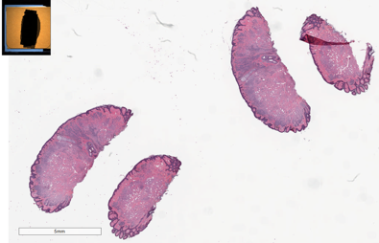

Data Anonymization
Under the Health Insurance Probability and Accountability Act (HIPAA), patient identity is kept anonymous.
The scanner and slides resides at the hospital. The digital images are also stored on a secure HIPAA network until the data is anonymized.
Data Anonymization
Case Reports
Digital Slides
Patient’s name
MRN
Specimen ID
Anonymizing slide labels’ information

Slide 34








Data Annotation
Rectangle Tool
Elliptical Tool
Pen Tool
Region of the annotation is selected using the rectangle, ellipsis and pen tool.
An annotation is created by a pathologist by describing the event
(e.g., the type of cancer).
We are early in the process of developing annotation standards.

Slide 35




Corpus Development Workflow
Scanned slides are uploaded to the petabyte server
Slides are loaded onto the Digital Slide Scanner (DSS)
Slides from the server are uploaded to the electronic slide manager (eSM)
Annotated slides are now available to be anonymized before being available in the public domain
Pathologists review and annotate the slides

Slide 36
Preliminary Statistics For A Pilot Corpus
Tissue Type | Patients | Cases | Slides | Avg. Slides Per Patient | Avg. Slides Per Case
Breast | 304 | 324 | 3694 | 12.15 | 11.40
Cardiovascular | 2 | 2 | 5 | 2.50 | 2.50
Gastrointestinal | 199 | 240 | 2657 | 13.35 | 11.07
Gynecology | 64 | 64 | 872 | 13.63 | 13.63
Head and Neck | 15 | 15 | 162 | 10.80 | 10.80
Hernia Sac | 3 | 3 | 7 | 2.33 | 2.33
Lymph Nodes | 31 | 48 | 1268 | 40.90 | 26.42
Nervous System | 3 | 3 | 6 | 2.00 | 2.00
Pulmonary | 8 | 8 | 124 | 15.50 | 15.50
Skeletal System | 19 | 19 | 112 | 5.89 | 5.89
Skin | 12 | 13 | 61 | 5.08 | 4.69
Soft Tissue | 28 | 28 | 118 | 4.21 | 4.21
Tonsil | 14 | 14 | 31 | 2.21 | 2.21
Spinal Epidural | 2 | 4 | 37 | 18.50 | 9.25
Urinary Prostate | 191 | 206 | 5296 | 27.73 | 25.71
Total Cataloged | 895 | 991 | 14450 | 11.79 | 9.84
Uncataloged
Newly Scanned | N/A | N/A | 12627 | N/A | N/A
W.I.P. | 1953 | 1953 | 11390 | 5.83 | 5.83
Pathologist Slides | N/A | N/A | 1371 | N/A | N/A
Total Uncataloged | 1953 | 1953 | 25388 | 5.83 | 5.83
Total | 2848 | 2944 | 39838 | 11.41 | 9.59
Since: 06/15/19 | (+948) | (+819) | (+19049) | (+0.88) | (+0.21)
TUDP database statistics as of August 8, 2019.

Slide 37

Database for Algorithm Development
A baseline system using CNN was developed for a simple database which includes with and without pen marks with 1000 WSIs.
The size of the slides averaged around 5000x2500 pixels in size.
Every 50x50 pixel patch was annotated for the mark class.
We split the dataset into 800 slides for training and 200 slides for evaluation. We used cross-validation and split the training set into randomly selected five partitions of 700 training slides and 100 development set slides.
We used framing and windowing technique with proper labels to divide the slides into frames for feeding the deep learning model.

Slide 38

The Deep Learning Algorithm
Our software was developed using Python and executes on general purpose processors and high-speed GPUs.
For faster software integration and model development, we used deep learning tools such as TensorFlow and Keras.
The models were trained on RTX 2080 GPU with 8 GB of memory. Training each model for 15 epochs took an average of 7 minutes per epoch.
Our best system contains 50x50 frames and 100x100 windows. It achieved 98.9%, 100.0%, and 99.0% sensitivity for the mark set respectively in the train, dev test, and eval set.

Slide 39
Summary
The ability to scan slides into digital images and place them on a secure HIPPA network accessible to pathologists promotes remote accessibility and collaboration on patient cases.
The physical storage required to manage such a large archive electronically is now affordable and can be implemented using a relatively simple architecture.
Our primary goal in this three-year project is to scan and annotate 1M slides, where each image will have an associated clinical report.
This corpus will enable the development of state-of-the art machine learning systems, which require vast amounts of training data, for pathology applications such as cancer identification.
This project will also enable the development of software systems to assist diagnosis and accelerate the diagnostic process, thereby easing pathologist workloads. This is important since the industry expects there will be a severe shortage of pathologists over the next 20 years.
Digital pathology is also enhancing educational practice by providing access to a large, open source pathology corpus that can be easily searched.
More information about our project can be found at:
https://www.isip.piconepress.com/projects/nsf_dpath/

Slide 40
Acknowledgements
This material is based upon work supported by the National Science Foundation under Grant No. CNS- 1726188. Any opinions, findings, and conclusions or recommendations expressed in this material are those of the author(s) and do not necessarily reflect the views of the National Science Foundation.

Slide 41
References
“Mounting Tissue Sections,” National Diagnostics, 2011. https://www.nationaldiagnostics.com/histology/article/mounting-tissue-sections.
D. Gutman, J. Cobb, D. Somanna, Y. Park, F. Wang, T. Kurc, J. Saltz, D. Brat, L. Cooper, and J. Kong, “Cancer Digital Slide Archive: an informatics resource to support integrated in silico analysis of TCGA pathology data,” J. Am. Med. Informatics Assoc., vol. 20, no. 6, pp. 1091–1098, 2013.
J. Barker, A. Hoogi, A. Depeursinge, and D. Rubin, “Automated classification of brain tumor type in whole-slide digital pathology images using local representative tiles,” Med. Image Anal., vol. 30, no. 1, pp. 60–71, 2016.
J. Picone, T. Farkas, I. Obeid, and Y. Persidsky, “MRI: High Performance Digital Pathology Using Big Data and Machine Learning,” Major Research Instrumentation (MRI), Division of Computer and Network Systems, National Science Foundation, January 1, 2018.
M. Satyanarayanan, A. Goode, B. Gilbert, J. Harkes, and D. Jukic, “OpenSlide: A vendor-neutral software foundation for digital pathology,” J. Pathol. Inform., vol. 4, no. 1, p. 27, 2013.
R. Brzezinski, HIPAA Privacy and Security Compliance - Simplified: Practical Guide for Healthcare Providers and Managers 2016 Edition, 3rd ed. Seattle, Washington, USA: CreateSpace Independent Publishing Platform, 2016.
I. Obeid and J. Picone, “The Temple University Hospital EEG Data Corpus,” Front. Neurosci. Sect. Neural Technol., vol. 10, p. 00196, 2016.
“Simple Monthly Calculator,” Amazon Web Services, 2018. http://calculator.s3.amazonaws.com/index.html
C. Campbell, N. Mecca, T. Duong, I. Obeid, and J. Picone, “Expanding an HPC Cluster to Support the Computational Demands of Digital Pathology,” in IEEE Signal Processing in Medicine and Biology Symposium, 2018, pp. 1–2.
N. Jhala, “Digital pathology: Advancing frontiers,” in IEEE Signal Processing in Medicine and Biology Symposium (SPMB), 2017.

