Slide 1
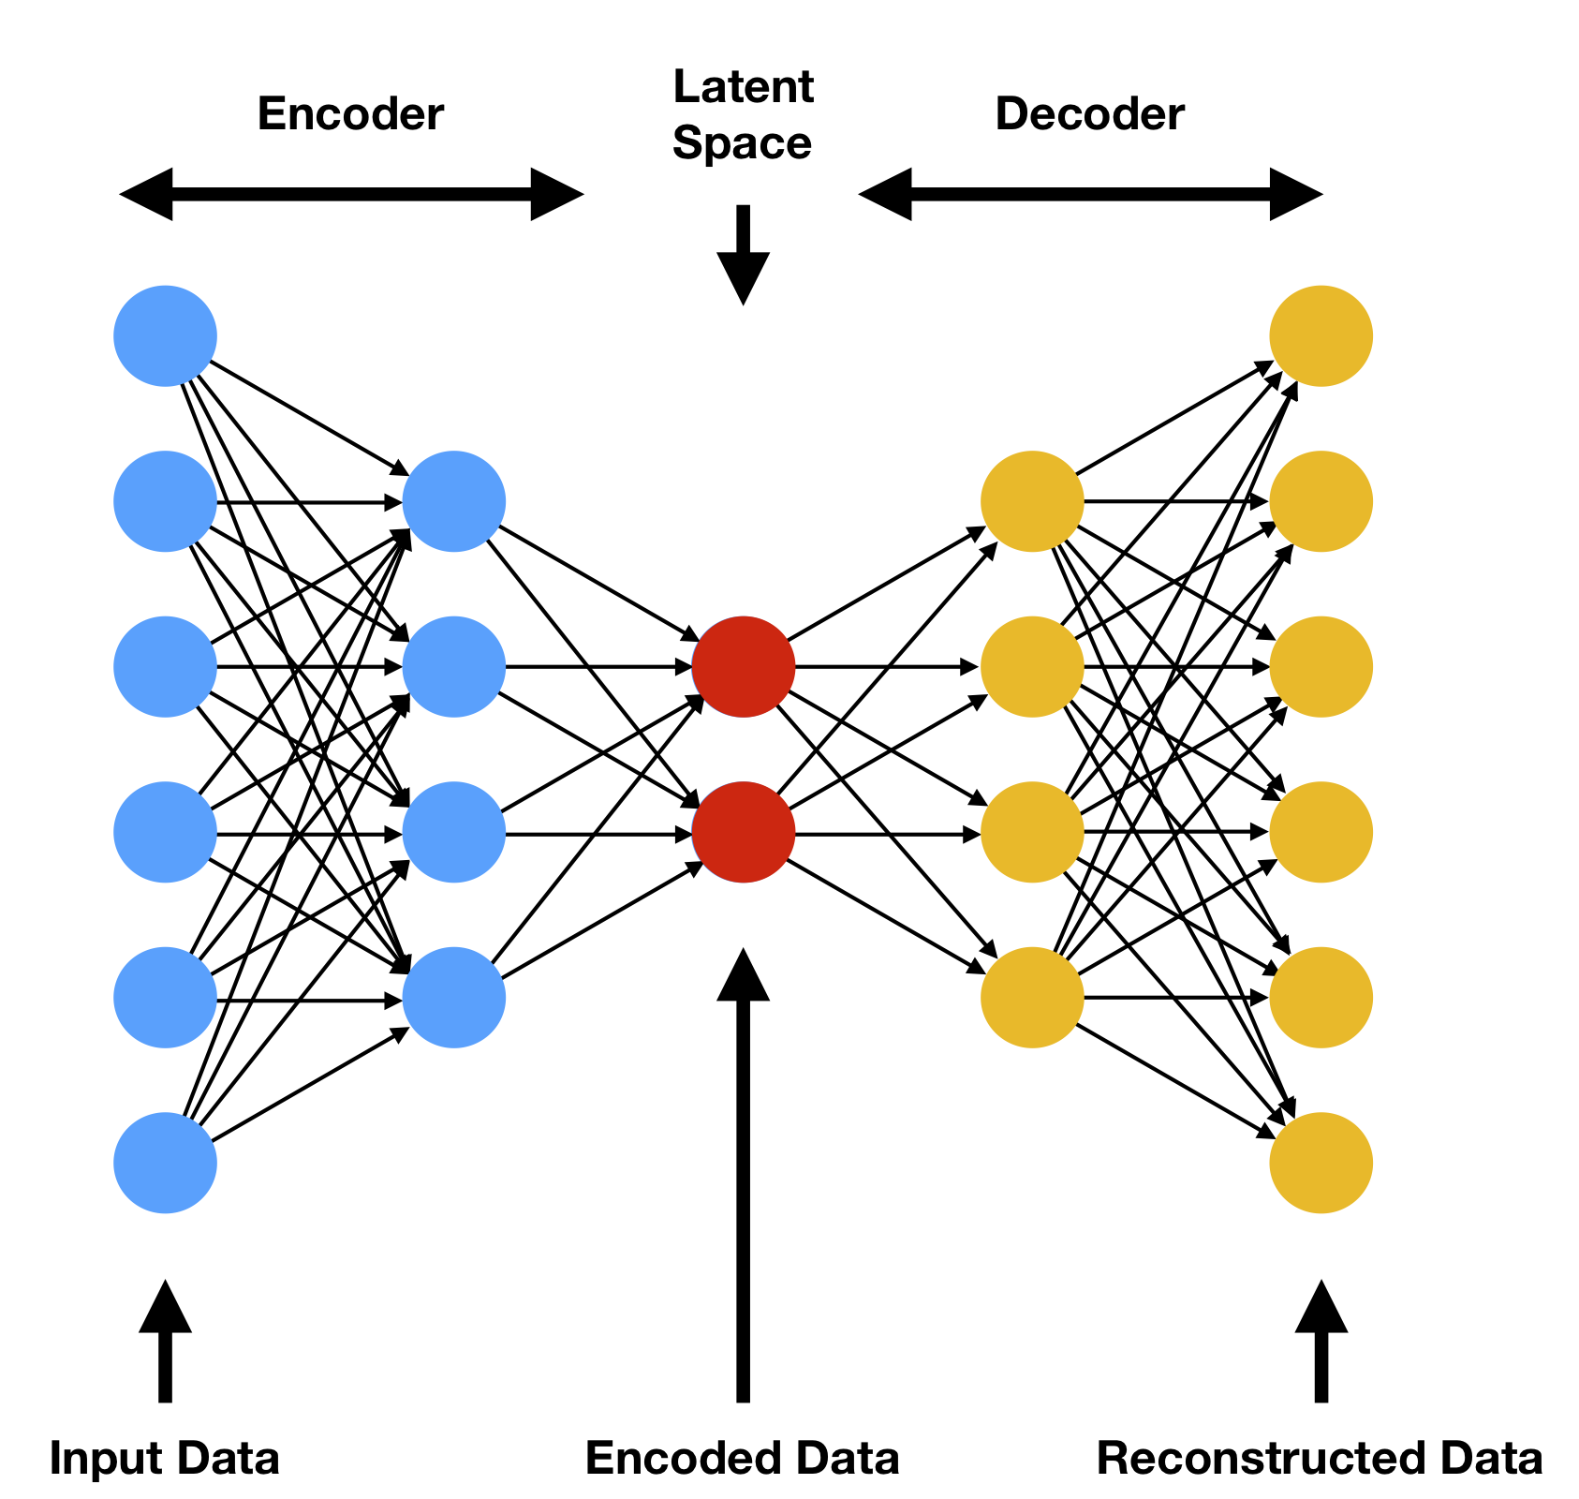
Unsupervised Feature Learning in Electroencephalography (EEG)
Presented By:
Nabila Shawki
Department of Electrical and Computer Engineering,
Temple University
Submitted to:
Advisor:
Dr. Joseph Picone, Dept. of Electrical and Computer Engineering
Committee:
Dr. Iyad Obeid, Dept. of Electrical and Computer Engineering
Dr. Albert Kim, Dept. of Electrical and Computer Engineering
Dr. Eduard Dragut, Dept. of Computer and Information Sciences
External Reader:
Dr. Georgios Lazarou, Dept. of Electrical and Computer Engineering, University of South Alabama

Slide 2
Abstract
Extracting features from time-series data poses some challenges:
When the dynamics of time-series data are either complicated or unknown, the traditional methods are unable to model complex nonlinear behavior.
Modeling such complex time series data is expensive, time-consuming and requires significant amounts of subject matter expertise.
Autoencoders allow us to use unlabeled data for training. This significantly increases the amount of data available for training deep learning systems.
Deep learning systems needs lots of data to achieve high performance.
A convolutional autoencoder was able to detect seizures in EEG segments with an error rate of 7.10% on a database published by University of Bonn.
In speech recognition, a type of variational autoencoder separated sequence-independent features from sequence-dependent features and reduced the word error rate by 41.34% absolute on the Aurora-4 database compared to traditional filter bank features.
Our ultimate research goal is to replace our standard linear frequency cepstral coefficient (LFCC) front end with an unsupervised feature extraction module to achieve clinically acceptable performance in seizure detection (75% sensitivity and 1 false alarm per 24 hours).

Slide 3
Three Selected Papers
The papers reviewed for this preliminary exam were:
Wen, T., & Zhang, Z. (2018). Deep Convolution Neural Network and Autoencoders-Based Unsupervised Feature Learning of EEG Signals. IEEE Access, 6, 25399–25410. https://doi.org/10.1109/ACCESS.2018.2833746.
Hsu, W. N., & Glass, J. (2018). Extracting Domain Invariant Features by Unsupervised Learning for Robust Automatic Speech Recognition. In ICASSP, IEEE International Conference on Acoustics, Speech and Signal Processing - Proceedings (Vol. 2018-April, pp. 5614–5618). Alberta, Canada: IEEE. https://doi.org/10.1109/ICASSP.2018.8462037
Craik, A., He, Y., & Contreras-Vidal, J. L. (2019). Deep learning for electroencephalogram (EEG) classification tasks: a review. Journal of Neural Engineering, 16(3). https://doi.org/https://doi.org/10.1088/1741-2552/ab0ab5.

Slide 4
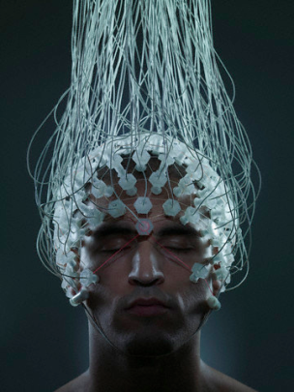
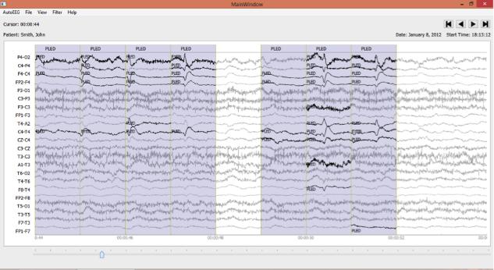
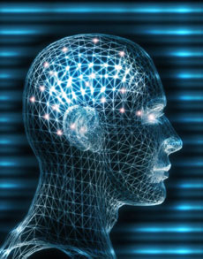
Electroencephalography (EEG)
Electroencephalograms (EEGs) are used in a wide range of clinical settings to record electrical activity of the brain.
EEGs are the primary means by which neurologists diagnose brain-related illnesses such as epilepsy, Alzheimer’s, and schizophrenia.
Scalp EEG recordings are commonly used in primary care settings because they are noninvasive.
An EEG can record brain signals with high temporal resolutions.
An EEG is also portable, and cost-effective.

Slide 5
Seizure Detection Research
Epilepsy is a chronic neurological disorder that affects 2.4 million people around the world each year.
A diagnosis of epilepsy is a life-changing event, so it must be carefully made.
An EEG is the primary tool used to diagnose epilepsy. In critical care settings, neurologists are overwhelmed by the amount of data that must be manually reviewed before a diagnosis can be made.
A clinical decision support tool that automatically interprets EEGs can reduce time to diagnosis, reduce error, and enhance real-time applications such as ICU monitoring.
Many EEG datasets are now publicly available such as the TUH EEG Corpus, but these contain a relatively small amount of manually annotated data.
Supervised machine learning, and particularly deep learning algorithms, require extremely large amounts of annotated data to achieve high performance.
State of the art in seizure detection does not yet achieve clinically acceptable performance. Increasing the amount of training data is a critical challenge and a major focus of this presentation.

Slide 6
EEG Classification Pipeline
Artifact Removal
Feature Extraction
Classification
A typical signal processing pipeline includes preprocessing of the data and then some form of model-driven feature extraction (e.g., linear frequency cepstral coefficients).
Artifact removal is the process where one removes unnecessary signals, such as eye blinks and muscle artifacts, from the EEG signal. Such artifacts cause high false alarm rates.
Independent Component Analysis (ICA) is a popular technique for denoising the signal.
Features are often hand-engineered by experts. Deep learning systems typically use a dimensionality reduction technique such as Principle Component Analysis (PCA) to preprocess features and manage complexity.
The data can be classified using popular supervised learning algorithms such as Support Vector Machines (SVM) or Multilayer Perceptrons (MLP).

Slide 7
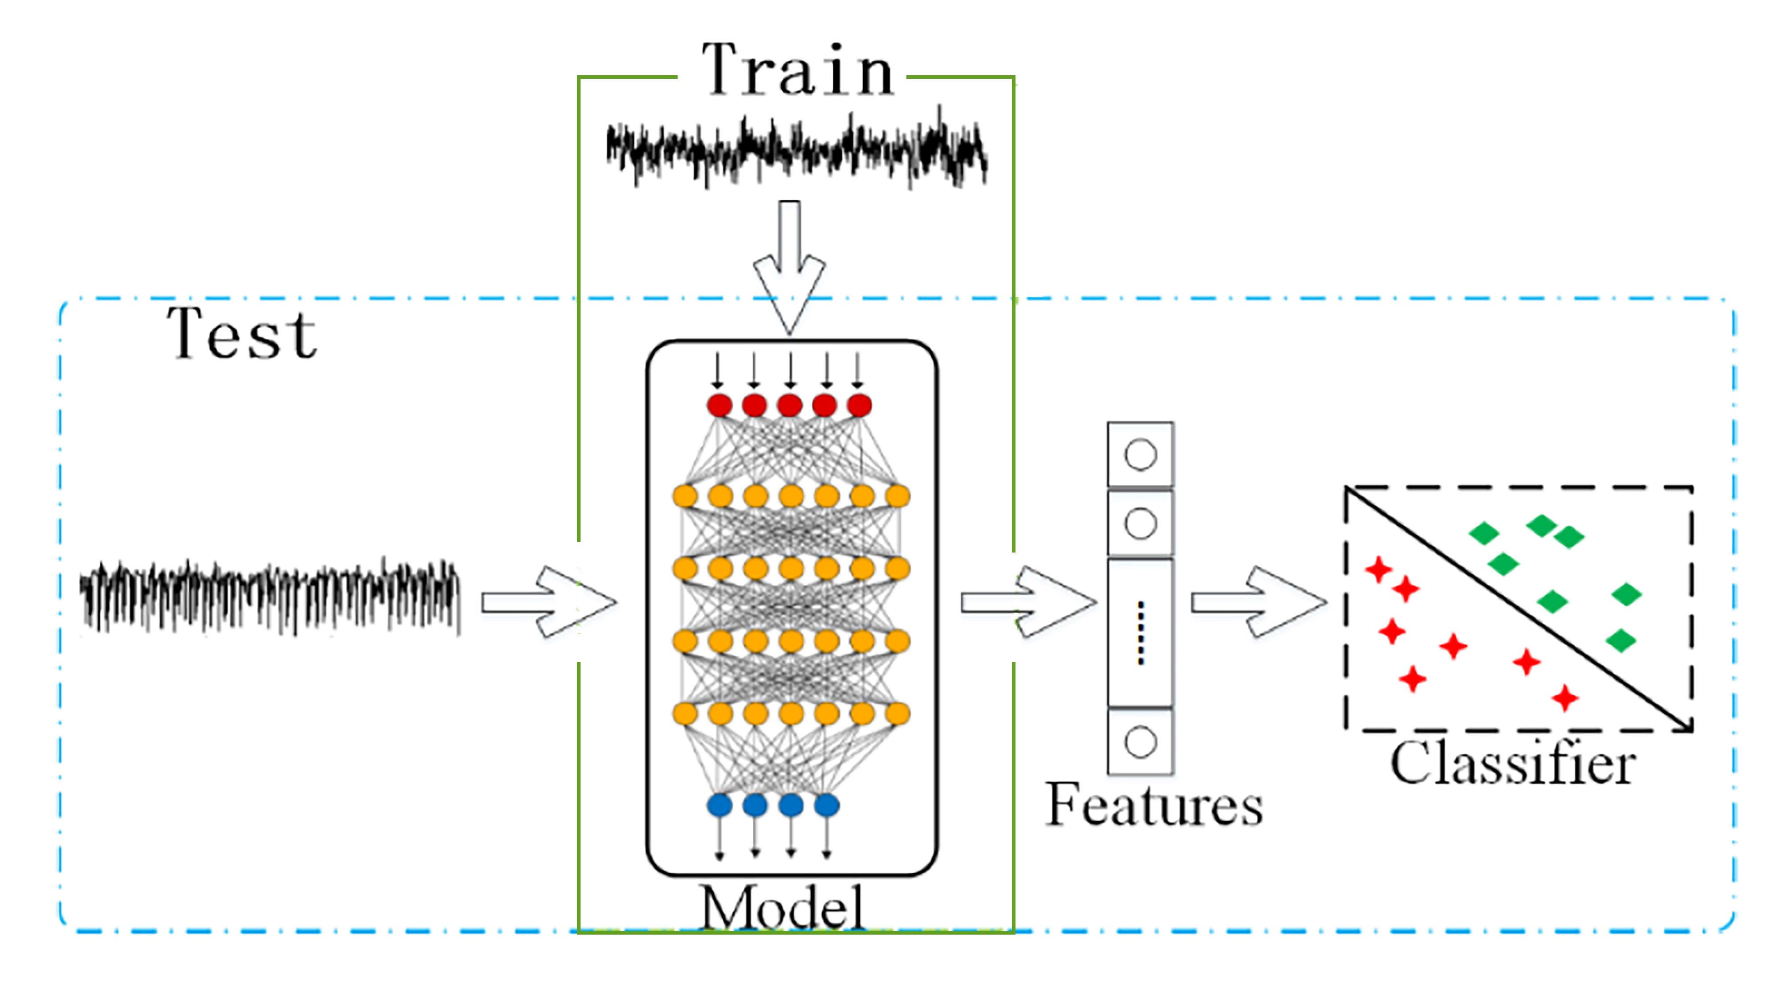
Unsupervised Feature Learning
Unsupervised feature learning techniques can extract useful features from unlabeled data, remove redundant information from the input, and preserve the unique aspects of the input data.
The machine learning algorithm used to train the system adjusts the weights of the network such that it can replicate the input data at the output layer.
In the evaluation phase, we extract relevant features from the test data. We can use classifiers to verify the validity of the features.

Slide 8
Challenges of Extracting Features from Time-series Data
Most real-world data, such as speech, video and EEGs, are sequential data –events happen in a temporal order, and that order can be exploited to improve classification performance.
Traditional approaches for estimating parameters sometimes cannot extract high performance features from complex, noisy time series data (e.g., autoregressive models and linear dynamic systems).
When the dynamics of the data are either complicated or unknown, these methods are unable to model complex nonlinear behavior.
Sampled time-series data can contain noise and be highly dimensional.
Sometimes, the data itself does not contain enough information to support discovery and modeling of the underlying process. A critical characteristic of time series data, particularly from stochastic or chaotic systems, is that an identical input can provide different outputs at different times.
Some physical signals, such as speech and EEG, can be considered quasi-stationary.
Developing domain-specific techniques for modeling such complex time-series data is time-consuming and requires subject matter expertise.

Slide 9
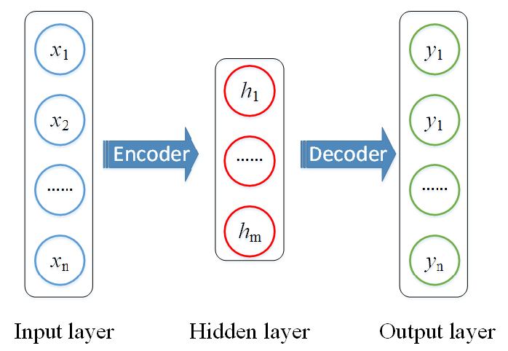
Autoencoders
An autoencoder is an unsupervised deep learning technique which uses neural networks.
Autoencoders have two components:
Encoder: preserves the essential features from the input data.
The decoder restores the input data using the extracted features.
The objective is to reduce the difference between the input and the output as much as possible.
The extracted features can be used for classifying data with a supervised classifier.
The performance of an autoencoder can be improved using advanced deep learning layers (e.g., long short-term memory (LSTM) and convolutional neural network (CNN) algorithms).

Slide 10
A Simple Autoencoder
A simple autoencoder has three layers: an input layer, a hidden layer, and an output layer.
During training, the system adjusts the weights of the hidden layer such that it can replicate the input data at the output layer.
The hidden layer learns the structure of the signal and delivers the desired feature representation.
Let the input data be x ∈[0,1]^{n}. Then, the features, h∈[0,1]^{m},
h = encoder(x) = g(W∙x+b) .
where:
W∈R^{(m×n)} is the weight matrix that connects the input and the hidden layers,
b∈[0,1]^{m} is the bias vector,
g is the activation function.
The decoding process is:
y = decoder(h) = g(W$′$∙h+b$′$) .
where:
W$′$∈R(n×m) is the weight matrix between the hidden layer and output layer,
b$′$∈[0,1]n is the bias vector.
The goal is to recreate the training data at the decoder by minimizing the objective function:
$min \sum_{i=1}^{n}{|y_{i} −x_{i}|}$ .

Slide 11
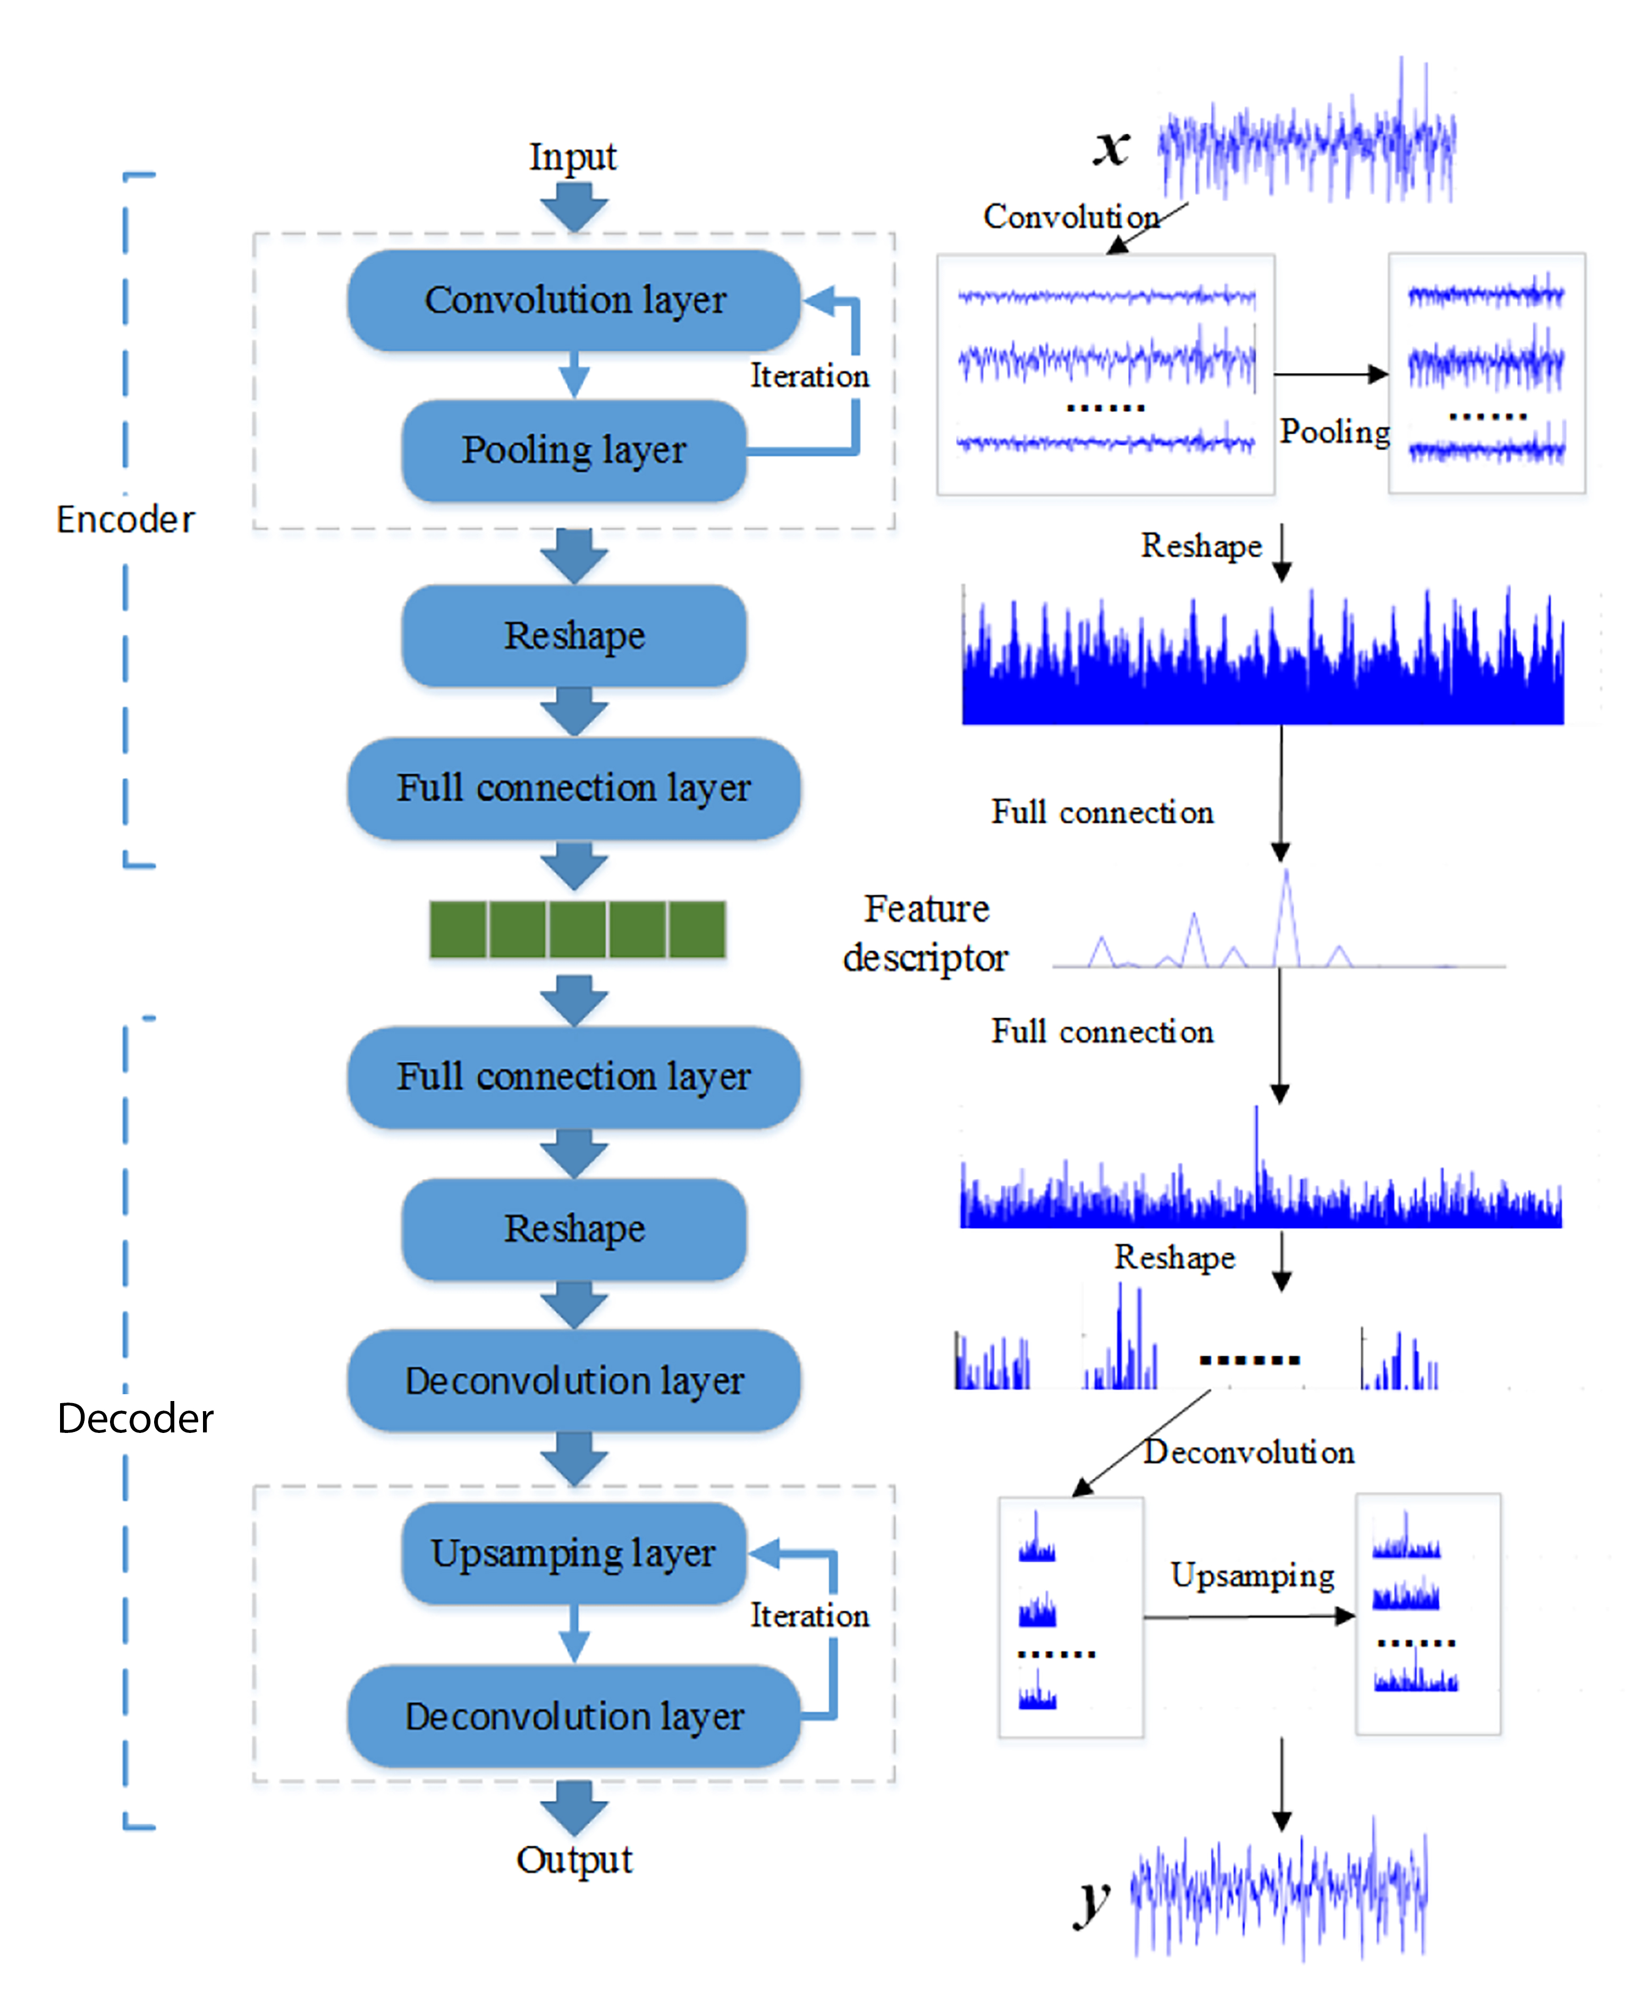
AE-CDNN: A Model Integrating Autoencoders and CNNs
AE-CDNN – a deep convolutional neural network (CNN) and an autoencoder-based model. It was proposed by Wen and Zhang.
AE-CDNN uses convolution layers and maxpooling layers iteratively to extract the useful features of an EEG segment.
The decoder upsamples the features with a deconvolution layer.
Depending on the loss functions, two models were tested:
AE-CDNN-L1: $Loss1= \sum_{i=1}^{N}{\frac{\left|x^{\left(i\right)}−y^{\left(i\right)}\right|}{N}} ,$
where$N$ is the number of samples.
AE-CDNN-L2: $Loss2=(\frac{1}{N})\sum_{i=1}^{N}{\frac{\left|x^{\left(i\right)}−y^{\left(i\right)}\right|}{avg\left(x^{(i)}\right)}}$ .
Introduced to reduce the impact of $N$on the difference of each sample when the input size is large.

Slide 12
AE-CDNN: Data Collection
The EEG segments were collected from two sources.
The first was published by the University of Bonn.
The database contains 500 EEG samples of 23.6 seconds durations (4,096 samples recorded at 173.5 samples/sec).
Five subsets: The recordings in A and B were collected from healthy volunteers, C and D records were collected from epileptic patients, but the records do not contain seizure, and the E subset contains seizures.
The second is the CHB-MIT corpus that contains EEG recordings from 23 children with refractory epilepsy.
Each recording lasts for one hour in duration and has 23 channels (921,600 samples @ 256 samples/sec).
The authors extracted 200 EEG samples with seizures and 200 without seizures.
They selected one channel based on the variance. The reason behind selecting channels based on variance is when epilepsy occurs, the signal fluctuates significantly which results in larger variance across the signal.
Each of these signals has a duration of 4,096 samples, which matches the sample length from the first dataset.
These EEG segments were normalized from 0 to 1 to using minimum and maximum values across all dimensions.

Slide 13
AE-CDNN: Experimental Setup
The study used sigmoid function for layer activation.
The extracted features were classified using several classification algorithms: K nearest neighbor (kNN), SVM, decision tree (DT), random forest (RF), Multilayer perceptron (MLP), AdaBoost Algorithm (ADB), and Gauss Bayesian Classification (GBC).

Slide 14
AE-CDNN: Results
The figure shows average accuracies of the models versus the feature dimension.
Both models achieved superior accuracies when the number of features was 32.
The models performed more consistently as the feature dimension increased for dataset 1. For dataset 2, the accuracies vary across the feature dimension.
The highest accuracy (92.9%) for dataset 1 was achieved with AE-CDNN-L1.
The authors reported that after 10-fold cross-validation they were able to achieve accuracies higher than 90% for both datasets when feature dimension was greater than 16.

Slide 15
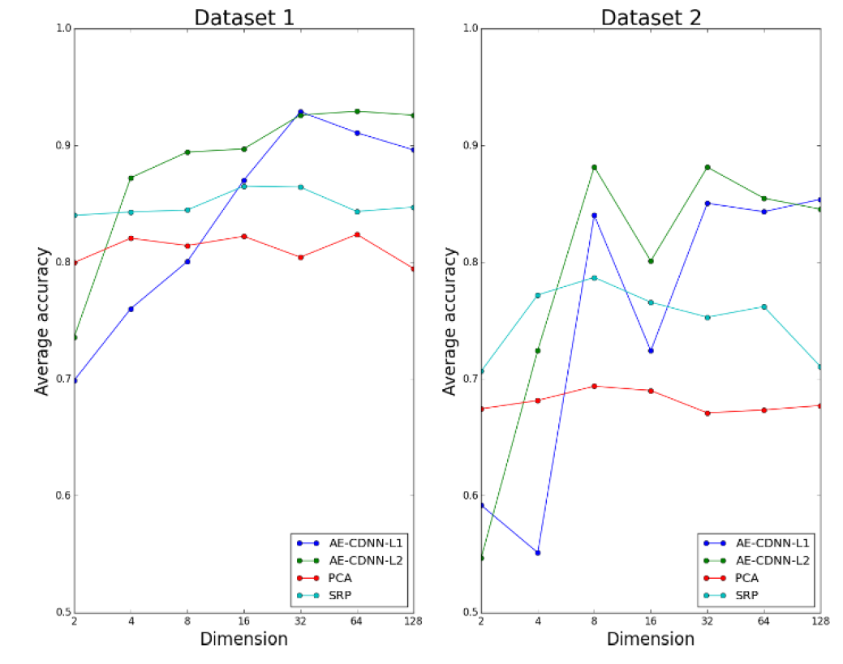
AE-CDNN: Comparison with Traditional Techniques
The authors considered Principle Component Analysis (PCA) and Sparse Random Projection (SRP).
PCA can extract low dimensional features by a linear transformation of high dimensional data.
SRP reduces dimensionality by projecting the original input space using a sparse random matrix.
PCA and SRP’s accuracies were more stable than AE-CDNN models with respect to feature dimensions. Their accuracy did not vary as the feature dimension increased.
As the number of features increased, both AE-CDNN models performed better than traditional techniques.

Slide 16
AE-CDNN: Discussion
The authors extracted the features without preprocessing the EEG segments and tested the features without tuning the hyperparameters of eight different classifiers.
The extracted features achieved above 90% average accuracy on two databases when the feature dimension was greater than 16.
A limitation of the study is that the model was not tested using sequential EEG data.
They also extracted a segment from one channel in multi-channel EEG file.
The authors also did not discuss sensitivity, specificity, and false alarms which are important metrics for a clinically acceptable automatic seizure detection tool.
Nevertheless, this model provides a promising baseline that can be used to support further investigations.

Slide 17
Factorized Hierarchical Variational Autoencoder (FHVAE)
When an autoencoder can extract the lower-dimensional features from a given input, a variational autoencoder (VAE) can learn the prior distribution of latent space.
FHVAE attempts to learn disentangled and interpretable representations from sequential data in an unsupervised manner using an inference model and a generative model. Hsu and Glass proposed this model.
This model extracts the sequence-dependent and sequence-independent priors in a factorized hierarchical graphical model.
Sequence-level attributes ($z_{2}$, $μ_{2}$) – fundamental frequency (F0), volume, etc.
Segment-level attributes ($z_{1}$) – spectral contours.
FHVAE uses a discriminative segment variational lower bound with a weighting parameter $α$ that encourages discriminability and does not let FHVAE degenerate into a variational autoencoder if the sequence level probability is the same for all utterances.
The segment-level features are domain invariant and can be utilized to recognize noisy speech data.

Slide 18
FHVAE: Experimental Setup
The authors used two datasets for verifying their proposed model.
Aurora-4 contains clean and noisy data with six artificial noise types and two microphone types.
CHiME-4 database contains clean and naturally noise induced data.
The FHVAE model used LSTM layers in its encoder and decoder.
For unsupervised feature generation, the FHVAE model used 80-dimensional filter bank (FBank) energies that were extracted from the speech sequences.
An automatic speech recognition (ASR) system was trained using FHVAE features from the clean data from Aurora-4 and CHiME-4 and was evaluated on the noisy data.
The ASR system was a three-layer LSTM network with a cross-entropy criterion and was trained using a truncated-backpropagation-through-time (BPTT) algorithm.
For comparison purposes, they also trained the ASR with the filter bank features and features from a variational autoencoder (z).

Slide 19
FHVAE: Aurora-4 Results
Settings |  |  |  |  |  | Avg. WER (%)
Exp. Index | Feature | #Layers in Encoder/ Decoder | #Units | $$α$$ | Seq. Label
1 | FBank | - | - | - | - | 65.64
 | $$z$$ | 1/1 | 256/256 | - | - | 44.79
 | $$z$$ | 1/1 | 512/256 | - | - | 40.31
 | $$z_{1}$$ | 1/1 | 256/256 | 10 | uttid | 26.58
2 | $$z_{1}$$ | 1/1 | 256/256 | 10 | uttid | 26.58
 | $$z_{1}$$ | 2/2 | 256/256 | 10 | uttid | 25.54
 | $$z_{1}$$ | 3/3 | 256/256 | 10 | uttid | 24.30
3 | $$z_{1}$$ | 1/1 | 128/128 | 10 | uttid | 34.66
 | $$z_{1}$$ | 1/1 | 256/256 | 10 | uttid | 26.58
 | $$z_{1}$$ | 1/1 | 512/512 | 10 | uttid | 26.97
4 | $$z_{1}$$ | 1/1 | 256/256 | 0 | uttid | 33.30
 | $$z_{1}$$ | 1/1 | 256/256 | 5 | uttid | 30.55
 | $$z_{1}$$ | 1/1 | 256/256 | 10 | uttid | 26.58
 | $$z_{1}$$ | 1/1 | 256/256 | 15 | uttid | 29.92
 | $$z_{1}$$ | 1/1 | 256/256 | 20 | uttid | 32.64
5 | $$z_{1}$$ | 1/1 | 256/256 | 10 | uttid | 26.58
 | $$z_{1}$$ | 1/1 | 256/256 | 10 | noise | 32.27
 | $$z_{1}$$ | 1/1 | 256/256 | 10 | speaker | 34.95
6 | $$z_{1}$$ | 1/1 | 256/256 | 10 | uttid | 26.58
 | $$z_{1}−μ_{2}$$ | 1/1 | 256/256 | 10 | uttid | 43.61
Fbank – Filter bank features, $z$ – VAE features, $z_{1} \text{–}$ segment-level features, $μ_{2} \text{–}$ sequence-level features

Slide 20
FHVAE: Aurora-4 Experiments
In experiment no. 1, the authors used three feature sets (Fbank, z, z1) for establishing a baseline. The FHVAE features, z₁, outperformed the other two feature sets with an average word error rate (WER) of 26.58% while Fbank’s average WER was 65.64% and VAE’s average WER was 40.31%.
In experiment no. 2, the authors varied the number of layers of the FHVAE. The system performance increased as they increased the number of layers.
In experiment no. 3, they changed the number of units in the FHVAE layers. In this case, 256/256 was the best combination.
In experiment no. 4, For α= [0, 10], the performance increased as the system can factorize the sequence and segment level information more. For, α>10 the performance decreased as it prevents the system from learning by inhibiting its capacity for understanding the lower level features.
In experiment no. 5, the sequence labels were varied for supervised classification. Using the noise label or the speaker ID decreased the performance as the speaker id and noise id are sequence-level information which are not a part of the segment level features.
In experiment no. 6, the authors compared z₁ and a combination of z₁ and $μ_{2}$. The performance decreased (43.61%) for z1- $μ_{2}$ feature set as the features obtained in this model are like those of VAE.

Slide 21
FHVAE: CHiME-4 Results
Settings |  |  |  |  |  | Avg. WER (%)
Exp. Index | Feature | #Layers in Encoder/Decoder | #Units | $$α$$ | Seq. Label | Clean | Noisy
1 | FBank | - | - | - | - | 19.37 | 87.69
 | $$z$$ | 1/1 | 512/256 | - | - | 19.47 | 73.95
 | $$z_{1}$$ | 1/1 | 256/256 | 10 | uttid | 19.57 | 67.94
2 | $$z_{1}$$ | 1/1 | 256/256 | 10 | uttid | 19.57 | 67.94
 | $$z_{1}$$ | 2/2 | 256/256 | 10 | uttid | 19.73 | 62.44
 | $$z_{1}$$ | 3/3 | 256/256 | 10 | uttid | 19.52 | 60.39
In experiment no. 1, the features from FHVAE performed worse than FBank and VAE features by a small margin when it was tested on the clean dataset. But it outperformed the others when it was used on the noisy set.
In experiment 2, the WER decreased as the number of layers was increased. The best performance, 60.39% WER, was achieved when the encoder and decoder had three layers each.

Slide 22
FHVAE: Discussion
The FHVAE model was thoroughly tested and was applied on two datasets where it outperformed the traditional filter bank features and features from a variational autoencoder for mismatched domains.
The FHVAE features showed better performance for detecting speech corrupted with artificial noise, natural noise and microphone mismatches.
By showing the result for the cases considering the sequence-dependent features ($μ_{2}$) and attributes (speaker and noise id), the authors emphasized the effectiveness of the segment-level features for domain invariant speech recognition.
However, other robust ASR training techniques exist in the literature:
Enhancement-based methods which require parallel data from all domains (e.g., clean and noisy speech)
Training an ASR system on a dataset that contains labeled data from all anticipated ambient environments.
The authors did not compare the performance of their technique with these existing methods.
EEG can contain noise and inter-patient ictal patterns could be different. FHVAE can assist in seizure detection when there is such domain mismatch.

Slide 23
Applications of Deep Learning to EEG Event Classification
After feature extraction, the next step is classification. We will study recent trends in preprocessing methods, input formulation, and deep learning methods used in several EEG classification tasks.
The authors, Craik and Contreras-Vidal, presented a consolidated review of 90 papers that they chose from 349 papers using PRISMA (Preferred Reporting Items for Systematic Reviews and Meta-Analyses) study method.
They selected the papers based on the following criteria:
Electroencephalography Only – the search excluded the studies which presented EEG with other physiological signals or videos, such as electrooculography and electromyography.
Task Classification – the authors focused only on human brain activity related studies. They excluded power analysis, non-human studies, and feature selection without any end classification.
Deep Learning – the review defined deep learning as a neural network with at least two hidden layers. This criterion might have discarded any studies that might have used any traditional machine learning algorithms along with the deep learning architectures.
Time – the review included papers from the last five years.

Slide 24
EEG Event Classification Tasks
Emotion Recognition (16%): A few subjects watch videos that are associated with certain emotions after which they take an emotion self-assessment test. The results from the self-assessment tests and the original emotion class are mapped into a pair of valence and arousal values.
Motor Imagery (22%): A user thinks about a specific movement using their limbs or tongue for collecting the data for the classifier.
Mental Imagery (16%): The data acquisition procedure involves collecting EEG data while a person accomplishes mental tasks.
Seizure Detection (14%): EEG signals of patients with epilepsy were recorded so that their brain activity can be observed during a seizure event.
Sleep Stage Scoring (9%): EEG data were recorded overnight and annotated by experts. They classified the stages into 1, 2, 3, 4, and rapid eye movement stage.
Event Related Potential (10%): EEG signals were recorded while the subjects watched a rapid sequence of pictures or letters and attempted to focus on a specific indicator.
Other Studies (13%) – Gender related studies, depression studies.

Slide 25
Preprocessing Methods and Input Formulation
Tasks | Studies | Artifact removal strategies |  |  |  | Input formulations
 |  | Manual Removal (Count) | Automatic Removal (Count) | No Removal (Count) | Not Addressed (Count) | Signal Values | Calculated Features | Images
Emotion Recognition | 16% | 4 | − | 2 | 3 | 4% | 9% | 5%
Motor Imagery | 22% | 5 | 2 | 3 | 7 | 9% | 13% | 4%
Mental Workload | 16% | 3 | 2 | 1 | 4 | 4% | 9% | 5%
Seizure Detection | 14% | 1 | 1 | 1 | − | 9% | 3% | 5%
Sleep Stage Scoring | 9% | 3 | − | 1 | 3 | 5% | 4% | 1%
Event Related Potential | 10% | 1 | 2 | 2 | 3 | 6% | 4% | 1%
Others | 13% | − | − | − | − | − | − | −
Total | 100% | 29% | 8% | 22% | 41% | 39% | 41% | 20%
Most studies limited the bandwidth of the EEG data using frequency domain filters.
About 50% of the studies used a low pass filter to keep data at or below 40 Hz. No studies considered if a deep learning algorithm gives comparable results if no preprocessing methods were applied.

Slide 26
Deep Learning Architecture Choices
Deep Learning Algorithms | Tasks |  |  |  |  |  |  | Input Formulations
 | Emotion Recognition | Motor Imagery | Mental Workload | Seizure Detection | Sleep Stage Scoring | Event Related Potential | Overall | Signal Values | Calculated Features | Images
CNN | 29% | 40% | 29% | 46% | 38% | 56% | 43% | 55% | 15% | 30%
DBN | 29% | 26% | 22% | − | − | 22% | 18% | 28% | 72% | −
SAE | 8% | − | 15% | 8% | 12% | 22% | 8% | 12% | 88%
MLPNN | 14% | 14% | − | 8% | 12% | − | 9% | 10% | 90%
Hybrid | 14% | 6% | 28% | − | 38% | − | 12% | − | −
RNN | 6% | 14% | 6% | 38% | − | − | 10% | 36% | 44% | 20%
An important parameter for a deep learning architecture is the activation function. About 70% of the studies with convolutional layers used a rectified linear unit (ReLU) as the layer activation function.
For seizure detection, the authors recommended CNNs and RNNs.

Slide 27
Discussion: Unsupervised Learning Techniques
AE-CDNN used convolutional layers to extract features from segments. These features were used in conjunction with several popular classifier architectures to detect seizures.
AE-CDNN can be modified to extract features from segments of EEG data and can replace the linear frequency cepstral coefficient features currently used in our best seizure detection system.
FHVAE can extract segment-level features successfully from speech data under noisy conditions. This property of FHVAE inspired us to investigate this model closely.
EEG data contains noise and artifacts. The performance of an automatic seizure detection tools often suffers as they detect muscle artifacts as seizure. Again, ictal pattern varies between patients which can also reduce a system’s performance.
FHVAE can be used for extracting domain-invariant EEG features for seizure detection.

Slide 28
Discussion: EEG Applications
Convolutional neural network (CNN) and recurrent neural network (RNN) are more popular for EEG classification tasks than other types of deep learning architectures.
Deep belief networks are popular in mental workload, motor imagery, event related potential, and emotion recognition tasks. In a shared database for emotion recognition, DEAP, DBN with power spectral density (PSD) features outperformed all other networks by achieving 89% accuracy. We will explore this model for seizure detection task.

Slide 29
Conclusion
Extracting features from time-series data poses challenge because of their inherent high-dimensionality and non-stationary characteristics.
Currently, we have a vast amount of unlabeled data in the TUH EEG Corpus that we cannot use for training. We also have difficulty with detecting long duration seizure events (e.g., seizures lasting longer than 60 seconds).
We showed that features extracted using unsupervised deep learning algorithms for time-series data are more optimal than hand-engineered features or features from traditional machine learning algorithms.
We reviewed two of such techniques: AE-CDNN for seizure detection and FHVAE for automatic speech recognition. We also looked at EEG classification tasks with preprocessing methods and input formulation.
Future work will include implementing AE-CDNN and FHVAE for detecting seizures in sequential EEG data.
We will reduce a channel to multiple segments with sliding windows and use AE-CDNN to extract features from those segments.
We will investigate if FHVAE can extract useful segment-level features from raw EEG data to identify seizure events.

Slide 30
Additional References
Chai, X., Wang, Q., Zhao, Y., Liu, X., Bai, O., & Li, Y. (2016). Unsupervised domain adaptation techniques based on auto-encoder for non-stationary EEG-based emotion recognition. Computers in Biology and Medicine, 79, 205–214. https://doi.org/10.1016/j.compbiomed.2016.10.019.
Hsu, W. N., Zhang, Y., & Glass, J. (2017). Unsupervised Learning of Disentangled and Interpretable Representations from Sequential Data. Advances in Neural Information Processing Systems, 1876-1887. Long Beach, California, USA. https://papers.nips.cc/paper/6784-unsupervised-learning-of-disentangled-and-interpretable-representations-from-sequential-data.pdf.
Shah, V., Anstotz, R., Obeid, I., & Picone, J. (2018). Adapting an Automatic Speech Recognition System to Event Classification of Electroencephalograms. I. Obeid & J. Picone (Eds.), Proceedings of the IEEE Signal Processing in Medicine and Biology Symposium (SPMB) (p. 1). Philadelphia, Pennsylvania, USA. https://doi.org/10.1109/SPMB.2018.8615625.
Masci, J., Meier, U., Cireşan, D., & Schmidhuber, J. (2011). Stacked Convolutional Auto-encoders for Hierarchical Feature Extraction. In Proceedings of the 21st International Conference on Artificial Neural Networks - Volume Part I, 52–59. Espoo, Finland: Springer-Verlag. http://dl.acm.org/citation.cfm?id=2029556.2029563.
Yuan, Y., Xun, G., Jia, K., & Zhang, A. (2017). A Multi-view Deep Learning Method for Epileptic Seizure Detection Using Short-time Fourier Transform. Proceedings of the 8th ACM International Conference on Bioinformatics, Computational Biology, and Health Informatics (pp. 213–222). Boston, Massachusetts, USA: ACM. https://doi.org/10.1145/3107411.3107419.

Slide 31
Questions

Slide 32
Thank You

