Slide 1
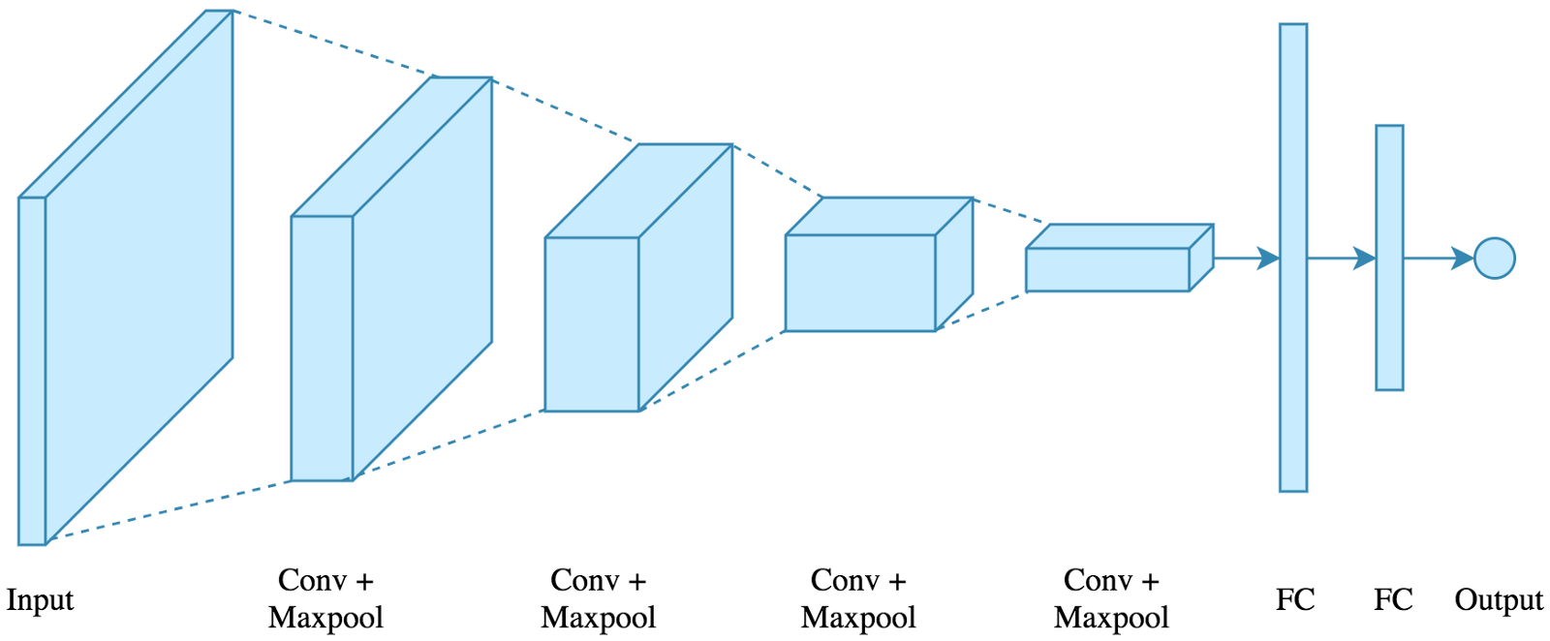
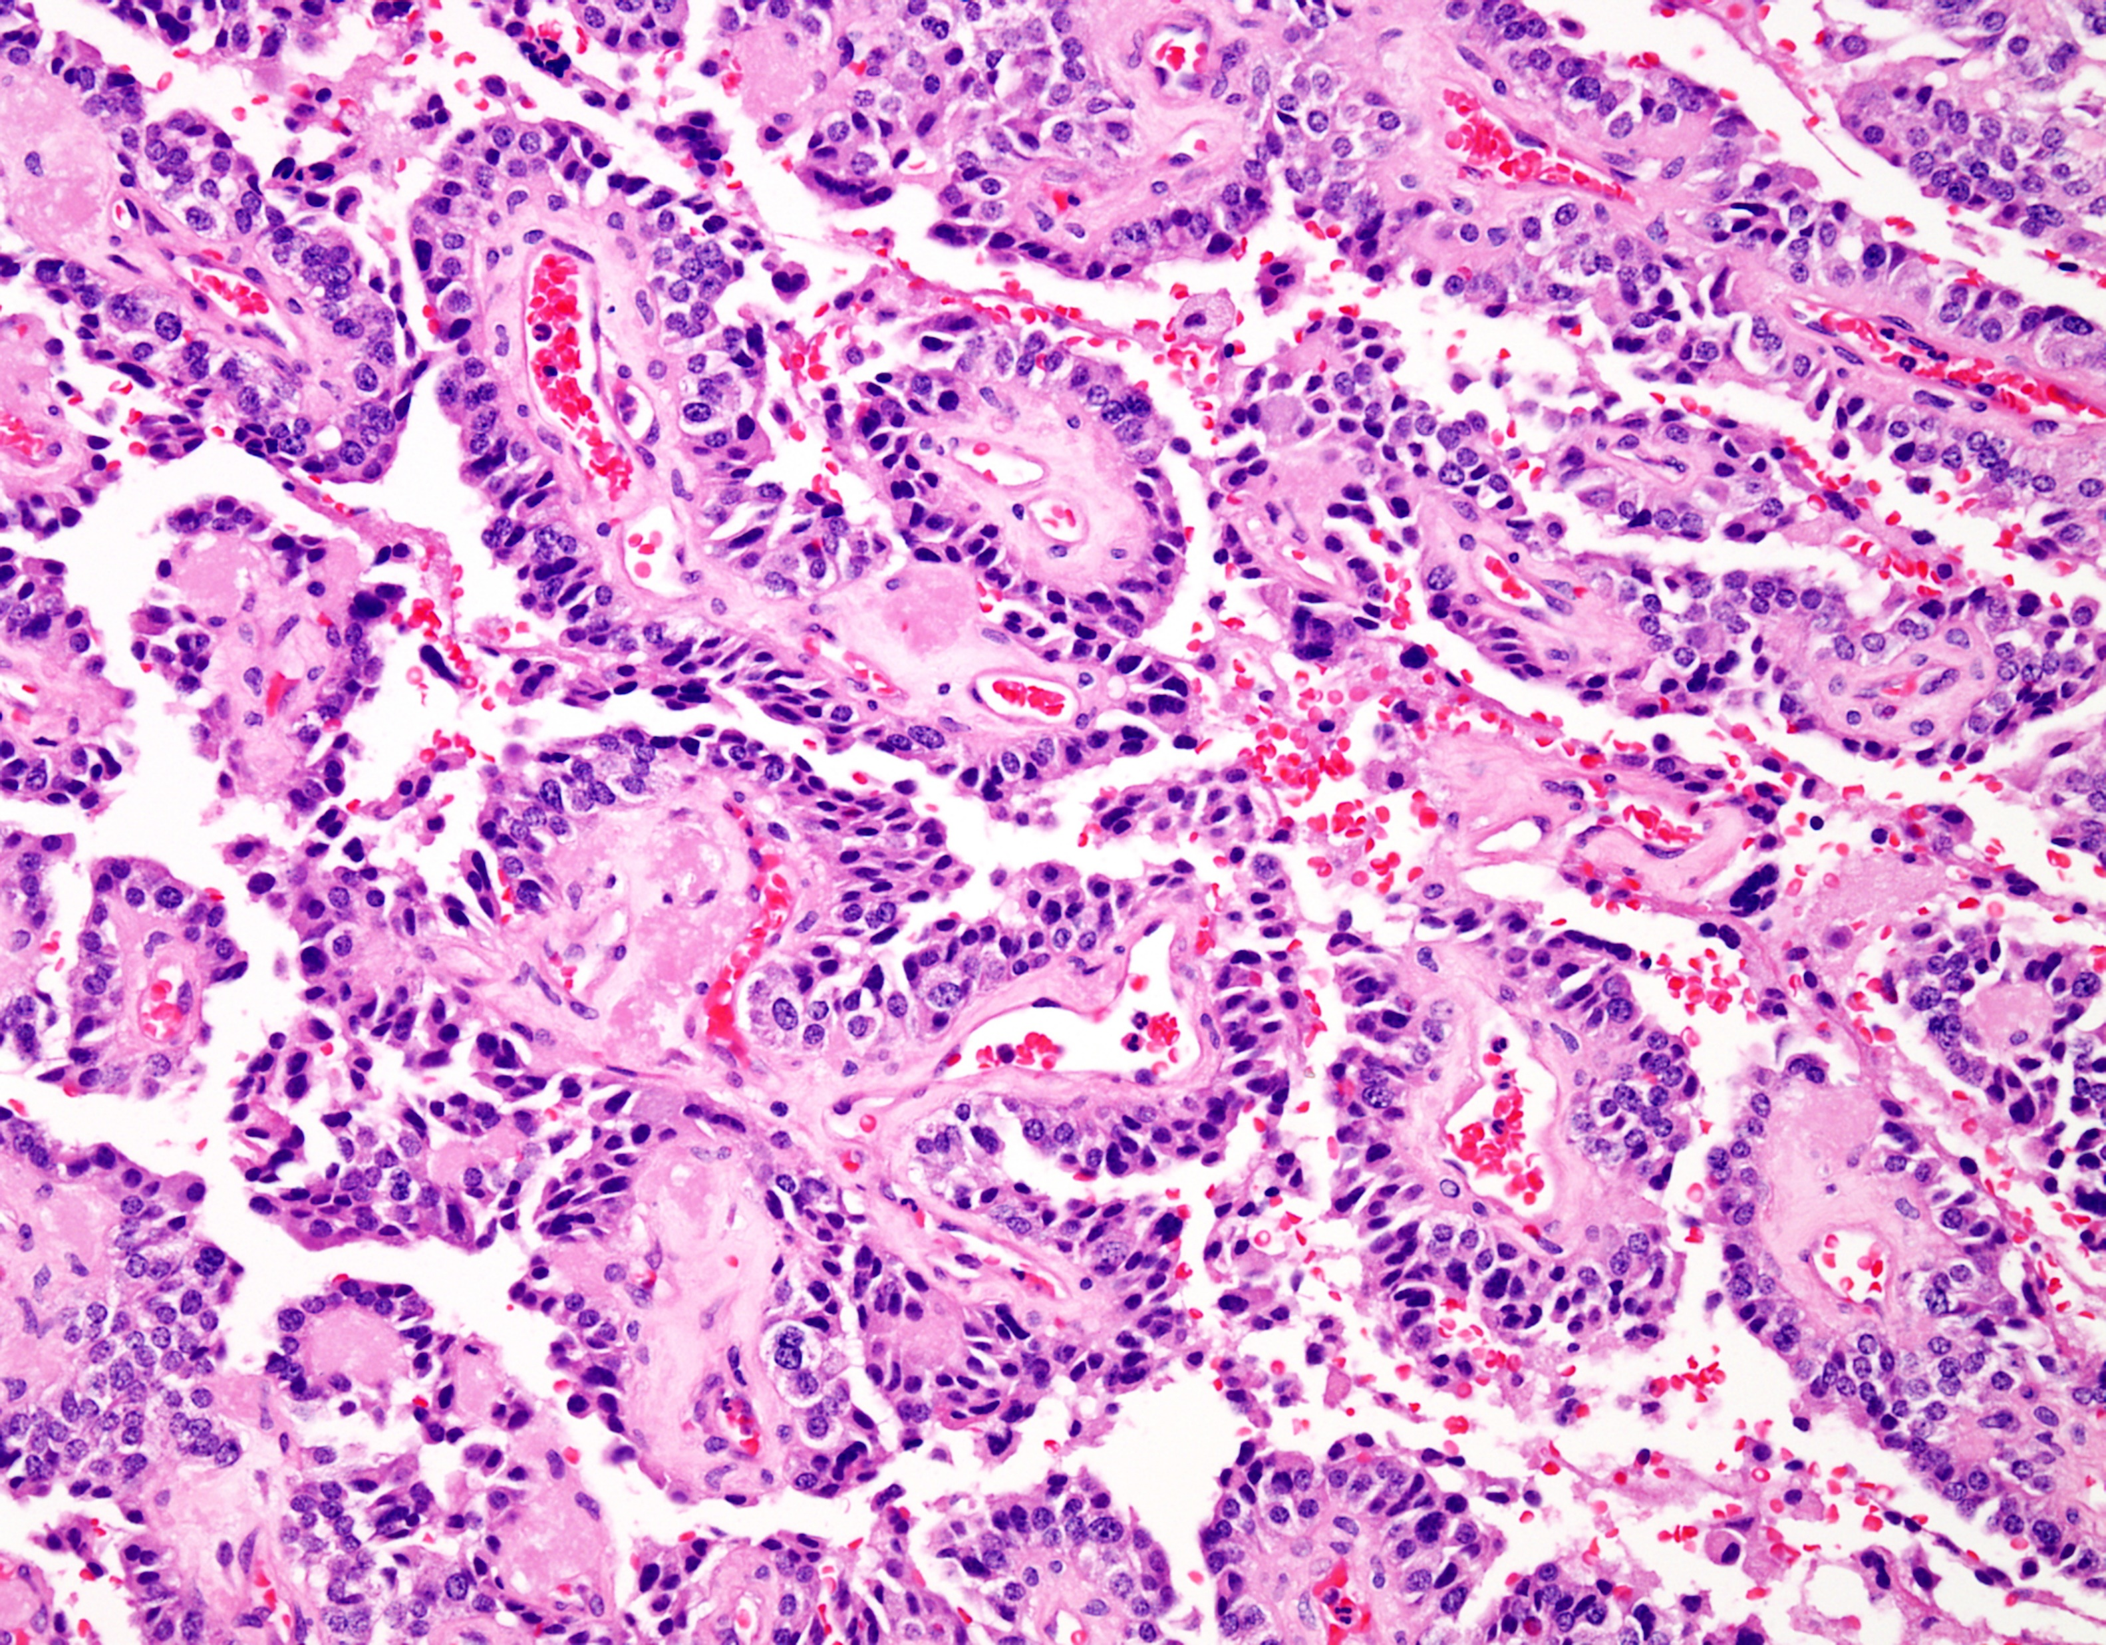
Preprocessing Digital Pathology Images for Efficient Training
Tarek Elseify
Neural Engineering Data Consortium
Temple University

Slide 2
Previous Data Generation Method
Each image was treated as a batch, so having a batch size of 3, for example, would mean training on every window of each image.
A lot of issues with this method: 1.) Some images may be significantly and unpredictably larger than others 2.) Impossible to train on images without first downsampling 3.) Inconsistent number of windows fed to the training algorithm
One of the major issues was with frame and window sizes that were too far apart. For example, an image with 3500 frames with a frame size of 50x50 and window size of 400x400 would have 560M pixels generated, while a window size of 50x50 would have 8.75M pixels (a difference of a factor of 64).
These issues greatly reduced the flexibility of the software, and prevented us from training on super high resolution images, increasing the window size, having consistent memory usage, etc.
Same frame and window size
Small frame large window size
Figure 1
Figure 2
T. Elseify: Preprocessing Digital Pathology Images for Efficient Training
April 13, 2019

Slide 3
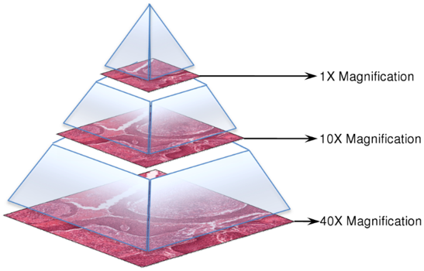
Solution to the Memory Management Issue
The main issue with the previous method is the lack of control we had over the amount of data, or windows, the deep learning algorithm received.
To fix this issue, we need to set up a generator that is able to return the exact number of windows we request.
Instead of having the batch size represent a single image, we can have it so the batch size represents the number of windows to be trained on. This has the following advantages: 1.) The algorithm will receive the same number of pixels each batch. 2.) Memory usage of the script will not spike unexpectedly. 3.) There is no limit to the size of images we can train on. 4.) We can have large disparities in frame and window size
A possible issue arises with this method when using tradition file formats (JPG, PNG, etc.) since they do not support random reads, and the full image must be read.
Since the scanned digital pathology slides are always in SVS format, and SVS/TIFF images support random reads, we do not have to worry about redundant I/O.
Figure 3
T. Elseify: Preprocessing Digital Pathology Images for Efficient Training
April 13, 2019

Slide 4
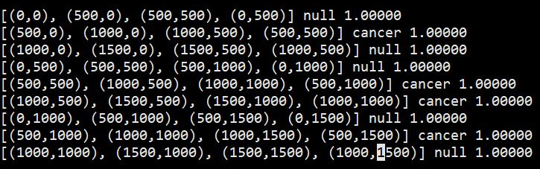
Generating TSE Annotation Files
The output of the DPATH annotation tool needs to be converted to a TSE file containing labels for each frame.
The labels of the frame are determined by a user defined threshold. That is to say, if a frame contains an annotation, but the annotation’s area inside the frame does not meet the threshold, it will be given the background label.
It is more efficient to generate these labels prior to training to avoid repetitive and redundant calculations. The downside is that TSE may take up a significant amount of space depending on the frame and image size.
0
1
0
The steps of creating the TSE file: 1.) Get the dimensions of the corresponding image 2.) Loop through each frame of the image and check if the frame contains any annotation 3.) If any annotation exists, check to see if the annotations meets the user threshold
0
1
1
0
1
1
0
1
0
4.) If the threshold is met, the frame gets the annotation label. If not, it will receive a null, or background, label.
0
1
1
0
1
0
Figure 4
T. Elseify: Preprocessing Digital Pathology Images for Efficient Training
April 13, 2019

Slide 5
Generator: Mapping Data Structure
The generator is responsible for returning a batch of windows and their corresponding labels to the DL network. This is an overview of this process.
Match the image file with the corresponding TSE file. The TSE file is processed and all the labels are stored in a list. The TSE file contains the slide level it was read in, and this is used to determine the dimensions of the image.
Using the dimensions of the image, we can calculate the number of frames in the image (which is equal to the length of the list of labels). The mapping is then created for all images in the dataset in this form:
When Keras calls the get_item method, the generator must return a batch of windows equal to the user set batch size.
The get_item function takes in an index (which Keras guarantees is unique each time it is called), and we slice the full mapping as such [i*batch_size:(i+1) * batch_size]
Figure 5
The full mapping will contain
(N * num_frames(N)) entries where N is an image
T. Elseify: Preprocessing Digital Pathology Images for Efficient Training
April 13, 2019

Slide 6
Generator: Partitioning Batches of Frames
Certain edge cases arise when generating a batch of frames. For example, what if instead of all the frames coming from one image, there are two images in a batch? In a more extreme case, what if the dataset has been completely randomized, and there are hundreds or thousands of different images in the same batch.
For this, we partition each batch into a triple list. The outermost list represents all the frames in the batch. The second layer is each unique image. The third layer would be the individual frames themselves.
This is essential because we have to handle each image differently. The first image’s dimensions to be read are completely different than the second, and separating them is crucial
Figure 6
/data/isip/img_0.svs
/data/isip/img_1.svs
T. Elseify: Preprocessing Digital Pathology Images for Efficient Training
April 13, 2019

Slide 7
Generator: Read Area of an Image
For each partitioned image, we need to understand the locality of the frames
The frames in the mapping need to be separated by rows. For example, in Figure 7, the frames are partitioned by figuring out the first and last frames of the same row.
If there are 2 or more consecutive rows that can be combined together, the first frame of the first row and last frame of the last frame are used. This is to reduce I/O, as we can read more of the image at a time.
F
L
F
L
F
L
Each of areas is read from the image individually. A buffer will slide over the areas that are read, and continually add all the windows of each area. Once this is done for all images in the batch, the generator returns the windows and their labels to the CNN.
T. Elseify: Preprocessing Digital Pathology Images for Efficient Training
April 13, 2019

Slide 8
Current State of the Baseline System
The training algorithm, depending on the frame and window size, will complete an epoch on 800 digital pathology images at slide level 2 (around 5K by 5K) in 6 min to 2.4 hours. The larger the disparity between the frame and window size, the more drastic the increase of runtime.
Parameter sweeps of the frame and window size showed that a frame size of 50x50 and window size of 100x100 yielded the best performance. The time to train per epoch using this configuration is around 12 minutes. Memory is no longer an issue to the system at all. Using the new generator method, we are able to run the full resolution images through the network (around 50K by 50K).
T. Elseify: Preprocessing Digital Pathology Images for Efficient Training
April 13, 2019

